Slide 1
PITWALL
Tyre degradation intelligence from confounded race data
We built the model everyone builds, proved it gives the wrong answer,
and shipped the one that survives an actual race.
AI Motorsport Intelligence · Tyre Degradation Intelligence
Team Handsome Squidward
Aditya · Ruhani

Slide 2
THE PROBLEM
Everyone fits the same model. It comes out backwards.
▪ The brief asks us to isolate true tyre wear from fuel weight, traffic and track evolution.
▪ The default approach fits lap time against tyre age and calls the slope “degradation.”
▪ On the full 2026 season that slope reports two of three compounds getting FASTER as they wear.
▪ That is not a bias to note in a limitations section — it is a wrong answer to the exact question asked.
naive HARD-tyre “degradation”
−0.15 s/lap
the model claims a 30-lap-old tyre is over a second faster than a fresh one.
PITWALL · TrackShift 2026
2

Slide 3
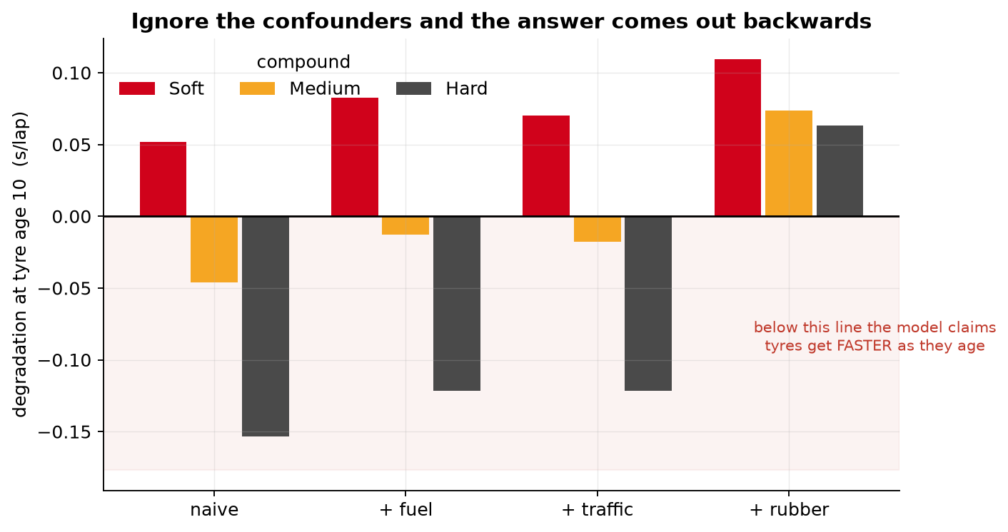
WHY IT FAILS
Inside a run, fuel burns at exactly the rate tyres age
1 Fuel makes the car faster as the run goes on; tyres make it slower. Within a single run the two are perfectly collinear.
2 The naive slope measures their difference — not wear.
3 Correcting fuel, then traffic, then track evolution flips every compound to a physically sensible positive number.
→ Deconfounding is not cosmetic here. It changes the sign of the answer, and therefore the pit-stop call.
PITWALL · TrackShift 2026
3

Slide 4
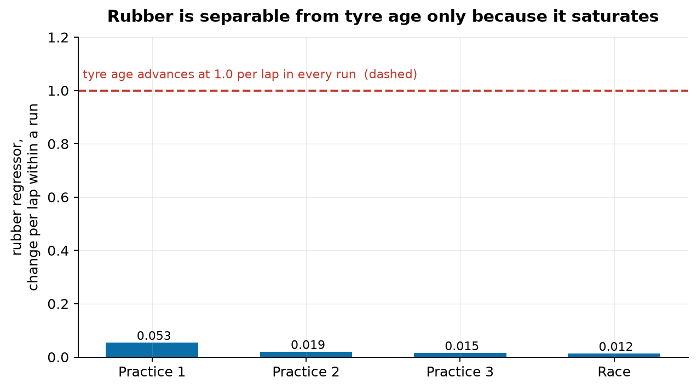
IDENTIFICATION
Three levers make the tyre effect recoverable
Fuel — from the race, where fuel falls monotonically while tyre age saw-tooths at every stop. λ = +0.029 s/kg, matching the literature 0.030–0.035.
Evolution — as log1p(weekend laps). Its within-run slope varies ~11× from FP1 to FP3 while tyre age is always 1/lap, so the log saturates and is not collinear with age.
Traffic — measured from car position telemetry: a KD-tree snap to the racing line gives the time gap to the car ahead. Measured, never guessed.
PITWALL · TrackShift 2026
4

Slide 5
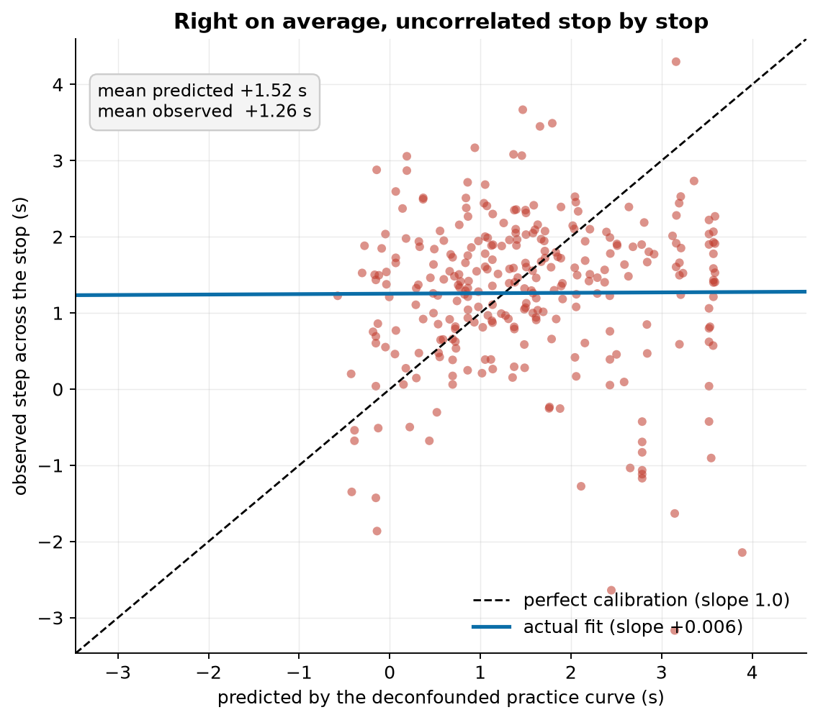
THE TEST MOST TEAMS SKIP
A clean in-sample curve that does not survive a race
▪ We could have stopped at the deconfounded curve. Instead we asked whether it predicts a real race.
▪ Prediction target: the pace gained across 288 actual pit stops.
▪ It is right on average — +1.52 s predicted vs +1.26 s observed — and its stop-by-stop variation is uncorrelated with truth.
▪ Calibration slope 0.006. A saturating form does not rescue it: the timescale τ is unidentified.
PITWALL · TrackShift 2026
5

Slide 6
THE PIVOT
Model the decision, not the curve
▪ The pit stop is a natural experiment: across it, tyre age resets to zero but fuel barely moves.
▪ So the step in pace across a stop measures the tyre effect with fuel almost entirely cancelled — no model assumption required.
▪ We model the quantity an engineer actually decides on: the seconds per lap a fresh tyre buys. Learned from race history, not a practice fit.
a fresh tyre is worth
+1.26 s/lap
288 stops · 12 events · sd 1.03
PITWALL · TrackShift 2026
6

Slide 7
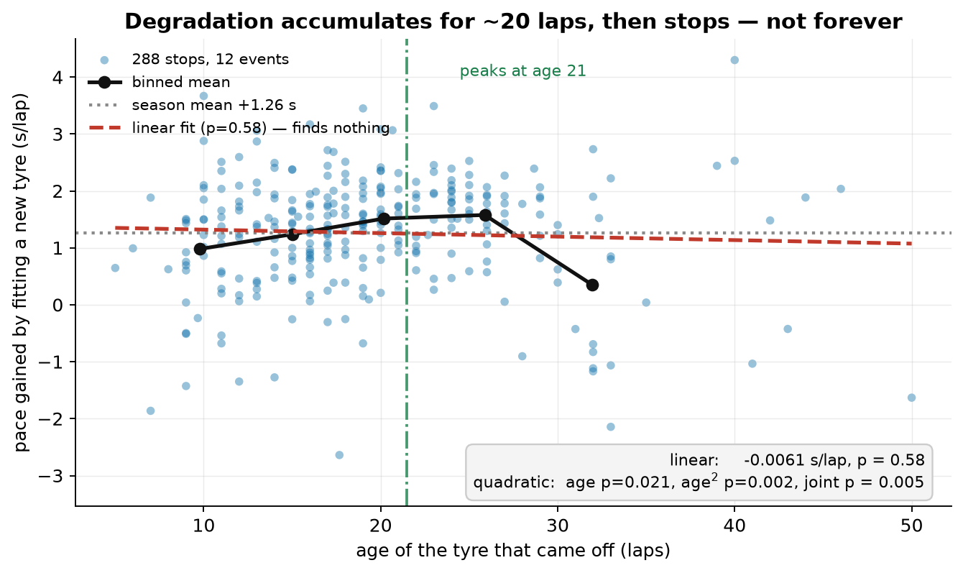
THE FINDING
Degradation accumulates for ~20 laps — then stops
▪ A linear test on tyre age finds nothing (p = 0.58). That is the trap, not the answer.
▪ With curvature, age and age² are jointly significant (p = 0.005) and the value of a stop peaks near tyre age 21, then declines.
▪ It is an inverted U. A straight line averages it to zero and reports a confident, wrong null.
→ Consequence: a curve that keeps climbing over-values a late stop — a systematic bias toward stopping too often.
PITWALL · TrackShift 2026
7

Slide 8
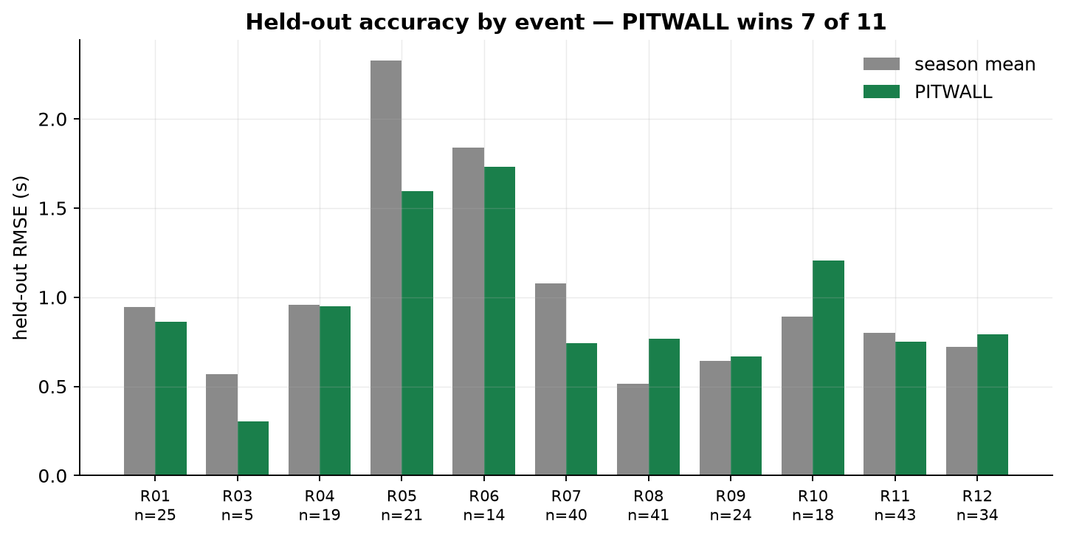
RESULTS
Beats the baseline out of sample, event by event
▪ Leave-one-event-out, with no free constant granted to any method — the model must get the level right, not just the shape.
+11.1% RMSE over the season-mean baseline; calibration slope 0.79; wins 7 of 11 held-out events.
▪ Robust to method-blind outlier caps (+9.6–11.1% across all cuts).
▪ Signal: compound pair, track temp (+0.039 s/°C, p<0.001) and traffic (+0.50 s, p=0.003). Tyre age is reported but not deployed — it costs accuracy out of sample.
PITWALL · TrackShift 2026
8

Slide 9
WHY TRUST IT
Validated against a natural experiment, not its own fit
▪ Ground truth is the pit-stop step, where fuel cancels — not an in-sample R² the model can inflate on its own.
▪ Leave-one-event-out cross-validation; no method receives a free constant.
▪ Cluster-robust standard errors — by run for lap fits, by event for stop fits.
▪ Falsification: the traffic measure rises monotonically from P1–3 to P16–20, exactly as it must.
▪ Limits stated, not smoothed: the pooled gain is carried by larger events; track temp partly proxies circuit identity over only 12 events.
OUT-OF-SAMPLE SCORECARD
RMSE, out of sample 0.96 s/lap
RMSE gain vs season mean +11.1%
calibration slope 0.79
events won 7 / 11
stops scored 288
fuel λ vs literature 0.029 / 0.030–0.035
PITWALL · TrackShift 2026
9

Slide 10
WHAT WE CUT
Three features we built, tested, and killed
1 The practice degradation curve. Clean in sample, and its stop-by-stop variation is uncorrelated with 288 real stops — calibration slope 0.006.
2 The pit-lap recommendation. It covers 68.4% of real stops; the same window placed mid-race covers 65.8%. Per event a constant tracks the chosen lap better than we do (MAE 4.9 laps vs 8.4), and with race length divided out we carry no signal at all (r = +0.08, p = 0.80).
3 “You will gain a place.” Over 137 head-to-head duels our undercut margin ranks the winner at AUC 0.836 — and so does the gap alone, with no model. Our own term scored by itself is 0.490, a coin flip.
→ The third one is arithmetic, not a bug: margin = gain − gap, and the gain we supply has sd 0.46 s against the gap's 14.6 s. A term 31× smaller cannot reorder anything.
WHAT SURVIVED CONTACT
practice curve → a race
CUT calib 0.006
pit window → vs mid-race
CUT 68.4 / 65.8
undercut → track position
CUT AUC 0.836 / 0.836
fresh-tyre pace → measured step
SHIPS 0.96 s/lap
check_window_placebo.py · check_undercut_backtest.py
PITWALL · TrackShift 2026
10

Slide 11
BEYOND MOTORSPORT
The same trap sits in Indian fleet tyre management
▪ The transferable method: recover a wear signal from confounded operating conditions, then validate on a natural experiment — never in sample.
▪ Target: Indian commercial-vehicle fleets. Wear is confounded by axle load, road roughness, ambient temperature and driver behaviour — structurally the identical problem.
▪ Tyre cost is a top controllable line item in Indian trucking, and tyre burst is a recognised cause of highway fatalities.
→ The warning transfers too: an in-sample wear curve can look excellent and carry almost no predictive value. Only a natural experiment reveals which you have.
SAME MATH, NEW CONFOUNDERS
fuel → axle load
traffic → road roughness
track evo → ambient temp
pit stop → tyre swap record
PITWALL · TrackShift 2026
11

Slide 12
STACK
Built on real telemetry, reproducible end to end
DATA
FastF1 — full 2026 F1 season
14,310 laps · 12 events · 1,068 runs
Per-lap timing, tyre compound and age, plus 4–10 Hz car position telemetry.
METHODS
• Two-stage hierarchical fuel + degradation model
• Frisch–Waugh–Lovell demeaning absorbs ~1,100 run fixed effects
• Cluster-robust standard errors
• KD-tree racing-line traffic measurement
• Profile likelihood over the saturating form
TOOLS
Python
pandas · NumPy · statsmodels · SciPy · matplotlib
REPRODUCIBILITY
One script regenerates every number and figure from the cached season.
PITWALL · TrackShift 2026
12

Slide 13
PITWALL
We built the model everyone builds, proved it gives the wrong answer,
and shipped the one that survives an actual race.
+0.029 s/kg
fuel sensitivity, matches the literature
0.006
calibration of the curve everyone ships
+11.1%
out-of-sample gain of the model we ship
Team Handsome Squidward · Aditya · Ruhani
AI Motorsport Intelligence · TrackShift 2026

