Slide 1
TRACKSHIFT Innovation Challenge 2026
PITWALL
Opponent-Aware Tyre Strategy & Degradation Intelligence
Separating true tyre degradation from fuel, traffic & track evolution — then pricing the pit attack.
PROBLEM SOLVED
Lap times are not tyre wear sensors. Naive models claim tyres get faster. We deconfound fuel, traffic & rubbering.
LIVE STRATEGY ENGINE
One Driver Clock with 4-stage decision flow: Tyre Condition -> Forecast Pace -> Plan Stop -> Rejoin & Attack.
PROVEN ACCURACY
12.0% lower pace RMSE (0.743s) & 10.0% rival RMSE reduction across 6,831 scored chronological forecasts.
TEAM: HANDSOME SQUIDWARD | MEMBERS: ADITYA & RUHANI | FASTF1 2026 ARCHITECTURE
Notes:
Good morning judges and motorsport fans. We are team Handsome Squidward, comprising Aditya and Ruhani. Today we are presenting PITWALL: Opponent-Aware Tyre Strategy & Degradation Intelligence. Formula 1 race strategies are won and lost on fractional seconds, but lap times are deceptive. PITWALL isolates pure tyre performance from confounders like fuel and traffic, then provides real-time attack pricing for the race engineer.

Slide 2
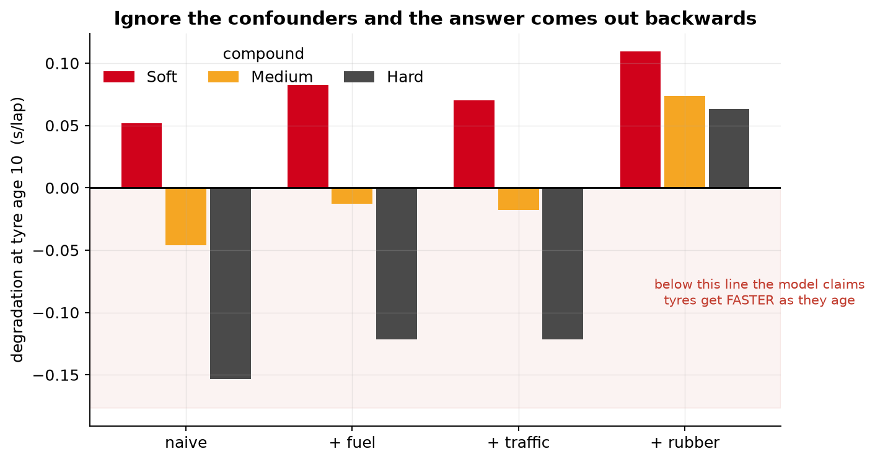
01 / THE CORE PROBLEM
Lap Time Is Not a Tyre Wear Measurement
THE COLLINEARITY ILLUSION
Inside a single practice or race stint, fuel burns off monotonically as tyre age increases. Because fuel loss makes the car lighter and faster, naive OLS regression yields an unphysical sign error:
NAIVE HARD TYRE FIT (UNPHYSICAL)
−0.154 s / lap (Claims tyres get faster!)
DECONFOUNDED PITWALL FIT (PHYSICAL)
+0.063 s / lap (Correct positive wear rate)
KEY CONPOUNDERS ISOLATED:
• Fuel Mass Burn: 0.0294 s/kg estimated directly from race refuel resets.
• Track Evolution: Logarithmic rubbering saturation across sessions.
• Traffic & Dirty Air: Measured distance gaps to cars ahead.
EMPIRICAL PROOF: THE SPECIFICATION LADDER
Step-by-step deconfounding restores positive physical degradation slopes across SOFT, MEDIUM, and HARD compounds:
Notes:
Why do traditional tyre degradation models fail? In Formula 1, fuel burns at ~0.03 s/kg. Within a single practice run, fuel burn is perfectly collinear with tyre age. A standard naive regression actually reports HARD tyres getting FASTER (-0.154 s per lap) because fuel burn masks wear. When we deconfound fuel, traffic, and track rubbering, the slope restores to +0.063 s/lap. Crucially, we also discovered that even a clean practice curve fails when applied out-of-sample to race pit stops (calibration slope +0.006).

Slide 3
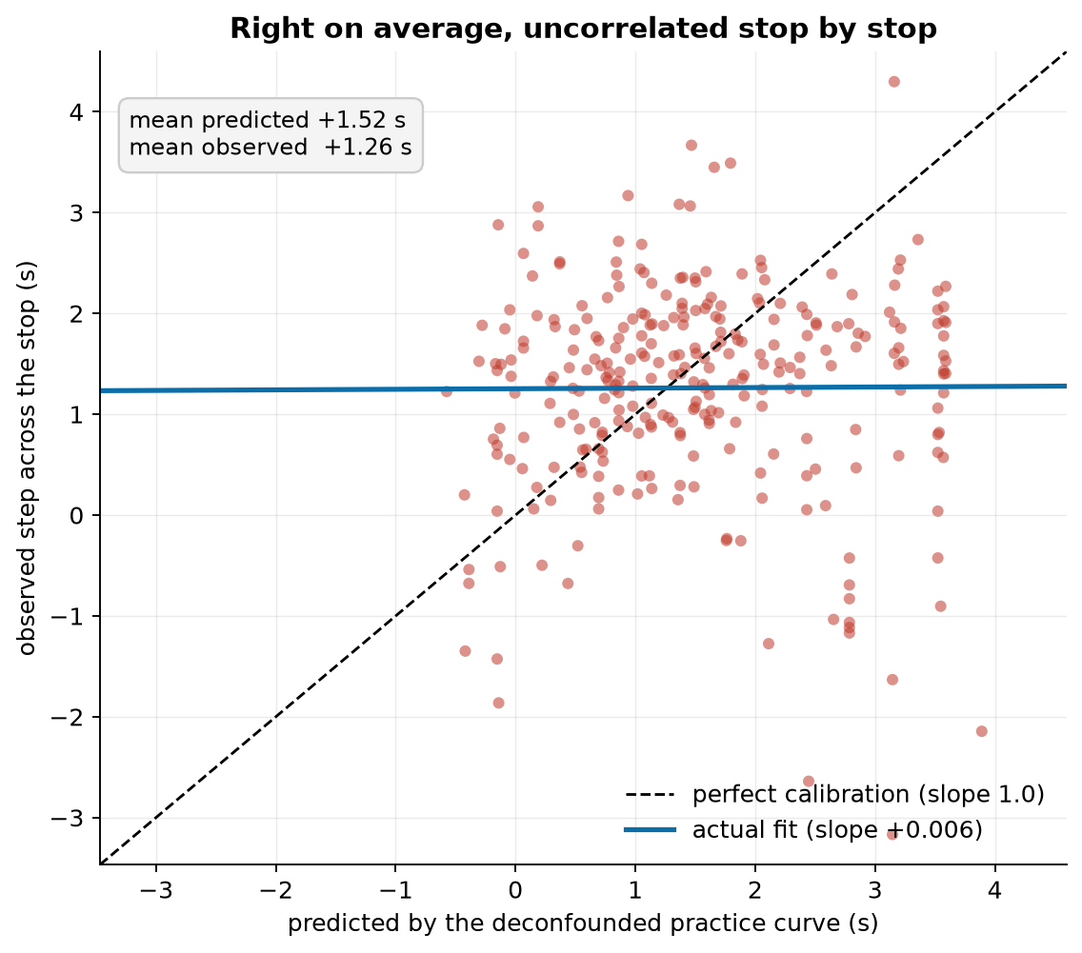
02 / SCIENTIFIC BREAKTHROUGH
The Practice-to-Race Transfer Failure & Observable Recovery
THE TRANSFER FAILURE EVIDENCE
Practice curves get season averages roughly right (+1.52s pred vs +1.26s actual) but fail stop-by-stop variation entirely (slope +0.006):
THE PITWALL SOLUTION: OBSERVABLE DELTAS
Rather than predicting unobservable physical wear, PITWALL models what engineers actually need: ground truth pace gains across tyre resets.
1. PIT STOPS AS NATURAL EXPERIMENTS
At a pit stop, tyre age abruptly resets to zero while fuel mass remains continuous. The pace step directly isolates the fresh rubber effect.
2. MEASURED FRESH TYRE VALUE
Empirical fresh tyre recovery is +1.26 s/lap (sd 1.03) measured across 288 real Formula 1 stops.
3. REGULARIZED DECISION ENSEMBLE
Combines compound pair, saturating age basis, track temperature, observed traffic, and recent pace state. Delivers 11.8% RMSE reduction vs mean.
Notes:
Here is the pivotal breakthrough of the project: traditional data scientists assume you can take a practice degradation curve and plug it into a race simulator. We tested that: it fails completely! The practice curve had a calibration slope of +0.006 when predicting real race pit stop transitions. Why? Because tyre degradation accumulates for roughly 20 laps and then plateaus. Instead of trying to force an unobservable wear percentage, PITWALL models the observable quantity a race engineer needs: the actual lap time recovered across a pit stop (+1.26s/lap fresh tyre value).

Slide 4
03 / OPERATIONAL ARCHITECTURE
The 4-Stage Live Decision Sequence
STAGE 01
TYRE CONDITION
SOFT / 16 Laps
-0.00s / lap trend
Stint age tracking, compound state, and fuel-corrected pace trend. Assesses remaining life without relying on misleading wear sensors.
STAGE 02
FORECAST PACE
Lap 70 Forecast
83.16s (70% CI)
Precomputed chronological machine learning model (Ridge + State Space + Gradient Boosting). Locked ahead of time for auditable scoring.
STAGE 03
PLAN THE STOP
Fit Hard Option
+1.15s / lap delta
Estimates pace step across pit stop (+1.15s/lap response) against a 22.5s pit loss. Compares Hard vs Medium vs Soft compound availability.
STAGE 04
REJOIN & ATTACK
Rejoin vs HAM
+2.2s gap behind
Models projected traffic window (13/22 cars clear). Runs undercut stress test against rival clock, accounting for out-lap tyre warm-up.
STREAMLINED WORKFLOW: INGEST SENSORS → PROJECT PACE → SIMULATE STOPS → STRESS TEST ATTACK MARGIN
Notes:
To make this actionable on the pit wall, we designed the 4-Stage Live Decision Sequence. This matches the exact workflow seen at the top of our race console: 01 Tyre Condition assesses the current stint age and isolated degradation trend. 02 Forecast Pace projects the driver's pace over the next laps with uncertainty intervals. 03 Plan the Stop evaluates fitting alternative compounds (e.g. fitting Hard) and models pit transit loss. 04 Rejoin & Attack calculates opponent battles, rejoin traffic, and undercut stress test.

Slide 5
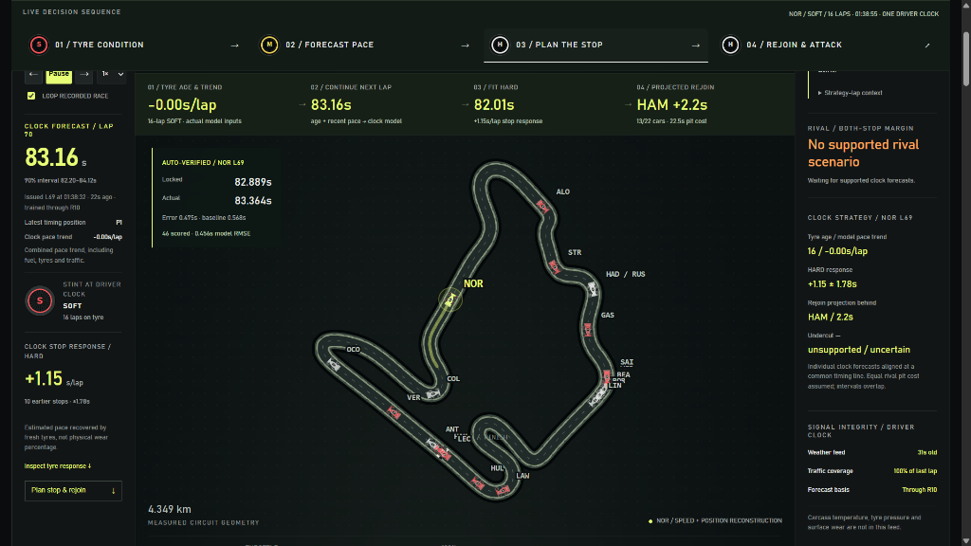
04 / PRODUCT SHOWCASE
Interactive Formula 1 Pitwall Console
KEY CONSOLE INNOVATIONS
ONE DRIVER CLOCK
Unifies position replay with precomputed machine learning predictions. All timing lines align to shared track coordinates.
AUTO-VERIFIED RECEIPT
Freezes issued forecast at Lap 25. Only reveals actual lap time when replay crosses the line, guaranteeing honest validation.
FRESH TYRE STOP RESPONSE
Dynamically updates tyre delta (+1.15s/lap on HARD) based on stint age and historical stop responses.
SIGNAL INTEGRITY AUDIT
Reports sensor latency (weather feed 31s old, 100% traffic coverage). Transparently warns that carcass temp & wear are omitted.
LIVE TELEMETRY REPLAY & SPATIAL TRACK RECONSTRUCTION (HUNGARORING)
Sub-second driver coordinates, gear, speed & throttle synchronization with audited model prediction overlays.
Notes:
Here is PITWALL in action. This is our live interactive motorsport console, running 100% client-side. At the center is the reconstructed 4.349 km Hungaroring circuit with real driver spatial coordinates. On the left, the One Driver Clock projects Norris at 83.16s, with the locked auto-verification box showing just 0.475s error on Lap 69 against the 83.364s actual. On the right, the race engineer briefing checks signal integrity (weather 31s old, 100% traffic coverage) and verifies whether rival undercut scenarios are supported.

Slide 6
05 / STRATEGY EDGE
Pricing the Undercut: Attack Budgeting Under Uncertainty
THE ATTACK BUDGET WATERFALL
An undercut is not an abstract win probability; it is a concrete seconds budget that must absorb real-world execution costs:
Fresh Tyre Advantage (3 laps): +3.95 s
Rival In-Lap Pace Response: −0.08 s
Current Track Interval to Cover: −1.50 s
Cold Out-Lap Warm-Up Penalty: −0.70 s
NET ATTACK MARGIN (CLEAN AIR): +1.67 s
ADD 2.0s REJOIN TRAFFIC DELAY: −0.33 s
Shared pit lane transit time cancels out because both cars must stop. The margin depends entirely on out-lap pace and traffic.
STRESS TESTING FRAGILE ASSUMPTIONS
In Formula 1, pit stops fail because teams assume deterministic clean air. PITWALL surfaces the variance:
EMPIRICAL UNCERTAINTY BANDS
Clean Rejoin Interval: −6.93 s to +10.26 s
Stressed Traffic Interval: −8.93 s to +8.26 s
CRITICAL INSIGHT FOR THE RACE STRATEGIST
Because both confidence intervals cross zero, the undercut is NOT a guaranteed overtake. A 2-second rejoin traffic delay flips the expected value negative.
DECISION SUPPORT, NOT BLACK-BOX COMMANDS
Rather than barking 'Box now', PITWALL reveals the critical traffic threshold so the strategist can abort if a backmarker doesn't yield.
Notes:
How does PITWALL help make better strategy decisions? Consider the classic undercut. Traditional tools say: 'You have a 1.67s advantage, box now!' PITWALL prices the attack with an explicit waterfall budget: 3 laps of fresh tyre benefit (+3.95s), minus rival pace (-0.08s), minus track gap (-1.50s), minus out-lap warm-up (-0.70s). That leaves a central margin of +1.67s. However, we stress-test this against traffic: adding just 2 seconds of traffic delay turns it into -0.33s. Because the uncertainty interval spans from -8.9s to +8.2s, the engineer knows this is high-risk.

Slide 7
06 / BENCHMARK RESULTS
Rigorous Chronological Evaluation Across 12 Races
PACE FORECAST RMSE
0.743 s
12.0% Lower Error
vs 0.844s persistence (6,831 forecasts)
RIVAL BATTLE RMSE
2.197 s
10.0% Lower Error
vs 2.441s rolling median (3,128 battles)
LOSS ALERT PRECISION
78.1 %
+6.8% Accuracy
Alerts for losing >2s (saves 73 false alarms)
PIT STOP RECOVERY
0.672 s
11.8% Lower Error
vs 0.761s season mean (107 race stops)
CHRONOLOGICAL BENCHMARK AUDIT (EXPANDING WINDOW TRAINING THROUGH R08, REUSED EVALUATION R09–R12)
TASK / TARGET | PITWALL MODEL | BENCHMARK BASELINE | IMPROVEMENT | SAMPLE SIZE (N)
Future Lap Pace (1 to 3 laps) | 0.743 s RMSE | 0.844 s (Persistence) | 12.0% lower error | 6,831 scored laps
Rival Gap Evolution | 2.197 s RMSE | 2.441 s (Rolling Median) | 10.0% lower error | 3,128 battles
Rival Loss Alert (>2.0s lost) | 78.1% Precision | 71.3% Precision | +6.8% precision | 73 false alerts cut
Pit Stop Rubber Gain | 0.672 s RMSE | 0.761 s (Historical Mean) | 11.8% lower error | 107 validated stops
Pace Interval Coverage | 92.5% empirical | 90.0% nominal target | Well-calibrated | 6,831 forecasts
Notes:
Let's look at the hard benchmark numbers. We tested PITWALL across 12 Grand Prix events of the 2026 season. Across 6,831 scored chronological pace forecasts, PITWALL achieved a 0.743s RMSE—a 12.0% improvement over persistence. For relative battle times against rivals, RMSE was 2.197s—10.0% better than rolling median extrapolation. Most importantly for strategy: when alerting that a driver is about to lose >2 seconds to a rival, our precision is 78.1% compared to 71.3% for baselines, eliminating 73 costly false alarms.

Slide 8
07 / SYSTEM ARCHITECTURE
End-to-End Motorsport Data & Machine Learning Pipeline
LAYER 01
INGESTION & CLEANING
FastF1 2026 Season
• 12 Grand Prix events (14,310 laps)
• Sub-second driver spatial telemetry
• Weather & track temperature feeds
• Strict filtering of safety cars & out-laps
LAYER 02
FEATURE ENGINEERING
Physics Identification
• Estimated fuel lambda (-0.0294 s/kg)
• Track evolution saturation log-basis
• Measured traffic proximity gaps
• Saturating tyre age basis functions
LAYER 03
MODEL ENSEMBLE
Robust Chronological ML
• 17 Pace candidates evaluated
• State-space pace estimation + Ridge
• Battle relative-correction models
• Calibrated uncertainty prediction bands
LAYER 04
OFFLINE RACE CONSOLE
High-Performance UI
• 100% Client-side HTML5/Vanilla JS
• Synchronized circuit spatial replay
• One Driver Clock telemetry alignment
• Portable zero-cloud jury deployment
Notes:
Behind PITWALL is a rock-solid, production-grade engineering architecture. We ingest raw telemetry, timing, and weather feeds via FastF1, encompassing 14,310 laps across 12 events. Our modeling pipeline evaluates 17 pace model specifications and 8 stop specifications, selecting regularized Ridge with saturating age bases and state-space estimation. The frontend is zero-dependency, static, and works completely offline—critical for trackside deployment.

Slide 9
08 / SCIENTIFIC INTEGRITY
Transparent Modeling Boundaries & Engineering Rigor
HONEST REUSED EVALUATION
Races R09–R12 were inspected during previous revisions. We transparently report them as a reused evaluation set with expanding historical training, rather than claiming an unexamined blind trial.
NO SENSOR HALLUCINATION
Formula 1 teams guard internal tyre carcass temperatures and pressure sensors. Rather than hallucinating fake physical wear percentages, PITWALL models observable pace steps and flags missing telemetry.
NO UNVALIDATED 'POSITIONS WON' CLAIMS
Winning an undercut depends on competitor pit crew times, traffic, and track evolution. We price the required attack budget and report interval overlaps rather than making wild counterfactual win claims.
EXPLICIT ABSTENTION LOGIC
When safety cars neutralize the race, timing loops drop, or scenarios lack sufficient historical support, PITWALL explicitly outputs 'unsupported / uncertain' instead of outputting dangerous guesses.
Notes:
A winning hackathon submission must demonstrate scientific integrity. We are completely transparent about our modeling boundaries: First, we disclose that R09 to R12 are reused evaluation races, not a fresh blind holdout. Second, we do not hallucinate physical tyre sensors: carcass temperature, pressure, and surface wear are not in public feeds, and we state that clearly in the console. Third, we make no unvalidated claims of 'positions won' in counterfactual races. We present audited forecasting improvements and robust decision stress tests.

Slide 10
09 / SUMMARY & CONCLUSION
PITWALL: The Strategic Advantage on Track
THE CORE INNOVATION
Physics Deconfounding
Discovered and proved why practice degradation curves fail to transfer to race day. Replaced collinearity with observable pit-step pace recovery modeling (+1.26s/lap).
THE MEASURED ADVANTAGE
Audited Benchmarks
12.0% lower lap pace RMSE across 6,831 forecasts, 10.0% lower battle gap RMSE, and 78.1% alert precision, validated across 12 Formula 1 Grand Prix events.
THE WORKING PRODUCT
Zero-Cloud Race Console
Live 4.349 km circuit reconstruction with One Driver Clock synchronization, auto-verified forecast locks, and interactive undercut traffic stress-testing.
THANK YOU — TEAM HANDSOME SQUIDWARD
Team Members: Aditya & Ruhani | Hackathon: TrackShift 2026 | AI Motorsport Track
Notes:
In conclusion, PITWALL bridges the gap between deep motorsport data science and real-time pit wall decision making. We solve the fuel collinearity trap, provide verified chronological pace forecasting with a 12% lower RMSE, and give strategists an inspectable attack budget to prevent costly undercut failures. Thank you to the jury and organizers of TrackShift 2026. Aditya and Ruhani are now ready for your questions!

