Slide 1
DIRECT Presentation
Black-Box-Optimization
by the Optimistic Optimizers
Sara Aalinezhad
Huat Chiang
Ahmed Eshaq
Elizabeth Harmon
Salek Segid

Slide 2
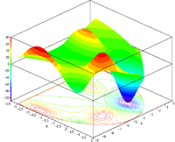
Project Description
Optimization is an important tool in making decisions and analyzing physical systems.
In mathematical terms, an optimization problem is attempting to find the best solution (i.e., maxima or minima) from among the set of all feasible solutions.
The goal of Black-Box-Optimization v1.0 is to test a variety of optimizers against our chosen functions and collect data related to each optimizers performance (such as time per trial, accuracy, etc.). Based on the results, our Machine Learning model will be able to predict which optimizer is ideal based on a user’s input.

Slide 3
Motivation
The principal challenge in optimization practice which is optimizing in the absence of algebraic model of the system to be optimized
Problems for which are algebraic models are either intractable to conventional optimization software, or are entirely unavailable
A few Use Cases include:
Optimizing material performances
Optimizing an experiment and prioritizing speed vs accuracy
Optimizing oil interfacial tension
Designing a combustion engine

Slide 4

Optuna Optimizer
Random Optimizer - randomly samples and returns the best one
Performs well in low dimensions
Fast
Tree of Parzen Estimator (TPE) - samples based on expected improvement
Performs well in high dimensions
Requires many samples
Covariance Matrix Adaptation Evolution Strategy (CmaEs) - creates a multivariate gaussian and updates it using evolutionary methods
Performs well in high dimensions
Requires many samples
Inefficient in low dimensions

Slide 5
Bayes_Opt
Bayesian optimization works by constructing a posterior distribution of functions (Gaussian process) that best describes the function to be optimized.
The algorithm becomes more confident as the number of observations increases and the posterior distribution improves.
The algorithm balances its needs of exploration and exploitation by considering what it knows about the target function as the number of iterations increases.
At each step, a Gaussian Process is fitted to the previously explored points, and the posterior distribution, combined with an exploration strategy (such Upper Confidence Bound or Expected Improvement), are used to determine the next point that should be explored.
Advantages:
Very accurate and fast
Works well on expensive functions
Disadvantages:
Results are sensitive to parameters of the surrogate model
Needs to sample the function many times
Notes:
Beth

Slide 6
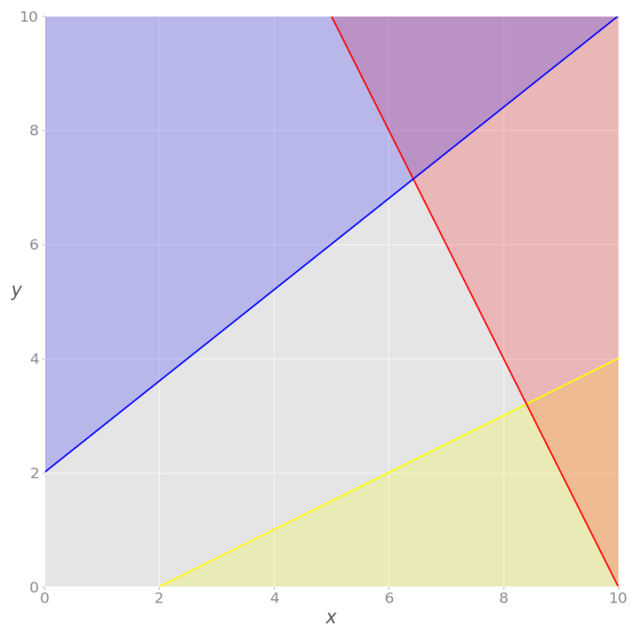
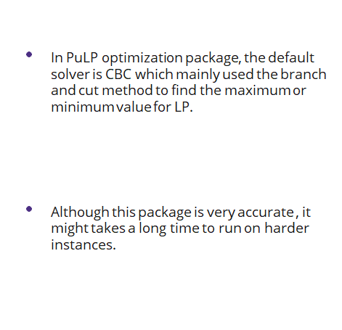
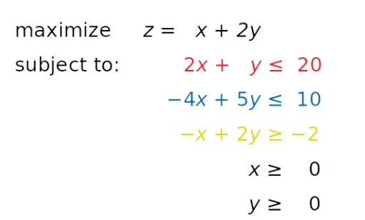
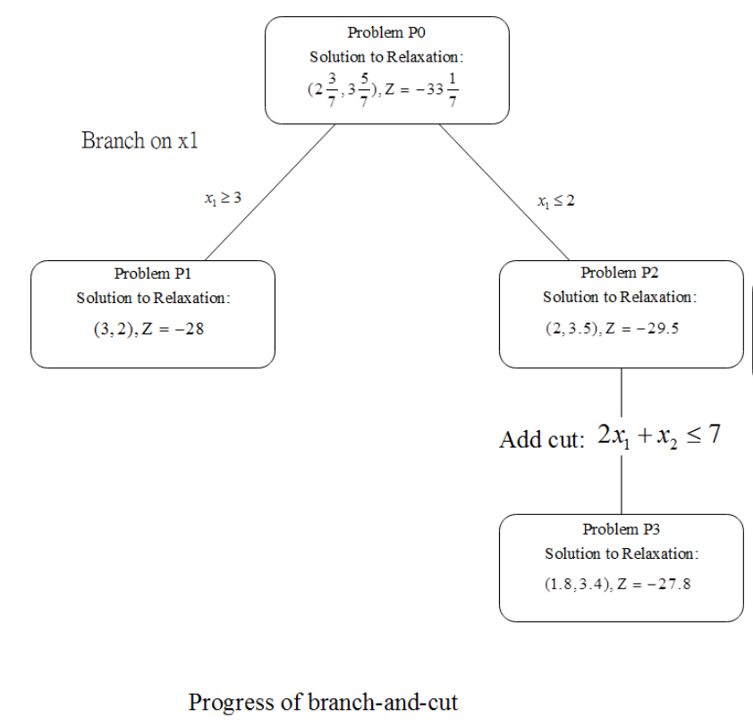

Slide 7
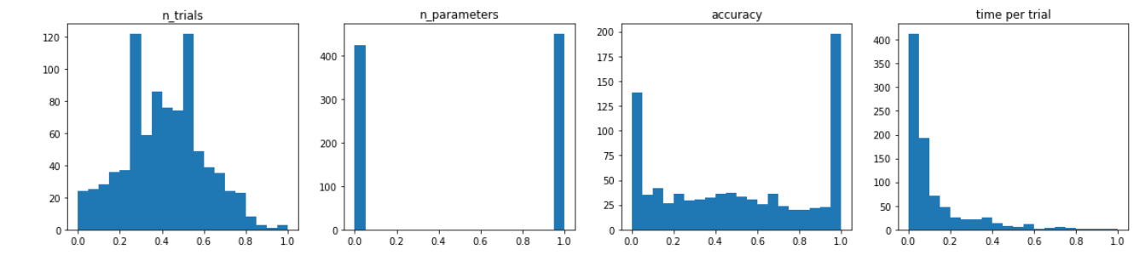

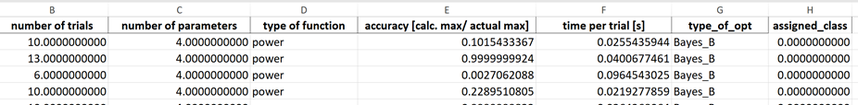
Data Collection

Slide 8
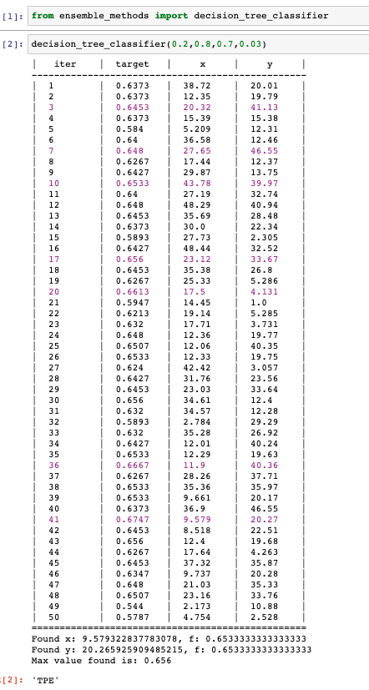

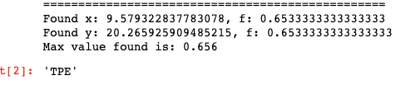
Testing a model – Machine Learning
number of number of accuracy time per iteration
trails parameters
Other methods tested:
KNN
SVM
Logistic regression and Random Forest

Slide 9
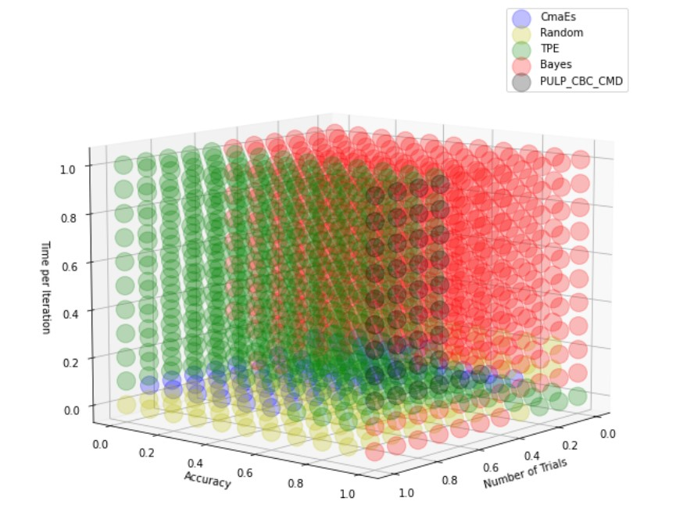
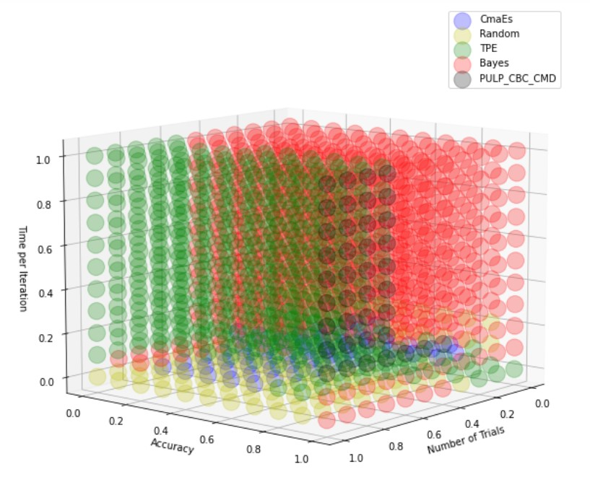
Results from the Decision Tree Classifier
2-dimensional function
4-dimensional function

Slide 10
Future work
Process the data to remove the skew
Implement more optimizers
Obtain more data for higher dimensional functions
Incorporate GUI for user inputs

Slide 11
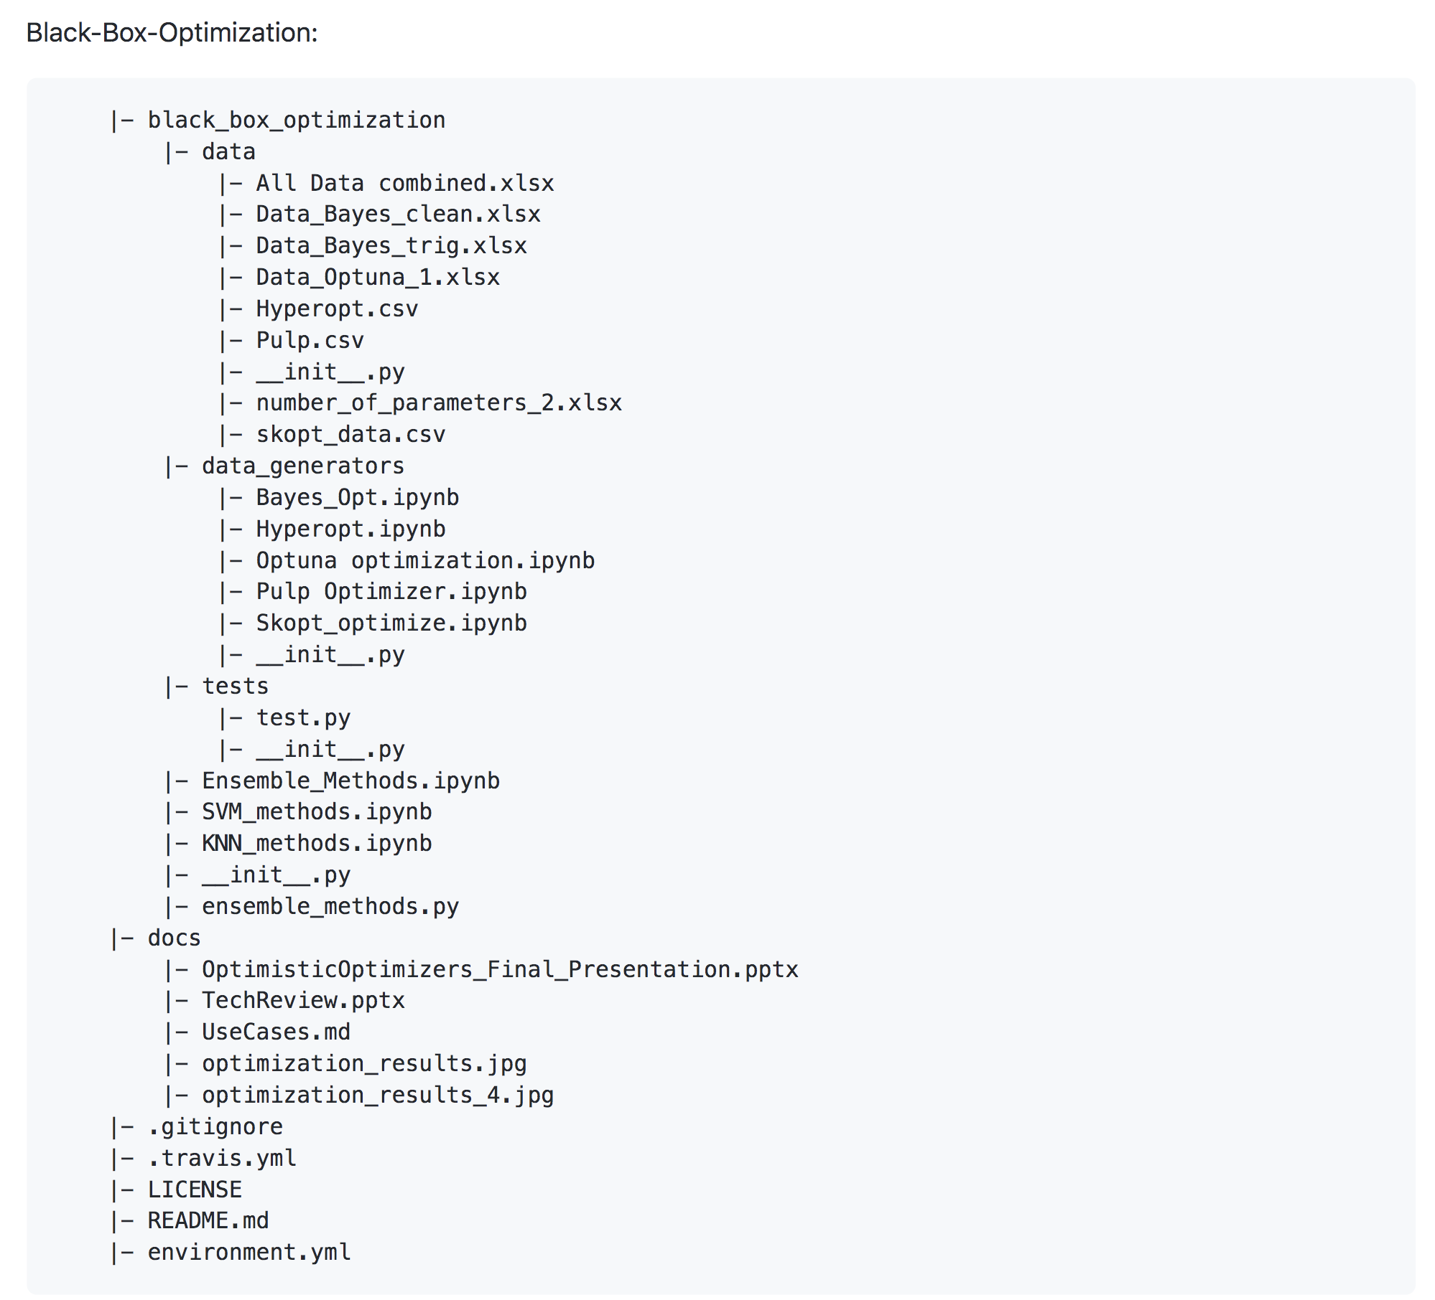
GitHub Organization
data files
optimizers
test file
presentation, tech review, ...

Slide 12
References
Amaran, S., N. V. Sahinidis, B. Sharda, and S. J. Bury, Simulation optimization: A review of algorithms and applications, Annals of Operations Research, 240, 351–380, 2016.

