Slide 1
최적화 스터디
other sorted range algorithm
마비노기 기술유닛 최동민

Slide 2
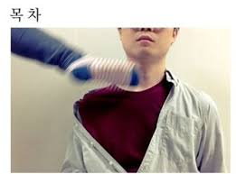
std::merge
std::inplace_merge

Slide 3
std::merge

Slide 4

std::merge

Slide 5

std::merge
Since C++ 17
Since C++ 20

Slide 6
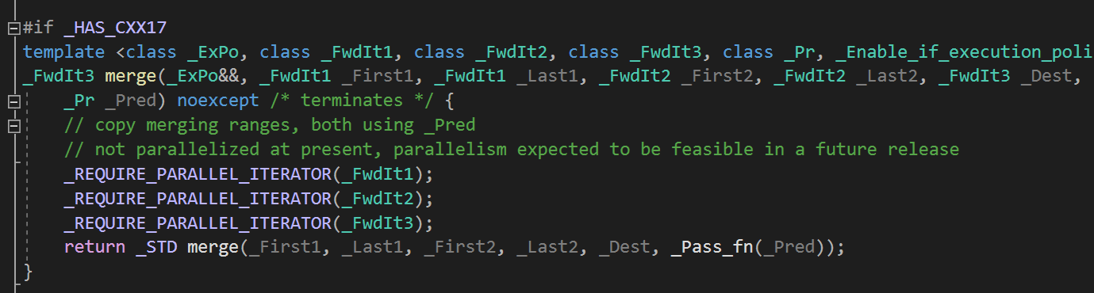
std::merge (with execution policy)
VS2019

Slide 7
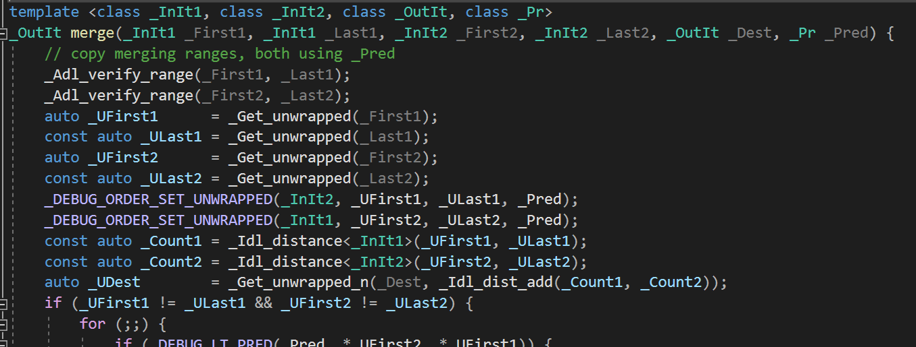
std::merge

Slide 8
std::merge

Slide 9
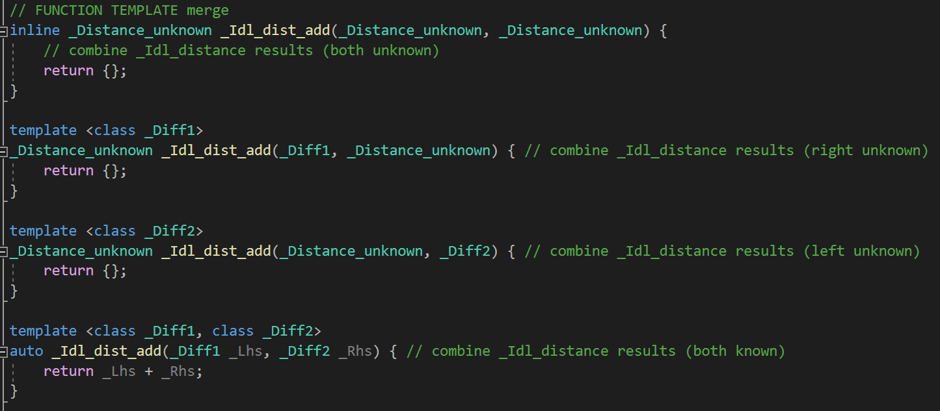
_idl_dist_add

Slide 10
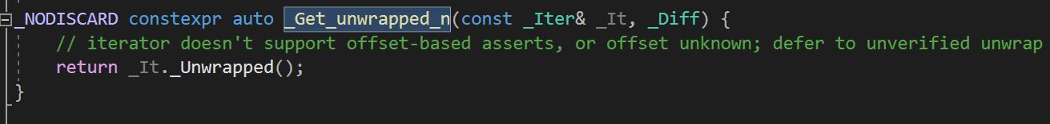
_Get_unwrapped_n
Notes:
diff 는 왜 받는거지?

Slide 11
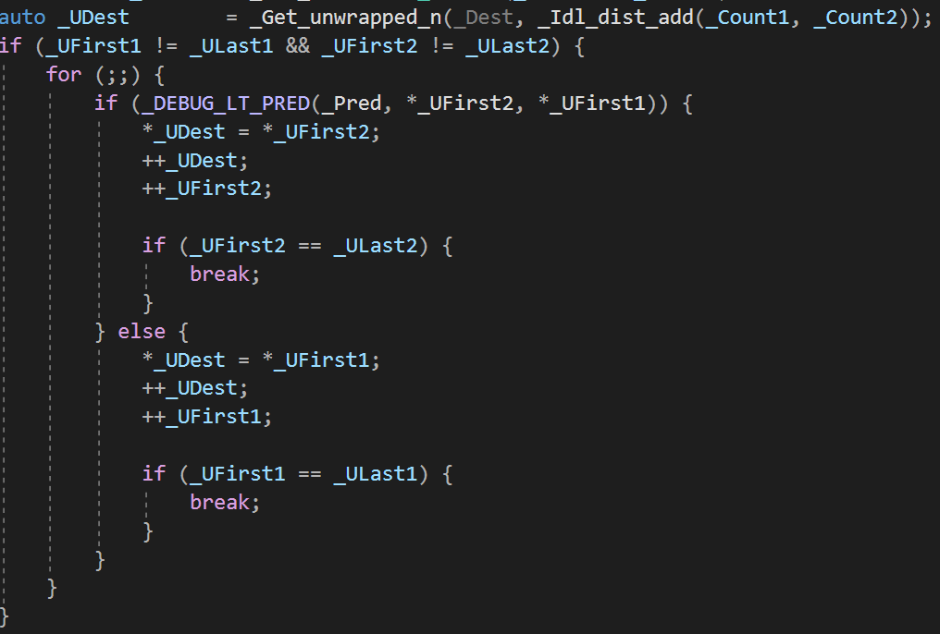
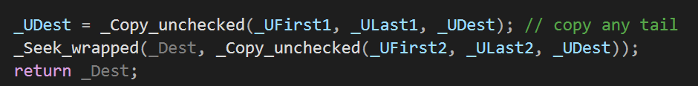
std::merge

Slide 12
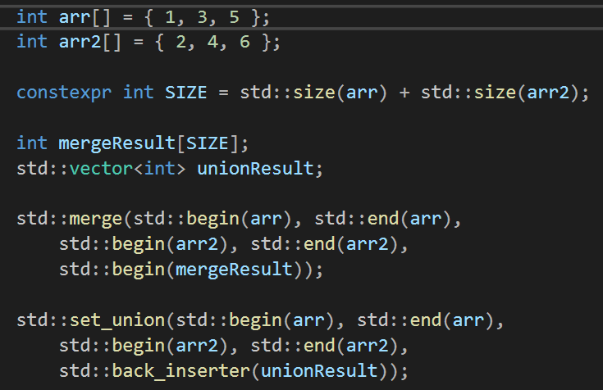
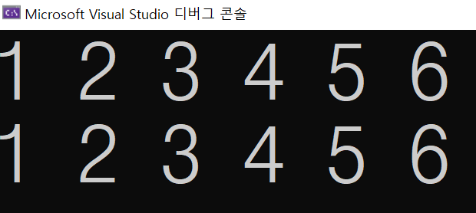
비슷한 함수 : std::set_union

Slide 13
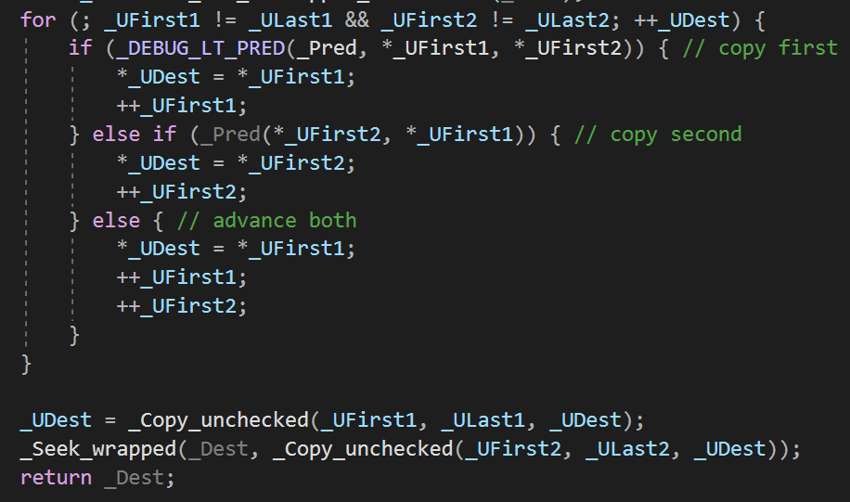
비슷한 함수 : std::set_union

Slide 14
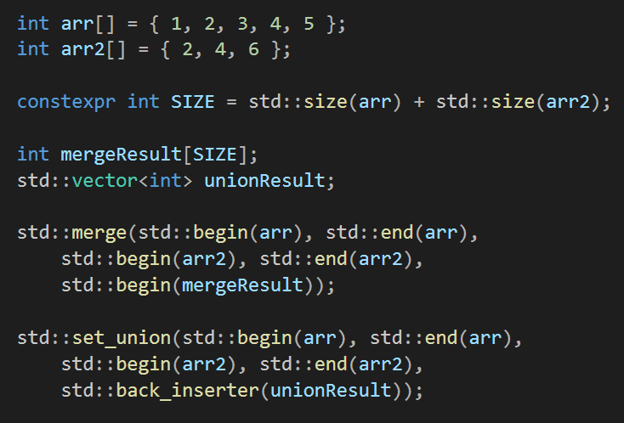
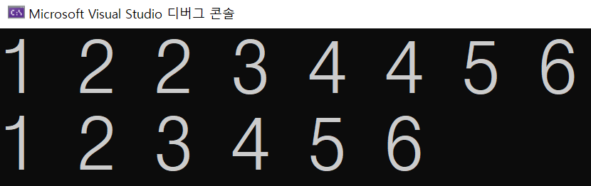
비슷한 함수 : std::set_union

Slide 15
std::inplace_merge

Slide 16
std::inplcae_merge
Notes:
constexpr 버전은 없음

Slide 17
std::inplcae_merge
Merges two consecutive sorted ranges [first, middle) and [middle, last) into one non-decreasing range [first, last).
한 컨테이너 안에 두 sorted range가 있을 때, 오름차순으로 정렬

Slide 18
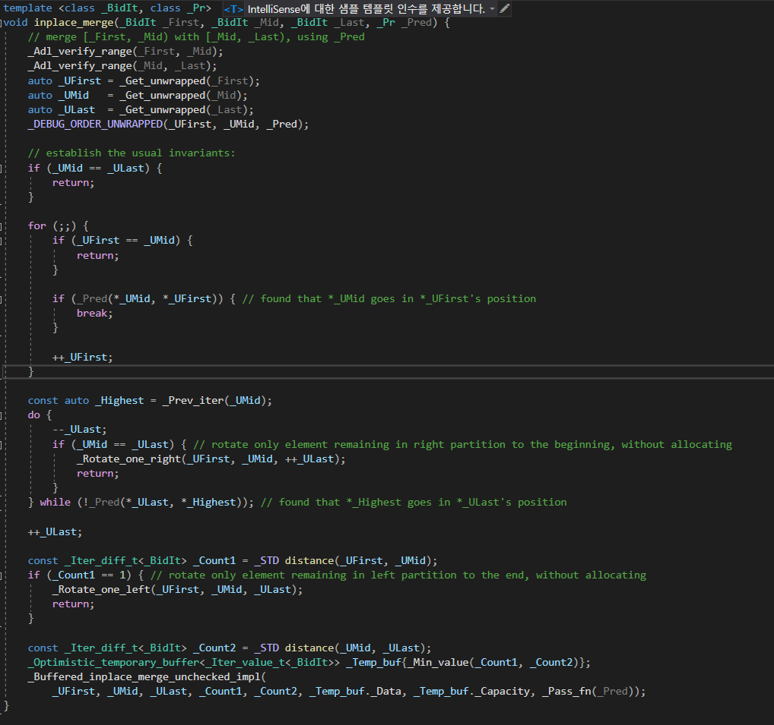
std::inplace_merge

Slide 19
std::inplace_merge

Slide 20
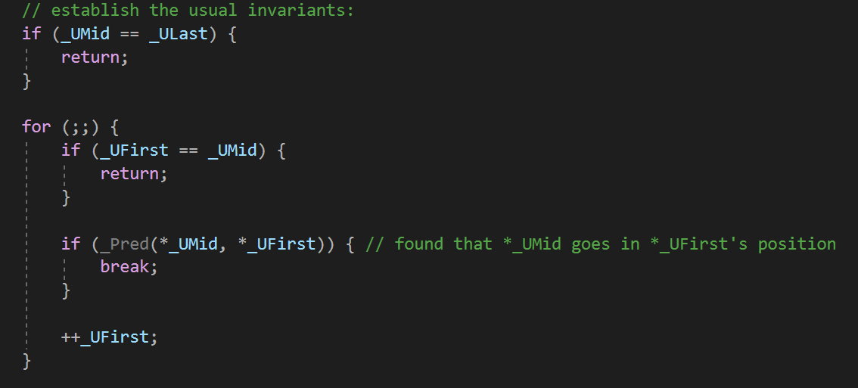
std::inplace_merge

Slide 21
std::inplace_merge

Slide 22
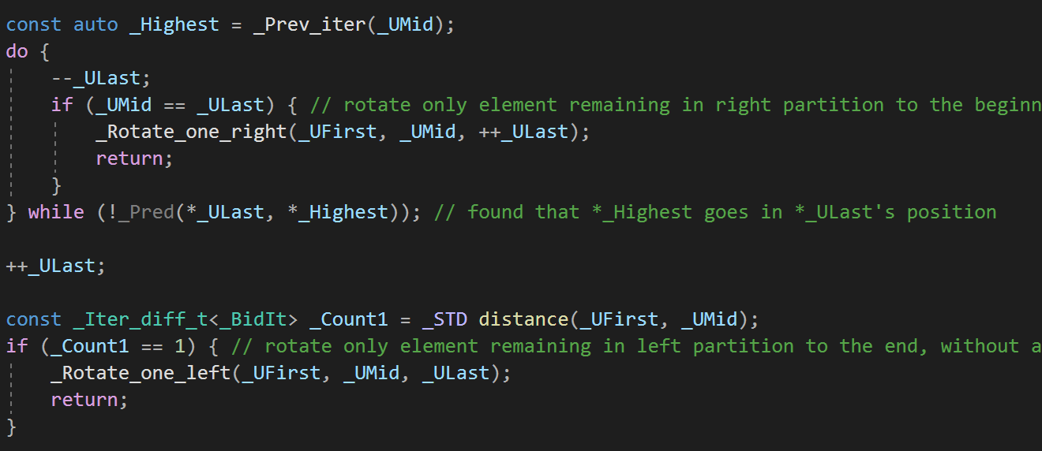
std::inplace_merge

Slide 23
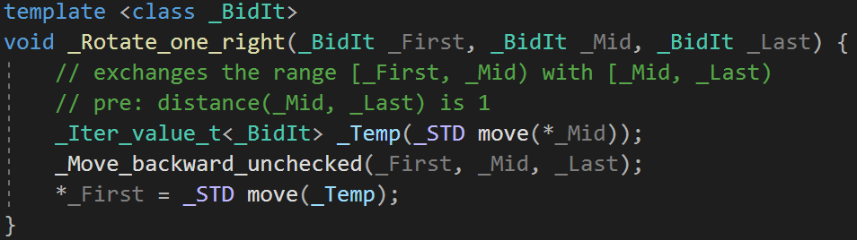
_Rotate_one_right

Slide 24
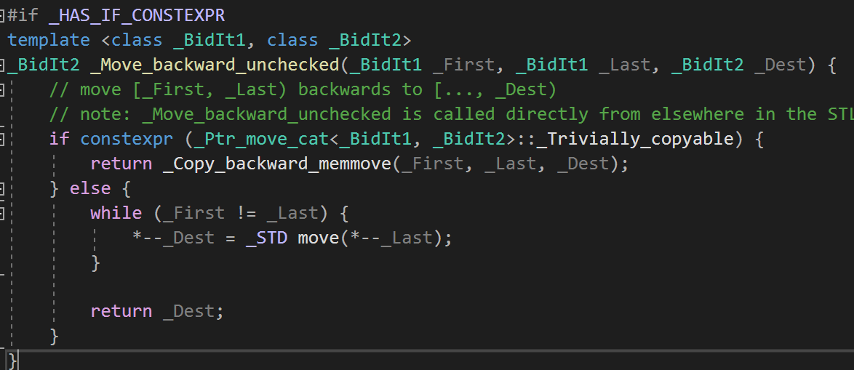
_Move_backward_unchecked

Slide 25
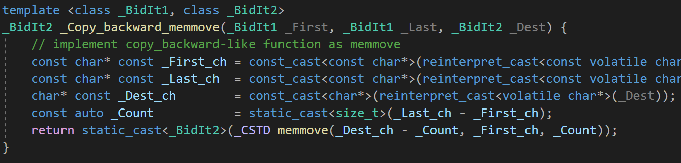
_Copy_backward_memmove

Slide 26
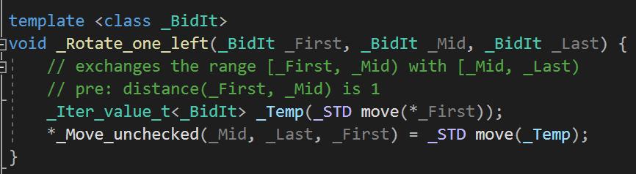
_Rotate_one_left

Slide 27
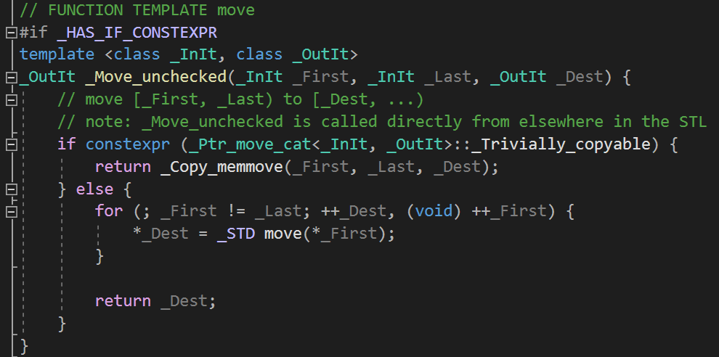
_Move_unchecked
Notes:
맨 끝 이터레이터가 리턴됨

Slide 28
std::inplace_merge

Slide 29
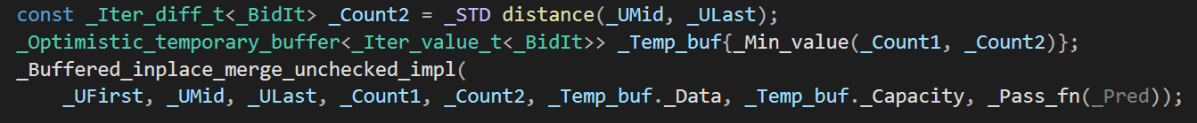
std::inplace_merge

Slide 30
std::inplace_merge
알고리즘을 위한 임시버퍼 생성

Slide 31
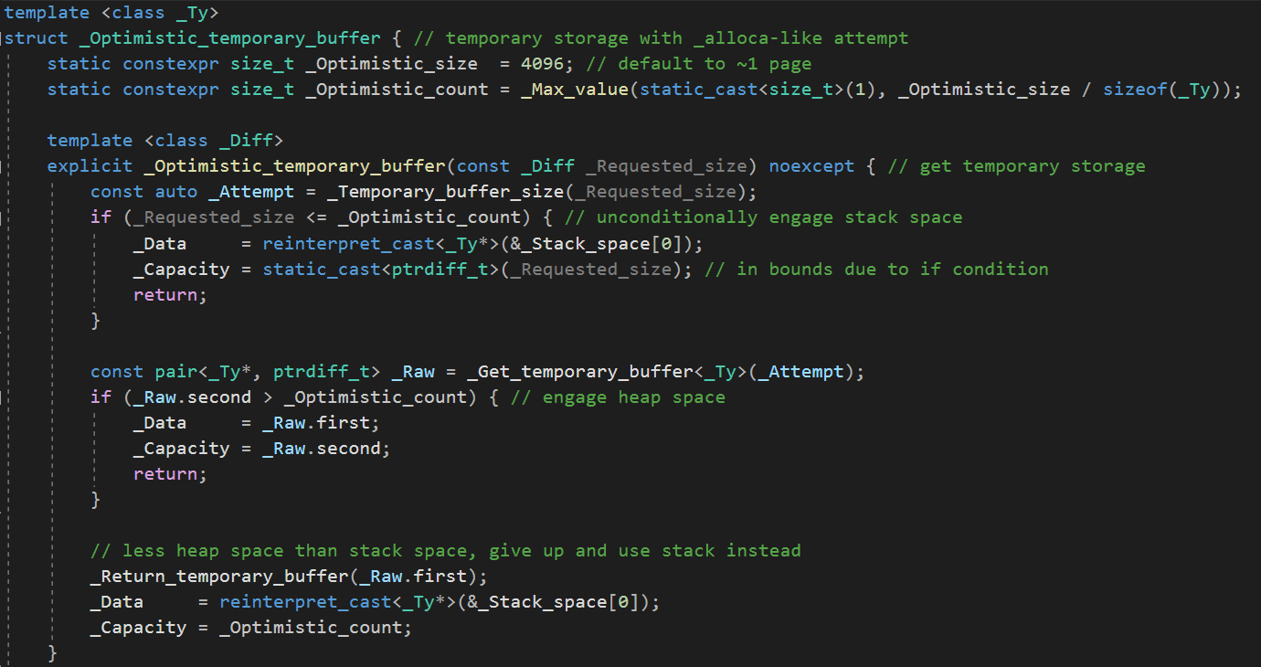
_Optimistic_temporary_buffer

Slide 32
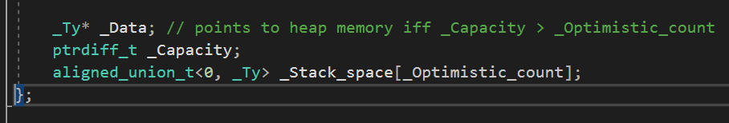
_Optimistic_temporary_buffer

Slide 33
_Optimistic_temporary_buffer

Slide 34
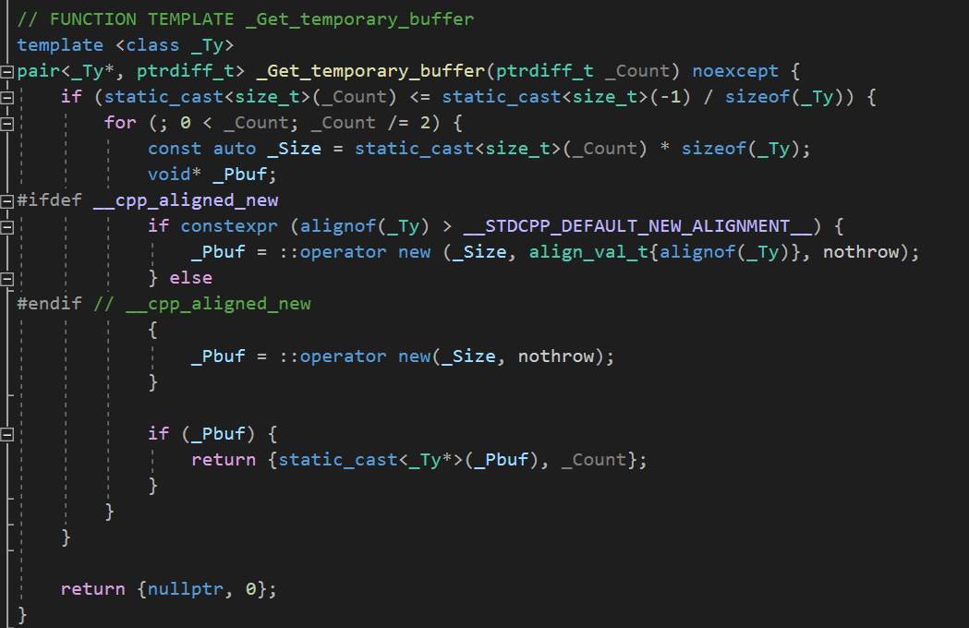
_Get_temporary_buffer

Slide 35
_Optimistic_temporary_buffer

Slide 36
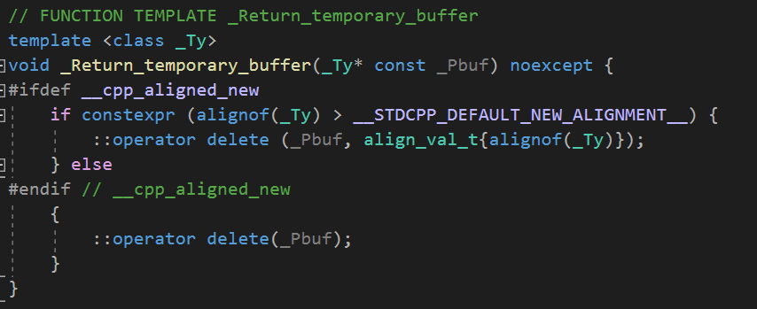
_Return_temporary_buffer

Slide 37
std::inplace_merge

Slide 38
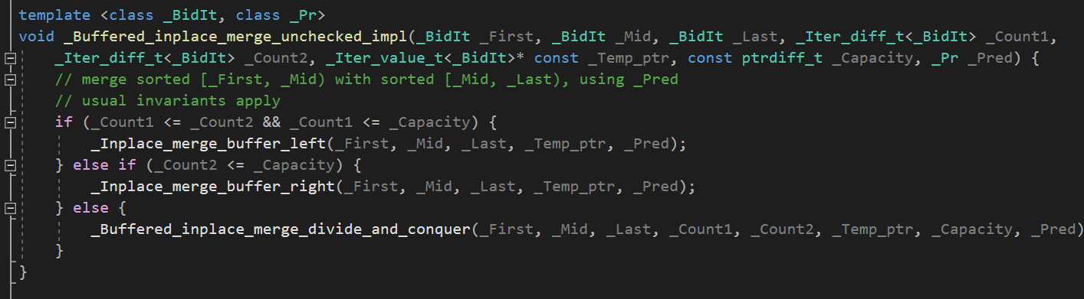
_Buffered_inplace_merge_unchecked_impl

Slide 39
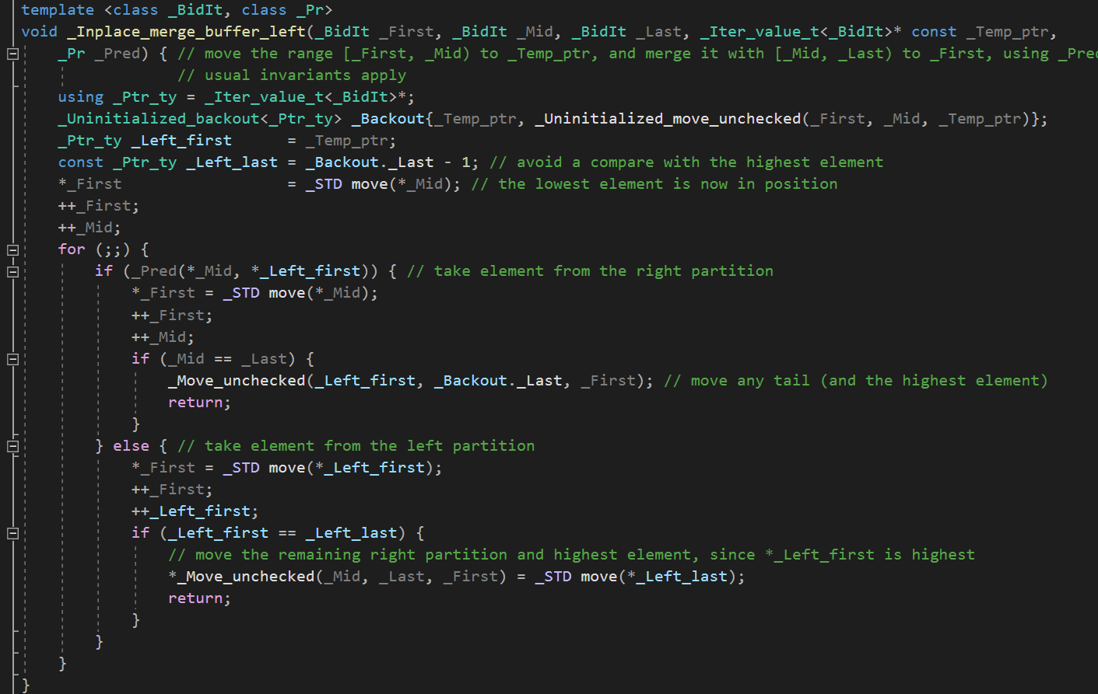
_Inplace_merge_buffer_left

Slide 40
감사합니다

