Slide 1
PRIVGUARD AI | VISION & POSITIONING
PRIVGUARD AI
The Independent Security Layer for AI Applications
Secure every prompt. Govern every tool. Protect every interaction.
• Decoupling safety and security policy enforcement from probabilistic LLMs.
• Local-first privacy enforcement with sensitive-data redaction before model transmission.
• Cryptographic task-scoped capability tokens for autonomous agent tools.
• Moon Sanctum Labs | Founder: Aniket Nandi (Kolkata, India) | Buildathon 2026
Moon Sanctum Labs • Decode. Build. Evolve. • Startup Buildathon India 2026

Slide 2
PRIVGUARD AI | PROBLEM STATEMENT
The Problem: The Fallacy of Model Self-Governance
Why Generative AI is Inherently Vulnerable in Production
You would never let a web user enforce database permissions. Why trust an LLM to govern itself?
• Data Ingress Leakage: Customer PII, secrets, and proprietary code sent raw to cloud APIs.
• Adversarial Hijacking: Prompt injections and jailbreaks effortlessly override soft system prompts.
• Ungoverned Agent Tools: Autonomous agents invoke sensitive APIs without cryptographic boundaries.
• Compliance Vacuum: Storing prompts violates DPDP/GDPR; omitting logs blinds forensic investigations.
Moon Sanctum Labs • Decode. Build. Evolve. • Startup Buildathon India 2026

Slide 3
PRIVGUARD AI | PROPOSED SOLUTION
The Solution: Deterministic Out-of-Band Gateway
Independent Enforcement Between Applications, Models & Tools
Fail-closed security kernel operating independently of model hallucinations.
• Ingress Defense: Scans secrets (entropy + patterns) & tokenizes PII (<EMAIL_1>, <PHONE_1>).
• Adversarial Quarantine: Halts prompt injections with HTTP 403 before model context is loaded.
• Tool Authorization: Issues single-use HMAC-SHA256 capability tokens for agent tools.
• Content-Free Auditing: Records keyed HMAC-SHA256 fingerprints—zero raw prompt storage.
Moon Sanctum Labs • Decode. Build. Evolve. • Startup Buildathon India 2026

Slide 4
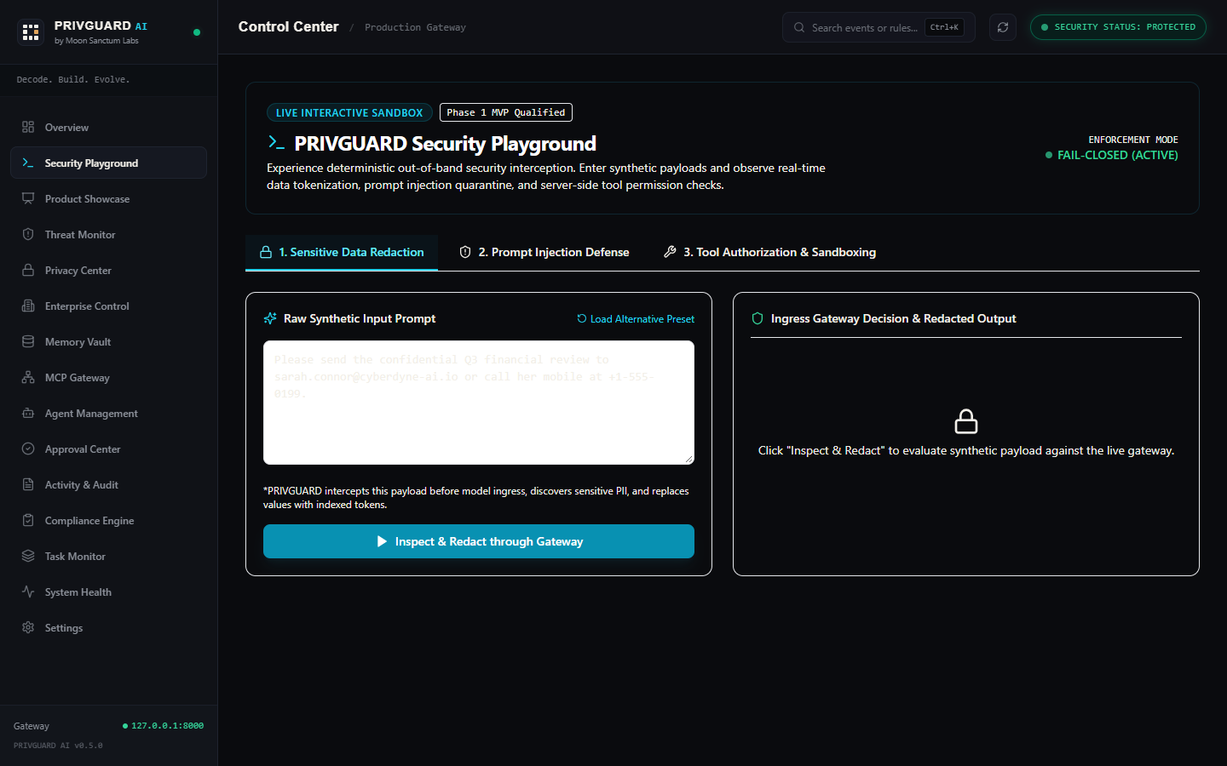
PRIVGUARD AI | DELIVERED PRODUCT
Current Product: Five Tested Phase 1 Capabilities
Completed MVP Verified Across 438+ Automated Backend Tests
Not a conceptual slide deck—a deployment-qualified security gateway.
• 1. Sensitive Data Protection: Presidio/regex tokenization & safe client-side de-tokenization.
• 2. Prompt Injection Defense: Deterministic signatures & heuristic quarantine (INJ_OVERRIDE_001).
• 3. Tool Authorization: Server-side ToolBroker with single-use task-scoped capability tokens.
• 4. Content-Free Activity Logs: Keyed HMAC fingerprints for DPDP/GDPR compliant forensics.
• 5. Policy Control Center: User-defined ALLOW/REDACT/BLOCK policies with real-time dry-run.
Moon Sanctum Labs • Decode. Build. Evolve. • Startup Buildathon India 2026

Slide 5
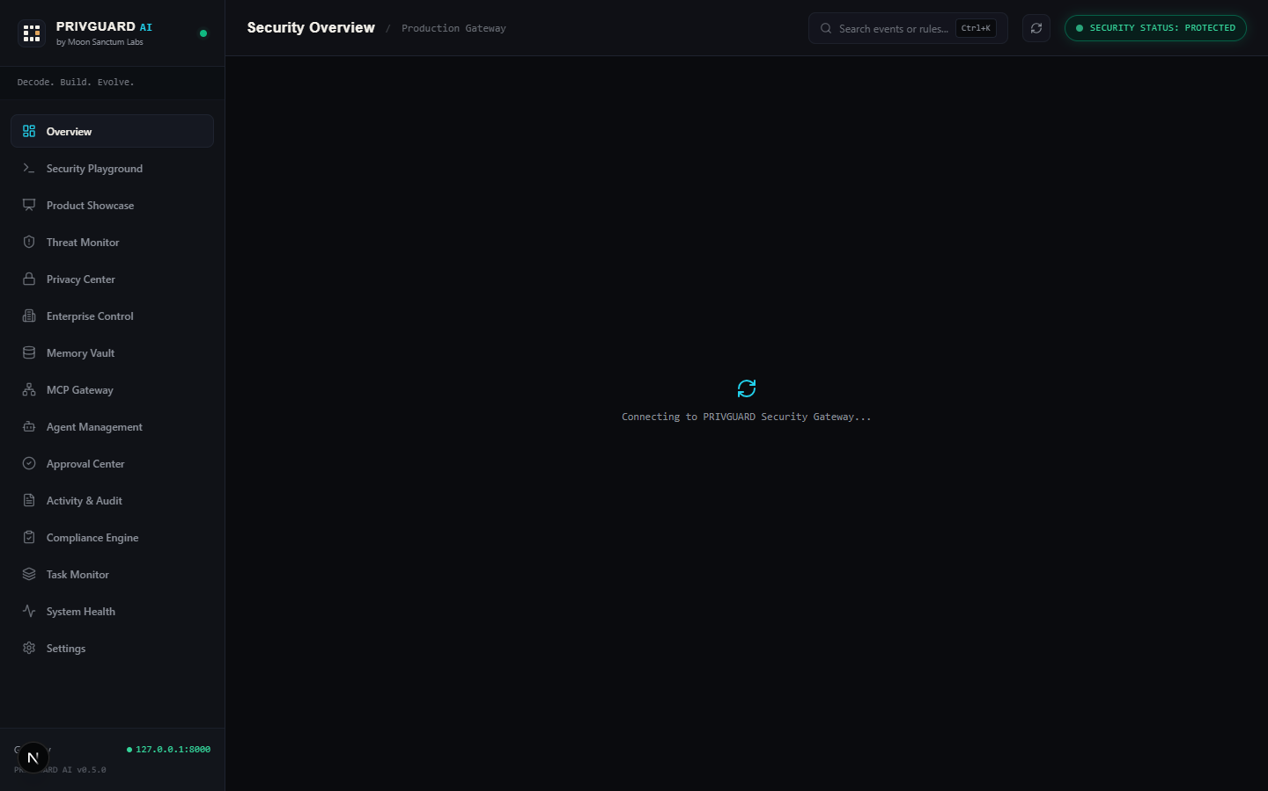
PRIVGUARD AI | PRODUCT SHOWCASE
Live Product: Executive Console & Security Playground
Real-Time Telemetry and Interactive Evaluation Sandbox
Full visibility into threats, redactions, and agent capabilities in real time.
• Interactive Playground: Evaluators test PII redaction, prompt injection, and tool checks.
• Executive Telemetry: Real-time counters for requests, blocked threats, and active agents.
• Live Local Integration: Tested end-to-end against local Ollama (llama3.2:3b).
• Zero Guesswork: Inspect exactly what was redacted and why a threat was quarantined.
Moon Sanctum Labs • Decode. Build. Evolve. • Startup Buildathon India 2026

Slide 6
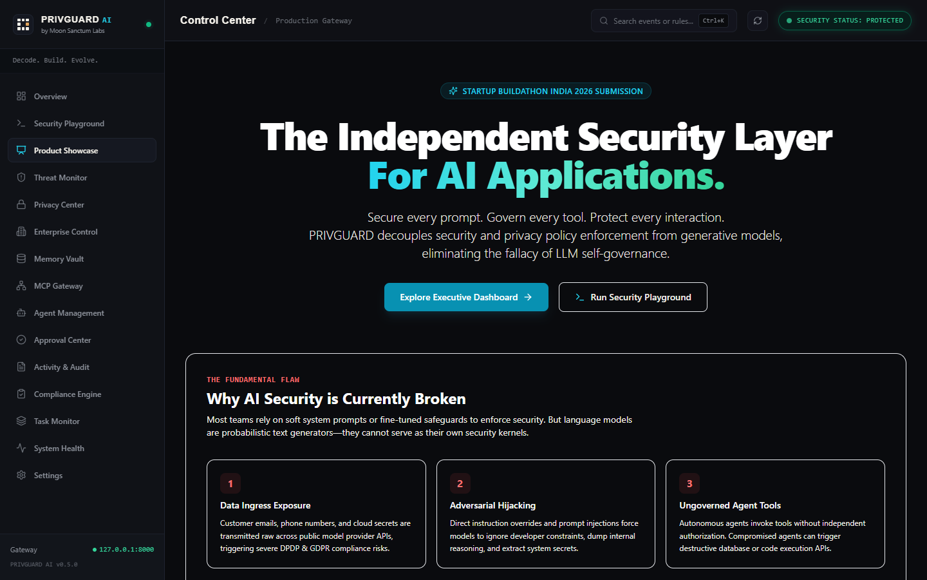
PRIVGUARD AI | TECHNICAL DESIGN
Technical Architecture & Enforcement Boundary
Application -> Ingress Pipeline -> ToolBroker -> Model -> Egress Inspection
Zero data egress in local mode; verified sensitive-data redaction in cloud mode.
• Client Layer: Standard OpenAI-compatible REST proxy interface (/v1/chat/completions).
• Ingress Pipeline: Secret scanning, prompt injection defense, PII tokenization.
• ToolBroker: Cryptographic HMAC capability validator with strict parameter constraints.
• Egress Pipeline: Model leakage inspection, placeholder restoration, content-free logging.
Moon Sanctum Labs • Decode. Build. Evolve. • Startup Buildathon India 2026

Slide 7
PRIVGUARD AI | COMPETITIVE ADVANTAGE
Market Differentiation: Why PRIVGUARD Wins
Architectural Superiority Over Traditional WAFs and Model Wrappers
Deterministic, local-first protection built specifically for the generative AI era.
• Enforcement Boundary: Operates at the AI application layer, not just generic network packets.
• Fail-Closed Philosophy: Malicious inputs and live secrets are blocked before reaching model APIs.
• Cryptographic Tool Grants: First gateway to treat agent tools as capability-gated primitives.
• Privacy by Design: Never stores raw user prompts, preventing secondary database leaks.
Moon Sanctum Labs • Decode. Build. Evolve. • Startup Buildathon India 2026

Slide 8
PRIVGUARD AI | MARKET & BUSINESS MODEL
Market Opportunity & Business Model Hypotheses
Targeting the $15B+ AI TRiSM (Trust, Risk & Security) Market
Developer-first adoption scaling into enterprise compliance infrastructure.
• Beachhead ICP: AI SaaS startups and engineering teams deploying customer copilots.
• Regulatory Urgency: India DPDP Act 2023 (₹250 Cr penalty floor) & EU AI Act compliance.
• Community Tier (Free): Local-first gateway, SQLite storage, local Ollama, community rules.
• Team & Enterprise ($99 - $5,000/mo): Multi-tenant policies, SIEM export, air-gapped clusters.
Moon Sanctum Labs • Decode. Build. Evolve. • Startup Buildathon India 2026

Slide 9
PRIVGUARD AI | ROADMAP & EXPANSION
Product Roadmap: The Three-Phase Vision
Clear Engineering Progression from Gateway to Mesh
What exists today, and what PRIVGUARD will become.
• Phase 1: Local-First AI Security Gateway (COMPLETED & QUALIFIED) - 438+ tests passed.
• Phase 2: Agent Security & Execution Mesh (PLANNED) - Multi-agent taint tracking & approval hooks.
• Phase 3: Privacy Infrastructure (LONG-TERM) - Confidential computing & zero-knowledge proofs.
• Commitment: Delivering verified, rock-solid engineering milestones before expanding.
Moon Sanctum Labs • Decode. Build. Evolve. • Startup Buildathon India 2026

Slide 10
PRIVGUARD AI | FOUNDER & EXECUTION
Founder & Execution Pedigree: Moon Sanctum Labs
Built from First Principles by Aniket Nandi (Kolkata, India)
Decode. Build. Evolve.
• Solo Founder: Full-stack systems engineer & product designer with obsessive focus on security.
• Verified Engineering: Single-handedly built gateway, test suite, and Next.js management console.
• Zero Security Vulnerabilities: Passed Bandit (0 high/medium) and Ruff clean static analysis.
• Vision: Establishing India's premier homegrown AI security infrastructure platform.
Moon Sanctum Labs • Decode. Build. Evolve. • Startup Buildathon India 2026

