Slide 1
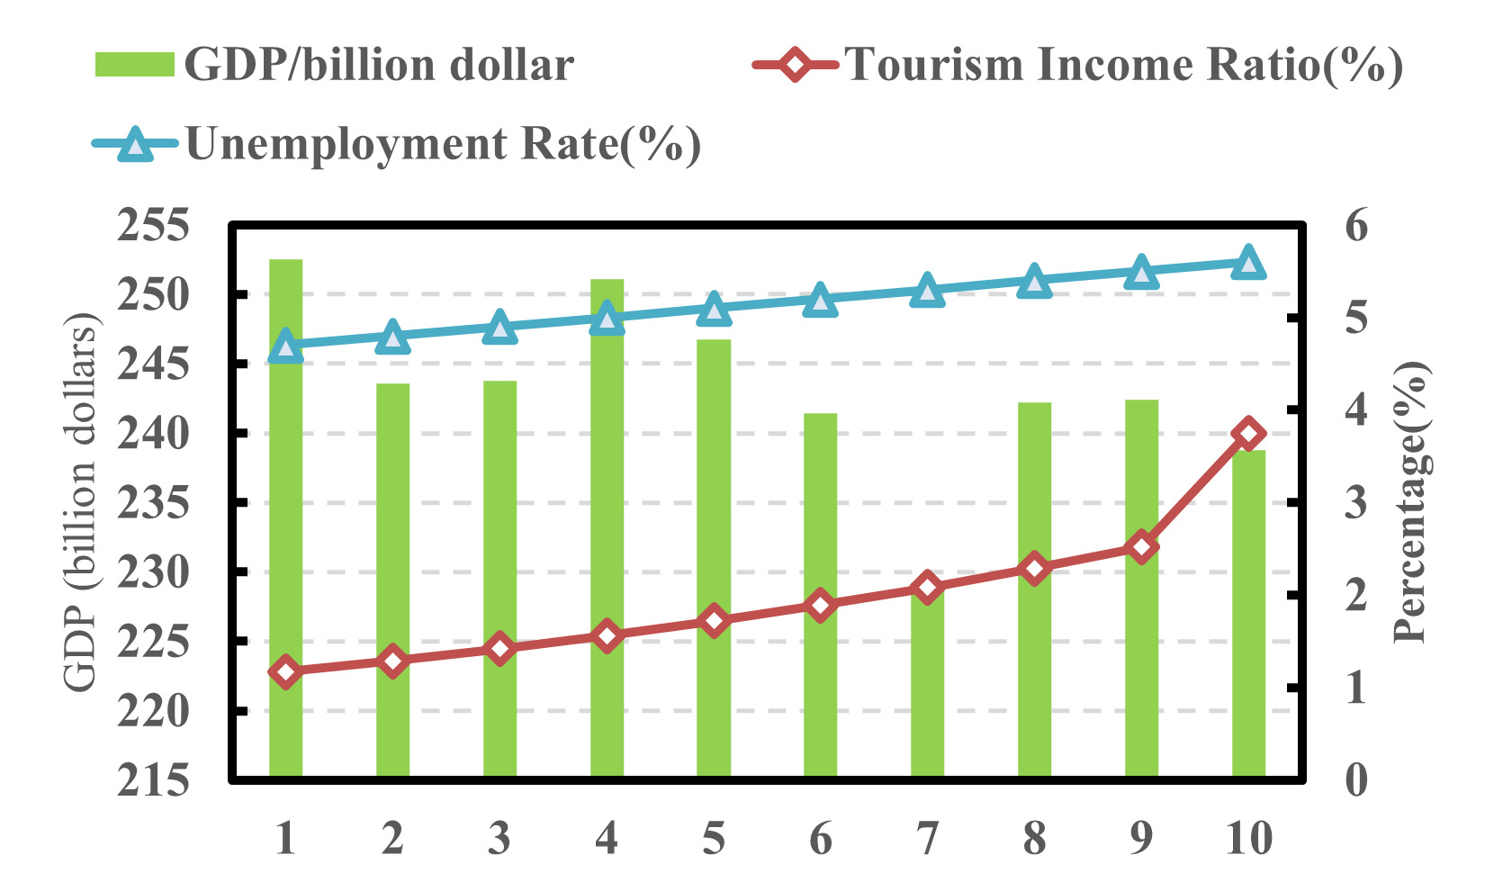
2014
2015
2016
2017
2018
2019
2020
2021
2022
2023

Slide 2
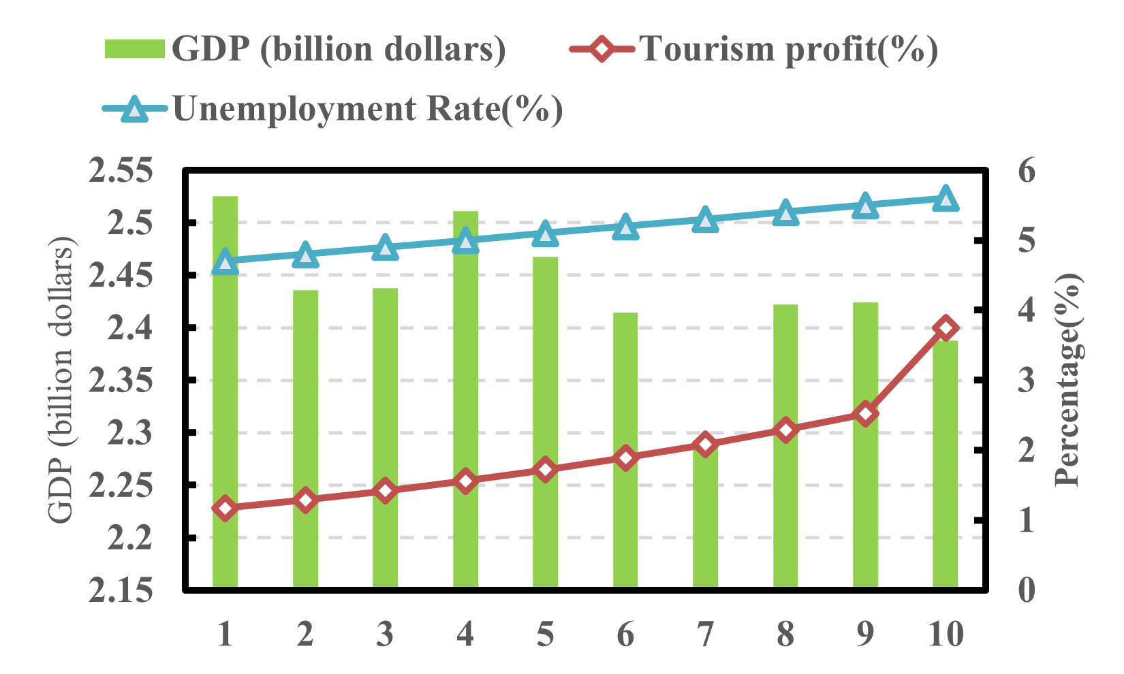
2014
2015
2016
2017
2018
2019
2020
2021
2022
2023

