Slide 1

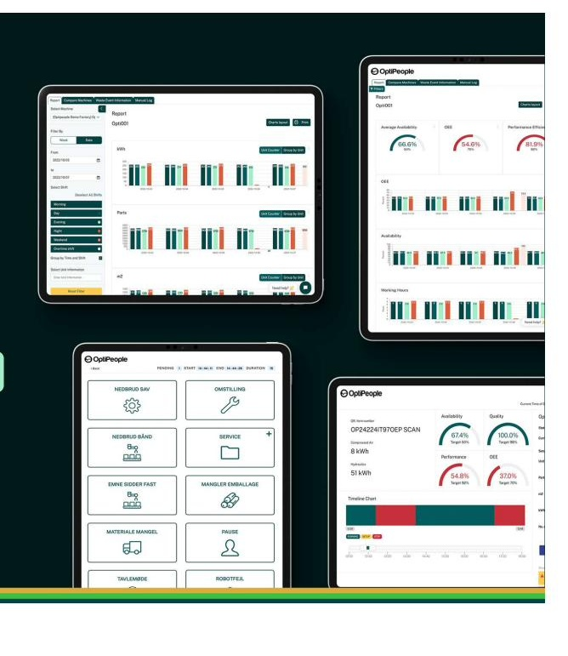
Digital modular operations platform · Digital strategic partner
OptiPeople for
OEM manufacturers
✦ Powered by AI + real-time data
Turning machine intelligence into
business advantage — from day one.

Slide 2





Why building great machines is only half the battle
Four challenges every OEM manufacturer faces
01
Always competing on price
02
Warranty costs you can't control
Building the best machines is not always enough.
New generations of customers identify value including smart software solutions alongside hardware.
Without ongoing customer value, the next sale is won on discount — not differentiation.
Machines are installed professionally — but success depends on the operator.
When something goes wrong, problems are always addressed to the supplier.
No data means no defence — disputes are resolved by gut feeling, not facts.
03
Customers drift away
04
Technology is too costly to build alone
Minimal revenue from spare parts and services after delivery.
Customer contact is sporadic — only when there is a problem.
No consistent recurring revenue to rely on in difficult times.
Developing own software solutions is expensive and slow.
Keeping up with AI, cyber security and latest tools requires continuous investment.
Dependency on PLC and PC supplier solutions is costly and limits flexibility.
Difficult to build customised services that create real customer value and revenue.
Business owners and CEOs recognise these pressures — and are actively searching for answers.

Slide 3
Everything we build around the machine starts with real data from the machine · AI integration · Digital strategic partner
One platform — machine intelligence at the core — AI-powered
Your machines
MACHINE
INTELLIGENCE
Warranty & OptiAssist
Sensors, PLC/CNC, hardware I/O. No extra hardware required in most cases.
24/7 cross-border digital support in local languages. AI-guided troubleshooting from day one.
▶
· OEE & availability
· Cycle time logging
· Error & stop data
· Energy monitoring
· Fleet overview
· AI-driven insights
▶
ERP / MES data
Subscription services
Orders, production plans, workforce data. Connect directly — no data silos.
Customers connected during warranty — helpdesk, AI insights, upgrade alerts, utilisation tips.
▶
▶
Operator input
▶
OEM revenue growth
Structured stop registrations, maintenance logs, manual quality entries.
▶
Freemium → paid tiers. Differentiate on service. Build recurring income beyond machine sales.
Machine intelligence is the backbone — every service, every revenue stream, every customer relationship is built on top of it.

Slide 4


From standard subscription to a fully branded OEM digital ecosystem · AI integration · Digital strategic partner
The OptiPeople platform — what it can do for you — AI-powered
AI & machine data
Customer performance reports
OptiAssist — 24/7 support
Utilisation + problem-solving
Integrates AI solutions for predictive maintenance, utilisation optimisation and anomaly detection.
Real customer-facing reports on machine performance, energy use, OEE and uptime — branded to you.
Digital service desk across borders, in local languages. AI-guided troubleshooting reduces field visits.
Combines machine utilisation data with the customer's ability to resolve issues — closing the loop on service.
OEM app journey — start standard, grow to fully branded
Level 1 — Standard
Start here
Level 2 — Customised
Grow with it
Level 3 — Strategic
Full OEM ownership
OptiPeople standard app
Your brand, your features
Your own supplier app
Customers start with the standard OptiPeople platform. Machine data, OEE dashboard, stop registration, AI insights and OptiAssist support — live within days. Zero customisation required.
Add your logo, colours and product-specific workflows. Customer-facing reports with your identity. Feature selection tailored to your machine type and service model.
A fully customised OEM app, powered by OptiPeople. Your product. Your customer journey. Integrated digital strategy — from pre-sale demo to lifetime service and upgrade path.

Slide 5
A complete digital strategy built on OptiPeople — from machine connection to branded customer app
Case: IDG — Italian Drying Group
Who is IDG?
What we built together
The opportunity
Group:
Italian Drying Group (IDG)
Brands: Incomac + Nardi
01
Full digital strategy
10,000+
kilns addressable
from launch
End-to-end OEM digital roadmap — from machine connection to customer lifetime value.
Industry:
Wood drying kilns & systems
Founded 1975 — 50 years of expertise
02
Incotech branded app
95
countries with
Installed machines
"Keep your drying rooms under control" — available on Google Play, powered by OptiPeople.
Scale:
10,000+ kilns installed
95 countries worldwide
03
Freemium model
24/7
OptiAssist support
across all time zones
10,000+ installed kilns reachable from day one. Free entry, paid upgrade path.
Mission:
Benchmark in drying — sustainability,
energy savings, lasting partnerships
04
OptiAssist integration
∞
Recurring revenue
for every connected kiln
24/7 AI support in local languages across all borders
IDG is proof of concept — a full OEM digital ecosystem, built on OptiPeople, already live in the market.

Slide 6
Revenue impact of an OptiPeople OEM partnership
The business case — what it's worth
New
Revenue model — illustrative ranges
recurring revenue stream
from software subscriptions
Revenue stream
Year 1
Year 3
Standard app subscriptions
€12–25k
€45–90k
Lower
Customised tier upsell
€8–15k
€30–60k
warranty & service costs
through data-backed decisions
Strategic OEM app + services
€15–30k
€60–120k
Higher
OptiAssist (support SLA)
€5–10k
€20–40k
sales close rate
with a differentiated digital offer
Illustrative ranges. Actual revenue depends on machine volume, tier uptake and partnership depth.

Slide 7

What you bring · What OptiPeople brings · How it works together
What the partnership looks like
You bring
OptiPeople brings
Your machines and customer base
OptiCloud IoT platform + AI infrastructure
Machine specifications and domain expertise
App dev, OptiAssist & branded customisation
⟷
Sales and service organisation
55+ OEM production environments of know-how
CEO commitment and internal ambassador
ERP / MES integration capability
Brand identity for the app
Ongoing development, roadmap & consultancy
Together: a differentiated digital product your customers return to — and pay for continuously.

Slide 8

Let's explore what this
looks like for you.
1
2
3
Discovery call
Concept session
Pilot proposal
30–45 min. We map your machine portfolio, customer base and current service model.
We define the right platform tier and OEM app strategy — tailored to your market.
A concrete scope, timeline and commercial model — yours to review and decide.

Slide 9
Three ways to start — choose what fits your ambition today
How would you like to get started? — your call, your pace
01
Test & discover
02
Explore & develop
03
Strategic partnership
Standard platform
subscription
20-machine pilot
— 1 year partnership
Full OEM digital
strategy
From €X/machine/month
Total investment: €12,000
Investment on proposal
Order a standard OptiPeople subscription directly
Subscription for 20 machines over 12 months
Deep involvement: digital strategy for existing + new customers
Connect your machines — live within days
4 online co-development sessions with OptiPeople
Custom OEM app powered by OptiPeople
Full access to machine data, OEE dashboards and OptiAssist
Define your digital appearance as a supplier
OptiAssist integrated into your service model
No customisation required — see the value before you invest further
Explore platform capabilities and customisation options
OptiPeople consultancy on tactical & operational initiatives
Cancel or upgrade anytime
Clarify integration paths and go-to-market possibilities
Ongoing roadmap to improve sales, service and revenue
Self-service entry point
50–100 OptiPeople hours included
Scope defined together

