Slide 1
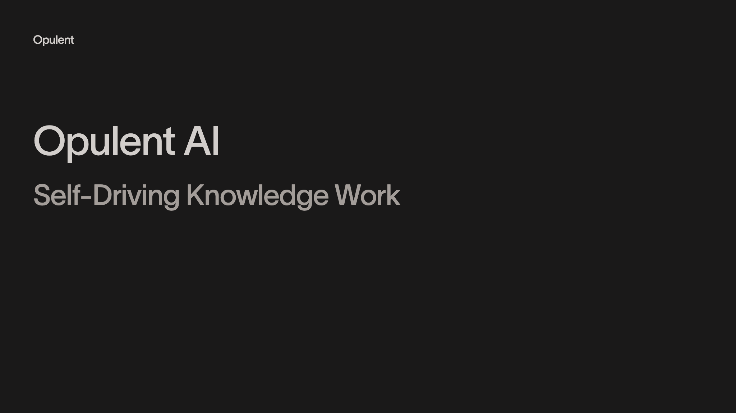
Notes:
Opulent Opulent AI Self-Driving Knowledge Work

Slide 2
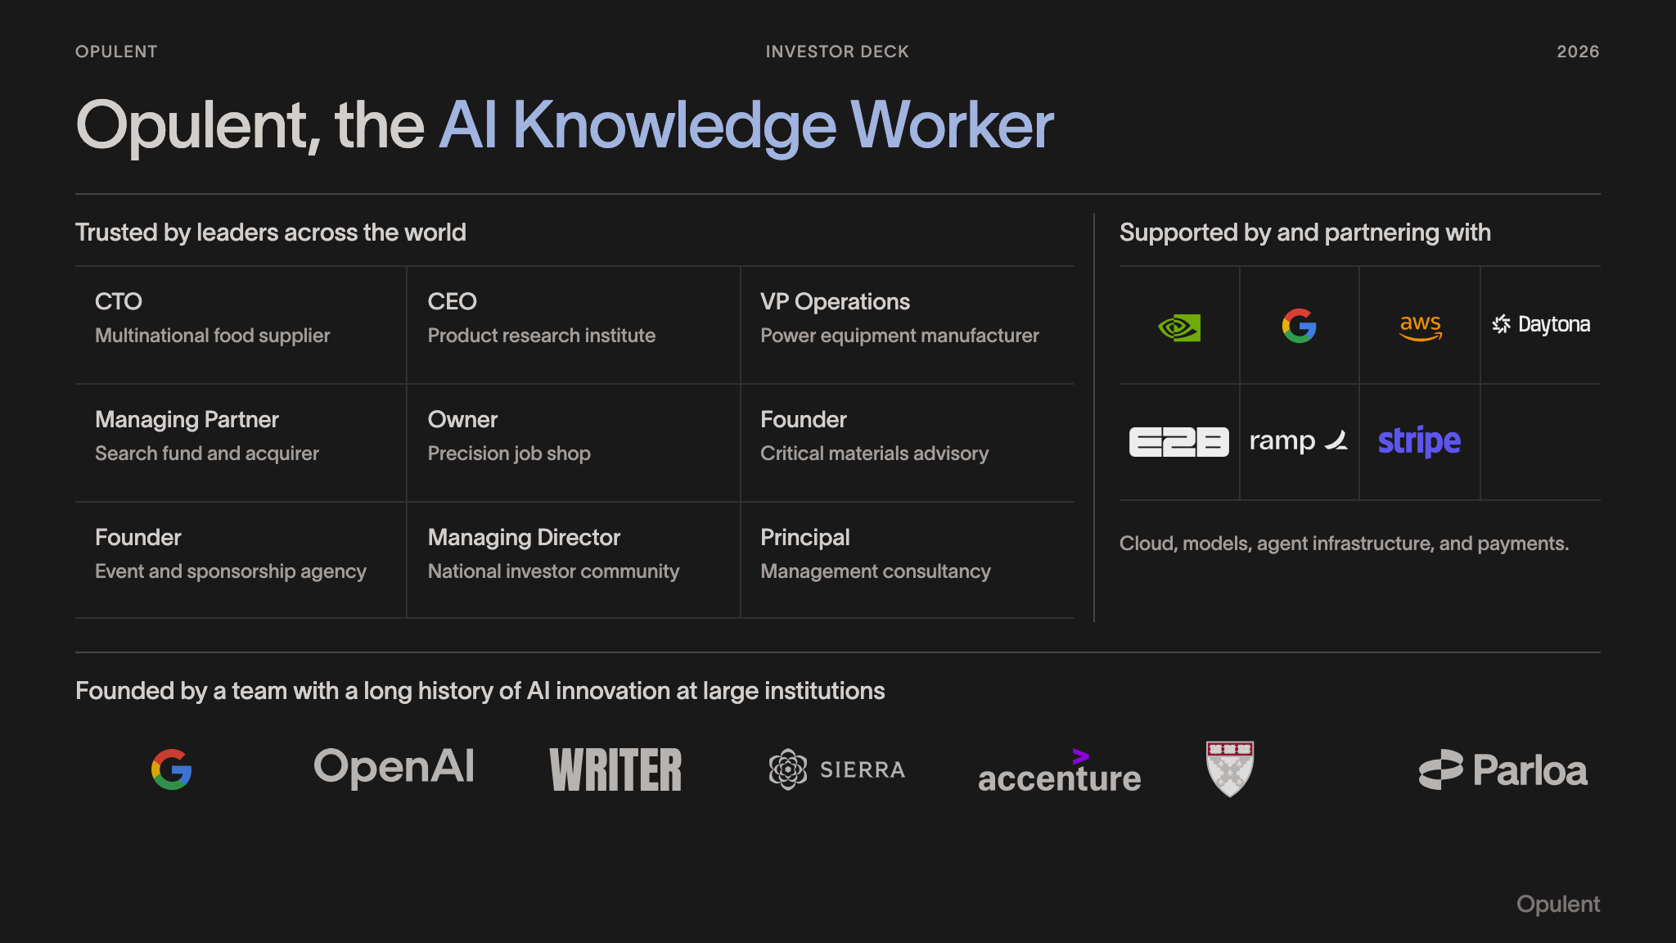
Notes:
OPULENT INVESTOR DECK 2026 Opulent, the AI Knowledge Worker Trusted by leaders across the world CTO Multinational food supplier CEO Product research institute VP Operations Power equipment manufacturer Managing Partner Search fund and acquirer Owner Precision job shop Founder Critical materials advisory Founder Event and sponsorship agency Managing Director National investor community Principal Management consultancy Supported by and partnering with Cloud, models, agent infrastructure, and payments. Founded by a team with a long history of AI innovation at large institutions Opulent

Slide 3
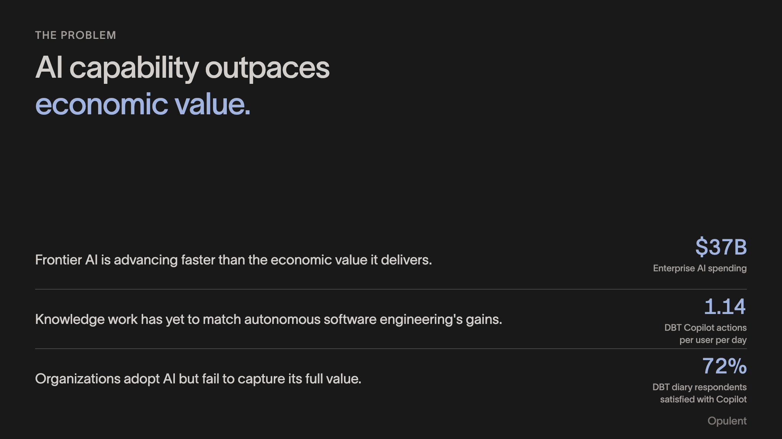
Notes:
THE PROBLEM AI capability outpaces economic value. Frontier AI is advancing faster than the economic value it delivers. $37B Enterprise AI spending Knowledge work has yet to match autonomous software engineering's gains. 1.14 DBT Copilot actions per user per day Organizations adopt AI but fail to capture its full value. 72% DBT diary respondents satisfied with Copilot Opulent

Slide 4
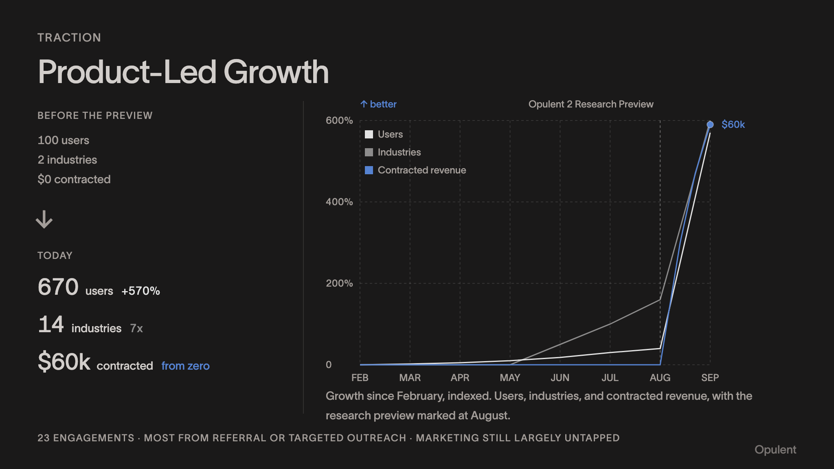
Notes:
TRACTION Product-Led Growth BEFORE THE PREVIEW 100 users 2 industries $0 contracted ↓ TODAY 670users+570% 14industries7x $60kcontractedfrom zero ↑ better Opulent 2 Research Preview 0 200% 400% 600% $60k FEB MAR APR MAY JUN JUL AUG SEP Users Industries Contracted revenue Growth since February, indexed. Users, industries, and contracted revenue, with the research preview marked at August. 23 ENGAGEMENTS · MOST FROM REFERRAL OR TARGETED OUTREACH · MARKETING STILL LARGELY UNTAPPED Opulent

Slide 5
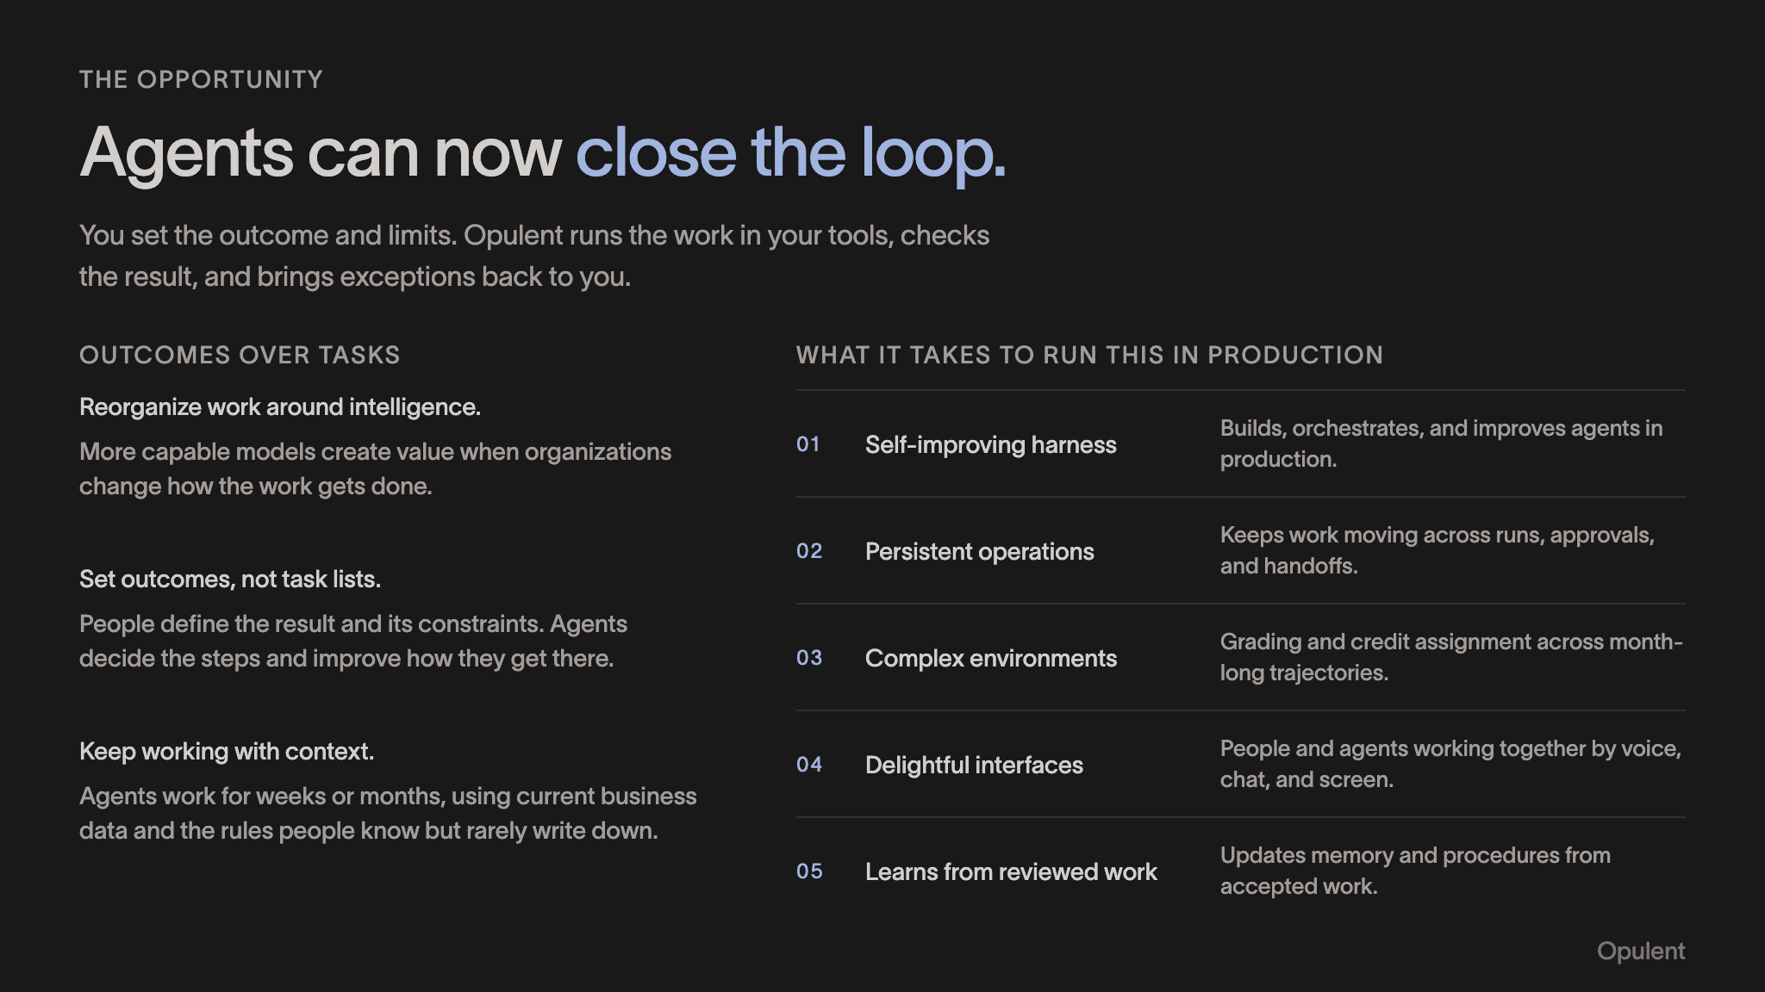
Notes:
THE OPPORTUNITY Agents can now close the loop. You set the outcome and limits. Opulent runs the work in your tools, checks the result, and brings exceptions back to you. OUTCOMES OVER TASKS Reorganize work around intelligence. More capable models create value when organizations change how the work gets done. Set outcomes, not task lists. People define the result and its constraints. Agents decide the steps and improve how they get there. Keep working with context. Agents work for weeks or months, using current business data and the rules people know but rarely write down. WHAT IT TAKES TO RUN THIS IN PRODUCTION 01 Self-improving harness Builds, orchestrates, and improves agents in production. 02 Persistent operations Keeps work moving across runs, approvals, and handoffs. 03 Complex environments Grading and credit assignment across month-long trajectories. 04 Delightful interfaces People and agents working together by voice, chat, and screen. 05 Learns from reviewed work Updates memory and procedures from accepted work. Opulent

Slide 6
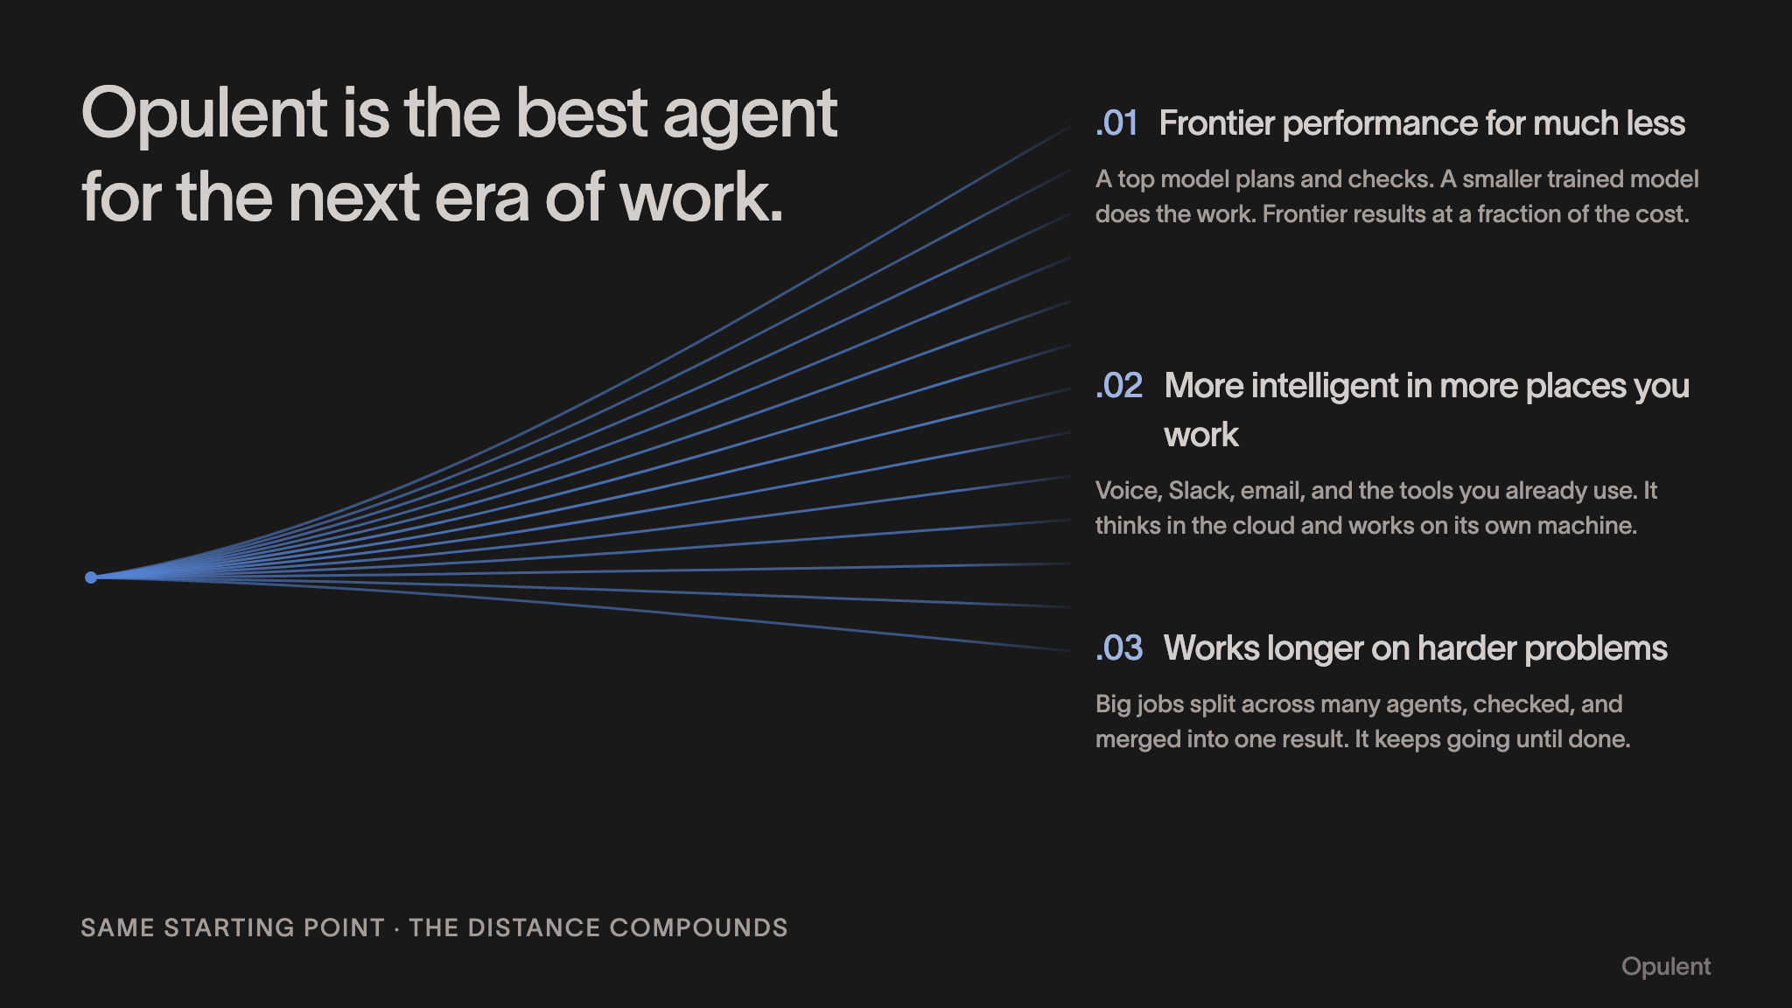
Notes:
Opulent is the best agent for the next era of work. .01 Frontier performance for much less A top model plans and checks. A smaller trained model does the work. Frontier results at a fraction of the cost. .02 More intelligent in more places you work Voice, Slack, email, and the tools you already use. It thinks in the cloud and works on its own machine. .03 Works longer on harder problems Big jobs split across many agents, checked, and merged into one result. It keeps going until done. SAME STARTING POINT · THE DISTANCE COMPOUNDS Opulent

Slide 7
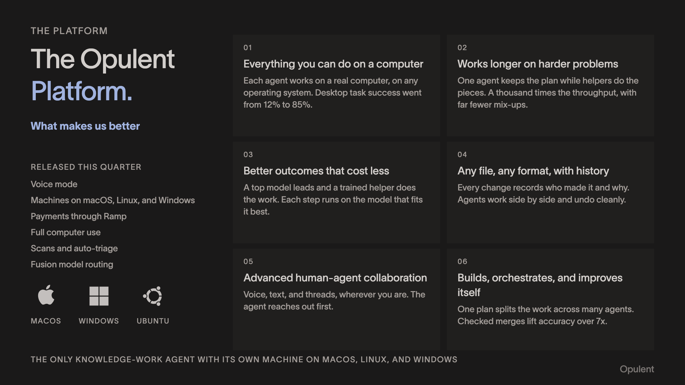
Notes:
THE PLATFORM The Opulent Platform. What makes us better RELEASED THIS QUARTER Voice mode Machines on macOS, Linux, and Windows Payments through Ramp Full computer use Scans and auto-triage Fusion model routing MACOS WINDOWS UBUNTU 01 Everything you can do on a computer Each agent works on a real computer, on any operating system. Desktop task success went from 12% to 85%. 02 Works longer on harder problems One agent keeps the plan while helpers do the pieces. A thousand times the throughput, with far fewer mix-ups. 03 Better outcomes that cost less A top model leads and a trained helper does the work. Each step runs on the model that fits it best. 04 Any file, any format, with history Every change records who made it and why. Agents work side by side and undo cleanly. 05 Advanced human-agent collaboration Voice, text, and threads, wherever you are. The agent reaches out first. 06 Builds, orchestrates, and improves itself One plan splits the work across many agents. Checked merges lift accuracy over 7x. THE ONLY KNOWLEDGE-WORK AGENT WITH ITS OWN MACHINE ON MACOS, LINUX, AND WINDOWS Opulent

Slide 8
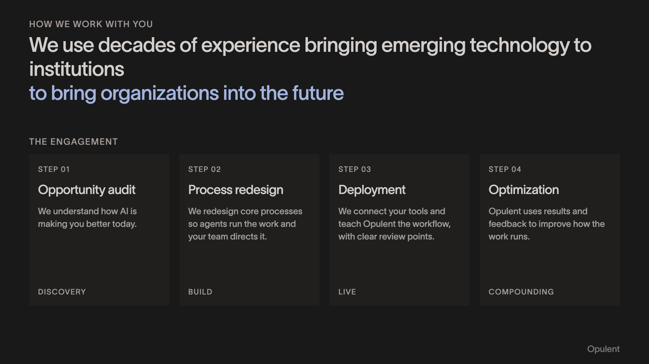
Notes:
HOW WE WORK WITH YOU We use decades of experience bringing emerging technology to institutions to bring organizations into the future THE ENGAGEMENT STEP 01 Opportunity audit We understand how AI is making you better today. DISCOVERY STEP 02 Process redesign We redesign core processes so agents run the work and your team directs it. BUILD STEP 03 Deployment We connect your tools and teach Opulent the workflow, with clear review points. LIVE STEP 04 Optimization Opulent uses results and feedback to improve how the work runs. COMPOUNDING Opulent

Slide 9
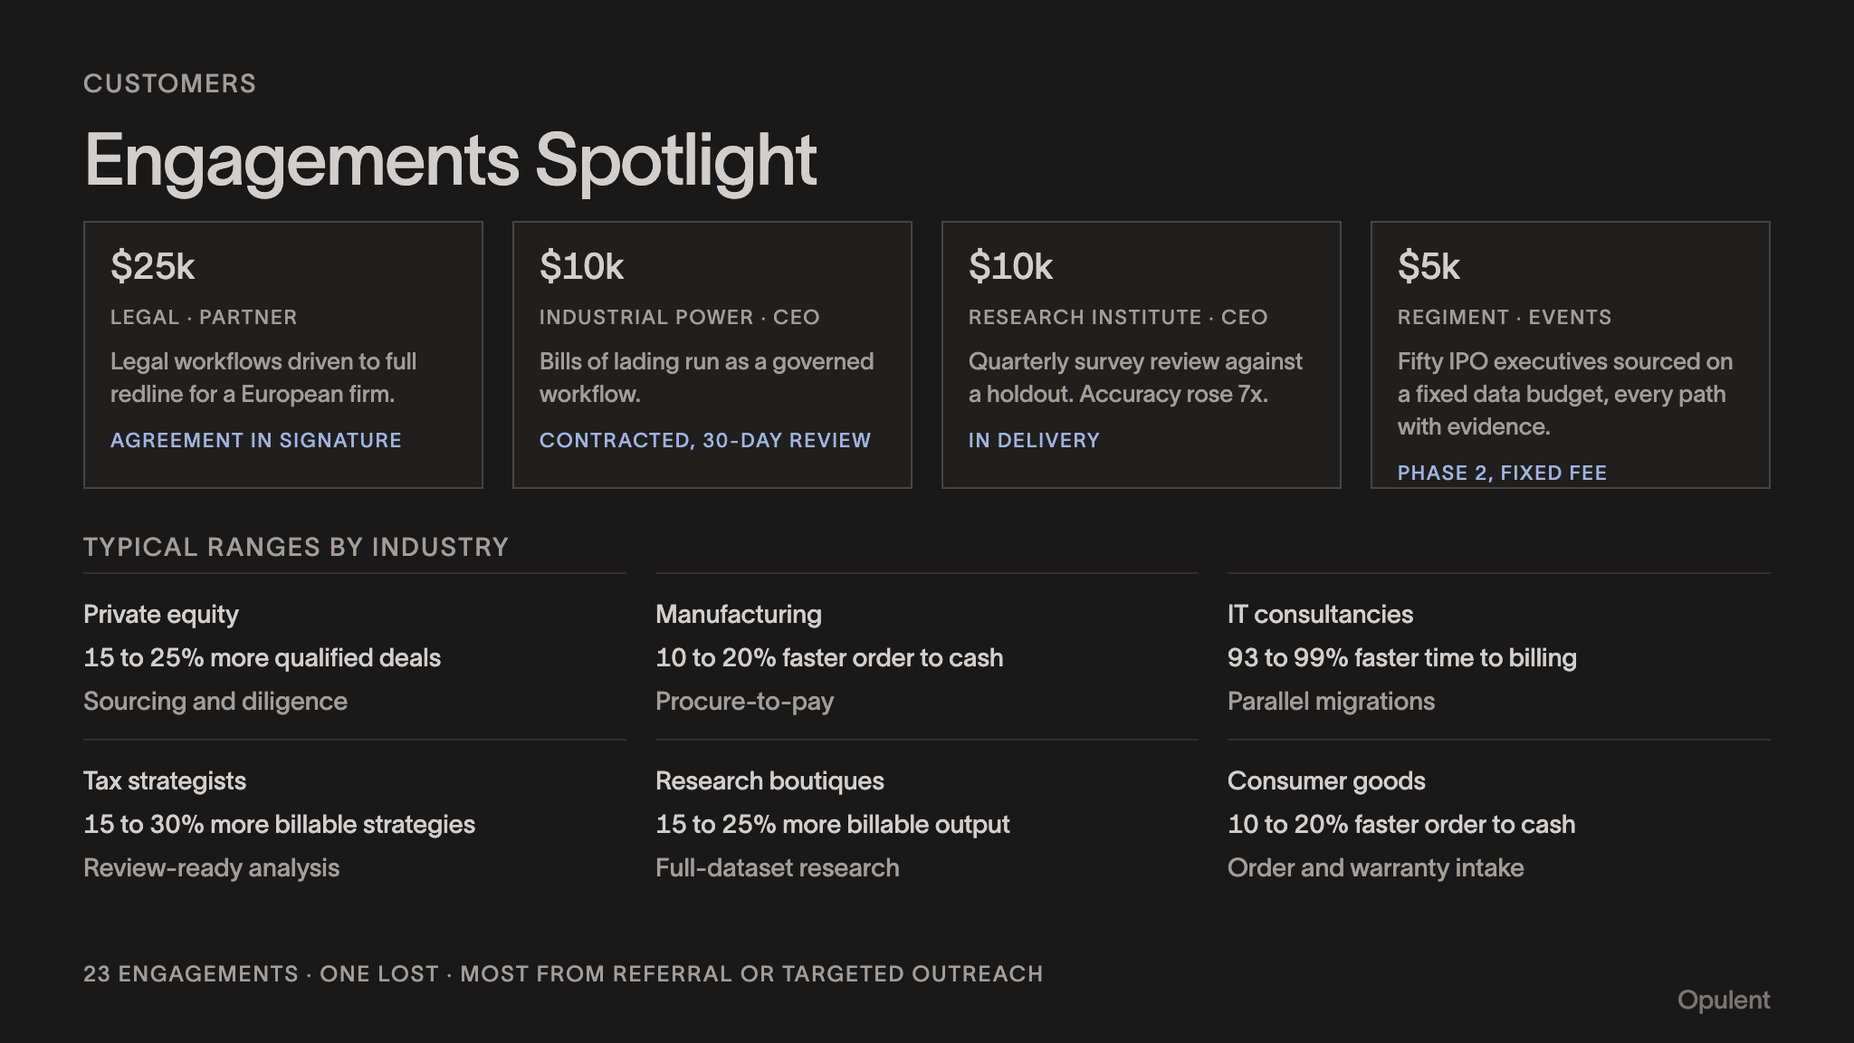
Notes:
CUSTOMERS Engagements Spotlight $25k LEGAL · PARTNER Legal workflows driven to full redline for a European firm. AGREEMENT IN SIGNATURE $10k INDUSTRIAL POWER · CEO Bills of lading run as a governed workflow. CONTRACTED, 30-DAY REVIEW $10k RESEARCH INSTITUTE · CEO Quarterly survey review against a holdout. Accuracy rose 7x. IN DELIVERY $5k REGIMENT · EVENTS Fifty IPO executives sourced on a fixed data budget, every path with evidence. PHASE 2, FIXED FEE TYPICAL RANGES BY INDUSTRY Private equity 15 to 25% more qualified deals Sourcing and diligence Manufacturing 10 to 20% faster order to cash Procure-to-pay IT consultancies 93 to 99% faster time to billing Parallel migrations Tax strategists 15 to 30% more billable strategies Review-ready analysis Research boutiques 15 to 25% more billable output Full-dataset research Consumer goods 10 to 20% faster order to cash Order and warranty intake 23 ENGAGEMENTS · ONE LOST · MOST FROM REFERRAL OR TARGETED OUTREACH Opulent

Slide 10
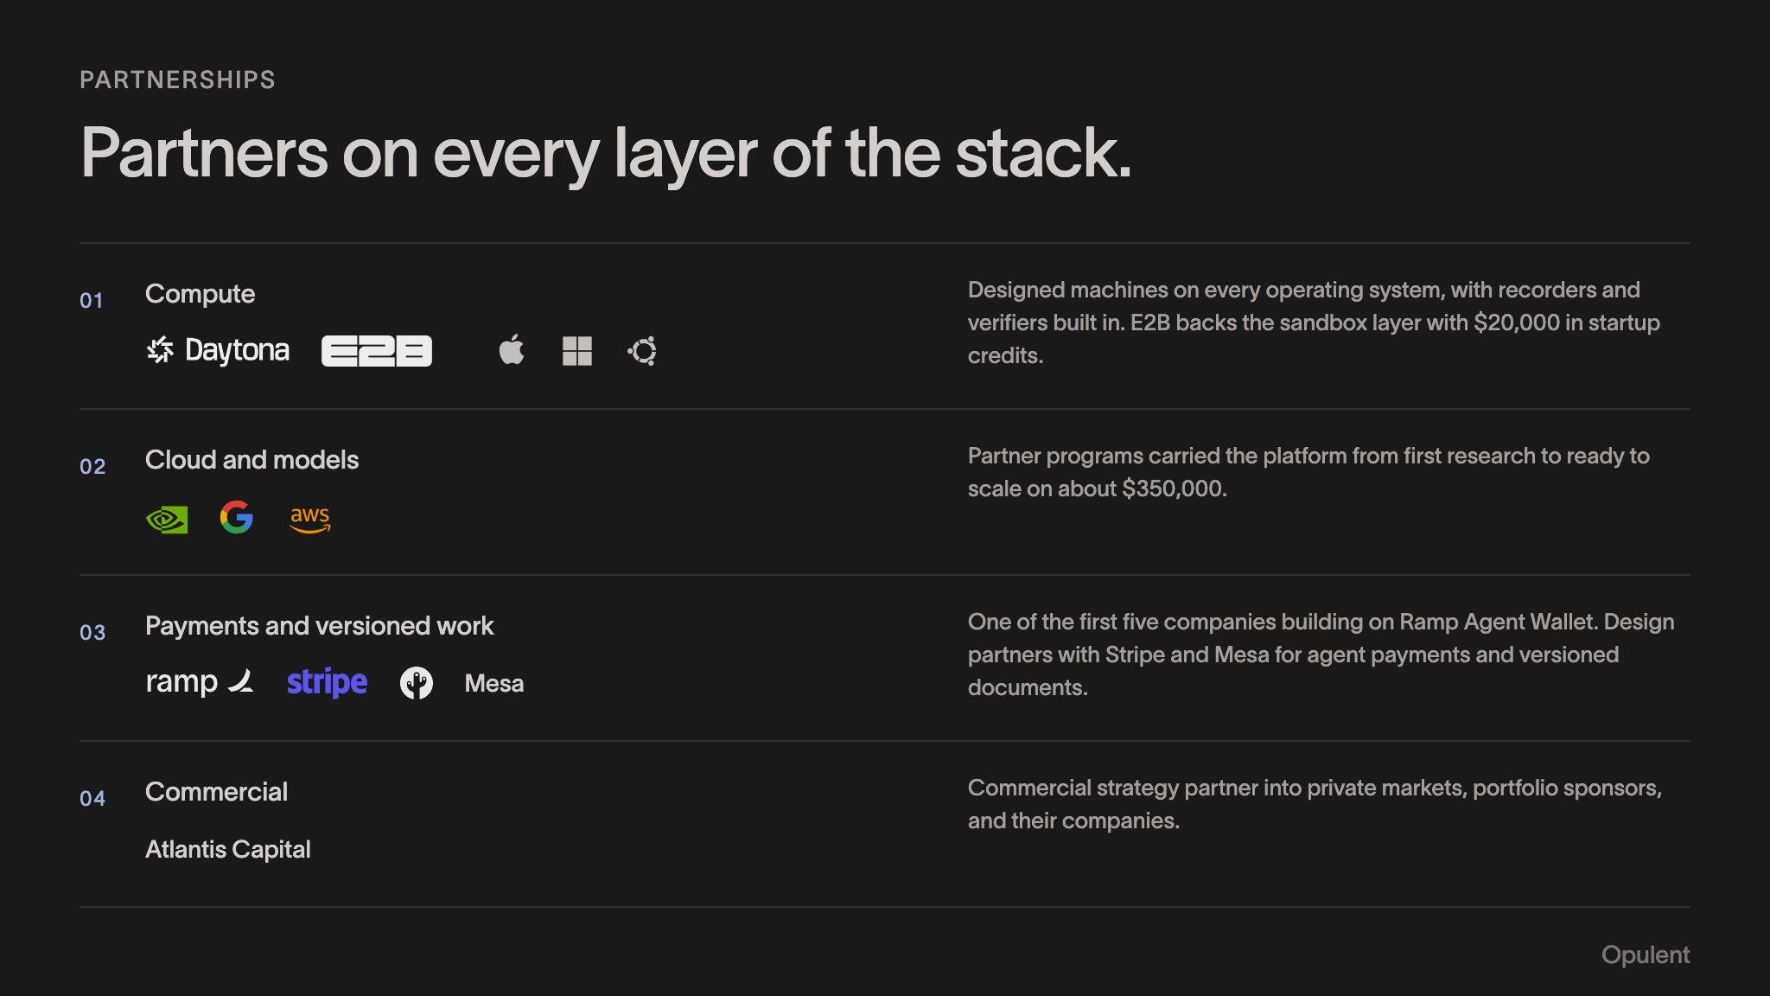
Notes:
PARTNERSHIPS Partners on every layer of the stack. 01 Compute Designed machines on every operating system, with recorders and verifiers built in. E2B backs the sandbox layer with $20,000 in startup credits. 02 Cloud and models Partner programs carried the platform from first research to ready to scale on about $350,000. 03 Payments and versioned work Mesa One of the first five companies building on Ramp Agent Wallet. Design partners with Stripe and Mesa for agent payments and versioned documents. 04 Commercial Atlantis Capital Commercial strategy partner into private markets, portfolio sponsors, and their companies. Opulent

Slide 11
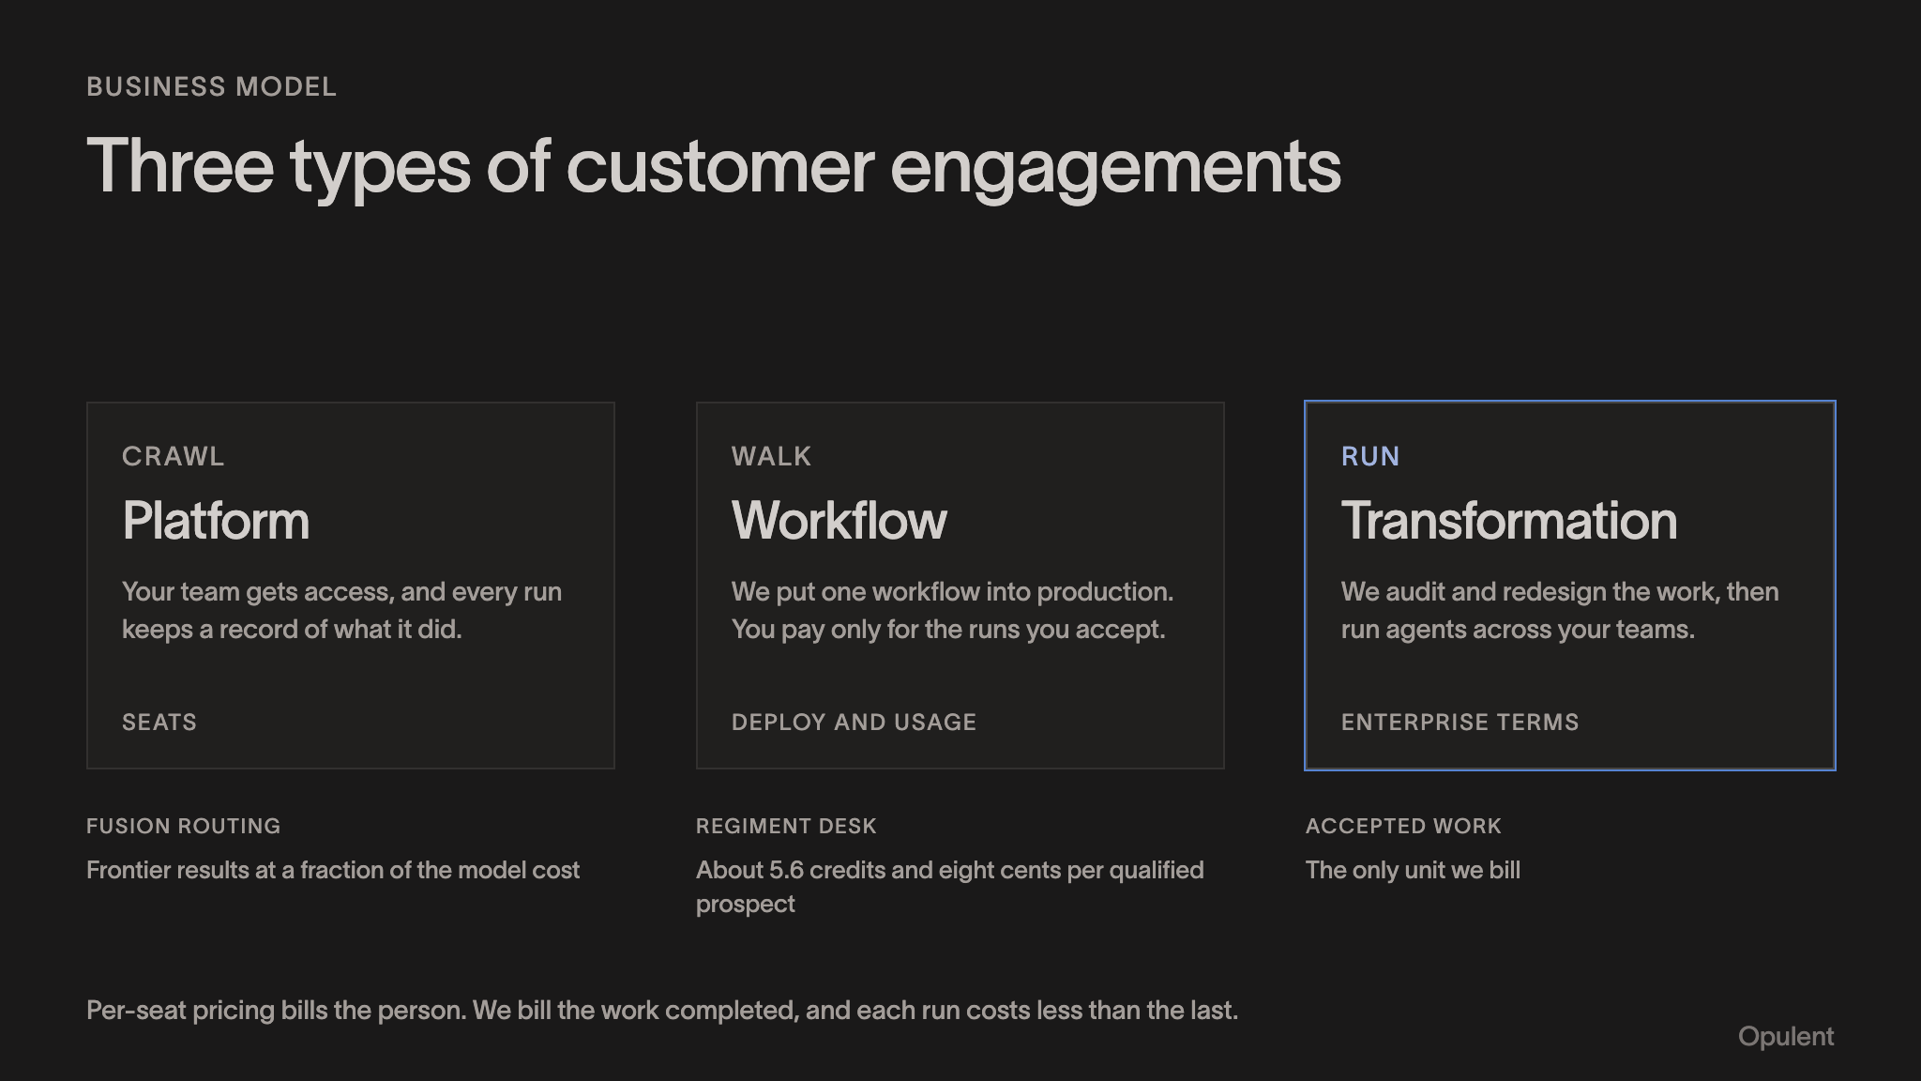
Notes:
BUSINESS MODEL Three types of customer engagements CRAWL Platform Your team gets access, and every run keeps a record of what it did. SEATS WALK Workflow We put one workflow into production. You pay only for the runs you accept. DEPLOY AND USAGE RUN Transformation We audit and redesign the work, then run agents across your teams. ENTERPRISE TERMS FUSION ROUTING Frontier results at a fraction of the model cost REGIMENT DESK About 5.6 credits and eight cents per qualified prospect ACCEPTED WORK The only unit we bill Per-seat pricing bills the person. We bill the work completed, and each run costs less than the last. Opulent

Slide 12
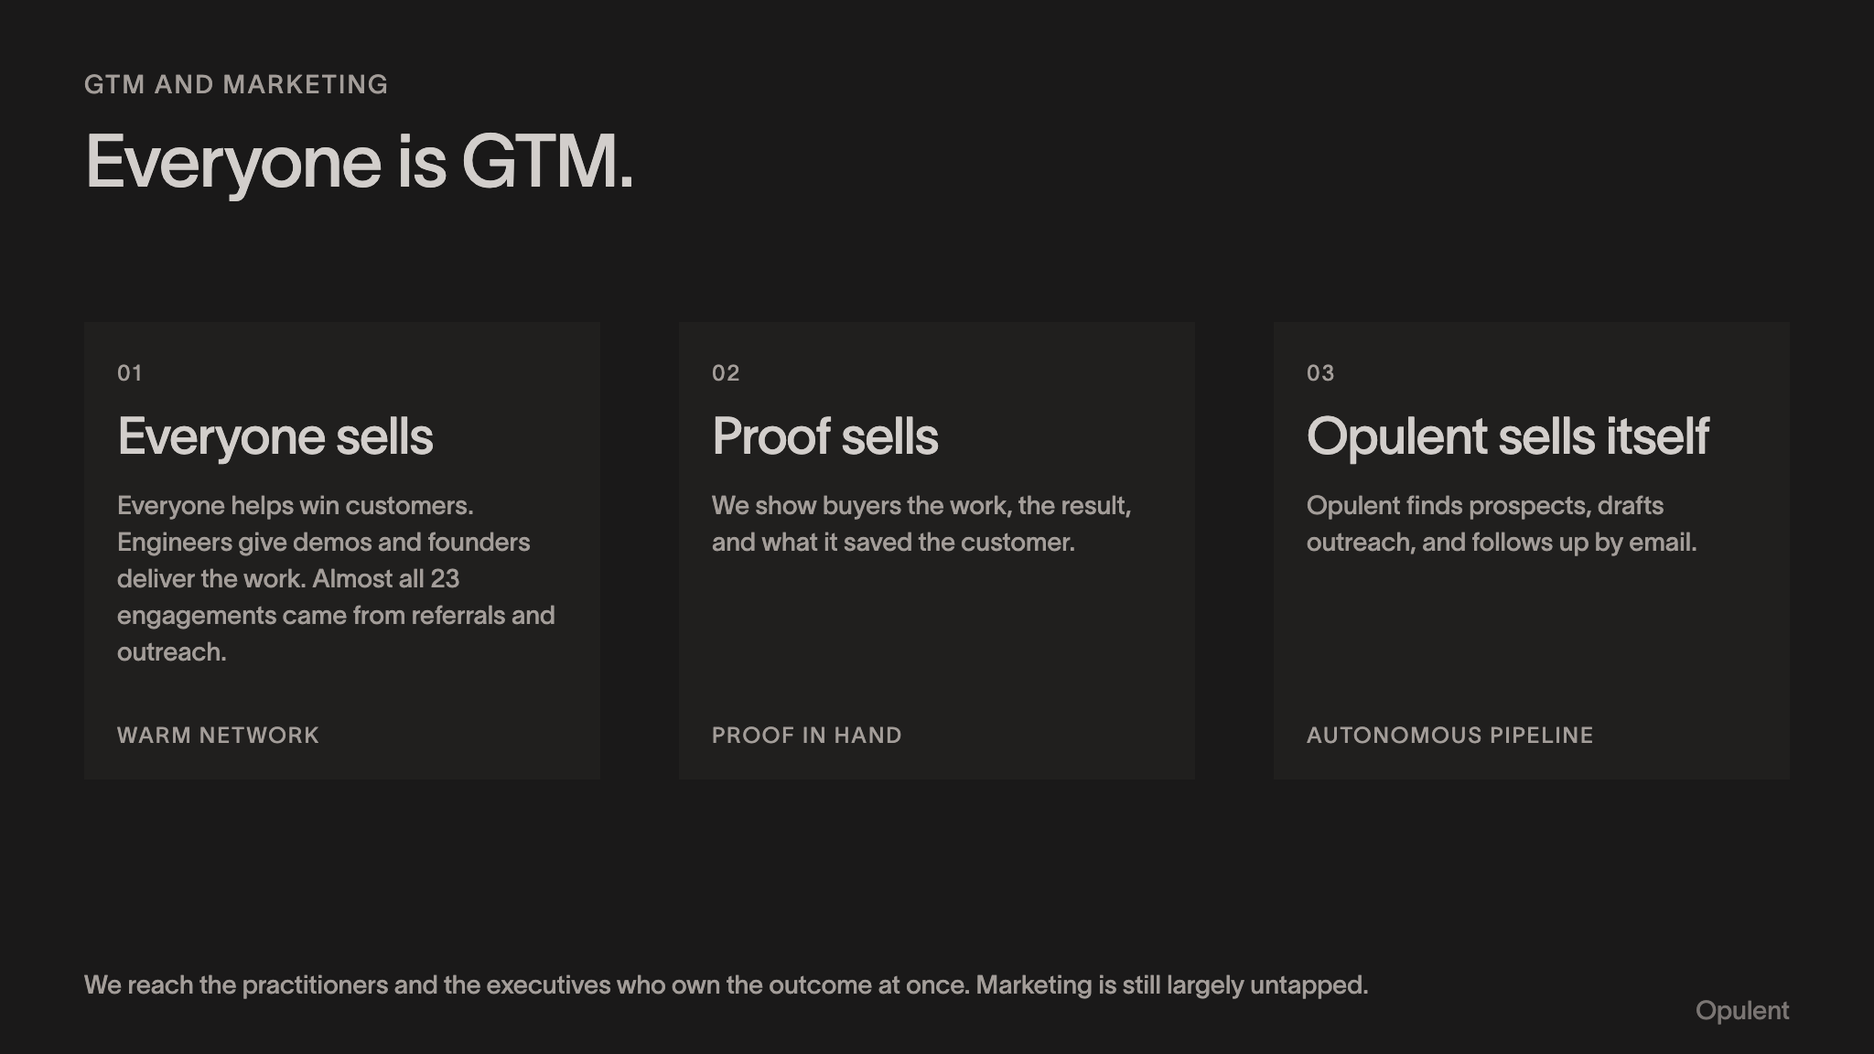
Notes:
GTM AND MARKETING Everyone is GTM. 01 Everyone sells Everyone helps win customers. Engineers give demos and founders deliver the work. Almost all 23 engagements came from referrals and outreach. WARM NETWORK 02 Proof sells We show buyers the work, the result, and what it saved the customer. PROOF IN HAND 03 Opulent sells itself Opulent finds prospects, drafts outreach, and follows up by email. AUTONOMOUS PIPELINE We reach the practitioners and the executives who own the outcome at once. Marketing is still largely untapped. Opulent

Slide 13
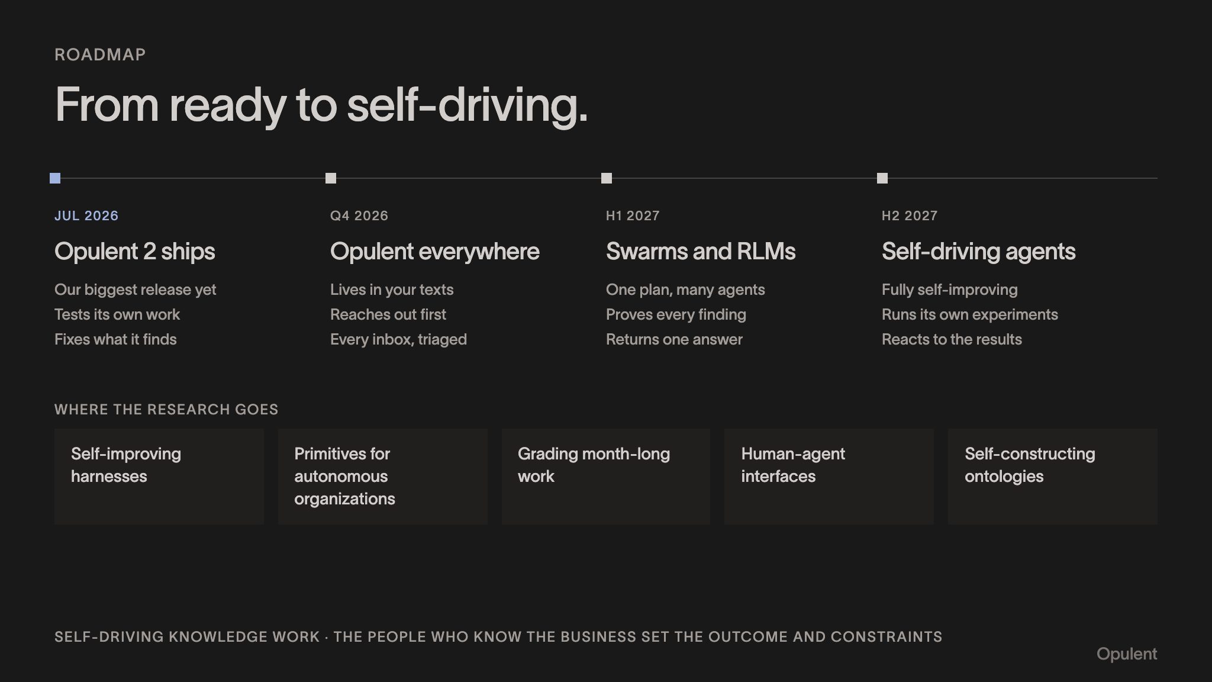
Notes:
ROADMAP From ready to self-driving. JUL 2026 Opulent 2 ships Our biggest release yet Tests its own work Fixes what it finds Q4 2026 Opulent everywhere Lives in your texts Reaches out first Every inbox, triaged H1 2027 Swarms and RLMs One plan, many agents Proves every finding Returns one answer H2 2027 Self-driving agents Fully self-improving Runs its own experiments Reacts to the results WHERE THE RESEARCH GOES Self-improving harnesses Primitives for autonomous organizations Grading month-long work Human-agent interfaces Self-constructing ontologies SELF-DRIVING KNOWLEDGE WORK · THE PEOPLE WHO KNOW THE BUSINESS SET THE OUTCOME AND CONSTRAINTS Opulent

Slide 14
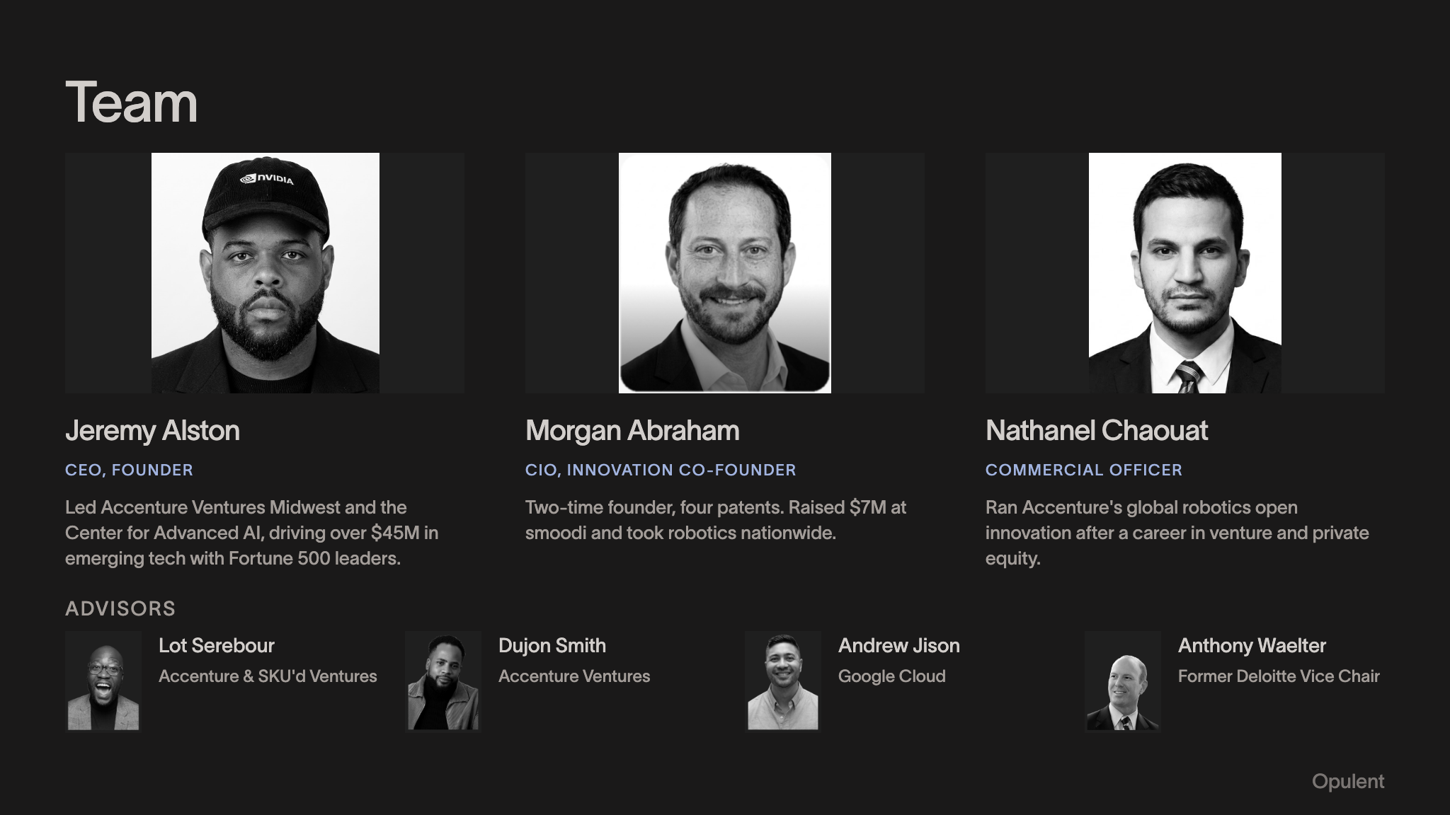
Notes:
Team Jeremy Alston CEO, FOUNDER Led Accenture Ventures Midwest and the Center for Advanced AI, driving over $45M in emerging tech with Fortune 500 leaders. Morgan Abraham CIO, INNOVATION CO-FOUNDER Two-time founder, four patents. Raised $7M at smoodi and took robotics nationwide. Nathanel Chaouat COMMERCIAL OFFICER Ran Accenture's global robotics open innovation after a career in venture and private equity. ADVISORS Lot Serebour Accenture & SKU'd Ventures Dujon Smith Accenture Ventures Andrew Jison Google Cloud Anthony Waelter Former Deloitte Vice Chair Opulent

Slide 15
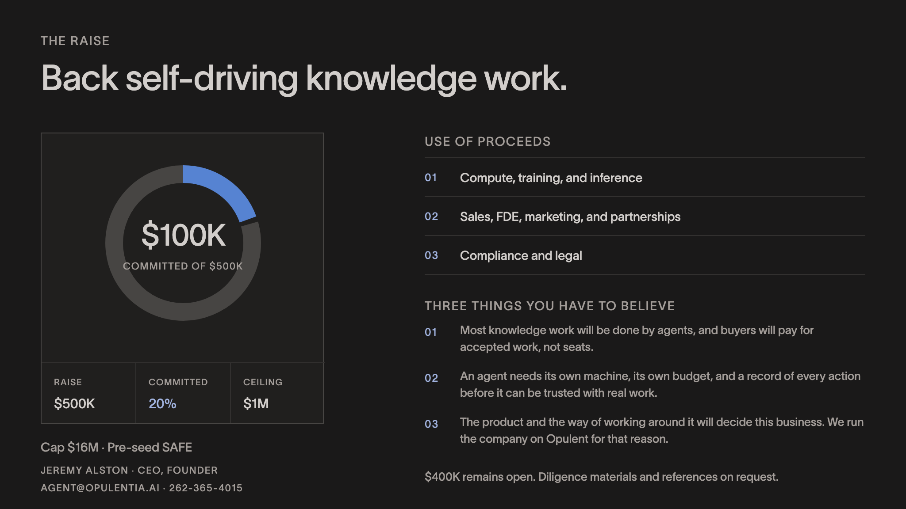
Notes:
THE RAISE Back self-driving knowledge work. $100K COMMITTED OF $500K RAISE $500K COMMITTED 20% CEILING $1M Cap $16M · Pre-seed SAFE JEREMY ALSTON · CEO, FOUNDER AGENT@OPULENTIA.AI · 262-365-4015 USE OF PROCEEDS 01 Compute, training, and inference 02 Sales, FDE, marketing, and partnerships 03 Compliance and legal THREE THINGS YOU HAVE TO BELIEVE 01 Most knowledge work will be done by agents, and buyers will pay for accepted work, not seats. 02 An agent needs its own machine, its own budget, and a record of every action before it can be trusted with real work. 03 The product and the way of working around it will decide this business. We run the company on Opulent for that reason. $400K remains open. Diligence materials and references on request.

