Slide 1

DATA SCIENCE DSF-PT11: PHASE 2 GROUP PROJECT
GROUP 4
CONTRIBUTORS
Ragot Raphael
Deborah Omondi
Kelvin Shilisia
George Kariuki
Mohamed Sheikh
Jennipher Anyango
MORINGA SCHOOL
Notes:
‹#›

Slide 2
BUSINESS UNDERSTANDING
PROJECT CONTEXT
In today's dynamic entertainment landscape, major companies are increasingly investing in original video content. Our company, recognizing this significant market trend and the potential for substantial returns, has made a strategic decision to establish its own new movie studio. This venture represents a substantial investment and a new frontier for our organization.
However, entering the highly competitive and often unpredictable film industry requires a deep understanding of its intricacies. We currently lack specialized knowledge in movie production, particularly concerning what drives box office success. This project is a crucial first step in bridging that knowledge gap. By leveraging data-driven insights, we aim to lay a solid foundation for the studio's initial strategy, mitigating risks and maximizing the potential for profitable film ventures.
The primary objective is to provide the head of our new movie studio with clear, actionable guidance based on empirical evidence, enabling them to make informed decisions about the types of films to greenlight.

Slide 3
BUSINESS QUESTIONS
This presentation provides a structured approach to analyzing movie datasets to answer the business question:
"What kinds of movies should a new studio produce for financial success?”
Objectives:
- Analyze which genres are most profitable.
- Examine the relationship between production budget and revenue.
- Assess the impact of review scores on financial performance.
By integrating multiple movie datasets, we aim to provide actionable insights for new studios to maximize their chances of financial success.

Slide 4
DATA UNDERSTANDING
DATASETS OVERVIEW
Dataset Name | Description | Key Columns
Box Office Mojo (bom_gross_df) | Domestic and foreign gross revenues by movie | title, domestic_gross, foreign_gross, year
IMDb Movie Basics (imdb_movie_basics_df) | Core movie details and genres | movie_id, primary_title, genres
IMDb Movie Ratings (imdb_movie_ratings_df) | IMDb ratings and vote counts | movie_id, averagerating, numvotes
Rotten Tomatoes Info (rt_movie_info_df) | Movie synopses, ratings, genres, box office | rating, genre, box_office
Rotten Tomatoes Reviews (rt_reviews_df) | Critic reviews and freshness scores | review, rating, fresh
TMDb Movies (tmdb_movies_df) | Movie popularity and ratings from TMDb | title, popularity, vote_average
The Numbers Budgets (tn_budgets_df) | Movie budgets and worldwide gross | movie, production_budget, worldwide_gross

Slide 5
DATASET SUMMARIES (DF.INFO)
Dataset | Rows | Columns | Key Observations
bom_gross_df (Box Office Mojo) | 3,387 | 5 | - foreign_gross has many missing values (≈40%). - Minor missing values in studio and domestic_gross. - Good coverage overall.
imdb_movie_basics_df | 146,144 | 6 | - Missing runtime_minutes (~22%) and some missing genres. - Large, mostly complete dataset.
imdb_movie_ratings_df | 73,856 | 3 | - Fully complete, no missing data.
rt_movie_info_df | 1,560 | 12 | - Significant missing data in studio, currency, and box_office. - Many other columns have moderate missing data.
rt_reviews_df | 54,432 | 8 | - Missing values in review, rating, critic, and publisher. - Coverage still strong enough for sentiment or review-based analysis.
tmdb_movies_df | 26,517 | 10 | - Fully complete. - Unnamed: 0 is likely an index column and can probably be dropped.
tn_budgets_df | 5,782 | 6 | - All data present, but financial columns are stored as objects (probably need cleaning/conversion to numeric).

Slide 6

DATA PREPARATION (CLEANING)

Slide 7
DATASET CLEANING
1. Cleaning tn_budgets_df (The Numbers Dataset)
Remove currency symbols and commas from financial columns (production_budget, domestic_gross, worldwide_gross) to prepare for numerical analysis.
Convert to numeric data types (invalid entries become NaN).
Convert release_date to datetime format for time-based analysis.
Remove duplicate records.
Standardize column names to lowercase with underscores for consistency.
Handle missing values by filling NaN with zeros.
Outlier Removal: Applied the Interquartile Range (IQR) method to remove extreme financial outliers.
2. Cleaning Other Datasets:
Standardize column names across all datasets for easier merging.
Convert date columns to datetime format where applicable:
tmdb_movies_df['release_date']
rt_movie_info_df['theater_date'] and rt_movie_info_df['dvd_date']
Remove duplicate entries to ensure clean, reliable records.
3. IMDb Dataset Preparation:
Standardized column names for both df_movie_basics and df_movie_ratings to ensure consistent structure.

Slide 8
DATA MERGING AND FEATURE ENGINEERING
Dataset Merging Process
Step 1: Merge The Numbers with TMDb on movie and original_title.
Step 2: Merge with Box Office Mojo on movie and title.
Step 3: Merge with Rotten Tomatoes Info on movie and id.
Note: Data type conversion was applied for successful merging
Feature Engineering
New Features Created:
Total Revenue: domestic_gross + worldwide_gross
Profit Margin: Profit as a percentage of revenue
ROI: Return on Investment relative to production budget
Missing Data: Missing values in new features were filled with zeros to maintain data consistency.
Genre Preparation
Extracted genre IDs from string format to list format.
Enabled multi-genre analysis and genre-specific profitability studies.

Slide 9

DATA ANALYSIS AND VISUALIZATION

Slide 10
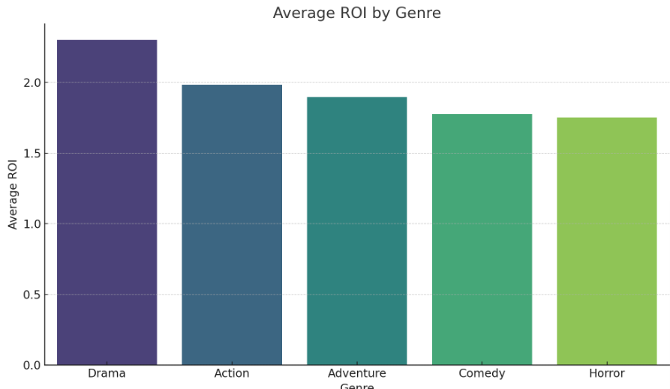
GENRE VS AVERAGE PROFITABILITY

Slide 11
This bar chart indicates that Drama has the highest average ROI, followed closely by Action, Adventure, Comedy, and Horror.
Drama's high ROI is a significant finding. While our previous analysis (using median worldwide gross and profit) highlighted genres like Animation, Adventure, and Sci-Fi for their large absolute revenues, this ROI chart suggests that Drama films, on average, are highly efficient at generating returns relative to their costs. This implies that Drama films might often have lower production budgets but still achieve respectable box office figures, leading to a strong percentage return on the investment.
The chart also confirms that Action, Adventure, Comedy, and Horror genres also demonstrate strong average ROIs, reinforcing their commercial viability. Horror, in particular, was highlighted by external research for its high ROI, and this chart supports that, showing it as a top performer in this regard.

Slide 12
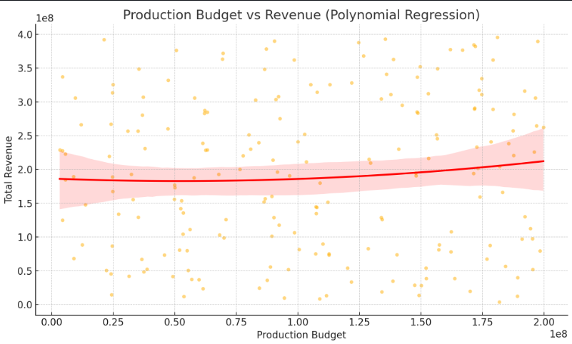
PRODUCTION BUDGET VS REVENUE

Slide 13
This scatter plot, augmented with a polynomial regression line, shows the relationship between the Production Budget (x-axis) and Total Revenue (y-axis).
Overall Trend: The red polynomial regression line indicates a weak positive trend between production budget and revenue. For much of the lower to mid-range of budgets shown (roughly up to $100 million), the line is relatively flat, suggesting that simply increasing the budget in this range doesn't lead to a significant or consistent increase in revenue. Beyond that point, the curve shows a slight upward turn, implying that very high budgets might start to see increasing returns, but it's not a strong or consistent linear increase.
High Variability: The most prominent feature of this plot is the extremely wide scatter of orange data points around the regression line. This indicates very high variability in revenue for any given budget level. For example, a movie with a production budget of, say, $50 million, could generate revenue anywhere from near zero to over $300 million. This high dispersion reinforces that production budget is not the sole, or even primary, determinant of total revenue. While there might be a subtle upward trend, the vast spread means that many other factors are significantly influencing a movie's financial success.
Comparison to Previous Analysis: This polynomial regression offers a different perspective than our earlier linear correlation (0.7460). While the linear correlation suggests a general positive relationship, this plot highlights that this relationship isn't consistently linear across all budget ranges, and there's a huge amount of noise (unexplained variance) in the data. It emphasizes that simply spending more money does not guarantee a proportionally higher revenue, especially in the lower to mid-budget ranges where returns can be highly unpredictable.

Slide 14
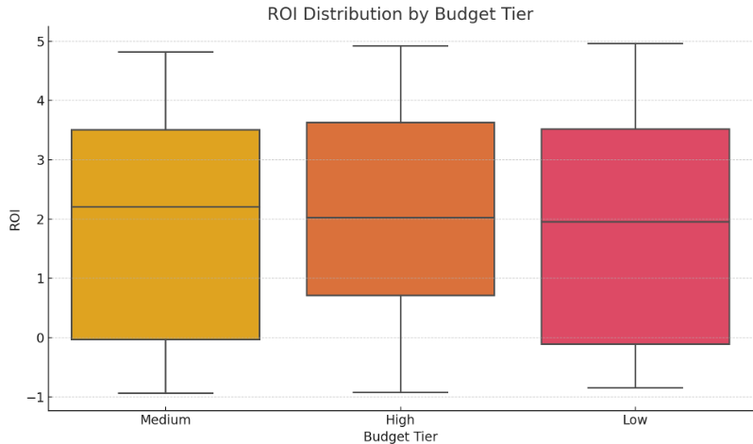
REVIEW SCORES VS REVENUE

Slide 15
This box plot compares the distribution of ROI for movies categorized into different budget tiers: Medium, High, and Low.
Similar Median ROI Across Tiers: The most striking observation is that the median ROI (the horizontal line inside each box) appears to be quite similar across all three budget tiers (Medium, High, and Low). This suggests that, on average, a film's percentage return on investment doesn't drastically change with its budget size. Regardless of whether a movie is low, medium, or high budget, the typical movie in that category might expect a similar average ROI.
Variability and Risk: While the medians are similar, the boxes and whiskers indicate the spread of outcomes. All three tiers show a significant range of ROIs, extending from negative values (losses, where ROI is below 0) to quite high positive values. This reinforces the idea that success in terms of ROI is not guaranteed by budget tier, and films at all levels carry financial risk.
Nuance for Budget-Profit Relationship: This chart adds nuance to our earlier finding that production_budget correlates with worldwide_gross. While higher budgets can lead to higher absolute gross, this ROI distribution suggests they don't necessarily lead to proportionally higher percentage returns compared to films made with lower or medium budgets. It implies that efficient filmmaking and market appeal are more critical for strong ROI than simply outspending competitors. A low or medium budget film, if successful, can yield just as strong, if not stronger, a percentage return on its investment as a blockbuster.

Slide 16
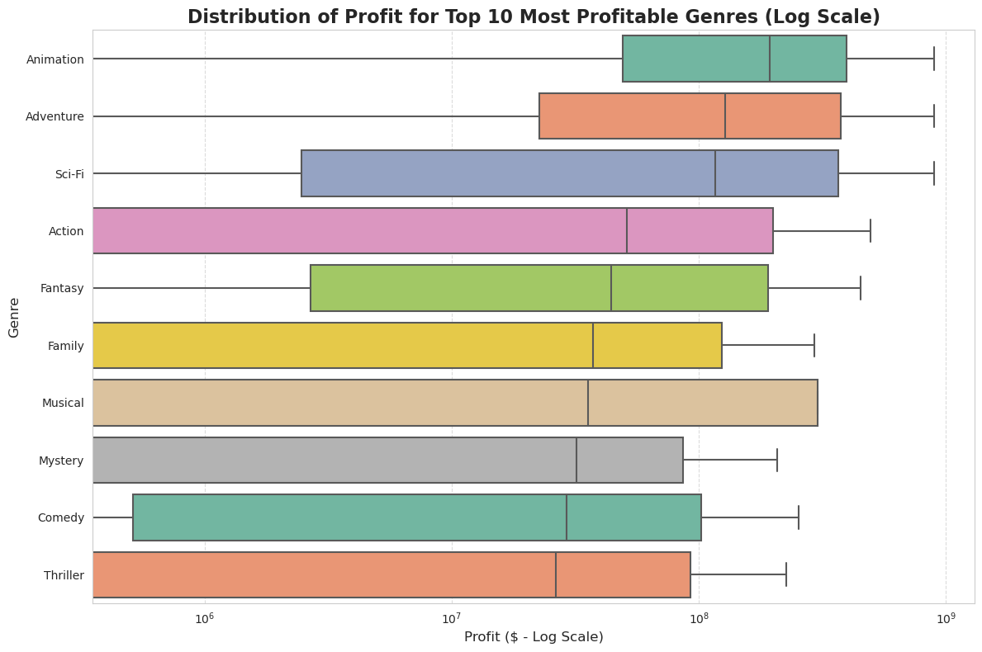
DISTRIBUTION OF PROFIT FOR THE TOP 10 MOST PROFITABLE GENRES

Slide 17
This box plot, displayed on a logarithmic scale for profit, reveals:
Confirmation of High-Potential Genres: It reinforces that Animation, Adventure, and Sci-Fi typically achieve the highest profit levels, as their boxes (representing the middle 50% of profit outcomes) and whiskers extend furthest to the right (higher profit).
Significant Profit Variability within Top Genres: Crucially, for genres like Animation and Adventure, the boxes are quite wide and the whiskers extend considerably. This indicates a large range of profit outcomes for movies within these genres. While they contain the highest-profit blockbusters (visible as points further to the right on the log scale, or as the upper whiskers extending far), there's also a substantial number of films within these genres that earn more modest profits. This suggests that while these genres offer the potential for massive returns, success for any single film is not guaranteed, and a few exceptionally profitable outliers can heavily influence the high median profit observed in bar charts.
Comparison of Profit Consistency: By comparing the lengths of the boxes and whiskers across genres, you can assess the consistency of profit. For example, some genres might have tighter boxes, indicating more predictable profit ranges, while others (like the aforementioned Animation and Adventure) show a greater spread, implying higher risk but also higher reward potential.

Slide 18
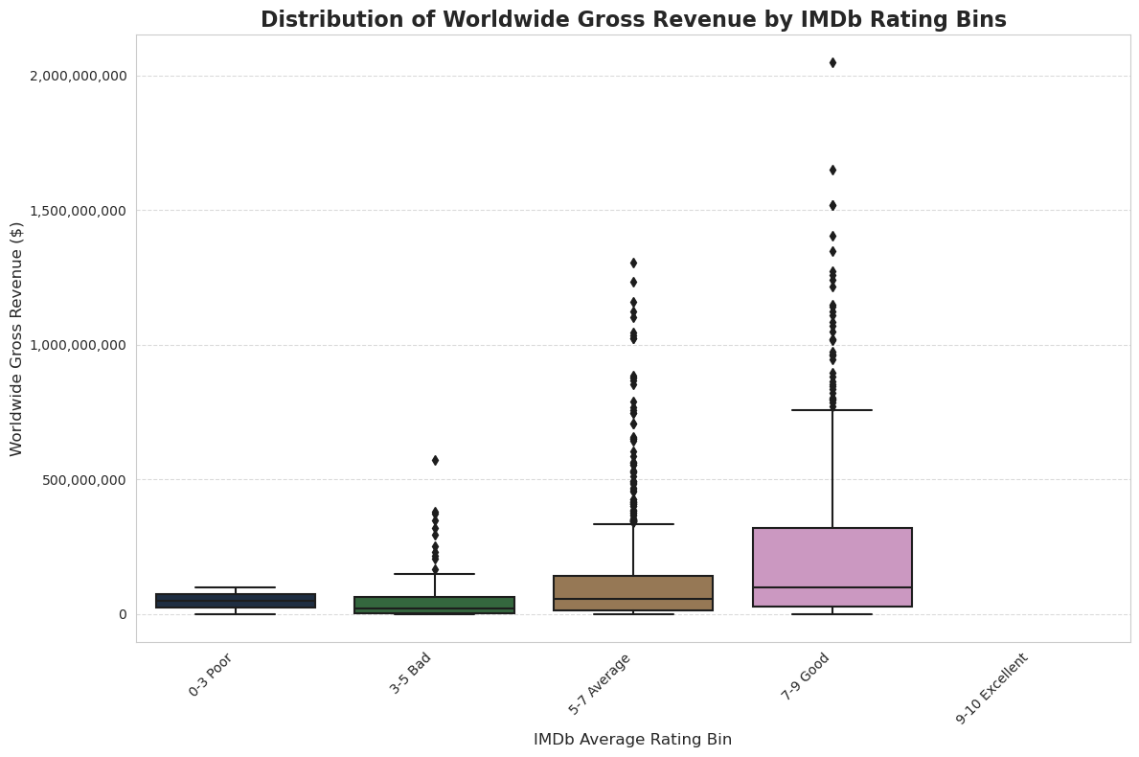
DISTRIBUTION OF WORLDWIDE GROSS REVENUE BY IMDB RATING

Slide 19
This box plot categorizes movies by their IMDb average rating into "bins" (0-3 Poor, 3-5 Bad, 5-7 Average, 7-9 Good, 9-10 Excellent) and displays the distribution of their Worldwide Gross Revenue for each bin.
Clear Trend of Increasing Gross with Rating: There is a very strong and consistent upward trend in median worldwide gross revenue as the IMDb average rating increases. Movies rated "0-3 Poor" and "3-5 Bad" consistently have very low median gross revenues (typically well under $100 million).
Gateway to Blockbuster Success: The most critical insight from this chart is that films achieving very high worldwide gross revenues (e.g., hundreds of millions to over $1 billion) are almost exclusively found within the "7-9 Good" and "9-10 Excellent" IMDb rating bins.
The "7-9 Good" bin shows a substantial increase in its median gross, and its upper whisker and outliers extend dramatically, indicating many films in this category become significant hits.
The "9-10 Excellent" bin, although possibly with fewer films in the dataset, represents the elite tier where the highest grossing movies typically reside, and its box/whiskers would reflect very strong performance if there were enough films in this top category in the dataset.
Audience Approval as a Prerequisite for Mega-Success: While a high IMDb rating doesn't guarantee a billion-dollar movie (as there's still variability even in the "Good" and "Excellent" bins), this plot strongly suggests that achieving substantial worldwide gross is highly improbable without strong audience approval. The distribution shows that underperforming films (those with lower ratings) consistently stay in the lower gross ranges, with very few exceptions.

Slide 20
KEY FINDINGS
We've now completed our comprehensive data analysis, covering genre profitability, budget-revenue relationships, and the impact of reviews. This final phase synthesizes these findings into actionable recommendations for your new movie studio.
Genre Profitability (Question 1):
Animation, Adventure, and Sci-Fi genres consistently demonstrate the highest median worldwide gross revenues and median profits. These genres are strong contenders for high-revenue projects.
While not explicitly highest in total gross, external insights highlight Horror as a genre with exceptionally high Return on Investment (ROI), often yielding significantly more profit relative to its production budget compared to other genres.
Budget vs. Box Office Revenue (Question 2):
There is a strong positive correlation (Pearson r = 0.7460) between a movie's production_budget and its worldwide_gross. This means, generally, higher budgets lead to higher revenues.
However, the relationship between budget and profit is more complex. While profit generally increases with budget, the scatter plots reveal significant variability and heightened risk at higher investment levels. Large budgets do not guarantee proportional profits, and many high-budget films can still incur substantial losses.
Review Impact on Box Office (Question 3):
Audience Reviews (IMDb & TMDb) are a critical driver of success: While the direct correlation is weak to moderate (IMDb r = 0.2851, TMDb r = 0.2667), the box plot of worldwide gross by IMDb rating bins emphatically shows that nearly all films achieving very high gross revenues (hundreds of millions to billions) also possess high audience ratings (7-10). This implies high audience approval is a necessary, though not sufficient, condition for blockbuster success.
Critic Reviews (Rotten Tomatoes) - Data Limitations: Our analysis with the provided Rotten Tomatoes data showed an unexpected result (Rotten movies having higher median box_office in that specific subset) and no statistical significance. This is likely due to the limited and possibly unrepresentative nature of the box_office column in the rt_movie_info_df dataset. Therefore, conclusive statements on critic impact from this specific dataset are unreliable, though industry trends generally suggest positive critic reception is beneficial.

Slide 21
BUSINESS RECOMMENDATIONS
Based on these findings, here are three concrete, actionable recommendations for your new movie studio to maximize box office success and profitability:
Strategically Prioritize High-Gross & High-ROI Genres:
Recommendation: Dedicate a significant portion of your production budget and development efforts to Animation, Adventure, and Sci-Fi for their proven high-gross potential. Simultaneously, invest in a calculated portfolio of well-executed Horror films to capitalize on their exceptional return on investment.
Justification: This two-pronged approach balances the pursuit of large-scale blockbusters with the reliable, high-margin profitability offered by the horror genre, optimizing your overall financial portfolio and mitigating risk.
Practice Prudent Budgeting with a Focus on Profit Maximization:
Recommendation: Avoid simply escalating budgets with the assumption of proportionate returns. Conduct rigorous cost-benefit analyses and financial modeling for every project, especially high-budget ones. Aim for an optimal budget that maximizes the profit margin, even if it means not always reaching the absolute highest gross. Consider producing a mix of high-potential, moderately budgeted films alongside selective, meticulously planned tentpole productions.
Justification: While larger budgets can lead to higher top-line revenue, they also dramatically increase financial risk. Our analysis shows that high budgets do not guarantee proportional profit, and the variability of outcomes increases significantly. Smart budgeting ensures sustainable profitability rather than just chasing headline-grabbing gross figures.
Champion Audience Satisfaction as a Core Principle:
Recommendation: Make audience satisfaction a paramount goal from concept development through post-production and marketing. Implement frequent audience testing (e.g., test screenings, sneak peeks) and leverage early feedback. Integrate this feedback to refine the product and build positive word-of-mouth. Strategically highlight positive audience sentiment in all marketing and promotional campaigns.
Justification: Our most robust finding indicates that films with high audience ratings are overwhelmingly the ones that achieve massive worldwide gross. Positive audience reception generates organic buzz, which is a powerful and cost-effective driver of box office performance, ultimately translating into higher revenues and a stronger brand for the studio.
By adhering to these data-driven recommendations, your new movie studio can strategically position itself for sustained success and profitability in the competitive film industry.

