Slide 1
Understanding Movie Performance Through Data

Slide 2
Overview
This project explores the movie industry using data to understand what makes a movie successful in terms of profit and popularity.
I have used five different movie-related datasets to examine how production budgets, audience opinions, and critic reviews influence box office performance.
Business Understanding
The entertainment industry invests millions in film production. Our goal was to answer three key questions:
What kinds of movies make the most profit?
How does a movie's budget relate to its financial return?
Do audience and critic reviews impact a movie’s success?
This analysis helps studios, investors, and marketing teams make better, data-driven decisions.

Slide 3
Data Understanding
I have worked with five datasets, each providing different insights:
Box Office Data: Revenue from domestic and foreign markets.
Movie Info: Genre, release dates, and film ratings.
Critic Reviews: What critics said about the movies.
Audience Metrics: Popularity scores, vote counts, and language.
Production Budgets: How much money was spent to make the movies.
We cleaned and merged these datasets to create one large view for analysis.

Slide 4
Data Analysis
We focused on three main areas:
Profitability
Identified the most profitable movies and genres.
Found that some movies made huge profits even with modest budgets.
Budget vs. Revenue
Generally, movies with bigger budgets earned more—but not always more profit.
Some low-budget films performed surprisingly well.
Audience & Critic Impact
Movies with high audience ratings usually did better at the box office.
Critics had some influence, but audience reviews had a stronger connection to success

Slide 5
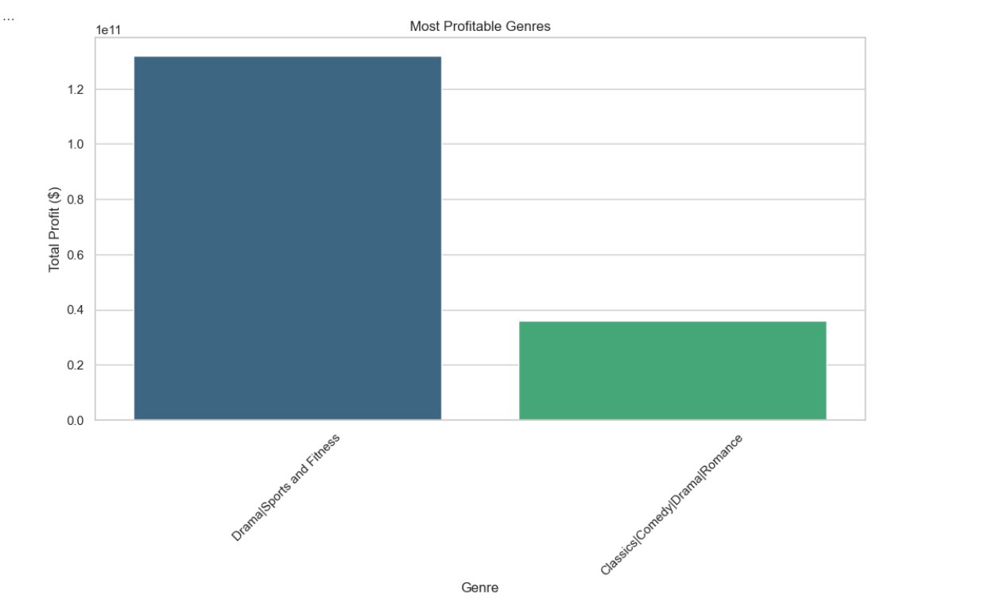
Data Visualization

Slide 6
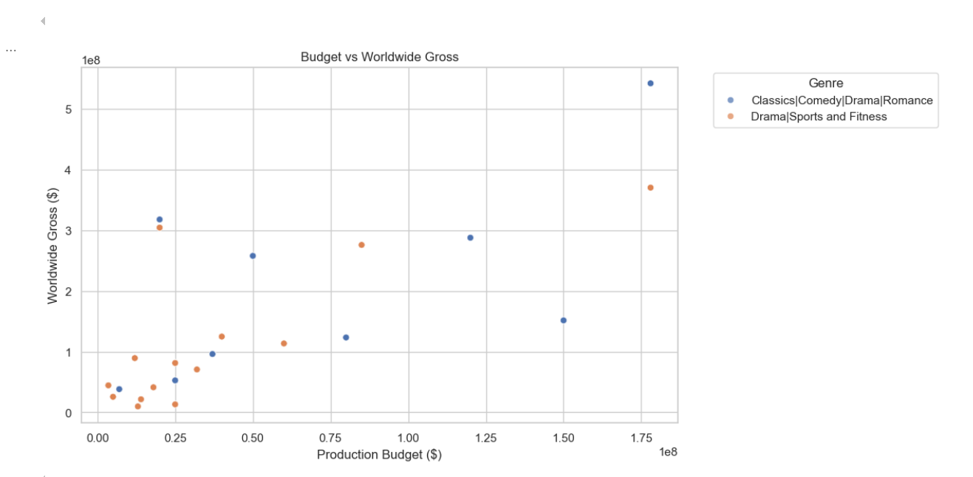

Slide 7
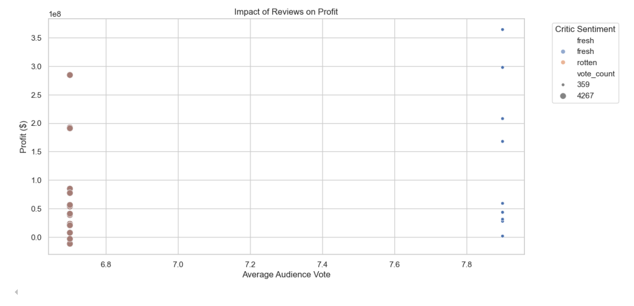

Slide 8
Recommendations
Based on our findings, we suggest the following:
Focus on High-Performing Genres Invest more in action, animation, or adventure genres—they consistently bring good returns.
Control Production Budgets Spending more doesn’t always guarantee profit. Budget planning should be data-informed.
Use Reviews Strategically Early audience feedback should guide marketing. Positive audience buzz boosts revenue more than critic reviews alone.
Make Data-Driven Decisions Use historical data when deciding what movies to greenlight or promote.
Next Steps
Incorporate streaming data to understand long-term success.
Build interactive dashboards for ongoing business monitoring.
Use machine learning to predict future movie success.

Slide 9
Prompt Questions
"Based on the insights shared, what factors do you think studios should prioritize most when greenlighting new movie projects—budget, genre, or audience feedback?“
"How might these findings change the way we market or promote films to different types of audiences?"
Thank You
Thank you for your time. This project shows how using data can improve decisions in the movie business. I am excited about what comes next and how this can shape smarter film production strategies
LinkedIn:
https://www.linkedin.com/in/kelvin-shilisia-2b289b108/

