Slide 1




BEHIND THE SCREENS
Data-Driven Insights for a New Movie Studio

Slide 2
THE TEAM
George Kariuki
Kelvin Shilisia
Raphael Ragot
Mohamed Abdi
Deborah Onondi

Slide 3
BUSINESS PROBLEM
Objective: Help a tech company launch a successful movie studio.
Challenge: Company lacks entertainment industry knowledge.
Goal: Identify traits of successful films (high revenue, positive reception).

Slide 4

IMDB TITLE BASICS – CORE INFO ABOUT MOVIES
DATASETS
1
2
IMDB RATINGS – AUDIENCE REVIEWS
3
BOX OFFICE MOJO – FINANCIAL PERFORMANCE
4
PRODUCTION BUDGETS – COST VS. REVENUE

Slide 5

METHODOLOGY
PART 1
• Data Cleaning: Merged and standardized datasets
• Feature Engineering: Derived ROI, genre indicators, etc.
PART 2
• EDA: Trends in genre, release year, budget vs revenue
• Visualization: Used Seaborn, Plotly

Slide 6

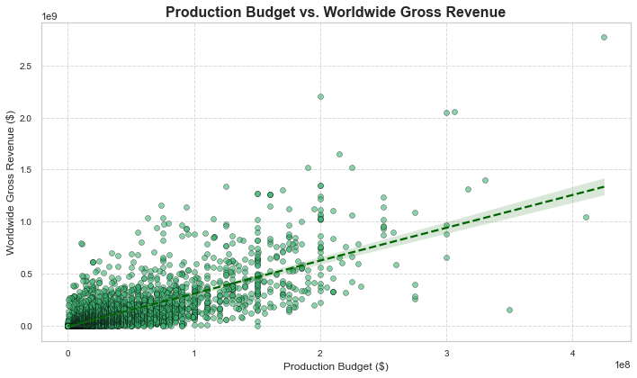

PRODUCTION BUDGET VS WORLDWIDE GROSS REVENUE
01

Slide 7
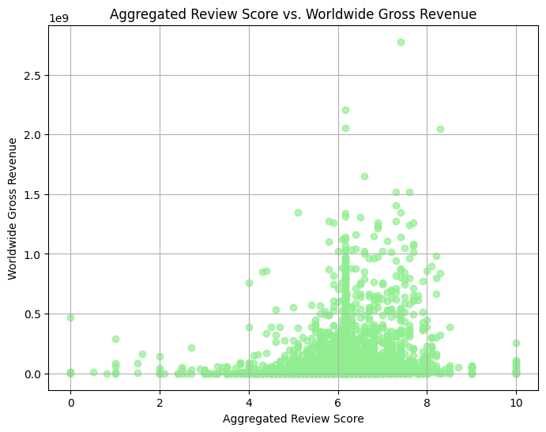
AGGREGATED REVIEW SCORE VS WORLDWIDE GROSS REVENUE
02

Slide 8
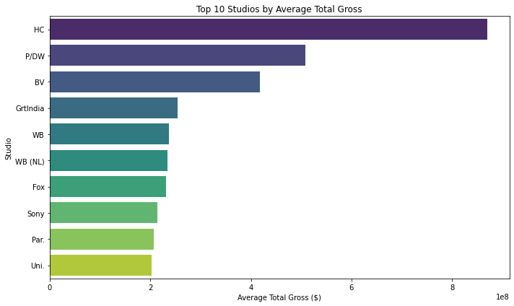
TOP 10 STUDIOS BY AVERAGE TOTAL GROSS
03

Slide 9
KEY INSIGHTS
Action & Adventure films consistently rank high in revenue.
Mid-to-high budgets often yield higher ROI.
Summer releases (May–August) dominate box office charts.

Slide 10
RECOMMENDATIONS
Invest in mid-to-high budget films in popular genres like Action and Adventure.
Prioritize releases during summer and holiday seasons.
Aim for high critic and audience engagement by focusing on quality scripts and production.
Use predictive models to forecast film success before production.

Slide 11
IMPLEMENTATION ROADMAP
Develop predictive models based on cleaned dataset.
Integrate real-time data pipelines for ongoing film performance tracking.
Establish partnerships with marketing and distribution experts.
Build internal dashboards for decision-making.

Slide 12

THANK
YOU!

