Slide 1



VAWG - Violence Against Women and Girls
Participants – Or Moshe & Gilad Ben Natan

Slide 2
One in three women is sexually assaulted during her lifetime.
According to the data of the World Health Organization, approximately 35% of women in the world experience physical sexual abuse during their lifetime.
According to the estimates of the Ministry of Internal Security, one in three women will be sexually assaulted in her lifetime - with 84,000 women being harmed a year. This means that in Israel, according to the estimate, about 230 sexual assaults take place every day. According to the National Violence Index, published by the Ministry in 2014, the rate of sexual violence offenses in Israel is 10% higher than the average rate in the member countries of the Organization of the Developed Countries (OECD).
In a study conducted by Dr. Abigail Moore in 2009 on a sample of Israeli women and girls between the ages of 16 and 28, it was found that 33% of the subjects had been physically sexually assaulted during their lifetime.
One in five women is raped.
Various studies in the world present data according to which between 20% and 25% of women are raped, or attempted rape, during their lifetime.
According to Moore's research, conducted on Israeli subjects, about 21% of girls and women in Israel have been raped

Slide 3
Details about assistance centers -
In Israel, there are 9 assistance centers for victims and victims of sexual assault, which provide free assistance to women and men who have been sexually assaulted and need listening, counseling, accompaniment and support. The emergency lines of the aid centers are operated by hundreds of volunteers throughout the country, and are active 24 hours a day, 7 days a week.
After the sexual assault, you may experience several common symptoms that can appear immediately after the assault, but also years later. Among the symptoms: restlessness, insomnia, repeated images of the event, disturbing thoughts, nervousness and tension, decreased appetite, feelings of guilt, lack of concentration, memory difficulties and shame.

Slide 4
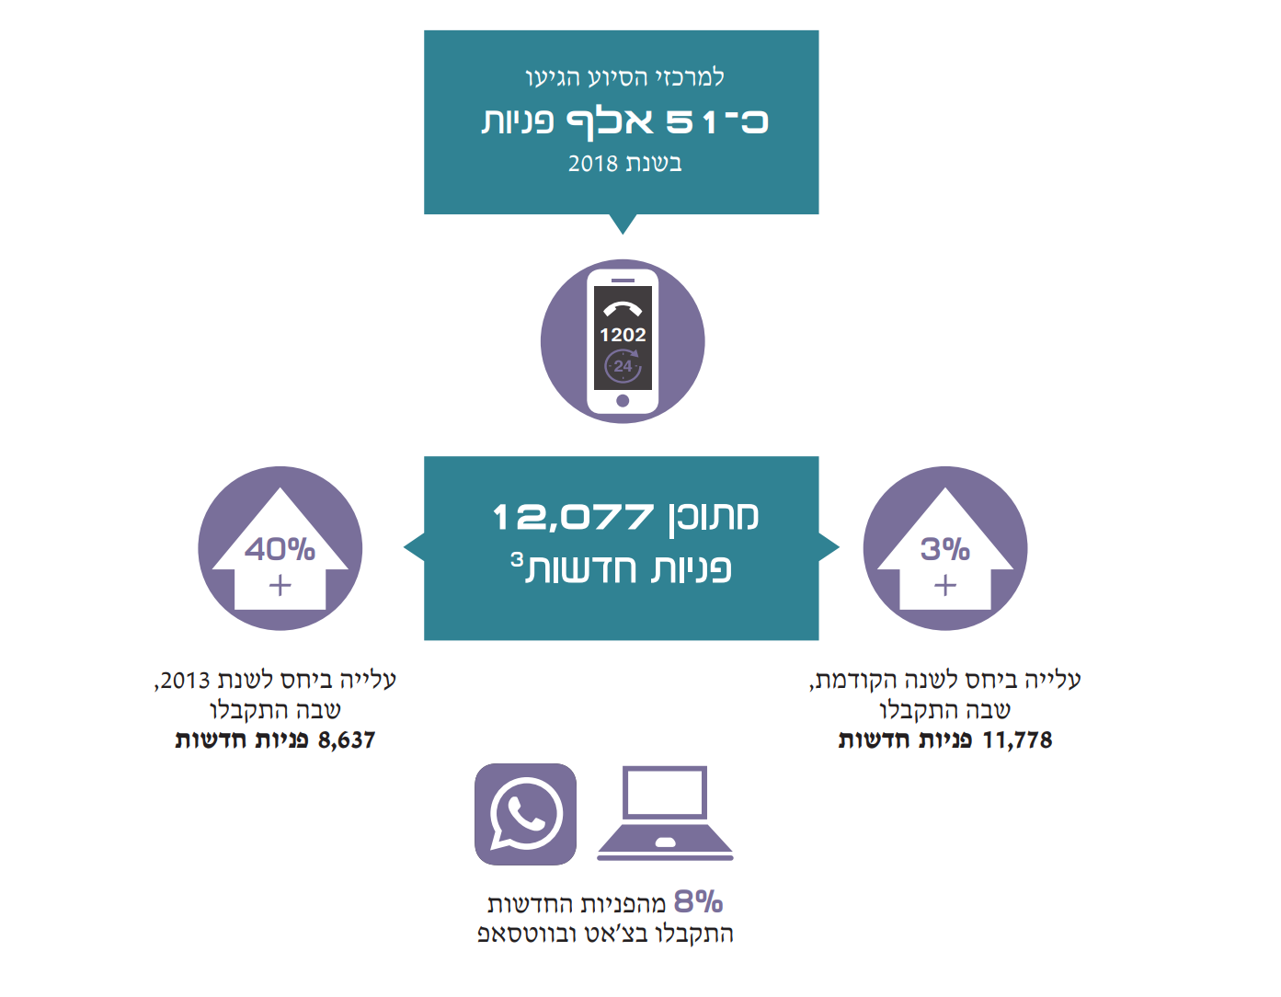

Slide 5
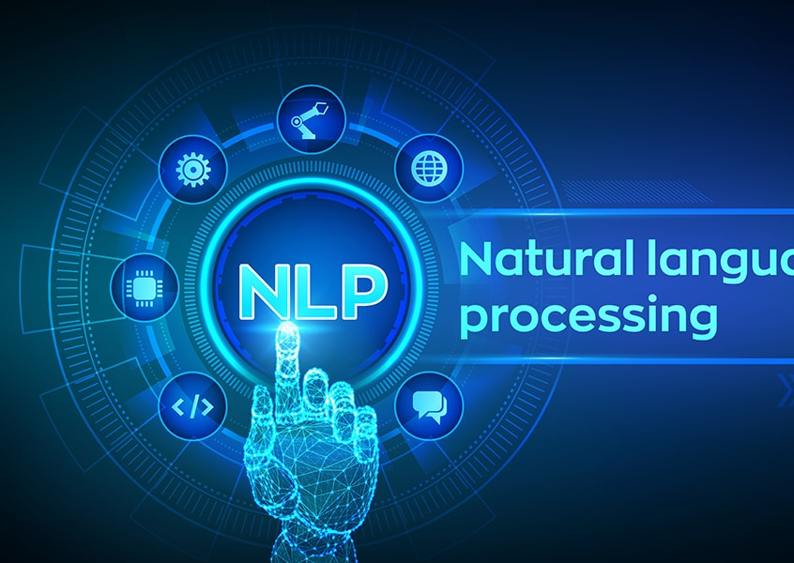
Our Solution is :
The problem is –
There is no system that supports the aid centers to more accurately and efficiently decipher the condition of the victims
A groundbreaking software harnessing Natural Language Processing (NLP) has emerged, designed to address the multifaceted experiences of women in distress. Utilizing advanced algorithms, this software adeptly characterizes various situations faced by women, offering a nuanced understanding of their needs and challenges. Through the power of NLP, it can analyze and interpret textual data, to identify patterns indicative of distress or danger. This innovative tool holds immense potential to revolutionize support systems for women, providing timely and tailored assistance based on their specific circumstances, ultimately fostering a safer and more supportive environment for those in need.

Slide 6
Review of the literature
Our exhaustive investigation of existing initiatives and projects in Israel revealed a notable absence of concepts like ours.
Through careful investigation and analysis, it became clear that our idea stands as a unique and innovative approach in the Israeli landscape.
The lack of similar models emphasizes the pioneering nature of our work and guarantees unprecedented solutions and opportunities in the field of classification and assistance of distress calls.
This unique location confirms the potential impact and relevance of our project and signals a transformative journey towards meeting critical social needs in Israel and abroad.
https://hopetraining.co.uk/harnessing-the-power-of-ai-in-the-violence-against-women-and-girls/
https://www.techuk.org/resource/how-nlp-and-victims-voices-are-supported-through-innovative-solutions-tackling-vawg-and-rasso-impact-days.html
https://www.omdena.com/blog/nlp-for-gender-based-violence-with-deep-learning

Slide 7

The first steps -
Collect data of WhatsApp conversations of women who were affected and contacted to report it and distribute help.
Contact assistance centers for help in classifying the classifications of the women's WhatsApp conversations.
Research about types of algorithms related to language processing.

Slide 8

Our Goals -
Our goal is to produce an innovative project to develop a user-friendly system for assistance centers, while improving their ability to identify and respond to the needs of the complainants in real time and retrospectively. By leveraging advanced algorithms and NLP technology, the system analyzes WhatsApp conversations to identify the type of problem the complainants are facing. By streamlining the classification process, it allows centers to offer more targeted and timely assistance, adapting to evolving trends and ensuring responsive access to support for people in need. This initiative promises to revolutionize support services, fostering a more empathetic and efficient environment for those seeking help.

Slide 9
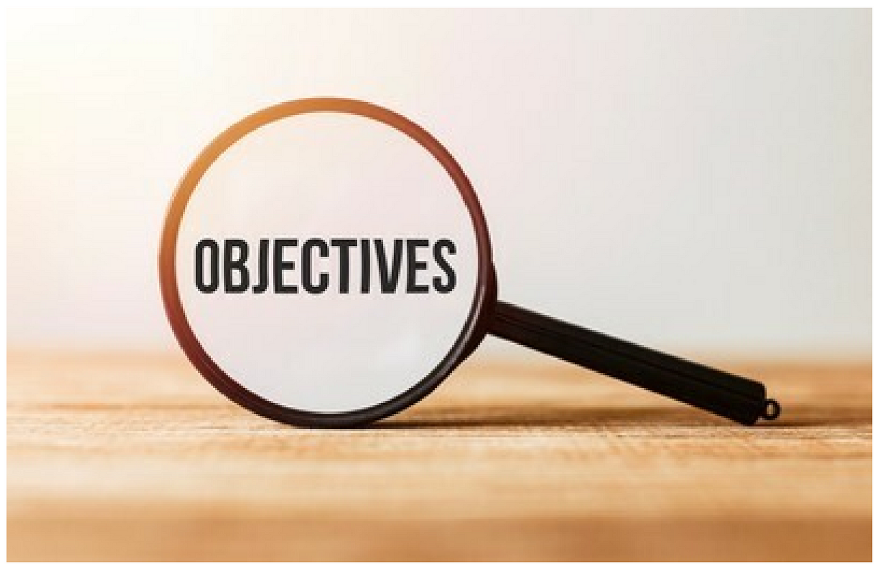
Objectives -
Display clearly graphs of statistics previously called calls and their classification:
Develop a feature to display statistics derived from previously analyzed conversations, providing insights into the frequency and distribution of various classifications.
Implement a user-friendly interface for helpdesks to easily access and interpret these statistics.
Ensure security and data privacy measures are in place to protect the confidentiality of conversations and their classifications.
Crack in real time the type of the victim's problem and give a more accurate answer:
Enhance the system's real-time processing capabilities to quickly analyze incoming calls and identify the type of problem the victim is experiencing.
Combine advanced algorithms and NLP techniques to improve accuracy and precision in classifying the nature of the problem.
Develop a feedback loop mechanism for continuous refinement of system understanding and classification accuracy based on user interactions and feedback.

Slide 10
measure of success:
Achieving a success rate of 70% or higher in the classification of calls is a key indicator of the effectiveness of the project.
Key Performance Indicators (KPI):
Classification accuracy rate: tracking the accuracy of the system in correctly classifying the type of problem in incoming calls.
Success data collection rate: Track the percentage of calls for which success data is obtained (ie, accurate classification).
User satisfaction: Collect feedback from help desk staff about the usefulness and reliability of the system in helping them provide support to victims.
Response time: evaluating the effectiveness of the system in providing classification in real time, while ensuring timely assistance to victims in distress.

Slide 11
Functional Requirements:
Trauma Recognition:
Implement NLP to understand and categorize trauma expressions in survivor narratives.
Recommend appropriate support services based on trauma severity.
User Interface:
Design a user-friendly interface for support representatives.
Ensure easy integration into their workflow for efficient usage.
File Upload:
Provide functionality for support representatives to upload files related to survivor cases.
Allow for attachments such as documents or images to be included with survivor interactions.
Integration with Correspondence Platform:
Integrate the system with a correspondence platform (e.g., WhatsApp, email) for seamless communication with survivors.
Enable support representatives to interact with survivors through the chosen platform directly within the system interface.
Notifications:
Implement a notification system for urgent survivor cases.
Provide real-time updates on survivor interactions.

Slide 12
Non-Functional Requirements:
Performance:
Ensure system efficiency with large datasets for timely support.
Maintain high accuracy in trauma recognition.
Scalability:
Design for scalability to accommodate growing interactions and users.
Optimize performance as system usage expands.
Security:
Adhere to privacy regulations to protect survivor confidentiality.
Implement security measures to prevent unauthorized access.
Usability:
Conduct usability testing for practical usage by support representatives.
Incorporate user feedback for continuous improvement.
Maintainability:
Establish mechanisms for regular updates and system maintenance.
Ensure adaptability to evolving needs and technologies.
Compatibility:
Ensure compatibility with different devices and browsers.
Facilitate seamless integration into support representatives' workflow.

Slide 13
Technologic Requirements:
Python: Python would serve as the primary programming language for building the backend logic of the system. Python's extensive libraries for Natural Language Processing (NLP) and machine learning make it well-suited for tasks such as analyzing text data from incoming calls and training classification models.
PostgreSQL: PostgreSQL would be used as the database management system for storing and managing the call data. Its support for complex queries and scalability makes it a suitable choice for handling the large volumes of data generated by the system.
Flask: Flask, a lightweight web framework for Python, could be used to develop the backend RESTful API that serves as the interface between the frontend and backend components of the system. Flask's simplicity and flexibility make it ideal for building web applications, allowing for easy integration with other technologies.
React/Flutter: React or Flutter could be used to develop the frontend user interface for the system. React is a popular JavaScript library for building user interfaces, while Flutter is a framework for building cross-platform mobile applications. Depending on the requirements and target platforms of the project, either React for web-based interfaces or Flutter for mobile applications could be chosen to create an intuitive and responsive user experience.

Slide 14
NLTK (Natural Language Toolkit) would be a valuable addition to your project stack. NLTK is a Python library widely used for NLP tasks such as tokenization, stemming, lemmatization, parsing, and semantic reasoning, among others. Here's how NLTK could be integrated into your project:
Text Preprocessing: NLTK can be used for preprocessing the text data extracted from incoming calls. This includes tasks like tokenization (breaking text into words or sentences), removing stopwords (commonly used words like "the", "is", etc.), and stemming or lemmatization (reducing words to their base form).
Feature Extraction: NLTK provides tools for extracting features from text data that can be used in machine learning models. For example, you can use NLTK to generate bag-of-words or TF-IDF representations of text, which can then be fed into classification algorithms.
Named Entity Recognition (NER): NLTK includes modules for identifying and extracting named entities such as names of people, organizations, locations, etc. This could be useful for identifying key entities mentioned in the calls, which may provide additional context for classification.
Sentiment Analysis: NLTK includes tools for sentiment analysis, allowing you to determine the sentiment (positive, negative, neutral) expressed in text. While this may not directly apply to your classification task, it could provide additional insights into the emotional tone of the calls.

Slide 15
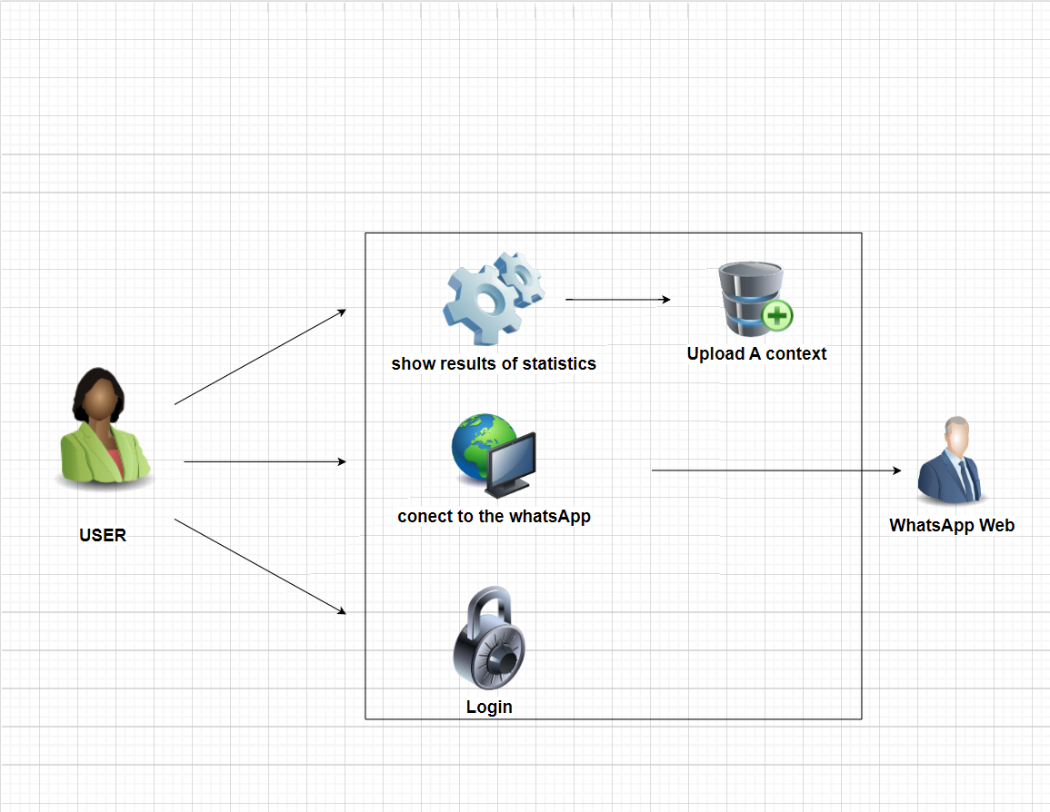
Architecture - UML

Slide 16
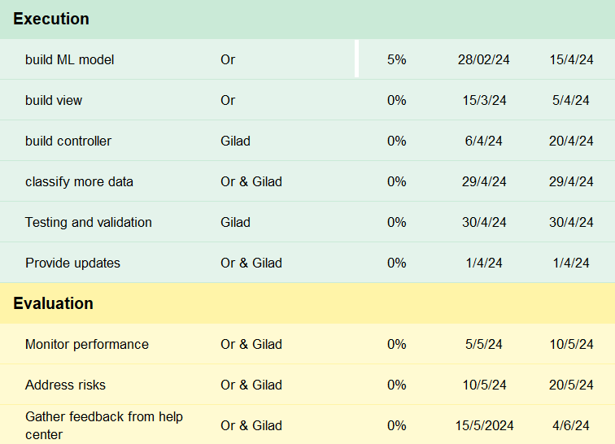
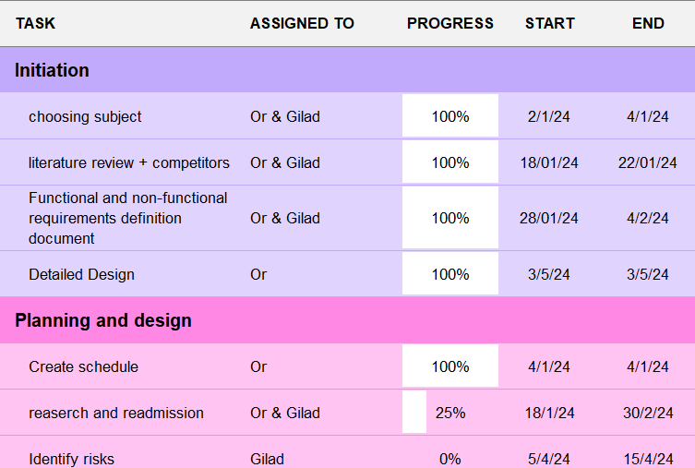
Gantt chart

Slide 17
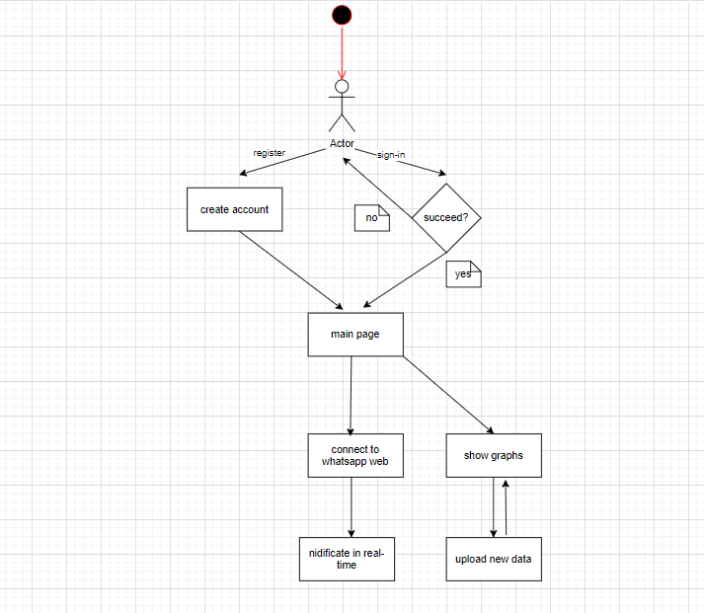
_UML-

