Slide 1

Github Actions Workshop
Or Elharar
09, Jul 2023

Slide 2
What is CI\CD ?
Continuous integration (CI) is a software development practice where developers frequently integrate their code changes into a shared repository, such as a version control system. This allows teams to detect errors early and often, and to make sure that all changes work together correctly.
Continuous delivery (CD) is a practice where software is automatically built, tested, and deployed to production after each change. This helps teams to release new features and bug fixes more frequently, and to reduce the risk of deployment errors.

Slide 3
Why use CI/CD?
CI/CD can help teams to:
Improve the quality of their software
Reduce the time it takes to release new features
Increase the stability of their deployments
Reduce the risk of deployment errors
Improve collaboration between teams
Automate away manual tasks

Slide 4
Why use CI/CD?
CI/CD tools can help teams to ship code faster by automating the build, test, and deploy process. This frees up developers to focus on more important tasks, such as writing new code.

Slide 5
Different Solutions for CI/CD systems
There are many different CI/CD systems available, some of the most popular include:
Jenkins
CircleCI
Travis CI
GitLab CI/CD
GitHub Actions
Each system has its own strengths and weaknesses, so it is important to choose the one that is right for your team's needs.

Slide 6
What is GitHub Actions?
GitHub Actions is a CI/CD system that is built into GitHub. It allows you to automate your build, test, and deploy workflows right from your GitHub repository.
GitHub Actions is a powerful tool that can help you to improve the quality, reliability, and security of your software. It is easy to use and can be integrated with a wide range of other tools and services.

Slide 7
What is GitHub Actions?
GitHub Actions is a great way for beginners to learn about CI/CD. The syntax is simple and the documentation is comprehensive. There are also many tutorials and examples available online.

Slide 8
Benefits of using GitHub Actions:
It is built into GitHub, so you don't need to set up and manage your own CI/CD server.
It is easy to use and can be configured using YAML files.
It is highly scalable and can handle even the most demanding workloads.
It is secure and uses industry-standard encryption.
It is reliable and has a 99.9% uptime SLA.
It is affordable and there is no minimum commitment.

Slide 9
Getting Started with GitHub Actions
To get started with GitHub Actions, you first need to create a GitHub Actions workflow. A workflow is a YAML file that defines a set of steps that will be executed when a certain event happens, such as a push to a branch or a pull request.
Once you have created a workflow, you can run it by pushing it to your GitHub repository. GitHub Actions will then automatically execute the steps in your workflow.
You can also trigger your workflows manually by clicking on the "Run workflow" button in your GitHub repository.

Slide 10
Creating a GitHub Actions Workflow
A GitHub Actions workflow is a YAML file that defines a set of steps that will be executed when a certain event happens. The basic structure of a GitHub Actions workflow is as follows:

Slide 11
Using Runners with GitHub Actions
GitHub Actions runners are virtual machines that are used to execute your workflows. You can use GitHub-hosted runners, which are free to use, or you can set up your own self-hosted runners.
If you are using GitHub-hosted runners, you can choose from a variety of runners that are pre-configured for different languages and frameworks.
If you are setting up your own self-hosted runners, you can choose the operating system, the software, and the hardware that you want to use.

Slide 12



Preview - .yaml files
YAML (YAML Ain't Markup Language) is a human-readable data serialization format commonly used for configuration files. It is designed to be easy to read and write by humans while still being machine-friendly. YAML files often have a .yml or .yaml extension.
Here are some key features of YAML files:
  Structure: YAML files use indentation and a hierarchical structure to organize data. Indentation is done using spaces (typically two or four spaces) and represents the parent-child relationships between elements.
  Key-Value Pairs: YAML files primarily consist of key-value pairs, where the
  key is separated from the value using a colon. For example:
  Lists and Arrays: YAML supports the use of lists and arrays by using hyphens or square brackets. Lists are denoted by a hyphen followed by a space, while arrays use square brackets. For example:

Slide 13
Preview - .yaml files
Some more key features of YAML files:
  Comments: YAML allows adding comments to provide additional information or explanations within the file. Comments start with the # symbol and are ignored by parsers.
  Nested Structures: YAML supports nesting of structures, allowing the creation of complex and hierarchical configurations. Nested structures are indicated by the use of indentation.
  Inclusion of External Files: YAML files can include other YAML files, allowing for modular and reusable configurations. This feature helps keep configurations organized and promotes code reuse.
  Data Types: YAML supports various data types, including strings, numbers, booleans, null values, dates, and more. It also allows for multi-line strings and special characters using escape sequences.

Slide 14

Preview - .yaml files
There is an obvious comparison between YAML and JSON files – In general, YAML offers a more human-friendly and flexible syntax with support for additional data types and features like comments and references. JSON, on the other hand, has a more concise and strictly defined syntax, making it a widely adopted format for data interchange and API responses. The choice between YAML and JSON depends on factors such as readability, compatibility, and the specific requirements of the system or tool using the configuration or data file.
YAML files are widely used in configuration files for applications, infrastructure-as-code tools (such as Ansible and Terraform), CI/CD pipelines (like GitHub Actions and GitLab CI/CD), and other systems that require structured and human-readable configuration.
Overall, YAML files provide a clean and easy-to-understand syntax for defining configurations, making them a popular choice for various use cases in software development and system administration.
For more info – visit
https://stackoverflow.com/questions/1726802/what-is-the-difference-between-yaml-and-json

Slide 15
Creating your first workflow
Create a .github/workflows directory in your repository on GitHub if this directory does not already exist.
In the .github/workflows directory, create a file named github-actions-demo.yml

Slide 16
In github-actions-demo.yml file
name: First Workflow
on: workflow_dispatch
jobs:
first-job:
runs-on: ubuntu-latest
steps:
- name: Print greeting
run: echo "First Workflow - Hello World!"
- name: Print goodbye
run: echo "Done - bye!"

Slide 17
In github-actions-demo.yml file
name: GitHub Actions Demo
run-name: ${{ github.actor }} is testing out GitHub Actions 🚀
on: [push]
jobs:
Explore-GitHub-Actions:
runs-on: ubuntu-latest
steps:
- run: echo "🎉 The job was automatically triggered by a ${{ github.event_name }} event."
- run: echo "🐧 This job is now running on a ${{ runner.os }} server hosted by GitHub!"
- run: echo "🔎 The name of your branch is ${{ github.ref }} and your repository is ${{ github.repository }}."
- name: Check out repository code
uses: actions/checkout@v3
- run: echo "💡 The ${{ github.repository }} repository has been cloned to the runner."
- run: echo "🖥️ The workflow is now ready to test your code on the runner."
- name: List files in the repository
run: |
ls ${{ github.workspace }}
- run: echo "🍏 This job's status is ${{ job.status }}."

Slide 18

Github Actions - Bird's eye view
Steps and Actions: Steps define the individual actions to be performed within a job. Each step can execute a shell command, use a pre-built GitHub Action, or reference a custom action. Shell commands can run scripts, execute commands, or perform operations like checking out code, installing dependencies, building the app, or deploying it to a target environment.
Resources and Dependencies: The deployment workflow may require specific resources or dependencies. GitHub Actions provides various built-in actions and community-created actions that can be used to interact with external services, deploy to cloud platforms, manipulate data, or perform other specialized tasks. These actions can be referenced within the steps to access and utilize the required resources.
Outputs and Artifacts: During the deployment workflow, outputs and artifacts can be generated. Outputs are values that can be passed between jobs within the workflow, allowing data sharing and dependency management. Artifacts are files or collections of files produced during the workflow run, such as build artifacts or test reports. They can be stored and accessed for further use or as a result of the deployment process.
Notifications and Logging: GitHub Actions provides features for sending notifications and logging the execution of the deployment workflow. Notifications can be sent to various channels, including email, Slack, Microsoft Teams, or other communication platforms, to inform team members about the deployment status. Logs capture the output of each step and provide visibility into the workflow execution for debugging and monitoring purposes.
In summary, GitHub Actions leverages YAML files to define deployment workflows. The YAML file specifies the triggers, machine environments, jobs, and steps required to deploy the application. Steps can execute shell commands or leverage pre-built actions to perform tasks such as code checkout, dependency installation, build processes, and deployment to target environments. By utilizing YAML files, GitHub Actions enables developers to automate the deployment process and integrate it seamlessly into their software development workflows.

Slide 19
Github Actions - Bird's eye view
GitHub Actions uses YAML (.yml) files to define workflows that automate various tasks in a software development project, including deploying applications. Let's explore how GitHub Actions utilizes YAML files for deploying an app:
YAML Workflow Definition: The deployment process starts with creating a YAML file (.yml) that defines the workflow. The YAML file contains a set of instructions and configurations for the deployment process. It specifies events that trigger the workflow, the jobs to be performed, and the steps within each job.
Event Trigger: The YAML file specifies the events that trigger the deployment workflow. Events can include actions like push, pull requests, scheduled triggers, or custom events. For example, the workflow can be triggered on a push to a specific branch or when a pull request is opened.
Machine Environment: The YAML file defines the machine environment where the deployment workflow runs. GitHub Actions provides a variety of machine environments to choose from, such as Ubuntu, Windows, and macOS. The chosen machine environment determines the operating system and other resources available during the workflow execution.
Jobs and Steps: Within the YAML file, one or more jobs are defined. Each job represents a unit of work that needs to be executed. Jobs run independently and can be parallelized or depend on the completion of other jobs. Each job consists of a series of steps that define specific actions to be taken.

Slide 20
Viewing your workflow results
On GitHub.com, navigate to the main page of the repository.
Under your repository name, click Actions.
In the left sidebar, click the workflow you want to display, in this example "GitHub Actions Demo."
From the list of workflow runs, click the name of the run you want to see, in this example "USERNAME is testing out GitHub Actions."
In the left sidebar of the workflow run page, under Jobs, click the Explore-GitHub-Actions job.
The log shows you how each of the steps was processed. Expand any of the steps to view its details.

Slide 21
Grant Permissions
Make sure Github's access token is set in the repository settings and that it has the necessary scope permissions to manage workflows. When creating or updating a workflow file,
the token must have the "workflow" scope.

Slide 22
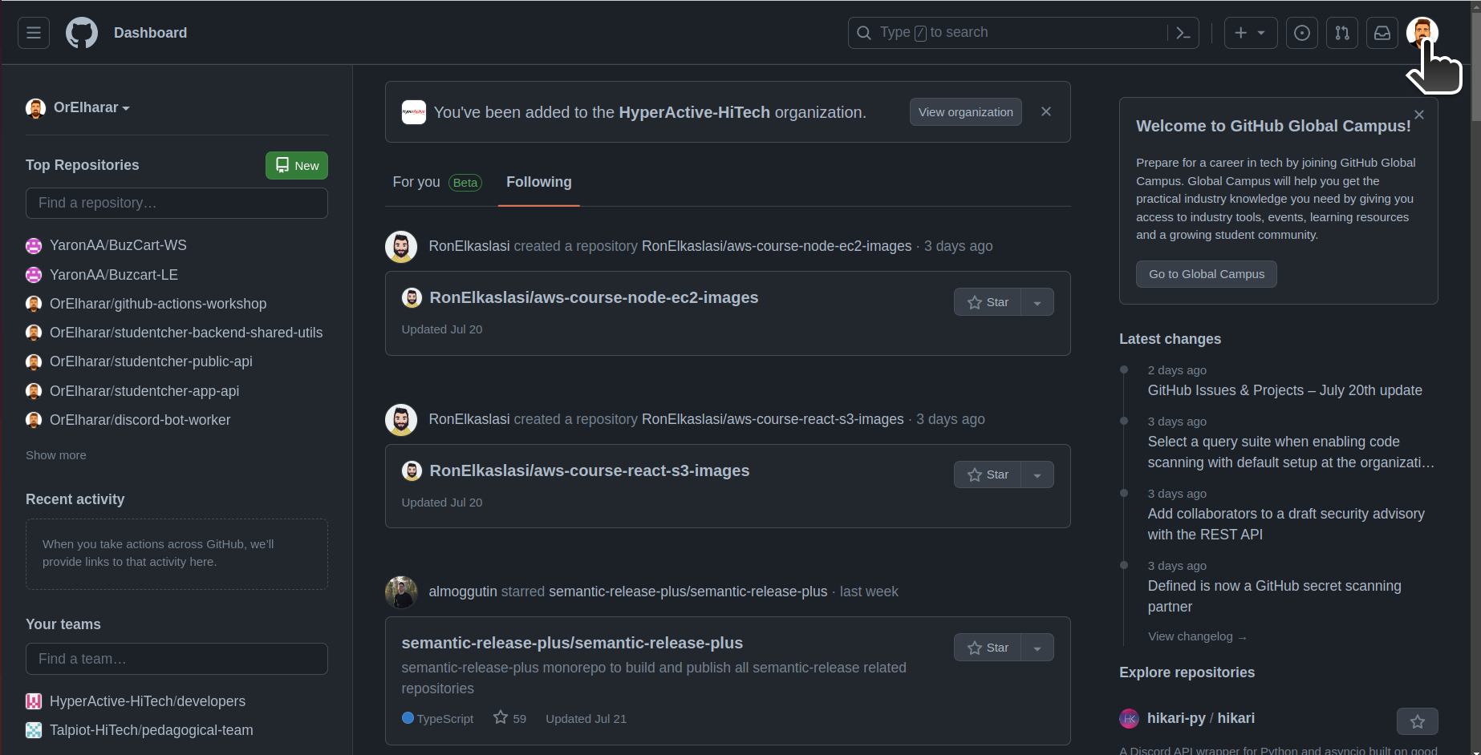
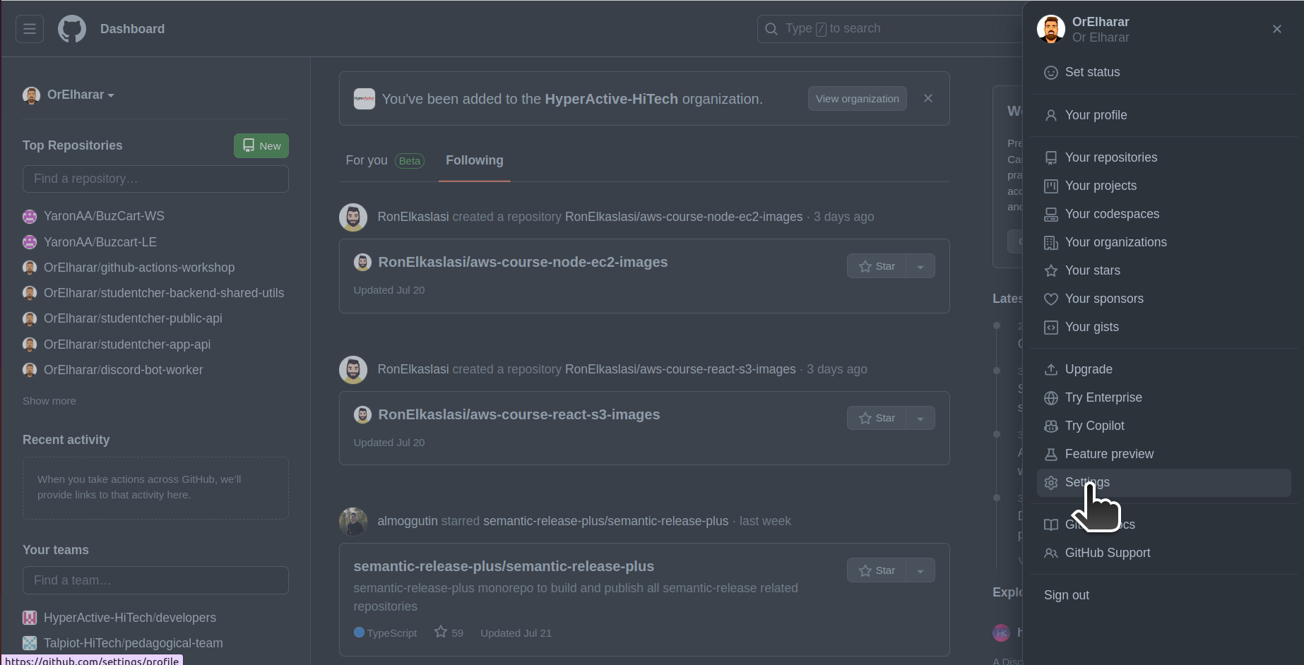
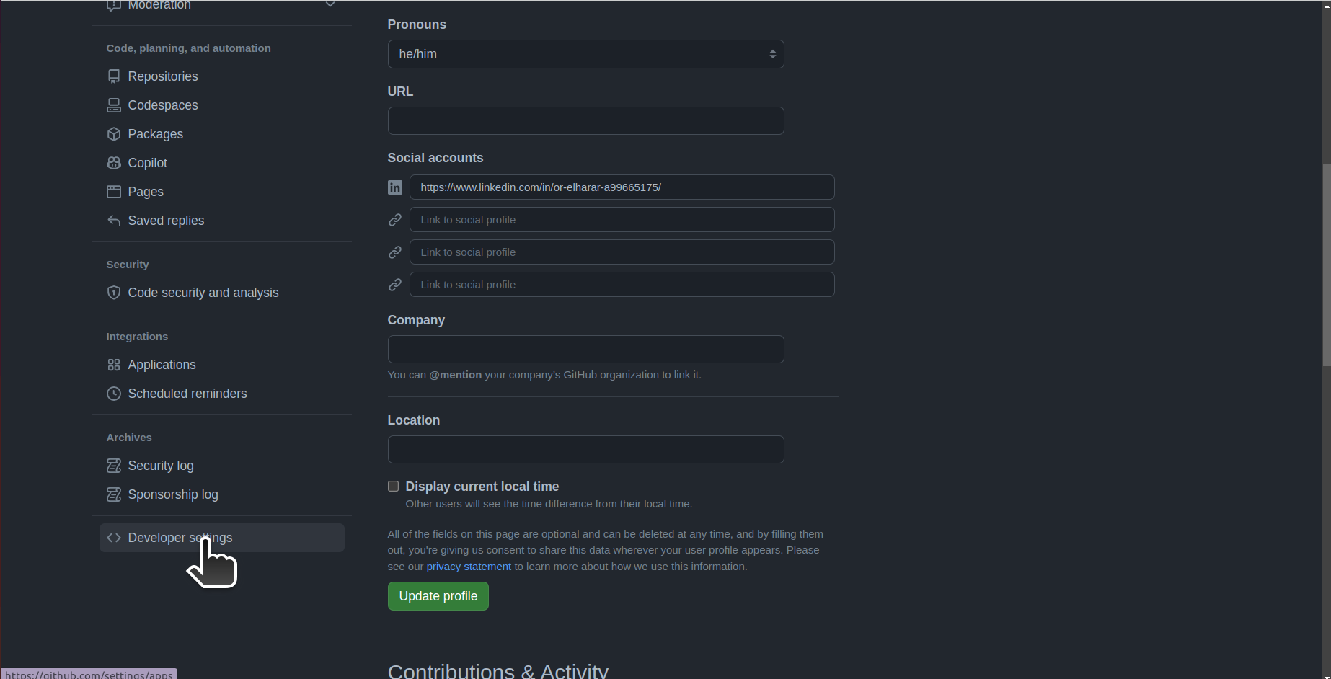
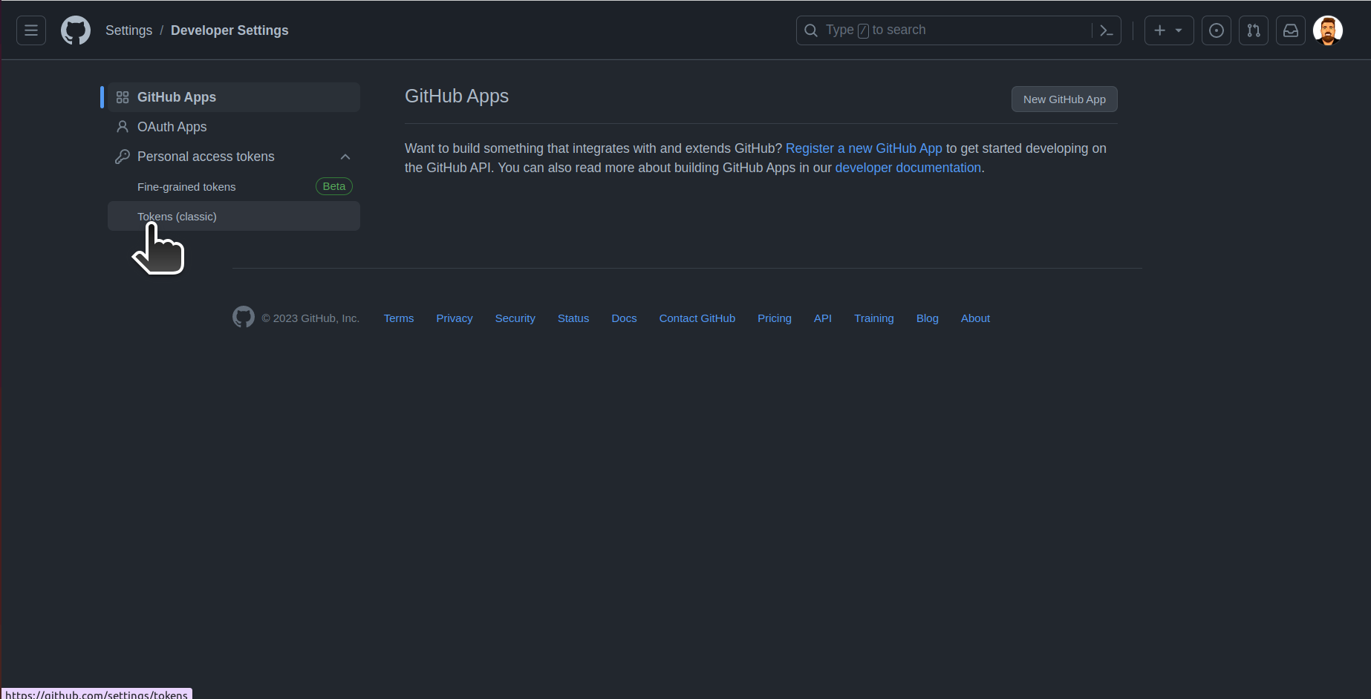

Slide 23
Viewing your workflow results
The provided GitHub Actions workflow is a demonstration that showcases various objects and features available in GitHub Actions. Let's go through the workflow and explain its key aspects, focusing on the GitHub-provided objects and the actions being used.
Workflow Triggering:
name: GitHub Actions Demo: Specifies the name of the workflow.
run-name: ${{ github.actor }} is testing out GitHub Actions 🚀: Sets the name of the workflow run to include the name of the actor (user or bot) who triggered the workflow, along with a message.
on: [push]: Triggers the workflow when a push event occurs in the repository.
Explore-GitHub-Actions Job:
runs-on: ubuntu-latest: Indicates that the job will run on an Ubuntu virtual machine provided by GitHub.
steps: The following steps are executed in sequence:
echo: Prints a message to the job's log. This step demonstrates how to use shell commands within an action.
Check out repository code: Utilizes the actions/checkout action to clone the repository's code onto the runner. This step allows subsequent steps to access and manipulate the repository's content.
echo: Prints additional messages, showcasing the availability of GitHub-provided context objects within the workflow. It displays the event name (github.event_name), runner's operating system (runner.os), the branch name (github.ref), and the repository name (github.repository).
List files in the repository: Executes a shell command (ls) to list the files in the repository's workspace directory (github.workspace).
echo: Prints the job's status (job.status), providing insight into the current state of the job.

Slide 24
Explanation and Importance:
GitHub Actions is a powerful automation platform that enables developers to build, test, and deploy software projects. This workflow demonstrates various capabilities and objects within GitHub Actions:
GitHub Context Objects: GitHub provides a rich set of context objects, such as github.actor, github.event_name, runner.os, github.ref, and github.repository. These objects store information about the event, the repository, the actor triggering the workflow, and more. Accessing these objects allows for dynamic and personalized workflows.
Actions/Checkout: The actions/checkout action is used to clone the repository's code onto the runner, providing access to the project's files and enabling further actions to interact with the codebase. This action simplifies the process of retrieving the repository content for subsequent steps.
Shell Commands: The workflow utilizes shell commands (e.g., echo, ls) to demonstrate the execution of arbitrary scripts on the runner. This flexibility allows developers to run custom commands, perform operations on files, execute tests, or deploy applications.
Logging and Job Status: The workflow demonstrates how to print messages to the job's log using the echo command. It also showcases accessing the current job's status (job.status), providing visibility into the workflow's progress and outcome.
Overall, this workflow serves as an introductory example, illustrating some fundamental features of GitHub Actions. It showcases the ability to leverage context objects, execute actions, manipulate repository code, and interact with the job's environment. Understanding these concepts and capabilities is crucial for building more complex and sophisticated workflows to automate various aspects of software development and deployment processes.

Slide 25
More starter workflows
GitHub provides preconfigured starter workflows that you can customize to create your own continuous integration workflow. GitHub analyzes your code and shows you CI starter workflows that might be useful for your repository. For example, if your repository contains Node.js code, you'll see suggestions for Node.js projects. You can use starter workflows as a starting place to build your custom workflow or use them as-is.
You can browse the full list of starter workflows in the actions/starter-workflows repository.
https://github.com/actions/starter-workflows

Slide 26
Push Event
name: GitHub Actions Demo
run-name: ${{ github.actor }} is testing out GitHub Actions 🚀
on: [push]
jobs:
Explore-GitHub-Actions:
runs-on: ubuntu-latest
steps:
- run: echo "🎉 The job was automatically triggered by a ${{ github.event_name }} event."
- run: echo "🐧 This job is now running on a ${{ runner.os }} server hosted by GitHub!"
- run: echo "🔎 The name of your branch is ${{ github.ref }} and your repository is ${{ github.repository }}."
- name: Check out repository code
uses: actions/checkout@v3
- run: echo "💡 The ${{ github.repository }} repository has been cloned to the runner."
- run: echo "🖥️ The workflow is now ready to test your code on the runner."
- name: List files in the repository
run: |
ls ${{ github.workspace }}
- run: echo "🍏 This job's status is ${{ job.status }}."

Slide 27
Explanation and Importance:
In the context of GitHub Actions, "actions" refer to reusable units of code that perform specific tasks within a workflow. Actions are individual tasks that you can combine to create custom workflows. They are stored in GitHub repositories and can be shared, reused, and extended by the GitHub community.
Actions can be used to automate various tasks such as building, testing, deploying, notifying, and more. They are typically written in JavaScript, TypeScript, or shell scripts, allowing for flexibility and versatility in what actions can accomplish. Each action is designed to be self-contained and focused on a specific purpose, which makes them easy to integrate and use within workflows. You can use pre-existing actions created by other developers or create your own custom actions to suit your specific workflow needs.
More actions can be found in the GitHub Marketplace - https://github.com/marketplace?type=actions
Now, let's delve into the specific actions/checkout@v3 action mentioned in the provided YAML file: The actions/checkout@v3 action is one of the official actions provided by GitHub. Its primary purpose is to fetch the contents of a specified repository, making it available for use in subsequent steps of the workflow. It clones the repository's code and files into the runner environment, allowing you to perform operations on the codebase during the workflow execution.
The @v3 part of the action name indicates the version of the action to use. GitHub Actions is versioned, and different versions might have variations or improvements in functionality. When the workflow executes the actions/checkout@v3 action, it ensures that the latest version of the repository's code is available to the rest of the workflow steps. This is crucial because actions in GitHub Actions operate in isolated environments, and without checking out the code, subsequent steps wouldn't have access to the repository's files.
The actions/checkout@v3 action is one of the most commonly used actions in GitHub Actions workflows, as it is a fundamental step to enable workflows to work with the repository's codebase effectively.
Overall, GitHub Actions, along with actions like actions/checkout@v3, provide a powerful and flexible automation platform for building CI/CD pipelines and automating various development and deployment tasks.

Slide 28
Multiple steps deployment
name: Deploy Project
on: [push, workflow_dispatch]
jobs:
test:
runs-on: ubuntu-latest
steps:
- name: Get repo code
uses: actions/checkout@v3
- name: Install NodeJS
uses: actions/setup-node@v3
with:
node-version: 18
- name: Install dependencies
run: npm ci
- name: Run tests
run: npm run test
deploy:
needs: test
runs-on: ubuntu-latest
steps:
- name: Get repo code
uses: actions/checkout@v3
- name: Install NodeJS
uses: actions/setup-node@v3
with:
node-version: 18
- name: Install dependencies
run: npm ci
- name: Build project
run: npm run build
- name: Deploy
run: "echo 'Deploying...'"

Slide 29
Next workflow explaination
Workflow Triggering:
on: [push, workflow_dispatch]: This workflow is triggered either on a code push to the repository or manually using the GitHub Actions UI.
Test Job:
  runs-on: ubuntu-latest: Specifies that the job will run on an Ubuntu virtual machine.
  steps: The following steps are executed in sequence:
  Get repo code: Checks out the repository code using the actions/checkout action.
  Install NodeJS: Sets up the required Node.js environment using the actions/setup-node action, with Node.js version 18.
  Install dependencies: Changes the directory to ./front-app-example and installs project dependencies using the npm ci command.
  Run tests: Changes the directory to ./front-app-example and executes tests using the npm run test command.
Deploy Job:
  needs: test: Specifies that the deploy job depends on the successful completion of the test job.
  runs-on: ubuntu-latest: Similar to the previous job, it runs on an Ubuntu virtual machine.
  steps: The following steps are executed in sequence:
  Get repo code: Checks out the repository code using the actions/checkout action.
  Install NodeJS: Sets up the required Node.js environment using the actions/setup-node action, with Node.js version 18.
  Install dependencies: Changes the directory to ./front-app-example and installs project dependencies using the npm ci command.
  Build project: Changes the directory to ./front-app-example and builds the project using the npm run build command.
  Deploy: Prints the message 'Deploying...'.

Slide 30
Step Relations
Step Relations:
needs: test: This line in the "deploy" job specifies that the "deploy" job depends on the successful completion of the "test" job. If the "test" job fails, the "deploy" job won't run. This ensures that code is only deployed if it passes the tests.
Optional Step Relations:
  Parallel Execution: In certain cases, you might have steps that can run independently of each other. To execute steps in parallel, you can create multiple jobs and define them under the jobs key. GitHub Actions willautomatically run them in parallel when resources are available.
  if Conditions: You can also conditionally execute steps based on specific conditions using the if keyword. This allows you to customize the workflow based on certain criteria, such as the branch being pushed or the type of event triggering the workflow.
These additional features give you the flexibility to create complex workflows that meet the specific requirements of your project deployment process.

Slide 31
Explanation and Importance:
This deployment workflow demonstrates a common pattern used in CI/CD pipelines. By separating the deployment into separate jobs, it allows for better organization, parallel execution, and clear dependencies between stages.
The test job is responsible for running tests on the project. It ensures that the code behaves as expected and passes predefined tests. Testing is crucial for maintaining code quality, catching bugs, and ensuring that new changes don't introduce regressions.
The deploy job, which depends on the success of the test job, handles the actual deployment process. It first checks out the repository code, sets up the necessary environment (Node.js), installs project dependencies, and builds the project. Finally, it prints the message 'Deploying...', which can be replaced with actual deployment commands.
The importance of having multiple steps in this deployment workflow lies in the ability to customize and extend the process as needed. Each step encapsulates a specific task, such as code checkout, dependency installation, testing, and building. This modular approach allows for fine-grained control, better troubleshooting, and the flexibility to add or modify steps based on project requirements.
By automating the deployment process with GitHub Actions, you can save time, improve consistency, and eliminate manual errors. Additionally, the visibility and traceability provided by the workflow ensure that the deployment process can be easily understood and reproduced, making it an essential tool for modern software development.

Slide 32
Another Demo
name: Events Demo 1
on:
pull_request:
types:
- opened
workflow_dispatch:
push:
branches:
- main
- 'dev-*' # Matches any branch that starts with 'dev-' up to the next '/' (e.g. dev-1, dev-2, dev-3, etc.)
- 'feature/**' # Matches any branch that starts with 'feature/' (e.g. feature/1, feature/2, feature/button/1, etc.)
paths-ignore:
- '.github/workflows/**'
jobs:
deploy:
runs-on: ubuntu-latest
steps:
- name: Output event details
run: echo "${{ toJson(github.event) }}"
- name: Get repo code
uses: actions/checkout@v3
- name: Install dependencies
run: npm ci
- name: Test
run: npm run test
- name: Build project
run: npm run build
- name: Deploy
run: echo "Deploying..."

Slide 33
Explanation and Importance:
The added factors in this workflow enhance event filtering and configurability, allowing for more precise control over when the workflow is triggered and which branches or paths are considered. Here's a breakdown of their significance:
Pull Request Event: The workflow is triggered only when a pull request is opened (pull_request: types: - opened). This enables automated processes to run specifically in response to pull request creation, such as code review checks or automated testing.
Manual Triggering: The workflow_dispatch event allows manual triggering of the workflow through the GitHub Actions UI. This feature provides flexibility for developers to trigger the workflow when desired, even outside of typical event-driven triggers.
Branch Filtering: The push: branches configuration filters push events based on branch names. This workflow is triggered for the main branch, branches starting with dev-, and branches starting with feature/. It enables targeted actions and deployments based on branch naming conventions commonly used in software development workflows.
Path Filtering: The push: paths-ignore configuration excludes changes made to the .github/workflows/** directory from triggering the workflow. This feature prevents triggering the workflow when changes are made to workflow files themselves, ensuring that the workflow remains focused on code changes rather than workflow modifications.
Outputting Event Details: The Output event details step prints the event details using the toJson(github.event) expression. This allows developers to inspect the triggered event's information, providing visibility into the context and data associated with the event.
These added factors showcase the flexibility of GitHub Actions in tailoring workflows to specific events, branches, and paths. By leveraging these features, developers can build powerful automation pipelines that respond to specific events, perform targeted actions, and ensure code quality and deployments are aligned with established development practices.

Slide 34
Lint
In coding, "lint" refers to the process of running a tool or program that analyzes source code to identify potential issues, errors, or violations of coding standards and best practices. The term "lint" originated from the Unix utility "lint," which was one of the first static code analysis tools used to detect bugs and programming errors in C code.
Modern programming languages have their own linting tools, and they are widely used by developers to ensure code quality and maintainability. Linting tools can catch various types of problems, such as syntax errors, unused variables, code style inconsistencies, and more, which helps developers write cleaner, more efficient, and bug-free code.

Slide 35
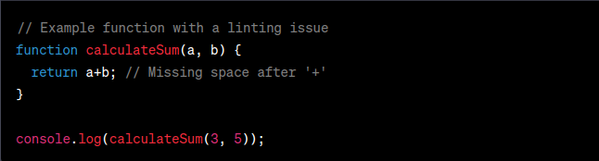
Lint
Example in JavaScript with ESLint:
Let's consider a simple JavaScript function that calculates the sum of two numbers and a small linting issue in the code:
In this example, there is a missing space after the + operator in the return statement. A linting tool like ESLint would detect this issue and flag it as a linting error or warning, indicating that the code should be improved for better readability and maintainability.

Slide 36
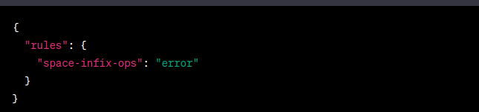
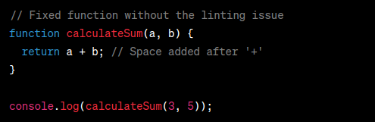
Lint
ESLint Configuration:
To use ESLint to lint the code and catch the missing space issue, you would need to have an ESLint configuration file (e.g., .eslintrc.json) in your project with appropriate rules. Here's a minimal ESLint configuration for our example:
In this example, there is a missing space after the + operator in the return statement. A linting tool like ESLint would detect this issue and flag it as a linting error or warning, indicating that the code should be improved for better readability and maintainability.

Slide 37
Cashe
name: Website Deployment
on:
push:
branches:
- main
jobs:
lint:
runs-on: ubuntu-latest
steps:
- name: Get code
uses: actions/checkout@v3
- name: Cache dependencies
id: cache
uses: actions/cache@v3
with:
path: ./node_modules
key: deps-node-modules-${{ hashFiles('**/package-lock.json') }}
- name: Install dependencies
if: steps.cache.outputs.cache-hit != 'true'
run: npm ci
- name: Lint code
run: npm run lint
test:
runs-on: ubuntu-latest
steps:
- name: Get code
uses: actions/checkout@v3
- name: Cache dependencies
id: cache
uses: actions/cache@v3
with:
path: ./node_modules
key: deps-node-modules-${{ hashFiles('**/package-lock.json') }}
- name: Install dependencies
if: steps.cache.outputs.cache-hit != 'true'
run: npm ci
- name: Test code
id: run-tests
run: npm run test
- name: Upload test report
if: failure() && steps.run-tests.outcome == 'failure'
uses: actions/upload-artifact@v3
with:
name: test-report
path: ./test.json
build:
needs: test
runs-on: ubuntu-latest
steps:
- name: Get code
uses: actions/checkout@v3
- name: Cache dependencies
id: cache
uses: actions/cache@v3
with:
path: ./node_modules
key: deps-node-modules-${{ hashFiles('**/package-lock.json') }}
- name: Install dependencies
if: steps.cache.outputs.cache-hit != 'true'
run: npm ci
- name: Build website
id: build-website
run: npm run build
- name: Upload artifacts
uses: actions/upload-artifact@v3
with:
name: dist-files
path: ./dist
deploy:
needs: build
runs-on: ubuntu-latest
steps:
- name: Get build artifacts
uses: actions/download-artifact@v3
with:
name: dist-files
- name: Output contents
run: ls
- name: Deploy
run: echo "Deploying..."
report:
needs: [lint, deploy]
if: failure()
runs-on: ubuntu-latest
steps:
- name: Output Information
run: |
echo "Something went wrong"
echo "{{ github }}"

Slide 38
Explanation and Importance:
The provided GitHub Actions deployment workflow demonstrates artifact upload and download, job outputs, and dependency caching. Let's go through the workflow and explain the important elements, utilizing the comments to provide a clearer understanding.
Cash dependencies: Uses dependency caching to store and restore Node.js dependencies from the ~/.npm directory. The caching is based on the package-lock.json file's content hash to ensure dependencies are restored only if they have not changed.
Build Job: This job depends on the successful completion of the test job and runs on an Ubuntu virtual machine. It includes the following steps:
  Get code: Checks out the repository code using the actions/checkout action.
  Cash dependencies: Uses dependency caching to restore Node.js dependencies.
  Install dependencies: Installs project dependencies using the npm ci command.
  Build website: Builds the website using the npm run build command.
  Publish JS filename: Searches for JavaScript files in the section-5-demo/dist/assets/ directory and sets the output script-filename to one of the discovered file names. This output can be used in subsequent jobs.
  Upload artifacts: Uploads the contents of the section-5-demo/dist directory as an artifact named dist-files.

Slide 39
Explanation and Importance:
Artifact Upload and Download: The workflow uses artifact upload (actions/upload-artifact) in the build job and artifact download (actions/download-artifact) in the deploy job. Artifacts allow passing data between jobs, persisting data after a workflow run, and transferring build outputs for deployment or further processing.
Job Outputs: The build job defines an output called script-filename, which is set during the execution of the Publish JS filename step. This output can be accessed in the deploy job using the ${{ needs.build.outputs.script-filename }} syntax. Job outputs enable sharing data between jobs within a workflow.
Dependency Caching: The Cash dependencies step in both the test and build jobs utilizes the actions/cache action. It caches the ~/.npm directory, where Node.js dependencies are typically stored. Caching dependencies helps reduce the setup time by restoring previously cached dependencies, resulting in faster workflow execution.
By incorporating artifact handling, job outputs, and dependency caching, this workflow demonstrates a more advanced deployment scenario. It enables the building and testing of the project, caching dependencies to improve performance, passing build outputs between jobs using artifacts and outputs, and finally deploying the project based on the generated artifacts and job outputs. These features contribute to a more efficient and streamlined CI/CD pipeline using GitHub Actions.

Slide 40
~/.npm in details
The ~/.npm directory is a specific directory path used by Node.js and npm (Node Package Manager) to store globally installed npm packages and other related data. Let's explore the ~/.npm directory in more detail:
Location:
  ~/.npm is an abbreviation for the user's home directory (~), followed by the .npm directory.
  On Unix-like systems (e.g., Linux, macOS), the ~/.npm directory is typically located at /home/username/.npm or /Users/username/.npm, where username represents the user's login name.
  On Windows, the ~/.npm directory is typically located at C:\Users\username\.npm, where username is the user's login name.
Purpose:
  The ~/.npm directory serves as a storage location for globally installed npm packages.
  When npm packages are installed globally using the -g or --global flag, they are placed in the ~/.npm directory.
  Global packages are accessible across all projects and can be used as command-line tools.
  Additionally, the ~/.npm directory stores other data, such as configuration files and package metadata.
Caching Dependencies:
  In the context of the GitHub Actions workflow provided, the ~/.npm directory is used for caching Node.js dependencies.
  Dependency caching helps improve workflow execution time by storing and restoring dependencies between workflow runs.
  The actions/cache action is employed to cache the ~/.npm directory, allowing the restoration of previously installed dependencies if they haven't changed since the last workflow run.
  By caching dependencies, the workflow avoids reinstalling the same dependencies, reducing the overall setup time.
Usage Considerations:
  The ~/.npm directory is automatically created when globally installing npm packages for the first time.
  It is generally recommended to avoid modifying or deleting the contents of the ~/.npm directory manually.
  When encountering issues related to globally installed packages or npm configuration, it can be helpful to clear the ~/.npm cache using the npm cache clean command.
  If you experience issues with dependency caching in GitHub Actions, it may be necessary to adjust the caching configuration or use more fine-grained caching options, depending on your specific workflow requirements.
Overall, the ~/.npm directory plays a vital role in managing globally installed npm packages and caching dependencies. By leveraging this directory, Node.js developers can easily access and utilize globally installed packages across their projects, while dependency caching helps optimize workflow execution time by reusing previously installed dependencies.

Slide 41
hashFiles( )
"hashFiles" is a function provided by GitHub Actions that generates a unique hash based on the contents of the specified files. It is typically used to create a cache key when caching dependencies in a workflow.
When you build a project, you often have dependencies (e.g., libraries, packages) that are specified in a file like package-lock.json or yarn.lock. These files contain information about the exact versions of thedependencies used in your project.
Caching these dependencies can significantly speed up subsequent workflow runs. However, you need a way to determine if the dependencies have changed since the last run, so you know whether to use the cached version or reinstall the dependencies.

Slide 42
Another Demo
name: Demo 6 - Using secrets
on: push
env:
EXAMPLE: ${{ secrets.EXAMPLE }}
jobs:
first-job:
runs-on: ubuntu-latest
steps:
- name: Print the secret
run: echo "Using secrets - example - ${{ secrets.EXAMPLE }}"

Slide 43
Explanation and Importance:
This workflow demonstrates the use of environment variables and secrets, along with environments, in GitHub Actions:
The output "echo "Using secrets - example - ***"" is expected behavior when printing the secret value in a GitHub Actions workflow.
When using secrets in GitHub Actions, the secret values are automatically masked in the workflow output to prevent accidental exposure of sensitive information. This masking is done by replacing the actual secret value with *** when printing it in the workflow logs, as seen in your example.
Even though you might have set the environment variable EXAMPLE to a specific value using the secret, when you echoor print it in the workflow, you'll only see ***, indicating that the actual value is masked and not visible in the workflow logs.
This masking mechanism ensures that secrets are not inadvertently exposed and helps maintain a secure environment in GitHub Actions workflows. Remember that secrets are intended to be used within the workflow's logic and are not displayed in plain text in the workflow logs or to users without the appropriate access privileges.
By leveraging environment variables, secrets, and environments, this workflow demonstrates secure and configurable workflows in GitHub Actions. It allows for the secure usage of sensitive data, customization of workflows based on environments, and optimization of workflow execution by caching dependencies. These features contribute to building reliable and efficient CI/CD pipelines with improved security and flexibility.

Slide 44
Another Demo
name: Website Deployment
on:
push:
branches:
- main
jobs:
lint:
runs-on: ubuntu-latest
steps:
- name: Get code
uses: actions/checkout@v3
- name: Cache dependencies
id: cache
uses: actions/cache@v3
with:
path: ./section-7-demo/node_modules
key: deps-node-modules-${{ hashFiles('**/package-lock.json') }}
- name: Install dependencies
if: steps.cache.outputs.cache-hit != 'true'
run: cd section-7-demo && npm ci
- name: Lint code
run: cd section-7-demo && npm run lint
test:
runs-on: ubuntu-latest
steps:
- name: Get code
uses: actions/checkout@v3
- name: Cache dependencies
id: cache
uses: actions/cache@v3
with:
path: ./section-7-demo/node_modules
key: deps-node-modules-${{ hashFiles('**/package-lock.json') }}
- name: Install dependencies
if: steps.cache.outputs.cache-hit != 'true'
run: cd section-7-demo && npm ci
- name: Test code
# continue-on-error: true
id: run-tests
run: cd ./section-7-demo && npm run test
- name: Upload test report
if: failure() && steps.run-tests.outcome == 'failure'
uses: actions/upload-artifact@v3
with:
name: test-report
path: ./section-7-demo/test.json
build:
needs: test
runs-on: ubuntu-latest
steps:
- name: Get code
uses: actions/checkout@v3
- name: Cache dependencies
id: cache
uses: actions/cache@v3
with:
path: ./section-7-demo/node_modules
key: deps-node-modules-${{ hashFiles('**/package-lock.json') }}
- name: Install dependencies
if: steps.cache.outputs.cache-hit != 'true'
run: cd section-7-demo && npm ci
- name: Build website
id: build-website
run: cd ./section-7-demo && npm run build
- name: Upload artifacts
uses: actions/upload-artifact@v3
with:
name: dist-files
path: ./section-7-demo/dist
deploy:
needs: build
runs-on: ubuntu-latest
steps:
- name: Get build artifacts
uses: actions/download-artifact@v3
with:
name: dist-files
- name: Output contents
run: cd section-7-demo && ls
- name: Deploy
run: echo "Deploying..."
report:
needs: [lint, deploy]
if: failure()
runs-on: ubuntu-latest
steps:
- name: Output Information
run: |
echo "Something went wrong"
echo "{{ github }}"

Slide 45
Explanation and Importance:
The provided workflow demonstrates the control of workflow and job execution using conditional statements (if statements) and various functions:
Conditional Statements: The if statement is used in certain steps to conditionally execute them based on the result of a conditional expression. Conditional statements allow fine-grained control over the execution flow of the workflow, enabling specific actions or steps to run based on conditions.
Special Conditional Functions:
failure(): Returns true when any previous step has failed. It can be used to conditionally execute steps or jobs if any prior step has failed.
success(): Returns true if none of the previous steps have failed. It can be used to conditionally execute steps or jobs when all prior steps have succeeded.
always(): Always returns true, enabling the associated step or job to run unconditionally.
cancelled(): Returns true if the workflow or job was cancelled.

Slide 46
Possible Use Cases:
Conditional Installation of Dependencies: In the test, lint, and build jobs, the Install dependencies step uses the conditional statement if: steps.cache.outputs.cache-hit != 'true' to install dependencies only if the cache was not hit. This optimizes workflow execution by avoiding unnecessary installation of dependencies when they are already cached, resulting in faster workflow runs.
Uploading Test Report on Failure: In the test job, the Upload test report step uses the conditional statement if: failure() && steps.run-tests.outcome == 'failure' to conditionally upload the test report artifact only if the tests fail. This allows for capturing and analyzing test results specifically when there are failures.
Conditional Execution of Report Job: The report job uses the conditional statement if: failure() to run only when there is a failure in any previous step or job. This job outputs information and performs additional steps specifically when there are failures, allowing for custom actions or notifications based on failure conditions.
By leveraging conditional statements and special conditional functions, this workflow provides flexibility in controlling the execution flow of the workflow, enabling condition-based actions, and allowing for targeted handling of failures. These features contribute to building resilient and adaptable workflows that respond to specific conditions and perform actions accordingly.

Slide 47
Another Demo
name: Matrix Demo
on: push
jobs:
build:
strategy:
matrix:
node-version: [14, 16, 18]
os: [ubuntu-latest, windows-latest, macos-latest]
include:
- node-version: 14
os: ubuntu-latest
exclude:
- node-version: 18
os: windows-latest
runs-on: ubuntu-latest
steps:
- name: Get Code
uses: actions/checkout@v3
- name: Install NodeJS
uses: actions/setup-node@v3
with:
node-version: ${{ matrix.node-version }}
- name: Install dependencies
run: cd ./section-7-matrix && npm ci
- name: Build project
run: cd ./section-7-matrix && npm run build

Slide 48
Explanation and Importance:
The matrix feature in GitHub Actions allows for the execution of a job with different configurations. It provides a convenient way to run the same job multiple times, each time using different values for specified variables. Here are some key points:
Multiple Configurations: The matrix feature allows you to define multiple configurations for a job by specifying different values for the defined variables (node-version and os in this example). This is useful when you want to test or build your project across various combinations of variables.
Include and Exclude: The include and exclude sections within the matrix provide further control over which configurations are included or excluded from the execution. You can specify specific configurations to include or exclude based on certain conditions or requirements.
Parallel Execution: With the matrix feature, the defined job steps are executed in parallel for each configuration, enabling efficient utilization of resources and faster overall execution.
Variable Substitution: Within the job steps, you can access the values of the matrix variables using the ${{ matrix.variable-name }} syntax. This allows you to dynamically set up the job environment or perform actions based on the specific matrix configuration.
The matrix feature is particularly useful when you need to test or build your project on different operating systems, versions of software, or other variable configurations. It provides a concise and scalable way to define and execute jobs with varying configurations, reducing duplication and simplifying workflow maintenance.

Slide 49
Another Demo
name: Reusable Deploy
on:
workflow_call:
inputs:
artificat-name:
description: 'Name of artifact to download'
required: false
default: 'dist-files'
type: string
jobs:
deploy:
runs-on: ubuntu-latest
steps:
- name: Get repo code
uses: actions/download-artifact@v3
with:
name: $${{ inputs.artifact-name }}
- name: Output info
run: echo "Deploying & Uploading..."

Slide 50
Explanation and Importance:
The provided workflow serves as a reusable deploy workflow template that can be called by other workflows. Here's a breakdown of its significance:
Workflow Reusability: By defining a workflow as reusable, it can be used as a template by other workflows. Other workflows can call this reusable deploy workflow using the workflow_call event, providing inputs and executing the defined steps.
Input Variables: The inputs section allows for defining input variables that can be provided when calling the workflow. In this case, the artifact-name input allows specifying the name of the artifact to download. The provided default value ensures that if the input is not explicitly provided, it defaults to 'dist-files'.
Download Artifact: The step Get repo code uses the actions/download-artifact action to download an artifact. The name of the artifact is specified using the value of inputs.artifact-name. This step allows for retrieving the specified artifact, which can be used for further processing or deployment tasks.
Customizable Deployment Steps: The deploy job can be customized with additional steps as needed for the deployment process. Developers can add steps for building, deploying to servers, or executing other deployment-specific actions based on their requirements.
Workflow Outputs: Although not present in the provided workflow, a reusable workflow can also define outputs that can be used by the calling workflow. Outputs can be used to pass information or artifacts back to the calling workflow for further processing or downstream actions.
By creating a reusable deploy workflow, developers can maintain a standardized deployment process that can be easily reused across multiple workflows, reducing duplication and ensuring consistency. It promotes modularity and reusability, simplifying workflow maintenance and making it easier to update and enhance deployment logic.

Slide 51
Another Demo
name: Use Reusable Workflow
on:
push:
branches:
- main
jobs:
lint:
runs-on: ubuntu-latest
steps:
- name: Get code
uses: actions/checkout@v3
- name: Cache dependencies
id: cache
uses: actions/cache@v3
with:
path: ./section-7-demo/node_modules
key: deps-node-modules-${{ hashFiles('**/package-lock.json') }}
- name: Install dependencies
if: steps.cache.outputs.cache-hit != 'true'
run: cd section-7-demo && npm ci
- name: Lint code
run: cd section-7-demo && npm run lint
test:
runs-on: ubuntu-latest
steps:
- name: Get code
uses: actions/checkout@v3
- name: Cache dependencies
id: cache
uses: actions/cache@v3
with:
path: ./section-7-demo/node_modules
key: deps-node-modules-${{ hashFiles('**/package-lock.json') }}
- name: Install dependencies
if: steps.cache.outputs.cache-hit != 'true'
run: cd section-7-demo && npm ci
- name: Test code
# continue-on-error: true
id: run-tests
run: cd ./section-7-demo && npm run test
- name: Upload test report
if: failure() && steps.run-tests.outcome == 'failure'
uses: actions/upload-artifact@v3
with:
name: test-report
path: ./section-7-demo/test.json
build:
needs: test
runs-on: ubuntu-latest
steps:
- name: Get code
uses: actions/checkout@v3
- name: Cache dependencies
id: cache
uses: actions/cache@v3
with:
path: ./section-7-demo/node_modules
key: deps-node-modules-${{ hashFiles('**/package-lock.json') }}
- name: Install dependencies
if: steps.cache.outputs.cache-hit != 'true'
run: cd section-7-demo && npm ci
- name: Build website
id: build-website
run: cd ./section-7-demo && npm run build
- name: Upload artifacts
uses: actions/upload-artifact@v3
with:
name: dist-files
path: ./section-7-demo/dist
deploy:
needs: build
uses: ./section-7-demo/.github/workflows/section-7-reusable_workflow.yml
report:
needs: [lint, deploy]
if: failure()
runs-on: ubuntu-latest
steps:
- name: Output Information
run: |
echo "Something went wrong"
echo "{{ github }}"

Slide 52
Explanation and Importance:
The provided workflow demonstrates the usage of a reusable workflow within a larger workflow. Here are the key points:
Workflow Composition: The deploy job references a reusable workflow located at ./section-7-demo/.github/workflows/section-7-reusable_workflow.yml. This allows incorporating the steps defined in the reusable workflow into the current workflow, providing a modular and reusable approach to workflow composition.
Conditional Execution of Report Job: The report job uses the conditional statement if: failure() to run only when there is a failure in any previous step or job. This allows for capturing and handling failures in a specific manner, such as generating custom reports or performing additional actions in response to failures.
Workflow Dependencies: The deploy job has a dependency on the build job (needs: build), ensuring that the build job is successfully completed before starting the deploy job. Similarly, the report job depends on both the lint and deploy jobs. These dependencies help establish a sequential workflow execution order.
Parallel Job Execution: Jobs such as lint, test, build, and report can run in parallel as their dependencies are satisfied. This enables efficient resource utilization and faster overall workflow execution.
By utilizing reusable workflows and establishing dependencies between jobs, this workflow structure promotes modularity, code reusability, and efficient execution. It allows for composition of complex workflows by referencing reusable components, enhances error handling through conditional execution, and maintains a clear workflow structure by specifying dependencies among jobs.

Slide 53
Another Demo
name: Section 8 - Deployment (Container)
on:
push:
branches:
- main
- dev
env:
CACHE_KEY: node-deps
MONGODB_DB_NAME: gha-demo
jobs:
test:
environment: testing
runs-on: ubuntu-latest
container:
image: node:16
env:
MONGODB_CONNECTION_PROTOCOL: mongodb
MONGODB_CLUSTER_ADDRESS: mongodb
# If not using container:
# MONGODB_CLUSTER_ADDRESS: 127.0.0.1:27017
MONGODB_USERNAME: root
MONGODB_PASSWORD: example
PORT: 8080
services:
mongodb:
image: mongo
# ports:
# - 27017:27017
env:
MONGO_INITDB_DATABASE: test-db
MONGO_INITDB_ROOT_USERNAME: root
MONGO_INITDB_ROOT_PASSWORD: example
steps:
- name: Get Code
uses: actions/checkout@v3
- name: Cache dependencies
uses: actions/cache@v3
with:
path: ~/.npm
key: ${{ env.CACHE_KEY }}-${{ hashFiles('**/package-lock.json') }}
- name: Install dependencies
run: cd section-8-demo && npm ci
- name: Run server
run: cd section-8-demo && npm start & npx wait-on http://127.0.0.1:$PORT # requires MongoDB Atlas to accept requests from anywhere!
- name: Run tests
run: cd section-8-demo && npm test
- name: Output information
run: |
echo "MONGODB_USERNAME: $MONGODB_USERNAME"
deploy:
needs: test
runs-on: ubuntu-latest
steps:
- name: Output information
env:
PORT: 3000
run: |
echo "MONGODB_DB_NAME: $MONGODB_DB_NAME"
echo "MONGODB_USERNAME: $MONGODB_USERNAME"
echo "${{ env.PORT }}"

Slide 54
Explanation and Importance:
The provided workflow focuses on deploying a containerized application with environment variables and service containers. Here's a summary of the key aspects:
Containerized Testing: The test job is executed within a container based on the node:16 Docker image. This ensures consistency in the execution environment and allows for easy management of dependencies.
Environment Variables: The workflow leverages environment variables to configure the application and enable interaction with MongoDB. The variables are set in both the test and deploy jobs, providing flexibility and consistency in configuration across different stages.
Service Containers: The workflow utilizes a service container named mongodb running the mongo image. This allows the application to interact with a MongoDB instance during testing, providing a dedicated environment for database-related operations.
Dependency Caching: The actions/cache action caches the ~/.npm directory, optimizing workflow execution time by restoring dependencies from the cache if no changes are detected in the package-lock.json file.
Parallel Job Execution: The test and deploy jobs can run in parallel, as the deploy job depends on the successful completion of the test job (needs: test). This allows for efficient resource utilization and faster workflow execution.
By employing containerization, environment variables, service containers, and caching, the workflow provides a streamlined and reliable deployment process for containerized applications. It ensures consistent execution environments, simplifies configuration management, facilitates database interactions, and optimizes dependency resolution for improved workflow performance.

Slide 55
Another Demo
name: Section 9 Deployment - Custom Actions
on:
push:
branches:
- main
jobs:
lint:
runs-on: ubuntu-latest
steps:
- name: Get code
uses: actions/checkout@v3
- name: Load & cache dependencies
id: cache-deps
uses: ./.github/actions/cached-deps
# For manipulate the action input, use the following syntax:
# with:
# should-cache: 'false'
- name: Output information
run: echo "Cache used? ${{ steps.cache-deps.outputs.used-cache }}"
- name: Lint code
run: cd section-9-demo && npm run lint
test:
runs-on: ubuntu-latest
steps:
- name: Get code
uses: actions/checkout@v3
- name: Load & cache dependencies
uses: ./.github/actions/cached-deps
- name: Test code
id: run-tests
run: cd section-9-demo && npm run test
- name: Upload test report
if: failure() && steps.run-tests.outcome == 'failure'
uses: actions/upload-artifact@v3
with:
name: test-report
path: test.json
build:
needs: test
runs-on: ubuntu-latest
steps:
- name: Get code
uses: actions/checkout@v3
- name: Load & cache dependencies
uses: ./.github/actions/cached-deps
- name: Build website
run: cd section-9-demo && npm run build
- name: Upload artifacts
uses: actions/upload-artifact@v3
with:
name: dist-files
path: ./section-9-demo/dist
deploy:
permissions:
id-token: write
contents: read
environment: testing
needs: build
runs-on: ubuntu-latest
steps:
- name: Get code
uses: actions/checkout@v3
- name: Get build artifacts
uses: actions/download-artifact@v3
with:
name: dist-files
path: ./section-9-demo/dist
- name: Output contents
run: ls
# - name: Get AWS permissions
# uses: aws-actions/configure-aws-credentials@v1
# with:
# roles-to-assume: ${{ secrets.AWS_ROLE_ARN }}
# aws-region: us-east-1
- name: Deploy site
id: deploy
uses: ./.github/actions/deploy-s3-docker
env:
AWS_ACCESS_KEY_ID: ${{ secrets.AWS_ACCESS_KEY_ID }}
AWS_SECRET_ACCESS_KEY: ${{ secrets.AWS_SECRET_ACCESS_KEY }}
with:
bucket: hyperactive-github-action-demo
region: us-east-1
dist-folder: ./section-9-demo/dist
- name: Output website URL
run: echo "Website URL - ${{ steps.deploy.outputs.website-url }}"

Slide 56
Explanation and Importance:
The workflow focuses on the deployment process using custom actions. Here are the key aspects:
Custom Actions: Custom actions are used to encapsulate complex logic and facilitate reusability across workflows. In this workflow, custom actions named cached-deps and deploy-s3-docker are utilized.
Code Linting, Testing, and Building: The workflow includes separate jobs for linting, testing, and building the website. Each job performs the necessary steps, including code checkout, dependency loading and caching, and executing specific commands.
Dependency Caching: The custom action cached-deps is responsible for loading and caching dependencies. This helps improve workflow execution time by restoring dependencies from the cache if no changes are detected.
Deployment with Custom Action: The deployment job utilizes the custom action deploy-s3-docker to deploy the website to an S3 bucket. It requires AWS access credentials passed as environment variables.
By utilizing custom actions, the workflow simplifies complex processes, promotes code reuse, and enhances the overall deployment experience. Custom actions allow for encapsulating logic in reusable components and sharing them across workflows and repositories.

Slide 57
Another Demo
name: Label Issues (Permissions Example)
on:
issues:
types:
- opened
jobs:
assign-label:
permissions:
issues: write
runs-on: ubuntu-latest
steps:
- name: Assign label
if: contains(github.event.issue.title, 'bug')
run: |
curl -X POST \
--url https://api.github.com/repos/${{ github.repository }}/issues/${{ github.event.issue.number }}/labels \
-H 'authorization: Bearer ${{ secrets.GITHUB_TOKEN }}' \
-H 'content-type: application/json' \
-d '{
"labels": ["bug"]
}' \
--fail

Slide 58
Explanation and Importance:
This workflow demonstrates the use of a custom action to assign a label to newly opened issues. The important aspects are:
Custom Action: The workflow uses a custom action in the form of a cURL command to interact with the GitHub REST API and perform the label assignment.
Permissions: The permissions block is used to specify the required permissions for the job. In this case, the issues permission is set to write to enable the action to modify issue labels. Controlling permissions at the job level adds an extra layer of security by limiting access to specific actions.
GitHub Token: The cURL command includes the secrets.GITHUB_TOKEN token in the authorization header. This token allows the action to authenticate and perform actions on behalf of the workflow within the scope of the repository. It is a secure way to authenticate and authorize actions without exposing sensitive credentials.
By utilizing custom actions and setting appropriate permissions, the workflow demonstrates how to automate tasks in response to specific events, in this case, labeling newly opened issues. The proper configuration of permissions ensures controlled access and protects sensitive repository resources.

Slide 59
Another Demo
name: Label Issues (Script Injection Example)
on:
issues:
types:
- opened
jobs:
assign-label:
runs-on: ubuntu-latest
steps:
- name: Assign label
run: |
issue_title="${{ github.event.issue.title }}"
if [[ "$issue_title" == *"bug"* ]]; then
echo "Issue is about a bug!"
else
echo "Issue is not about a bug"
fi

Slide 60
Integrating GitHub Actions with Other Tools
GitHub Actions can be integrated with a wide range of other tools and services, such as Docker, Jenkins, and Slack. This allows you to create a complete CI/CD pipeline that can automate all aspects of your software development process.
For example, you can use GitHub Actions to build and deploy your code to Docker containers, and then use Jenkins to run automated tests on those containers. You can also use Slack to notify your team when a new build is available.

Slide 61
Troubleshooting GitHub Actions
If you encounter any problems with your GitHub Actions workflows, there are a few troubleshooting steps that you can take. First, make sure that your workflows are properly configured. You can also check the logs to see if there are any errors. If you are still having problems, you can ask for help on the GitHub Actions community forum.

Slide 62
Best practices for GitHub Actions
There are a few best practices that you can follow when creating your GitHub Actions workflows. These include using clear and concise names for your workflows, using descriptive steps, and using variables to make your workflows more reusable.

Slide 63
Securing your GitHub Actions workflows
GitHub Actions workflows can be secured by using secrets. Secrets are encrypted values that are stored in GitHub and can only be accessed by your workflows. This allows you to store sensitive information, such as API keys, in a secure location.

Slide 64
Keys Explanation in deployment.yml File
name: The name of the workflow. This is used to identify the workflow in the GitHub Actions UI.
on: The events that trigger the workflow. In this case, the workflow is triggered when a push is made to the main branch.
jobs: The list of jobs that the workflow will run. Each job has a name, a set of steps, and a set of conditions that determine when the job should run.
steps: The list of steps that the job will run. Each step has a name, a command, and a set of inputs and outputs.
uses: The name of the action that the step will use. In this case, the actions/checkout@v3 action is used to check out the code from the repository.

Slide 65
Keys Explanation in deployment.yml File
id: The name of the step output. This can be used to reference the output in other steps.
with: The list of inputs that the action will use. In this case, the should-cache input is used to determine if the action should cache the dependencies.
run: The command that the step will run. In this case, the npm run lint command is used to lint the code.
if: A condition that determines if the step should run. In this case, the step will only run if the previous step failed and the outcome of the previous step was failure.
name: The name of the artifact that the step will upload. In this case, the test-report artifact will be uploaded.
path: The path to the file that the artifact contains. In this case, the test.json file will be uploaded.
permissions: The permissions that the job needs to run. In this case, the job needs to be able to write to the id-token and contents scopes.

Slide 66
Keys Explanation in deployment.yml File
environment: The environment that the job will run in. In this case, the job will run in the testing environment.
needs: The list of jobs that the job depends on. In this case, the deploy job depends on the build job.
env: The environment variables that the job will use. In this case, the AWS_ACCESS_KEY_ID and AWS_SECRET_ACCESS_KEY environment variables are used to authenticate with AWS.
with: The list of inputs that the action will use. In this case, the bucket, region, and dist-folder inputs are used to deploy the site to S3.
outputs: The list of outputs that the action will produce. In this case, the website-url output is produced.

Slide 67
Additional notes about the .yml file
The uses keyword is used to reference a custom action. Custom actions are actions that you create yourself. They can be written in any language and can be run in a container.
The with keyword is used to pass input parameters to a custom action.
The outputs keyword is used to define the outputs of a custom action.
The secrets keyword is used to store sensitive information, such as AWS access keys.
The id-token scope allows the job to access the authenticated user's ID token.
The contents scope allows the job to read and write files in the repository.
The testing environment is a pre-configured environment that is used for testing.
The OIDC (OpenID Connect) standard can be used to authenticate with AWS. This allows you to use an identity provider (IdP) to authenticate with AWS instead of using secrets.

