Slide 1
Target
Potential Lead
Lead
Non Lead
Acquired Non Lead

Slide 2
a
b
a
b
a
a
b
T
T
T
T
c
c
c
(1)
(2)
(3)
(4)
d
e
e
e
Target
a
a
a
Lead
b
b
b
Potential Lead
T
T
T
Non Lead
c
c
c
Acquired Non Lead
(5)
(6)
d
(7)
d
d

Slide 3
a
b
a
b
a
a
b
T
T
T
T
c
c
c
(1)
(2)
(3)
(4)
d
Target
Lead
Potential Lead
Non Lead

Slide 4
Basic Framework Process- FIFO
a
c
a
c
a
c
a
T
T
T
T
b
b
b
(1)
(2)
d
(3)
(4)

Slide 5
Basic Framework Process- CC
L1
L2
L3
L4
P1
P2
NL2
NL3
L4

Slide 6
Basic Framework Process- FM
T
L3
L2
L1
P2
NL1
P1

Slide 7
Basic Framework Process- new KD& promise
L1
L2
L3
L4
P1
P2
NL2
NL3
L4

Slide 8
Basic Framework Process- new KD& promise
L1
L2
L3
L4
L5
P1
P2
NL1
NL2
NL3

Slide 9
New promising
L1
L2
L3
L4
L5
L6
P1
L7
NL1
NL2
P2
NL3
NL4
L8

Slide 10
FM
T
L1
L2
P1
ANL1
P2

Slide 11
L1
L2
L3
L4
P1
P2
L4
NL2
NL3

Slide 12
TEMPLATE
L1
ANL1
ANL2
L2
L3
L4
NL1
P1
P2

Slide 13
FIFONL
L1
ANL1
ANL2
L2
L3
L4
NL1
P1
P2
Notes:
NL1
P1
P2

Slide 14
BASIC
a
b
c
d
e
f
g
h
i
j
k
l
m
n

Slide 15
Promisenl
ANL1
L1
L2
L3
P1
NL1
NL2
NL3
L4

Slide 16



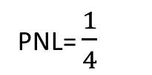
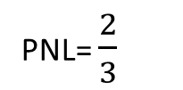
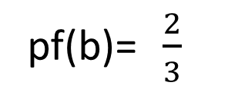
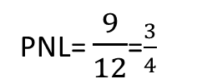
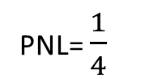
pf(b)= $\frac{2}{3}$
Lead
P1
NL2
NL3
NL1
Lead
Lead
PNL= $\frac{1}{4}$
Lead
PNL= $\frac{2}{3}$
PNL= $\frac{1}{4}$
PNL= $\frac{9}{12}$=$\frac{3}{4}$

