Slide 1
Week 1: Introduction to Data Engineering

Slide 2
Course Logistics
2 weekly hours
15% assignments
85% final exam
or.perets@shenkar.ac.il

Slide 3
Prerequisites
SQL query design and implementation
Basic data structures
Complexity and running-time intuition
Probability

Slide 4
Learning Outcomes
Core data engineering constraints
Design a basic source-to-consumer pipeline
Data engineer skills: DWH design, maintenance, ETL
Storage and performance optimization

Slide 5

What Is Big Data?
Data that exceeds traditional single-system processing
Defined by scale, speed, and complexity
Not a single tool or product

Slide 6
Big Data in Practice
User behavior tracking
Mobile and web application logs
IoT and sensor streams
Media and social network content

Slide 7
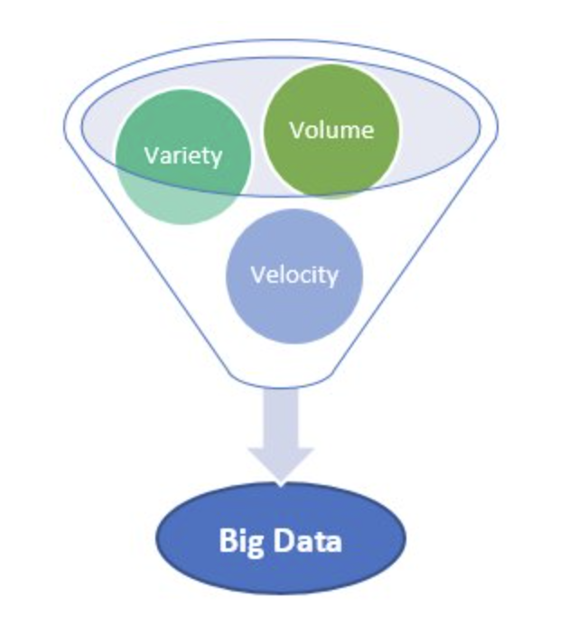
The 3Vs of Big Data
Velocity: data arrives continuously and quickly
Variety: structured, semi-structured, unstructured
Volume: very large scale (TB to PB)

Slide 8
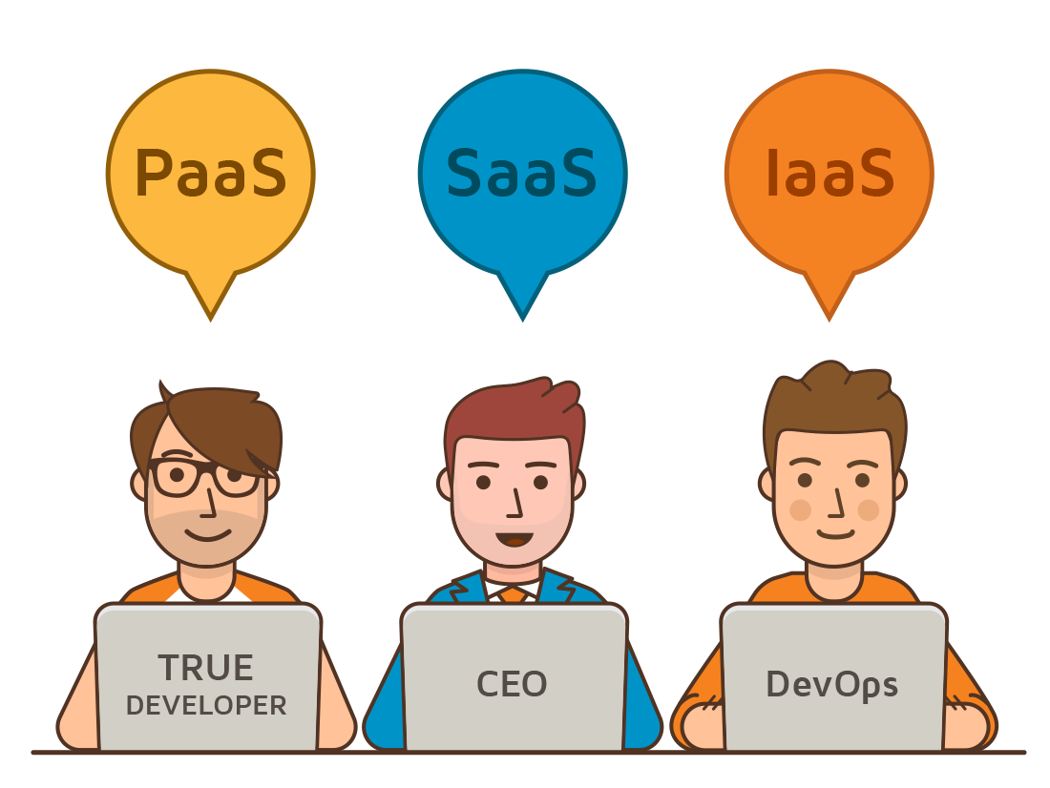
Cloud Service Models
SaaS: ready-to-use applications
PaaS: managed platform for development
IaaS: virtual compute, storage, networking

Slide 9
Data Scientist vs Data Engineer
Data scientists create models and insights
Data engineers build reliable data platforms
Both roles are interdependent in production systems

Slide 10
Data Engineer: Core Responsibility
Build and maintain the data platform
Ensure reliable ingestion and transformation
Deliver trusted datasets for analytics and ML

Slide 11
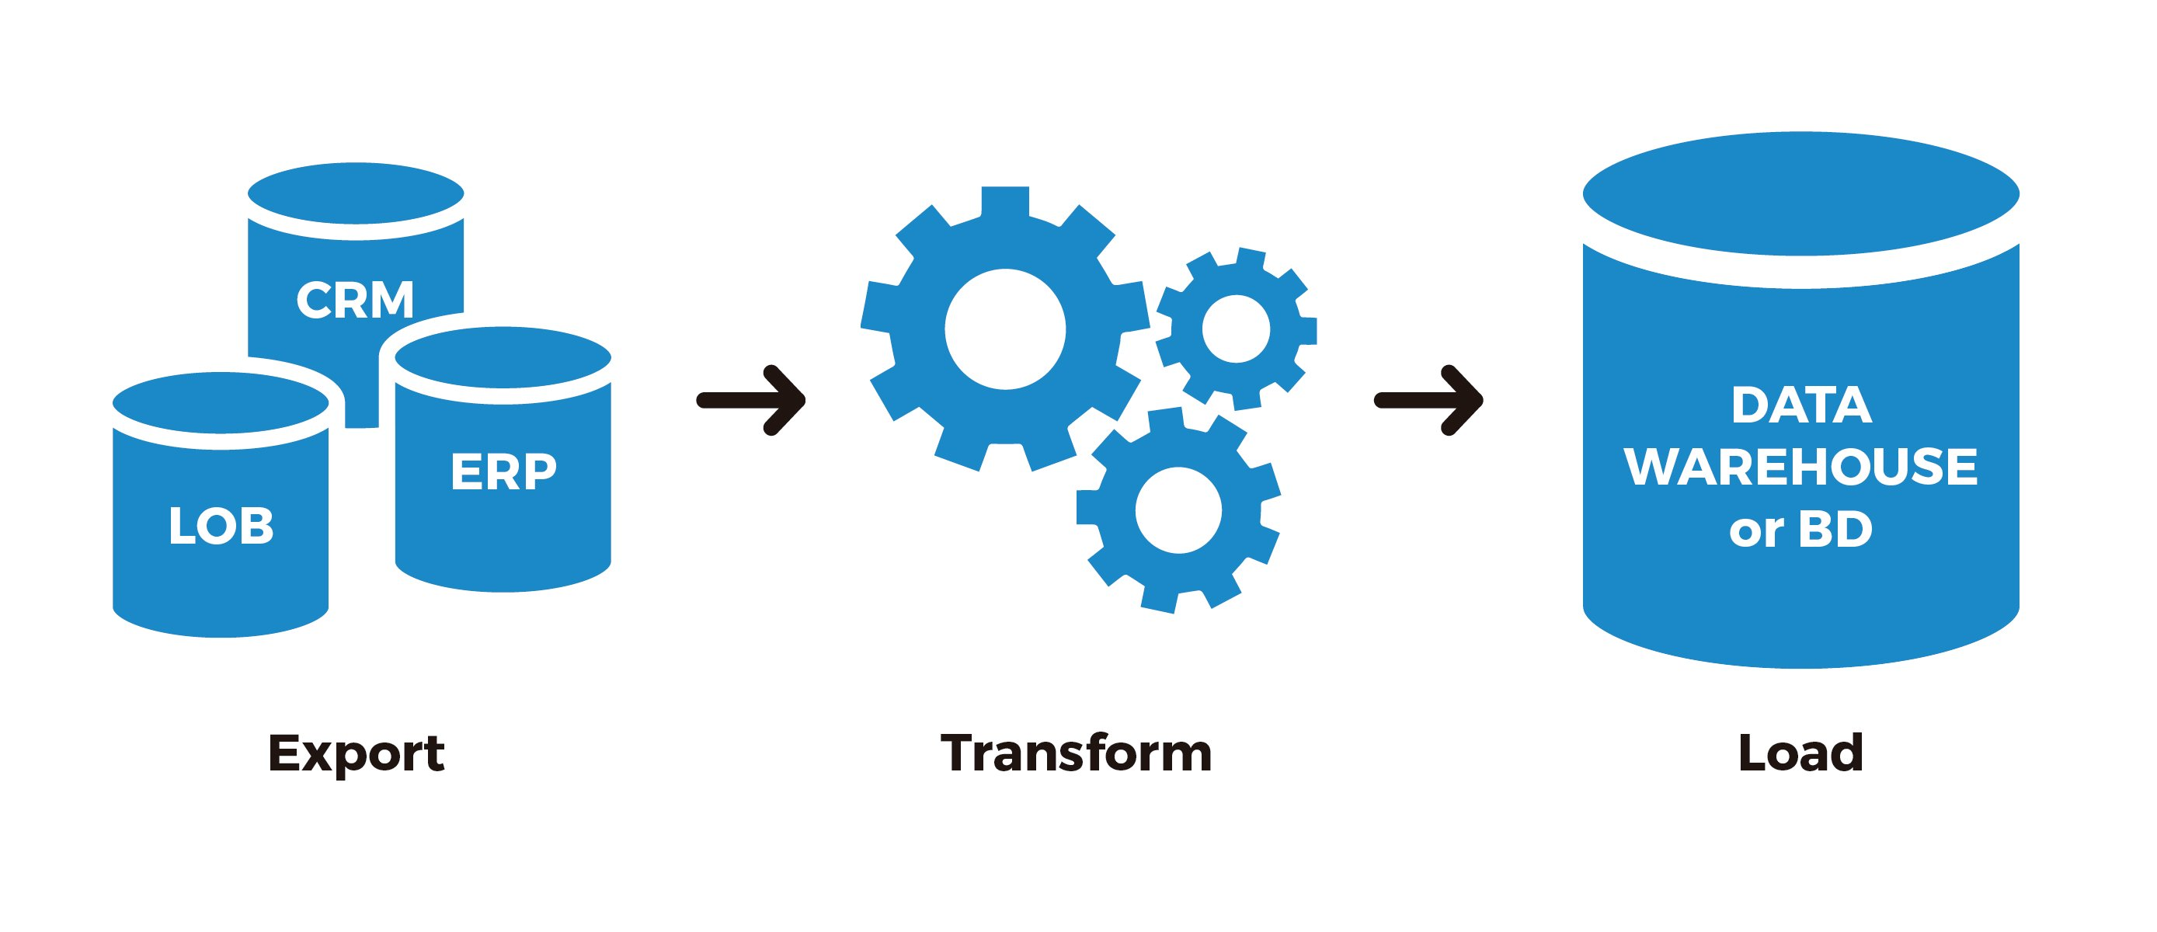
What Is Data Engineering?
Design systems that move and transform data
Serve dependable data for analytics, apps, and ML
Optimize for correctness, latency, and stability

Slide 12
Data Engineering Is Constraint Management
Sources are fragmented and heterogeneous
Data volume outgrows single-node capacity
Pipelines fail and must recover safely
Cost, latency, and reliability must be balanced

Slide 13
Core Problem Statement
Many producers, one consistent data view
Fresh data with clear quality guarantees
Scalable architecture without uncontrolled costs
Repeatable pipelines

Slide 14
Why Single Scripts Break
Runtime grows with data size
Limited observability slows incident response
Missing raw layer blocks safe replay
Non-idempotent writes corrupt outputs on rerun

Slide 15
Storage Design
Partition by date or high-value keys
Replicate for durability and availability
Model hot vs cold storage costs explicitly

Slide 16
E-Commerce Clickstream
Input: 20M events/day
Goal: daily product page-view aggregates
Data need to be available within 1 hour
Reliability target: 99.9% successful runs
Good luck for “regular” techniques….

Slide 17

Course Overview: SQL Optimization
Window functions
CTEs
Sub-queries

Slide 18
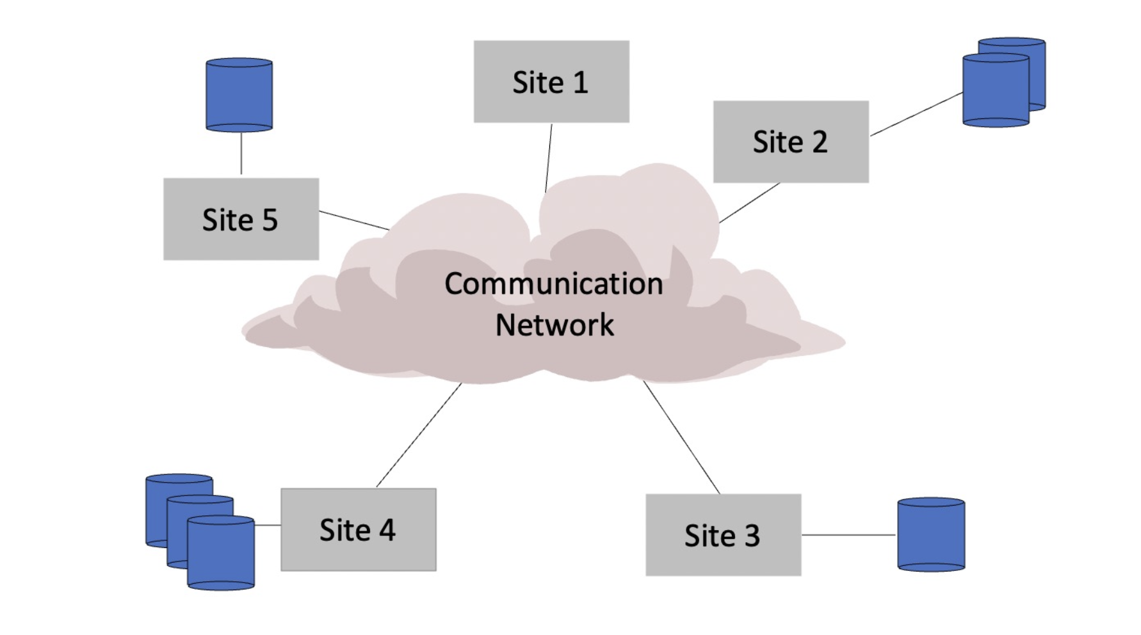
Course Overview: Distributed Computing

Slide 19
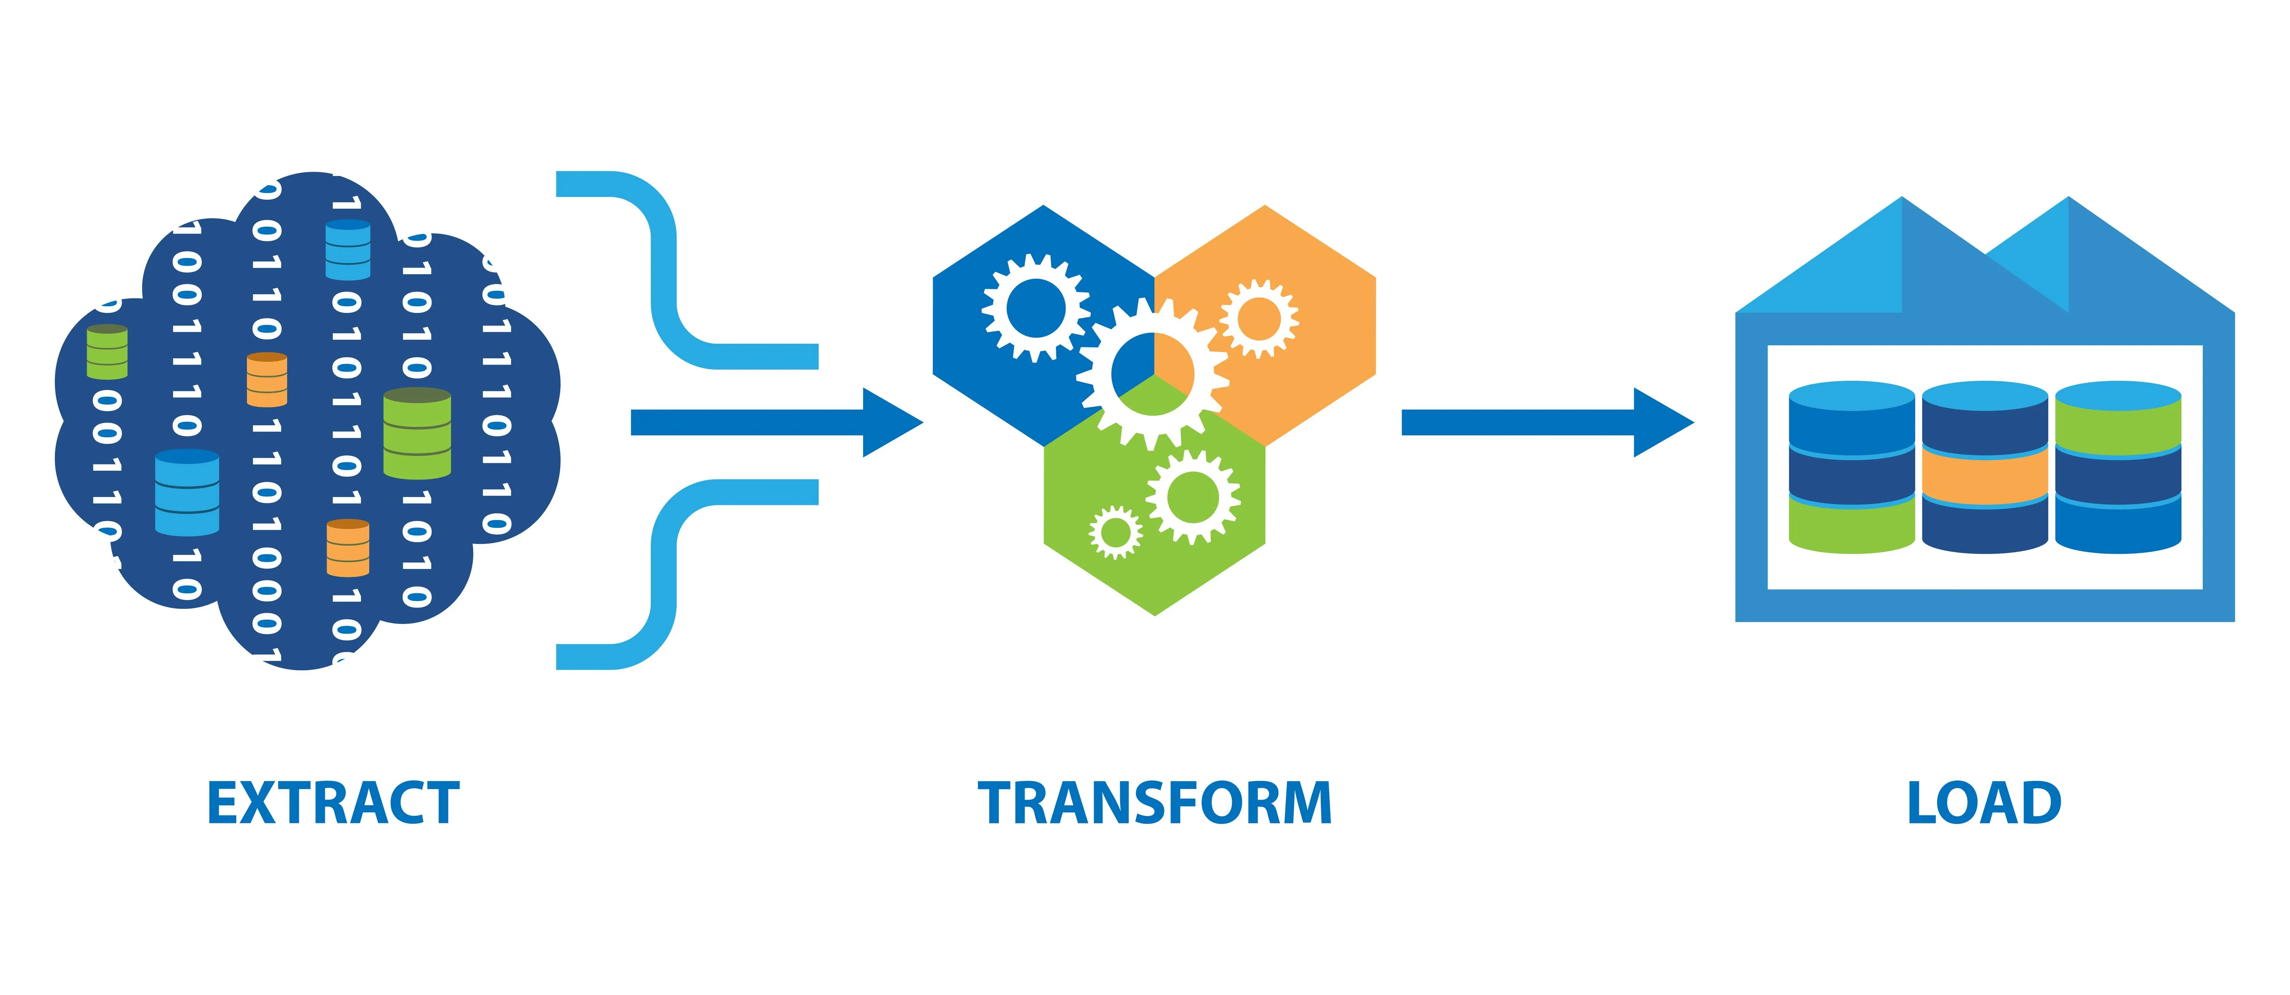
Course Overview: Data Warehouse, Data Lake, ETL

Slide 20
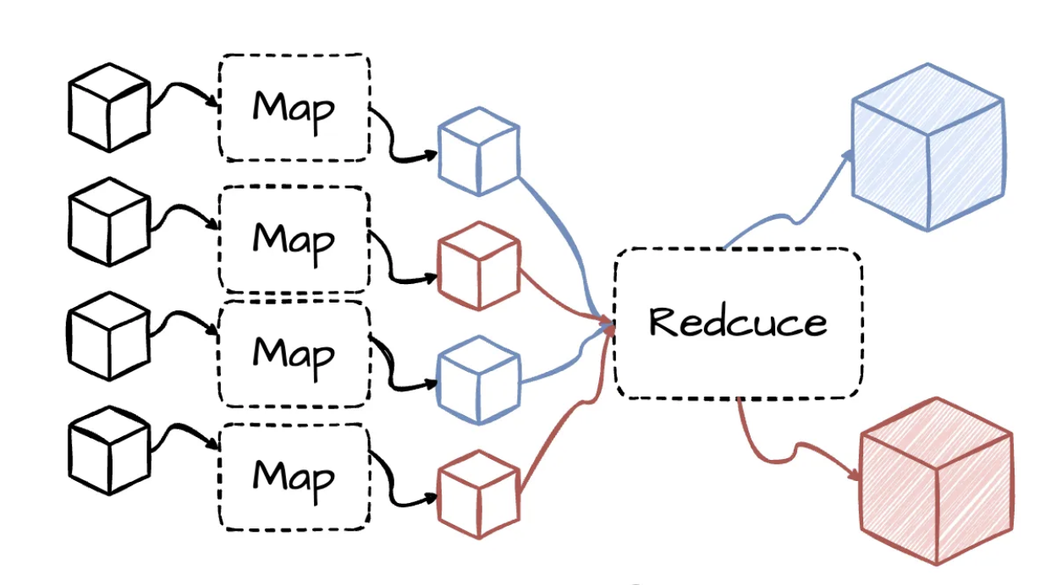
Course Overview: Map Reduce

Slide 21
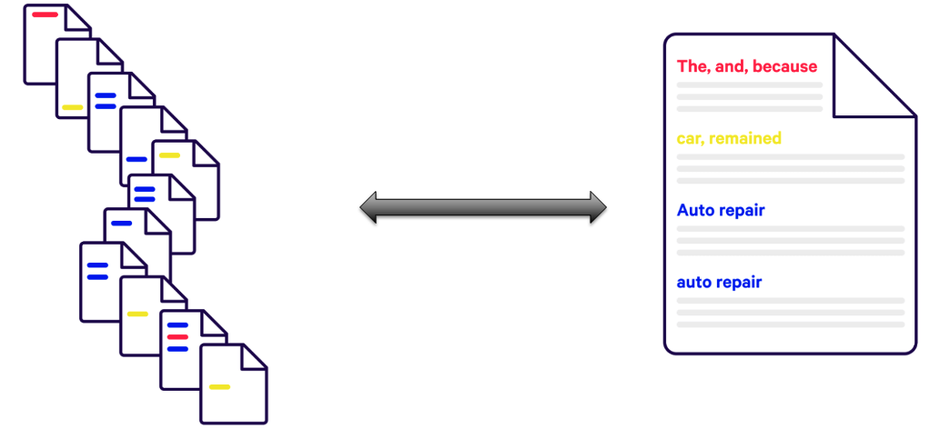
Course Overview: TF-IDF

Slide 22
Course Overview: Text Processing for LLMs
Course Overview: Streaming Data

Slide 23
SQL – Recap

Slide 24
Recap SQL
Differentiate SQL DML vs. DDL and apply each correctly
Choose the right join type and understand NULL results
Use subqueries with ALL, IN, and EXISTS
Apply window functions for aggregation, ranking, and value navigation

Slide 25
SQL Foundations (DML vs. DDL)
SQL is a query language that is table-oriented and optimized for fast access to data.
CRUD operations: Create, Read, Update, Delete.
DML: SELECT, INSERT, UPDATE, DELETE
DDL: CREATE, DROP, ALTER

Slide 26
Create + Insert + Verify (Example)
CREATE TABLE Students ( Id int NOT NULL, First_Name text, Last_Name text, Birth_Date date, Hour_Salary float ); INSERT INTO Students VALUES (123456789, 'Israel', 'Israeli', '1980-03-20', 120.40);

Slide 27
Example: Students and Courses Tables
FirstName | LastName | StudentID
Avi | Cohen | 111
Dan | Israeli | 222
Ofer | Bar | 333
StudentID | CourseNumber | CourseName | Grade
111 | 289 | DB | 96
111 | 281 | Algo | 85
222 | 281 | Algo | 78
Primary Key: StudentID in Students, Foreign Key: StudentID in Courses

Slide 28
How to Merge Two Tables? - Option 1
SELECT FirstName, CourseName, Grade FROM Students AS S, Courses AS C WHERE (S.StudentID = C.StudentID) AND (C.CourseName = 'Algo');

Slide 29
Option 2 (Explicit JOIN)
SELECT FirstName, CourseName, Grade FROM Students AS S JOIN Courses AS C ON S.StudentID = C.StudentID WHERE C.CourseName = 'Algo';

Slide 30
ON vs. USING
Use ON when join column names differ.
Use USING when column names are the same.
SELECT FirstName, CourseName, Grade FROM Students JOIN Courses USING (StudentID) WHERE CourseName = 'Algo';

Slide 31
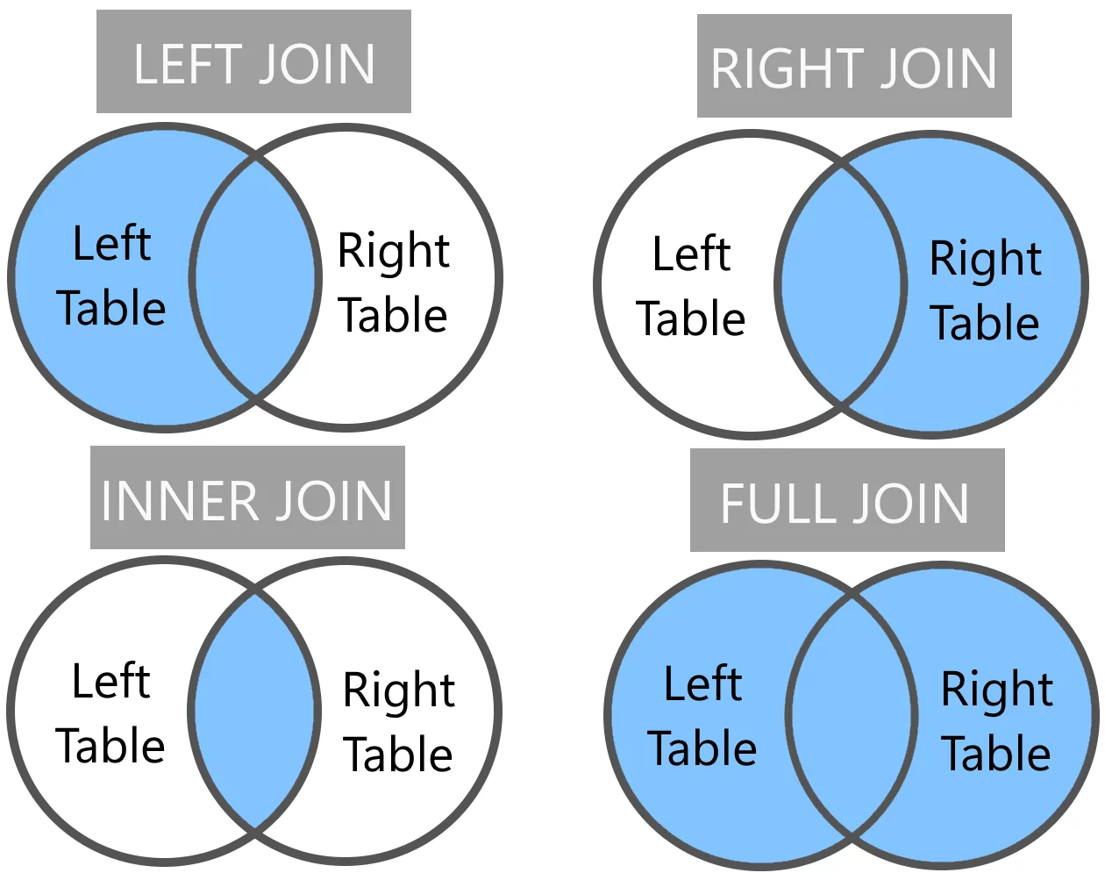
Join Types

Slide 32
Handling NULL Values
NULL values can come from:
Left/Right/Full outer joins
Missing data during inserts
Other data quality issues

Slide 33
Example: Find Rows with Missing Course Data
SELECT FirstName, LastName, CourseNumber FROM Student LEFT OUTER JOIN Courses USING (StudentID)
WHERE CourseNumber IS NULL
Use IS NULL / IS NOT NULL.
Wrong usage: FirstName = 'NULL’ NULL is not a string.

Slide 34
Subqueries: ALL
Find the city whose average amount is greater than or equal to all city averages:
SELECT S.FirstName FROM Students S JOIN Courses C
ON S.StudentID = C.StudentID GROUP BY S.StudentID HAVING AVG(C.Grade) >= ALL ( SELECT AVG(Grade) FROM Courses GROUP BY StudentID );

Slide 35
Subqueries: IN
Find all names living in specific cities:
SELECT LastName FROM Students WHERE FirstName IN (‘AVi’, ‘Ofer’);

Slide 36
Subqueries: EXISTS
SELECT S.FirstName FROM Students S WHERE EXISTS ( SELECT * FROM Courses C
WHERE C.StudentID = S.StudentID );

