Slide 1
SQL Optimization and Advanced Querying

Slide 2
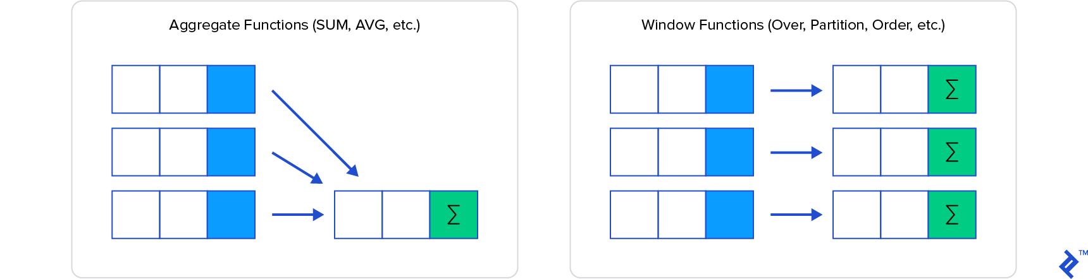
What is Window Functions?
Window functions are used to perform a calculation on an aggregate value based on a set of rows. Return multiple rows for each group.

Slide 3
Window Functions: Syntax
window_function_name([ALL] expression) OVER (
[PARTITION BY ...]
[ORDER BY ...]
)
ALL (optional): count all values along with duplicates. We cannot use the DISTINCT keyword in window functions.
Expression: the column name for which we calculate an aggregated value.

Slide 4
Window Functions: Clauses
OVER: defines the window.
PARTITION BY: splits rows into partitions for independent calculations.
ORDER BY: defines row order within each partition.

Slide 5
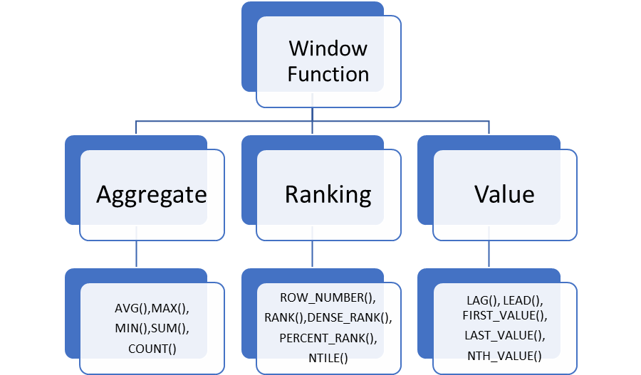
Types of Window Functions

Slide 6
Example: Sales Table
CREATE TABLE Sales ( Employee VARCHAR(45) NOT NULL, Year INT NOT NULL, Country VARCHAR(45) NOT NULL, Product VARCHAR(45) NOT NULL, Amount DECIMAL(12,2) NOT NULL, PRIMARY KEY (Employee, Year) );

Slide 7
Aggregate Window Functions - SUM
SELECT Employee, Year, Country, Product, Amount, SUM(Amount) OVER (PARTITION BY Country) AS Total FROM Sales;

Slide 8
SUM Output
Employee | Year | Country | Product | Amount | Total
Or Peretz | 2017 | Israel | Computer | 15000 | 45000
Or Peretz | 2018 | Israel | Computer | 10000 | 45000
Or Peretz | 2019 | Israel | TV | 20000 | 45000
Omer Doron | 2018 | USA | TV | 20000 | 30000
Omer Doron | 2019 | USA | Mobile | 10000 | 30000

Slide 9
Aggregate Window Functions - AVG
SELECT Employee, Year, Country, Product, Amount, AVG(Amount) OVER (PARTITION BY Country, YEAR(Year)) AS AvgSales FROM Sales;

Slide 10
AVG Output
Employee | Year | Country | Product | Amount | AvgSales
Or Peretz | 2017 | Israel | Computer | 15000 | 15000
Or Peretz | 2018 | Israel | Computer | 10000 | 15000
Or Peretz | 2019 | Israel | TV | 20000 | 15000
Omer Doron | 2018 | USA | TV | 20000 | 15000
Omer Doron | 2019 | USA | Mobile | 10000 | 15000

Slide 11
Aggregate Window Functions - COUNT
SELECT Employee, Year, Country, Product, Amount, COUNT(Product) OVER (PARTITION BY Country) AS TotalProduct FROM Sales;

Slide 12
Aggregate Window Functions - MAX
SELECT Employee, Year, Country, Product, Amount, MAX(Product) OVER (PARTITION BY Country) AS TotalProduct FROM Sales;

Slide 13
Ranking Window Functions - Data for Examples
FirstName | LastName | City
Luisa | Evans | Texas
Paul | Ward | Alaska
Peter | Bennett | California
Carlos | Patterson | New York
Rose | Huges | Florida
Marielia | Simmons | Texas
Antonio | Butler | New York
Diego | Cox | California

Slide 14
Example - RANK
SELECT FirstName, LastName, City, RANK() OVER (ORDER BY City) AS RankNo FROM table;

Slide 15
RANK Output
FirstName | LastName | City | RankNo
Paul | Ward | Alaska | 1
Peter | Bennett | California | 2
Diego | Cox | California | 2
Rose | Huges | Florida | 4
Carlos | Patterson | New York | 5
Antonio | Butler | New York | 5
Luisa | Evans | Texas | 7
Marielia | Simmons | Texas | 7

Slide 16
Example - DENSE_RANK
SELECT FirstName, LastName, City, DENSE_RANK() OVER (ORDER BY City) AS RankNo FROM table;

Slide 17
Example - NTILE
SELECT FirstName, LastName, City, NTILE(3) OVER (ORDER BY City) AS RankNo FROM table;

Slide 18
Value Window Functions - LEAD
SELECT Year, Product, Country, Amount, LEAD(Amount, 1) OVER (PARTITION BY Year ORDER BY Country) AS NextAmount FROM Sales;

Slide 19
Value Window Functions - LAG
SELECT Year, Product, Country, Amount, LAG(Amount, 1) OVER (PARTITION BY Year ORDER BY Country) AS PrevAmount FROM Sales;

Slide 20
FIRST_VALUE / LAST_VALUE
SELECT Year, Product, Country, Amount, FIRST_VALUE(Amount) OVER (PARTITION BY Country ORDER BY Country) AS FirstAmount, LAST_VALUE(Amount) OVER (PARTITION BY Country ORDER BY Country) AS LastAmount FROM Sales;

Slide 21
Key Takeaways
Correct join choice controls both correctness and NULL behavior.
Subqueries with ALL, IN, and EXISTS express different logical checks.
Window functions enable analytics patterns without losing row-level detail.

