Slide 1
Distributed Systems + Parallelism

Slide 2
Flow for today
The scaling problem: data and work outgrow one machine
Distributed data: partitioning, replication, and consistency trade-offs
Distributed work: parallelism, divide-and-conquer, and bottlenecks
Failure modes and decision checklist

Slide 3

Key terms: SLA
SLA (Service Level Agreement) A commitment between provider and customer (e.g. “99.9% uptime” or “p95 response time < 200 ms”).

Slide 4
Key terms: Why we care about response-time distribution
When we measure response time (e.g. how long a query or request takes), we care about the full distribution, not only the average.

Slide 5
Key terms: Latency percentiles (p50, p95, p99)
Term | Meaning | Why it matters
p50 (median) | Half of requests finish within this time | Typical user experience
p95 | 95% of requests finish within this time | Most user, long tail starts here
p99 | 99% of requests finish within this time | Worst regular users, SLA and penalties often defined here

Slide 6
Think like a system designer, not a programmer
Distributed database decisions Where is the data stored so service stays reliable and responsive?
Parallel processing decisions How is the workload split so decisions arrive on time at acceptable cost?

Slide 7
Two sides of the same coin
Distributed data many nodes store one logical database (where the data lives)
Parallel compute many workers process one logical job (how the work is split)
Same user experience, higher scale and resilience

Slide 8
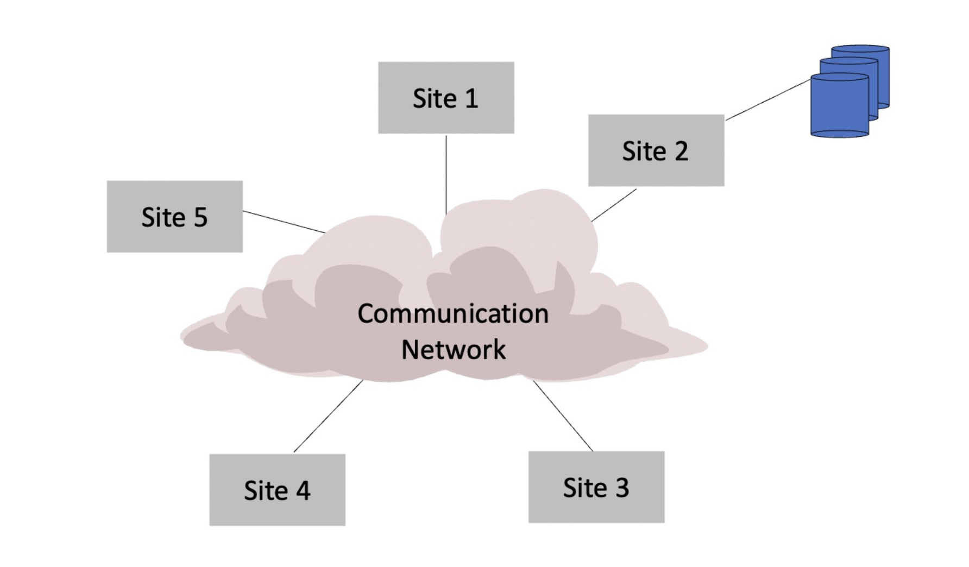
The Scaling Problem (Business View)
A single-node architecture often works early, then fails suddenly during growth.

Slide 9
Why this breaks (operations terms)
One machine becomes a bottleneck station.
Maintenance or failure creates a single point of stoppage.
Peak demand creates long tails (p95/p99 explode before average does).

Slide 10
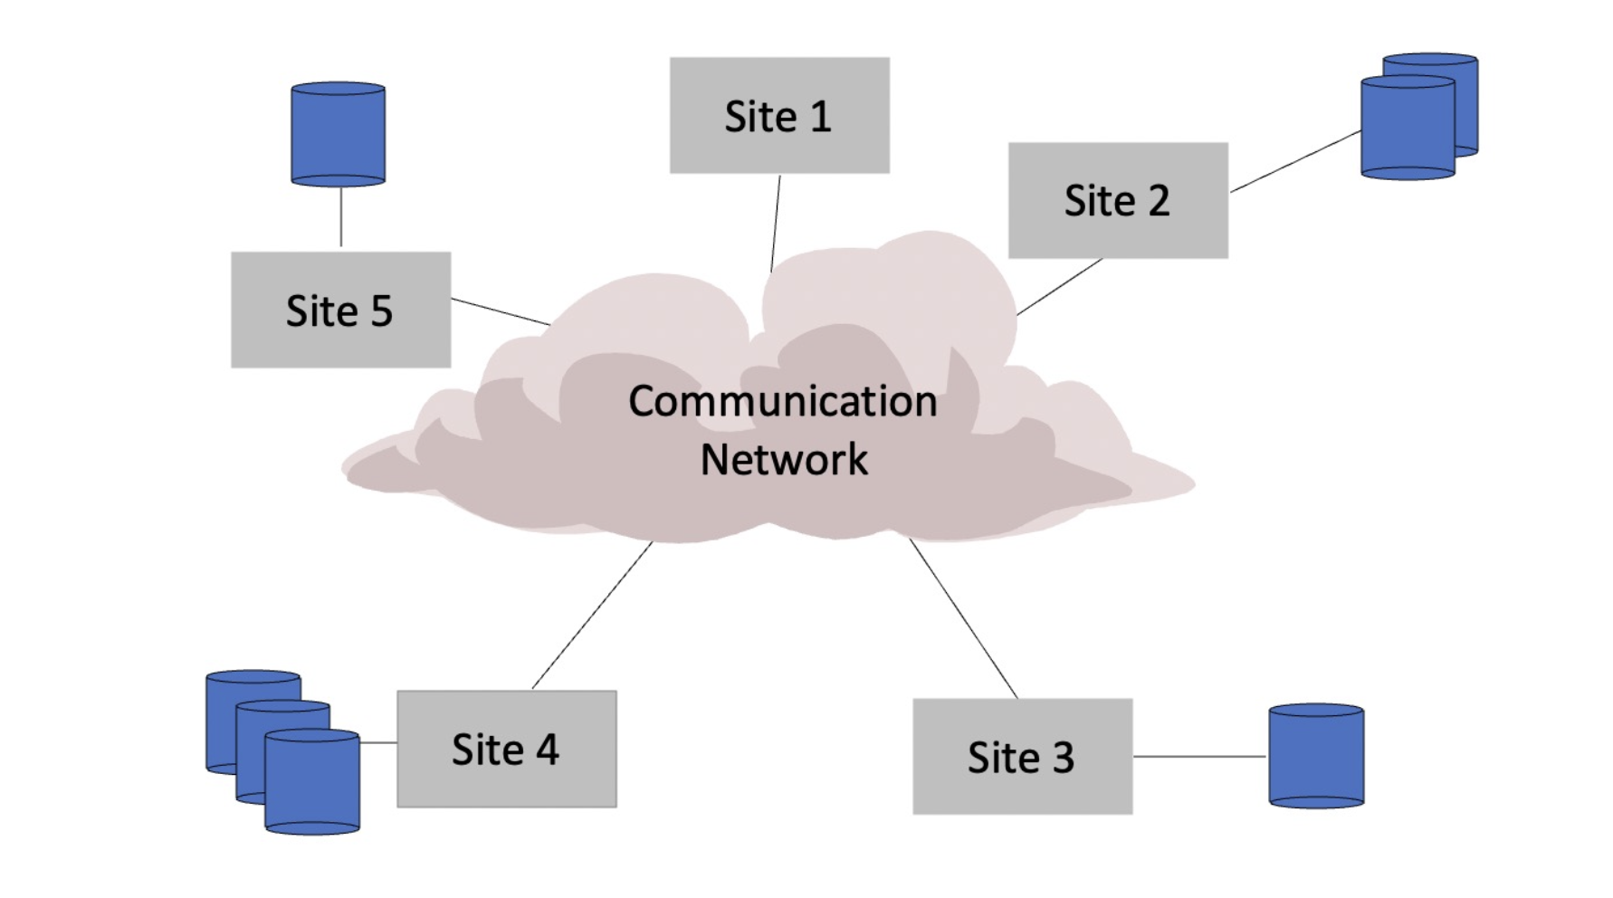
Distributed Databases

Slide 11
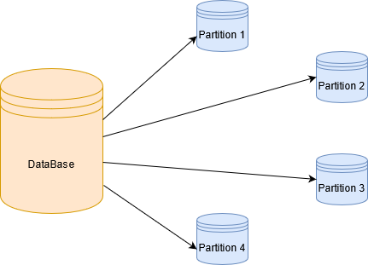
Partitioning: split data across nodes
Partitioning means dividing rows so each node stores a subset.

Slide 12
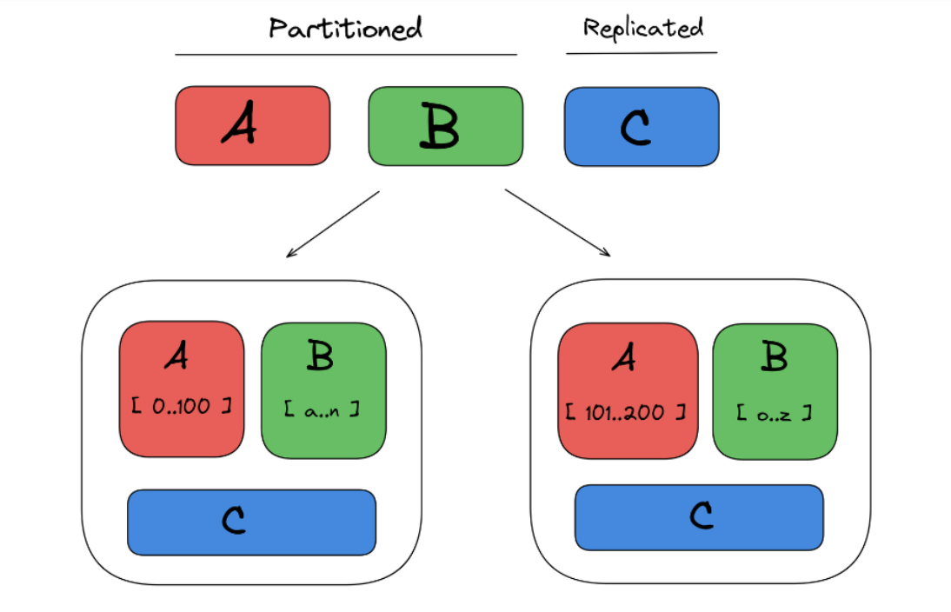
Replication: copy data for availability and read scale
Replication keeps multiple copies (primary + replicas).

Slide 13
SQL vs NoSQL trade-offs
Dimension | SQL systems (typical) | NoSQL systems (typical)
Strength | Strong integrity, joins, transactions | Flexible schema
Best fit | Finance, orders, master data | Event logs, feeds, session/state
Cost pattern | Higher coordination cost at very high scale | Lower per-operation coordination
Risk pattern | Performance bottlenecks under extreme scale | Consistency/freshness caveats

Slide 14
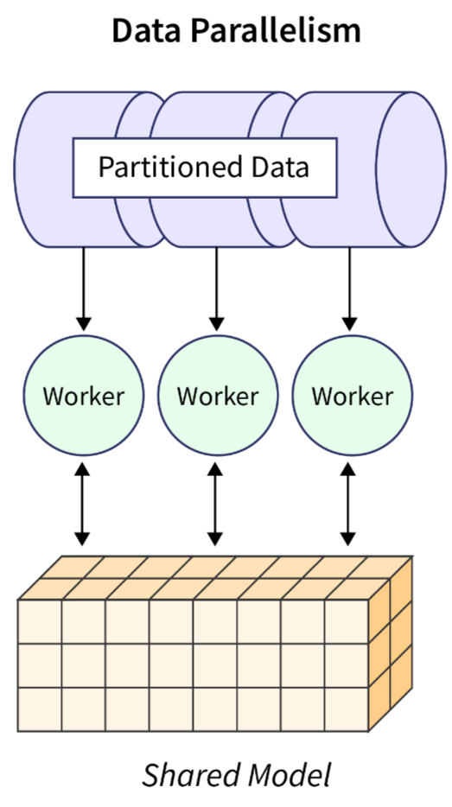
Parallelism & Work Distribution

Slide 15
Process vs. Thread
A process is an instance of a running program.
Process may contain one or more threads, but a thread cannot contain a process.
Process has a self-contained execution environment. It has its own memory space.
Process don't share its memory
Multiple threads in a process share resources.

Slide 16
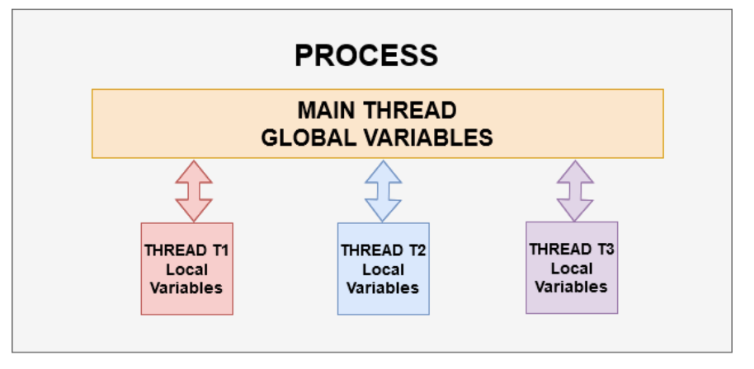
Parallel Computation
Threading allows you to have different parts of your process run concurrently. For example, A web-browser could be a process, an application running multiple cameras simultaneously could be a process.
multiple threads work together to achieve a common goal

Slide 17
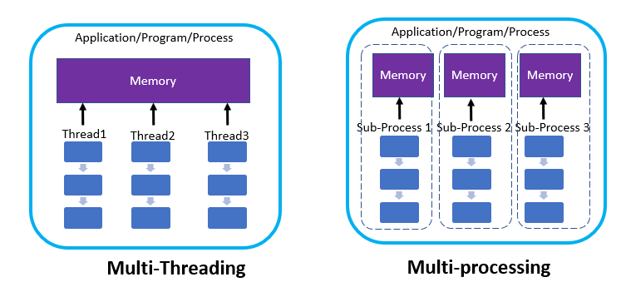
Parallel Computation
Multiprocessor/multicore several processors work on data stored in shared memory
Cluster several processor units work together by exchanging data over a network

Slide 18
Parallelism in Practice

Slide 19
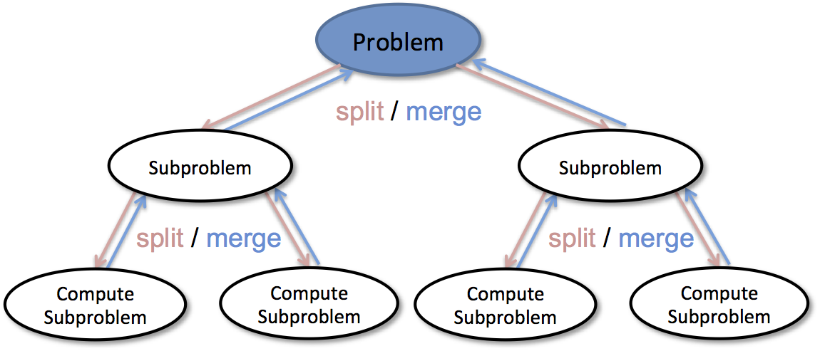
Divide-Conquer-Combine as the central model
Divide: partition data/workload.
Conquer: same operation on each partition independently.
Combine: merge partial outputs.

Slide 20
Example: Merge Sort
Merge Sort is a Divide and Conquer algorithm.
It divides the input array into two halves, calls itself for the two halves, and then merges the two sorted halves.
8
2
9
4
5
3
1
6

Slide 21
Example: Merge Sort
8
2
9
4
5
3
1
6
Divide
8 2 9 4
5 3 1 6
Divide
8 2
9 4
5 3
1 6
Divide
1 element
8 2 9 4 5 3 1 6
Merge
2 8 4 9 3 5 1 6
Merge
2 4 8 9 1 3 5 6
Merge
1 2 3 4 5 6 8 9

Slide 22
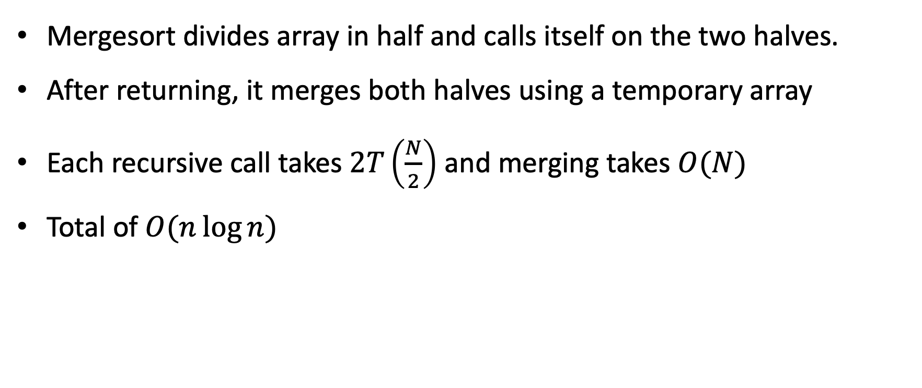
Example: Merge Sort
Mergesort divides array in half and calls itself on the two halves.
After returning, it merges both halves using a temporary array
Each recursive call takes $2T\left(\frac{N}{2}\right)$ and merging takes $O(N)$
Total of $O(n\log{n})$

