Slide 1
DWH + ETL

Slide 2
Why This Topic Is Critical
Most BI outages begin in ingestion, not dashboards
Small ingestion bugs create silent KPI drift
Source systems change faster than analytics models
Reliability requires explicit policies, not assumptions

Slide 3
Incident: Revenue Doubled After Rerun
Nightly pipeline failed at 02:10 after loading 2 of 3 partitions
Operator reran full job with plain INSERT
Same transactions loaded again, revenue KPI jumped ~2x
Root cause: no checkpoint + no idempotent target write

Slide 4
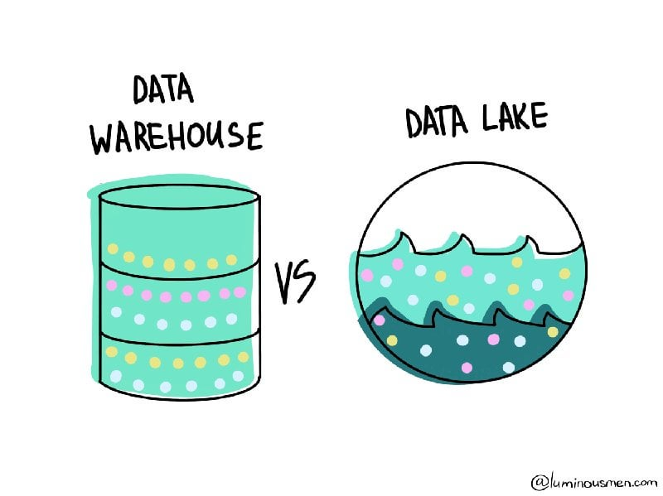
Core Stores: Warehouse vs Lake
Warehouse: curated, schema-on-write, BI-first
Lake: raw + processed zones, schema flexibility

Slide 5
Core Stores: Warehouse vs Lake
Warehouse optimizes consistency and discoverability
Lake optimizes ingestion agility and storage economics

Slide 6
Data Warehouse Definition
Subject-oriented
organized around major subjects (customer, product, sales)
Integrated
multiple heterogeneous sources, cleaned and consistent
Time-variant
historical perspective vs operational current-value data
Nonvolatile
physically separate, operational updates do not occur in the warehouse

Slide 7

Why Separate Data Warehouse?
Decision support requires historical data which operational DBs typically don’t maintain.
DS requires aggregation & summarization
Different sources typically use inconsistent data representations

Slide 8
Schema-on-Write vs Schema-on-Read
Write-time schema validation catches issues earlier
Read-time schema validation supports source variability
Schema-on-write reduces BI surprise and metric drift
Schema-on-read speeds onboarding but needs stronger governance

Slide 9
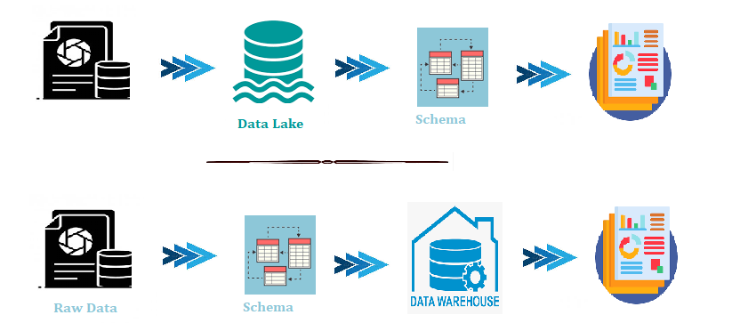
DWH vs Lake
On Read
On Write

Slide 10
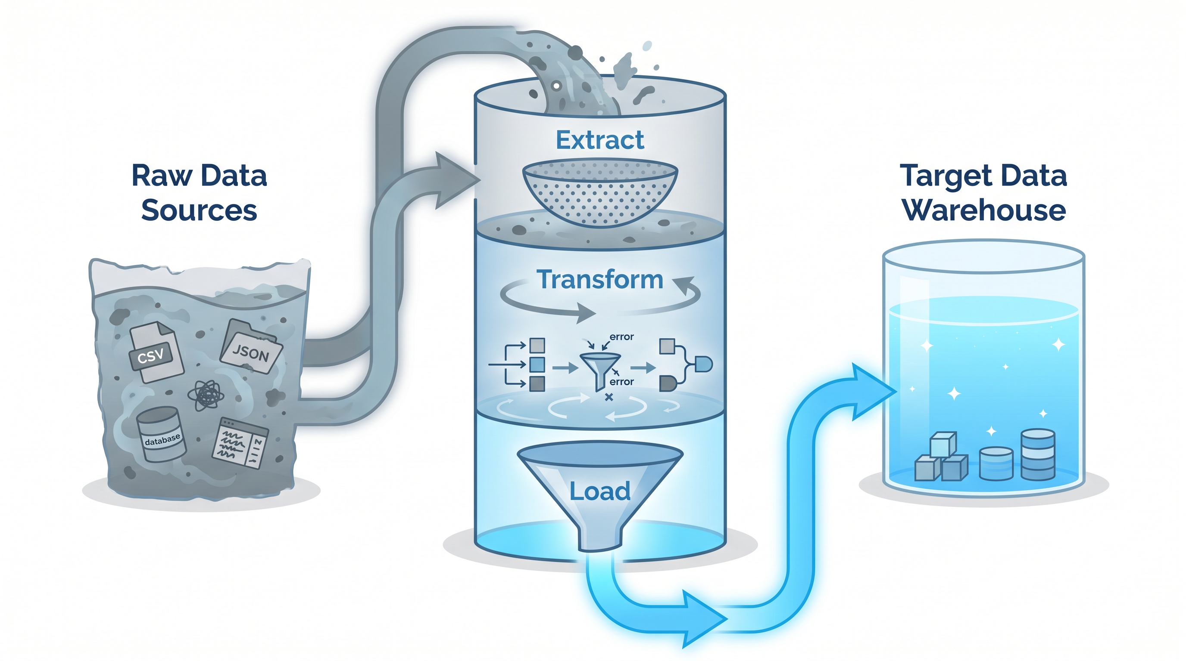
Extract, Transform, Load - ETL

Slide 11
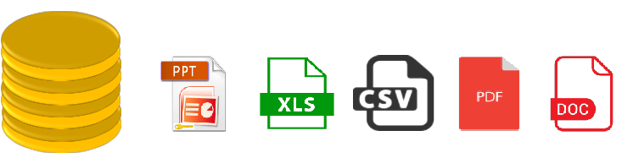
Extraction
The main goal of extraction is to collect the data from the source system as fast as possible and less convenient for these source systems.

Slide 12
Transformation
All the collected data has been transformed into the same format
Filtering: only relevant attributes going to DWH.
Cleaning: Filling up the null values with specific default values.
Joining: Join the multiple attributes into the one.
Splitting: Splitting the single attribute into multiple attributes.
Sorting: Sort the tuples based on the attributes.

Slide 13

Loading
Loading is the final step of the ETL process.
The big chunk of data is collected from various sources, transformed them,
loaded to the data warehouse.

Slide 14
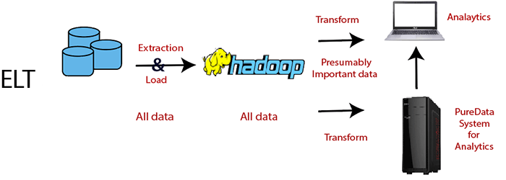
Extract, Load, Transform - ELT
After extracting the data, we immediately start loading phase, moving all the data sources into a single, centralized data repository.
Today, most of the processes are ELT

Slide 15
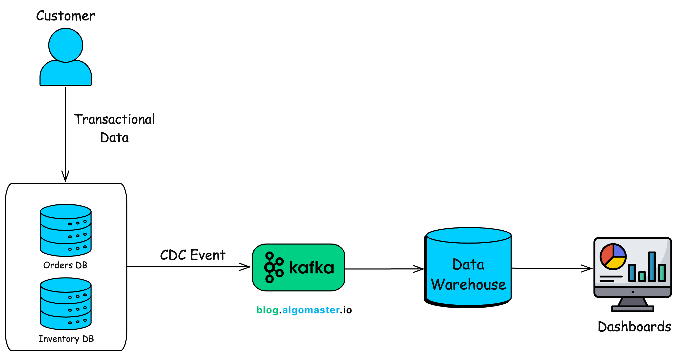
Change-Data-Capture (CDC) Options
Full snapshot compare: simple, expensive at scale
Timestamp: easy, misses hard deletes unless modeled
Trigger-based CDC: accurate but can burden source DB

Slide 16
CDC Example: Orders Table
Inserts: new orders must appear once
Updates: status changes from PENDING to PAID
Deletes: canceled rows may need tombstone semantics
Policy must specify how each change type maps to analytics

Slide 17
Ingestion Modes
Full refresh: easiest correctness, worst cost/latency at scale
Incremental batch: standard for most BI pipelines
Streaming: lowest latency, highest operational discipline

Slide 18
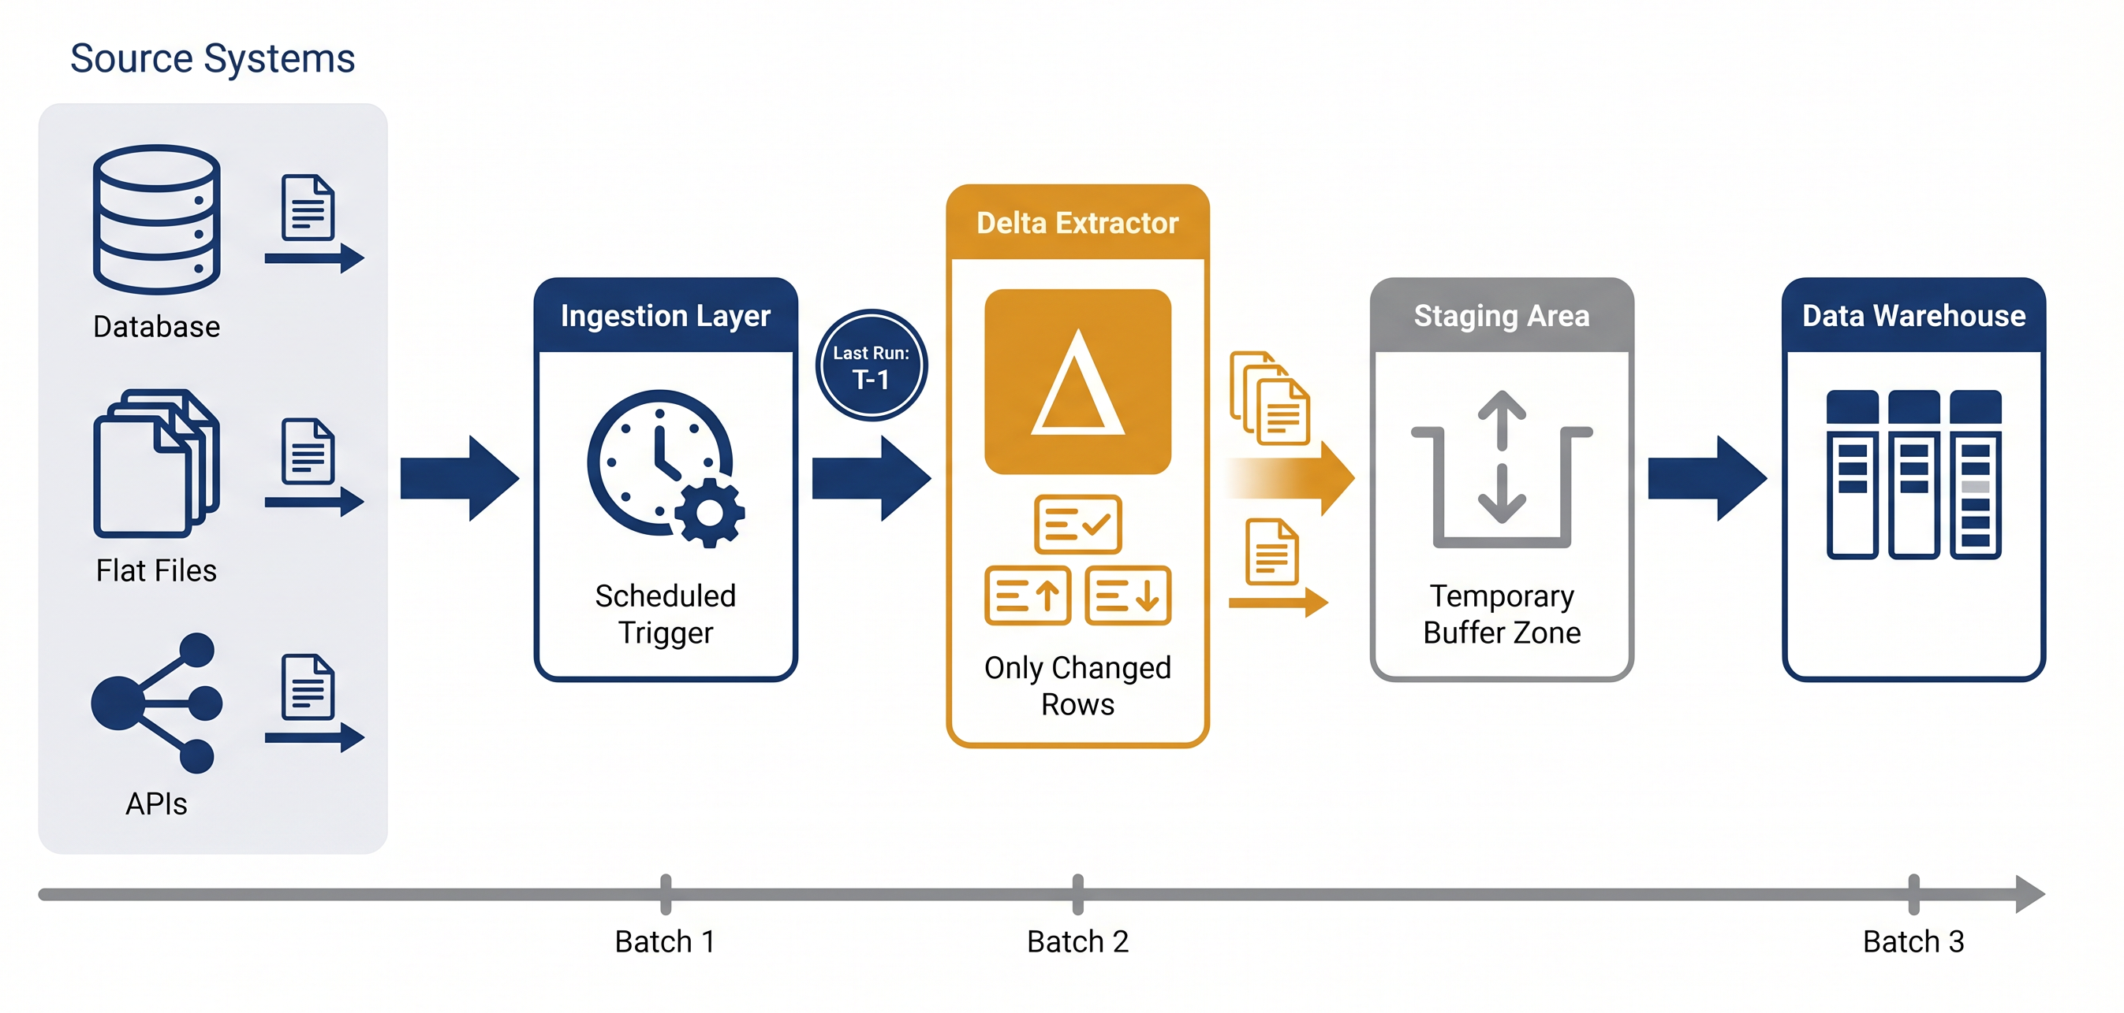
Ingestion Modes

Slide 19
Source-to-Target Mapping (STTM)
Source and target schemas rarely match when moving data between systems
a set of instructions defining how to transfer content.
Critical when integrating multiple sources into WH.

Slide 20
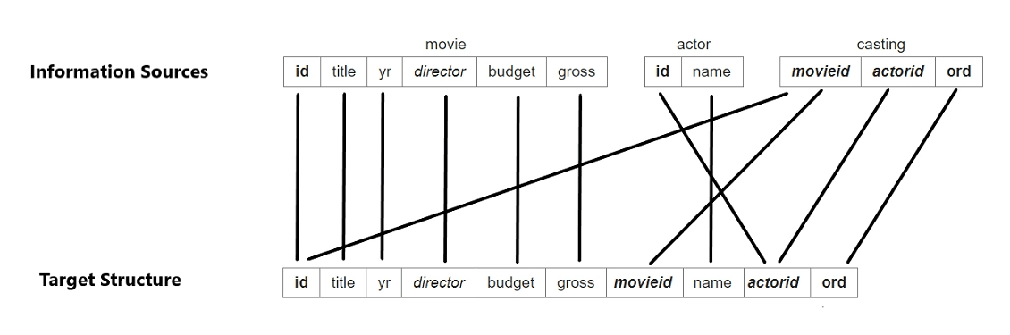
STTM Mapping Flow

Slide 21
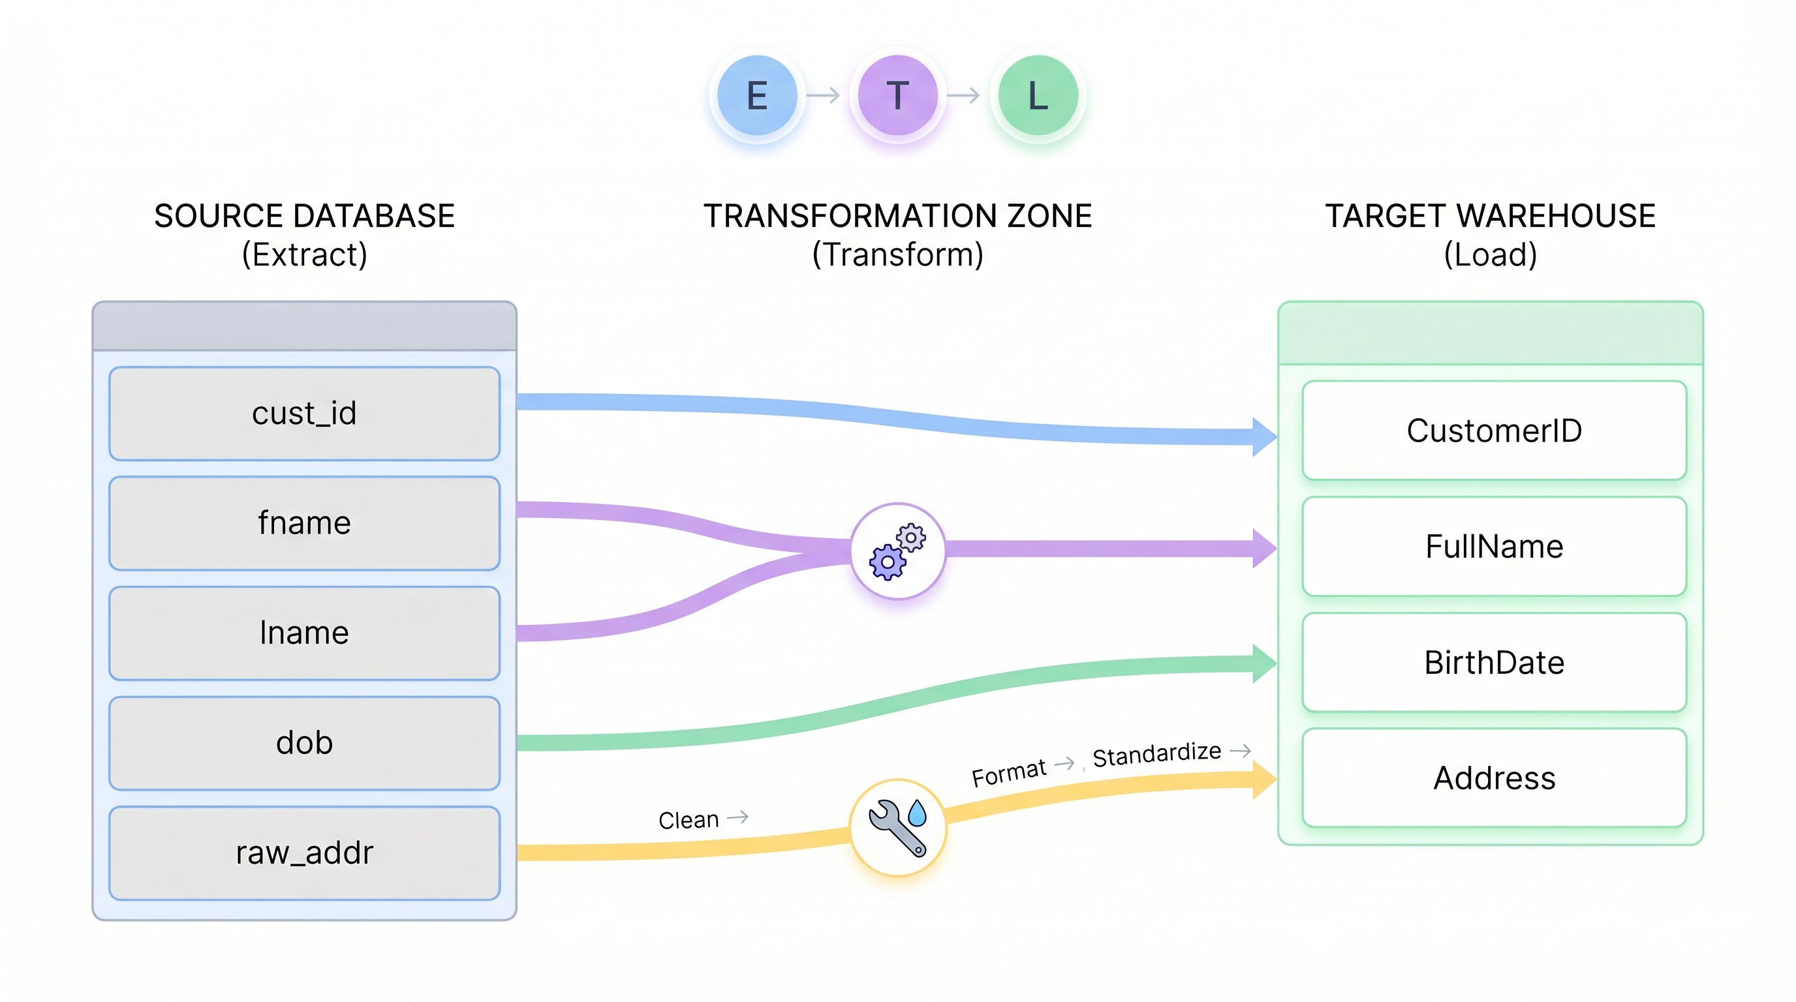
STTM Process Types

Slide 22
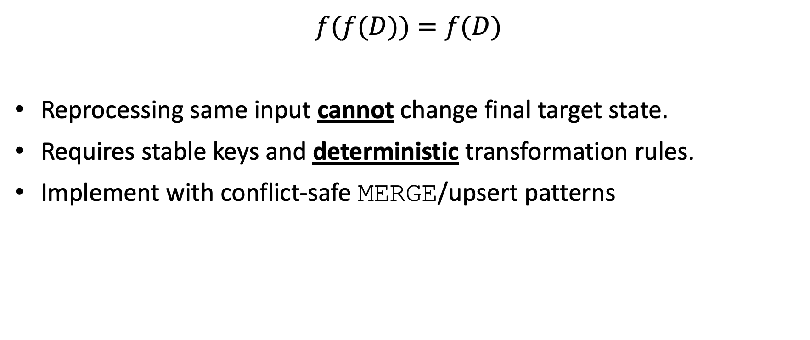
Idempotency Rule
$$f(f(D))=f(D)$$
Reprocessing same input cannot change final target state.
Requires stable keys and deterministic transformation rules.
Implement with conflict-safe MERGE/upsert patterns

Slide 23
DWH Schema Design

Slide 24
Fact and Dimension Contracts
Fact table: measurable business events at one declared grain
Dimension table: descriptive context used to filter, group, and explain facts
Measure: numeric value with explicit aggregation semantics
Hierarchy: governed drill path such as day -> month -> quarter -> year

Slide 25
The Multi-Dimensional Model
Store Info
Key columns joining fact table
to dimension tables
Numerical Measures
Prod Code Time Code Store Code Sales Qty
Fact table for
measures
Product Info
Dimension tables
Time Info

Slide 26
Dimensional Modeling
Dimensions organize attributes into stable analysis paths
E.g., Time: day -> week -> month -> quarter -> year
E.g., Product: SKU -> product line -> brand -> category
Conformed dimensions reuse the same keys and labels across facts
Role-playing dimensions reuse one table in different roles, e.g., order_date and ship_date

Slide 27
Concept Hierarchy: Location Dimension
all
all
region
Europe
...
North_America
country
Germany
...
Spain
Canada
...
Mexico
city
Frankfurt
...
Vancouver
...
Toronto
office
L. Chan
...
M. Wind

Slide 28
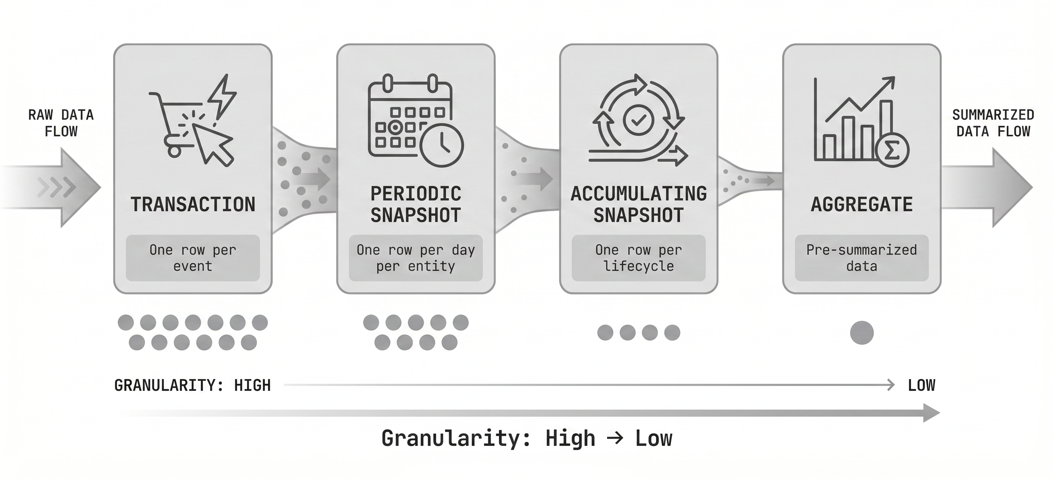
Declaring Fact Grain
Grain defines exactly what one row in the fact table represents
If the grain is ambiguous, double counting is likely
Document grain and natural uniqueness before writing ETL

Slide 29
Grain: What It Is
The grain is the business event level captured by the fact table
It answers the question: what does one row mean?
Changing grain later usually breaks joins, aggregates, and history
Or Peretz
9

Slide 30
Common Grain Options
Transaction grain: one row per event
Periodic snapshot grain: one row per entity per period
Accumulating snapshot grain: one row per process lifecycle
Aggregate grain: pre-summarized rows
Factless grain: event existence only
Or Peretz
10

Slide 31
Choosing the Right Grain
Start with the lowest atomic grain needed for analysis
Use aggregate grains only for performance measures
Avoid mixing grains in one fact table
Check that the proposed grain has a stable unique key
Write the grain statement before designing dimensions
Or Peretz
11

Slide 32
Table Behavior Types
Append-only
tables only insert new rows and preserve full event history
Mutable tables
allow updates and deletes when the latest state matters
Late-arriving
data reaches after the business event happened
Or Peretz
12

Slide 33
Append-Only vs. Mutable Tables
Append-only
best for logs, transactions, CDC history, and replayability
Mutable
best for current-state dimensions, operational mirrors
A common pattern is append-only raw layer plus curated mutable serving tables
Or Peretz
13

Slide 34
Measure Types and Aggregation Rules
Additive: safe to sum across all dimensions
Semi-additive: sum across product, not across time
Non-additive: calculate from numerator and denominator

Slide 35
Common Schemas

Slide 36
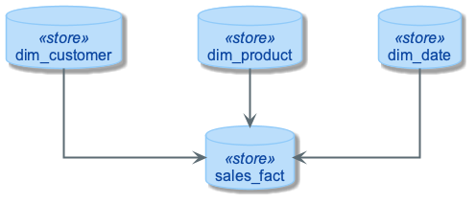
Star Schema: Default BI Design

Slide 37
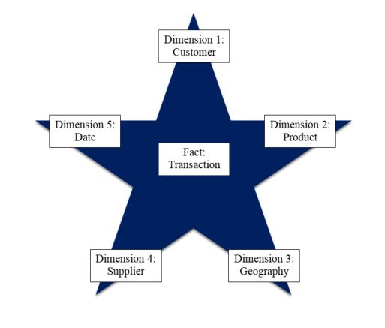
The Classic Star Schema
A fact table sits at the center and connects to denormalized dimensions.
Each dimension key appears once in the fact table primary/unique key.
Notes:
7
The Star is built for simplicity and speed. Forget everything you learned about designing relational databases. The Star Schema makes no excuses for the rules it breaks. The assumption behind it is that the database is static or ìquiet,î meaning that no updates are performed on-line.
Remember that most of the rules of relational database design are derived from the need to maintain atomicity, consistency and integrity (the ìACIDî test) in an On-Line Transaction Processing (OLTP) environment. Since the data warehouse is quiet, these constraints can be relaxed.

Slide 38
Snowflake Schema
Snowflaking normalizes selected dimension attributes into sub-dimensions
It can reduce redundancy in large dimensions
It adds joins, ETL complexity, and harder self-service BI
Common compromise: normalized core plus star marts

Slide 39
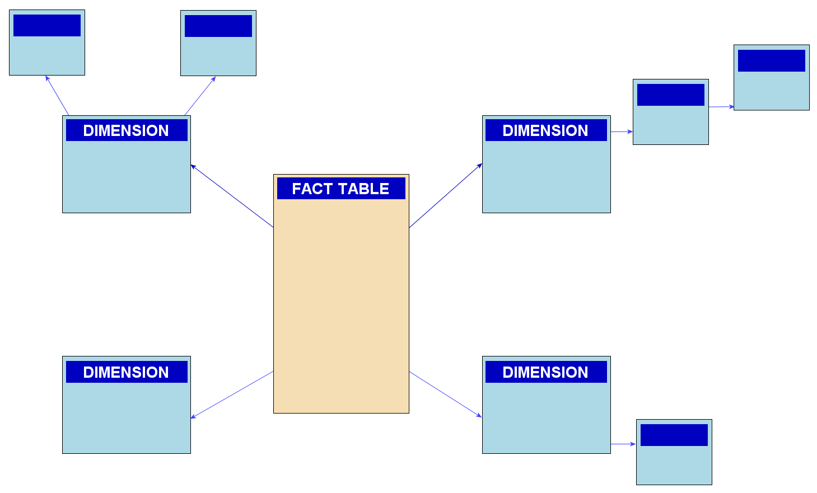
Snowflake Schema: Normalized Dimensions

Slide 40
Snowflaking a Product Dimension
Split shared hierarchy attributes into reference tables
Product stores brand_key and category_key
Benefit: less repetition and stronger governance
Cost: extra joins unless a mart denormalizes back
Product key
Product name
Product code
Brand key
Brand key
Brand name
Category key
Category key
Product category

Slide 41
Partitioning and Clustering Strategy
Partition large facts by the dominant time filter, usually date_key
Align partition granularity with query patterns and retention policy
Cluster or sort on common filters such as customer_key or product_key
Avoid tiny partitions and small files; they add metadata overhead
Validate design with bytes scanned, partitions read, and p95 latency

Slide 42
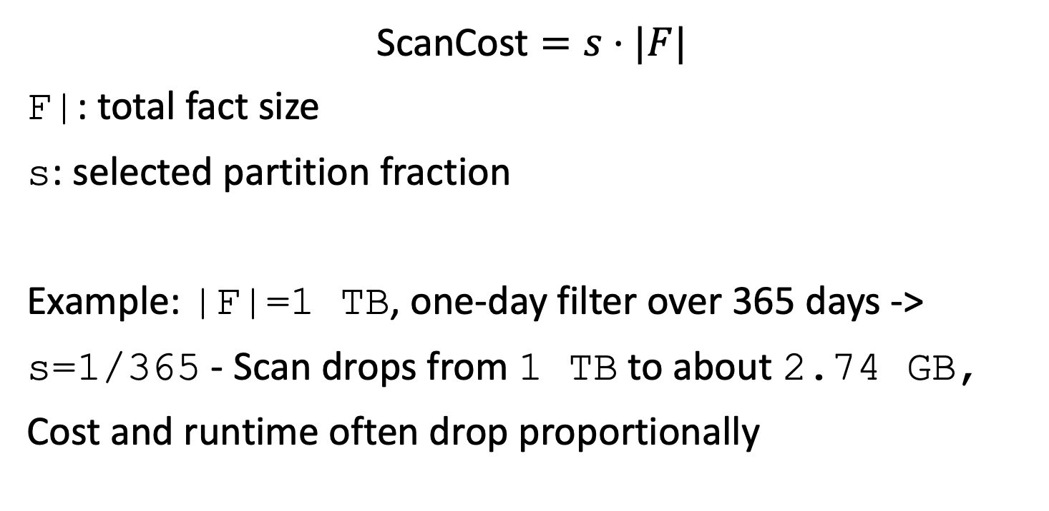
Partition Pruning Cost Model
$$\text{ScanCost}=s⋅|F|$$
F|: total fact size
s: selected partition fraction
Example: |F|=1 TB, one-day filter over 365 days -> s=1/365 - Scan drops from 1 TB to about 2.74 GB, Cost and runtime often drop proportionally

Slide 43
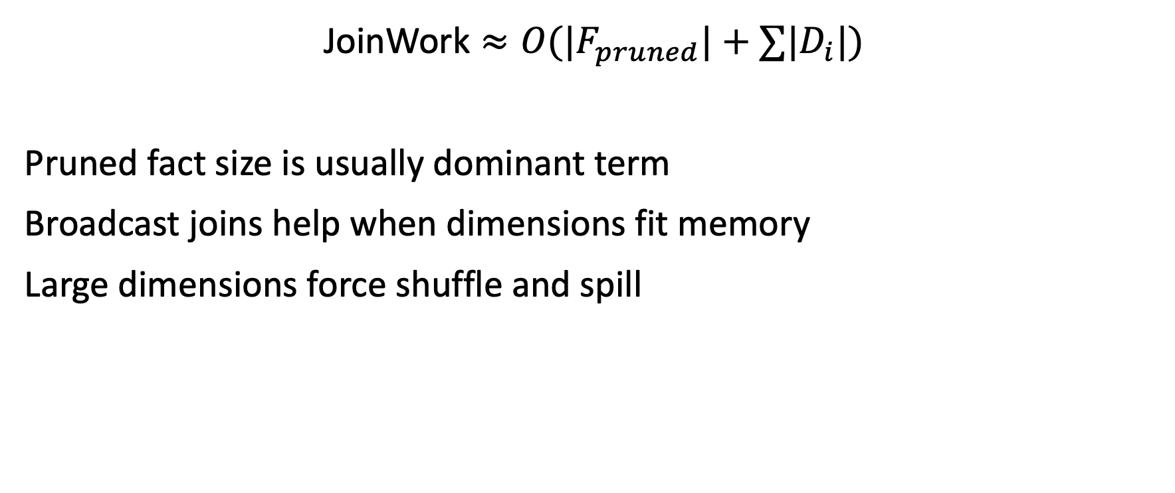
Join Cost Intuition
$$\text{JoinWork}≈O(|F_{pruned}|+∑|D_{i}|)$$
Pruned fact size is usually dominant term
Broadcast joins help when dimensions fit memory
Large dimensions force shuffle and spill

