Slide 1
DWH + ETL (Part 2)

Slide 2
Learning Objectives
Define fact grain and dimension strategy for accurate metrics
Compare star, snowflake, and galaxy schemas
Quantify partition pruning and join-cost effects on performance
Apply governance controls that prevent full scans and metric drift

Slide 3
Why This Topic Is Core to the Course
Most analytics cost/latency issues are modeling issues
Wrong grain or keys creates incorrect KPIs
Partition mistakes can multiply compute cost by 100x+
Governance must be encoded in data model and tooling

Slide 4
Fact and Dimension Fundamentals
Fact table: measurable events at declared grain
Dimension table: descriptive context for slicing metrics
Measures: additive or semi-additive numeric fields
Hierarchy: drill path (day -> month -> quarter -> year)

Slide 5
The Multi-Dimensional Model
Store Info
Key columns joining fact table
to dimension tables
Numerical Measures
Prod Code Time Code Store Code Sales Qty
Fact table for
measures
Product Info
Dimension tables
Time Info

Slide 6
Dimensional Modeling
Dimensions are organized into hierarchies
E.g., Time dimension: days → weeks → quarters
E.g., Product dimension: product → product line → brand
Dimensions have attributes
E.g., Time dimension: date, month, year
E.g., Store dimension: id, city, state, country

Slide 7
A Concept Hierarchy: Dimension (location)
all
all
region
Europe
...
North_America
country
Germany
...
Spain
Canada
...
Mexico
city
Frankfurt
...
Vancouver
...
Toronto
office
L. Chan
...
M. Wind

Slide 8
Declaring Fact Grain (Non-Negotiable)
Example grain: one row per sold order line
Grain determines valid aggregations and uniqueness
If grain is ambiguous, double counting is likely
Document grain and keys before writing ETL

Slide 9
Measure Types and Aggregation Rules
Additive: revenue, qty (sum across all dimensions)
Semi-additive: inventory_balance (sum across product, not across time)
Non-additive: ratios like conversion_rate
Define aggregation semantics in semantic layer

Slide 10
Surrogate Keys and Natural Keys
Natural key: source identifier (customer_id)
Surrogate key: warehouse-managed key (customer_key)
Surrogates isolate BI model from source key changes
Facts should join dimensions by surrogate key

Slide 11
Slowly Changing Dimensions (SCD)
Type 1: overwrite old value (no history)
Type 2: keep history with validity window
Type 3: limited history in extra columns
Choose by business need for historical truth

Slide 12
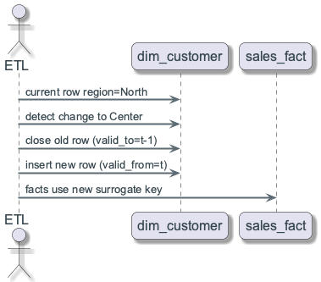
SCD Example: Customer Region Change
Customer moves from North to Center
Type 1: all past sales appear as Center
Type 2: past sales remain North, new sales Center
BI finance usually requires Type 2 for auditability
SCD Type 2 sequence

Slide 13
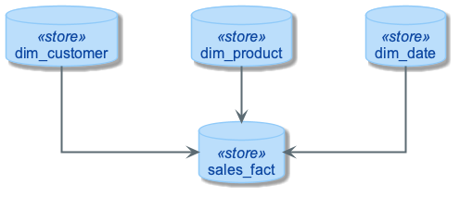
Star Schema (Default)

Slide 14
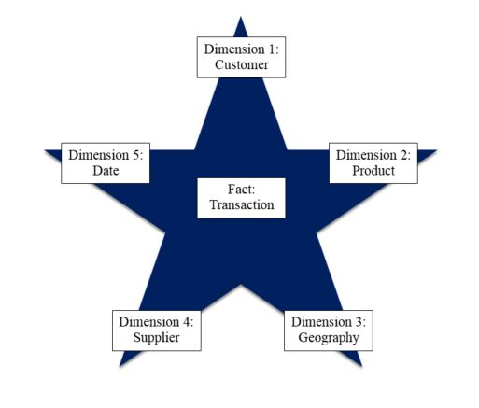
The “Classic” Star Schema
A relational model with a one-to-many relationship between dimension table and fact table.
A single fact table, with detail and summary data
Fact table primary key has only one key column per dimension
Each dimension is a single table, highly denormalized
Notes:
7
The Star is built for simplicity and speed. Forget everything you learned about designing relational databases. The Star Schema makes no excuses for the rules it breaks. The assumption behind it is that the database is static or ìquiet,î meaning that no updates are performed on-line.
Remember that most of the rules of relational database design are derived from the need to maintain atomicity, consistency and integrity (the ìACIDî test) in an On-Line Transaction Processing (OLTP) environment. Since the data warehouse is quiet, these constraints can be relaxed.

Slide 15
Snowflake Schema
Dimensions normalized into sub-dimensions
“Snowflaking” = normalizing dimension tables in a star schema
Reduces redundancy in large hierarchical dimensions
More joins and potentially higher latency
Useful when large hierarchical dimensions dominate maintenance and storage cost

Slide 16
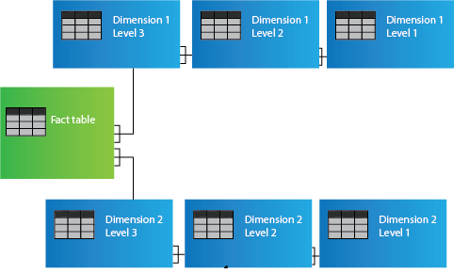
Snowflake Schema

Slide 17
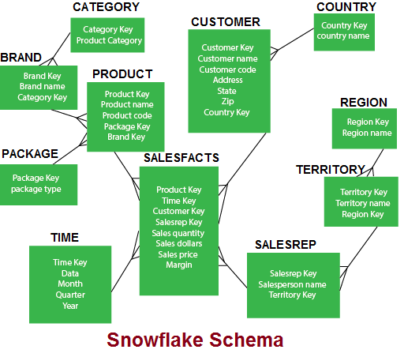
Example of Snowflake Schema

Slide 18
Snowflaking
The attributes with low cardinality in each original dimension table are removed to form separate tables. These new tables are linked back to the original dimension table through artificial keys.
Product key
Product name
Product code
Brand key
Brand key
Brand name
Category key
Category key
Product category

Slide 19
Incident: Full-Scan Dashboard Outage
Dashboard ran every 5 minutes on a 1 TB fact table
Missing date predicate caused full scans each refresh
Concurrent scans saturated cluster slots
Root cause: no guardrail for partition-filter enforcement

Slide 20
Partitioning Strategy
Partition large facts by dominant time filter (date_key)
Keep partition granularity aligned to query patterns
Use clustering/sorting on secondary filters (customer_key, product_key)
Avoid over-partitioning into tiny files

Slide 21
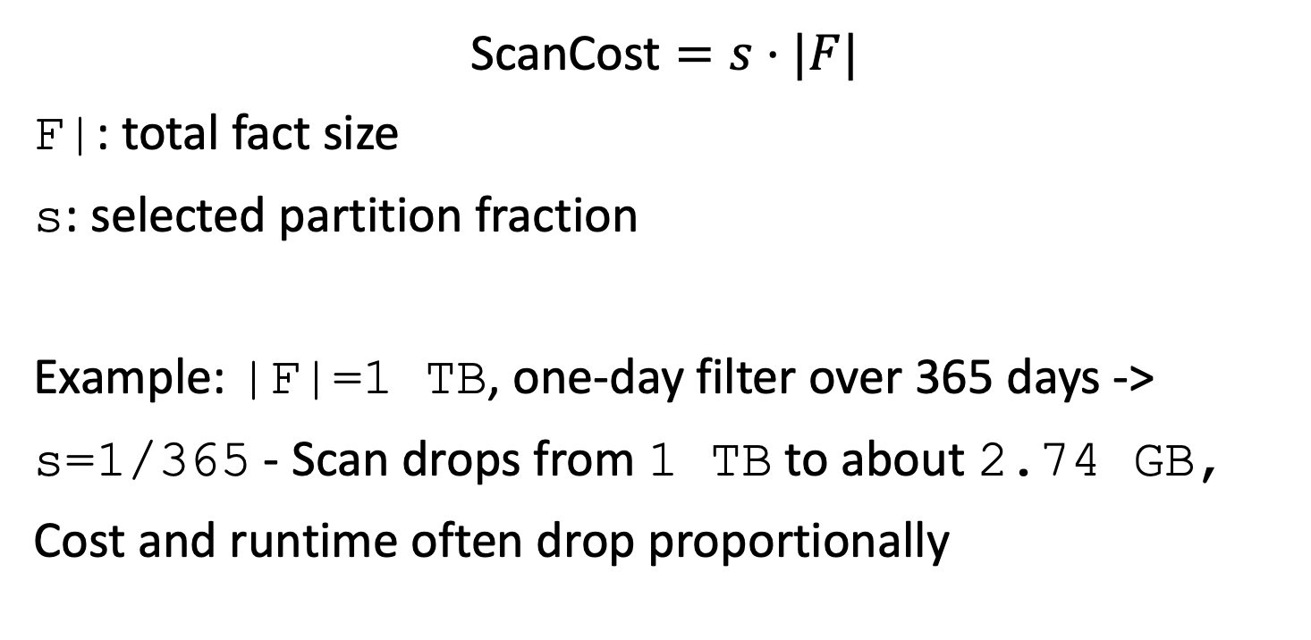
Partition Pruning Cost Model
$$\text{ScanCost}=s⋅|F|$$
F|: total fact size
s: selected partition fraction
Example: |F|=1 TB, one-day filter over 365 days -> s=1/365 - Scan drops from 1 TB to about 2.74 GB, Cost and runtime often drop proportionally

Slide 22
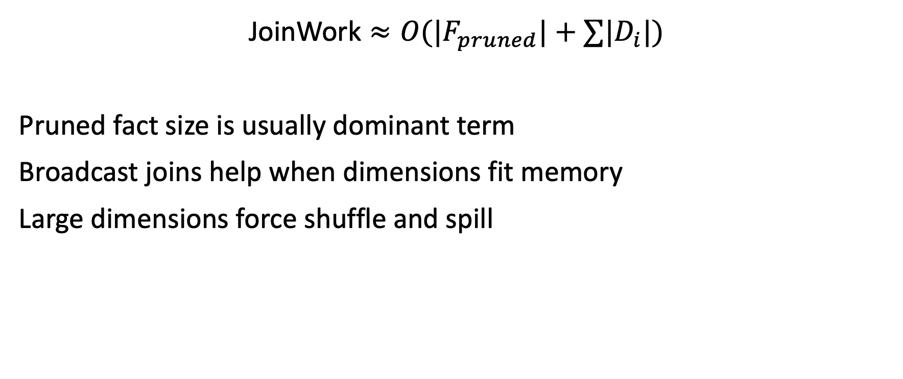
Join Cost Intuition
$$\text{JoinWork}≈O(|F_{pruned}|+∑|D_{i}|)$$
Pruned fact size is usually dominant term
Broadcast joins help when dimensions fit memory
Large dimensions force shuffle and spill

Slide 23
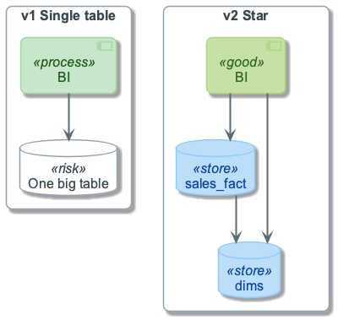
Architecture Evolution (v1 -> v2)
v1: one fact, few dimensions, manual definitions
v2: conformed dimensions, semantic contracts, cost guardrails
Add complexity only where workload proves need
Plan migration path to avoid breaking dashboards
Architecture evolution

Slide 24
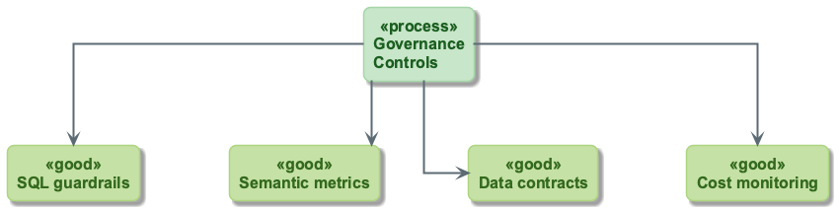
Governance Controls
SQL guardrail: block large-fact queries without time filter
Semantic layer: certified metric definitions
Data contracts: required fields and grain constraints
Cost monitoring: bytes scanned, slots consumed, partitions read

Slide 25
Operational Metrics
Bytes scanned per dashboard refresh
Partitions scanned per query
Query latency p50/p95 and queue time
Compaction backlog and small-file count

