Slide 1
MapReduce Algorithm

Slide 2
Purpose & Learning Objectives
Purpose: Learn the core model behind distributed processing. Learning Objectives:
Explain map, shuffle, and reduce as formal operators
Estimate runtime
Use combiners and partitioning strategies safely

Slide 3
Motivation
Process lots of data
Google processed about 24 petabytes of data per day in 2009.
A single machine cannot serve all the data
You need a distributed system to store and process in parallel
Parallel programming?
Threading is hard!
How do you facilitate communication between nodes?
How do you scale to more machines?
How do you handle machine failures?

Slide 4
Google’s Solution
Google solved this problem using an algorithm called MapReduce.
This algorithm divides the task into small parts and assigns them to many computers, and collects the results from them which when integrated, form the result dataset.
Centralized
System
User

Slide 5
Google’s Solution
Problem: Can’t use a single computer to process the data.
Solution: Use a group of interconnected computers.
Problem: Conventional algorithms are not designed around memory independence.
Solution: MapReduce
Definition. MapReduce is a programming paradigm model of using parallel, distributed algorithms to process or generate data sets.

Slide 6
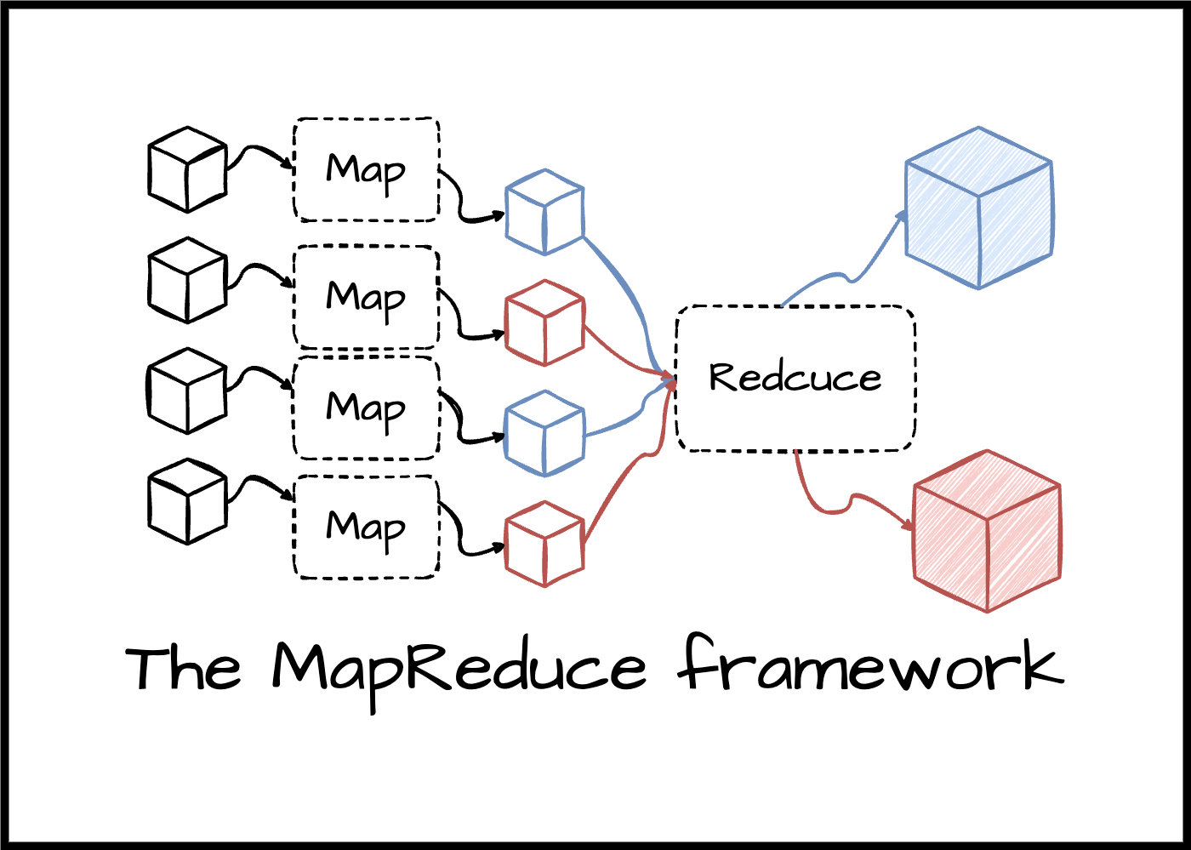
How Is It Work?
The MapReduce algorithm contains two important tasks:
The Map task takes a set of data and converts it into another set of data, where individual elements are broken down into tuples.
The Reduce task takes the output from the Map as an input and combines those tuples into a smaller set of tuples.
The reduce task is always performed after the map job.

Slide 7
Why MapReduce Matters
Single-node processing can not handle big-data.
MapReduce use parallel micro-batches with aggregation.
The real “cost center” is moving and consolidating data (shuffle), not local computation.
SQL lens: MapReduce is a physical execution model for GROUP BY and JOIN at scale.

Slide 8
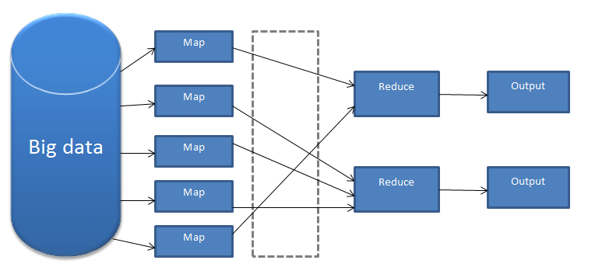
How Is It Work?

Slide 9
MapReduce workflow
Input Data
Output Data
Worker
write
Output
File 0
local
write
Worker
Split 0
read
Split 1
Worker
Split 2
Output
File 1
Worker
Worker
remote
read,
sort
Map
extract something you care about from each record
Reduce aggregate, summarize, filter, or transform

Slide 10
MapReduce Architecture
Input Phase − Here we have a Record Reader that translates each record in an input file and sends the parsed data to the mapper.
Map − Map is a user-defined function, which takes a series of key-value pairs and processes each one of them to generate zero or more key-value pairs.
Input
Input
Input
Input
Input
Map
Map
Map
Map
Map

Slide 11
MapReduce Architecture
Intermediate Keys − They key-value pairs generated by the mapper are known as intermediate keys.
Combiner (Optional) − A combiner is a type of local Reducer that groups similar data from the map phase into identifiable sets.
Input
Input
Input
Input
Input
Map
Map
Map
Map
Map
Keys
Keys
Keys
Keys
Keys
Combiner

Slide 12
MapReduce Architecture - Sorting
Input
Input
Input
Input
Input
Map
Map
Map
Map
Map
Keys
Keys
Keys
Keys
Keys
Combiner
S/S
S/S
S/S
S/S

Slide 13
MapReduce Architecture - Reduce
Input
Input
Input
Input
Input
Map
Map
Map
Map
Map
Keys
Keys
Keys
Keys
Keys
Combiner
S/S
S/S
S/S
S/S
Reduce
Reduce
Reduce
Reduce

Slide 14
Why Shuffle Is the Bottleneck?
All map outputs must be redistributed by key.
Network + disk spill dominate total runtime.
CPU can be idle while waiting for shuffle.
SQL lens:
This is like a global GROUP BY needing a full data repartition.

Slide 15
Example
Input
Split
Map
Shuffle & Sort
Reduce
A B R
C C R
A C B

Slide 16
Example
Input
Split
Map
Shuffle & Sort
Reduce
A B R
A B R
C C R
A C B
C C R
A C B

Slide 17
Example
Input
Split
Map
Shuffle & Sort
Reduce
A B R
A, 1
B, 1
R, 1
A B R
C C R
A C B
C C R
C, 1
C, 1
R, 1
A C B
A, 1
C, 1
B, 1

Slide 18
Example
Input
Split
Map
Shuffle & Sort
Reduce
A B R
A, 1
B, 1
R, 1
A, 1
A, 1
A B R
C C R
A C B
B, 1
B, 1
C C R
C, 1
C, 1
R, 1
C, 1
C, 1
C, 1
A C B
A, 1
C, 1
B, 1
R, 1
R, 1

Slide 19
Example
Input
Split
Map
Shuffle & Sort
Reduce
A B R
A, 1
B, 1
R, 1
A, 1
A, 1
A, 2
B, 2
C, 3
R, 2
A B R
C C R
A C B
B, 1
B, 1
C C R
C, 1
C, 1
R, 1
C, 1
C, 1
C, 1
A C B
A, 1
C, 1
B, 1
R, 1
R, 1

Slide 20

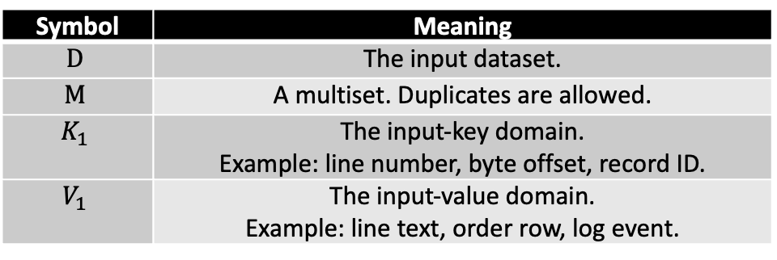
MR Algorithm – Formal Definition
Given dataset $D∈M\left(K_{1}×V_{1}\right),$ where:
The mapper $m$transform input record $(k_{1},v_{1})∈K_{1}×V_{1}$ to
$m : K_{1}×V_{1}→M(K_{2}×V_{2})$
The reducer $r$ transforms grouped records into $r:K_{2}×M(V_{2})→M(K_{3}×V_{3})$
Symbol | Meaning
$$D$$ | The input dataset.
$$M$$ | A multiset. Duplicates are allowed.
$$K_{1}$$ | The input-key domain. Example: line number, byte offset, record ID.
$$V_{1}$$ | The input-value domain. Example: line text, order row, log event.

Slide 21
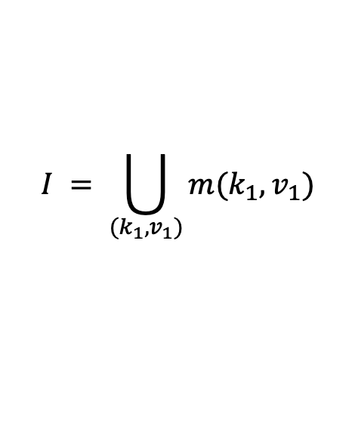
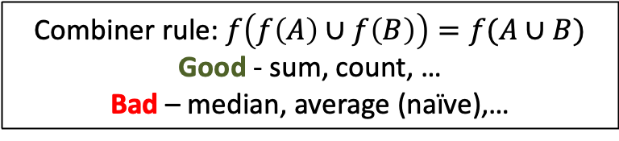
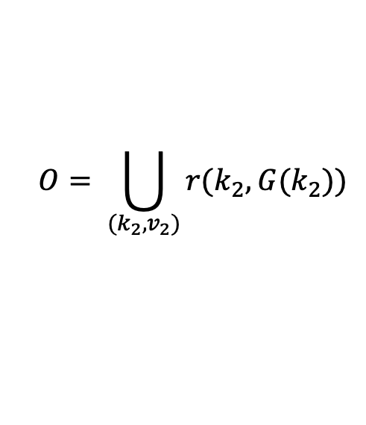
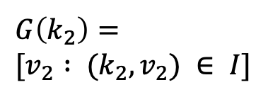

Job Definition
Map all records
$$I = \bigcup_{(k_{1},v_{1})}{m(k_{1},v_{1})}$$
Partition
$$p(k_{2})=h(k_{2}) mod R$$
Shuffle/group
$$G\left(k_{2}\right)= \\ [v_{2} : (k_{2},v_{2}) ∈ I]$$
Reduce
Combiner rule: $f\left(f\left(A\right)∪f\left(B\right)\right)=f(A∪B)$
Good - sum, count, …
Bad – median, average (naïve),…
$$O= \bigcup_{(k_{2},v_{2})}{r(k_{2},G(k_{2}))}$$
Or Peretz
22

Slide 22
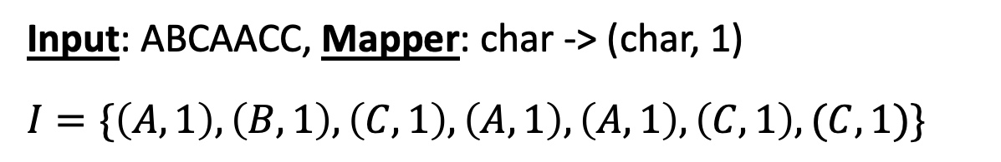
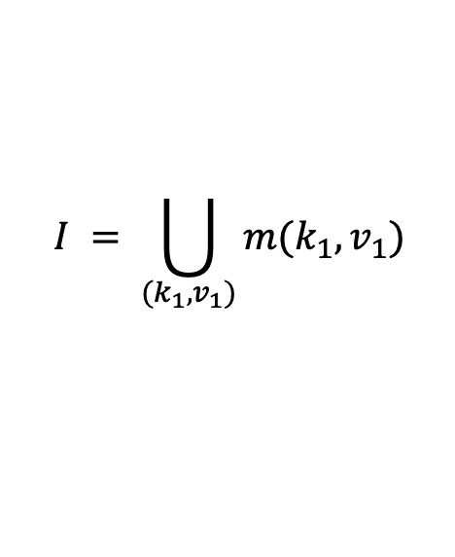
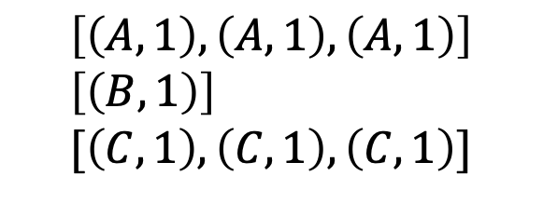
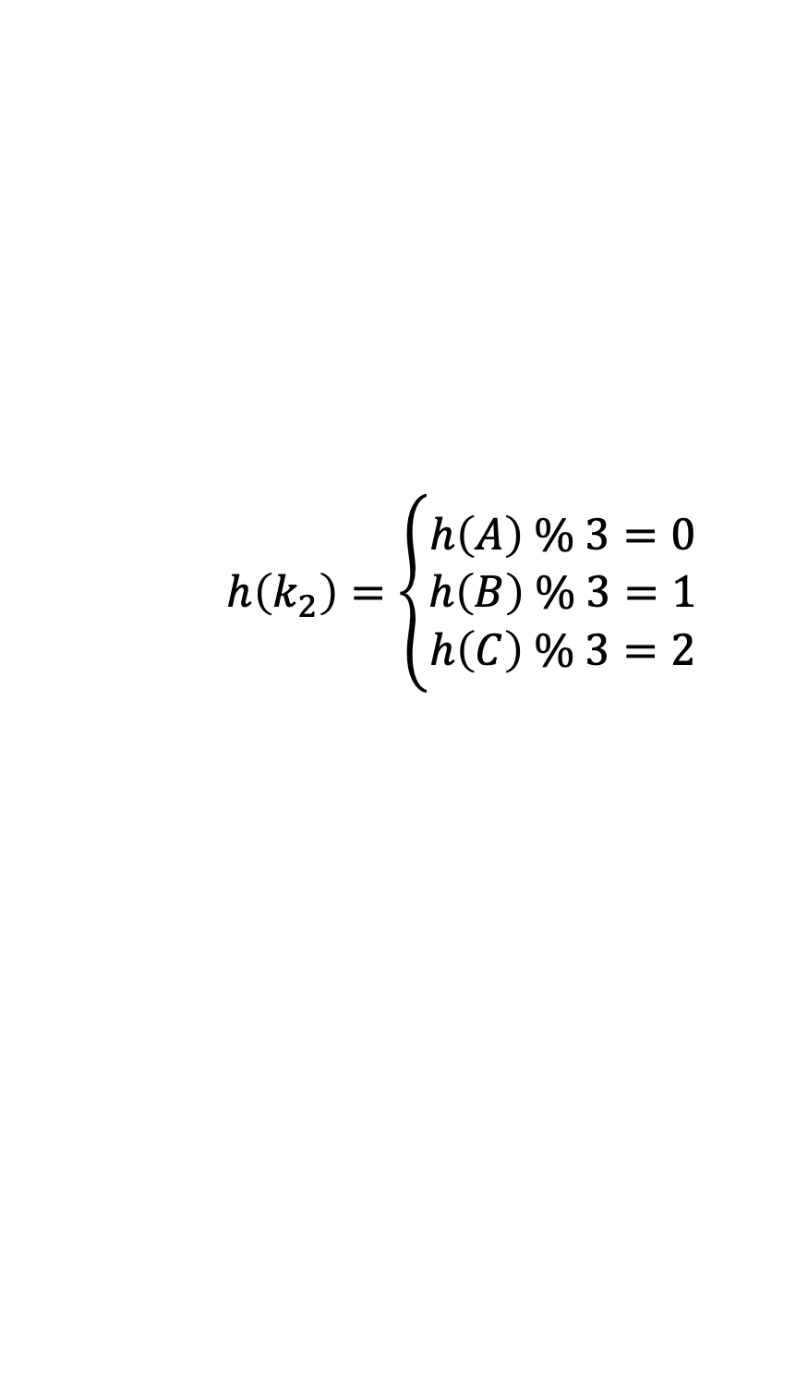

Example
Map all records
Input: ABCAACC, Mapper: char -> (char, 1)
$I=\{\left(A,1\right), \left(B,1\right), \left(C,1\right),\left(A,1\right), \left(A,1\right),\left(C,1\right),(C,1)\}$
$$I = \bigcup_{(k_{1},v_{1})}{m(k_{1},v_{1})}$$
Partition
$$p(k_{2})=h(k_{2}) mod R$$
$$h\left(k_{2}\right)=\left\{\begin{aligned}h\left(A\right) \% 3=0 \\ h\left(B\right) \% 3=1 \\ h\left(C\right) \% 3=2\end{aligned}\right.$$
$$\left[\left(A,1\right),\left(A,1\right),\left(A,1\right)\right] \\ \left[\left(B,1\right)\right] \\ [\left(C,1\right),\left(C,1\right),\left(C,1\right)]$$
Or Peretz
23

Slide 23

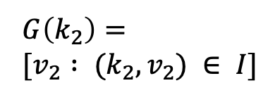

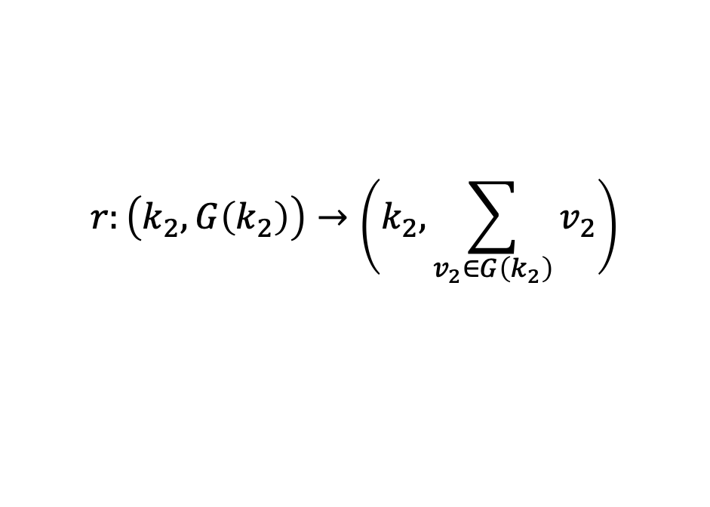


Mapper
$$G\left(A\right)=\left[1,1,1\right] \\ G\left(B\right)=[1] \\ G\left(C\right)=[1,1,1]$$
Shuffle/group
$$G\left(k_{2}\right)= \\ [v_{2} : (k_{2},v_{2}) ∈ I]$$
Reduce
$$r:\left(k_{2},G\left(k_{2}\right)\right)→\left(k_{2},\sum_{v_{2}∈G\left(k_{2}\right)}{v_{2}}\right)$$
$$O= \bigcup_{(k_{2},v_{2})}{r(k_{2},G(k_{2}))}$$
$$r\left(A, \left[1,1,1\right]\right)=\left(A,3\right) \\ r\left(B, \left[1\right]\right)=\left(B,1\right) \\ r\left(C,\left[1,1,1\right]\right)=(C,3)$$
$$O=\{\left(A,3\right),\left(B,1\right),(C,3)\}$$
Or Peretz
23

Slide 24
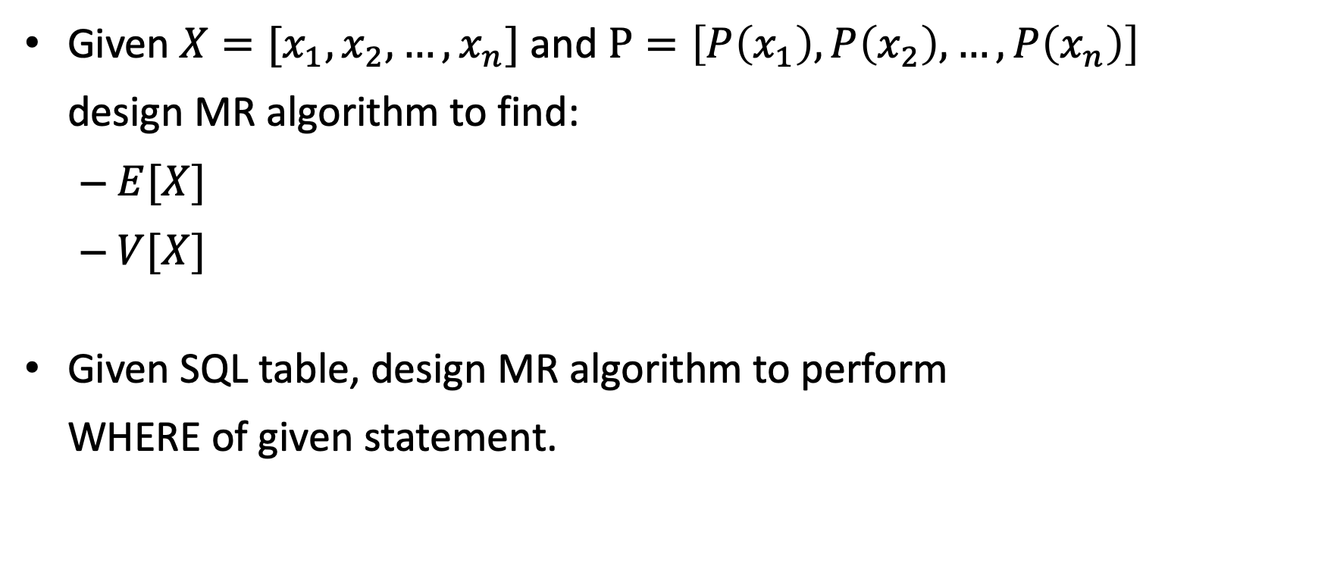
Exercises
Given $X=[x_{1},x_{2},…,x_{n}]$ and $P=\left[P\left(x_{1}\right),P\left(x_{2}\right),…,P\left(x_{n}\right)\right]$ design MR algorithm to find:
$E[X]$
$V[X]$
Given SQL table, design MR algorithm to perform WHERE of given statement.

