Slide 1
Regex & TF-IDF

Slide 2
Learning Path
Each block builds the input needed by the next one.
Messy text: tickets, complaints, logs.
Regex: extract and normalize fields.
Tokens: create stable units for counting.
TF-IDF: combine local focus with global rarity.
Pipeline: implement the stages and control operational risks.

Slide 3
Why Text Analytics Matters
Most operational signals arrive as text before they become structured data. The goal is not to read everything manually. The goal is to turn language into auditable features.
Source | Typical signal
Tickets | delays, faults, queues
Logs | errors, timeouts, retries
Complaints | refunds, churn, severity
Surveys | free-text satisfaction
Notes | supplier and field context

Slide 4
From Raw Text to Structured Features
Regex is usually the first stabilizing step in the pipeline.
Every transformation should be explainable, repeatable, and testable on examples.
Step | Example
Raw | Printer JAM!!! Ticket=TKT-1042
Extract | ticket_id = TKT-1042
Normalize | printer jam ticket tkt 1042
Tokens | printer, jam, ticket, tkt, 1042

Slide 5
Regex Basics as Building Blocks
A regex is a small grammar for matching text.
Combined pattern:
\bTKT-\d{4,6}\b
Building block | Pattern | Meaning
Literal | TKT | match these characters
Character class | \d | match one digit
Quantifier | {4,6} | repeat 4 to 6 times
Boundary | \b | do not leak into neighboring text

Slide 6
Character Classes: What Counts as a Match?
Classes define the alphabet that a pattern can consume.
Changing the class changes the evidence collected downstream.
Pattern | Meaning | Example match
\d | one digit | 7 in delay 7 days
\d+ | one or more digits | 1200 in USD 1200
[A-Z]+ | uppercase letters | ERR in ERR-404
\w+ | word characters | printer

Slide 7
Quantifiers Encode Business Rules
Quantifiers specify how many times the previous unit may repeat. TKT-\d{4,6}
{4,6} is the rule: valid ticket IDs contain 4 to 6 digits.
When this rule changes, historical data quality changes too. Document it.
Text | Decision
TKT-1042 | accept
TKT-998877 | accept
TKT-12 | reject
TKT-1042A | reject

Slide 8
Cleaning Example
Raw: "Printer JAM!!! Ticket=TKT-1042"
Extract ID: TKT-1042 becomes a field.
Lowercase: Printer JAM becomes printer jam.
Punctuation: replace punctuation with spaces.
Tokenize: split into stable terms.
Tokens:
printer | jam | ticket | tkt | 1042

Slide 9
Regex Case: Amount Extraction
Groups separate the currency from the numeric value.
(USD|ILS|EUR)\s?(\d+(?:\.\d{1,2})?)
Text: refund USD 120.50 requested Group 1: currency = USD Group 2: amount = 120.50
(?:\.\d{1,2})? is a non-capturing group. It structures the pattern without creating another output field.

Slide 10
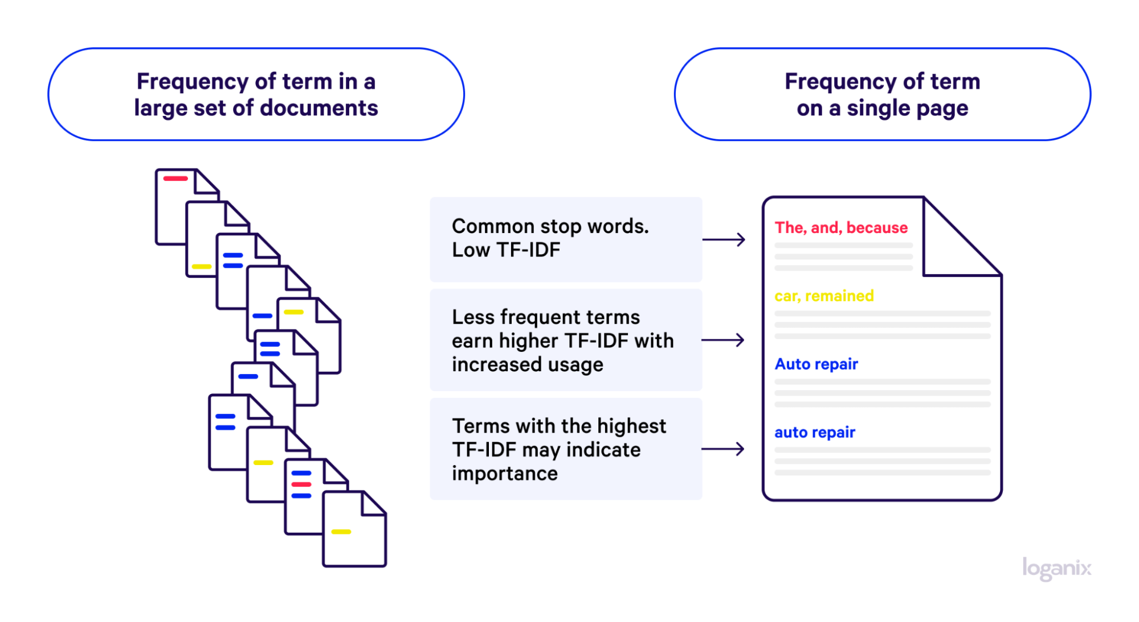
TF-IDF Mechanics
Local frequency, global rarity, and worked calculations.

Slide 11
TF-IDF Intuition
A high score needs both local focus and global rarity.
TF-IDF = local focus × global rarity.
Component | Question | Example
Term frequency | How much does this document talk about the term? | jam = 0.67, printer = 0.33
Inverse document frequency | How rare is this term across the corpus? | outage = 1.10, jam = 0.69

Slide 12
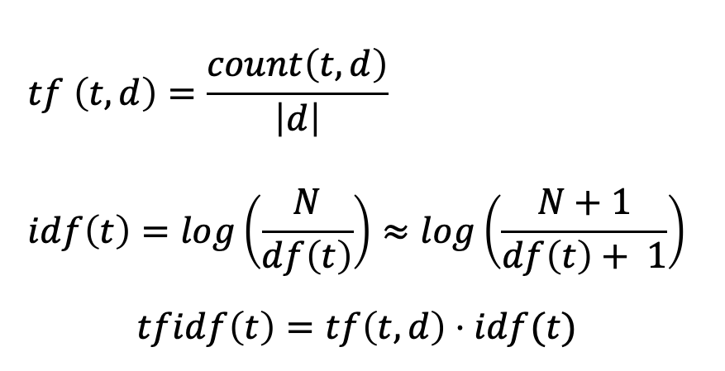
Notation Cheat Sheet
$$tf \left(t,d\right)=\frac{count\left(t,d\right)}{\left|d\right|} \\ idf\left(t\right)=log\left(\frac{N}{df\left(t\right)}\right)≈log\left(\frac{N+1}{df\left(t\right)+ 1}\right)$$
$$tfidf\left(t\right)=tf\left(t,d\right)⋅idf(t)$$
Symbol | Meaning
t | term after preprocessing
d | one document
N | number of documents
count(t,d) | count of term t in document d
|d| | number of tokens in document d
df(t) | number of documents containing t

Slide 13
Document 1 data science uses data.
Document 2 data engineering builds pipelines.
Document 3 science uses experiments.
Document 4 engineering uses data pipelines.
Example

Slide 14
Step 1: Counts
Term | S1 | S2 | S3 | S4
data | 2 | 1 | 0 | 1
science | 1 | 0 | 1 | 0
uses | 1 | 0 | 1 | 1
engineering | 0 | 1 | 0 | 1
builds | 0 | 1 | 0 | 0
pipelines | 0 | 1 | 0 | 1
experiments | 0 | 0 | 1 | 0

Slide 15
Step 2: Term Frequency (TF)
$$\frac{count of t in d}{number of words in d}$$
Term | S1 | S2 | S3 | S4
data | 0.5 | 0.25 | 0 | 0.25
science | 0.25 | 0 | 0.333 | 0
uses | 0.25 | 0 | 0.333 | 0.25
engineering | 0 | 0.25 | 0 | 0.25
builds | 0 | 0.25 | 0 | 0
pipelines | 0 | 0.25 | 0 | 0.25
experiments | 0 | 0 | 0.333 | 0

Slide 16
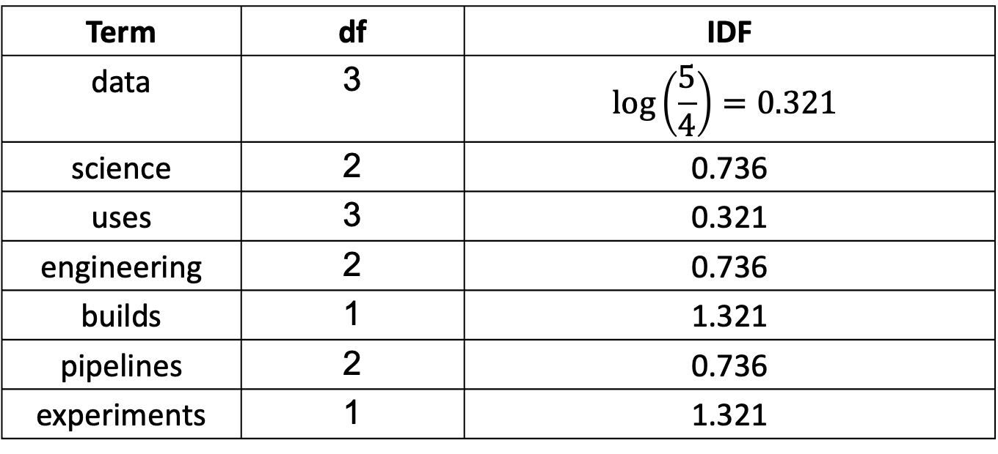
Step 3: Inverse Document Frequency (IDF)
$$\log\left(\frac{N+1}{DF\left(t\right)+1}\right), N=4$$
Term | df | IDF
data | 3 | $$\log\left(\frac{5}{4}\right)=0.321$$
science | 2 | 0.736
uses | 3 | 0.321
engineering | 2 | 0.736
builds | 1 | 1.321
pipelines | 2 | 0.736
experiments | 1 | 1.321

Slide 17
Step 4: TF-IDF
Term | S1 | S2 | S3 | S4
data | 0.161 | 0.080 | 0 | 0.080
science | 0.184 | 0 | 0.245 | 0
uses | 0.080 | 0 | 0.107 | 0.080
engineering | 0 | 0.184 | 0 | 0.184
builds | 0 | 0.330 | 0 | 0
pipelines | 0 | 0.184 | 0 | 0.184
experiments | 0 | 0 | 0.440 | 0

Slide 18
Step 4: TF-IDF
Term | S1 | S2 | S3 | S4
data | 0.161 | 0.080 | 0 | 0.080
science | 0.184 | 0 | 0.245 | 0
uses | 0.080 | 0 | 0.107 | 0.080
engineering | 0 | 0.184 | 0 | 0.184
builds | 0 | 0.330 | 0 | 0
pipelines | 0 | 0.184 | 0 | 0.184
experiments | 0 | 0 | 0.440 | 0

Slide 19
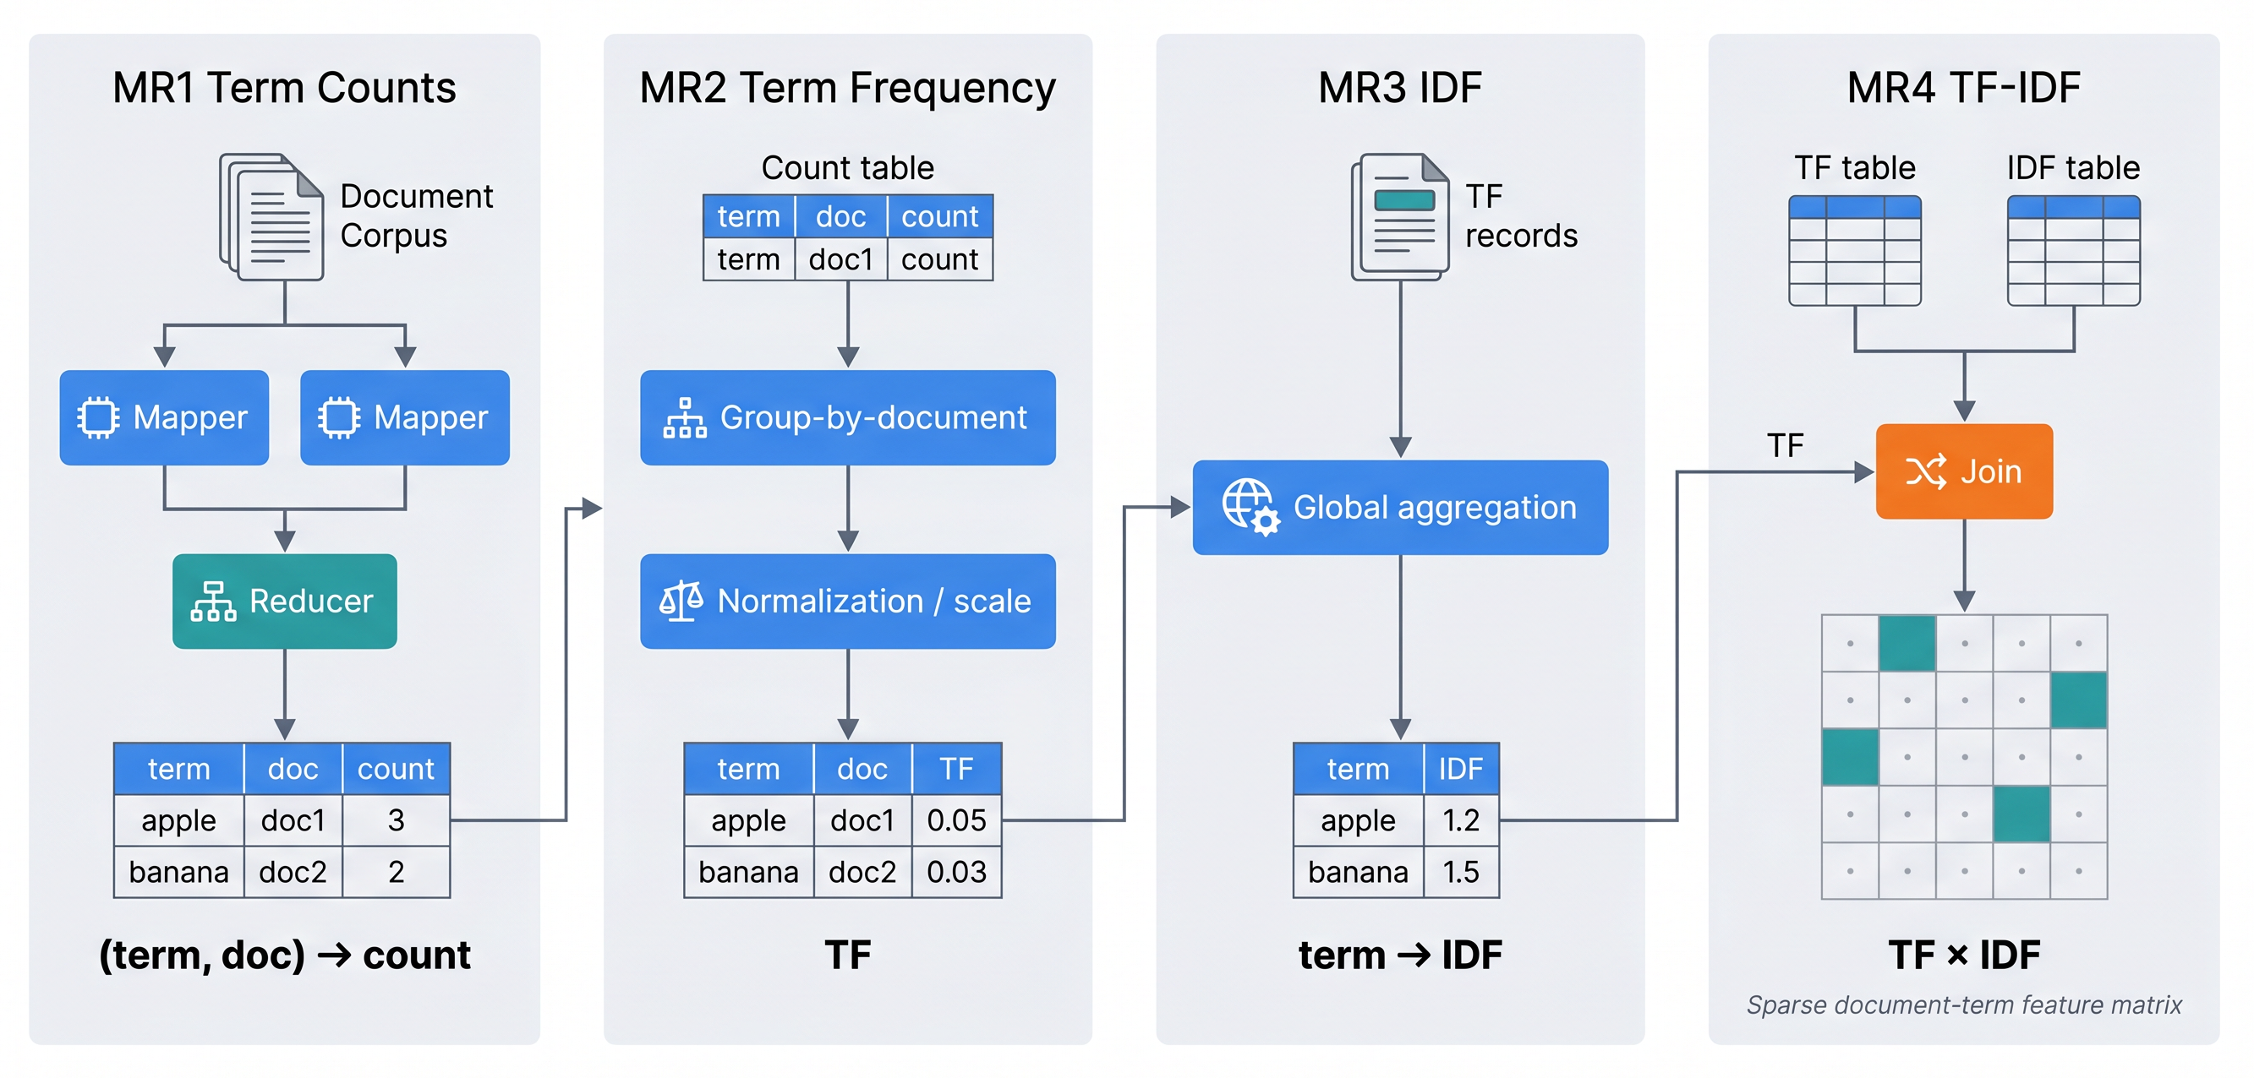
Distributed TF-IDF

Slide 20
Task 1 Mapper: Word Frequency in Doc
Mapper:
Input: (docname, contents) Output: ((word, docname), 1)
Example input:
(D1, "data science uses data.")
Example output:
((data, D1), 1), ((science, D1), 1), ((uses, D1), 1), ((data, D1), 1)

Slide 21
Task 1 Reducer: Sum Word Counts
Reducer:
Input: ((word, docname), [1, 1, ...]) Output: ((word, docname), n)
Example shuffle and reduce:
grouped key | values | reducer output
(data, D1) | [1, 1] | ((data, D1), 2)
(science, D1) | [1] | ((science, D1), 1)
(uses, D1) | [1] | ((uses, D1), 1)

Slide 22
Task 2 Mapper: Group by Document
Mapper:
Input: ((word, docname), n) Output: (docname, (word, n))
Example input from Task 1:
((data, D1), 2), ((science, D1), 1), ((uses, D1), 1)
Example output:
(D1, (data, 2)), (D1, (science, 1)), (D1, (uses, 1))

Slide 23
Task 2 Reducer: Add Document Length
Reducer:
Input: (docname, [(word, n), ...]) Output: ((word, docname), (n, doc_len))
For D1:
doc_len(D1) = 2 + 1 + 1 = 4
Reducer output:
((data, D1), (2, 4)) ((science, D1), (1, 4)) ((uses, D1), (1, 4))

Slide 24
Task 3 Mapper: Group by Word
Mapper:
Input: ((word, docname), (n, doc_len)) Output: (word, (docname, n, doc_len, 1))
Example mapper output for data:
(data, (D1, 2, 4, 1)) (data, (D2, 1, 4, 1)) (data, (D4, 1, 4, 1))
Each document contributes 1 to df(data).

Slide 25
Task 3 Reducer: Compute Document Frequency
Reducer:
Input: (word, [(docname, n, doc_len, 1), ...]) Output: ((word, docname), (n, doc_len, df))
For data:
df(data) = 1 + 1 + 1 = 3
Reducer output:
((data, D1), (2, 4, 3)) ((data, D2), (1, 4, 3)) ((data, D4), (1, 4, 3))

Slide 26
Task 4 Mapper: Calculate TF-IDF
Mapper:
Input: ((word, docname), (n, doc_len, df)) Output: ((word, docname), tfidf)
Example for (data, D1):
tf = 2 / 4 = 0.5000 idf = ln((4 + 1) / (3 + 1)) = 0.2231 tfidf = 0.5000 * 0.2231 = 0.1116
Mapper output:
((data, D1), 0.1116)

Slide 27
Task 4 Reducer: Identity Reducer
Reducer:
Input: ((word, docname), [tfidf]) Output: ((word, docname), tfidf)
Example:
Input: ((data, D1), [0.1116]) Output: ((data, D1), 0.1116)
The final score is already computed by the mapper.

Slide 28
SQL Implementation: Same Logic
In file “tf-idf.sql”.

