Slide 1
Advanced Text Analytics: N-Grams and Language Models

Slide 2
Why Unigrams Are Sometimes Not Enough
Text | Unigram problem | Needed context
not working | working looks positive alone | negation
memory leak | memory is too broad | technical phrase
late payment | late and payment separate are weaker | business event

Slide 3
N-grams preserve local word order while staying simpler than full sequence models.

Slide 4
Two Meanings of N-grams
N-gram feature: a contiguous token sequence used as a feature, e.g., not working.
N-gram language model: a probabilistic model for token sequences using a Markov assumption.
The same counted phrases can support both ideas, but they answer different questions.

Slide 5

N-gram Features: Definition
A word n-gram is a contiguous sequence of n tokens.
A unigram has n=1, a bigram has n=2, and a trigram has n=3.
For document length L, the number of n-gram windows is:
$$max(L−n+1,0)$$

Slide 6
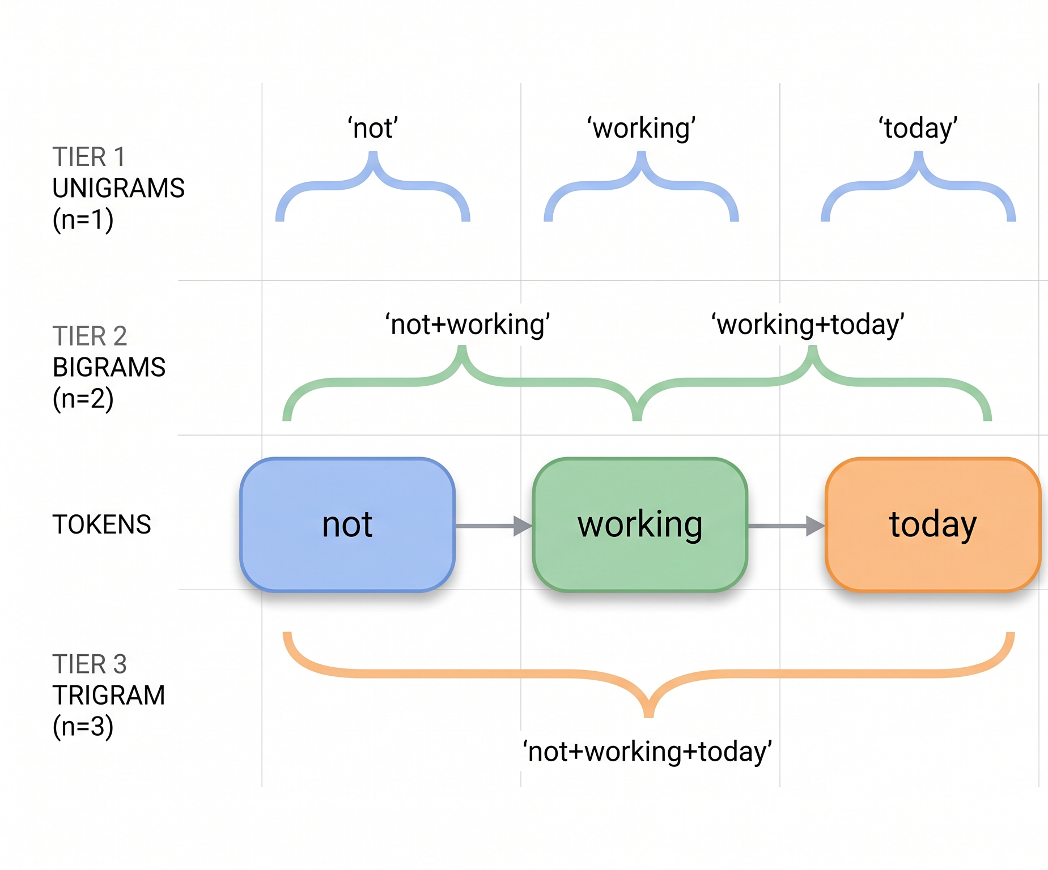
N-gram Feature Example

Slide 7
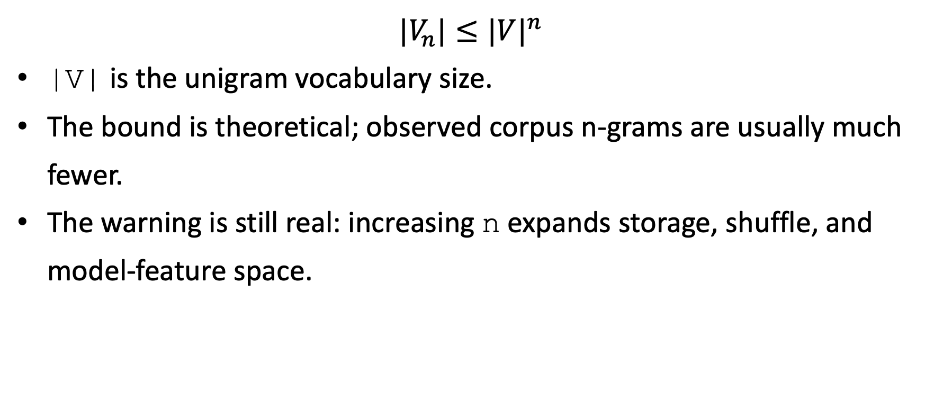
N-gram Feature Growth
$$|V_{n}|≤|V|^{n}$$
|V| is the unigram vocabulary size.
The bound is theoretical; observed corpus n-grams are usually much fewer.
The warning is still real: increasing n expands storage, shuffle, and model-feature space.

Slide 8
N-grams as TF-IDF Features
Replace term with ngram in the TF-IDF pipeline.
The TF denominator should be the number of n-gram windows in the document, not raw token length.
Example: not working today has two bigram windows, so tf("not working",d)=1/2.

Slide 9
N-gram Language Model: Definition
A language model assigns probability to a token sequence.
An n-gram language model assumes the next token depends only on the previous n-1 tokens.
This is an (n-1)-order Markov assumption over tokens.

Slide 10
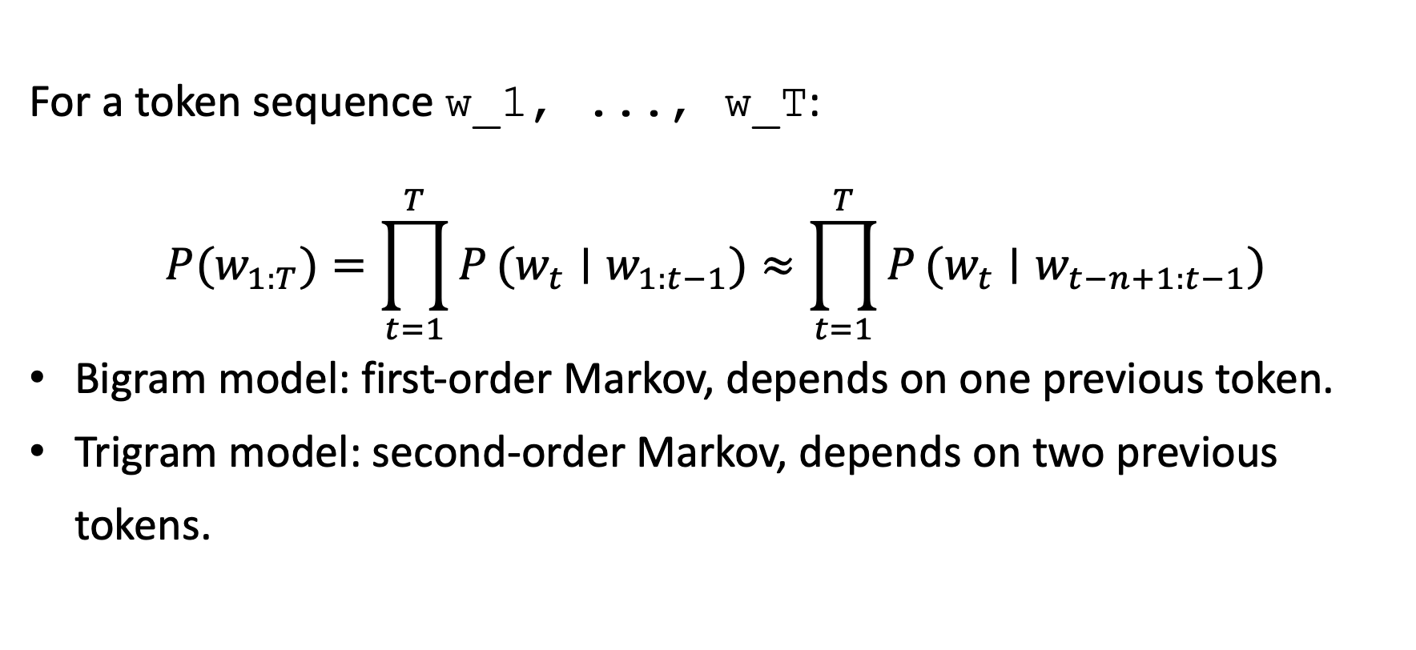
N-gram Markov Formula
For a token sequence w_1, ..., w_T:
$$P(w_{1:T})=\prod_{t=1}^{T}{P}(w_{t}∣w_{1:t−1})≈\prod_{t=1}^{T}{P}(w_{t}∣w_{t−n+1:t−1})$$
Bigram model: first-order Markov, depends on one previous token.
Trigram model: second-order Markov, depends on two previous tokens.

Slide 11
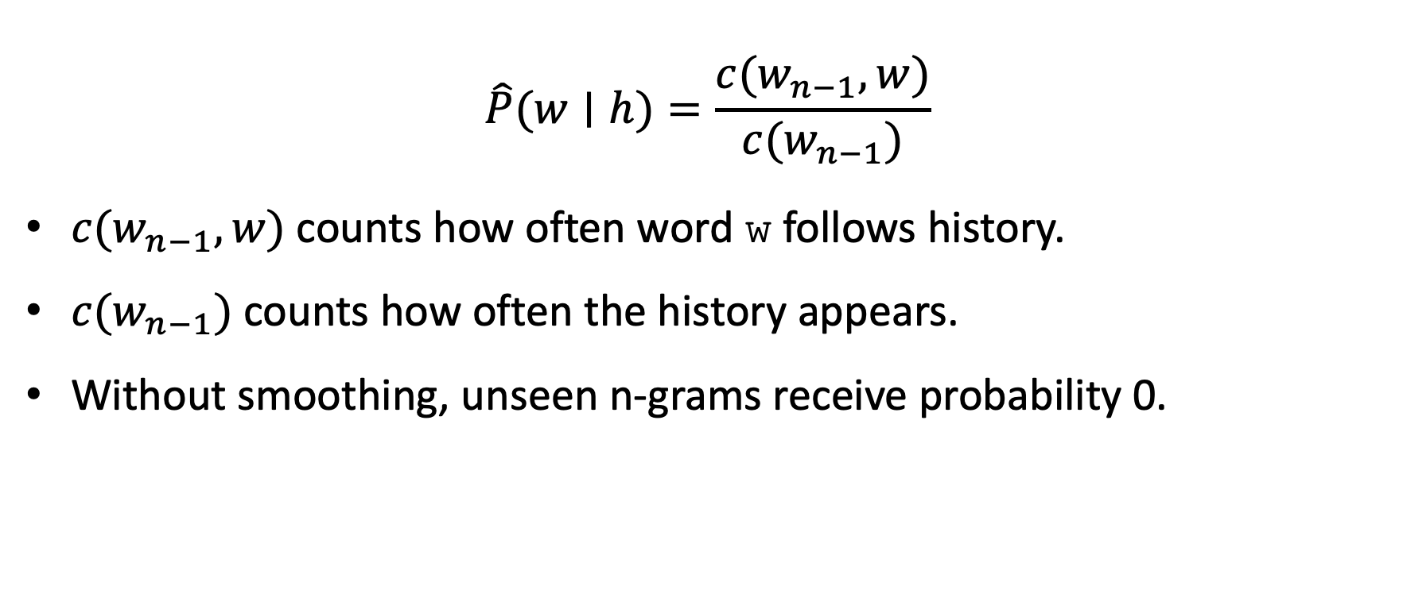
Count-Based Probability Estimate
$$\hat{P}(w∣h)=\frac{c(w_{n−1},w)}{c(w_{n−1})}$$
$c(w_{n−1},w)$counts how often word w follows history.
$c(w_{n−1})$counts how often the history appears.
Without smoothing, unseen n-grams receive probability 0.

Slide 12
Markov Example Corpus
<s> not working </s> <s> working now </s> <s> not responding </s> <s> not working </s>
<s> and </s> mark sentence boundaries.
Boundary tokens make sequence probabilities well-defined.

Slide 13
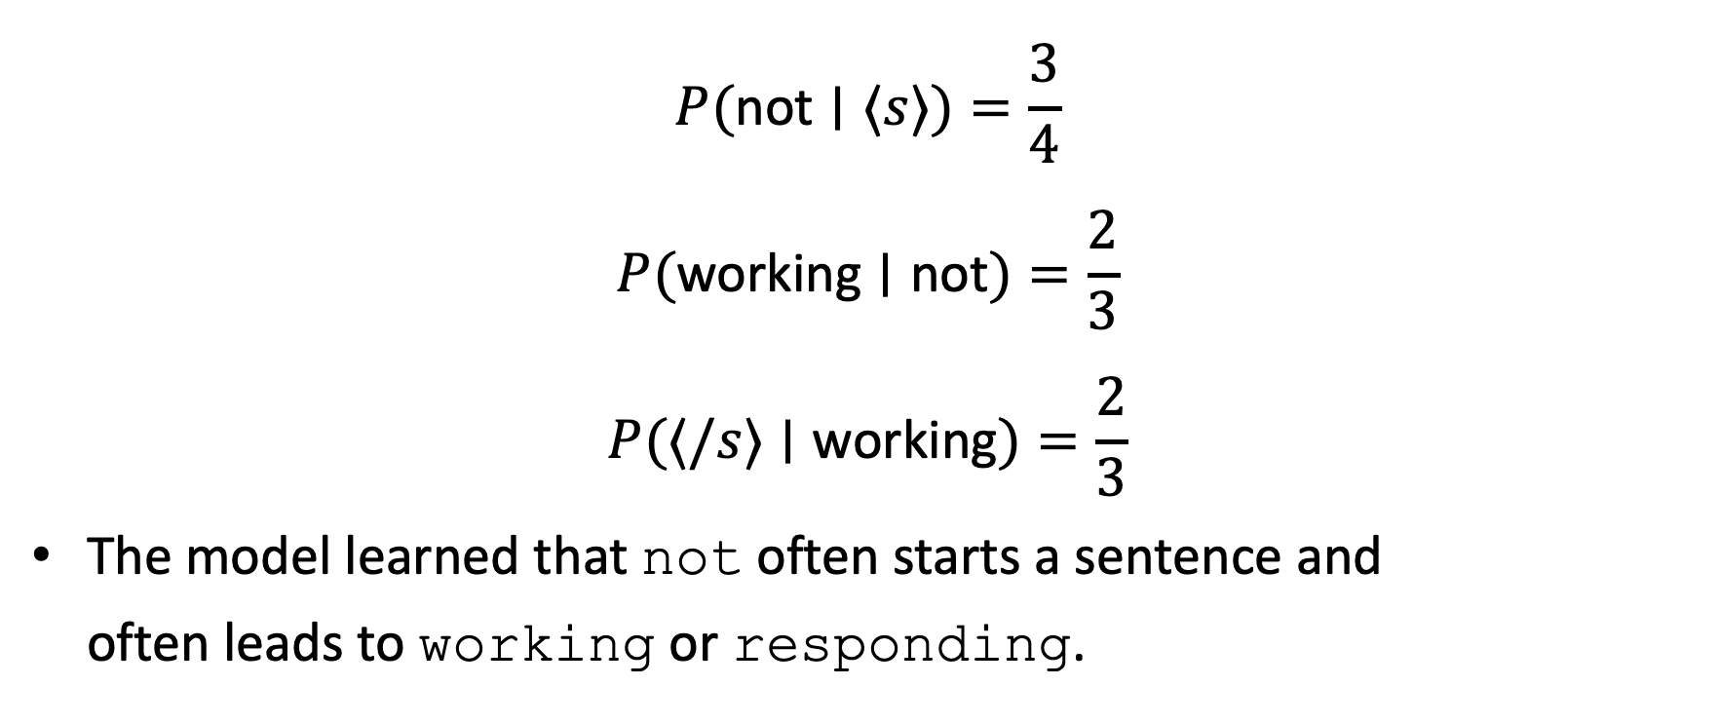
Bigram Probability Example
$$P(\text{not}∣⟨s⟩)=\frac{3}{4}$$
$$P(\text{working}∣\text{not})=\frac{2}{3}$$
$$P(⟨/s⟩∣\text{working})=\frac{2}{3}$$
The model learned that not often starts a sentence and often leads to working or responding.

Slide 14
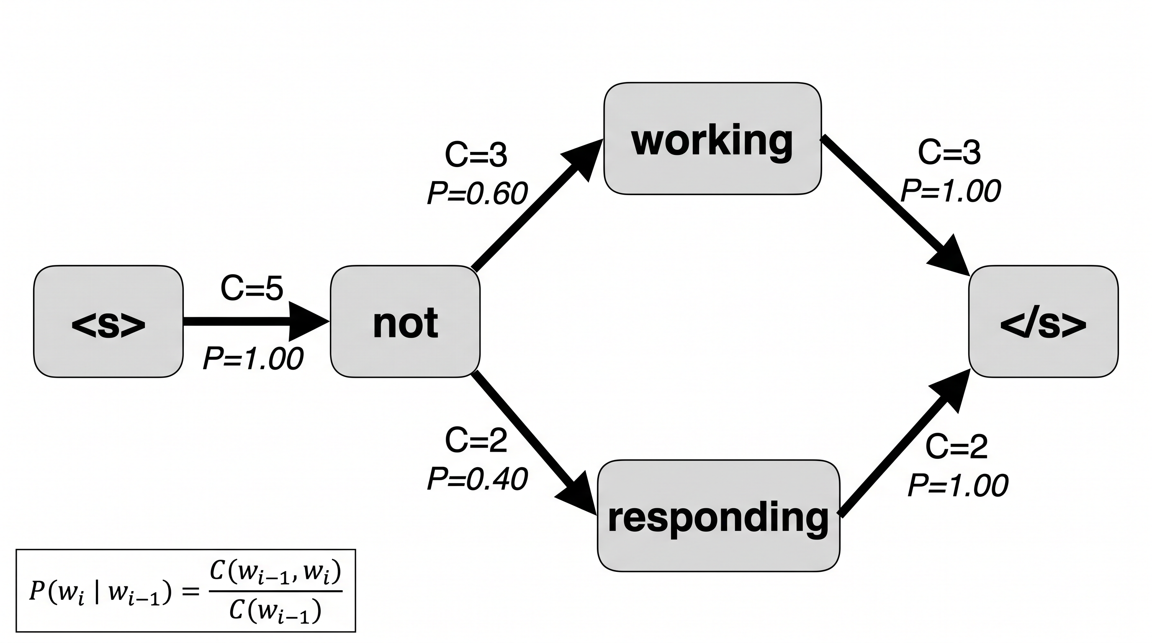

Count-Based Probability Estimate
$$\hat{P}(w∣h)=\frac{c(w_{n−1},w)}{c(w_{n−1})}$$

Slide 15
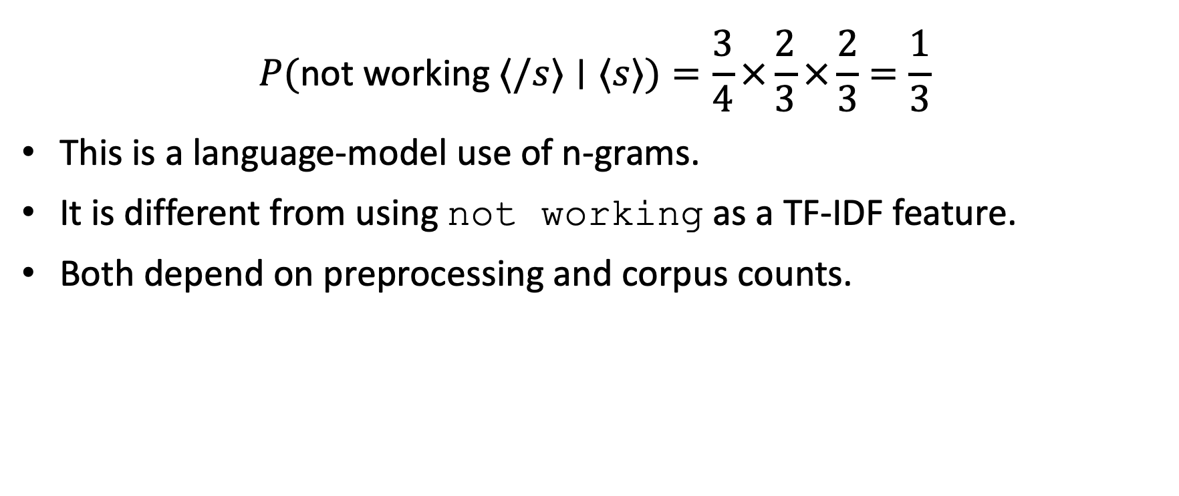
Sentence Probability Example
$$P(\text{not} \text{working} ⟨/s⟩∣⟨s⟩)=\frac{3}{4}×\frac{2}{3}×\frac{2}{3}=\frac{1}{3}$$
This is a language-model use of n-grams.
It is different from using not working as a TF-IDF feature.
Both depend on preprocessing and corpus counts.

Slide 16
Smoothing and Backoff
Zero probability is too harsh for unseen but plausible phrases.
Smoothing adds small probability mass to unseen events.
Backoff uses a shorter history when the longer n-gram is rare or unseen.
In engineering systems, smoothing choices must be versioned like any other feature rule.

Slide 17
N-gram SQL-Lens
-- conceptual window generation SELECT doc_id, token || ' ' || LEAD(token) OVER ( PARTITION BY doc_id ORDER BY position ) AS bigram FROM tokens;
Real implementations must remove the final null bigram per document.
Window generation expands rows and increases shuffle volume.
Token order must be deterministic inside each document.

Slide 18
N-gram Pipeline Stages
Tokenize and assign stable positions inside each document.
Generate n-gram windows with boundary rules.
Count (doc_id, ngram) pairs.
Compute df(ngram) across documents.
Compute TF-IDF or probability estimates, depending on the objective.

Slide 19
N-gram Operational Hazards
Common phrases such as call back, not available, or thank you can become hot keys.
Long n increases feature sparsity and reduces repeated counts, limiting combiner benefits.
Without vocabulary pruning, feature tables grow faster than students usually expect.

Slide 20
Embeddings: What They Add
TF-IDF is sparse and interpretable but mostly lexical.
Embeddings map words, documents, or queries into dense numeric vectors.
Similar meanings can be close even when they use different words.
This helps clustering, semantic search, duplicate-ticket detection, and recommendations.

Slide 21
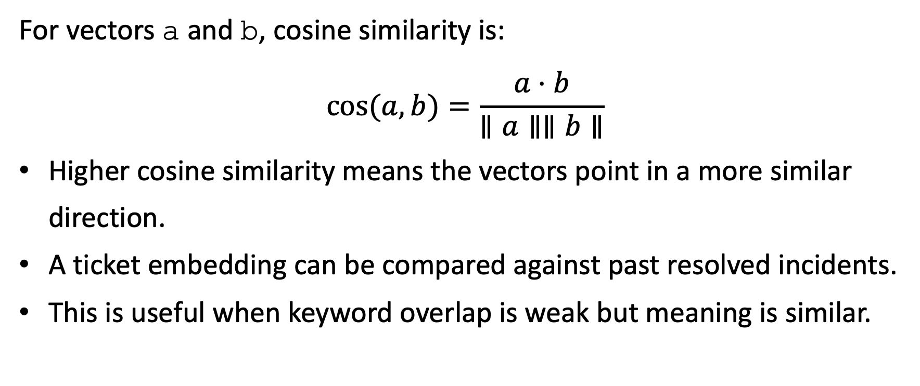
Embedding Similarity Formula
For vectors a and b, cosine similarity is:
$$cos(a,b)=\frac{a⋅b}{∥a∥∥b∥}$$
Higher cosine similarity means the vectors point in a more similar direction.
A ticket embedding can be compared against past resolved incidents.
This is useful when keyword overlap is weak but meaning is similar.

Slide 22
TF-IDF vs Embeddings
Dimension | TF-IDF | Embeddings
Interpretability | high | lower
Compute cost | usually lower | often higher
Semantic matching | lexical | stronger semantic matching
Governance | tokenizer and corpus versions | model, tokenizer, vector versioning

Slide 23
Embedding Operational Risks
OOV or unknown tokens reduce quality if the model cannot represent new language.
Embedding model upgrades can shift vector space and break historical comparisons.
Dense vectors are harder to inspect than TF-IDF terms.
Monitoring must include OOV rate, version mismatches, and similarity-score drift.

Slide 24
Method Choice Checklist
Use unigram TF-IDF when keywords are enough and interpretability matters.
Use n-gram TF-IDF when local order changes meaning, such as negation or technical phrases.
Use regex extraction when structured facts are embedded in free text.
Use embeddings when semantic similarity matters more than exact wording.

