Slide 1
Week 10: Streaming Data and Approximation Algorithms

Slide 2
Probability for Approximation (Prerequisites)
This section reviews probability concepts used in approximation and randomization algorithms for streaming.

Slide 3
Probability: Expectation & Variance

Slide 4
Expectation
Let $X$ be a discrete random variable with values $x_{1},x_{2},…,x_{n}$.
$$E[X]=\sum_{i=1}^{n}{x_{i}}⋅P(X=x_{i})$$
Interpretation: weighted average of outcomes by their probability.
Linearity (always): $E[X+Y]=E[X]+E[Y]$; $E[cX]=c⋅E[X]$.

Slide 5
Variance
Let $X$ be a discrete random variable.
$$V[X]=E[X^{2}]−(E[X])^{2}$$
Scaling: $V[cX]=c^{2}V[X]$.
Interpretation: spread around the mean; used in tail bounds.

Slide 6
Independence
$X$ and $Y$ are independent iff:
$$P(X=x_{i},Y=y_{j})=P(X=x_{i})⋅P(Y=y_{j})$$
Consequence: $E[XY]=E[X]E[Y]$; variances of sums add when independent.

Slide 7
Probability: Tools & Bounds

Slide 8
Union Bound
For events $E_{1},E_{2},…,E_{n}$:
$$P(E_{1}∪E_{2}∪⋯∪E_{n})≤P(E_{1})+P(E_{2})+⋯+P(E_{n})$$
Interpretation: upper bound on “at least one event happens”; no independence required.

Slide 9
Bernoulli and Series (Useful Bounds)
Bernoulli’s inequality: $(1+x)≤e^{x}$ for real $x$ — used to bound collision probabilities.
Sum of arithmetic series: $S_{n}=\frac{n}{2}(a_{1}+a_{n})$ — used in collision bound $1+2+⋯+(m−1)=\frac{(m−1)m}{2}$.

Slide 10
Tail Inequalities: Markov
Let $X≥0$ with $E[X]=μ$. For any $ϵ>0$:
$$P(X>(1+ϵ)μ)≤\frac{1}{1+ϵ}$$
Interpretation: bounds probability of exceeding mean by a factor; no variance needed.

Slide 11
Tail Inequalities: Chebyshev
Let $X$ have $E[X]=μ$ and $Var(X)=σ^{2}$. For any $ϵ>0$:
$$P(|X−μ|≥ϵμ)≤\frac{σ^{2}}{μ^{2}ϵ^{2}}$$
Interpretation: uses variance to bound deviation from mean; used to analyze approximation error.

Slide 12
Collision Probability

Slide 13
Collision Probability: Motivation
Using hash functions in streaming algorithms requires collision analysis.
Model: $m$ balls, $n$ bins; each step one ball is thrown into a bin.
Goal: bound probability that no bin gets more than one ball (no collision).
Bernoulli’s inequality $(1+x)≤e^{x}$ is used for the bound.

Slide 14
Collision Probability: Events
$m$ balls, $n$ bins; each step one ball goes to a bin.
Events: $A_{i}$ = no collision when the $i$-th ball is thrown.
$P(A_{1})=1$; $P(A_{2}∣A_{1})=1−\frac{1}{n}$; $P(A_{3}∣A_{2},A_{1})=1−\frac{2}{n}$.
Goal: probability of no collision = $A_{1}∩A_{2}∩⋯∩A_{m}$.

Slide 15
Collision Probability: General Formula
Chain rule:
$$P(A_{1}∩⋯∩A_{m})=\prod_{i=1}^{m−1}{\left(1−\frac{i}{n}\right)}$$
Interpretation: each new ball must avoid all previously occupied bins.

Slide 16
Collision Probability: Bernoulli Bound
Using $(1+x)≤e^{x}$:
$1−\frac{1}{n}≤e^{−1/n}$, $1−\frac{2}{n}≤e^{−2/n}$, $…$
So the product is at most:
$$e^{−\frac{1}{n}−\frac{2}{n}−⋯−\frac{m−1}{n}}$$

Slide 17
Collision Probability: Final Bound
Arithmetic series: $1+2+⋯+(m−1)=\frac{(m−1)m}{2}$.
$$P(\text{no collision})≤e^{−\frac{m(m−1)}{2n}}$$
Interpretation: enables choosing $n$ (e.g., number of bins/hash buckets) to minimize collisions in hash-based designs.

Slide 18
Approximation and Randomization

Slide 19
Why Approximation and Randomization?
Many quantities are hard to compute exactly over a stream (e.g., “same count in two streams?”).
Approximation: answer correct within some factor (e.g., within 10%).
Randomization: allow a small probability of failure (e.g., correct except with probability 1/10,000).

Slide 20
$(ϵ,δ)$-Approximations
Approximation: answer within $(1±ϵ)$ factor of the true value.
Randomization: success with probability $(1−δ)$.
Goal: develop $(ϵ,δ)$-approximation algorithms.

Slide 21
Approximation Formalism
$$\text{True answer}≤\text{output}≤α⋅\text{True answer}$$
Goal: minimize $α$ (best is $α=1+ϵ$ for $ϵ>0$).
Holds with probability $1−δ$.
Example: $ϵ=\frac{1}{3}$, $δ=0.01$ → error > 33% only 1% of the time.

Slide 22
Streaming Model (Main Content)

Slide 23
Purpose
Design real-time pipelines for unbounded event streams.
Use sketch/approximation methods when exact state is too expensive.
Balance accuracy, latency, and resource usage in production.

Slide 24
Learning Objectives
Explain stream-processing constraints and window semantics.
Choose approximation algorithms for count/distinct/frequency queries.
Size sketch parameters from error requirements.
Build reliable event-time pipelines with watermarks and idempotent sinks.

Slide 25
Why This Lecture Matters
Stream systems cannot rely on full-history scans.
Exact answers are often too costly in memory/time.
Approximation gives controlled error with strong efficiency gains.
Correctness depends on time semantics and replay safety.

Slide 26
Basic Stream Data Model
A stream is a sequence arriving one by one: $⟨x_{1},x_{2},x_{3},…⟩$.
Constraints: data read sequentially in one pass; bounded storage; fast per-element processing.
Goal: maintain a sketch that captures properties we care about.

Slide 27
Sketch
A small summary of a large data set that (approximately) captures statistics we care about.
Desirable: easy to add an element; mergeable (combine sketches from disjoint sets); optional deletions; flexible query types.

Slide 28
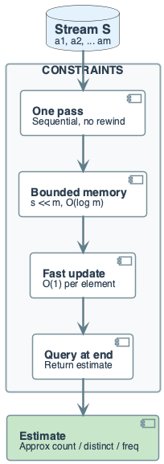
Streaming Model (Diagram)
Data arrives continuously and may be out of order.
Processing must be online (single pass).
Memory is bounded relative to stream size.
Per-event update cost must stay low.

Slide 29
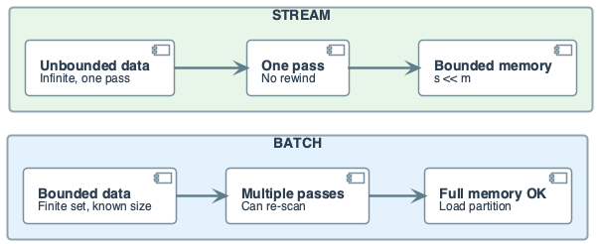
Batch vs Stream
Batch: finite input, full recomputation possible.
Stream: unbounded input, incremental state updates.
Batch optimizes throughput; stream optimizes freshness.
Many systems combine both modes.

Slide 30
Why Approximation Is Needed
Exact distinct counting requires large state at scale.
Exact per-key frequency for huge domains is expensive.
Latency targets conflict with heavy exact structures.
Approximate sketches trade tiny error for major savings.

Slide 31
Error Framework & Counting

Slide 32
Simple Counting
Naïve: counter += 1 for each element → space $O(logn)$ bits for count $n$.
For very large $n$, even $O(logn)$ may not fit.
Need approximate counting with smaller state.

Slide 33
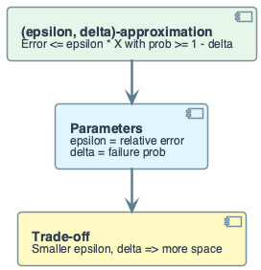
Error Framework
$$P(|\hat{X}−X|≤ϵX)≥1−δ$$
$ϵ$: error tolerance.
$δ$: failure probability.
Smaller error / tighter confidence → more memory.
Core tuning contract for sketches.

Slide 34
Morris Counter

Slide 35
Algorithm 1: Morris Counter — Goal & Idea
Goal: Given stream $a_{1},a_{2},…,a_{n}$, estimate $n$ with sub-linear space.
Idea: Track $logn$ instead of $n$ → use $O(loglogn)$ bits instead of $O(logn)$.

Slide 36
Morris Counter: Algorithm
Initialize $X=0$.
When item arrives: increment $X$ by 1 with probability $2^{−X}$.
Output: $\hat{n}=2^{X}−1$.
Key: $E[2^{X}]=n+1$ (unbiased in log space).

Slide 37
Morris Counter: Properties & Trace
Variance: $V[2^{X}]=n^{2}$ (high — single estimator is noisy).
Memory: $X≈logn$ → $O(loglogn)$ bits.
Trace example: Stream of eight 1’s → $X$ evolves 0→1→1→2→2→2→2→3, estimate $2^{3}−1=7$.

Slide 38
Morris Counter: Why Naïve Version Fails
Chebyshev: $P(|X−μ|≥ϵn)≤\frac{σ^{2}}{μ^{2}ϵ^{2}}=\frac{n^{2}}{ϵ^{2}n^{2}}=\frac{1}{ϵ^{2}}$.
For $(ϵ,δ)$-approximation we need $\frac{1}{ϵ^{2}}<δ$.
Example: $ϵ=0.1$ ⇒ $δ>100$ (impossible).
Single estimator has too high variance → need multiple estimators.

Slide 39
Morris Counter: Beta Version — Idea & Algorithm
Idea: Maintain $s$ independent counters; average results to reduce variance.
Initialize each $X_{i}=0$.
On arrival: increment each $X_{i}$ by 1 independently with probability $2^{−X_{i}}$.
Output: 1si​(2Xi−1).

Slide 40
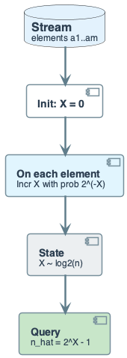
Morris Counter: Beta Version — Variance & Sizing
Variance reduction: $V[\text{avg}]=\frac{n^{2}}{s}$ (by independence).
Chebyshev: $P(|\hat{n}−n|≥ϵn)≤\frac{1}{sϵ^{2}}$.
For probability $<δ$: need $s≥\frac{1}{δϵ^{2}}$.
Example: $ϵ=\frac{1}{4}$, $δ=0.01$ ⇒ $s=1600$ counters.

Slide 41
Distinct Count ($F_{0}$)

Slide 42
Data Streams and Frequency Moments
Stream of $m$ elements from domain $\{1,2,…,n\}$: $⟨x_{1},x_{2},…,x_{m}⟩$.
Frequency: $f_{a}$ = number of times $a$ appears.
Moments: $F_{0}$ = distinct count; F1=a​fa = total count; F2=a​fa2 (not covered here).

Slide 43
Counting Distinct Elements ($F_{0}$)
Use case: How many unique rows? (DISTINCT in SQL.)
Exact: Hash table → size $Ω(n)$ for $n$ distinct elements.
Goal: Small sketch with approximate distinct count.

Slide 44
Algorithm 2: Flajolet-Martin — Idea & Example
Idea: Hash elements; count trailing zeros in binary hash; max relates to distinct count.
For each element $a$: compute $h(a)$, count trailing zeros $r_{i}$.
Output: $2^{\max_{i}r_{i}}$.
Example: Stream $⟨1,3,5,7,5,2,7⟩$; $h(x)=3x+1 mod 5$ → hashes 4,0,1,2,1,2,2 → max trailing zeros = 2 → estimate $2^{2}=4$ (true distinct = 5).

Slide 45
Flajolet-Martin: Single Estimator Problem
Single estimator: $E[X]=\frac{1}{n+1}$, $V[X]=\frac{n}{(n+1)^{2}(n+2)}$ — too noisy.
Need multiple hashes and averaging (like Morris Beta).

Slide 46
Flajolet-Martin: Final Version (Multiple Hashes)
Run FM with $q$ independent random hash functions → $X_{1},…,X_{q}$.
Z=1qi​Xi; output $\frac{1}{Z}−1$.
Variance: $V[Z]=\frac{1}{q}⋅\frac{n}{(n+1)^{2}(n+2)}$.
For $(ϵ,δ)$: need $q≥\frac{1}{δϵ^{2}}$.
Example: $ϵ=0.01$, $δ=0.1$ ⇒ $q>100,000$.

Slide 47
Algorithm 3: HyperLogLog (Practical Distinct)
Uses many registers + harmonic mean estimator.
Mergeable across partitions.
Memory-efficient and production-proven.
Relative error roughly $1.04/\sqrt{m}$.

Slide 48
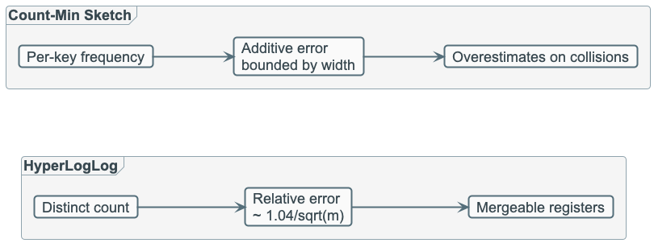
Algorithm 4: Count-Min Sketch (Frequency)
Estimates per-key counts with bounded additive error.
Fast updates and queries.
Overestimates due to hash collisions.
Great for heavy-hitter and traffic monitoring.

Slide 49
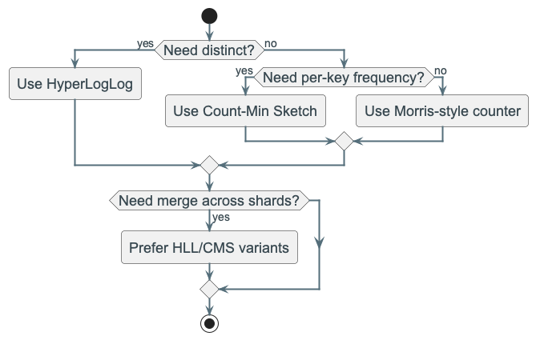
Sketch Selection Guide
Need distinct count → HyperLogLog.
Need per-key frequency → Count-Min Sketch.
Need tiny-memory rough count → Morris-style.
Need mergeability across shards → HLL or CMS.

Slide 50
Windows & Time Semantics

Slide 51
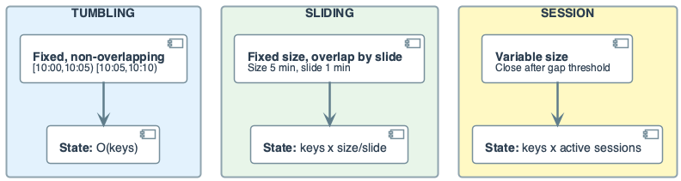
Window Semantics
Tumbling: fixed non-overlapping windows.
Sliding: overlapping windows with finer cadence.
Session: user/activity gap-based windows.
Window choice defines state size and business meaning.

Slide 52
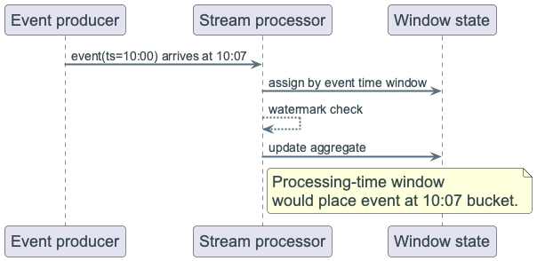
Event Time vs Processing Time
Event time: when the event actually happened.
Processing time: when the system saw it.
Event time yields replay-stable results.
Processing time is simpler but less deterministic.

Slide 53
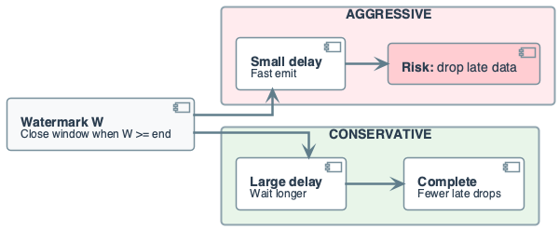
Watermarks and Late Data
Watermark: approximates “no more data before this time.”
Aggressive watermark → lower latency, more late data dropped.
Conservative watermark → better completeness, more delay.
Tune from SLA and lateness distribution.

Slide 54
Reliability & Production

Slide 55
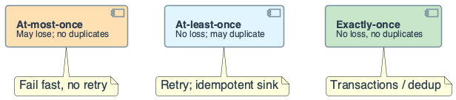
Delivery Guarantees
At-most-once: may lose; no duplicates.
At-least-once: no loss; duplicates possible.
Exactly-once: strongest semantics; more complexity.
Most systems use at-least-once + idempotent sink logic.

Slide 56
Idempotent Sink Pattern
Sink key includes window + business key.
Writes are upserts/merge-safe.
Retries replay safely without double counting.
Essential for reliable production reprocessing.

Slide 57
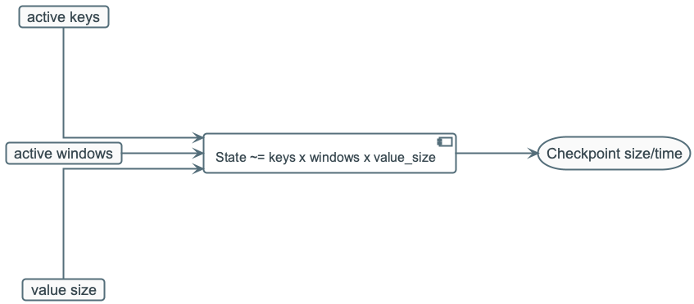
State Sizing Intuition
State grows with keys × active windows × value size.
Sliding/session windows can grow state quickly.
Watermark and TTL policies bound state.
Monitor checkpoint duration and state growth trends.

Slide 58
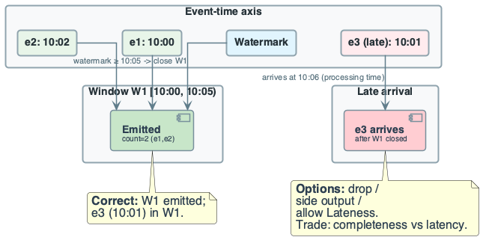
Failure Modes
Unbounded late data inflates state.
Incorrect watermark drops valid events.
Consumer lag causes stale outputs.
Sketch parameter mis-sizing causes poor accuracy.

Slide 59
Monitoring Signals
Consumer lag and throughput.
Late event percentage.
State size and checkpoint time.
Accuracy drift from sampled exact comparisons.

Slide 60
Engineering Checklist
Are event-time and watermark policies explicit?
Is sink idempotent under retries?
Are sketch params derived from $ϵ$/$δ$ goals?
Are state growth and lag alerts configured?

Slide 61
Recap
Streaming systems optimize freshness under bounded resources.
Approximation algorithms make large-scale queries feasible.
Correctness depends on windowing, time semantics, and idempotency.
Next: feature engineering pipelines for ML and analytics.

Slide 62
Instructor Notes: Flow & Common Mistakes
Flow: Probability prerequisites (expectation, variance, tail bounds, collision) → approximation formalism → stream model → Morris → Flajolet-Martin → HLL/CMS → windows & time → delivery & idempotency → failure modes & checklist.
Common mistakes: Confusing event time vs processing time; ignoring variance when sizing Morris/FM; treating sketches as exact; forgetting idempotent sink for exactly-once semantics.

Slide 63
Instructor Notes: Blackboard Flow
Derive collision bound from balls-and-bins + Bernoulli.
Walk Morris: single counter (high variance) → average of $s$ counters (sizing $s≥1/(δϵ^{2})$).
Sketch FM idea (trailing zeros → distinct estimate); then HLL/CMS selection.
Draw event time vs processing time; watermark tradeoff; idempotent sink key (window + business key).

