Slide 1
Week 18: AI Agents and Governed Decision Systems

Slide 2
Purpose
Define AI agents as bounded decision systems.
Separate reasoning, retrieval, tools, skills, and execution.
Design safe agent flows for production data systems.
Apply governance, authority, guardrails, and audit controls.
Evaluate agent readiness before autonomous rollout.

Slide 3
Learning Objectives
Define agent, tool, skill, MCP, guardrail, and semantic layer.
Explain why the LLM is not the whole agent.
Design a bounded decision scope for an agent workflow.
Choose agent patterns and authority levels.
Build an auditable runtime flow with deterministic tools.
Evaluate production readiness with measurable controls.

Slide 4
Sources Used (Reference Only)
/Users/orperetz/Downloads/DSM-Workshop.pdf
/Users/orperetz/Downloads/From-Concept-to-Production (5).pdf
lectures/17-language-models/lecture.md
diagrams/week18/week18_lecture_slide08_rag_agent_stack.puml
diagrams/week18/week18_lecture_slide18_retrieval_flow.puml
diagrams/week18/week18_lecture_slide26_agent_runtime_flow.puml and week18_lecture_slide32_guardrail_failure_flow.puml

Slide 5
Diagram Manifest
week18_lecture_slide08_rag_agent_stack.puml -> governed agent system stack.
week18_lecture_slide18_retrieval_flow.puml -> policy-filtered retrieval flow.
week18_lecture_slide26_agent_runtime_flow.puml -> production agent runtime flow.
week18_lecture_slide32_guardrail_failure_flow.puml -> blocked unsafe request flow.

Slide 6
Why This Lecture Follows RAG
RAG answers questions with retrieved evidence.
Agents choose actions, not only answers.
Actions require authority, tools, and audit.
Production agents must be governed systems.
Data engineering provides the trusted execution substrate.

Slide 7
Mental Model
Layer | Main question
LLM | What does the request mean?
Retrieval | What evidence is trusted?
Tool | What action can be executed?
Skill | What workflow should be followed?
Guardrail | What must never happen?
Audit | What exactly happened?

Slide 8
From Assistant to Agent
A chatbot mostly produces text.
A RAG assistant retrieves and cites evidence.
An agent selects actions under a goal.
A production agent executes only inside policy.
The difference is controlled decision-making.

Slide 9
Definition: AI Agent
An AI agent is a goal-driven decision system.
It observes context and user intent.
It plans a bounded sequence of steps.
It invokes approved tools or workflows.
It evaluates outputs before responding.

Slide 10
Agent Loop
Catch context and intent.
Plan next steps.
Select approved tool or skill.
Act through deterministic execution.
Observe results and validate.
Respond with evidence and trace.

Slide 11
Agent vs Classic Automation
Dimension | Classic automation | AI agent
routing | fixed rules | context-aware
inputs | structured | often ambiguous
decisions | deterministic | policy-bounded reasoning
updates | manual rule changes | prompt, skill, and policy changes
risk | predictable failure | non-deterministic reasoning risk

Slide 12
The LLM Is Not the Agent
The LLM is the reasoning surface.
The agent is the complete system.
Tools execute deterministic actions.
Policies define allowed behavior.
Logs make runs inspectable.
Owners remain accountable.

Slide 13
Reasoning vs Execution
Component | Should handle
LLM | intent recognition, planning, explanation
tool | calculation, query, API call, update
guardrail | policy enforcement and validation
semantic layer | certified business meaning
audit layer | run trace and evidence record

Slide 14
Why Reasoning Cannot Execute Directly
Natural language output is not a control plane.
Model responses vary across runs.
Business rules need consistency.
Sensitive actions require permissions.
Production systems need replayable traces.

Slide 15
Tools: Atomic Actions
A tool performs one explicit action.
It receives structured input.
It executes once.
It returns structured output.
It does not decide business policy.
The agent decides whether it may be used.

Slide 16
Tool Categories
Tool type | Examples
data access | read SQL, retrieve tickets, fetch metric
metadata | inspect schema, lineage, freshness
calculation | risk score, SLA timer, validation
action | create ticket, route case, send email
governance | check RBAC, write audit event

Slide 17
Tool Contract
Name: clear operation name.
Input schema: required fields and types.
Output schema: result, evidence, error state.
Permissions: who may invoke it.
Side effects: read-only or write.
Timeout and retry policy.

Slide 18
Tool Schema Example
{ "tool": "score_ticket_priority", "input": {"ticket_id": "T-1042", "customer_tier": "gold"}, "output": {"score": 0.87, "priority": "High"}, "permissions": ["support_analyst"], "side_effect": "none" }

Slide 19
Skills: Specialized Workflows
A skill teaches an agent how to perform a task.
It packages instructions, examples, and resources.
It can contain scripts, templates, and checklists.
It should be versioned and testable.
It is larger than a tool.
It is more operational than a prompt.

Slide 20
Skill Folder Contract
File or folder | Purpose
SKILL.md | task workflow and rules
scripts/ | reusable deterministic helpers
templates/ | output structure and examples
references/ | domain policy and background
tests/ | expected behavior and edge cases

Slide 21
Skill vs Tool
Question | Tool | Skill
scope | one action | whole workflow
execution | deterministic function | guided task process
example | run read-only SQL | investigate data quality incident
output | structured result | completed deliverable
owner | platform team | domain or workflow owner

Slide 22
Agent Rules
Define the agent purpose.
List available skills and tools.
Specify routing logic.
Declare authority boundaries.
State forbidden actions.
Define escalation behavior.

Slide 23
Example Agent Rule
IF request asks to change billing status AND user lacks operator role THEN do not call write tools AND route to human approval AND return approval request ID

Slide 24
MCP: Model Context Protocol
MCP standardizes model-to-tool connections.
Tools expose typed callable interfaces.
Policy can be enforced at the boundary.
Execution becomes traceable.
The model asks; the governed system executes.

Slide 25
Why MCP Matters
Without enforced tool calls | With enforced tool calls
free-text speculation | typed result
weak permission boundary | explicit policy checks
hard to replay | trace ID and evidence IDs
hidden data access | governed tool surface
fragile integration | reusable interface contract

Slide 26
Semantic Layer
The semantic layer defines trusted business meaning.
It maps raw data to certified metrics.
It keeps KPI logic consistent.
Agents should read it, not rewrite it.
It is the contract between data and AI.

Slide 27
Semantic Layer Example
Concept | Certified definition
active incident | incident status is open or investigating
SLA breach risk | deadline minus current time below threshold
gold customer | customer tier from CRM master table
high priority | risk score above threshold or confirmed outage

Slide 28
Governed Retrieval Flow
Query is embedded or searched.
Candidate evidence is retrieved.
RBAC and freshness filters apply.
Prompt is built from approved context.
Answer includes evidence identifiers.
Diagram: week18_lecture_slide18_retrieval_flow.puml

Slide 29
Guardrails
Guardrails enforce what the agent can do.
They run before and after model reasoning.
They restrict prompts, data, tools, and outputs.
They block unsafe requests.
They log policy decisions.

Slide 30
Guardrail Scope
Control | Example
prompt boundary | block instruction override
tool access | allow read-only SQL only
data access | filter by user permissions
output validation | require JSON schema
action policy | require HITL for refunds

Slide 31
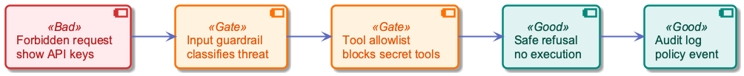
Blocked Request Flow
User asks for forbidden information.
Input guardrail classifies the threat.
Tool allowlist blocks secret access.
System returns a safe refusal.
Audit log records the policy event.
Diagram: week18_lecture_slide32_guardrail_failure_flow.puml

Slide 32
Authority Levels
Level | Meaning | Example
read-only | observes and analyzes | summarize open incidents
recommend | proposes action | suggest ticket priority
approve-write | writes after approval | submit refund request
act | autonomous within policy | auto-route low-risk ticket

Slide 33
Human Approval Gates
Use HITL for high-impact actions.
Use HITL when confidence is low.
Use HITL for regulated workflows.
Use HITL when context is incomplete.
Use HITL when authority is unclear.

Slide 34
Decision-First Design
Start with the decision, not the model.
Define required inputs and outputs.
Define acceptable error rates.
Define owner and accountability.
Define low-confidence behavior.
Define rollback or reversal path.

Slide 35
Decision Scope Canvas
Field | Example
decision | classify ticket department and priority
input | ticket text, customer tier, incident state
output | department, priority, reason
owner | support operations manager
authority | recommend; auto-route low-risk only
escalation | HITL for high priority

Slide 36
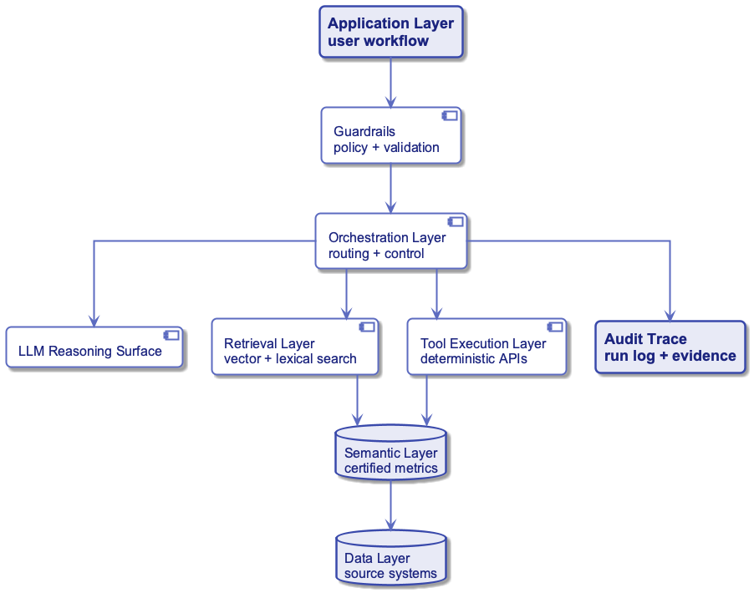
Production Agent Stack
Application handles user workflow.
Orchestration routes decisions.
LLM interprets intent.
Retrieval and tools provide evidence and action.
Semantic and data layers define truth.
Audit stores the run record.
Diagram: week18_lecture_slide08_rag_agent_stack.puml

Slide 37
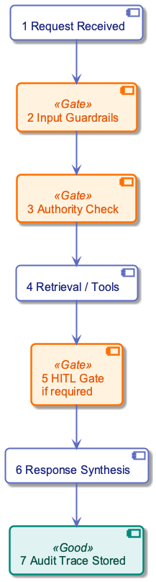
Runtime Flow
Request received.
Input guardrails validate.
Authority check runs.
Retrieval or tools execute.
HITL gate applies if required.
Response and audit trail are stored.
Diagram: week18_lecture_slide26_agent_runtime_flow.puml

Slide 38
Policy-Based Routing
Map intent to approved toolchain.
Verify role and action permissions.
Select deterministic tool path.
Apply confidence thresholds.
Escalate when policy requires.
Return traceable response.

Slide 39
Failure Rules
Never fabricate missing evidence.
Return explicit uncertainty.
Provide error context.
Validate before user response.
Log failed tool calls.
Escalate blocked decisions.

Slide 40
Single-Agent Pattern
One agent owns one bounded decision.
It has a small tool surface.
Its policy is easy to audit.
It fits narrow workflows.
Example: support ticket triage.

Slide 41
Multi-Agent Pattern
Multiple agents handle different roles.
Each agent has separate authority.
Handoffs must be typed.
Transfers must be auditable.
Use when workflows cross domains.
Avoid when one agent is sufficient.

Slide 42
Multi-Agent Design Rules
Rule | Reason
separate ownership | prevents unclear accountability
typed handoffs | avoids vague natural-language state
policy per agent | constrains authority
shared audit trace | supports replay
escalation path | handles conflicts

Slide 43
ReAct Pattern
ReAct interleaves reasoning and acting.
The agent reasons about the next step.
It calls a tool and observes output.
It repeats until task completion.
Good for exploratory workflows.
Risk: too much tool-loop freedom.

Slide 44
ReWOO Pattern
ReWOO means Reason Without Observation.
The agent plans steps before execution.
Execution can be deterministic and batched.
It reduces dynamic improvisation.
Good for predictable enterprise workflows.
Risk: bad initial plan can propagate.

Slide 45
Planner-Executor Pattern
Planner creates the step sequence.
Executor runs approved tools.
Evaluator validates outputs.
Policy decides whether to continue.
Audit records plan, calls, and evidence.

Slide 46
Router Pattern
A router classifies user intent.
It chooses a bounded workflow.
It does not solve every task itself.
It reduces prompt complexity.
It makes authority checks easier.

Slide 47
Evaluator Pattern
An evaluator checks output quality.
It can validate schema and citations.
It can detect missing evidence.
It can require human approval.
It should not be the only safety layer.

Slide 48
Deterministic Design Principle
Let the LLM interpret and explain.
Let tools calculate and update.
Let policy approve or block.
Let semantic models define truth.
Let logs prove what happened.

Slide 49
Case: Support Ticket Triage Agent
Item | Design
input | ticket text plus customer context
output | department, priority, reason
authority | recommend; auto-route low-risk
hard limit | no refunds or direct DB writes
HITL trigger | high priority or policy-sensitive

Slide 50
Step 1: Bounded Decision
Classify department.
Set priority.
Return reason.
Use allowed departments only.
Do not invent actions.
Escalate unsupported cases.

Slide 51
Step 2: Semantic Truth
Priority uses certified evidence.
Ticket wording is not enough.
Incident status comes from governed source.
SLA risk comes from certified calculation.
Customer tier comes from CRM master data.

Slide 52
Step 3: Deterministic Risk Score
LLM extracts signals from text.
Tool computes risk score.
Policy maps score to priority.
Tool returns evidence IDs.
Agent explains the decision.
$$score=0.45I+0.30S+0.15C+0.10U$$

Slide 53
Risk Score Symbols
Symbol | Meaning | Range
$I$ | confirmed incident signal | 0 or 1
$S$ | SLA breach risk | 0 to 1
$C$ | customer criticality | 0 to 1
$U$ | urgency extracted from text | 0 to 1

Slide 54
Risk Score Example Inputs
Assume:
signal | value
$I$ | 1.00
$S$ | 0.80
$C$ | 0.60
$U$ | 0.90

Slide 55
Risk Score Example Calculation
Confirmed incident has the largest weight.
SLA risk strongly increases priority.
Customer criticality adds business impact.
Urgency contributes but does not decide alone.
$$score=0.45(1)+0.30(0.8)+0.15(0.6)+0.10(0.9)=0.87$$

Slide 56
Priority Rule
Score condition | Priority | Authority
$score≥0.80$ | High | HITL required
$0.50≤score<0.80$ | Medium | auto-route allowed
$score<0.50$ | Low | auto-route allowed
missing evidence | Other | human review

Slide 57
Step 4: Governed Retrieval and Audit
Retrieve only approved policy sources.
Cite evidence IDs.
Store tool inputs and outputs.
Store authorization check result.
Store final decision and owner.

Slide 58
Executive Receipt
Field | Example
user | analyst_17
intent | classify support ticket
tools | retrieve_policy, score_priority
policy | high-priority requires approval
evidence | incident_442, policy_sla_03
result | manager approval requested

Slide 59
Evaluation Metrics
Metric | Formula
policy violation rate | $violations/runs$
HITL rate | $human_gates/runs$
tool success rate | $successful_calls/calls$
audit completeness | $complete_traces/runs$
autonomous precision | $correct_auto/auto_actions$

Slide 60
Confidence Thresholding
Autonomous action needs high confidence.
Recommendation can tolerate lower confidence.
Missing evidence lowers confidence.
Policy-sensitive cases override confidence.
Thresholds should be measured, not guessed.
$$act_allowed=confidence≥τ∧policy_pass$$

Slide 61
Production Readiness Gates
Accuracy meets target on labeled cases.
Critical policy violations are zero.
Latency stays within SLO.
Audit traces are complete.
Tool failures are handled safely.
Owners approve authority level.

Slide 62
Release Hardening
Stage | Agent authority
shadow | logs decisions only
HITL | proposes actions for approval
limited autonomy | acts on low-risk cases
full production | acts within authority tiers

Slide 63
Operational Readiness
Define SLOs.
Monitor latency and failures.
Track policy violations.
Maintain incident runbook.
Define abort thresholds.
Assign on-call ownership.

Slide 64
Fix Lever Principle
Do not only edit the prompt.
Fix instructions for routing errors.
Fix semantic definitions for KPI errors.
Fix retrieval for evidence errors.
Fix tools for calculation errors.
Fix policy for authority errors.

Slide 65
Common Failure Modes
Failure | Root cause
unsafe action | missing authority gate
hallucinated answer | missing evidence rule
wrong priority | uncertified metric definition
data leakage | weak RBAC filter
untraceable run | missing audit schema

Slide 66
Engineering Checklist
Is the decision bounded?
Is every tool typed and permissioned?
Is the semantic layer certified?
Is HITL defined for high-risk cases?
Is every run replayable?
Are failure responses non-fabricated?

Slide 67
Design Exercise Prompt
Design an agent for one workflow:
Choose one bounded decision.
Define inputs and outputs.
List approved tools and skills.
Set authority level.
Define HITL triggers.
Define audit fields and metrics.

Slide 68
Recap
Agents are governed decision systems.
LLMs reason; tools execute.
Skills package repeatable workflows.
Semantic layers define trusted meaning.
Guardrails enforce boundaries.
Production requires authority, audit, and rollout gates.

