Slide 1
DWH Schema Design (Part 2)

Slide 2
Learning Objectives
Declare fact grain, keys, measures, and aggregation rules
Choose star, snowflake, or galaxy schemas by workload
Model history, table behavior, and conformed dimensions
Design partitioning and governance controls for production use

Slide 3
Why Schema Design Matters
Schema design is where business meaning becomes executable
Wrong grain or keys silently corrupt KPIs and downstream models
Physical choices such as partitioning determine cost and latency
Professional DWH design balances correctness, performance, and operability

Slide 4
Fact and Dimension Contracts
Fact table: measurable business events at one declared grain
Dimension table: descriptive context used to filter, group, and explain facts
Measure: numeric value with explicit aggregation semantics
Hierarchy: governed drill path such as day -> month -> quarter -> year

Slide 5
The Multi-Dimensional Model
Store Info
Key columns joining fact table
to dimension tables
Numerical Measures
Prod Code Time Code Store Code Sales Qty
Fact table for
measures
Product Info
Dimension tables
Time Info

Slide 6
Dimensional Modeling
Dimensions organize attributes into stable analysis paths
E.g., Time: day -> week -> month -> quarter -> year
E.g., Product: SKU -> product line -> brand -> category
Conformed dimensions reuse the same keys and labels across facts
Role-playing dimensions reuse one table in different roles, e.g., order_date and ship_date

Slide 7
Concept Hierarchy: Location Dimension
all
all
region
Europe
...
North_America
country
Germany
...
Spain
Canada
...
Mexico
city
Frankfurt
...
Vancouver
...
Toronto
office
L. Chan
...
M. Wind

Slide 8
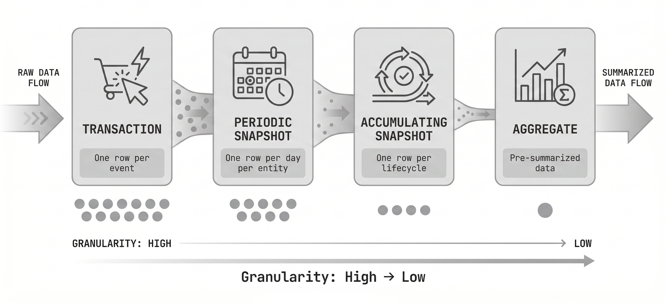
Declaring Fact Grain
Grain defines exactly what one row in the fact table represents
If the grain is ambiguous, double counting is likely
Document grain and natural uniqueness before writing ETL

Slide 9
Grain: What It Is
The grain is the business event level captured by the fact table
It answers the question: what does one row mean?
Changing grain later usually breaks joins, aggregates, and history
Or Peretz
9

Slide 10
Common Grain Options
Transaction grain: one row per event
Periodic snapshot grain: one row per entity per period
Accumulating snapshot grain: one row per process lifecycle
Aggregate grain: pre-summarized rows
Factless grain: event existence only
Or Peretz
10

Slide 11
Choosing the Right Grain
Start with the lowest atomic grain needed for analysis
Use aggregate grains only for performance measures
Avoid mixing grains in one fact table
Check that the proposed grain has a stable unique key
Write the grain statement before designing dimensions
Or Peretz
11

Slide 12
Table Behavior Types
Append-only
tables only insert new rows and preserve full event history
Mutable tables
allow updates and deletes when the latest state matters
Late-arriving
data reaches after the business event happened
Or Peretz
12

Slide 13
Append-Only vs. Mutable Tables
Append-only
best for logs, transactions, CDC history, and replayability
Mutable
best for current-state dimensions, operational mirrors
A common pattern is append-only raw layer plus curated mutable serving tables
Or Peretz
13

Slide 14
Measure Types and Aggregation Rules
Additive: safe to sum across all dimensions
Semi-additive: sum across product, not across time
Non-additive: calculate from numerator and denominator

Slide 15
Common Schemas

Slide 16
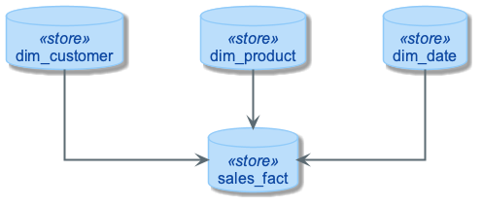
Star Schema: Default BI Design

Slide 17
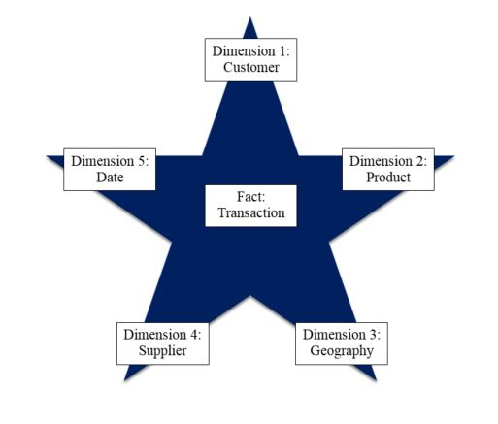
The Classic Star Schema
A fact table sits at the center and connects to denormalized dimensions.
Each dimension key appears once in the fact table primary/unique key.
Notes:
7
The Star is built for simplicity and speed. Forget everything you learned about designing relational databases. The Star Schema makes no excuses for the rules it breaks. The assumption behind it is that the database is static or ìquiet,î meaning that no updates are performed on-line.
Remember that most of the rules of relational database design are derived from the need to maintain atomicity, consistency and integrity (the ìACIDî test) in an On-Line Transaction Processing (OLTP) environment. Since the data warehouse is quiet, these constraints can be relaxed.

Slide 18
Snowflake Schema
Snowflaking normalizes selected dimension attributes into sub-dimensions
It can reduce redundancy in large dimensions
It adds joins, ETL complexity, and harder self-service BI
Common compromise: normalized core plus star marts

Slide 19
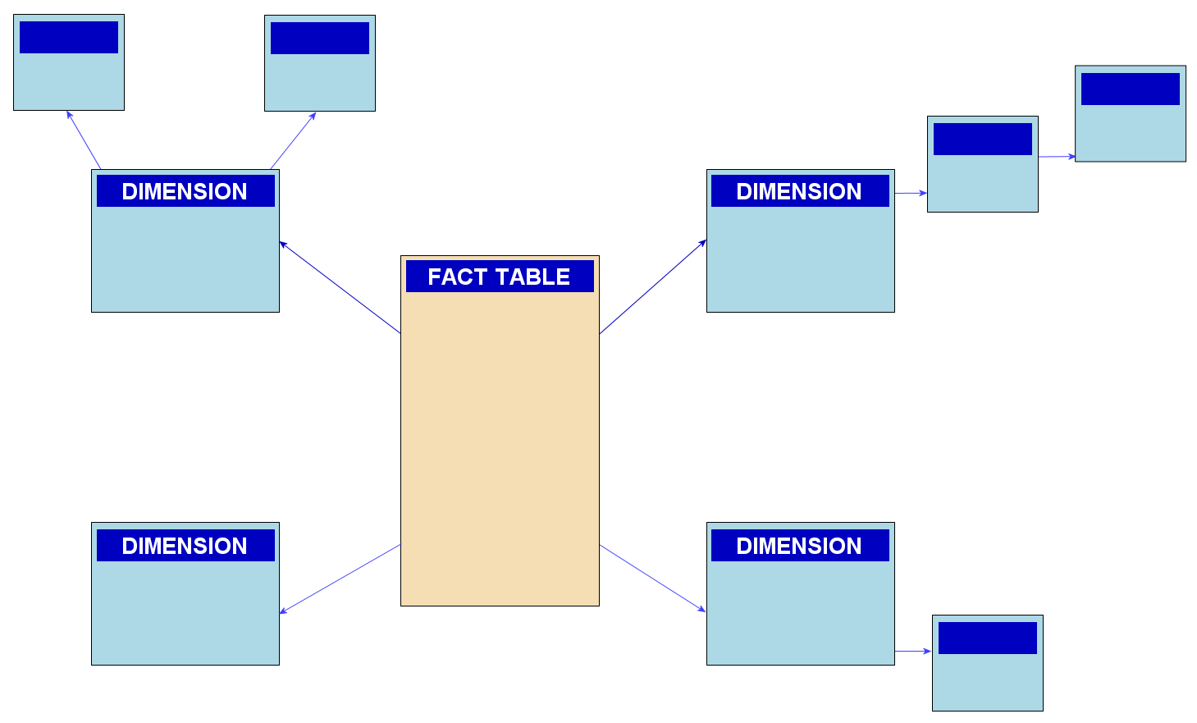
Snowflake Schema: Normalized Dimensions

Slide 20
Snowflaking a Product Dimension
Split shared hierarchy attributes into reference tables
Product stores brand_key and category_key
Benefit: less repetition and stronger governance
Cost: extra joins unless a mart denormalizes back
Product key
Product name
Product code
Brand key
Brand key
Brand name
Category key
Category key
Product category

Slide 21
Partitioning and Clustering Strategy
Partition large facts by the dominant time filter, usually date_key
Align partition granularity with query patterns and retention policy
Cluster or sort on common filters such as customer_key or product_key
Avoid tiny partitions and small files; they add metadata overhead
Validate design with bytes scanned, partitions read, and p95 latency

Slide 22
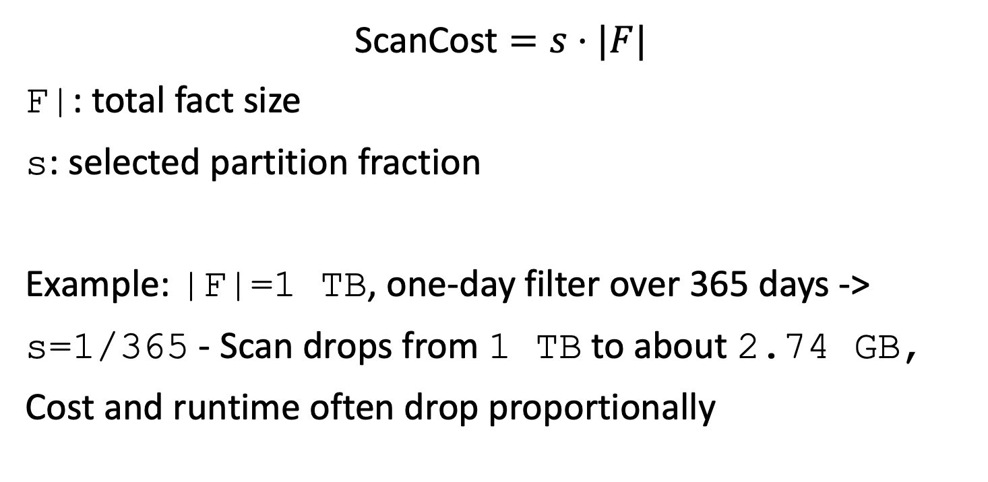
Partition Pruning Cost Model
$$\text{ScanCost}=s⋅|F|$$
F|: total fact size
s: selected partition fraction
Example: |F|=1 TB, one-day filter over 365 days -> s=1/365 - Scan drops from 1 TB to about 2.74 GB, Cost and runtime often drop proportionally

Slide 23
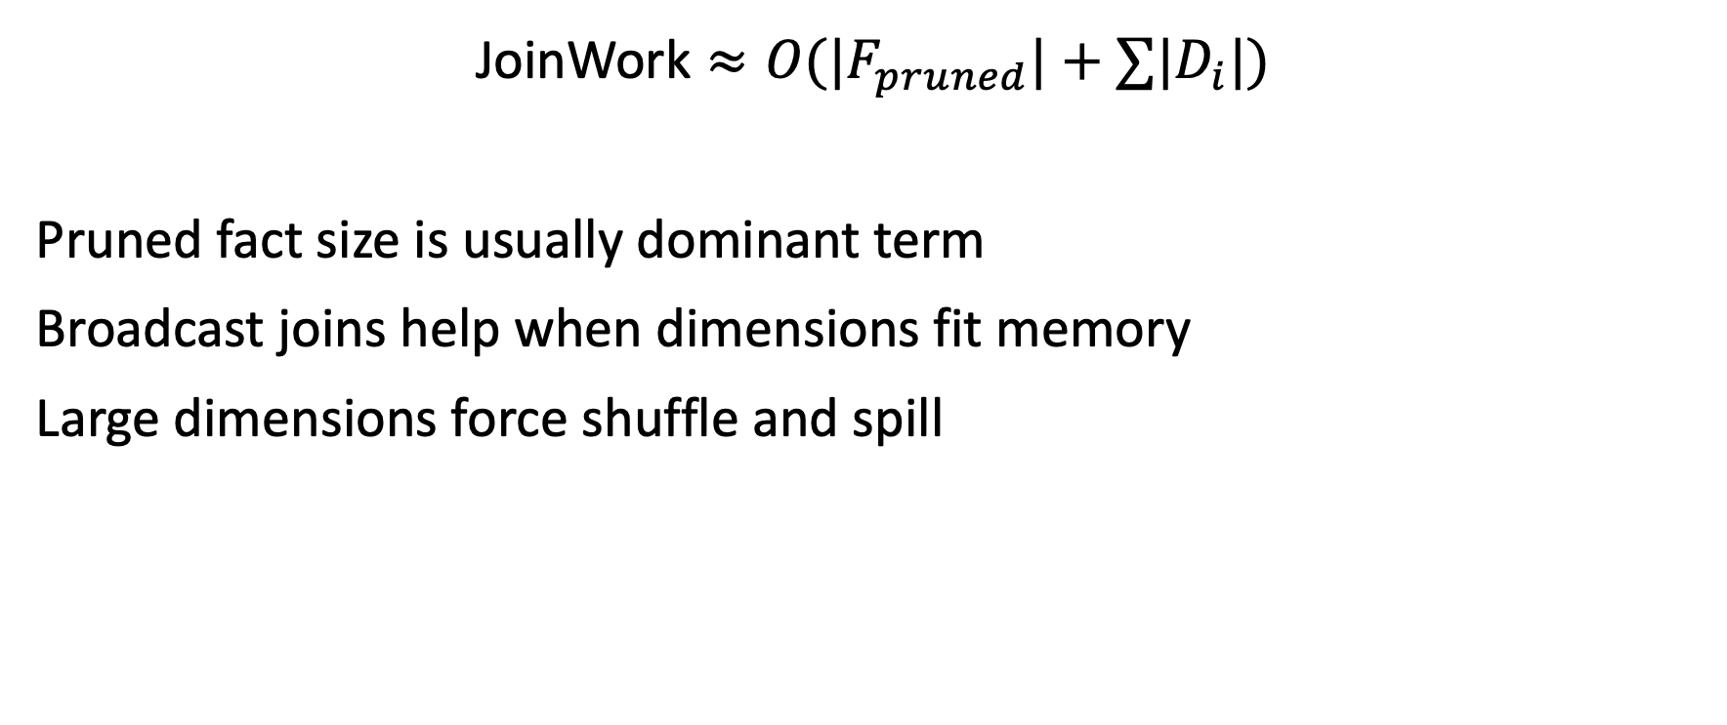
Join Cost Intuition
$$\text{JoinWork}≈O(|F_{pruned}|+∑|D_{i}|)$$
Pruned fact size is usually dominant term
Broadcast joins help when dimensions fit memory
Large dimensions force shuffle and spill

