Slide 1
Week 17: Language Models and End-to-End RAG

Slide 2
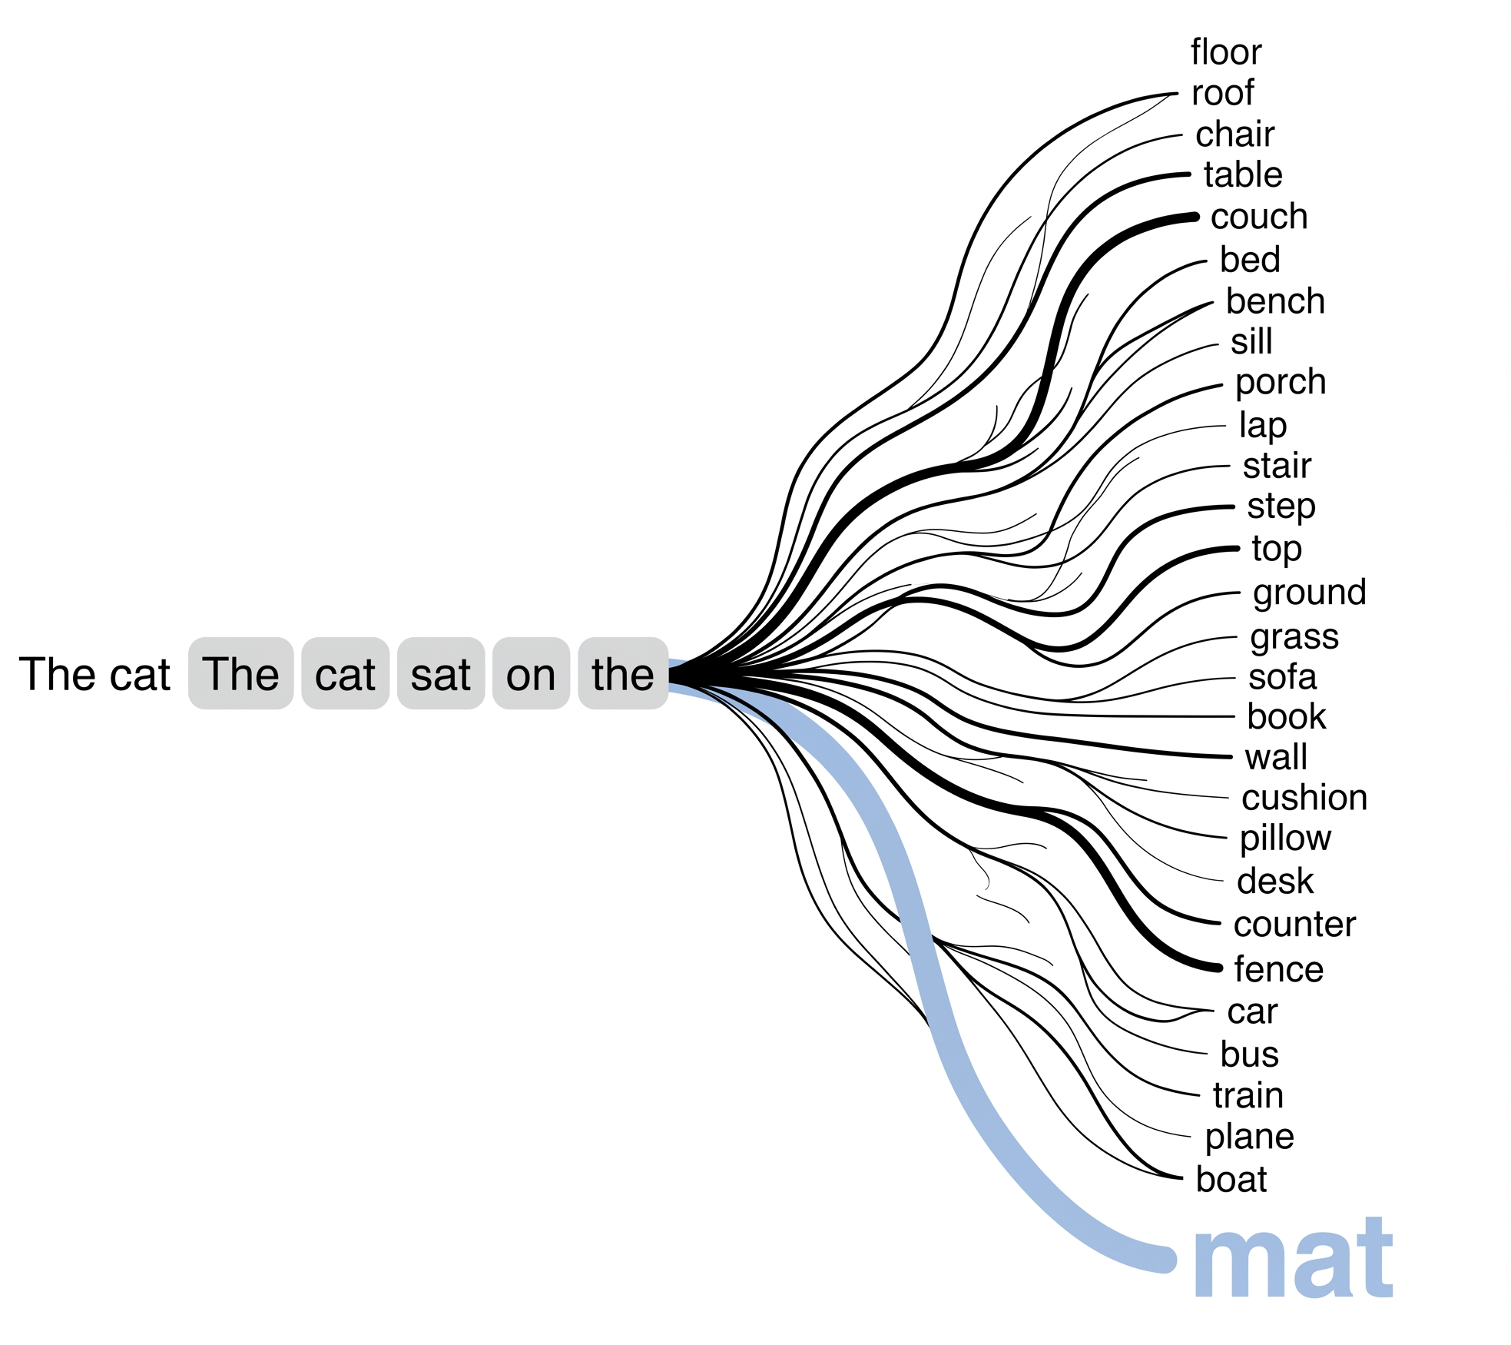
What Is a Language Model?
A language model assigns probabilities to text.
It predicts likely next tokens from previous tokens.
Generation repeats prediction, selection, and appending.
The output is probabilistic, not guaranteed truth.

Slide 3
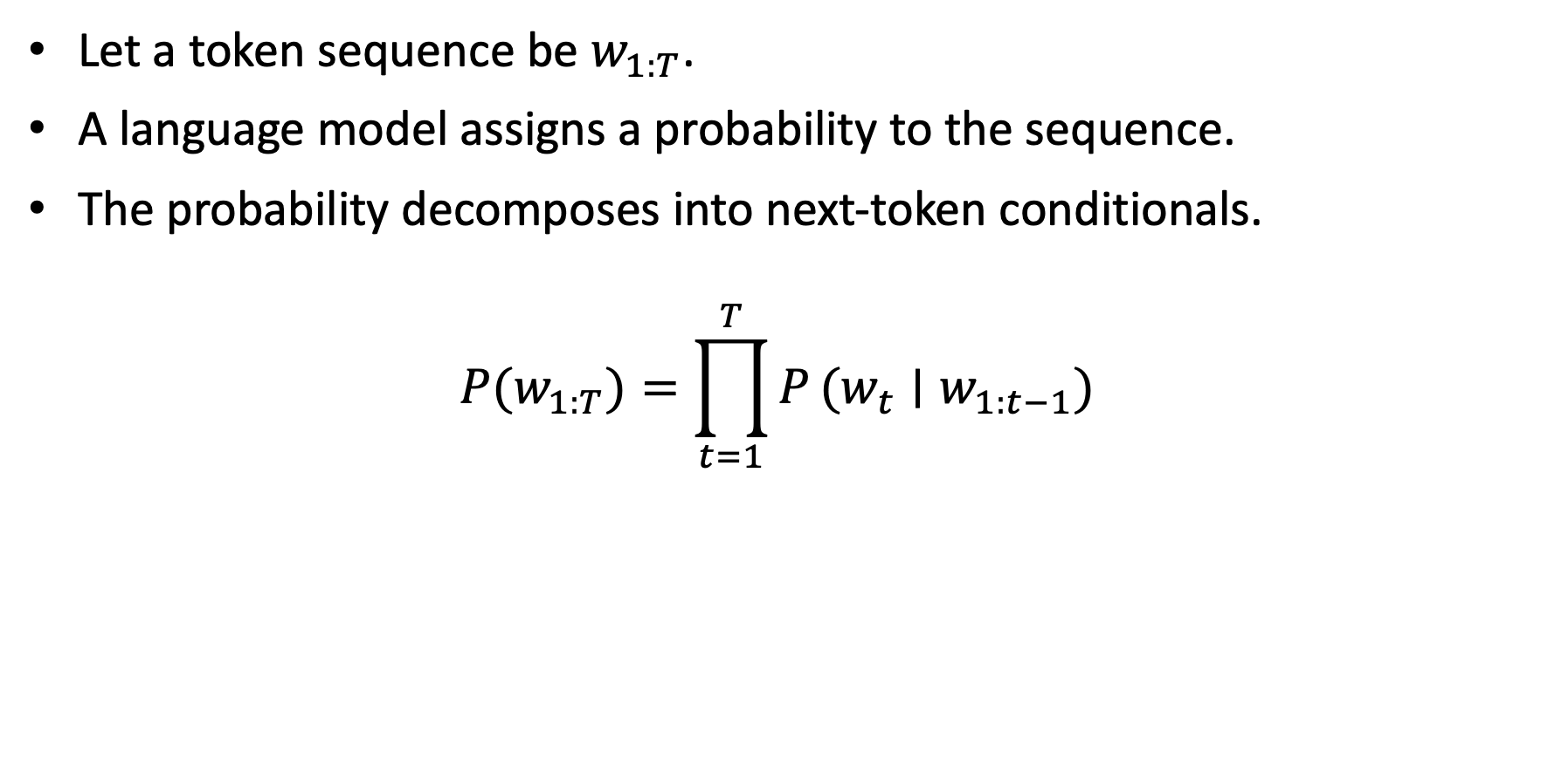
Formal Definition
Let a token sequence be $w_{1:T}$.
A language model assigns a probability to the sequence.
The probability decomposes into next-token conditionals.
$$P(w_{1:T})=\prod_{t=1}^{T}{P}(w_{t}∣w_{1:t−1})$$

Slide 4
Simple Example
Given:
The final project is due
A language model estimates:
next token | probability
tomorrow | 0.34
Friday | 0.27
next | 0.13
late | 0.04

Slide 5
Tokenization
Models do not directly process words.
Text is split into tokens.
Tokens can be words, word pieces, punctuation, or spaces.
Tokenization controls cost, context length, and reproducibility.
text | possible tokens
homework deadline | home, work, deadline
RAG pipeline | R, AG, pipeline

Slide 6
Sequence Probability Example
Assume these next-token probabilities:
step | token | probability
1 | homework | 0.50
2 | is | 0.40
3 | due | 0.25
product | sequence probability | 0.50 * 0.40 * 0.25 = 0.05

Slide 7
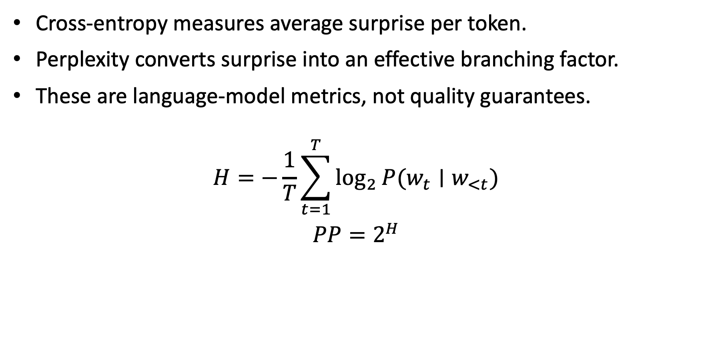
Cross-Entropy and Perplexity
Cross-entropy measures average surprise per token.
Perplexity converts surprise into an effective branching factor.
These are language-model metrics, not quality guarantees.
$$H=−\frac{1}{T}\sum_{t=1}^{T}{\log_{2}}P(w_{t}∣w_{<t})$$
$$PP=2^{H}$$

Slide 8
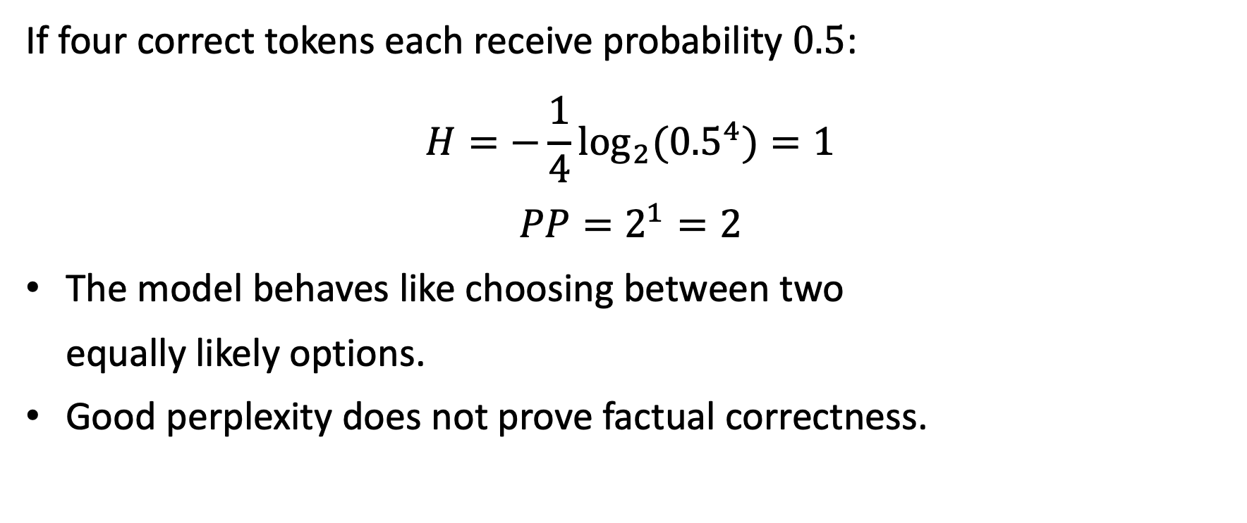
Perplexity Mini-Calculation
If four correct tokens each receive probability $0.5$:
$$H=−\frac{1}{4}\log_{2}({0.5}^{4})=1$$
$$PP=2^{1}=2$$
The model behaves like choosing between two equally likely options.
Good perplexity does not prove factual correctness.

Slide 9
Generation Loop
Read prompt tokens.
Estimate next-token distribution.
Select a token by greedy decoding, sampling, or beam search.
Append the token to the context.
Repeat until stop condition or token budget.
This is why prompt wording changes outputs.

Slide 10
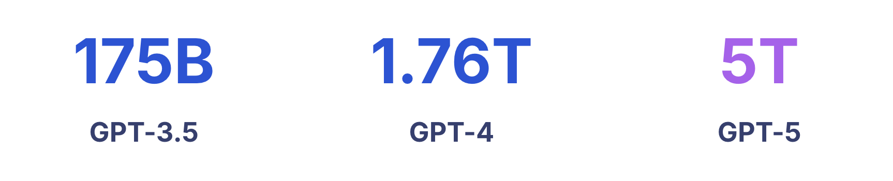
What Makes an LLM Different?
Dimension | Meaning
scale | many parameters and training examples
context | can condition on long prompts
instruction tuning | follows natural-language tasks better
tool ecosystem | can be wrapped with retrieval, tools, and policy
parameters

Slide 11
Critical Limitation
A language model completes text.
It does not automatically verify truth.
It may answer from outdated training data.
It may invent a plausible rule when evidence is missing.
Factual tasks need evidence outside the model.

Slide 12
What Is RAG?
RAG means Retrieval-Augmented Generation.
Retrieve relevant evidence from a trusted corpus.
Augment the prompt with that evidence.
Generate an answer grounded in retrieved sources.
Problem with LM alone | RAG response
training data may be old | retrieve current documents
private data is absent | index internal corpus
answer is hard to verify | cite evidence IDs
context window is limited | retrieve only relevant chunks

Slide 13
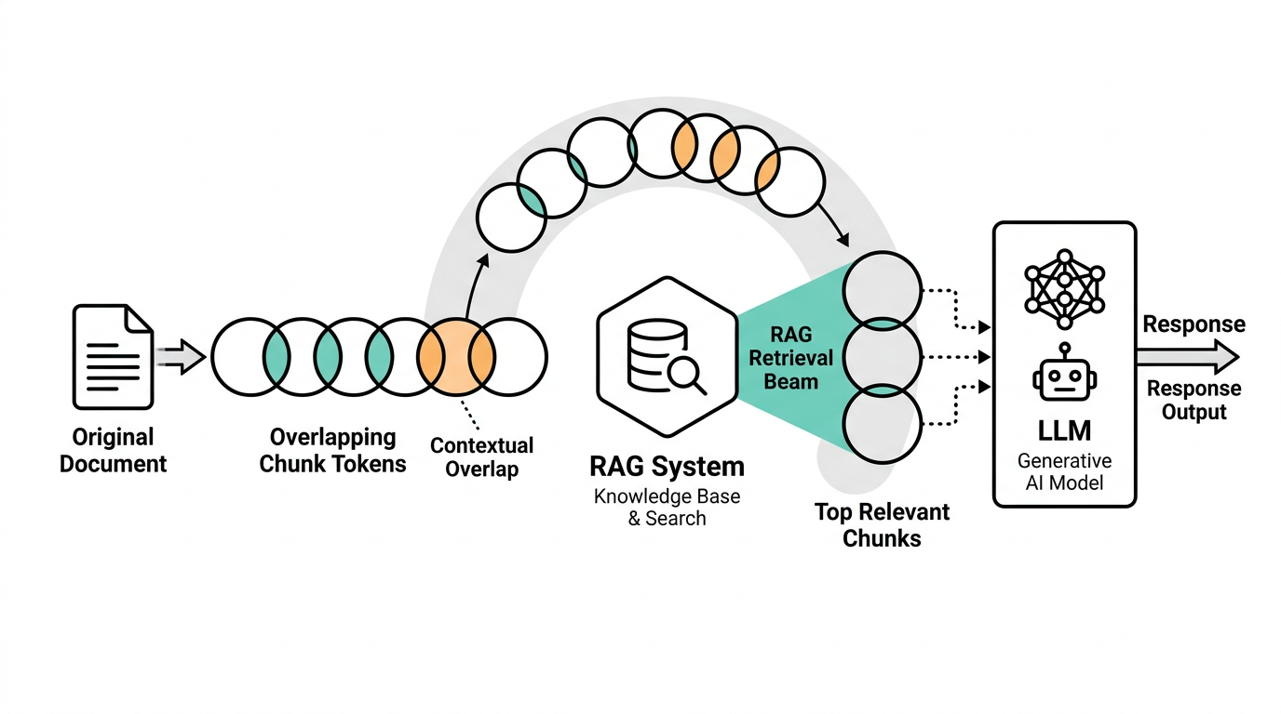
RAG Flow

Slide 14
Step 1: Ingest and Clean
Collect PDFs, slides, markdown files, and policy pages.
Extract text with page, section, and document metadata.
Remove boilerplate, broken headers, and duplicated footers.
Normalize whitespace and encoding.
Store the original source reference.

Slide 15
Step 2: Chunk the Corpus
A chunk is a small passage used for retrieval.
Chunking makes long documents searchable.
Too large: expensive and noisy.
Too small: loses context.
Overlap protects information near boundaries.

Slide 16
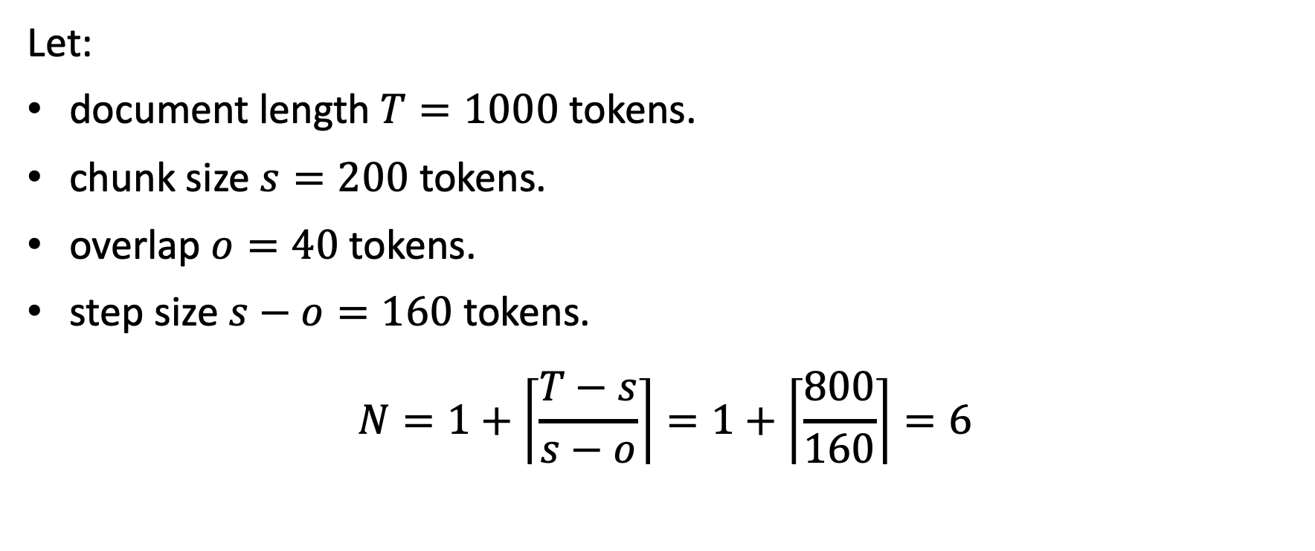
Chunking Calculation
Let:
document length $T=1000$ tokens.
chunk size $s=200$ tokens.
overlap $o=40$ tokens.
step size $s−o=160$ tokens.
$$N=1+\left\lceil \frac{T−s}{s−o}\right\rceil =1+\left\lceil \frac{800}{160}\right\rceil =6$$

Slide 17
Step 3: Store Chunk Metadata (Why??)
field | example
chunk_id | D1-C2
doc_id | D1
source_title | Homework Policy
section | Late Submissions
text | Late homework is accepted…
token_count | 188
updated_at | 2026-05-08
permissions | students

Slide 18
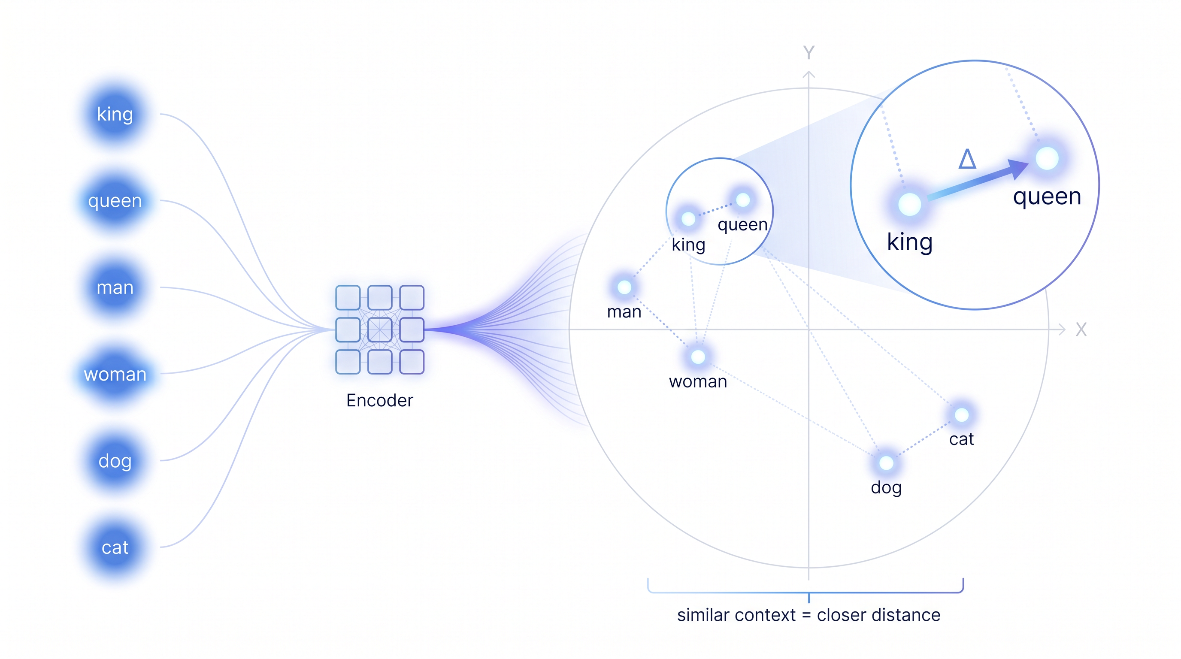
Step 4: Embed and Index
Each chunk is converted to an embedding vector.
Store vectors in a vector index.
Vector are semantic and context oriented.

Slide 19
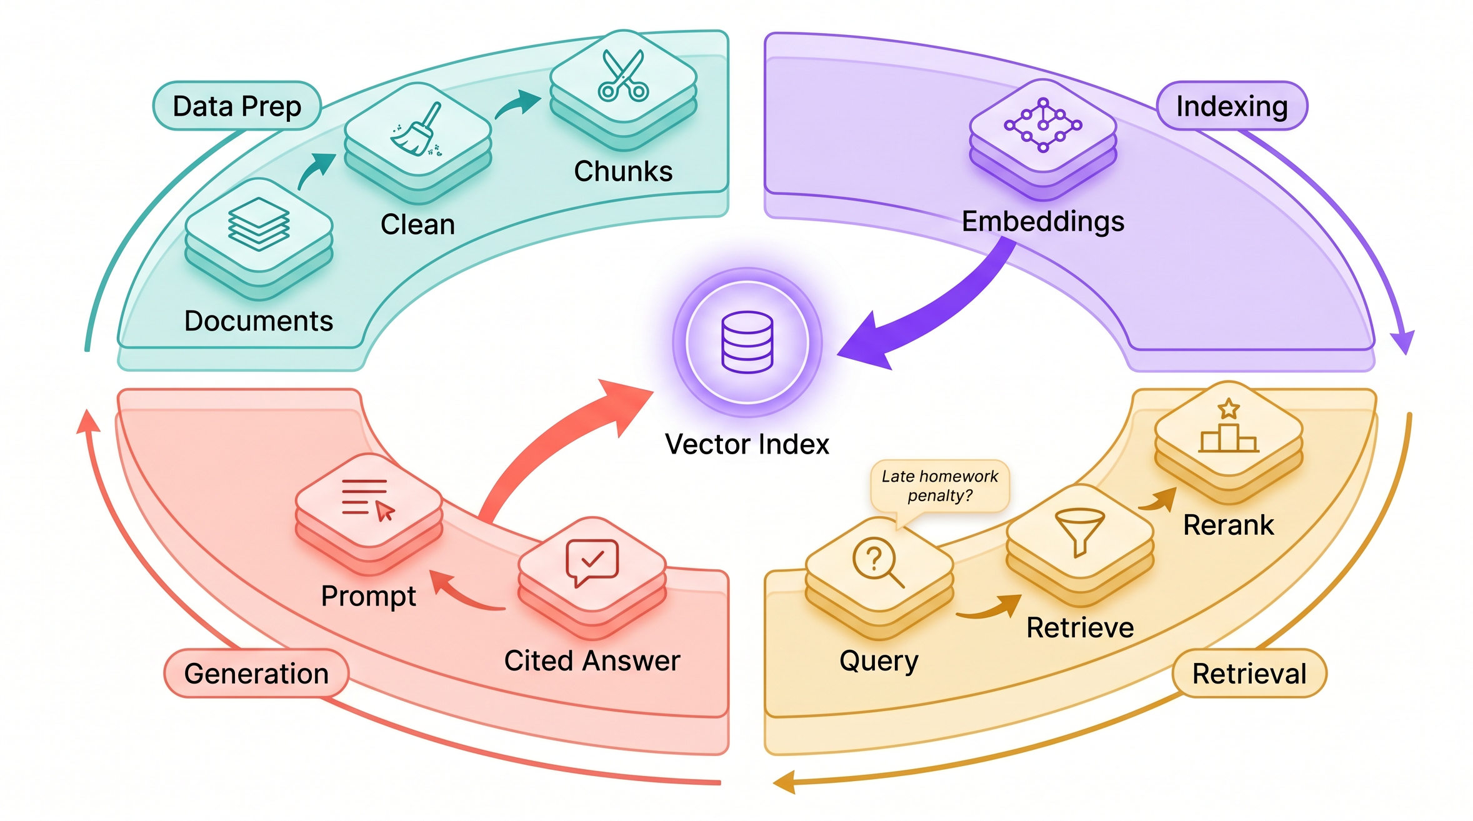
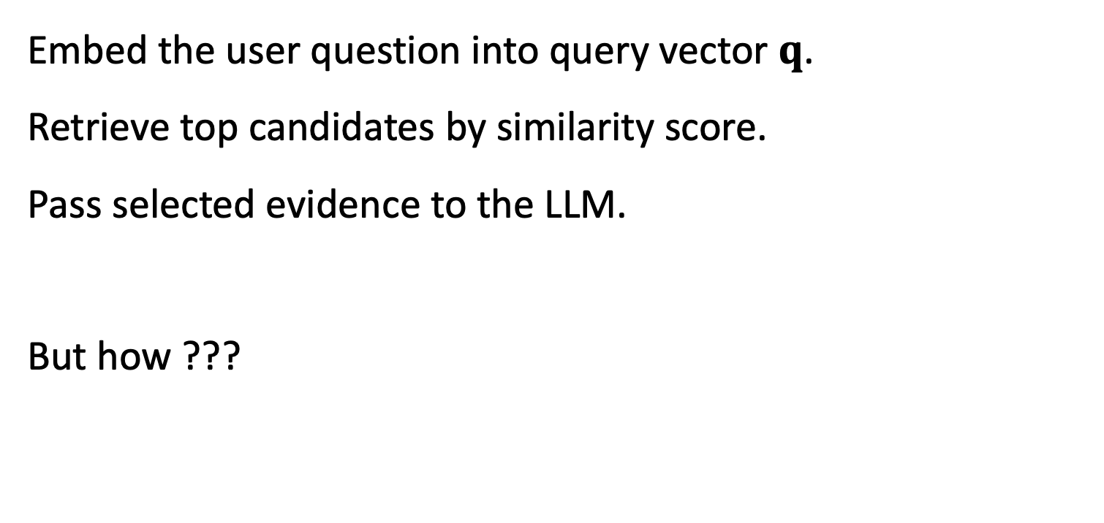
Step 5: Query-Time Retrieval
Embed the user question into query vector $q$.
Retrieve top candidates by similarity score.
Pass selected evidence to the LLM.
But how ???

Slide 20
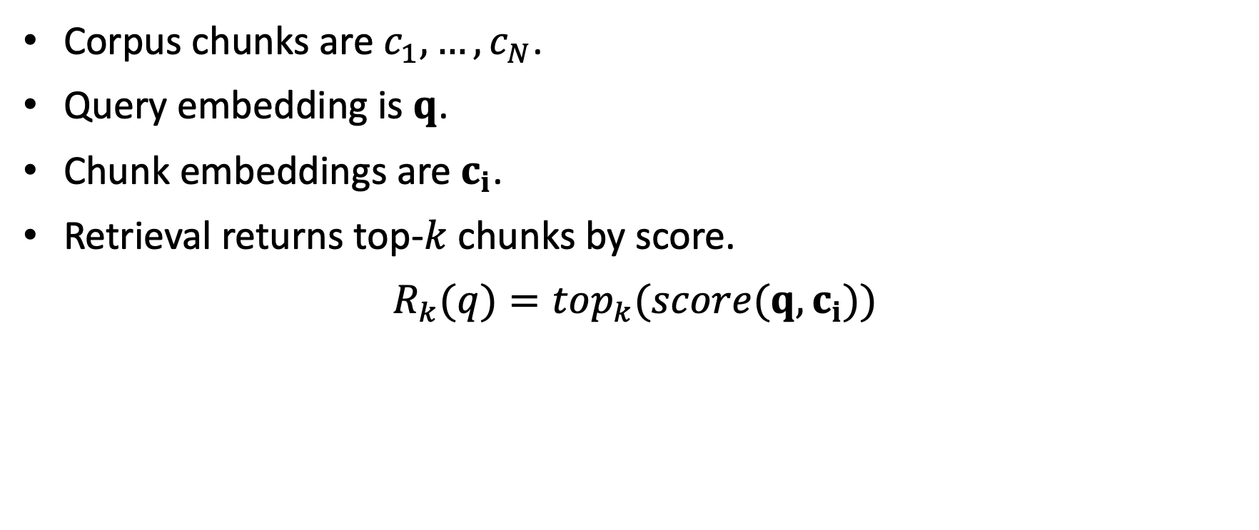
Formal Retrieval Model
Corpus chunks are $c_{1},…,c_{N}$.
Query embedding is $q$.
Chunk embeddings are $c_{i}$.
Retrieval returns top-$k$ chunks by score.
$$R_{k}(q)=top_{k}(score(q,c_{i}))$$

Slide 21
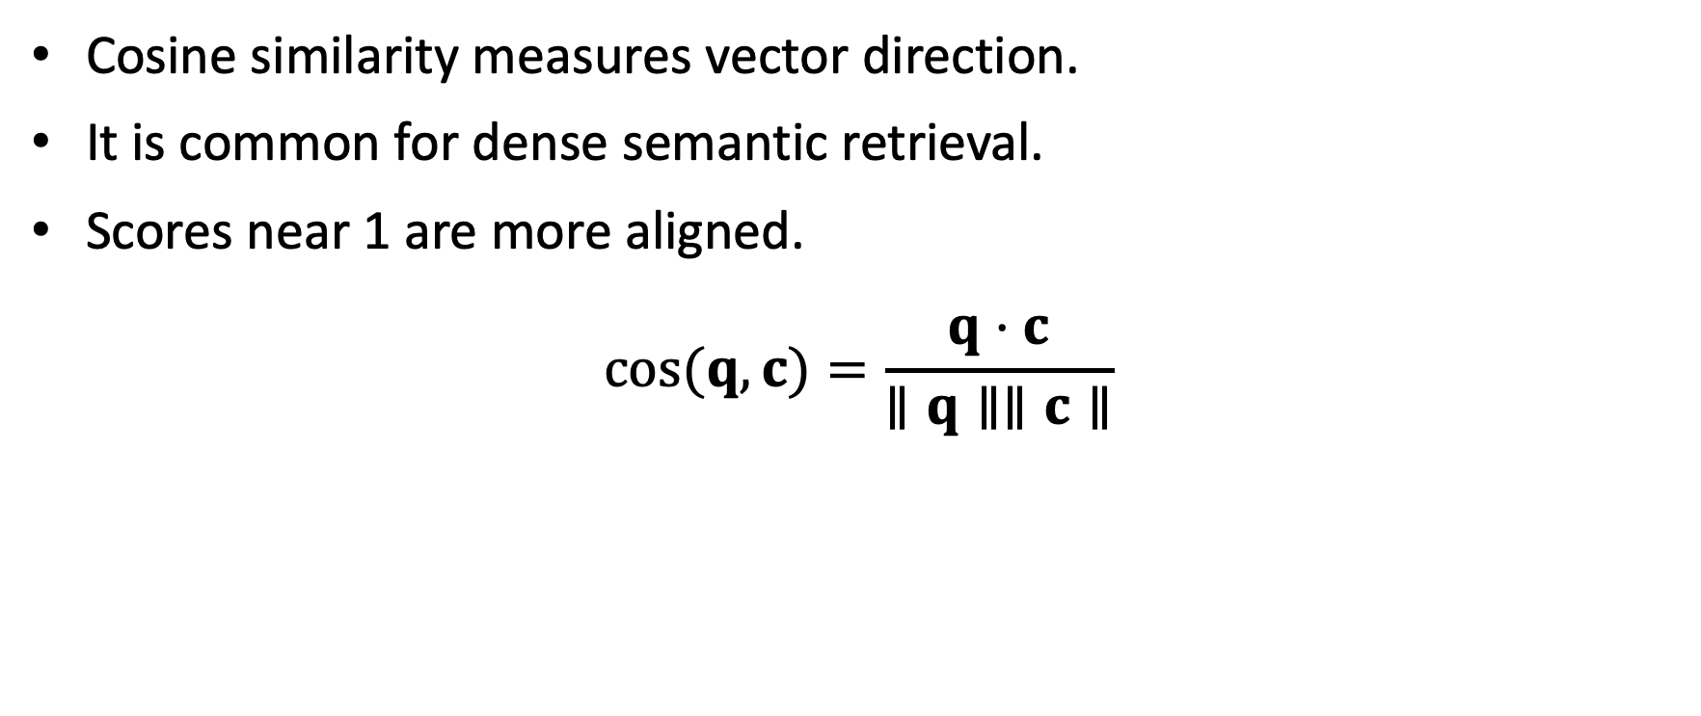
Cosine Similarity
Cosine similarity measures vector direction.
It is common for dense semantic retrieval.
Scores near 1 are more aligned.
$$cos(q,c)=\frac{q⋅c}{∥q∥∥c∥}$$

Slide 22

Worked Example: Candidate Vectors
Query:
q = (0.8, 0.6, 0.0)
chunk | meaning | vector
C1 | late homework penalty | (0.9, 0.5, 0.1)
C2 | office hours | (0.1, 0.2, 0.9)
C3 | homework grading weight | (0.6, 0.7, 0.2)
$$q⋅C1=0.8⋅0.9+0.6⋅0.5+0.0⋅0.1=1.02$$
$$∥q∥=\sqrt{{0.8}^{2}+{0.6}^{2}}=1.00$$
$$∥C1∥=\sqrt{{0.9}^{2}+{0.5}^{2}+{0.1}^{2}}=1.034$$
$$cos(q,C1)=1.02/(1.00⋅1.034)=0.986$$

Slide 23
Similarity Ranking
chunk | cosine score | rank
C1 | 0.986 | 1
C3 | 0.954 | 2
C2 | 0.216 | 3
Not sure its enough for ”understanding” context ☹

Slide 24
Why BM25 Appears in RAG
RAG often starts with a search problem.
Dense vectors find semantic similarity.
BM25 finds exact lexical evidence.
A good retriever often combines dense and lexical scores.
BM25 (Best Matching) is improvement of simple TF-IDF ☺

Slide 25
BM25 Core Idea
BM25 rewards a document when:
query terms appear in the document.
rare terms appear.
terms appear enough times, but not endlessly.
the document is not only long because it contains many words.
This improves over raw word counts.

Slide 26
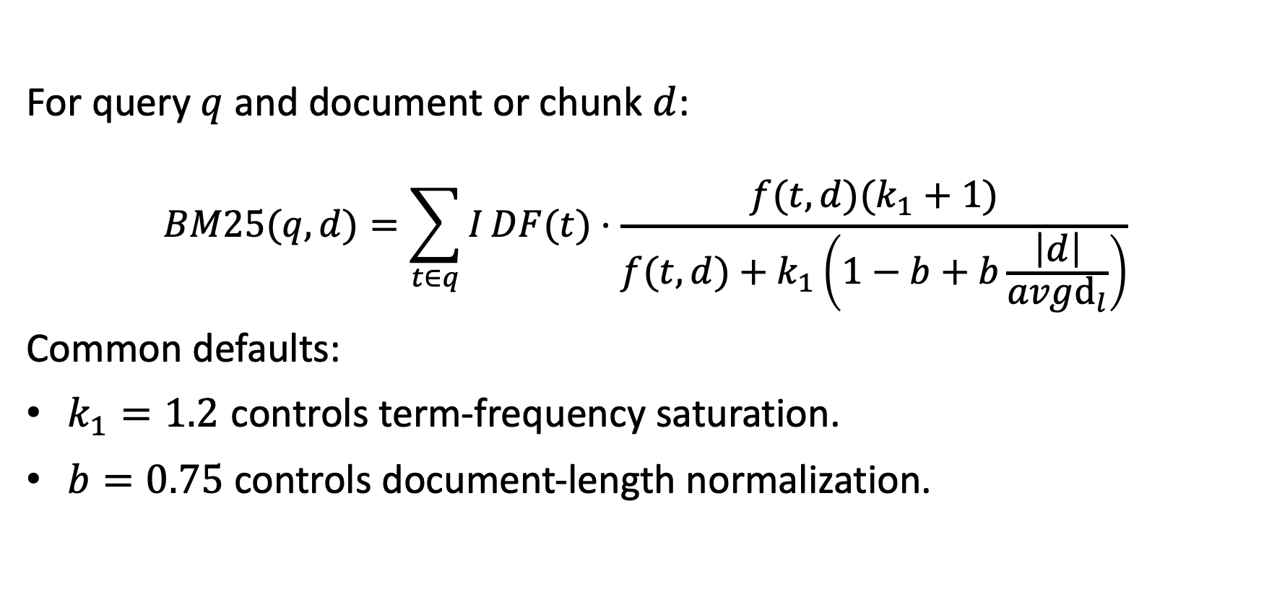
BM25 Formula
For query $q$ and document or chunk $d$:
$$BM25(q,d)=\sum_{t∈q}^{​}{I}DF(t)⋅\frac{f(t,d)(k_{1}+1)}{f(t,d)+k_{1}\left(1−b+b\frac{\left|d\right|}{avgd_{l}}\right)}$$
Common defaults:
$k_{1}=1.2$ controls term-frequency saturation.
$b=0.75$ controls document-length normalization.

Slide 27

IDF: Rarity Weight
Rare query terms should matter more than common terms.
$$IDF(t)=log\left(1+\frac{N−df(t)+0.5}{df(t)+0.5}\right)$$
variable | meaning
N | number of chunks
df(t) | chunks containing term t

Slide 28

IDF Example
Assume $N=1000$ chunks.
term | df | IDF intuition | IDF value
penalty | 10 | rare | 4.56
homework | 500 | common | 0.69
the | 900 | very common | 0.11

Slide 29

Term Frequency Saturation
BM25 does not reward repeated words linearly.
Assume $k_{1}=1.2$ and average-length chunks.
term count | BM25 tf weight
1 | 1.00
2 | 1.38
5 | 1.77
10 | 1.96

Slide 30

Document Length Normalization
Long chunks naturally contain more words.
$$length_norm=1−b+b\frac{|d|}{avgd_{l}}$$
Assume $b=0.75$ and $avgdl=200$.
chunk length | length norm
80 | 0.55
200 | 1.00
400 | 1.75

Slide 31

BM25 Mini-Corpus
Query:
late homework penalty
Assume $avgdl=6$, $k_{1}=1.2$, $b=0.75$.
chunk | text summary | length
C1 | late homework penalty policy | 8
C2 | office hours schedule | 5
C3 | homework grading weight | 6
setting | value | meaning
avgdl | 6 | average chunk length
k1 | 1.2 | tf saturation
b | 0.75 | length normalization

Slide 32
BM25 Term Statistics
term | df | IDF
late | 1 | 0.981
homework | 2 | 0.470
penalty | 1 | 0.981

Slide 33
C1 Term Frequencies
For C1:
all three terms appear once.
chunk length is 8 tokens.

Slide 34
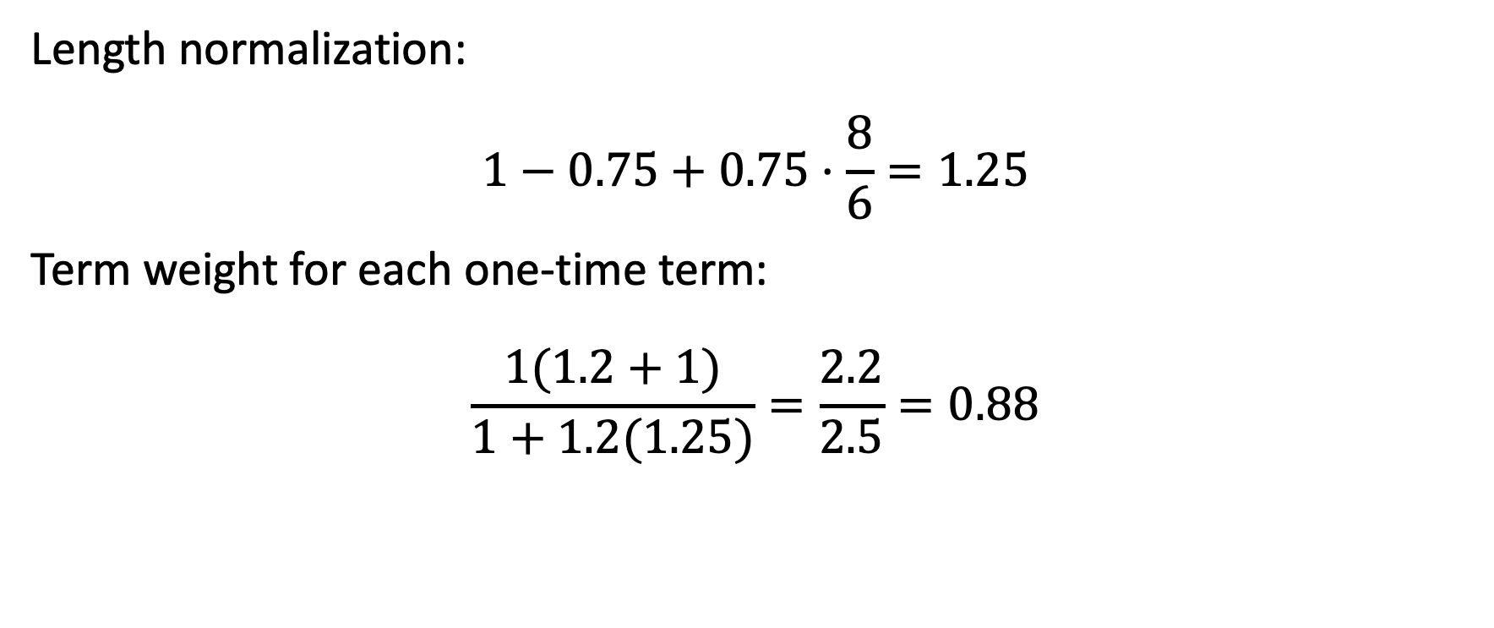
BM25 Worked Example: C1
Length normalization:
$$1−0.75+0.75⋅\frac{8}{6}=1.25$$
Term weight for each one-time term:
$$\frac{1(1.2+1)}{1+1.2(1.25)}=\frac{2.2}{2.5}=0.88$$

Slide 35

BM25 Worked Score: C1
C1 contains late, homework, and penalty.
$$BM25(C1)=0.88(0.981+0.470+0.981)$$
$$BM25(C1)=0.88⋅2.432=2.140$$
C1 receives a strong lexical score.

Slide 36
BM25 Ranking Example
chunk | matched query terms | raw BM25
C1 | late, homework, penalty | 2.140
C3 | homework | 0.470
C2 | none | 0.000

Slide 37

Normalizing BM25
BM25 is not naturally bounded like cosine similarity.
Before mixing scores:
$$BM{25}_{norm}(d)=\frac{BM25(d)−min(BM25)}{max(BM25)−min(BM25)}$$
chunk | raw BM25 | normalized
C1 | 2.140 | 1.00
C3 | 0.470 | 0.22
C2 | 0.000 | 0.00

Slide 38
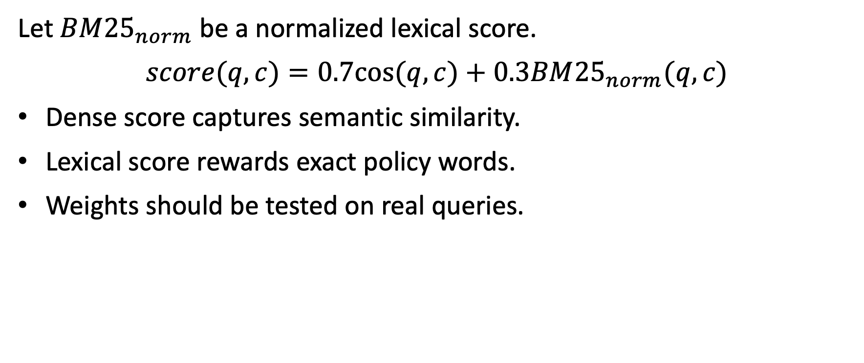
Hybrid Score
Let $BM{25}_{norm}$ be a normalized lexical score.
$$score(q,c)=0.7cos(q,c)+0.3BM{25}_{norm}(q,c)$$
Dense score captures semantic similarity.
Lexical score rewards exact policy words.
Weights should be tested on real queries.

Slide 39
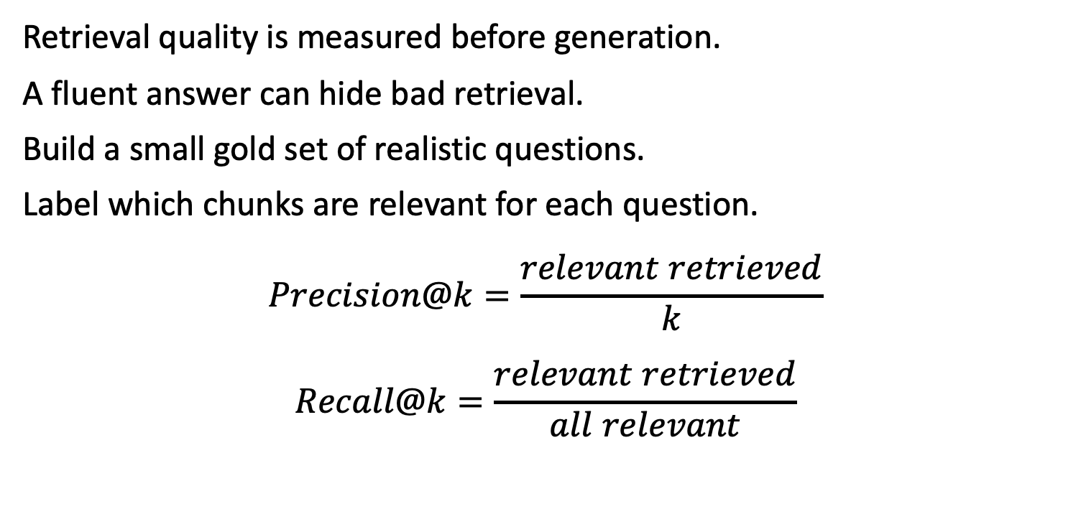
Retrieval Evaluation
Retrieval quality is measured before generation.
A fluent answer can hide bad retrieval.
Build a small gold set of realistic questions.
Label which chunks are relevant for each question.
$$Precision@k=\frac{relevant retrieved}{k}$$
$$Recall@k=\frac{relevant retrieved}{all relevant}$$

Slide 40
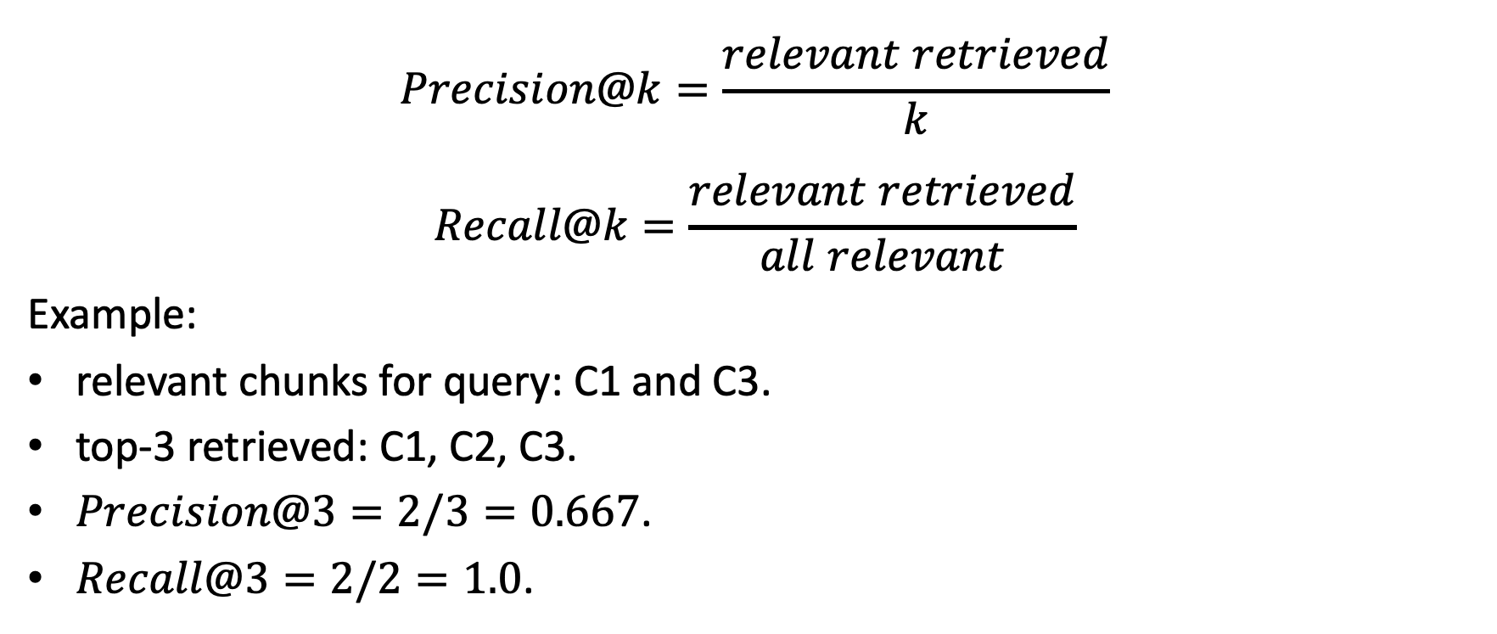
Precision and Recall
$$Precision@k=\frac{relevant retrieved}{k}$$
$$Recall@k=\frac{relevant retrieved}{all relevant}$$
Example:
relevant chunks for query: C1 and C3.
top-3 retrieved: C1, C2, C3.
$Precision@3=2/3=0.667$.
$Recall@3=2/2=1.0$.

Slide 41
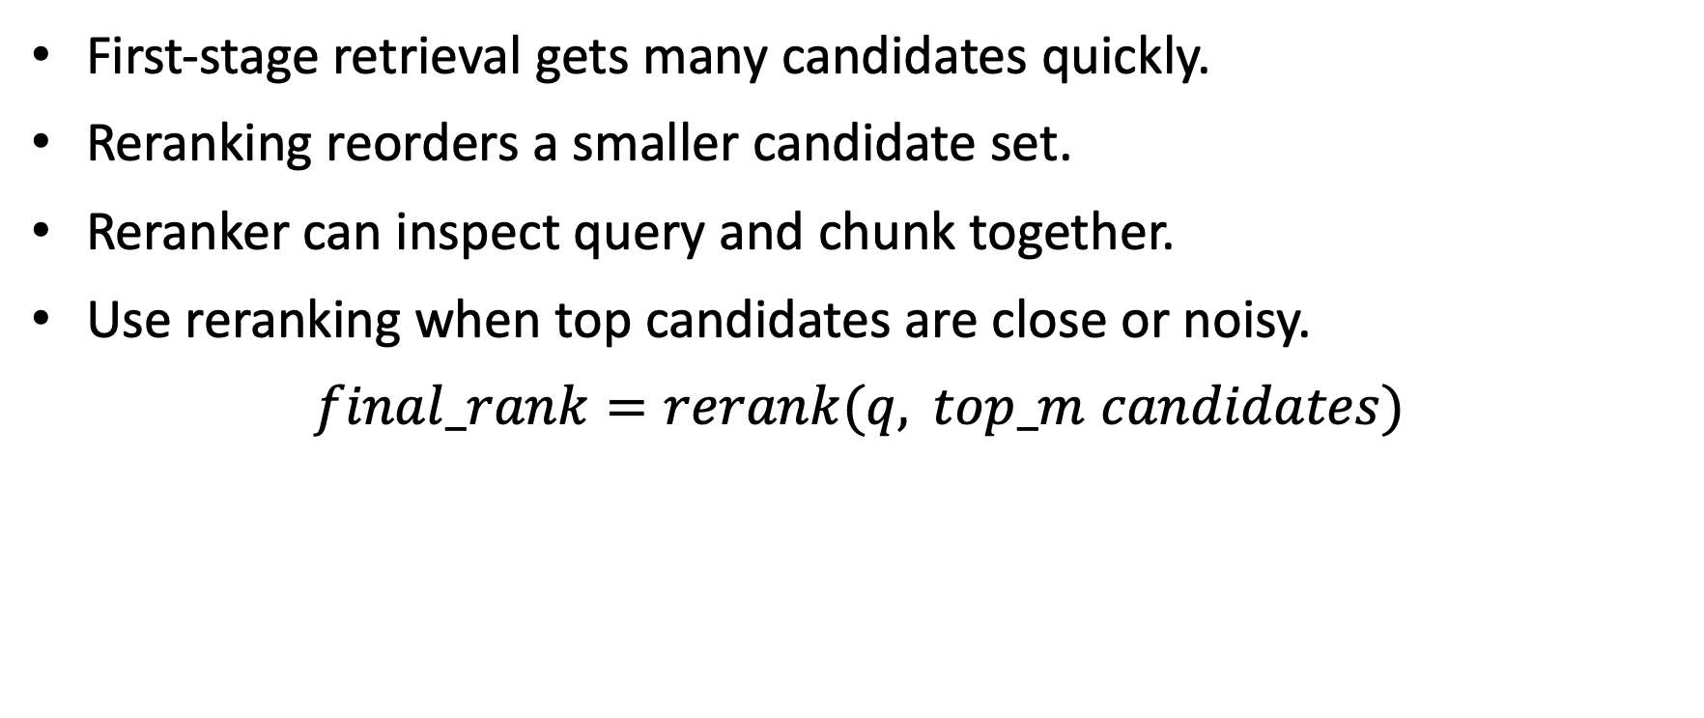
Reranking
First-stage retrieval gets many candidates quickly.
Reranking reorders a smaller candidate set.
Reranker can inspect query and chunk together.
Use reranking when top candidates are close or noisy.
$$final_rank=rerank(q, top_m candidates)$$

