Slide 1
Week 2: Distributed Databases: SQL vs NoSQL

Slide 2
Purpose
Understand why single-node databases fail at scale
Learn how partitioning and replication enable growth
Choose SQL, NoSQL, or hybrid architecture from workload needs

Slide 3
Learning Objectives
Calculate per-node data load under partitioning/replication
Explain ACID, BASE, and CAP in engineering terms
Design partition keys for dominant read/write paths
Identify distributed failure modes and practical mitigations

Slide 4
Flow for Today
Why we distribute databases
Partitioning + replication mechanics
SQL vs NoSQL decision framework
Consistency trade-offs and failure handling
End-to-end design example

Slide 5
Why Single-Node Databases Break
Storage, throughput, and availability have hard ceilings
Vertical scaling becomes expensive and eventually plateaus
Maintenance windows and failures become business risks
Growth requires horizontal architecture

Slide 6
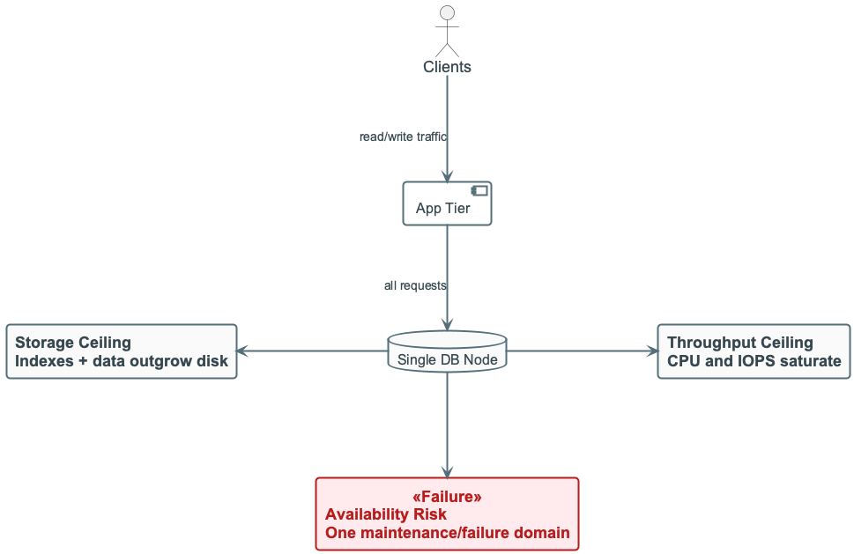
Single-Node Limits — Architecture
Single-node limits

Slide 7
Single-Node Limits (Quick Numbers)
Storage headroom shrinks as data and indexes grow
Write throughput saturates during traffic spikes
99.9% uptime still means hours of downtime per year
Recovery time often dominates incident impact

Slide 8
From Centralized to Distributed
Centralized DBMS: simple operations, one main failure domain
Distributed DBMS: multiple nodes, higher scale and resilience
User goal remains the same: one logical database view

Slide 9
GFS: Motivation for Distributed Storage
Google File System (GFS) pioneered scalable distributed storage for large data-intensive applications
Key observations: component failures are the norm; huge files (multi-GB) are common; files often mutated by appending
Design principles: constant monitoring, fault tolerance, co-design of applications and APIs
Files are broken into 64 MB chunks; each chunk replicated on multiple servers (default 3)

Slide 10
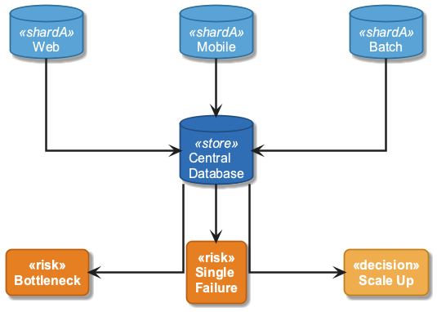
Centralized DBMS
Centralized database architecture

Slide 11
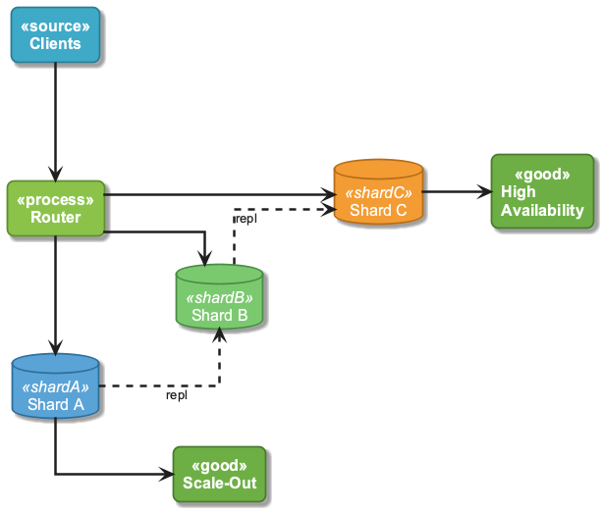
Distributed DBMS
Distributed database architecture

Slide 12
Distributed Database: User View
Application queries a single logical database
Distribution details are hidden by the DB layer
Engineering complexity moves from app code into data platform

Slide 13
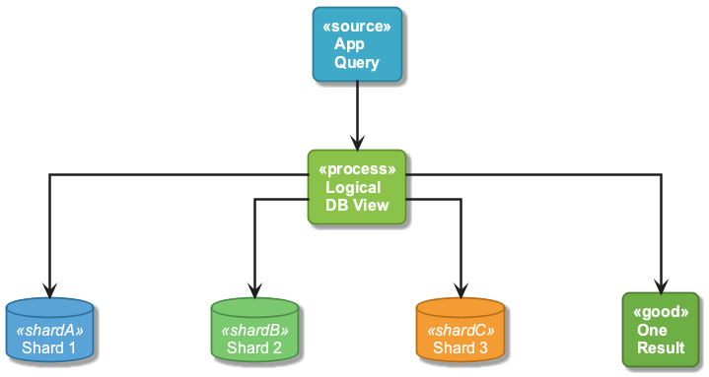
User View — Logical vs Physical
Logical vs physical view

Slide 14
Distributed Database Basics
Partitioning splits data across nodes for scale
Replication copies data for durability and availability
Coordination happens over an unreliable network
Partial failures are expected, not exceptional

Slide 15
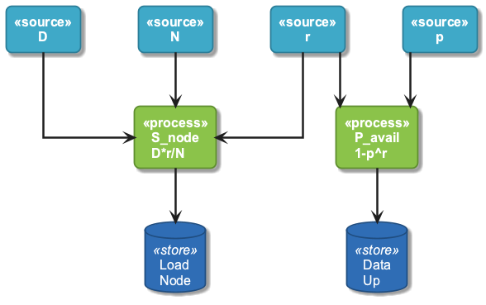
Partitioning + Replication Model
$$S_{node}=\frac{D⋅r}{N}$$
$$P_{avail}≈1−p^{r}$$
- D: total data, N: nodes, r: replication factor, p: node-failure probability - Higher r improves availability but increases write and storage cost
Partitioning formula visual

Slide 16
Worked Sizing Example
Given: D = 24 TB, N = 12, r = 3
Per-node data: S_node = (24 * 3) / 12 = 6 TB
If node failure probability is p = 0.02, then
Availability of a replicated item: 1 - 0.02^3 = 99.9992%

Slide 17
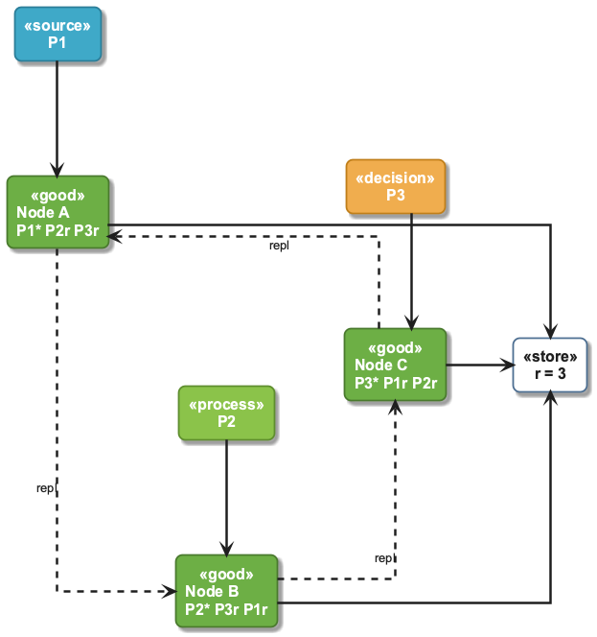
Partitioning and Replication Visual
Partitioning and replication model

Slide 18
Time and Cost Intuition
Local key lookups have low, stable latency
Cross-partition operations add network and coordination latency
Replication multiplies write traffic
Stronger consistency usually increases p99 latency and cost

Slide 19
Partitioning Strategy
Choose partition key from dominant access pattern
Keep common reads/writes single-partition when possible
Avoid skewed keys that create hot partitions
Revisit partition key as traffic shape changes

Slide 20
Partition Key Example: Good vs Bad
Good for user feed service: partition by user_id
Bad for same workload: partition by country (few hot values)
Symptom of bad key: one node has high CPU/queue lag while others are idle
Typical mitigation: key salting or sub-sharding for hot values

Slide 21
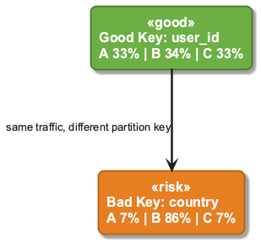
Key Distribution Visual
Partition key: good vs bad

Slide 22
Replication Read/Write Path
Writes typically flow leader -> followers
Reads may be leader-only or replica-enabled
Replica reads improve scale and often reduce latency
Replica lag can return stale reads

Slide 23
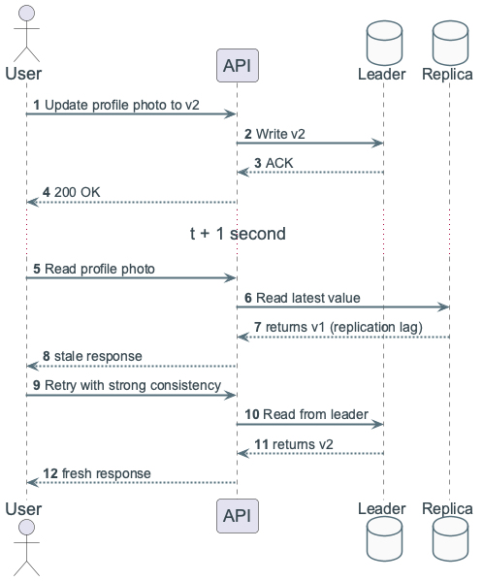
Stale Read Example
User updates profile picture at 10:00:00
Replica lags by 2 seconds
Read at 10:00:01 from replica returns old image
If this is unacceptable, route that read to leader
Stale read sequence

Slide 24
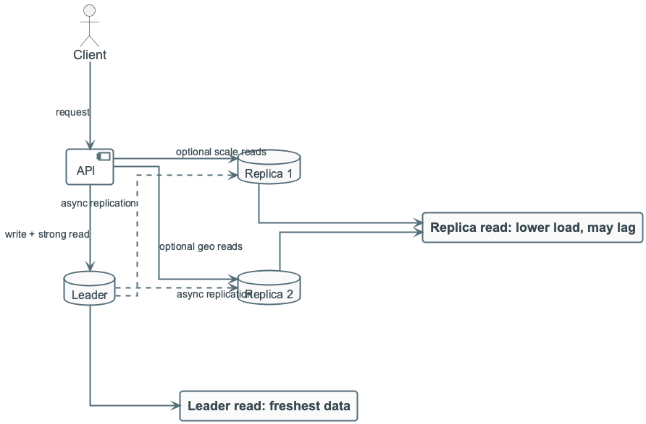
Replication Visual
Replication read/write path

Slide 25
SQL vs NoSQL: Decision Lens
SQL: relational model, joins, mature transactional tooling
NoSQL: key-centric model, simpler horizontal scaling for serving paths
Choose from access patterns, SLA, and consistency requirements
Hybrid is common when serving and analytics needs diverge

Slide 26
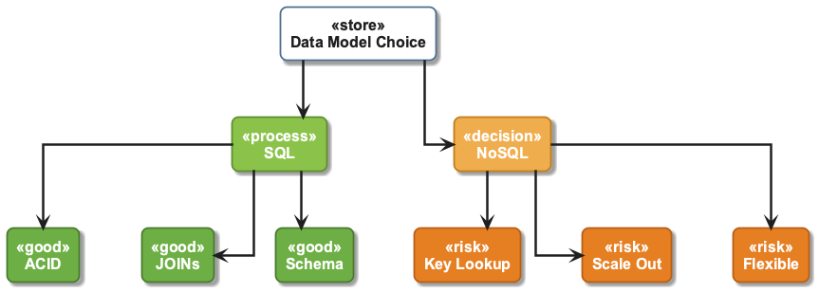
SQL vs NoSQL — Architecture
SQL vs NoSQL access patterns

Slide 27
SQL in Distributed Systems: Strengths and Costs
Strong guarantees are useful for money and inventory workflows
Cross-partition joins require expensive data movement
Distributed transactions add coordination latency
Best fit for correctness-critical multi-entity operations

Slide 28
NoSQL in Distributed Systems: Strengths and Costs
Key-based reads/writes are fast and predictable
Denormalization removes many runtime joins
Eventual consistency requires reconciliation logic
Best fit for high-throughput serving workloads

Slide 29
ACID (Transactional Guarantees)
Atomicity: all operations commit or none do
Consistency: constraints remain valid after commit
Isolation: concurrent transactions do not leak partial state
Durability: committed writes survive crashes

Slide 30
BASE (Scale-Oriented Guarantees)
Basically available: system responds despite some failures
Soft state: replicas may temporarily diverge
Eventually consistent: replicas converge when updates stop

Slide 31
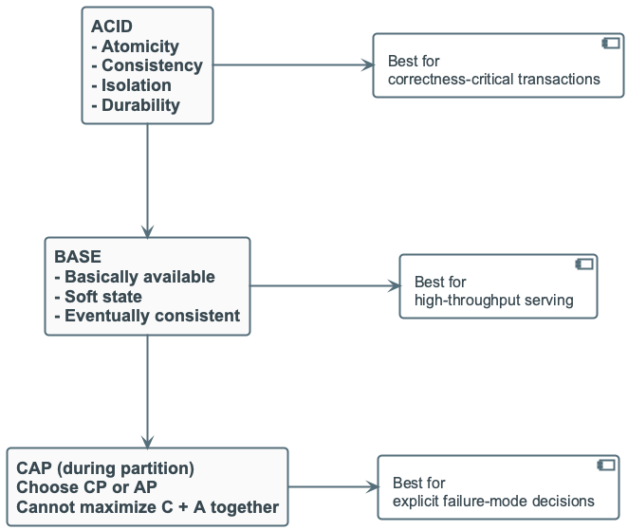
CAP (Under Network Partition)
Consistency: read returns latest write
Availability: every request gets a response
Partition tolerance: system continues despite network splits
During partition, you choose CP or AP, not both
ACID BASE CAP comparison

Slide 32
CAP Scenario: Shopping Cart Partition
CP option: block conflicting updates until partition heals
AP option: accept writes in both partitions and merge later
CP reduces inconsistency risk but impacts UX availability
AP protects UX but requires clear merge policy

Slide 33
Distributed Transactions: 2PC Risk
Two-phase commit enforces atomicity across nodes
Coordinator failure can block participants
Valuable for strict consistency, expensive operationally

Slide 34
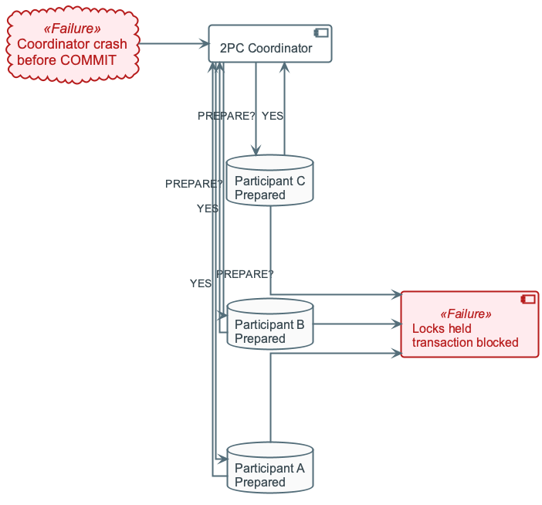
2PC — Blocking Risk
2PC blocking risk

Slide 35
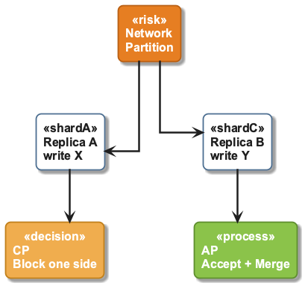
CAP in Practice
CAP network partition scenario

Slide 36
Running Example: Activity Log Service
100M events/day (~20 GB/day raw)
Query A: feed by user_id
Query B: analytics by item_id
SLA: p99 read latency under 50 ms for serving API

Slide 37
SQL-Oriented Design (Example)
Normalized tables: users, items, events
Great for flexible analytics and relational queries
Feed query may require cross-partition join + sort
Latency degrades under heavy fan-out

Slide 38
NoSQL-Oriented Design (Example)
Partition events_by_user by user_id
Feed query stays single-partition and predictable
item_id analytics needs separate materialized view
Better serving latency, higher modeling complexity

Slide 39
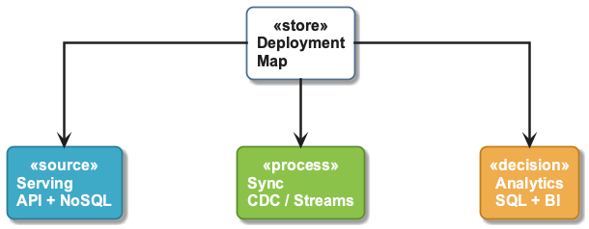
Recommended Hybrid Architecture
NoSQL store for online serving paths
SQL warehouse/lakehouse for analytics
Stream or batch sync between serving and analytics stores
Clear ownership per workload and data contract
Hybrid deployment view

Slide 40
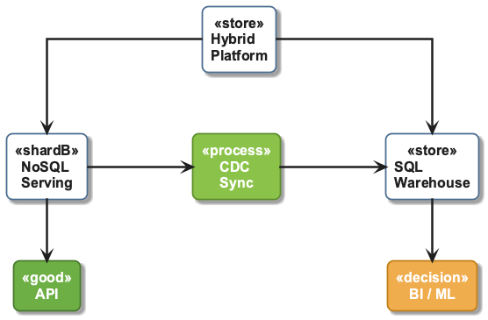
Hybrid Architecture — Overview
Hybrid architecture

Slide 41
Common Failure Modes
Hot partitions from skewed keys
Replica lag causing stale reads
Network partitions causing split-brain risk
Coordinator failure in multi-node workflows

Slide 42
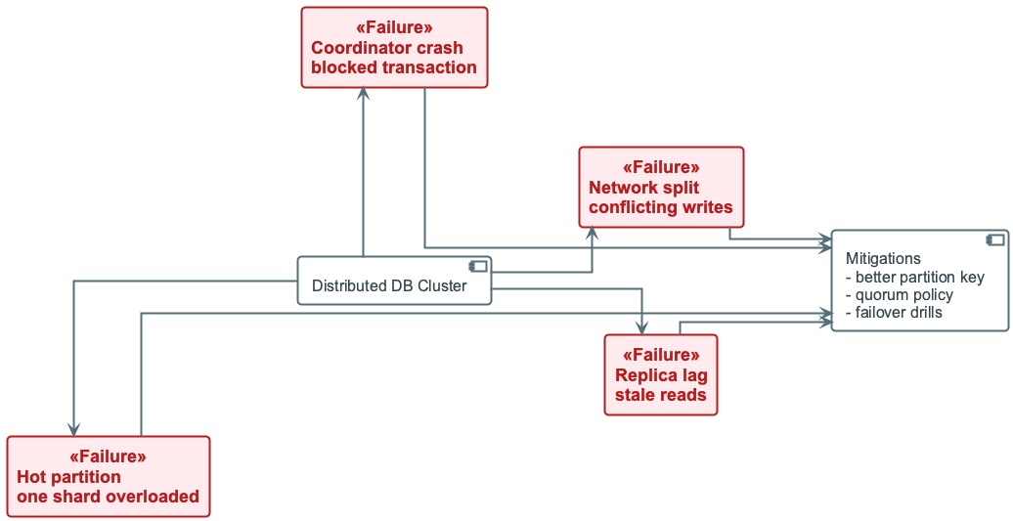
Failure Scenario Visual
Common failure modes

Slide 43
Mitigation Playbook
Define quorum and consistency per endpoint
Add salting/sharding for hot keys
Monitor p99 latency, replication lag, and error rate
Rehearse failover, partition, and recovery drills

Slide 44
Design Checklist
What are your top 3 read/write paths?
Which operations require strong consistency?
What stale-read window is acceptable?
How will node count and cost change in 12 months?

Slide 45
60-Second Decision Heuristic
If correctness-critical cross-entity transactions dominate -> start SQL/CP
If ultra-low-latency key access dominates -> start NoSQL/AP-aware
If both are critical -> hybrid with explicit sync boundaries
Re-evaluate quarterly as workload shape changes

Slide 46
Recap
Distributed databases trade simplicity for scale and resilience
Partition-key quality is your strongest performance lever
SQL and NoSQL solve different workload segments
Next: parallel processing and distributed compute patterns

