Slide 1
Week 5: Data Warehousing and Data Lakes

Slide 2
Purpose
DWH and Data Lake are primary stores for analytics and BI
Schema-on-read vs schema-on-write drives cost and flexibility
Partitioning and pruning determine query cost at scale

Slide 3
Learning Objectives
Define Data Warehouse (DWH) vs Data Lake
Explain schema-on-read vs schema-on-write trade-offs
Model analytical data with star schema (fact + dimensions)
Apply partitioning and partition pruning
Reason about join size and query cost in OLAP
Connect DWH/Lake to ETL output and BI consumers

Slide 4
The Real Problem This Lecture Solves

Slide 5
Full Scan Incident
Company put all analytics in one huge table
No partition key; BI built “revenue by region” with no date filter
Table grew to 1 TB; query scanned full table every time

Slide 6
Consequences
Dashboards started timing out
Finance and sales could not refresh reports
Teams exported to Excel and duplicated logic
Governance collapsed

Slide 7
Root Cause and Takeaway
No partition key in the model
No governance requiring partition filter
Takeaway: bad warehouse design breaks trust

Slide 8
The System We Are Building

Slide 9
Domain Overview
Domain: e-commerce sales analytics
Revenue by region, by category, by time
Sources: operational DB and/or ETL output from Week 4

Slide 10
Partition Pruning Cost Model
Fact table size (|F|), partition selectivity (s) (fraction scanned)
$$\text{ScanCost}=s⋅|F|$$
Interpretation: pruning reduces I/O linearly with (s)
Engineering implication: choose partition keys aligned with filters
Star join with dimension sizes (|D_i|)
JoinWork=O(|F|+i​|Di|)
Interpretation: fact table dominates join cost
Engineering implication: keep dimensions small; broadcast when possible

Slide 11
Architecture
Raw: Lake raw zone or DWH staging; schema-on-read
Curated: DWH star schema: sales_fact + dimensions
sales_fact partitioned by date_key
Consumers: BI tools (Tableau, Looker); analysts

Slide 12
Diagram Manifest
Slide 13 → week5_lecture_slide13_system_overview.puml
Slide 14 → week5_lecture_bad_architecture.puml
Slide 15 → week5_lecture_evolution_v1_v2.puml
Slide 22 → week5_lecture_slide22_query_flow.puml
Slide 38 → week5_lecture_slide38_failure_partition.puml
week5_star_schema.puml — Star schema: fact + dimensions (FK, partition)
week5_dwh_vs_lake.puml — DWH vs Data Lake comparison
week5_partition_pruning_cost.puml — Full scan vs pruned scan cost
week5_schema_on_read_vs_write.puml — Schema-on-write vs schema-on-read
week5_dimension_hierarchy.puml — Time and product hierarchies (OLAP)
week5_star_vs_snowflake.puml — Star vs Snowflake schema
week5_inmon_characteristics.puml — Inmon DWH: four characteristics

Slide 13
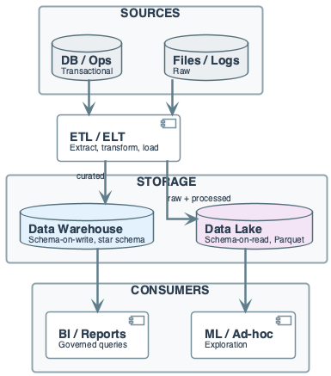
Core Concepts
Data Warehouse (DWH): centralized store for analytical data
Schema-on-write; optimized for SQL/OLAP
Data Lake: store for raw and processed data
Often schema-on-read; files (Parquet, ORC)
OLAP: aggregations, joins, reporting over large datasets

Slide 14
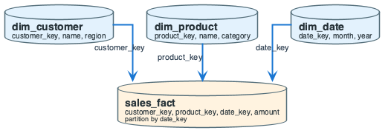
Core Concepts
Star schema: one fact table + dimension tables
Denormalized for query speed
Partitioning: data split by key (e.g. date)
Partition pruning: skips irrelevant partitions
DWH: typically ACID; Lake: often eventual consistency

Slide 15
Data Context: Star Schema (Sales)
sales_fact: 1 TB/year, partitioned by date_key
dim_customer: ~10K rows; region attribute
dim_product: ~1K rows; category attribute
dim_date: date_key, month, year

Slide 16
In-Lecture Exercise 1: Partition Pruning Check
Define partition pruning in one sentence
Why is a query without date_key filter expensive?

Slide 17
In-Lecture Exercise 1: Solution
Pruning skips partitions that fail the WHERE predicate
Only relevant partitions are scanned

Slide 18
In-Lecture Exercise 1: Solution
No date_key filter forces a full scan of all partitions
I/O scales with total table size, not query scope

Slide 19
In-Lecture Exercise 1: Takeaway
Partition filters are mandatory for large fact tables
Missing filters convert OLAP into full scans

Slide 20
Data Warehouse Definition (Formal)

Slide 21
Bill Inmon’s Definition
“A data warehouse is subject-oriented, integrated, time-variant, and nonvolatile”
Collection of data supporting decision-making

Slide 22
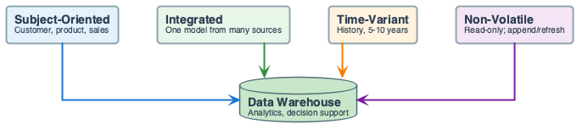
Key Characteristics
Subject Oriented: organized around major subjects
Customer, product, sales
Focusing on modeling and analysis for decision makers

Slide 23
Key Characteristics
Integrated: multiple heterogeneous data sources
Consistent naming conventions and encoding
Time Variant: provides historical perspective (5-10 years)
Non-Volatile: physically separate; operational updates don’t occur

Slide 24
Why Separate Data Warehouse?
Missing data: DS requires historical data
Operational DBs don’t typically maintain history
Data consolidation: DS requires aggregation and summarization
Data quality: different sources use inconsistent representations
Performance: analytical queries shouldn’t impact operations

Slide 25
DWH Back-End Tools and Utilities

Slide 26
Data Processing Steps
Data extraction: get data from multiple external sources
Data cleaning: detect errors and rectify when possible
Data transformation: convert from legacy to warehouse format
Load: sort, summarize, consolidate, compute views
Refresh: propagate updates from sources to warehouse

Slide 27
DWH Process Architectures
Centralized: single centralized storage and processing
Huge structure (memory, processor, storage)
Distributed: information across data centers
Processing localized; results grouped centrally
Trade-off: centralized simpler; distributed better for scale

Slide 28
Multidimensional Modeling

Slide 29
What is Multidimensional Modeling?
Technique for structuring data around business concepts
ER models: entities and relationships (operational focus)
Multi-dimensional: measures and dimensions (analytical focus)

Slide 30
Measures and Dimensions
Measures: numerical data being tracked
Can be analyzed and examined (e.g., sales amount, quantity)
Dimensions: business parameters defining a transaction
E.g., time, product, store, customer

Slide 31
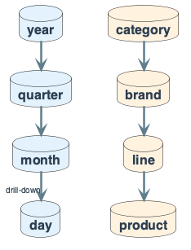
Dimensional Hierarchy
Dimensions are organized into hierarchies
Time example: days → weeks → quarters → years
Product example: product → line → brand → category
Dimensions have attributes (date, month, year; id, city, state)
Hierarchies enable drill-down and roll-up in OLAP

Slide 32
DWH Schema Types

Slide 33
The Star Schema
Definition: relational model with one-to-many relationships
Between dimension tables and fact table
Single fact table with detail and summary data
Fact table PK has one key column per dimension
Each dimension is a single, denormalized table

Slide 34
The Star Schema
Benefits: easy to understand; intuitive mapping
Easy to define hierarchies; reduces joins
Drawbacks: summary data can yield poorer performance
Huge dimension tables can be a problem

Slide 35
Star Schema Example
Sales Fact Table: time Dimension:
- time_key (FK) - time_key (PK)
- item_key (FK) - day, day_of_week
- branch_key (FK) - month, quarter, year
- location_key (FK)
- units_sold item Dimension:
- dollars_sold - item_key (PK)
- avg_sales - item_name, brand, type

Slide 36
In-Lecture Exercise 2: Join Size Reasoning
Query: revenue by region for December 2025
sales_fact pruned to December; dim_customer is small
Decide which side to broadcast in a distributed join
What if dim_customer were 10 GB instead of 10 MB?

Slide 37
In-Lecture Exercise 2: Solution
Fact slice is far larger than dim_customer
Broadcast dim_customer; keep fact partitions local

Slide 38
In-Lecture Exercise 2: Solution
If dim_customer is 10 GB, broadcast is too large
Use shuffle/hash join on customer_key instead

Slide 39
In-Lecture Exercise 2: Takeaway
Join strategy depends on relative table sizes
Small dimensions should be broadcast when possible
Size shifts can flip the optimal strategy

Slide 40
The Snowflake Schema
Definition: some dimensions don’t connect directly to fact
Must join through other dimension tables
Snowflaking: normalizing dimension tables in star schema
Low cardinality attributes form separate tables

Slide 41
Snowflake Schema Trade-offs
Suitable for: many-to-many and one-to-many relationships
Result: more complex queries; reduced performance
Advantages: small storage savings; easier to maintain
Disadvantages: less intuitive; difficult to browse

Slide 42
The Galaxy Schema (Fact Constellation)
Definition: two or more fact tables sharing dimensions
Use case: multiple business processes share common dimensions
Example: sales fact and shipping fact sharing time, item, location

Slide 43
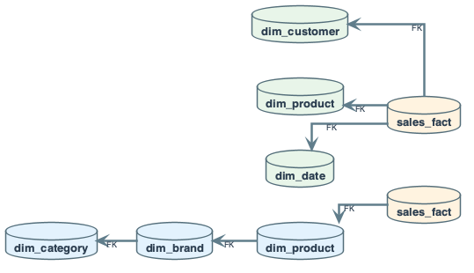
Which Schema Design is Best?
Performance benchmarking determines best for your use case
Snowflake: easier when dimension tables very large
Star: more effective for data cube browsing (fewer joins)
Engineering rule: start with star; snowflake if proven bottleneck

Slide 44
Architectural Fork: Lake First vs DWH First

Slide 45
Option A — Lake First
Ingest raw to Lake; process in Lake (Spark)
Sync curated tables to DWH or query Lake with SQL engine
Pros: raw preserved; flexibility for ML; storage cheap
Cons: two places to govern; small-file issues in Lake

Slide 46
Option B — DWH First
Ingest (or ETL) directly into DWH; star schema in DWH
BI only on DWH
Pros: one place for BI; strong consistency
Cons: raw may be limited; less flexibility for ML
Decision: Lake for raw + ML; DWH for governed reporting

Slide 47
Schema-on-Read vs Schema-on-Write

Slide 48
Schema-on-Write (DWH Default)
Data validated and typed on load
Bad row fails load
Pros: predictable types; simple queries
Cons: one bad row fails batch; schema change = migration

Slide 49
Schema-on-Read (Lake Default)
Load raw (Parquet/JSON); apply schema when querying
Pros: flexibility; schema evolution without reload
Cons: consumers handle types; consistency is eventual
Decision: schema-on-write for curated; schema-on-read at landing

Slide 50
DWH vs Data Lake
DWH: structured; schema enforced on load
SQL engines (Snowflake, BigQuery, Redshift)
Best for curated reporting
Lake: raw + processed; schema applied at read
File-based (S3, HDFS); best for flexibility and cost

Slide 51
DWH vs Data Lake
Cost model: DWH compute + storage often coupled
Lake: storage cheap, compute on demand
Hybrid: Lakehouse (Delta, Iceberg) combines both
What breaks: DWH = large single table scans
Lake = small-file problem; both: skew and hot partitions

Slide 52
Star Schema and OLAP (This System)

Slide 53
Fact Table
sales_fact(sale_id, customer_key, product_key, date_key, quantity, amount)
Partitioned by date_key
BI queries always filter by date_key

Slide 54
Dimension Tables
dim_customer(customer_key, name, region)
dim_product(product_key, name, category)
dim_date(date_key, date, month, year)
Benefit: simple joins; predictable query patterns

Slide 55
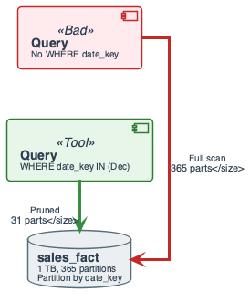
Partitioning and Pruning

Slide 56
Partition Key
E.g. date_key; data stored in directories per partition
Query with WHERE date_key BETWEEN 20251201 AND 20251231
Reads only those partitions

Slide 57
Pruning Cost
Scan size ≈ (selected partitions / total) × table size
Pruning reduces I/O significantly
Engineering: require partition filter in WHERE

Slide 58
In-Lecture Exercise 3: Pruning Cost Math
365 partitions/year; total size 1 TB
December query uses date_key between 20251201 and 20251231
Compute partitions read and bytes scanned
What if the date filter is missing?

Slide 59
In-Lecture Exercise 3: Solution
Partitions read: 31 (one per day in December)
Size per partition: 1 TB / 365 ≈ 2.7 GB
Bytes scanned: 31 × 2.7 GB ≈ 84 GB

Slide 60
In-Lecture Exercise 3: Solution
Without date filter: all 365 partitions scanned
Full 1 TB scan for every report
Cost and latency explode

Slide 61
In-Lecture Exercise 3: Takeaway
Partition pruning is the main cost lever in OLAP
Always enforce date filters in BI queries
Full scans break dashboards at scale

Slide 62
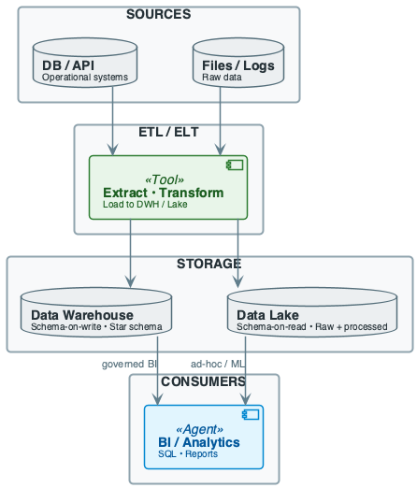
DWH and Lake: Pipeline Overview
Sources (DB, logs) → ETL/ELT → DWH (star) and/or Lake (raw + processed)
BI and analytics query DWH or Lake via SQL engines

Slide 63
Bad Architecture: Why This Fails

Slide 64
Anti-Pattern
One huge fact-like table; no partition key
BI reports with no date filter
Every query does full table scan
At 1 TB, queries timeout; dashboards break

Slide 65
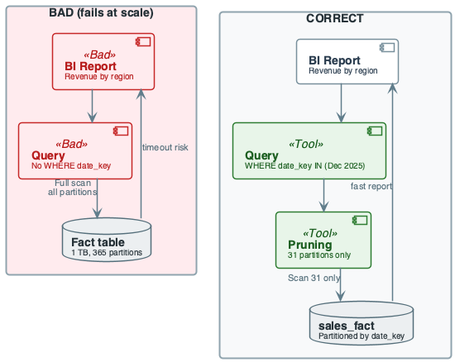
Hot Partition Problem
If partitioned but only by date, “today” gets all writes and reads
⇒ throttle and skew

Slide 66
Cost of Naïve Design (DWH / Lake)

Slide 67
Naïve Choices
Naïve: one big table; no partition key
“We’ll add filters in the query”
Cost: full scan at 1 TB ⇒ 15+ min or timeout

Slide 68
Real Cost
Dashboards fail; teams export to Excel
Duplicate logic; governance collapses
Engineering rule: partition by time; require filter in WHERE

Slide 69
Evolution: v1 Single Table → v2 Star + Partitioned

Slide 70
v1: Single Table
One big table; no partition key; ad-hoc WHERE
Fails at scale: full scan; unpredictable join cost

Slide 71
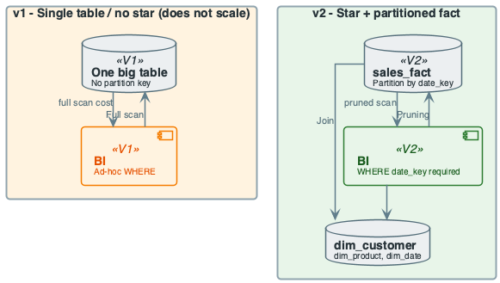
v2: Star + Partitioned
Star schema; fact partitioned by date_key
Dimensions small; BI required to filter by date_key
Pruned scan; predictable cost; governance

Slide 72
Running Example — Data & Goal
Domain: e-commerce sales analytics
Fact: sales_fact(sale_id, customer_key, product_key, date_key, quantity, amount)
Partitioned by date_key
Dimensions: dim_customer, dim_product, dim_date
Goal: revenue by region and by category with pruning

Slide 73
Running Example — Step-by-Step
Step 1: Fact table partitioned by date_key (one partition per day)
Sample: (1, 101, 201, 20251201, 2, 19.98)
Dimensions: small; not partitioned

Slide 74
Running Example — Step-by-Step
Step 2: Query: revenue by region for December 2025
Join sales_fact → dim_customer on customer_key
Filter date_key between 20251201 and 20251231
Partition pruning: only December partitions scanned

Slide 75
Revenue by Region Query
SELECT c.region, SUM(f.amount) AS total_revenue
FROM sales_fact f
JOIN dim_customer c ON f.customer_key = c.customer_key
WHERE f.date_key BETWEEN 20251201 AND 20251231
GROUP BY c.region ORDER BY total_revenue DESC;

Slide 76
Running Example — Step-by-Step
Step 3: Same fact, different dimension: revenue by category
Join sales_fact → dim_product on product_key
Same date filter; same partition pruning
Different dimension join; same fact scan

Slide 77
Running Example — Step-by-Step
Output: (region, total_revenue) and (category, total_revenue)
Conclusion: star schema + partition by date = predictable joins
Trade-off: denormalization duplicates attributes; acceptable for analytics

Slide 78
Cost & Scaling Analysis
Time model: query time ≈ scan + join + aggregate
Scan time ∝ rows read; partition pruning reduces rows
Formula:
$$T∝R_{\text{scan}}/\text{throughput}$$

Slide 79
Cost & Scaling Analysis
Memory / storage: fact table dominates; dimensions small
Partition fact to bound scan per query
DWH often columnar (compress well); Lake: Parquet/ORC
Peak memory: join buffers or hash tables for large joins

Slide 80
Cost & Scaling Analysis
Network / throughput: in distributed DWH, shuffle for joins
Partition pruning reduces data moved
Co-location by key reduces shuffle
Latency: BI queries often 1–30 s

Slide 81
Cost Intuition: What Changes at 10× Scale

Slide 82
Fact Table Growth
10M → 1B rows: full scan 100× more I/O than 10M
Without pruning, dashboards time out
With 31-day filter, scan ≈ 1/12 of year ⇒ ~30M rows

Slide 83
Partition Strategy
Daily vs hourly partitions: more partitions = smaller size
Avoid 10K+ tiny files in Lake (coalesce to 100 MB–1 GB)
Rule of thumb: at 10× data, enforce partition filter

Slide 84
Query Flow: From BI to Result

Slide 85
Query Execution Steps
BI tool issues SQL → query planner
Partition pruning (filter by partition key)
Scan only selected partitions
Join fact to dimensions (broadcast small dims)
Aggregate; return result

Slide 86
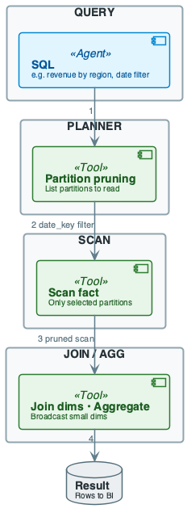
Query Flow Diagram
Parse query; extract partition filter
List partitions to read; skip others
Scan fact partitions; join to dimensions; aggregate

Slide 87
Join Size and Cost Intuition
Fact–dim join: fact has FK; dimension small
Cost ≈ scan fact (pruned) + lookup dim (in memory)
Large join: if dimension huge, shuffle dominates
Best practice: partition fact by time; keep dimensions small

Slide 88
Failure Story 1: Full Scan Kills Dashboards

Slide 89
Incident
Table grew to 1 TB; “revenue by region” had no date filter
New analyst copied old query without WHERE date_key
Report ran 15+ minutes or timed out

Slide 90
Root Cause and Fix
No partition filter; optimizer scanned all partitions
Fix: enforce partition filter above size threshold
BI template requires date range; monitor bytes read

Slide 91
Failure Story 2: Small-File Explosion

Slide 92
Incident
Streaming inserts wrote one small file per micro-batch
Partition “2025-12-01” had 50K files
Queries over that partition took minutes

Slide 93
Root Cause and Fix
Many small files; scan cost = file open + read
50K files ⇒ 50K× metadata overhead
Fix: compaction job; coalesce to 100 MB–1 GB per file
Use table formats (Delta, Iceberg) with automatic compaction

Slide 94
Pitfalls & Failure Modes
No partition key in query: full table scan
High latency and cost; common in ad-hoc SQL
Schema evolution: new columns in Lake
DWH requires ALTER or new version
Small-file problem (Lake): many tiny files; overhead per file

Slide 95
Pitfalls: Full Scan When Pruning Missed
Query “revenue by region” without WHERE on date
Engine scans all partitions ⇒ full scan
Fix: require partition filter in critical reports

Slide 96
Pitfalls: Hot Partition and Skew
One partition (today) gets most writes and reads
Can throttle writes and slow queries
Many small files in one partition
Mitigation: partition by date + bucket by key

Slide 97
Pitfalls: Dimension Too Large
If dimension is huge, join causes large shuffle
Options: pre-aggregate; keep only needed attributes
Or partition dimension
Join size ≈ O(|fact scan|) if dim fits in memory

Slide 98
Pitfalls: Detection
Monitor: query scan size (rows/bytes); partitions read
Alert: full table scan; long-running joins; OOM on dim join
Metrics: per-query bytes read; partition count; join spill

Slide 99
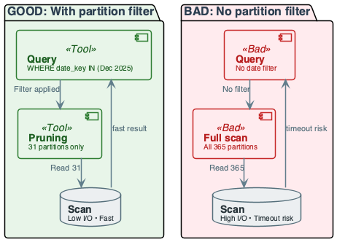
Pitfalls: Mitigation Summary
Always use partition filter where possible
Coalesce small files in Lake; size partitions for 100MB–1GB

Slide 100
Engineering Judgment

Slide 101
Key Rules
Never expose large fact table without partition key
Default: partition by date; require date range in WHERE
In Lake, never leave small-file problem unaddressed
Target 100 MB–1 GB per file per partition
Choose DWH for governed BI, Lake for raw + ML

Slide 102
Rerun and Idempotency
Incremental load into fact: watermark on date
Same pattern as Week 4 ETL
Rerun must not duplicate fact rows
Use MERGE or partition-level overwrite

Slide 103
Control Table
last_loaded_date; update only after successful load

Slide 104
Lake: Small-File and Compaction
Many small writes create many small files per partition
Each file has metadata and open overhead
Compaction: coalesce small files into larger ones

Slide 105
DWH: Partition Key in Every Query
Critical reports must filter by partition key
Without filter: optimizer may scan all partitions
Governance: require filter for tables above size threshold

Slide 106
Cost Recap: Pruning vs Full Scan
Pruned: scan size = (selected / total) × table size
E.g. 1/365 of year
Full scan: 365× more I/O and time
Enforce filters in BI; document partition key

Slide 107
Failure: What We Want
Query with date filter → few partitions → low latency
Query without date filter → all partitions → high latency

Slide 108
Pitfalls & Failure Modes
Detection: scan size, partition count, join spill
Mitigation: enforce partition filters; coalesce files
Lake + DWH: Lake for raw and ML; DWH for governed BI

Slide 109
BI Consumers and Dashboards

Slide 110
What is a Dashboard?
Stephen Few (2004): visual display of most important information
Needed to achieve one or more objectives
Consolidated on a single screen
Can be monitored at a glance

Slide 111
What is a Dashboard?
Big Book of Dashboards (2017): visual display of data
Used to monitor conditions and/or facilitate understanding
Key insight: dashboards are primary DWH consumers
Design DWH for dashboard query patterns

Slide 112
What Makes a Good Dashboard?
Answers a set of questions
Follows a flow and invites interactivity
Primarily summaries and exceptions
Specific to and customized for audience
Makes strategic use of color

Slide 113
UI/UX Design Principles for BI
User familiarity: user-oriented terms
Consistency: appropriate level in display
Minimal surprise: predictable operation
User guidance: help systems, online manuals
User diversity: different interaction preferences

Slide 114
Human Factors in Dashboard Design
Limited short-term memory: ~7 items maximum
Presenting more increases mistakes
People make mistakes: inappropriate alarms increase stress
Different preferences: some like pictures, some like text

Slide 115
Color Use Guidelines
Limit the number of colors used
Use color change to show status change
Use color coding to support the task
Be consistent; be careful about color pairings

Slide 116
Information Presentation Types

Slide 117
Static vs Dynamic Information
Static: initialized at session start; does not change
Dynamic: changes during session; must communicate changes
Engineering implication: DWH must support batch and near-real-time

Slide 118
BI Tools Connection to DWH
BI tools connect via SQL, stored procedures, or APIs
Common: SQL Server, Excel, Tableau, Power BI, Looker
Architecture: DWH → Stored Procedures → BI Tool → Reports
All tools assume clean, well-modeled data in DWH

Slide 119
Best Practices
Model analytics with star schema; partition fact by date
Always include partition key in WHERE for large tables
Use surrogate keys in fact for dimensions (SCD Type 2)
Keep dimensions small or partitioned
In Lake: store in columnar format (Parquet/ORC)
Coalesce small files; schema evolution with care

Slide 120
Best Practices
Document partition key and expected query patterns
Monitor query cost (bytes read, partitions read)
Alert on full scans
Separate raw, processed, and curated zones
Govern access to curated layer
Enforce: no fact query without partition filter above size threshold

Slide 121
Recap (Engineering Judgment)
DWH vs Lake: DWH for governed BI; Lake for raw and ML
Hybrid when you need both
Partition pruning is the lever: full scan kills dashboards
Star schema + partition by time: predictable joins and pruning
Cost: at 10× data, enforce partition filter
Monitor bytes/partitions read; alert on full scan

Slide 122
Pointers to Practice
Build star schema (fact + ≥2 dimensions) with sample rows
Write OLAP query with partition filter
Show partition pruning: which partitions are read
Reason about join size and cost
Optional: incremental load into fact from Week 4

Slide 123
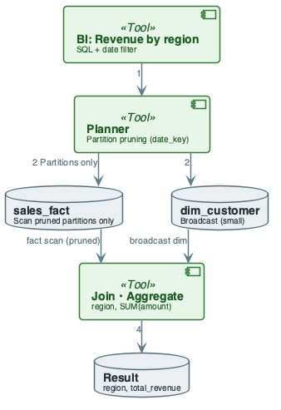
Additional Diagrams
Practice: Star Query Flow

