Slide 1
LogTriage
Explainable Multi-Output Triage for E-Commerce Microservice Logs
NLP Course Final Presentation • Synthetic benchmark • Real local baseline evaluation
Reproduce results: python src/train_baselines.py
LogTriage - NLP Course Final Presentation
1

Slide 2
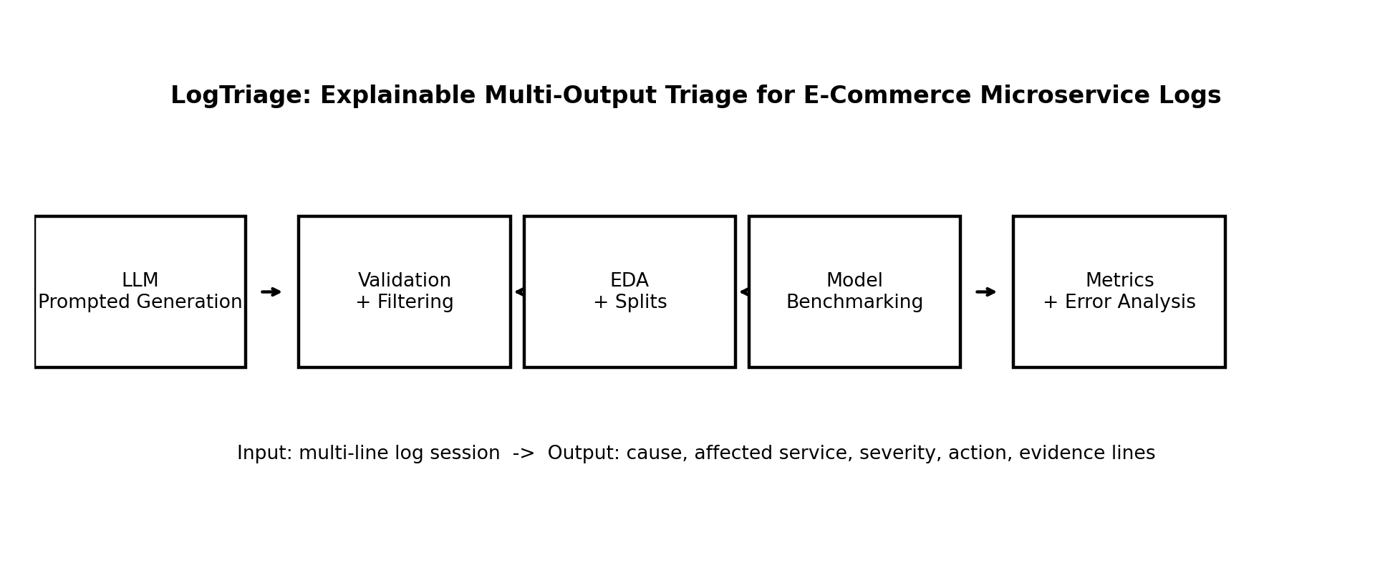
Review and refined project definition
Input
Output
[1] gateway INFO POST /checkout request_id=req_912
[2] checkout INFO validating cart_id=cart_771
[3] payment-service WARN provider_latency=4900ms
[4] payment-service ERROR payment gateway timeout after 5000ms
[5] order-service ERROR order creation failed: auth missing
[6] gateway ERROR status=503 route=/checkout
{
"failure_cause": "payment_gateway_timeout",
"affected_service": "payment-service",
"severity": "high",
"recommended_action": "check_payment_gateway_and_retry",
"evidence_lines": [3, 4, 6]
}
Motivating use case
Checkout incidents create logs across gateway, auth, cart, payment, inventory, orders, and queues.
Operators need fast, structured triage: what failed, where, how severe, what action, and what evidence.
Manual reading and keyword search are slow and inconsistent.
Formal ML framing
Multi-output NLP classification + evidence-line selection from numbered log sessions.
Fixed schema enables measurable outputs: cause, service, severity, action, evidence lines.
Compares rule-based, TF-IDF/LogReg, prompt-based LLM baselines, and prepared transformer training pipeline.
Metrics: macro-F1/accuracy per field, evidence-line F1, and full JSON exact match.
LogTriage - NLP Course Final Presentation

Slide 3
Project achievements and novelty
Completed project artifacts
Novelty claim
Not only anomaly detection: the system returns operator-ready triage decisions.
Predicts cause + affected service + severity + action + supporting evidence lines.
Synthetic benchmark is explainable and measurable end-to-end.
5,000
3 splits
synthetic log sessions
train / validation / test
Fixed
0
cause, service, severity, action taxonomy
schema validation issues
6 Tested Baselines
EDA + metrics
Anomaly detection vs. LogTriage
majority, rules, TF-IDF LogReg/SVM/NB, Char-SVM
charts, confusion matrix, error analysis
Traditional
LogTriage
→
Normal / abnormal
Limited operator context
Cause + service + severity
Action + evidence
LogTriage - NLP Course Final Presentation

Slide 4
Fixed label taxonomy
Controlled outputs enable fair, measurable evaluation.
Label type | Taxonomy size | In dataset | Examples
Failure cause | 10 | 10 | payment_gateway_timeout, database_query_failure, message_queue_backlog, ...
Affected service | 12 | 7 | payment-service, queue-service, database-service, gateway-service, ...
Severity | 4 | 4 | low, medium, high, critical
Recommended action | 10 | 10 | scale_queue_consumers, rollback_deployment, check_database_query, ...
Evidence lines | 1–8 lines | avg 3.3 | 1-based log line indices supporting cause and action
Cause and action are paired in the generator; severity is intentionally harder because it depends on impact context.
LogTriage - NLP Course Final Presentation
4

Slide 5
Related work: gaps vs. LogTriage
Existing datasets are strong RCA/anomaly references; the gap is operator-ready text triage with action + evidence supervision.
Careful novelty claim: RCA/log anomaly detection is not new. LogTriage adds a controlled synthetic NLP benchmark for cause + service + severity + action + evidence lines.
Project / dataset | Main focus | What it gives | Gap vs. LogTriage
RCAEval | Microservice RCA | 735 injected failure cases from Online Boutique, Sock Shop and Train Ticket; includes metrics, logs, traces and annotated root-cause service / indicator. | Strong RCA benchmark, but output stops mainly at root-cause localization. It does not provide fixed action labels, severity, or line-level evidence as operator-ready JSON.
LO2 | API anomaly / failure prediction | Production microservice logs + metrics connected to API errors; useful for realistic failure/anomaly patterns and API-level symptoms. | Less focused on what the operator should do next. It lacks a fixed recommended-action taxonomy and traceable evidence-line supervision.
AnoMod | Anomaly + RCA | Multi-modal microservice dataset with logs, metrics, traces, API responses and code coverage; covers performance, service, DB and code-level faults. | Broader and multi-modal. LogTriage is narrower: text-log NLP triage for e-commerce sessions with cause + service + severity + action + evidence.
GAIA / AIOps | AIOps anomaly / fault localization | Open AIOps data for anomaly detection, log analysis and fault localization; useful for operational patterns and evaluation inspiration. | General AIOps source data, not a controlled benchmark for operator decision JSON or action/evidence labels.
LogHub | Real system logs | Large public collection of real logs from many systems; useful for realistic log wording, parsing, templates and anomaly baselines. | Usually lacks rich incident labels: root cause, severity, recommended action and exact supporting evidence lines.
LogSage / agents | LLM RCA + remediation | LLM-based diagnostic/remediation framework over raw logs; conceptually close because it connects diagnosis with possible resolution. | Different domain and agent framework. LogTriage is a supervised, measurable NLP benchmark with fixed taxonomies and synthetic controlled data.
Takeaway: existing work gives realistic RCA/anomaly patterns; LogTriage fills the gap by turning text logs into measurable operator triage: cause + service + severity + action + evidence lines.

Slide 6
Synthetic log generation: uniqueness and quality controls
Main challenge: generate logs that are realistic, diverse, and challenging without leaking labels.
Attributes
→
Prompt
→
LLM log
→
Validation
→
Dataset
1. Avoid label leakage
2. Preserve realism
3. Enforce diversity
Do not include exact class names as obvious text
Use paraphrases and indirect symptoms
Check shortcut keywords and repeated label phrases
Each line must look like a real microservice log entry (timestamps, levels, services).
Sessions follow a plausible checkout incident timeline.
LogHub structural check (compare_external_logs.py): profile our log lines vs. LogHub HDFS 2k sample on timestamp rate, log levels, token count, and key-value format. Sanity check on log structure only—not label or domain matching. Timestamps 100% on both sides.
Vary service path, length, style, severity and noise
Deduplicate and check similarity
Generate more than small template variants
Noise-level checks
Low/medium/high noise validated with measurable properties: log length, evidence-line ratio, unrelated-service count, and distractor INFO/WARN lines outside evidence.
Noise ordering confirmed in EDA (none < low < medium < high); per-noise metrics on results slide.
Automated validation before training (src/validate_data.py) on all 5,000 sessions: JSON/schema, taxonomy labels, label coverage, cause-action consistency, evidence-line support, label-leakage detection, noise-level consistency, and duplicate sessions. 500 leakage cases fixed; final run: 0/5,000 failures. Output: results/data_validation_report.json

Slide 7
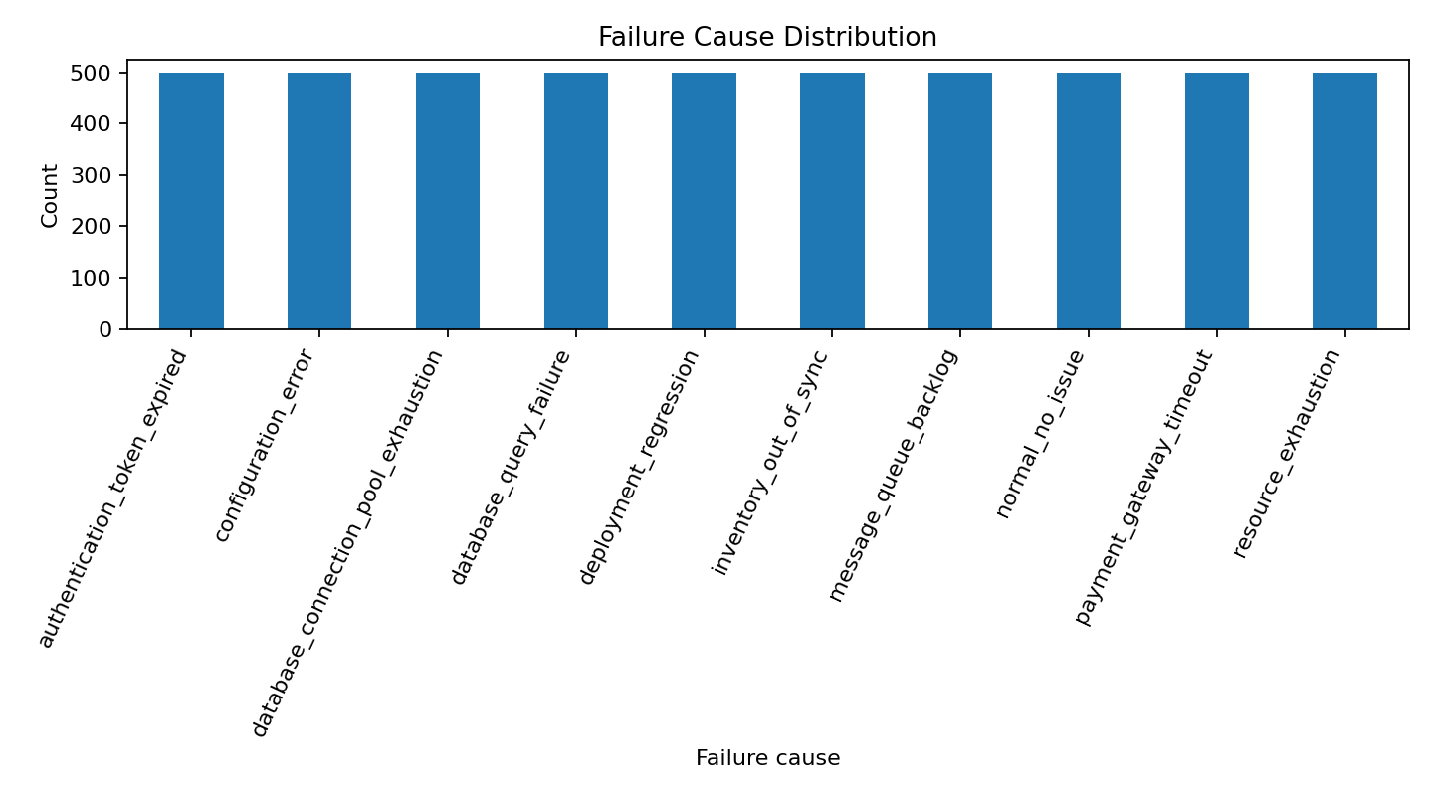
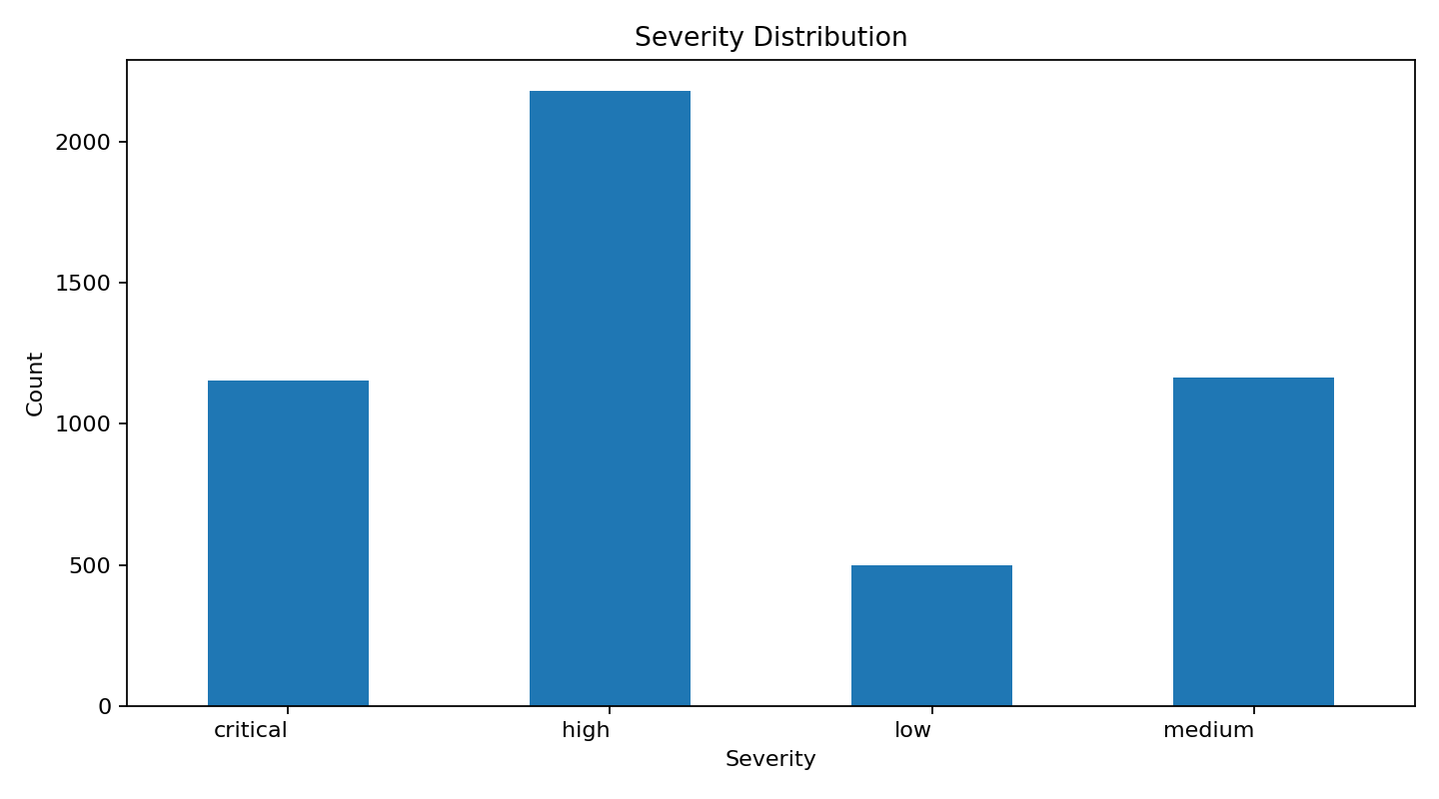
Review methodology
Controlled
attributes
→
LLM synthetic
generation
→
Schema + label
validation
→
EDA + split
→
Baselines +
evaluation
Synthetic data recipe
EDA checks
Model experiments
LLM prompted with fixed attributes: cause, service, severity, action, noise, log length, and style.
JSON schema forces numbered logs and evidence-line labels.
Validation removes malformed JSON, invalid labels, invalid line references, and duplicates.
Rule-based baseline
evaluated
TF-IDF + Logistic Reg.
evaluated
TF-IDF + Linear SVM
evaluated
TF-IDF + Naive Bayes
evaluated
Dataset
5,000 examples
70 / 15 / 15 split (3500 / 750 / 750)
Avg. 7.67 log lines
Character TF-IDF + SVM
evaluated
Zero/few-shot LLM
evaluated (n=30)
DistilBERT classifier
evaluated (n=75)
LogTriage - NLP Course Final Presentation

Slide 8
Example triage: rules vs. TF-IDF SVM
Test session sess_02876 — keyword rules miss affected service; ML learns log cues.
Log excerpt
Gold
cause: message_queue_backlog
service: queue-service
severity: high
action: scale_queue_consumers
Rules
cause: message_queue_backlog
service: notification-service
severity: medium
action: scale_queue_consumers
[1] 2026-05-01 10:14:01 shipping-service INFO feature_flag fast_inventory=enabled
[2] 2026-05-01 10:14:02 notification-service INFO metrics cpu=54% mem=1438MB
[3] 2026-05-01 10:14:03 payment-service INFO heartbeat ok instance=2
[4] 2026-05-01 10:14:04 order-service INFO publishing order_created event order_id=7046
[5] 2026-05-01 10:14:05 queue-service WARN topic=order-events lag=9363 consumers=2
[6] 2026-05-01 10:14:06 queue-service ERROR message queue backlog exceeded threshold
TF-IDF SVM
cause: message_queue_backlog
service: queue-service
severity: medium
action: scale_queue_consumers
• Rules match cause/action keywords but pick notification-service instead of queue-service.
• TF-IDF SVM recovers the correct service from queue-related log lines.
• Severity remains hard for both models on this example (gold=high, pred=medium).
LogTriage - NLP Course Final Presentation
8

Slide 9
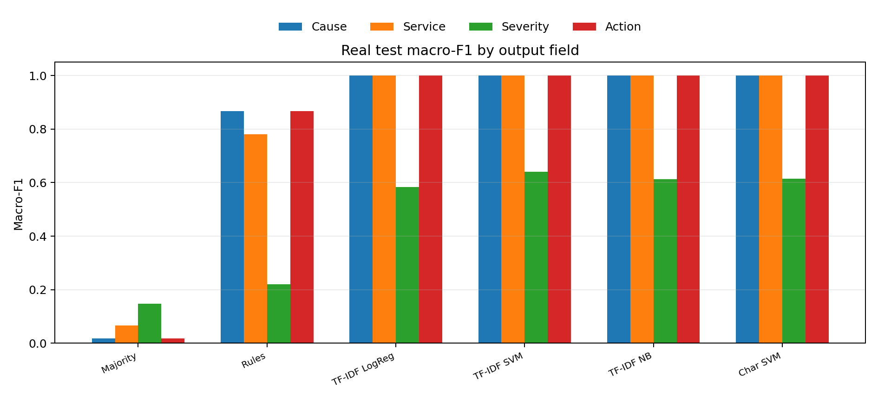
Results: real model testing on held-out test set
Model | Cause F1 | Service F1 | Severity F1 | Action F1 | Full exact | Evidence F1
Majority | 0.018 | 0.066 | 0.148 | 0.018 | 0 | 0.822
Rules | 0.804 | 0.253 | 0.481 | 0.804 | 0.175 | 0.861
TF-IDF LogReg | 1 | 1 | 0.585 | 1 | 0.545 | 0.886
TF-IDF SVM | 1 | 1 | 0.64 | 1 | 0.561 | 0.886
TF-IDF NB | 1 | 1 | 0.421 | 1 | 0.492 | 0.886
Char SVM | 1 | 1 | 0.607 | 1 | 0.556 | 0.886
LLM zero-shot | 1 | 0.734 | 0.441 | 1 | 0.3 | 0.942
LLM few-shot | 1 | 1 | 0.643 | 1 | 0.533 | 0.99
DistilRoBERTa | 0.704 | 0.186 | 0.129 | 0.75 | 0.067 | 0.877
Best cause/service/action
Hardest output
Strict exact match
LLM subset scope
TF-IDF models reach ~1.000 F1 on cause and action; service is 1.000 for most models (0.997 for NB) because the synthetic data has strong learnable signals.
Severity is lower: it depends on impact/context, not only words. Best real severity F1: 0.64 with Linear SVM.
Full exact requires all 4 labels correct together; it is limited mainly by severity errors.
LLM rows above are real API runs on n=30 (not the full 750). Valid JSON rate: 100% for both modes. DistilRoBERTa fine-tuned on n=300 train / n=75 test (CPU subset).
Note
Best local baseline (full n=750): TF-IDF SVM — 0.561 full exact. Best LLM (n=30): few-shot — 0.533. DistilRoBERTa (n=75): 0.067 full exact.
LogTriage - NLP Course Final Presentation

Slide 10
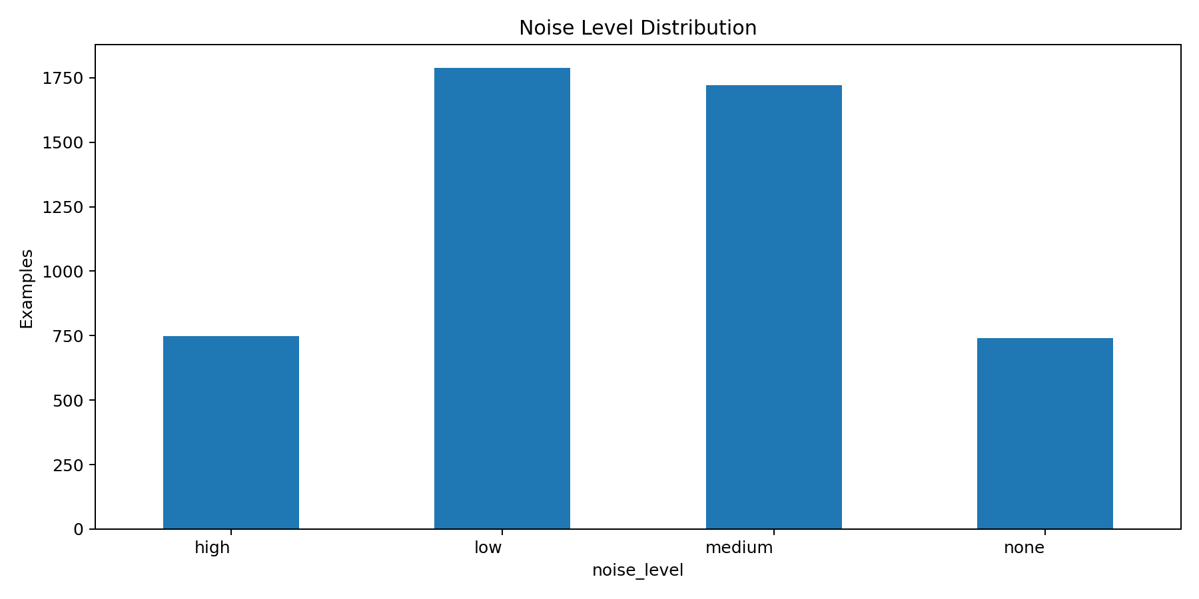
Robustness by noise level (TF-IDF SVM)
Best model performance on the same held-out test split, grouped by low / medium / high noise.
Noise level | N | Severity F1 | Full exact
low | 195 | 0.632 | 0.549
medium | 269 | 0.645 | 0.569
high | 203 | 0.641 | 0.567
Interpretation
• Cause, service, and action stay at 1.000 macro-F1 across all noise levels.
• Severity F1 is stable (~0.632–0.645) but remains the bottleneck.
• Full exact match stays near 56% — severity errors dominate end-to-end success.
LogTriage - NLP Course Final Presentation
10

Slide 11
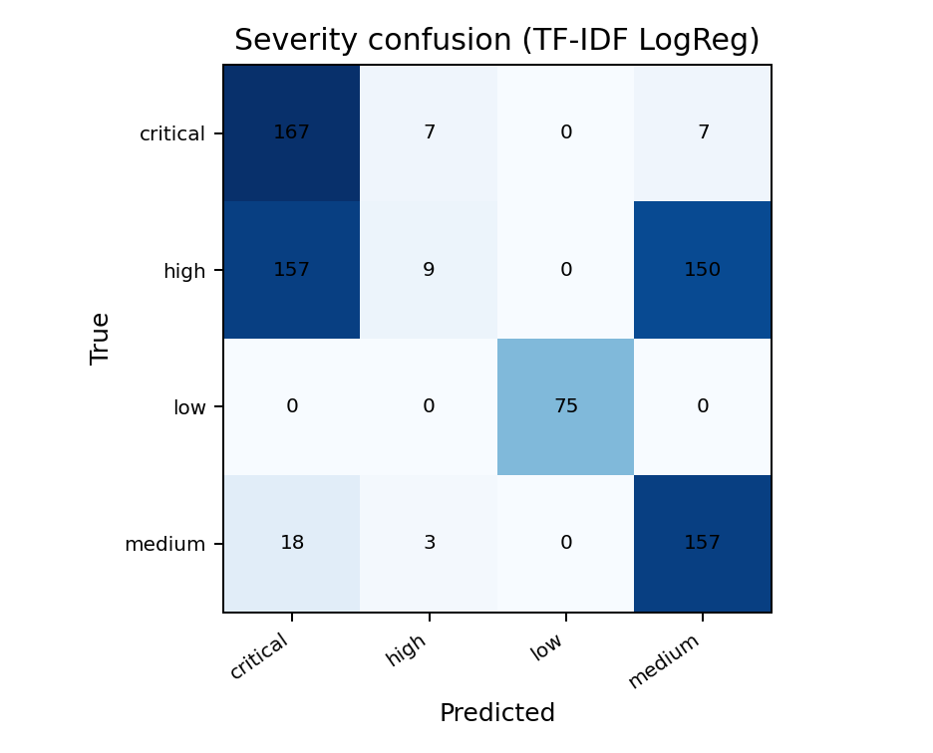
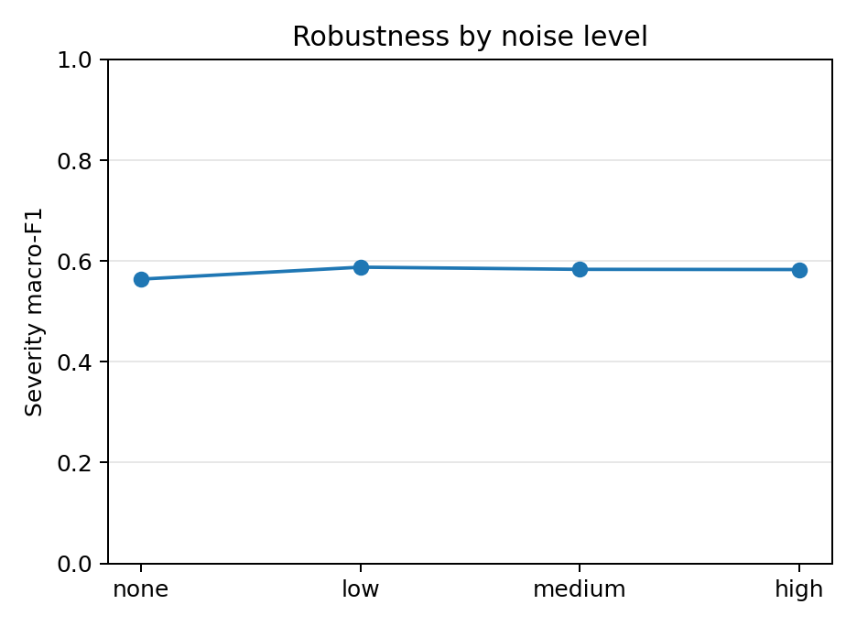
Detailed results: label accuracies and evidence metrics
Model | Cause Acc | Service Acc | Severity Acc | Action Acc | Evidence P/R/F1
Majority | 0.1 | 0.3 | 0.421 | 0.1 | 0.767/0.886/0.822
Rules | 0.825 | 0.412 | 0.453 | 0.825 | 0.795/0.941/0.861
TF-IDF LogReg | 1 | 1 | 0.545 | 1 | 0.838/0.940/0.886
TF-IDF SVM | 1 | 1 | 0.561 | 1 | 0.838/0.940/0.886
TF-IDF NB | 1 | 1 | 0.492 | 1 | 0.838/0.940/0.886
Char SVM | 1 | 1 | 0.556 | 1 | 0.838/0.940/0.886
LLM zero-shot | 1 | 0.8 | 0.367 | 1 | 0.989/0.900/0.942
LLM few-shot | 1 | 1 | 0.533 | 1 | 0.990/0.990/0.990
DistilRoBERTa | 0.72 | 0.453 | 0.347 | 0.747 | 0.817/0.947/0.877
What the real test shows
Severity confusion
Evidence-line metric
Next data fix
Cause/service/action are almost perfectly learnable by TF-IDF, which is useful but also signals possible lexical shortcuts in the synthetic data.
Most mistakes are high/critical/medium shifts. Low severity is easy; impact level needs better generation rules and harder examples.
Evidence F1 compares selected log line numbers vs. gold evidence lines. The shared heuristic reaches ~0.86–0.89 F1; future work should train a dedicated line-level evidence model.
Label leakage was detected and fixed (500 sessions); validation pipeline added. Future: more paraphrases and misleading-noise cases.
LogTriage - NLP Course Final Presentation

Slide 12
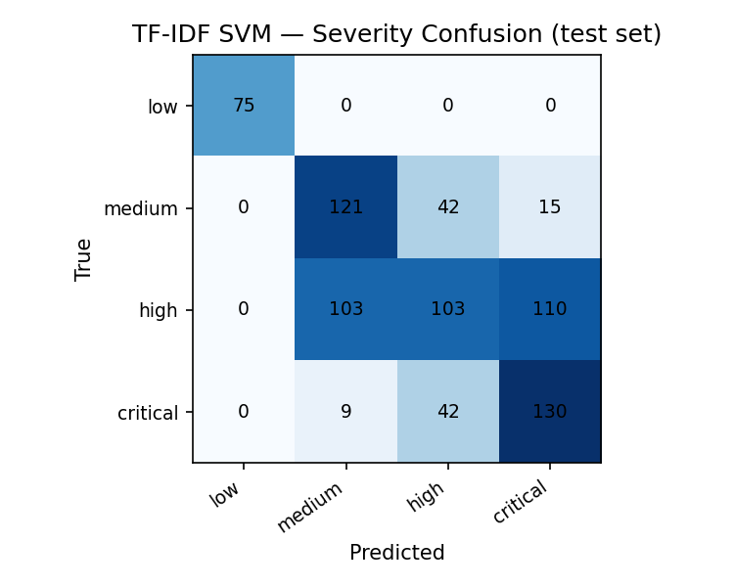
Error analysis categories
Patterns from real test-set predictions across all six baselines.
1. Severity confusion (all models)
2. Service misclassification (rules)
• Most full-exact failures come from high / critical / medium mislabels.
• Low severity is easiest; impact level needs richer context in generation.
• Keyword rules reach ~0.80 cause F1 but only ~0.25 service F1.
• Rules count service mentions instead of identifying the failing component.
3. Lexical shortcut success (TF-IDF)
4. Evidence-line heuristic
• Near-perfect cause/service/action F1 suggests strong keyword cues in synthetic logs.
• Motivates harder generation: paraphrases, misleading symptoms, weaker label leakage.
• Shared heuristic reaches ~0.86–0.89 F1 across models.
• Future work: train a dedicated line-level evidence selector.
LogTriage - NLP Course Final Presentation
12

Slide 13
Conclusion
Did we achieve the desired result?
What we learned
Future work
Yes: the project demonstrates a full NLP pipeline for explainable log triage.
The package includes synthetic data, validation, EDA, baselines, metrics, visuals, report, prompts, and code.
The results show that structured triage is feasible on controlled synthetic logs.
Fixed taxonomies are essential; free-form actions are hard to evaluate.
Synthetic data must be validated because LLM labels may be inconsistent.
High model scores can indicate useful patterns, but also possible lexical shortcuts.
Evidence-line metrics are important for explainability and debugging.
LLM zero/few-shot evaluated on n=30 with gpt-4o-mini; scale to full test set when budget allows.
DistilRoBERTa evaluated on n=75 test subset; scale to full data for stronger comparison.
Add harder examples with misleading noise and weaker keyword cues.
Manually review a gold subset and test on real anonymized logs.
Main takeaway
Final repository artifacts
LogTriage converts noisy logs into operator-ready decisions with evidence.
Scope choice
data/
src/
prompts/
results/
visuals/
slides/
docs/
E-commerce was chosen for clarity; the method can adapt to SaaS, banking, delivery, or cloud logs.

