Slide 1
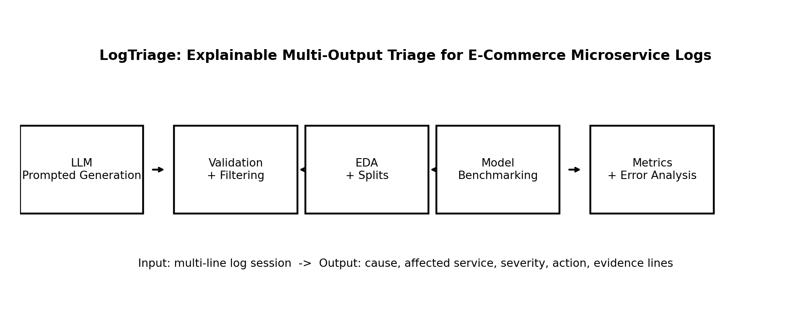
Project review
Project motivation
What changed from proposal
Current contributions
E-commerce checkout failures produce logs across multiple services.
Operators need structured triage: cause, service, severity, action, and evidence.
The task is explainable multi-output NLP, not just anomaly detection.
Added affected_service as a prediction output.
Expanded the fixed taxonomy to 12 causes and 12 actions.
Created 5,000 examples instead of a small prototype.
Added validation, EDA visuals, and baseline evaluation.
5,000
0
synthetic sessions
schema issues
12
4
failure causes
model families
Novelty
The benchmark predicts operator-ready triage with evidence lines, not only normal/abnormal labels.
LogTriage - Interim Presentation

Slide 2
Previous work
Related work table
Paper / year
Task
Methods
Data
Relation to LogTriage
LogLLM (2024)
Log anomaly detection
LLM-based log understanding
Public system logs
Shows LLMs can capture log semantics; our task adds triage + evidence.
AIOps benchmark datasets (2022)
Anomaly/RCA benchmarks
Large-scale benchmark construction
Real-world AIOps data
Motivates benchmark design; our dataset is synthetic and explainable.
Synthetic data generation survey (2024)
LLM synthetic data quality
Generation, curation, filtering
Text benchmarks
Supports controlled generation + validation methodology.
Takeaway: prior work covers anomaly detection and RCA, so LogTriage is framed narrowly as explainable multi-output operator triage with action and evidence-line prediction.
LogTriage - Interim Presentation

Slide 3
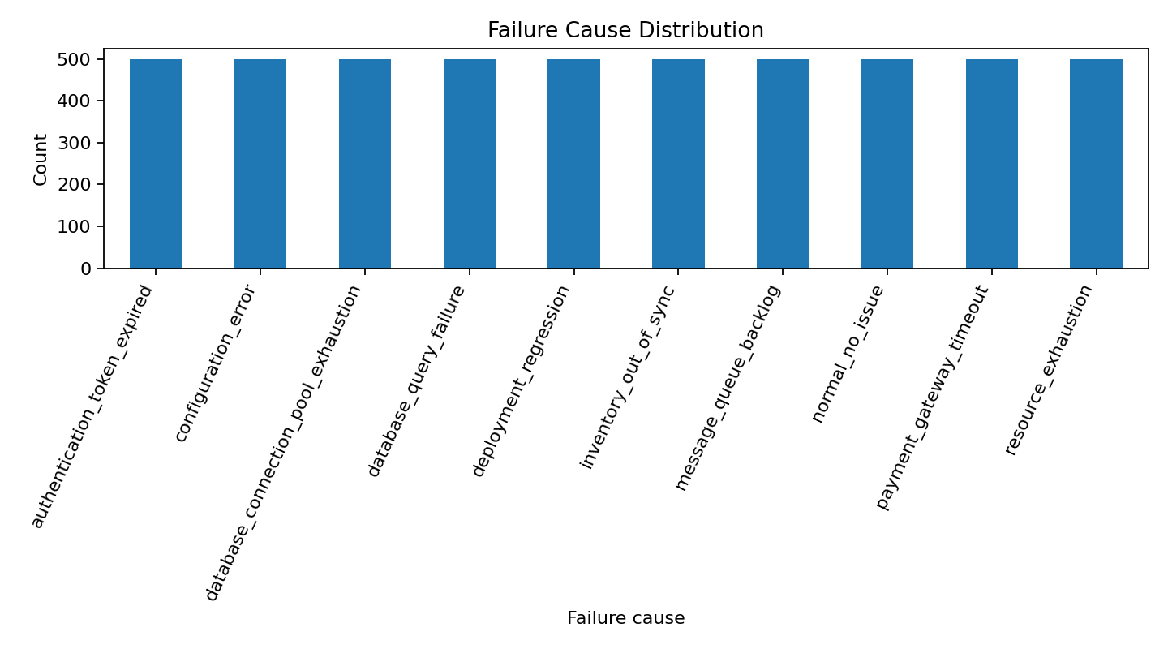
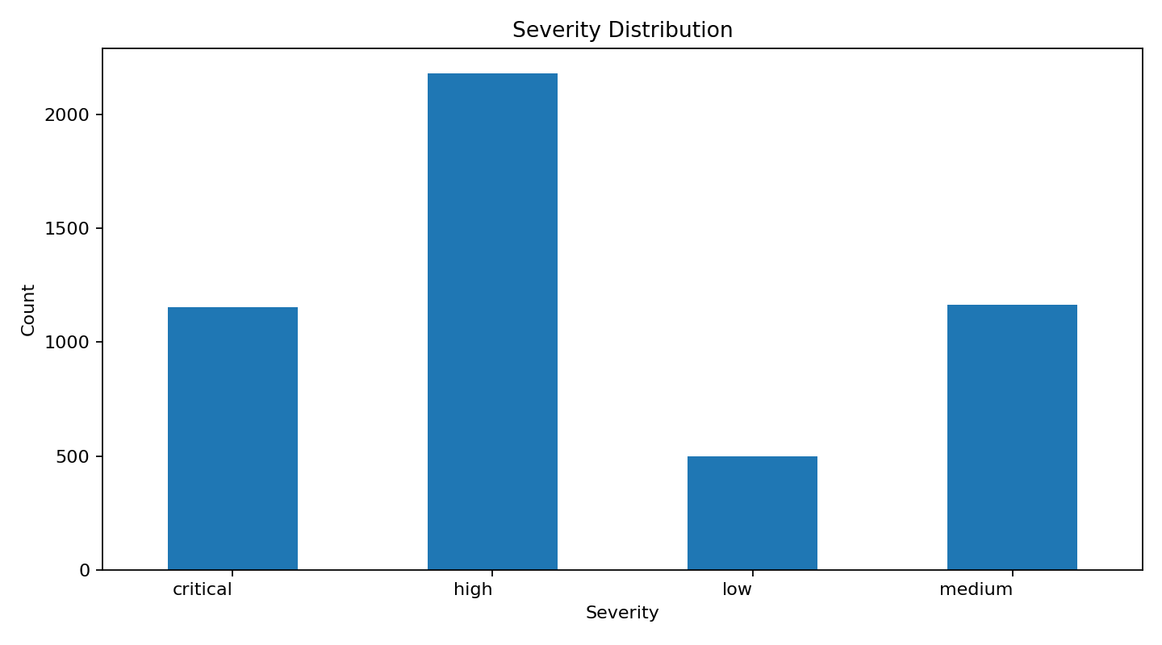
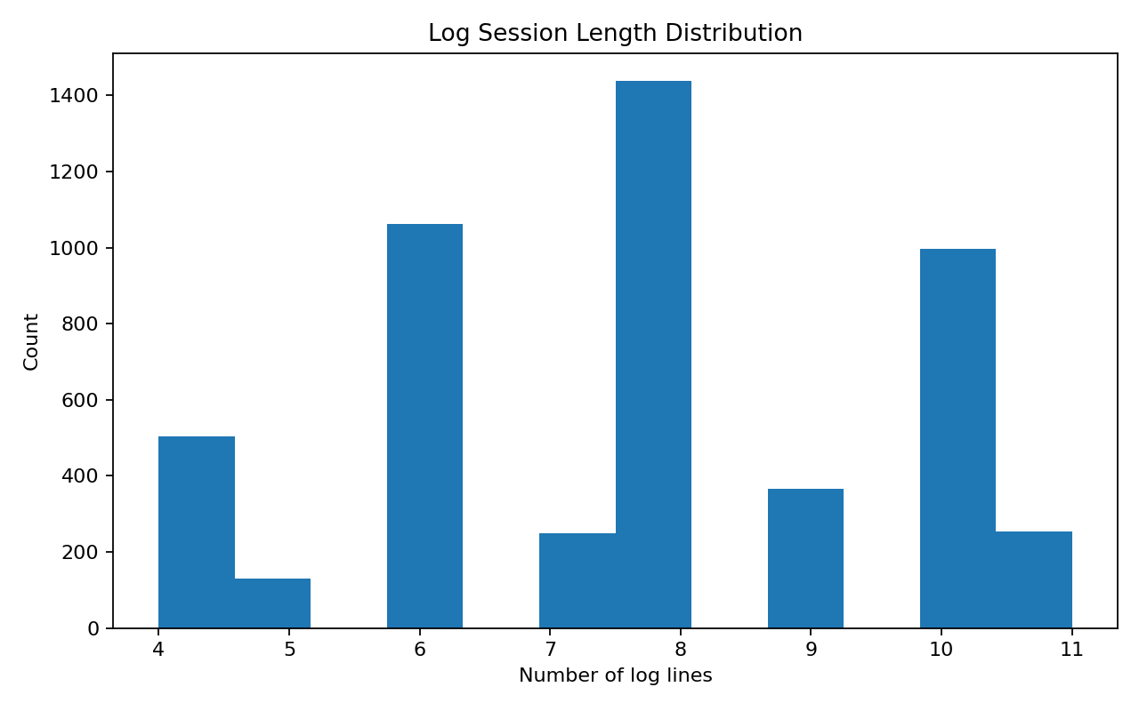
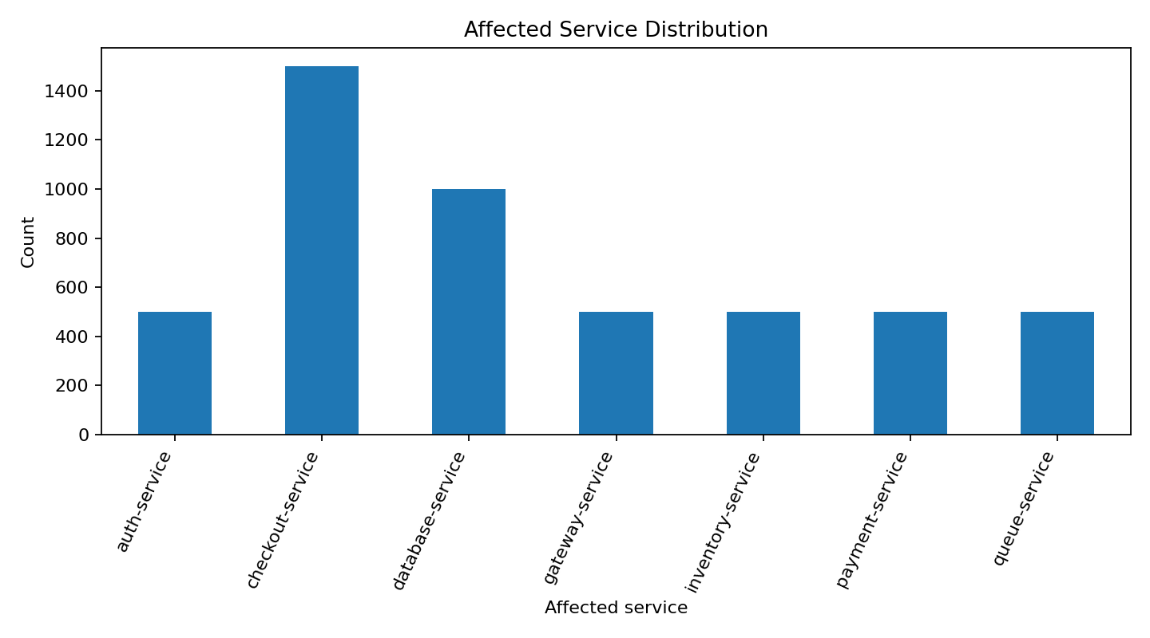
Dataset
Generated dataset
EDA: label coverage
EDA: input quality
5,000
3,500
examples
train
750
750
valid
test
Each record includes numbered logs and structured labels.
Labels are generated using controlled attributes and fixed taxonomies.
Validation checks JSON schema, allowed labels, evidence-line numbers, and duplicates.
Severity, noise, and session length are tracked because they affect model difficulty.
Cause and service distributions are checked to avoid one-label dominance.
LogTriage - Interim Presentation

Slide 4
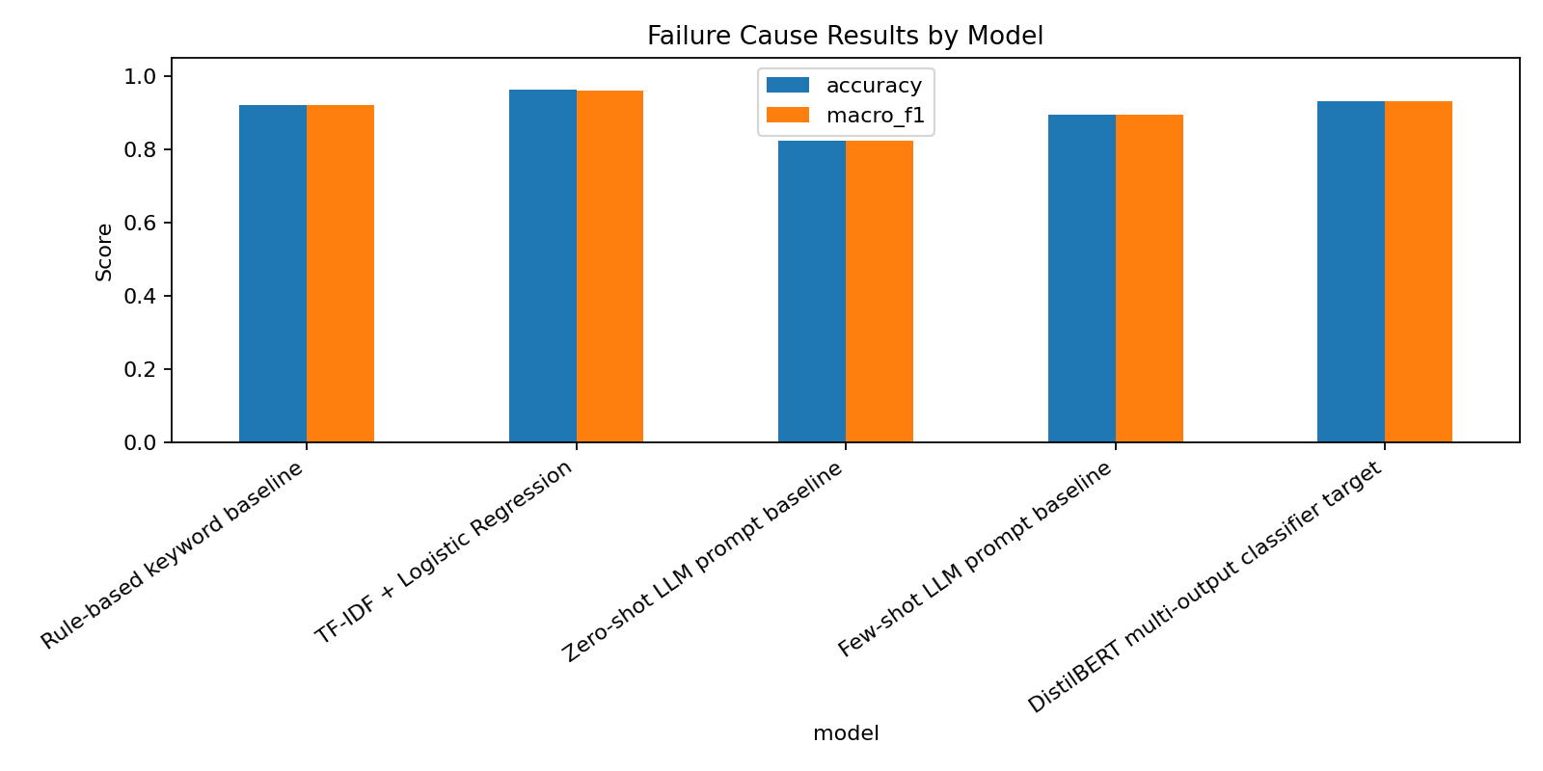
Baseline solution and results
Baseline methods
Results table
Visual + errors
Rule-based baseline: transparent keyword/runbook rules.
TF-IDF + Logistic Regression / Linear SVM: classical NLP baseline.
LLM prompt baselines prepared as zero-shot/few-shot evaluation scripts.
Transformer training script prepared for final extension.
Model Cause Sev. Action
Rule-based 0.920 0.905 0.897
TF-IDF + LogReg 0.961 0.952 0.959
Zero-shot LLM prepared prepared prepared
Inspected error types
Few-shot LLM prepared prepared prepared
timeout vs external API confusion
symptom lines selected instead of root cause
severity depends on context and impact
synthetic wording may create lexical shortcuts
Baseline goal
Measure how much can be solved before expensive fine-tuning.
Current completed results focus on implemented baselines. LLM/transformer runs are prepared for final evaluation or future extension.
LogTriage - Interim Presentation

Slide 5
Plan
Remaining project plan
Step
Scope
Technical work
Expected outcome
Status
1
Data hardening
Add harder noise and misleading symptom lines
More realistic test set
next
2
LLM baselines
Run zero-shot/few-shot API evaluation
LLM comparison table
next
3
Transformer
Fine-tune DistilBERT/RoBERTa classifier
Fine-tuned benchmark
next
4
Error analysis
Inspect wrong examples by class and noise level
Explain results
in progress
5
Final presentation
Prepare final 5-slide deck + report artifacts
Submit/present final project
last
Expected final outcome: a complete course package with task definition, synthetic data recipe, validation, EDA, model benchmarking, evaluation, error analysis, slides, code, data, and report.
LogTriage - Interim Presentation

