Slide 1
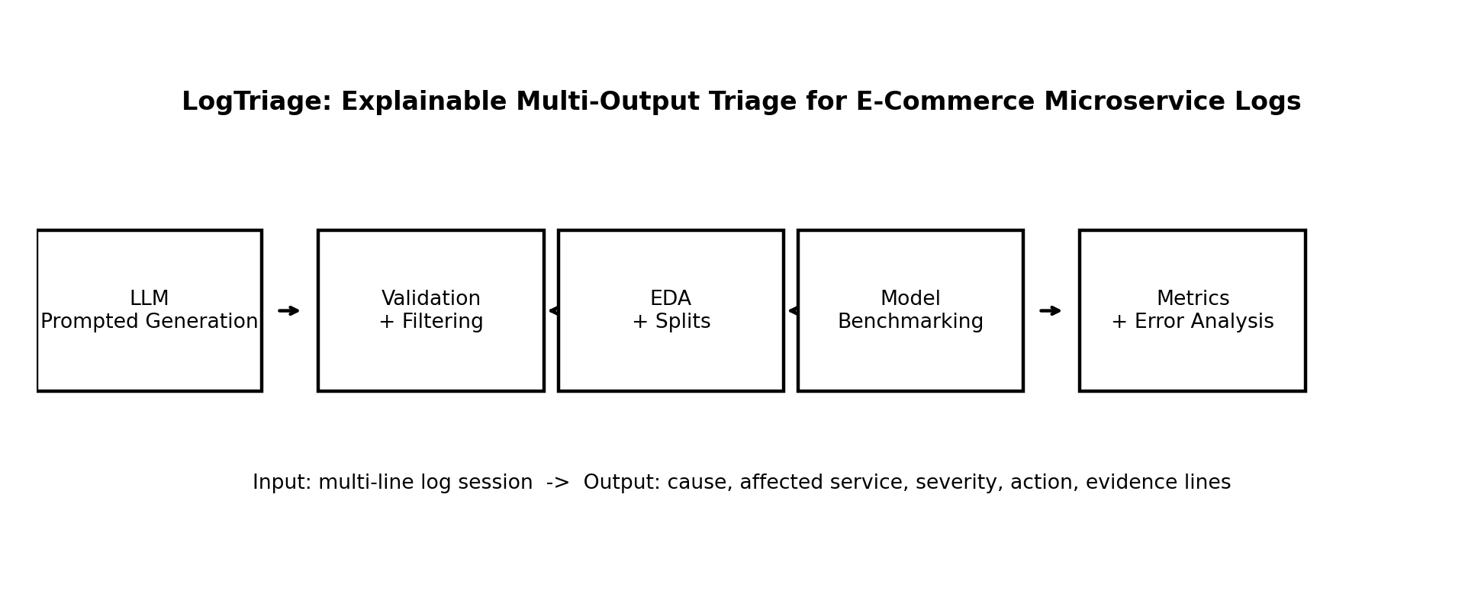
Motivating use case
E-commerce checkout incident
Why it is challenging
Project idea
Logs are noisy and distributed across services.
Symptom lines often hide the root cause.
Actions must be specific and consistent with the failure.
Evidence must be traceable to log line numbers.
Turn noisy logs into structured operator triage:
failure cause
affected service
severity
Checkout failures affect users, orders, and revenue.
A single failure creates logs across gateway, auth, cart, payment, inventory, order, database, and queues.
Operators must quickly decide: what failed, where, how severe, what action, and what evidence.
recommended action
evidence lines
Today
manual log reading + keyword search + runbooks
Scope: a fictional ShopFlow e-commerce microservice platform. The method can later adapt to other domains.
LogTriage - Proposal Presentation

Slide 2
Project task description
Formal problem statement
Structured output schema
Given a numbered multi-line log session from an e-commerce microservice system, predict a structured triage JSON with the root failure, affected service, severity, action, and evidence lines.
{
"failure_cause": "payment_gateway_timeout",
"affected_service": "payment-service",
"severity": "high",
"recommended_action": "check_payment_gateway_and_retry",
"evidence_lines": [3, 4, 6]
}
Input log session
[1] gateway INFO POST /checkout request_id=req_912
[2] checkout INFO validating cart_id=cart_771
[3] payment-service WARN provider_latency=4900ms
[4] payment-service ERROR payment gateway timeout after 5000ms
[5] order-service ERROR order creation failed: payment authorization missing
[6] gateway ERROR status=503 route=/checkout
Fixed taxonomies make the task measurable
failure_cause: 12 classes such as payment timeout, database query failure, authentication failure
affected_service: gateway, auth, payment, inventory, database, queue, etc.
recommended_action: retry, check credentials, scale, rollback, inspect dependency, open incident
Key novelty
Not only abnormal/normal. LogTriage produces operator-ready structured decisions with traceable evidence.
LogTriage - Proposal Presentation

Slide 3
Models and methods
Taxonomy
→
LLM generation
→
Validation
→
EDA
→
Baselines
→
Evaluation
Generation + validation
Model comparison plan
Quality adjustments
LLM creates log sessions from controlled attributes.
Validator checks JSON, allowed labels, evidence-line references, duplicate sessions, and class balance.
Manual spot-checking planned for a gold subset.
Rule baseline
keywords/runbook rules
Balance failure classes and severity levels.
Vary noise level, length, wording, service path, and log format.
Add misleading symptom lines to reduce keyword shortcuts.
Use error analysis to refine generation prompts.
TF-IDF + LogReg/SVM
classical NLP baseline
Zero/Few-shot LLM
prompt-only benchmark
DistilBERT/RoBERTa
fine-tuned extension
Fine-tuning approach: train classifiers for cause, service, severity, and action; evaluate evidence lines separately.
LogTriage - Proposal Presentation

Slide 4
Data specification and generation
Data schema
Controlled attributes
Generation prompt flow
Each example contains:
failure cause
Attributes
session_id
numbered logs[]
failure_cause
affected_service
severity
recommended_action
evidence_lines[]
noise_level + metadata
affected service
↓
severity
Prompt template
recommended action
↓
noise level
LLM output
log length
5,000
70/15/15
↓
log style
target examples
split
Validation + split
service path
12
0
failure types
schema issues
Why controlled generation?
Generated examples are labeled by construction, then filtered for consistency.
It improves diversity, balance, and reproducibility compared with asking the LLM to generate examples randomly.
LogTriage - Proposal Presentation

Slide 5
Metrics and KPIs
End-to-end KPIs
Metric table
Quality measurements
Accuracy and macro-F1 for each classification output.
Evidence-line precision, recall, and F1.
Full JSON exact match: all fields correct together.
Valid JSON rate for LLM outputs.
Output
Metric
Data quality: class balance, duplicate rate, length distribution, noise distribution.
Model quality: benchmark table + confusion matrix + error analysis.
Explainability: evidence-line scores and examples of correct/wrong evidence.
Robustness: compare performance by noise level and failure type.
cause
accuracy, macro-F1
service
accuracy, macro-F1
severity
accuracy, macro-F1
action
accuracy, macro-F1
Ground truth
evidence
precision, recall, F1
Synthetic labels from controlled generation + schema validation + manual review subset.
full JSON
exact match
Expected final result
A complete pipeline that proves structured log triage is measurable and feasible on controlled synthetic logs.
LogTriage - Proposal Presentation

