Slide 1
ROUND · SOLANA MOBILE
Save together.
Stay committed.
round.
Shared savings goals.
Separate on-chain vaults.
Built for Seeker · Working Android app on devnet
ROUND / CLOCK IN 2026 / Solana devnet
01
Notes:
ROUND is a mobile group savings and commitment app. The submission demonstrates real Solana devnet transactions with test tokens. Source: ROUND application and contract in github.com/Oracle00999/round. No mainnet launch or independent audit is claimed.

Slide 2
THE PROBLEM
Friends can share a goal.
Holding the money is harder.
Saving alone
Handing money to a treasurer
A goal is easy to postpone.
Progress stays invisible to the group.
One person holds the funds
and coordinates everyone’s payout.
ROUND pairs shared accountability with individual savings vaults.
ROUND / CLOCK IN 2026 / Solana devnet
02
Notes:
This is the product problem and design hypothesis, not a claim from a market survey. Initial use cases include friends saving for travel, devices and other planned expenses.

Slide 3
THE PRODUCT
One agreement.
Each member’s savings stay separate.
Agree together
Withdraw independently
Set the contribution amount,
payment schedule and unlock date.
Share an invitation to join.
Each member has a USDC vault.
After unlock, recover what you saved—
even if you missed a contribution.
No rotating group payout. No member acts as treasurer.
ROUND / CLOCK IN 2026 / Solana devnet
03
Notes:
Implementation: create_round fixes schedule and amounts; join_round creates member savings/bond vaults; withdraw checks the on-chain end time and member authority. No administrator withdrawal instruction is present in current code. Upgrade authority still exists, so this is not an immutability claim.

Slide 4
THE EXPERIENCE
A simple habit, from invite to withdrawal.
01
02
03
04
Create
Invite
Contribute
Withdraw
Set a goal, payment schedule and optional commitment lock.
Friends review the rules and join with their own wallets.
Approve each USDC payment. Follow your group’s progress.
Claim your savings and any bond after unlock. No group approval.
ROUND / CLOCK IN 2026 / Solana devnet
04
Notes:
Actual app journey. Creating also joins the creator; USDC is paid separately after the start. Joining closes at the start. Each member can make one fixed contribution per period. The presentation uses a two-minute start delay and three-minute periods, with labelled edits across waiting times.

Slide 5
SKR INTEGRATION
Commit to the goal.
Get your bond back.
SKR
Locked when you join
The chosen SKR amount enters
your separate bond vault.
An optional bond
for a shared commitment.
Returned after unlock
Returned in full, even with missed
contributions. No slashing or yield.
ROUND / CLOCK IN 2026 / Solana devnet
05
Notes:
SKR bond is configured by the creator and is the same required amount for each member of that ROUND. The feature is optional at creation. Current deployment uses a custom devnet SKR test mint, not real mainnet SKR. This is a time lock, not staking and not yield.

Slide 6
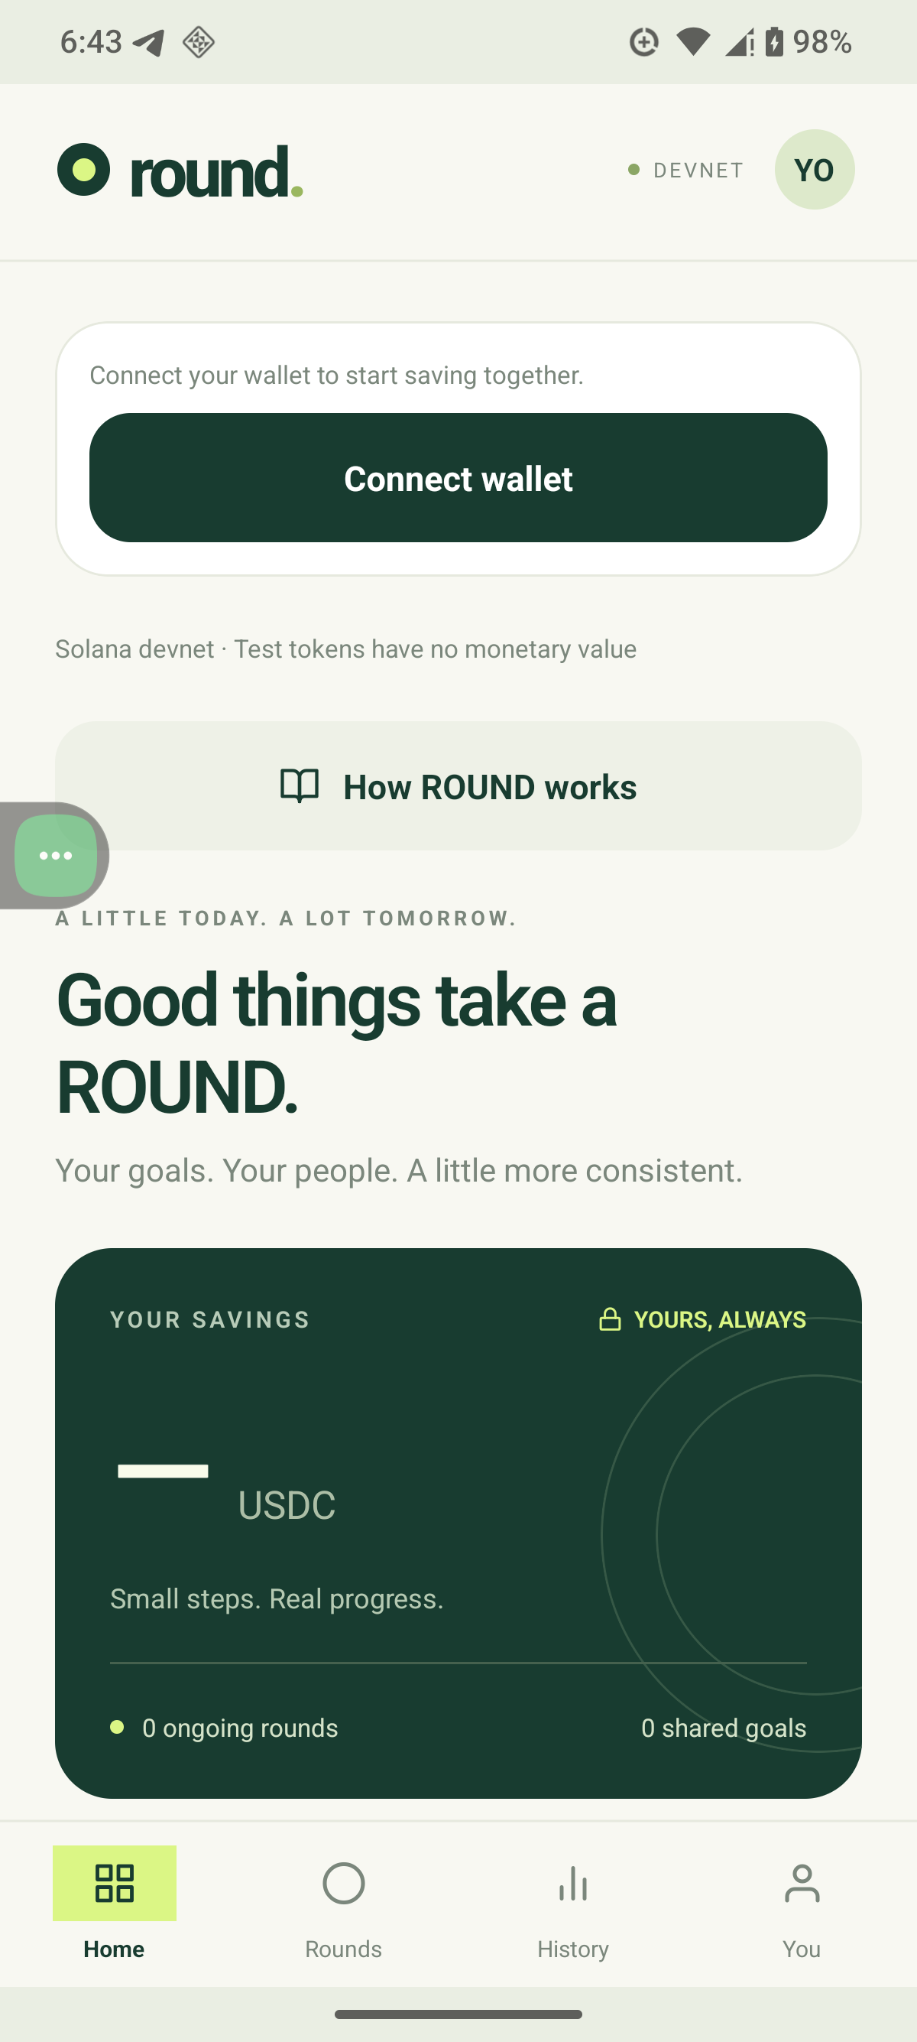
BUILT FOR SEEKER
Your savings, on your phone.
Approve with Seeker Wallet
Connect through Mobile Wallet Adapter.
Review and approve every payment.
Know when to act
Local reminders, payment receipts
and your group’s savings progress.
ROUND / CLOCK IN 2026 / Solana devnet
06
Notes:
Actual ROUND Home screen captured on the connected Seeker. Implemented with React Native / Expo, Mobile Wallet Adapter and local Android notifications. Alert delivery depends on permissions and Android scheduling. Seeker is the current tested wallet.

Slide 7
BUILT AND CHECKED
A working devnet product,
with contract tests behind it.
57
Verified on Seeker
Wallet signing, ROUND creation
and loading saved on-chain data.
automated tests passing
What the tests protect
Including 11 tests executing
the compiled Solana program.
Payment windows, duplicate payments,
account substitution and withdrawals.
ROUND / CLOCK IN 2026 / Solana devnet
07
Notes:
Evidence: latest successful 57-test run in .local/tests-mainnet.log includes 11 actual SBF integration tests. Phone success was confirmed by the user for creation and loading. Full two-account phone lifecycle and all notification delivery states remain validation work. Testing is not an independent security audit. Mainnet work is paused.

Slide 8
NEXT STEPS
Start with small circles.
Earn the right to grow.
First users
Next milestones
Friends with one concrete goal:
a trip, a device, or a shared plan.
Each invitation brings the next saver.
Complete two-account device testing.
Validate reminders and recovery.
Review security before a mainnet pilot.
Seeking feedback from Seeker users and Solana Mobile builders.
ROUND / CLOCK IN 2026 / Solana devnet
08
Notes:
These are proposed launch and validation steps, not achieved user traction. No active-user counts, revenue or partnerships have been invented. Mainnet rollout requires further verification and funding.

Slide 9
ROUND
Make consistency a shared habit.
Your goal.
Your people.
Your savings.
github.com/Oracle00999/round
ROUND / CLOCK IN 2026 / Solana devnet
09
Notes:
Repository: https://github.com/Oracle00999/round. Submission: CLOCK IN Solana Mobile Hackathon. Devnet demonstration only; test tokens have no monetary value. This deck accompanies the functional APK and the separate three-minute demo video.

