Slide 1
TECH TALK:
OCI Command line Interface for Researchers
Friday, November 13, 2020
10:300 AM US EDT
Rajib Ghosh
Global Solutions Architect
Oracle for Research

Slide 2
TECH TALK HOUSEKEEPING
Today’s webinar is being recorded. We will share the link to the recording with you via email after the event. The recording will also be made available to the Oracle for Research community.
We invite your comments and questions, both about the tech topic being discussed and about the series more generally. Questions may be submitted using the Q&A box on your screen or you may ask questions directly using your microphone. When not asking a question, please mute your microphone.
Questions may be asked during the presentation and we will also have a Q & A time at the end of the presentation when you can ask questions directly and engage in discussion.
At Oracle for Research, we believe that research and innovation happen best when a diverse and thoughtful community is free to engage in respectful, compassionate, and open dialog. To that end, when asking a question or providing feedback, we ask that all participants be respectful, collaborative, and constructive.

Slide 3
OCI Command line interface
Rajib Ghosh
(Senior solutions architect @ Oracle for Research

Slide 4
Agenda
Recap and asks
1. Architectures and automation
2. Oracle for Research sandbox images
OCI Command line
Interface (CLI)
1. OCI-CLI Overview
2. Researcher use-cases
3. Resources and guidelines
Demo
1. Research Gateway Image – includes (OCI-CLI)
2. Github documentation
3. CLI scripts and development workflow for researchers
Researcher presentation
(CCHMC)
1. OCI-CLI implementation by a researcher
2. Pre-requisites, OCI-CLI usage on compute, BV attachments etc
2. OCFS2 Implementation
3. Benefits from a researcher perspective. Any other implementation areas
Recommendations
and Q & A
Recommendations
Oracle for Research Github collaboration

Slide 5
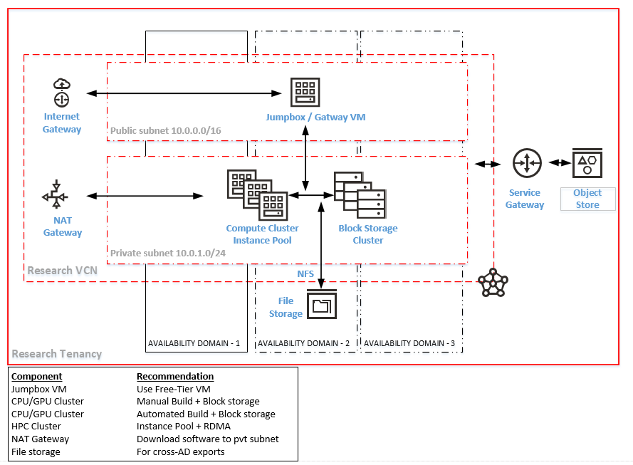
OCI Standard cluster architecture for Researchers

Slide 6
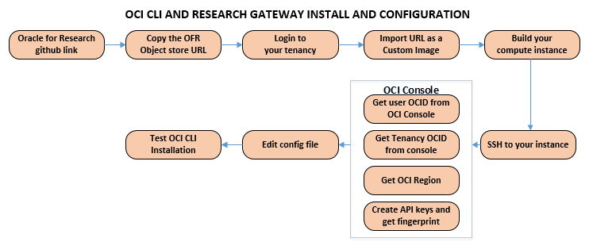
OCI-CLI and Research Gateway Image
OCI-CLI
1. All functionality of OCI console + additional commands
2. Built on OCI python SDK that calls OCI REST APIs
3. OCI-CLI can run over Linux shell, Windows batch or Mac
Research Gateway
1. An Oracle Linux image with OCI-CLI installed
2. Available as a custom image from Oracle for Research (github link)
3. Implement in a public subnet VM / standard architecture
Research Gateway and OCI CLI Features
1. Programmatic usage OCI Console features
2. Quick and easy install
3. Low learning curve
4. Multiple tenancy support
4. Integrates well with Linux shell commands
5. APIs released before console features
6. Command generation options
7. JSON support
8. Extensible usage and cost API
9. Notification API
10. Logging and audit API
11. Manage console resources stack and Terraform

Slide 7
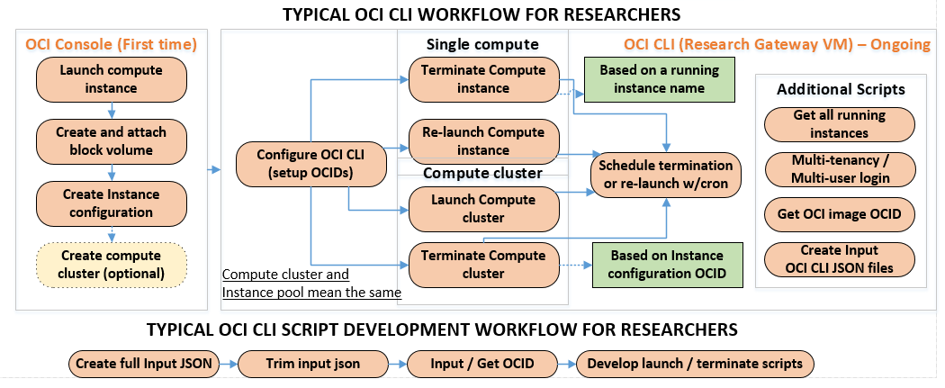
OCI-CLI Workflows
Why this is important?
1. Automatic termination saves researcher credits. (GPU/BM clusters are expensive)
2. Enables Oracle to better utilize GPU / CPU resources & support more researchers
3. Reduce service limit request processing time and saves researchers wait time

Slide 8
OCI CLI vs OCI Console usage
OCI Command line interface / API
OCI Console
Recommended for – Repeatable tasks
1. Starting and terminating an instances
2. Attaching / detaching block volumes / file systems
3. Copying, deleting and exporting data
4. Integration with Linux shell / cron & scheduling
5. Benchmark data collection and storage
6. Monitoring CPU / RAM / Storage utilization
7. Integration with HPC Cluster provisioning
8. Cloud advisor and cost report customization
9. Object storage data pulls and replication
10. Docker/Singularity and container integration
11. API based Cloud bursting integration
Recommended for – One-time setup tasks
1. User setup and federated identity management
2. Importing Marketplace / Custom images
3. Importing Oracle for Research Images
4. Quick data transfer from on-premise to object store
5. Block volume / FSS creation and administration
6. Resource quota and usage analysis
7. Auto-scaling based setup
8. Standard architecture and networking setup
9. Resource stack and Terraform setup
10. Data science & data flow PaaS services
11. Autonomous and PaaS databases

Slide 9
OCI-CLI links
Github and documentation
1. OCI- CLI Documentation & OCI Documentation
2. Quickest way to install / configure OCI-CLI
3. OCI-CLI scripts collections and examples
OCI reporting tool and extensions
Usage and cost reporting
Auto-scaling
Universal credit balance & usage consumption
Using Telemetry service with Grafana
Nightly stop script
Audit script with OCI CLI Audit logs
Autonomous databases, DB systems with OCI-CLI
4. Oracle for Research OCI-CLI page
5. Oracle OCI-CLI github page
OCI-CLI blogs
1. Introduction to CLI, API and OCI Data integration
2. Easy provisioning with OCI-CLI
3. Using OCI-CLI with Kubernetes cron-jobs
4. Quickly run OCI-CLI with Docker container
4. OCI-CLI with a federation from a Docker container
5. Deploying a microservice to Oracle cloud with Github actions
6. New packages for OCI-CLI/GlusterFS , Terraform
8. Automated CLI scripts to scale autonomous databases
9. Using CLI with Restricted object store buckets

Slide 10
TECH TALK:
Oracle command line interface for Researchers
Questions, Answers & Discussion

Slide 11
TECH TALK:
Oracle Command line interface for Researchers
Questions? Comments? Feedback?
Contact us!
Website: oracle.com/oracle-for-research/
Github: github.com/OracleforResearch
Twitter: @OracleResearch
Email: OracleForResearchTech_ww@oracle.com
Next Tech Talk: November 13, 2020, 10:30AM EDT

