Slide 1
TECH TALK:
Architecture and Automation for Researchers
Friday, October 23, 2020
10:30 AM US EDT
Rajib Ghosh
Global Senior Solutions Architect
Oracle for Research

Slide 2
TECH TALK HOUSEKEEPING
Today’s webinar is being recorded. We will share the link to the recording with you via email after the event. The recording will also be made available to the Oracle for Research community.
We invite your comments and questions, both about the tech topic being discussed and about the series more generally. Questions may be submitted using the Q&A box on your screen or you may ask questions directly using your microphone. When not asking a question, please mute your microphone.
Questions may be asked during the presentation and we will also have a Q & A time at the end of the presentation when you can ask questions directly and engage in discussion.
At Oracle for Research, we believe that research and innovation happen best when a diverse and thoughtful community is free to engage in respectful, compassionate, and open dialog. To that end, when asking a question or providing feedback, we ask that all participants be respectful, collaborative, and constructive.

Slide 3
Agenda
Recap and asks
1. Shape selection , storage and performance testing
2. Architectures and automation
3. Performance benchmarks & Data science (platform vs Image usage)
Architectures
for Researchers
1. Standard researcher architecture (Demo)
2. Cloud bursting architectures
OCI Automation
1. Instance scaling (demo)
2. Resource stacks and Terraform (demo)
3. Programmatic automation with OCI CLI and API
Github and links
1. Technical How-Tos
2. Repositories and Images
3. Researcher collaboration
Q & A
Q & A
What works best? Any researcher wish list?

Slide 4
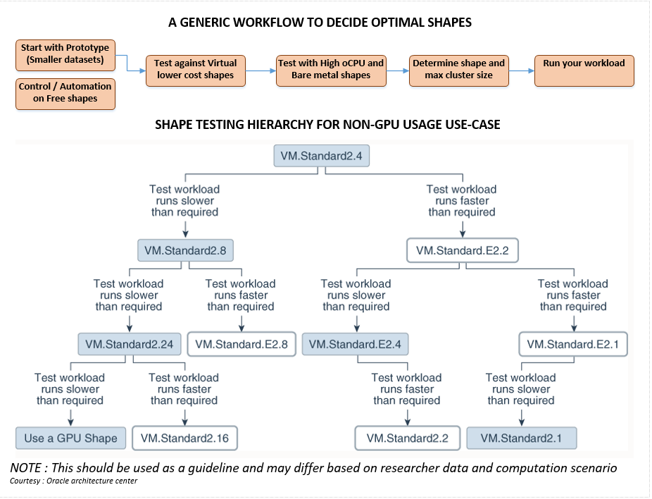

Slide 5
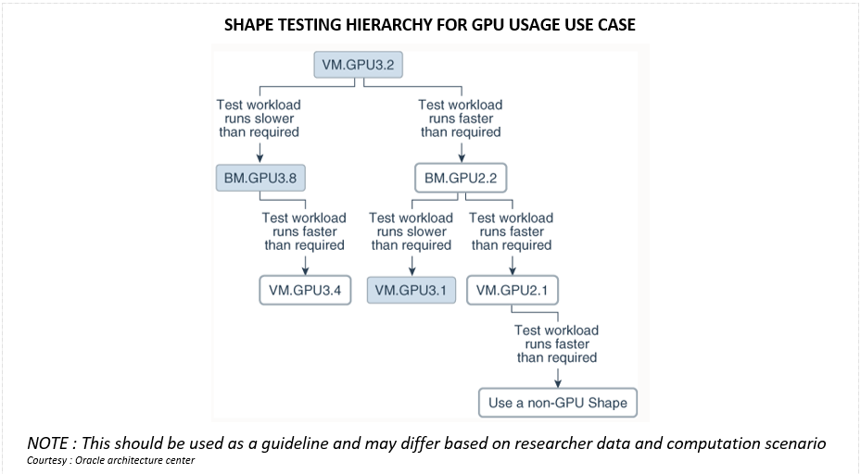

Slide 6
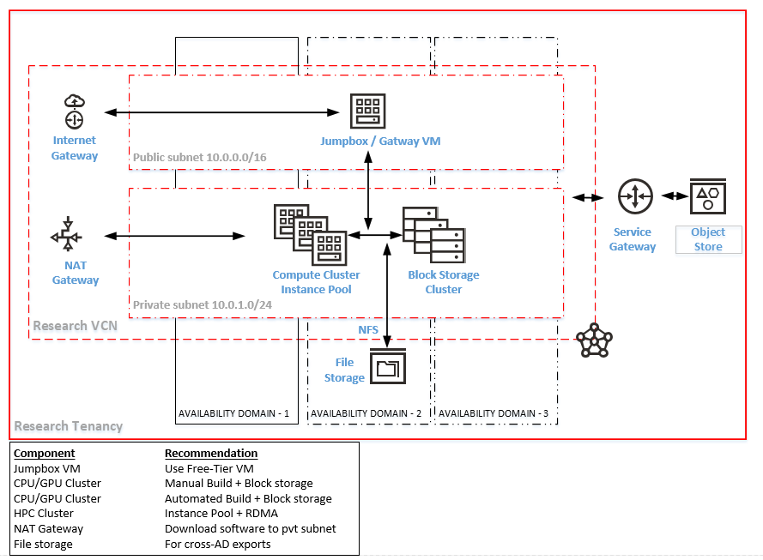
OCI Standard cluster architecture for Researchers

Slide 7
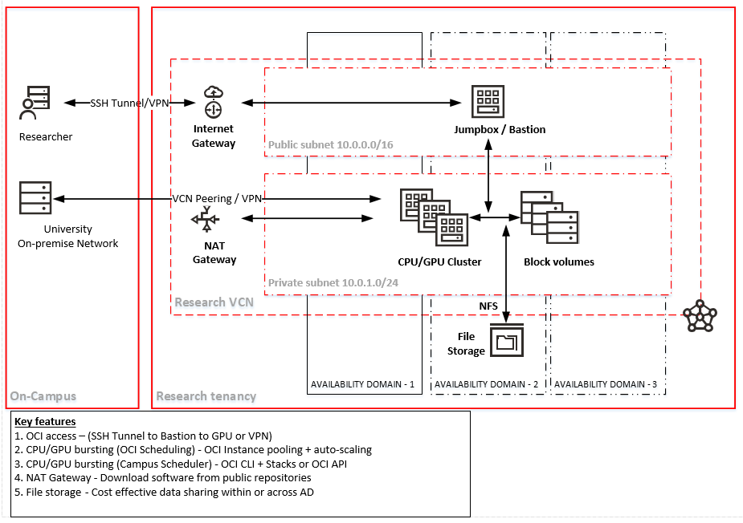
Cloud bursting architecture for Researchers

Slide 8
Architecture use-cases
Standard Architecture
Cloud bursting Architecture
Recommended when
1. Quickly standup the application / cluster in Oracle cloud
2. Entire application would run in cloud
3. Database centric ML applications (Autonomous DB / Roracle)
4. Dynamic scaling of cluster nodes
5. Hybrid cluster with multiple shapes
6. Different workload types (Emb parallel / Tightly-coupled)
7. Simple SSH but secure access to computational VMs
8. All data contained in the cloud
9. Benchmarking against on-campus / clouds
10. Using Oracle cloud automation framework & scripts
Not recommended when
1. Computation in cloud but data is resident outside Oracle cloud
2. On-campus resources are sufficient for workloads
3. Non-research operational projects
4. Frequent transfer of code and data in/out from Oracle cloud
Recommended when
1. A percentage of the workload can be run on Oracle cloud
2. Infrequent cloud usage
3. On-premise workload scheduling
4. On-premise cluster is overloaded
5. Reduce workload by moving an application/data to OCI
6. Smaller computational data sets
7. Performance benchmarking against on-campus / other clouds
8. Scheduling automation is tested and working
9. Containerized applications & canary testing
10. Benchmarking against OCI shapes
11. Embarrassingly parallel HPC jobs
Not recommended when
1. Large data migration during bursting
2. Tightly-coupled apps (Cross node communication)

Slide 9
Why standard architecture is important?
Being Standard
1. Quick and easy to implement
2. Easier resource management
3. Single & common reference for all researchers
Automation
1. One-click standup and shutdown of instance through console (Stacks and Terraform)
2. Quick and easy configuration management
3. Programmatic automation (CLI / API) through a Free-tier VM
Better resource
utilization
1. Planned utilization of CPU/GPU/Storage resources
2. Effective cluster and computational planning
3. Better credit usage and service limit allocation
Better benchmarking
1. Benchmarking against similar hardware & computational specifications
2. Leverage performance tips from Oracle
3. Testing same workload against higher end shapes
Quicker support
1. Issues can ne resolved faster
2. Issues can be replicated/tested without access to researcher tenancies
3. Comparative benchmarks from the community can help tune your implementation
Security
1. Private subnet insulates your computation VM and data
2. Access only through a jump box / secure gateway VM
3. NAT access provides direct internet access for code / patch downloads

Slide 10
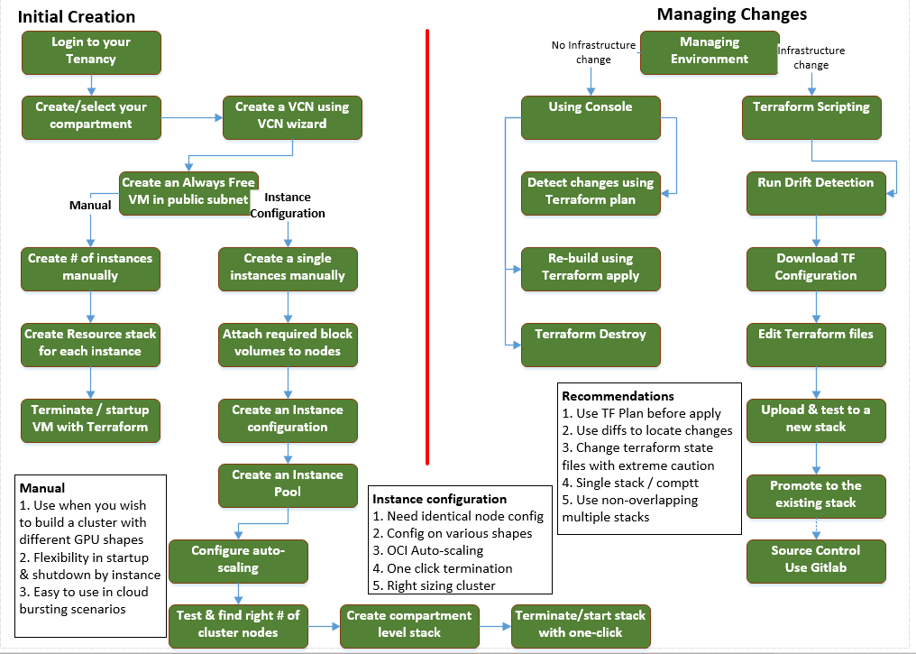
Automation Setup & management workflow
Notes:
Data science Image - https://console.us-ashburn-1.oraclecloud.com/marketplace/application/78643201/usageInformation
Oracle-Linux-7.8-Gen2-GPU-2020.05.26-0 Image Family: Oracle Linux 7.x • Operating System: Oracle Linux • Kernel Version: kernel-uek-4.14.35-1902.302.2.el7uek.x86_64. • CUDA Version: 10-2-10.2.89-1 • cuDNN Version: 7.3.1 • Release Date: June 1, 2020
Genome analysis toolkit - https://console.us-ashburn-1.oraclecloud.com/marketplace/application/81390072/usageInformation Release Notes:

Slide 11
Oracle for Research github – https://github.com/OracleForResearch
Technology How-Tos
1. Short 2-page How-Tos (Categorized)
2. Important OCI links (Supplemental pages)
3. Aligned and dedicated to researcher needs
Image Sandbox
1. AIML Sandbox & AFNI (Base reference images with CPU/GPU versions on OL7 and Ubuntu)
2. Actively worked on by Oracle for Research
3. OFR will develop more based on active researchers participation and feedback
Researcher
Collaboration
1. Contributions (benchmarks, test results, data )
2. OFR and OCI reviews
3. Researcher publications repository
Images & Applications
1. One stop place for Oracle provided images
2. Oracle cloud Images for Research only
3. Researcher image contribution
1. Molecular dynamics
2. Open source and proprietary images
3. Agro & farm data images
Technology Talks
1. Oracle for Research presentations
2. Relevant Tech presentations for researchers
3. Product updates
Coming up..
Benchmarking and guidelines
Choosing the right data science platform.
Researcher images for sharing and publication
What we need? – Your feedback / what makes sense?

Slide 12
TECH TALK:
Architecture and Automation for Researchers
Questions, Answers & Discussion

Slide 13
TECH TALK:
Architecture and Automation for Researchers
Questions? Comments? Feedback?
Contact us!
Website: oracle.com/oracle-for-research/
Twitter: @OracleResearch
Email: OracleForResearchTech_ww@oracle.com
Next Tech Talk: November 13, 2020, 10:30AM EDT

Slide 14
Parking lot
For Reference

Slide 15
Oracle for Research Tech Talk Oracle Cloud Topics
Foundational
Oracle cloud – Getting you started and running
Cloud instances and cloud storage options
Migrating data and running computations
Architecture
Reference architecture patterns for researchers
New features updates and recommended practices
Performance benchmarks and data
Tools and automation
Tool selection, version and guidance
Image repositories, Terraform and interfaces
HPC and cluster
High performance computing, workload classification, parallelization
Cluster setup, utilization and monitoring
Machine and Deep
Learning
Model selection guidance
Researcher guidance
Functional and data guidance and curation support
Industry models with research computing

Slide 16
Instance Type | Shape series | Shape | Purpose
Virtual | Always Free | VMStandardE2.1Micro | Automation control, gateway,configurations
 | Standard | VMStandard1.1~1.16 | Low workload testing / Image builds / installs
 | AMD (Gen 2) | VMStandardE2.1~2.8 | Prototype workload testing
 | DenseIO | VMDenseIO2.x (NVMe) | Heavy IO workload testing
 | GPU (P100) | VM.GPU2.1 | AI / ML or other GPU prototype testing
 | GPU (V100) | VM.GPU3.1~3.4 | Tensor core AI / DL workloads
 | Intel Skylake (Fixed) | VM.Standard2.1~2.24 | Workloads to save on credits
 | AMD Rome (Flex) | VM.StandardE3.Flex | Benchmarking / price-performance
Bare metal | HPC | BM.HPC2.36 (NVMe) | CPU+high throughput for HPC workloads
 | AMD (Gen 3) | BM.StandardE3.128 | High CPU/throughput workloads
 | Standard | BM.Standard1.36/B1.44 | Low CPU/RAM utilization at lowest BM cost
 | AMD (Gen 2) | BM.StandardE2.52 | Best price-performance for BM workloads
 | AMD (Gen 3) | BM.StandardE2.64 | Best Gen3 price-performance for BM workloads
 | DenseIO | BM.DenseIO2.52 (NVMe) | Best price performance for IO intensive workloads
 | GPU (P100) | BM.GPU2.2 | Benchmarking pascal based GPU workloads
 | GPU (V100) | BM.GPU3.8 | Best price performant for large GPU workloads
 | GPU (A100) | BM.GPU4.8 | Fastest GPU – large DL applications (pre-GA)

Slide 17
Oracle cloud storages
Storage type | Features | Recommended usage
On Campus storage
Good for on-campus data processing requirements
Data could be distributed (laptops) or centralized
Quick data retrieval for on-campus computations
Store data for on-campus computational purpose
Store data if storage is available and it is already paid for
Object storage archive
Unlimited data storage in Oracle cloud
Low cost ($0.0026/GB/Month) by consumption
Better if cost/GB is lower than on-campus storage
Not so good for frequent large data retrievals
Not readily available for computational purpose
Object storage standard
Unlimited data storage with faster access than OS archive
Costs (0.0255/GB/Month) by consumption
Good for frequently accessed data across cloud tenancies
Secured and encrypted data at rest and in transit (https)
Store data backups for quick downloads in cloud / campus
Store large data volumes at relatively lower cost
Store data that is infrequently processed
Block volume
Most common storage for compute/databases
Mountable across multiple instances within an AD
Cost (0.0255/GB/month) – based on total volume in GB
Supports parallel filesystem & best price performance
Leverage to store computational data for most loads
Extend storage / instance as needed
Fill up allocated capacity to save on costs
File system storage
NFSv3 unlimited file system storage mountable across AD
Higher cost (0.3/GB/month) on consumption
Good for file sharing across tenancies and OS
Performs linearly or better with higher data set size
Not good for cross AD data transfer in computational cycle
Good for moving large volumes of data quickly across AD
Use sparingly
Local NVMe
Highest IOPS and throughput & good for IO intensive loads
Higher cost (built into compute)
Non-persistent data
Part of DenseIO and HPC shapes
Use for IO intensive parallel CPU workloads

Slide 18
Useful links
Getting Started
Key concepts and terminology
Signing in to console, Sign-in options and changing your password
Setting up your tenancy
Tutorial – Launching your first Linux instance
Tutorial – Launching your first windows instance
Object storage and Pre-authenticated access
Image import and export
File storage system concepts
OCI Hands on labs
New features and navigation updates
Oracle cloud Free tier and FAQ
Custom key generation with puttygen or ssh-keygen
Frequently asked Questions
Getting help and contacting support
Identity federation
Federated identity for single sign-on
Migrating from on-premise to Oracle identity service
Databases and moving data
Oracle Autonomous databases and Tools
MySQL and NoSQL Services
Key concepts and terminology
Migrating databases to cloud
Loading data to autonomous with OCI Functions
Single-click move to autonomous
Data science and AI/ML
Oracle Data science platform and Tutorials
Genome analysis toolkit
Julia AI/HPC GPU Image
NVIDIA images and NVIDIA GPU image
Building a ML sandbox on Oracle cloud
Setting up an open-source ML and AI Environment
Machine learning autonomously
High performance computing (HPC)
Oracle HPC Cluster and Oracle HPC File system
NVIDIA GPU Cloud machine image
Oracle Linux 7 Cluster Networking Image
Oracle marketplace slurm image (HPC + Slurm combo)
Oracle cloud slurm image
Github OCI-HPC
Enabling HPC Cluster networking
Deploy High performance computing on Oracle cloud Infrastructure
Deploy scalable and distributed file system using Lustre
Deploy BEEGFS parallel file system
UoB Cluster in the cloud
Cluster in the cloud - github
Molecular dynamics NAMD runbook and GROMACS runbooks
Usage, billing and credit control
Oracle cloud storage costs
Resource billing for stopped instances
Oracle cloud universal credit PaaS and IaaS service descriptions

Slide 19

Oracle for Research Tech Talk Series Will Cover:
Technology training
Reference architectures
Best practices
Tools and automation
Cost control
Collaboration
Q & A Live discussions
Tips and tricks library
Community forum
Meet Oracle experts
Product announcements
OFR technology updates
OCI product updates
Images and containers
Public data
Researcher for researchers
Technology Innovations
Researcher publications
Benchmarks
Lessons learned

Slide 20
OCI Automation for Researechers
Common Researcher
Issues
1. Where to start?
2. What shapes, images and storages do I need?
3. How to manage my credit allocation effectively?
1. Any automation to terminate idle instances?
2. How do I scale or burst my workload?
3. Can I use my on-campus identity to login?
OCI Architectures
for Researchers
1. Standard researcher architecture – Bastion Free Tier VM + Private subnet for compute
2. Shape and storage selection guidelines
3. Scaling and cloud bursting architectures
Automation and
usage control
Instance scaling (demo)
Resource stacks and Terraform (demo)
Tooling with OCI CLI
Credit control
mechanisms
Cost analysis and cost reports
Setting budgets and alerts
Github and links
Overview of the repositories
Collaboration with Oracle and Researchers
Q & A
Q & A
What works best and researcher wish list?

