Slide 1





Surveillance techniques evaluation, a computer science and public law study
From an example
Mélanie romano, Nicolas Rougier, pauline gervier
SSN 9-12th of june 2026

Slide 2
Summary
What is an augmented camera ?
History
Case studies
2024 Olympic Games
AVS in stores
Results
Reglementation vs. reality
Surveillance techniques’ evaluation
Conclusion and openings

Slide 3
What is an augmented camera ?
Augmented cameras are video devices (AVS Algorithmic Video Surveillance) that incorporate algorithmic image analysis capabilities (often using AI).
Can be done in real-time or via recordings
3 contexts : public spaces, private spaces and « personal »
In France, regulated by only one text : the Olympic and paralympic games Act
Only one EU regulatory text regulates it : the AI Act
[40], [41]

Slide 4
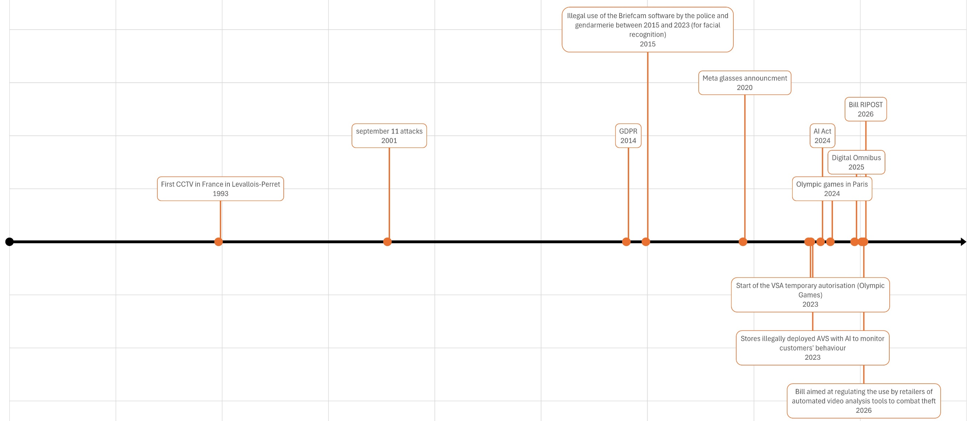
History
[35] , [36] , [37] , [38]

Slide 5
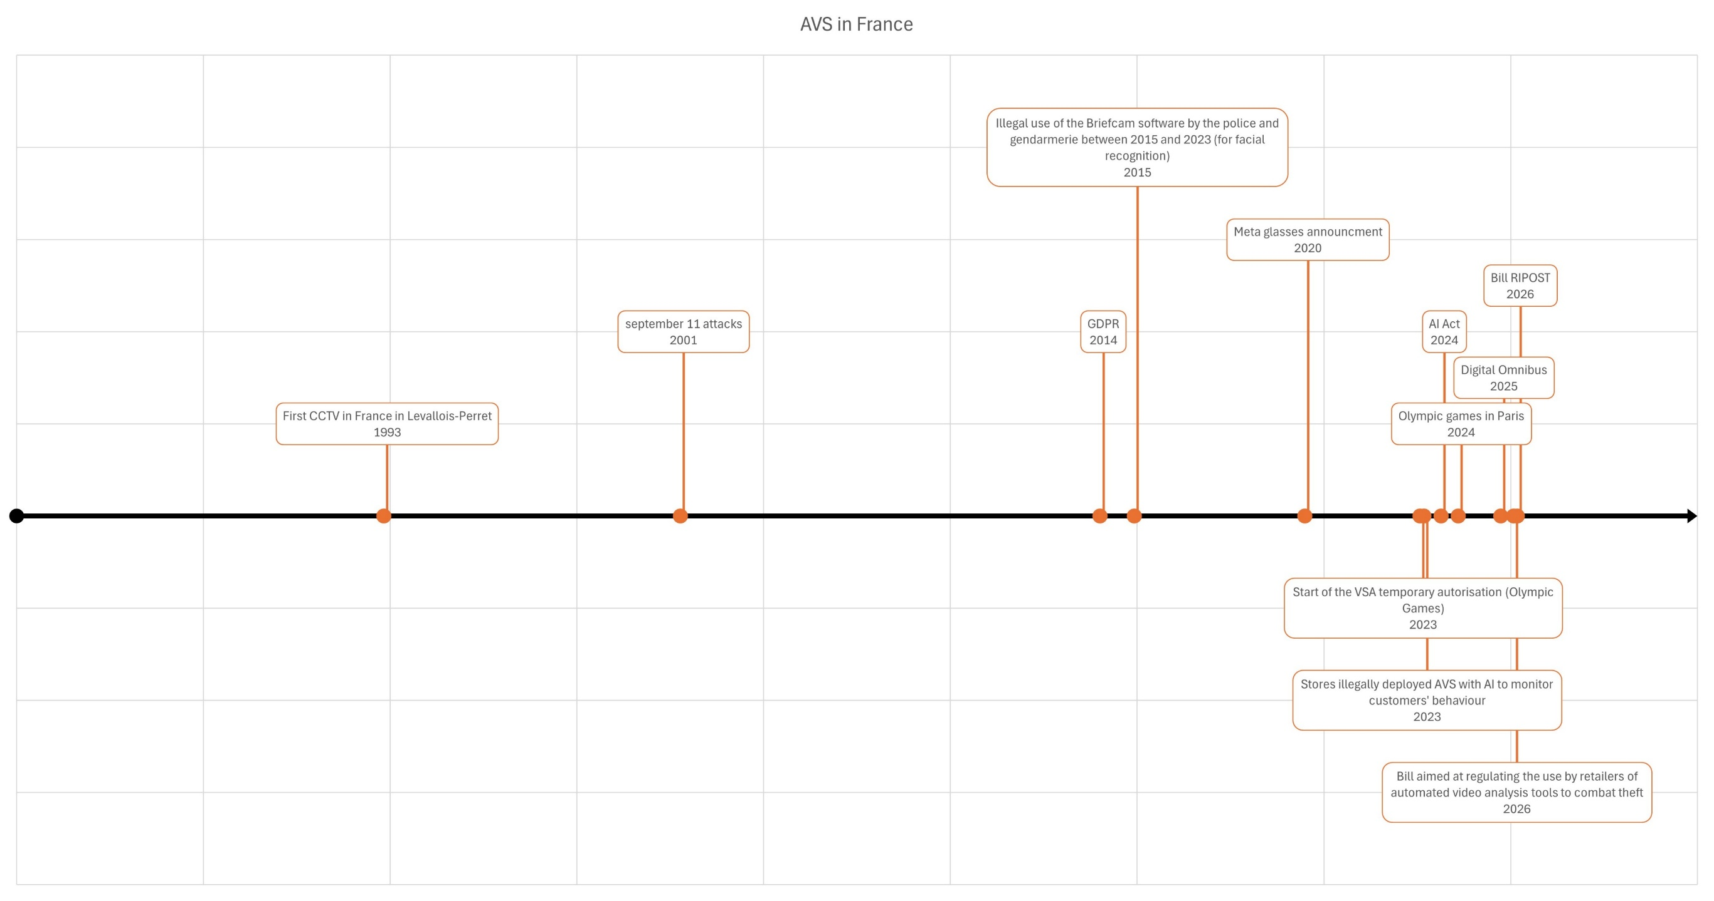
Case study : AVS in the Paris Olympic Games
Olympic and paralympic games Act (temporary experimentation Text)
High risk AI in the AI Act
Forbidden to use facial recognition (but clothes recognition as well)
Reconducted until Olympics 2030
RIPOST bill using the experimentation in order to entrench the experimentation in the regulation
Regulation before the usage of the technology
Start of the VSA temporary authorisation (Olympic Games)
2023
Olympic games in Paris
2024
Bill RIPOST
2026
[15] , [16] , [17] , [18] , [19] , [20]

Slide 6
Case study : AVS in the stores
Which data to train those AI, to demonstrate?
Not in the Olympic and paralympic games Act
Regulation after the first technology’s usage
Compliant with AI Act? And the GDPR?
Stores illegally deployed AVS with AI to monitor customers' behavior
2023
Bill aimed at regulating the use by retailers of automated video analysis tools to combat theft
2026
[11] , [12] , [13] , [14]

Slide 7
Which results ?
Public CCTV in France: from the French Court of Auditors (Cour des comptes)
Used to support investigations and public-order operations.
No overall correlation between the presence of CCTV cameras (the level of street crime, or crime resolution rates)
➔ Highlighted the lack of rigorous evaluation methods and called for more evidence-based assessments of CCTV effectiveness.
Algorithmic Video Surveillance (AVS) Olympic Games 2024
The experiment produced mixed results
Good to detect : intrusion in restricted areas, wrong-way vehicle detection and to monitor controlled environments (metro corridors, etc.)
Significant limitations : high FPR, difficulties analysing dense crowds and to detect abandoned objects in complex environments
➔ Concluded that the limited duration of the experiment and the small number of real incidents prevented definitive conclusions regarding overall effectiveness.
[16] , [17] , [18], [30], [31], [32]

Slide 8
Regulation vs. Reality
Multiple texts (including bills) to regulate the practices
The temporary might be set in stone at some point (Olympic Games exception)
Context dependent
However, most of the AVS are illegal
Technology driven → some illegal usages can be done (what about « personal » AVS such as Meta glasses ?)

Slide 9
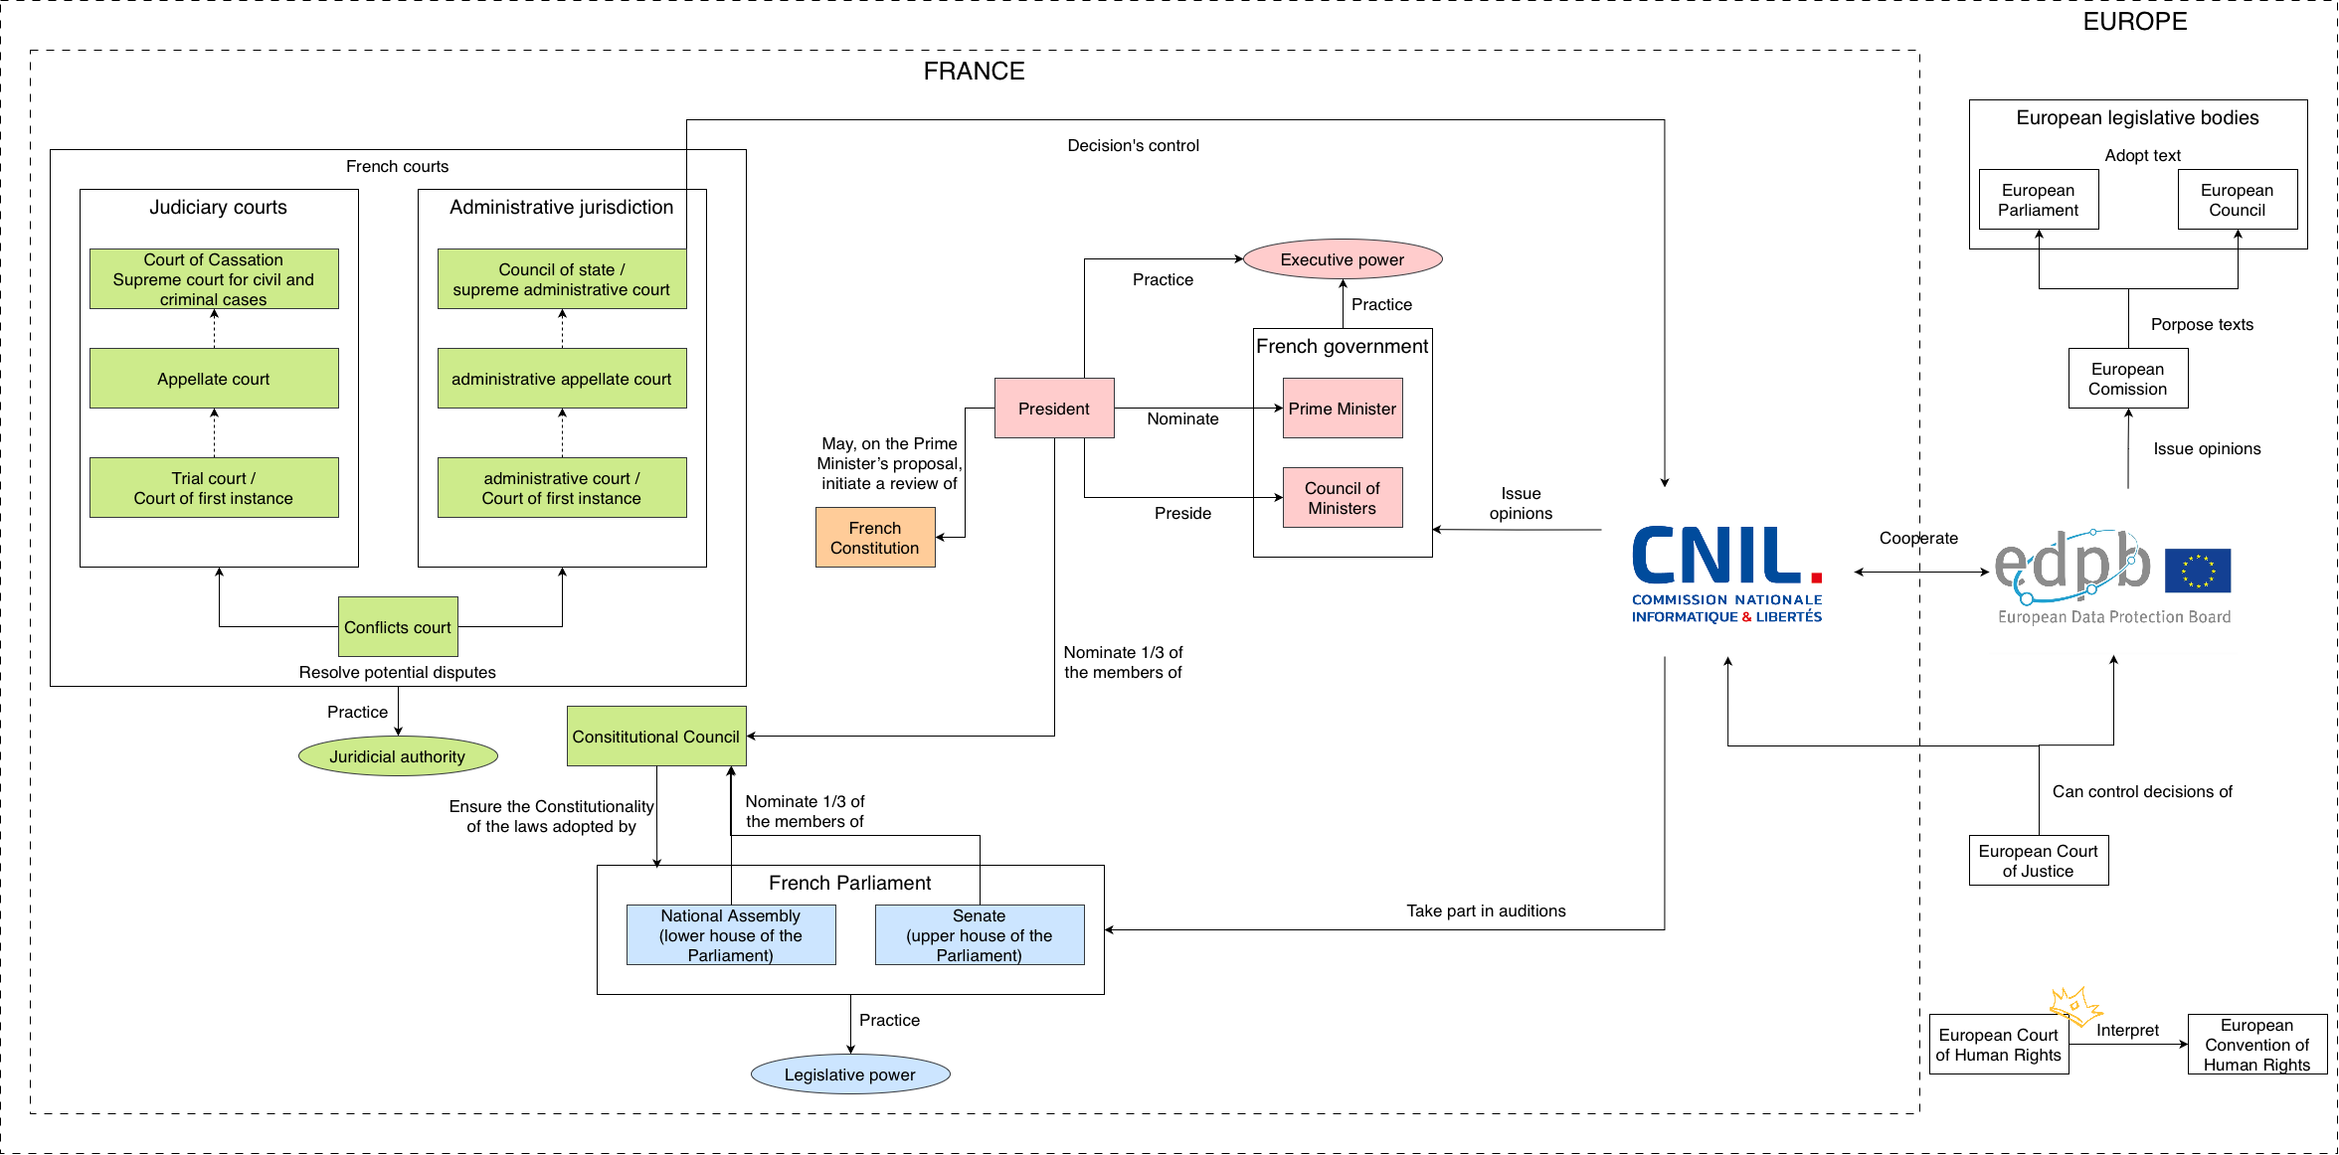
Regulation vs. Reality
Regulatory context

Slide 10
Regulation vs. Reality
Who propose regulation ?
« Upststream » regulation (AI Act)

Slide 11
Regulation vs. Reality
Who propose regulation ?
Country-based regulation (Olympic Games)

Slide 12

Regulation vs. Reality
Who propose regulation ?

Slide 13
Surveillance techniques’ evaluation
C. Collect or G. Generation | 1. Target (who)
 | 2. Duration (when)
 | 3. Materiality (how)
 | 4. Type (where and what)
S. Storage | 1. Duration (when)
 | 2. Acces (who)
 | 3. Storage (where)
 | 4. Materiality (how)
A. Analyse | 1. Date (when)
 | 2. Treatment (where)
 | 3. Treatment (who)
 | 4. Goals (what)
Legality (text regulating the technique)
Independant supervision
Transparency
Remedies
Impacted fundamental right(s)
Success rate (technological)
Any report (other domain)
Possibility of connection with other database (ease)
Use of AI (ease)
Credit : Some of those criterias come from Elia Verdon’s work (big thanks to her)

Slide 14

Conclusion and openings
Numerous criterias
Context dependent
(At best) mitigated results
Lack of assessment methods on those technologies
Different regulatory texts (when avaliable)
Technology driven world and regulation
Acceleration this past decade
AVS is only a small portion of surveillance techniques
Source : "Madagascar", Dreamworks

Slide 15


Thank you for your attention !
If you want to download the presentation and the bibliography
Source : "Madagascar", Dreamworks
https://github.com/Oraclia/SSN_2026/blob/main/README.md

