Slide 1
IoTufa
Adriano Mendes
Diego Lopes
Oracy Martos
Notes:
<number>

Slide 2

Process Flow
Configurations
On/Off
Functions
Informations
Temperatura
Irrigation
Minimum amount of Mary Jane
Turn on
Turn Off
Minimun Alert
On/Off Irrigator
Turn off empty greenhouse
Amount of Mary Jane
Temperature
Notes:
<number>

Slide 3
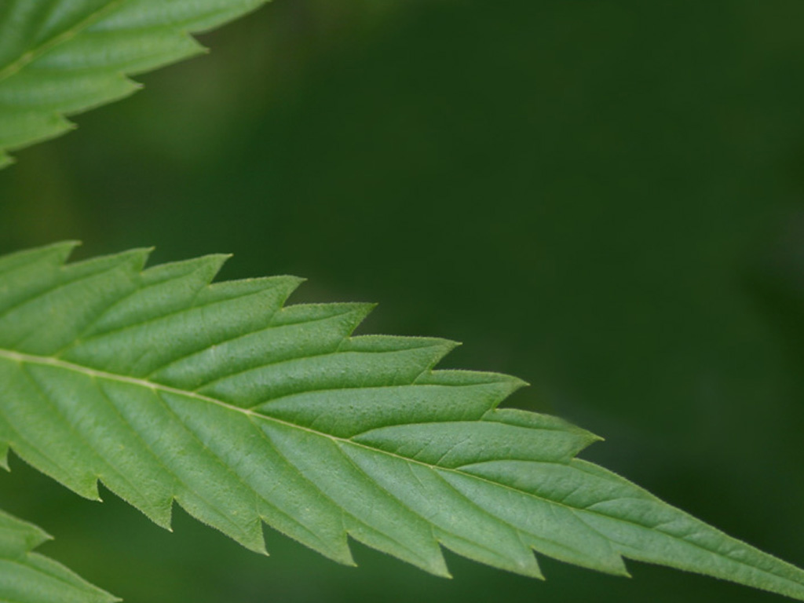
Questions????
Não compre, plante!
Notes:
<number>

