Slide 1

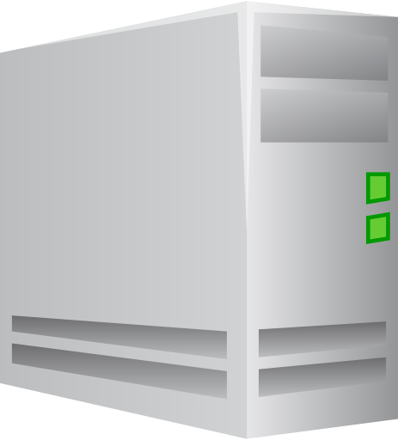
Web Client
Web Server
DB Server
5. Contents
(HTML/JSON.. )
4. Query Result
Web
Browser
Web
Server
Servlet
JSP
DB
6. HTTP Response
2. Request
3. SQL Query
JVM
1. HTTP Request

Slide 2
Web Server
Web Application
Apache
(Web Server)
ajp13
프로토콜
Tomcat
(WAS)
mod_jk
JVM

