Slide 1

Search for new pulsars
Wei Cheng
26.02.26

Slide 2
Potential target

Slide 3
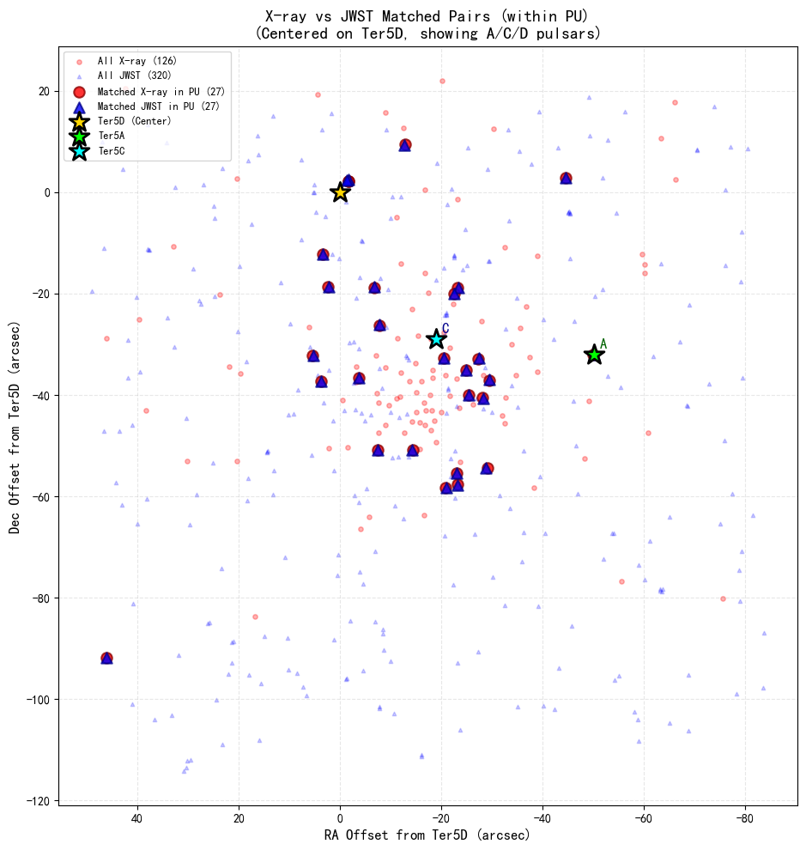
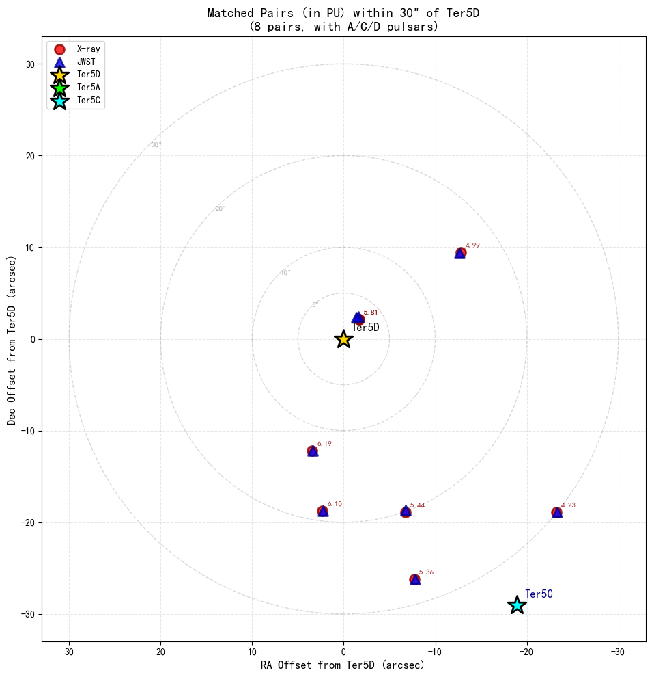
Xray-infrared matched pairs around Ter5D:

Slide 4
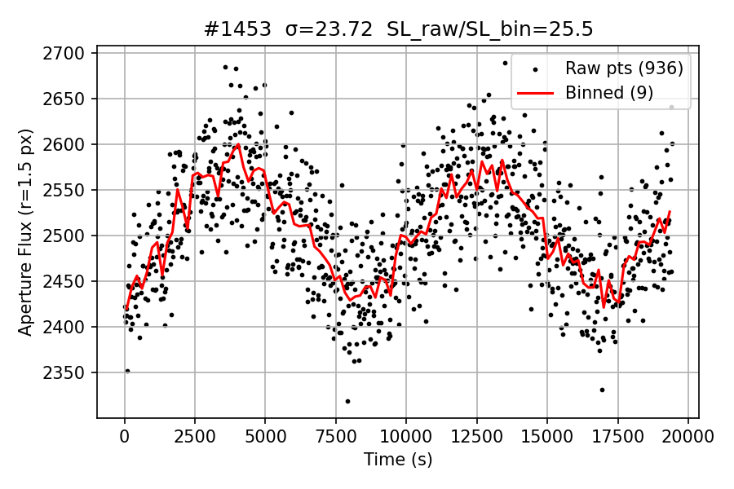
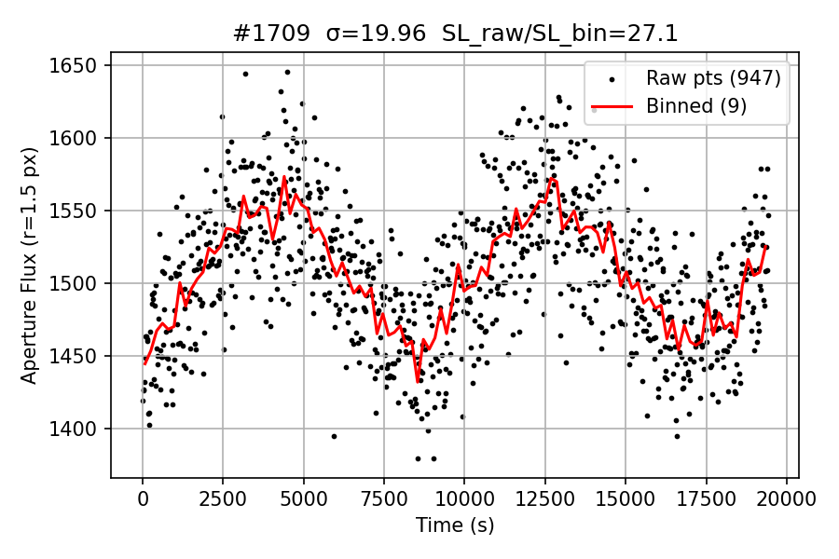
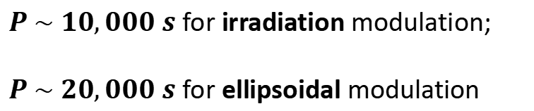
The nearest source:
$P \sim 10,000 s$ for irradiation modulation;
$P \sim 20,000 s$ for ellipsoidal modulation

Slide 5
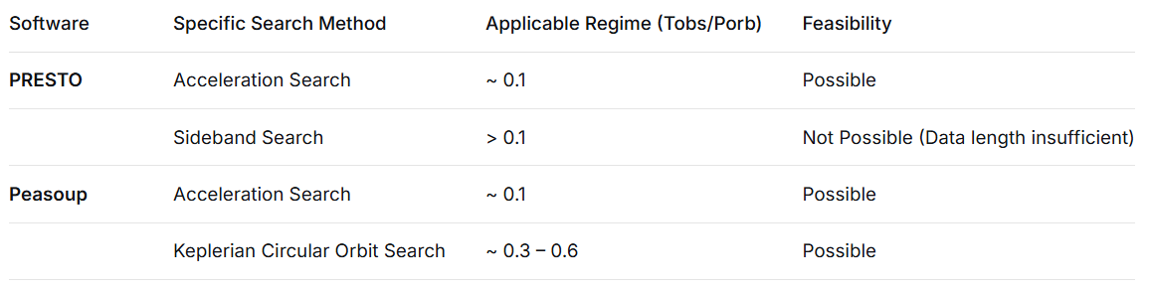
Searches to be Conducted:
A complete pipeline is required, including data combination, RFI mitigation, searching, candidate folding and analysis.

Slide 6
Polarization and RM

Slide 7
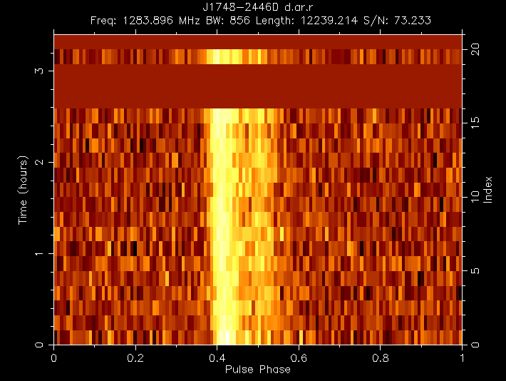
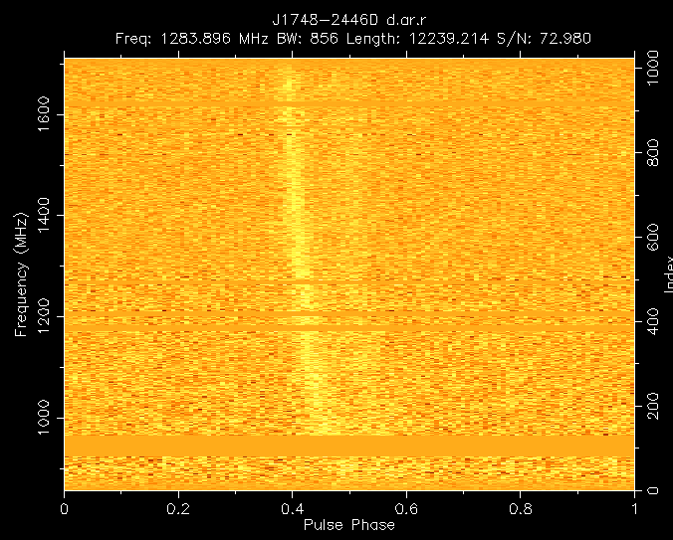
Ter5D total observation:
（1）Not the optimal DM correction;
（2）The double-peak separation decreases with decreasing frequency.

Slide 8
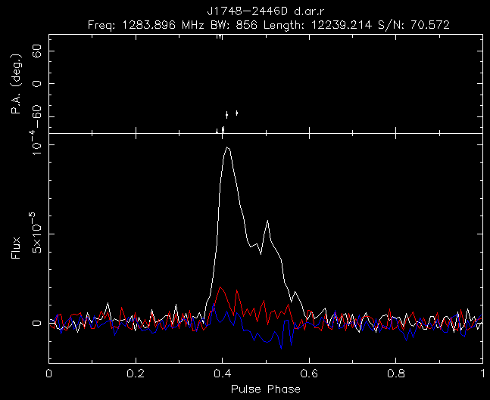
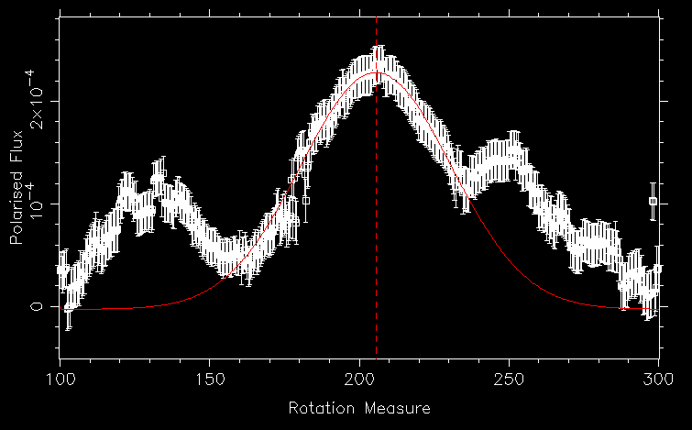
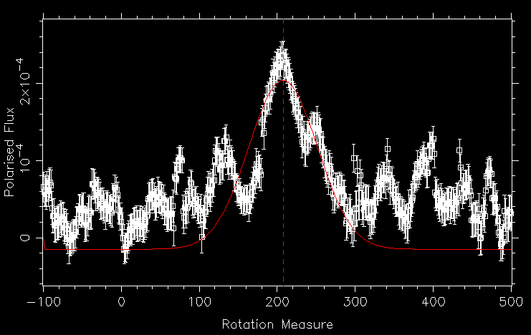
Ter5D total observation:
Best RM is: 205.581 +/- 17.74
Best RM is: 207.456 +/- 31.05

Slide 9
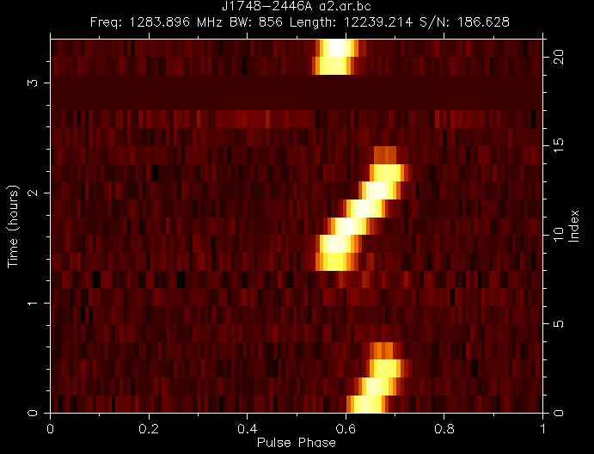
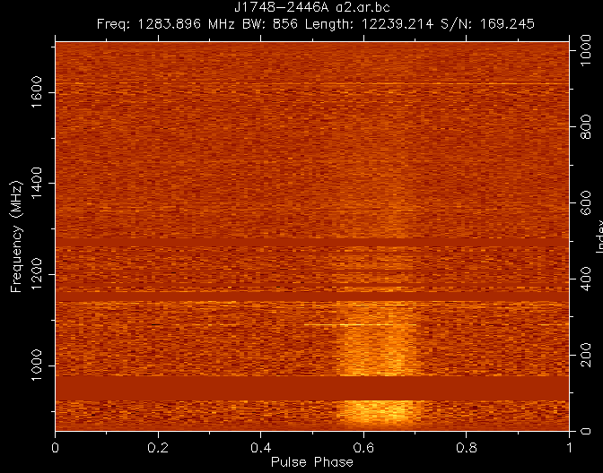
Ter5A total observation:
Keplerian orbit-based folding is required!

Slide 10
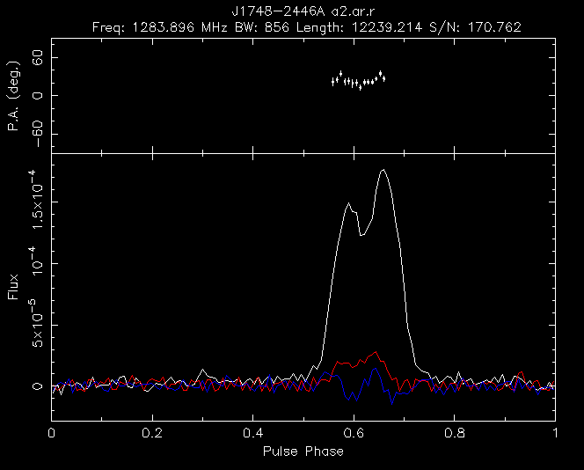
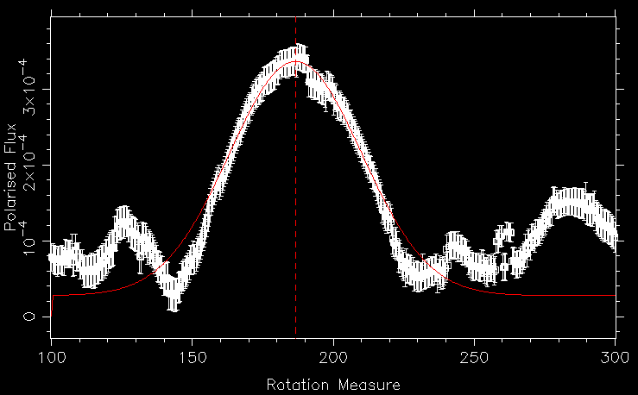
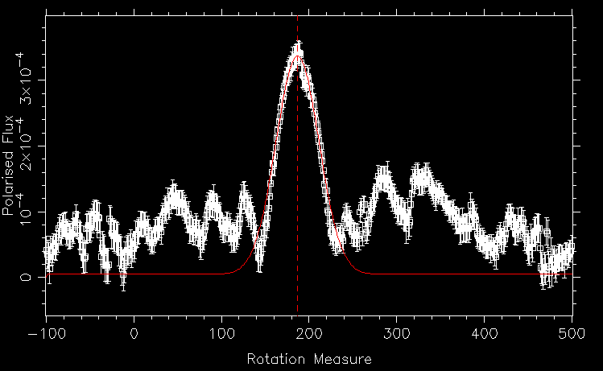
Ter5A total observation:
Best RM is: 186.643 +/- 16.61
Best RM is: 186.751 +/- 17.38

Slide 11
FFA and Pruning

Slide 12
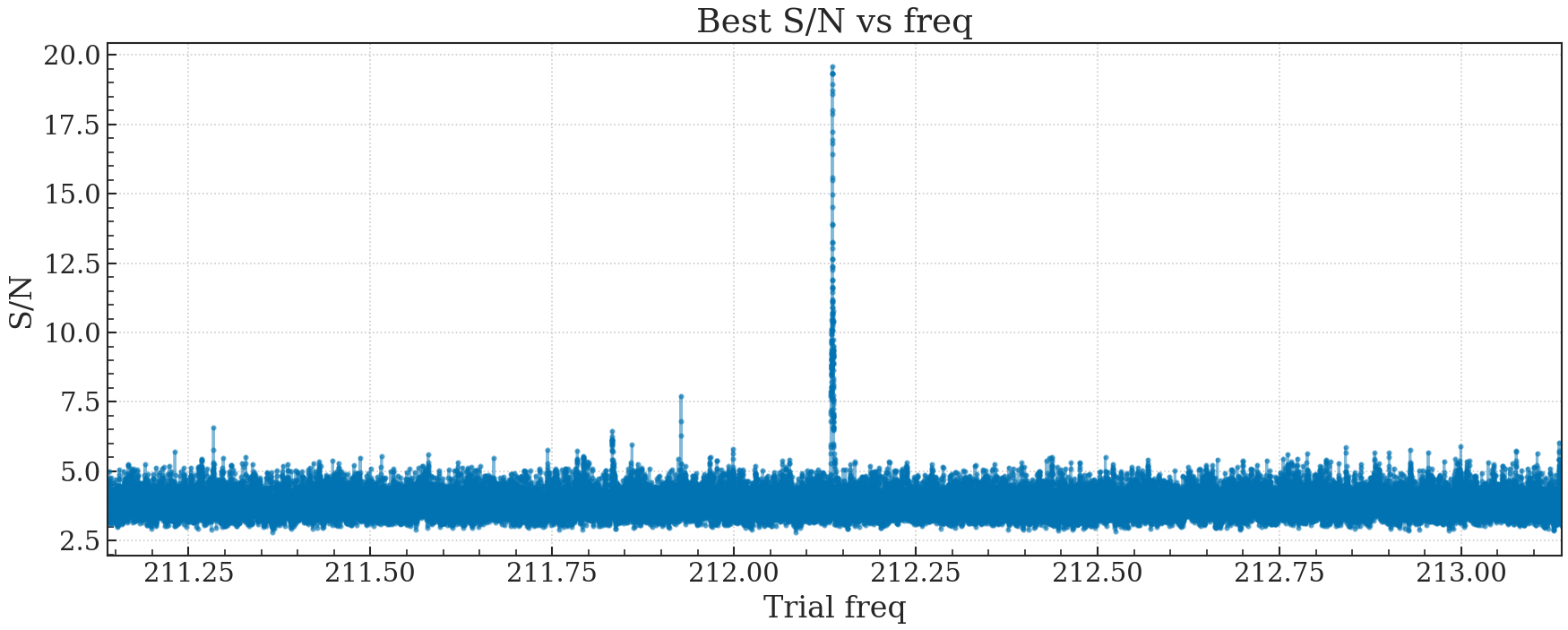
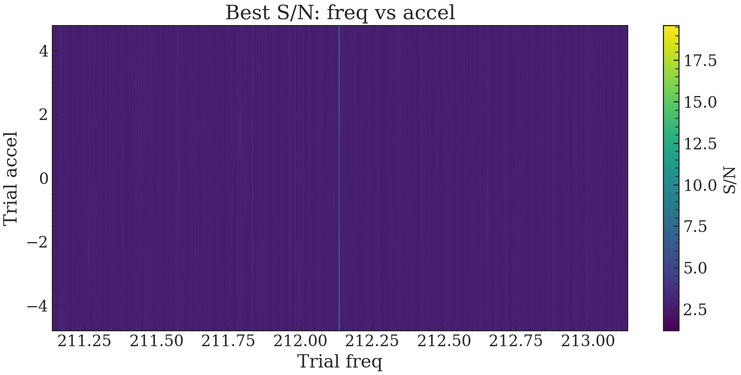
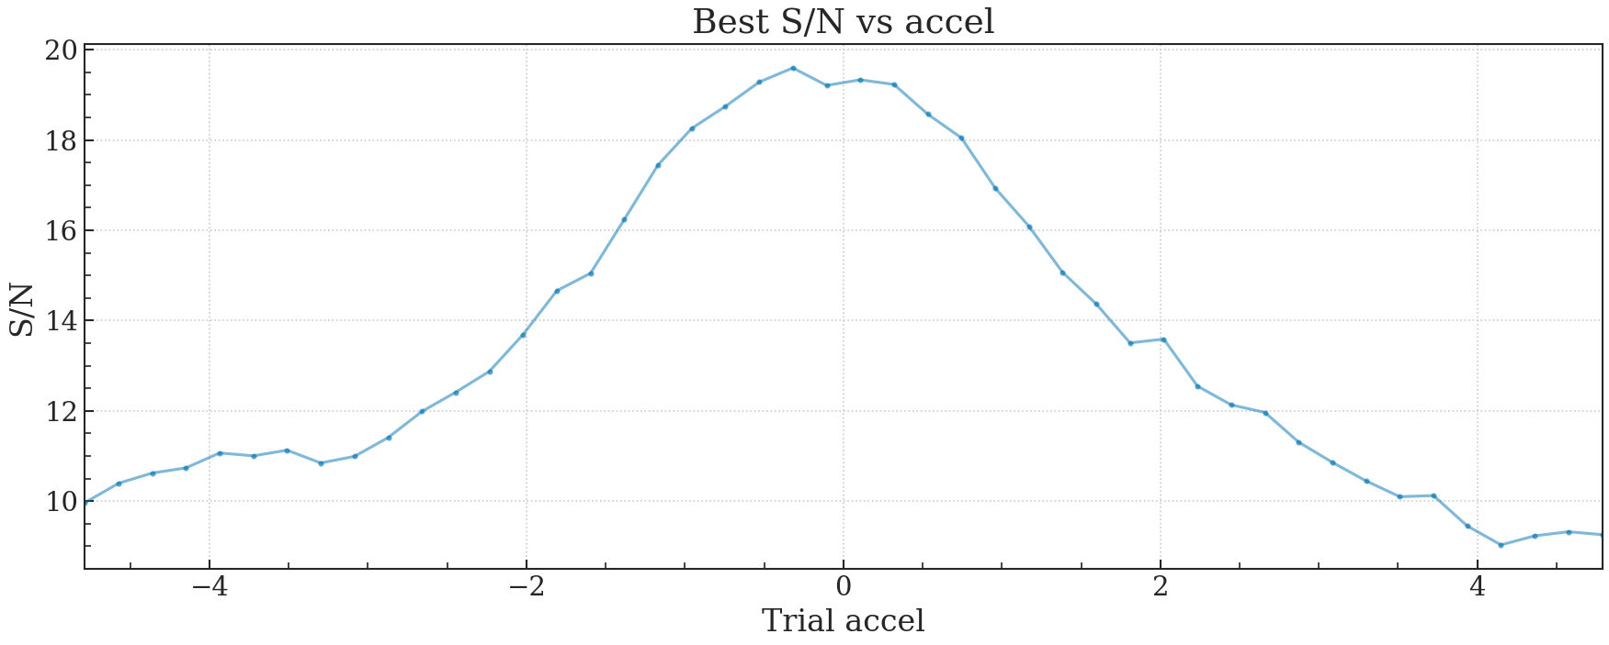
FFA of Ter5D with 21.4min:
FFA requires substantial computational resources and is not well-suited for acceleration searches, as it cannot adopt a fine grid in the acceleration space. It can reflect that Ter5D is a single pulsar with an acceleration of 0.

Slide 13
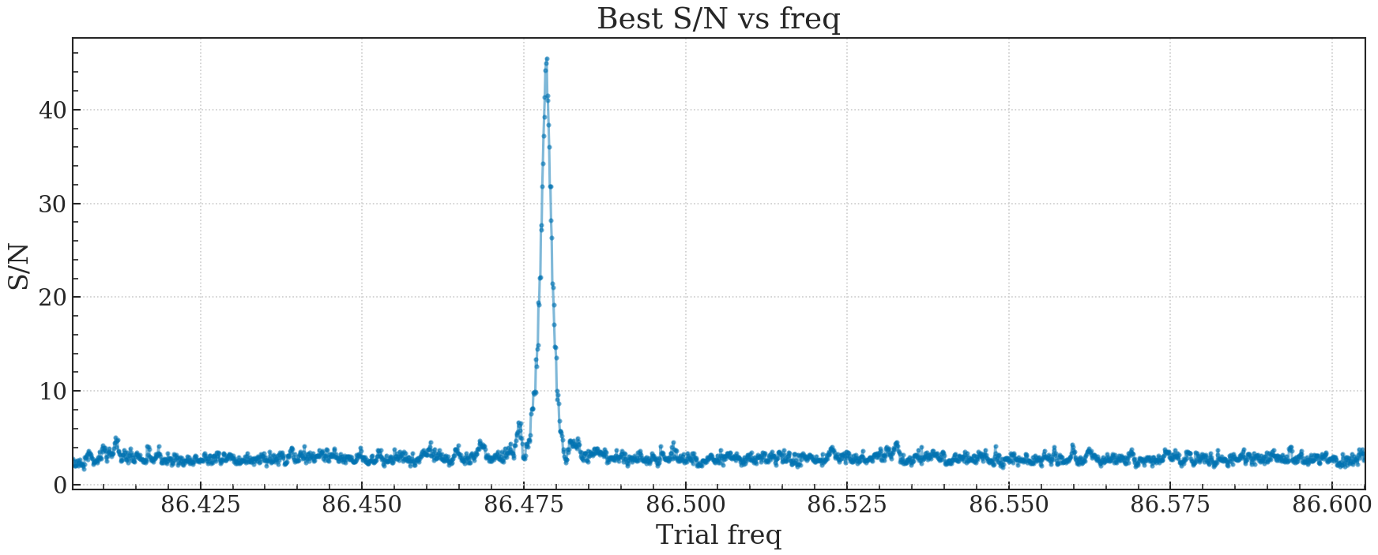
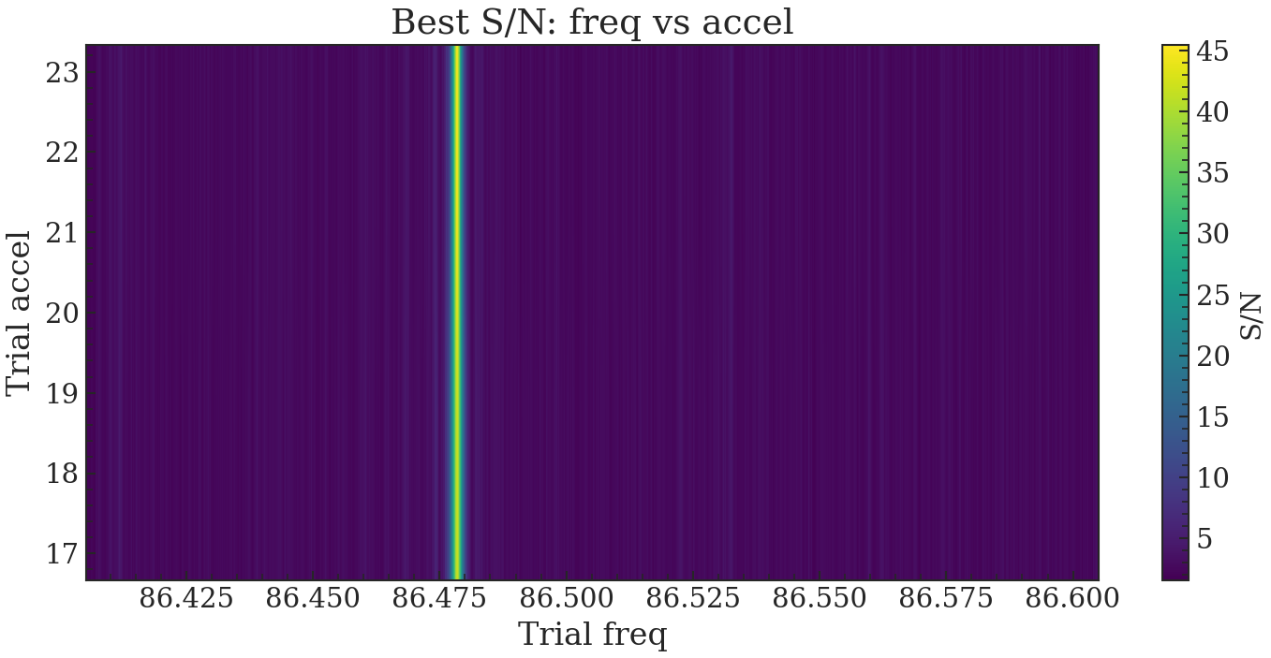
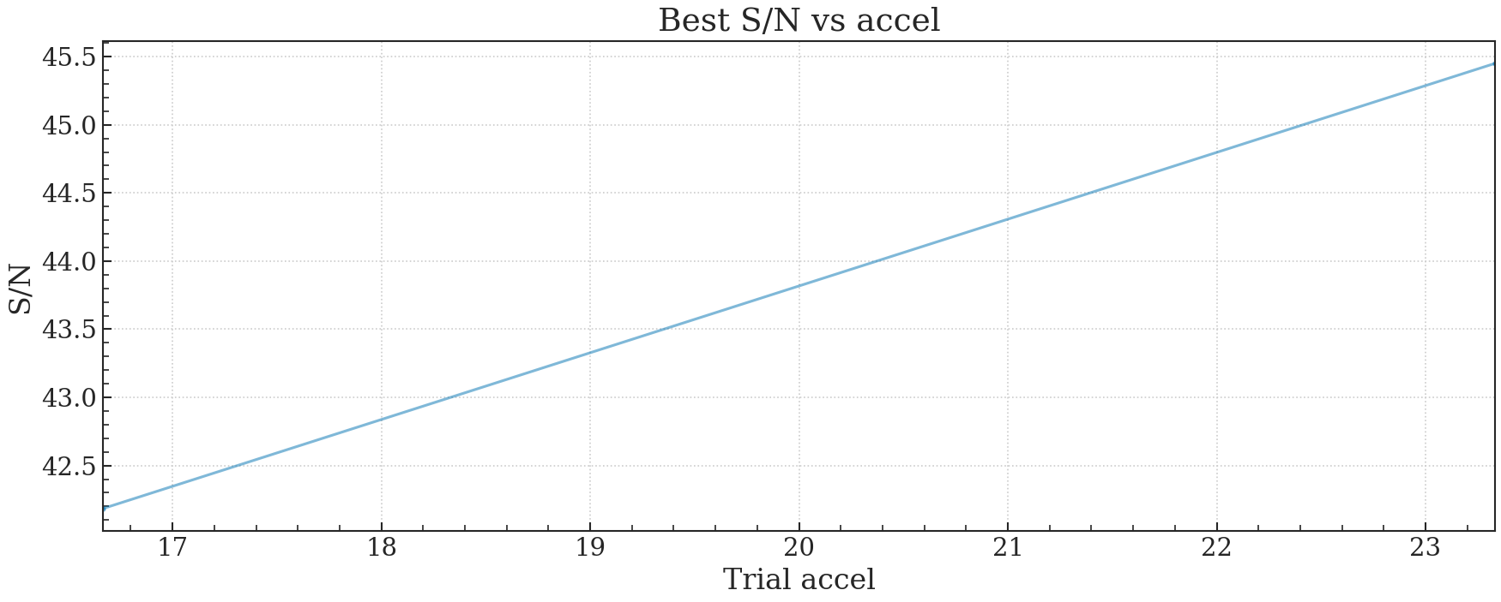
FFA of Ter5A with 320sec:
FFA requires substantial computational resources and is not well-suited for acceleration searches, as it cannot adopt a fine grid in the acceleration space. It can reflect that Ter5D is a single pulsar with an acceleration of 0.

Slide 14
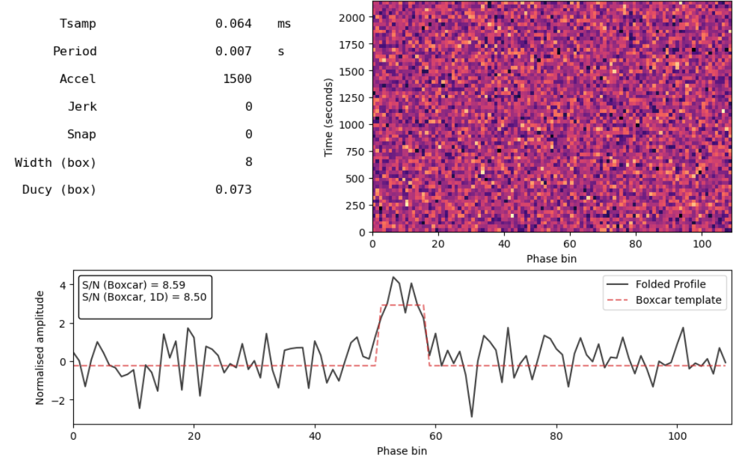
Pruning test:
simulation signal form developer

Slide 15
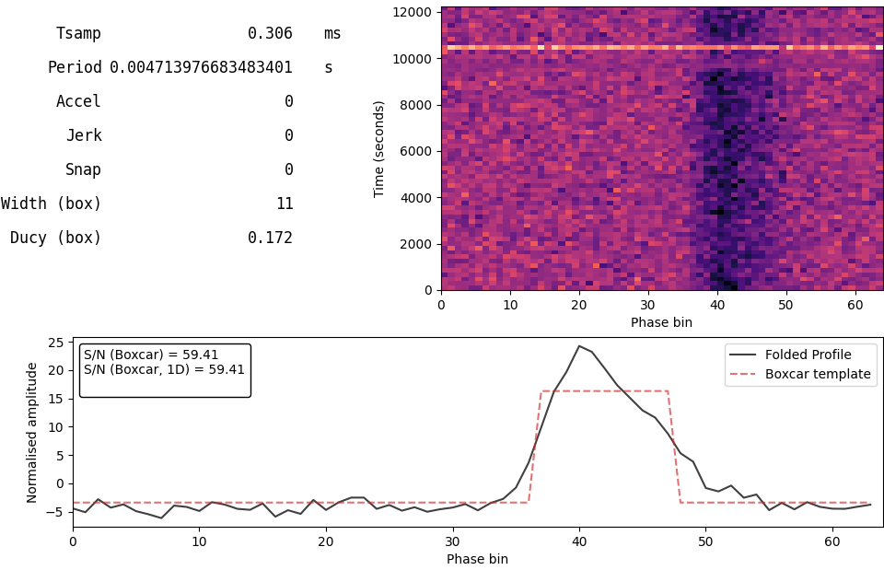
Pruning test:
Ter5D

