Slide 1
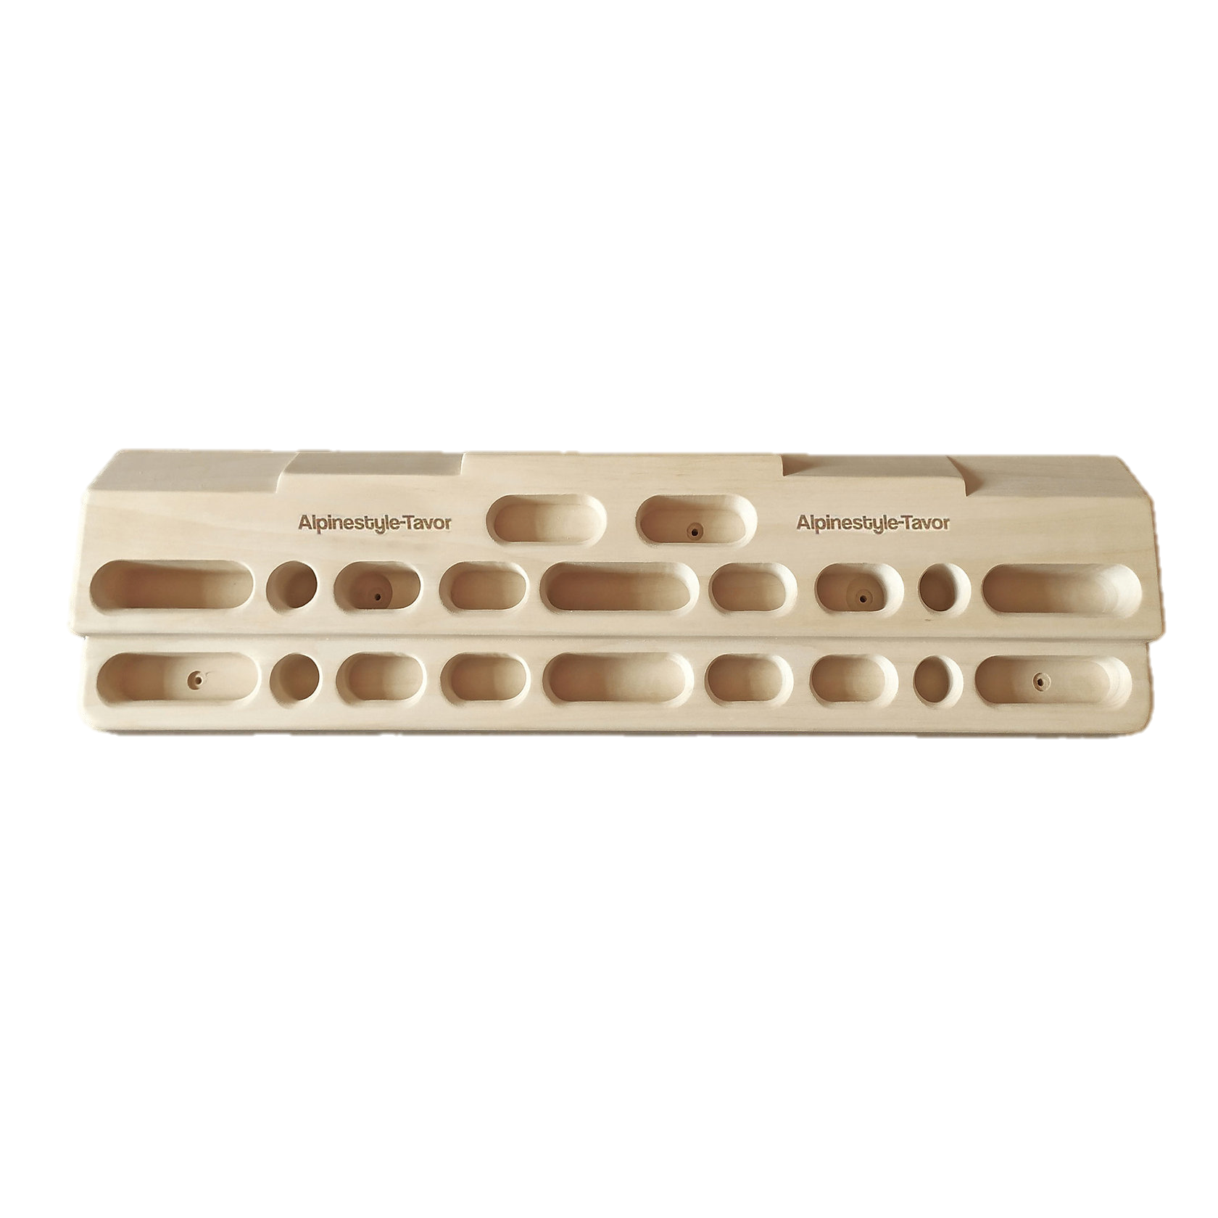
Sign out
Home
My Climbs
Easy
Medium
Hard
2:26
Stop Climbing

Slide 2
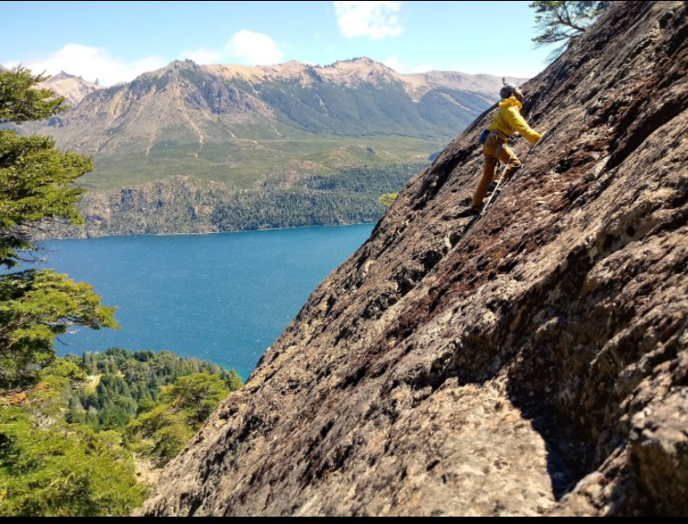

Log in
About
My Climbs
Lets Go
Sign up
Welcome! Registration Page
Email*
Password
Name
About us:
Last Name
Max Climbing Grade
Short Description… More Info…
Type of max Strength Holds
Submit

Slide 3

Sign out
Home
Lets Go
When | Duration | Level
18/08/2022 | 3:56 | Easy
19/08/2022 | 1:21 | Medium
20/08/2022 | 2:43 | Easy
21/08/2022 | 0:54 | Hard
22/08/2022 | 0:50 | Hard
23/08/2022 | 1:23 | Medium
24/08/2022 | 2:38 | Medium
25/08/2022 | 0:35 | Hard
26/08/2022 | 0:48 | Hard
27/08/2022 | 2:50 | Easy
28/08/2022 | 1:43 | Easy
29/08/2022 | 1:55 | Easy
30/08/2022 | 1:11 | Medium
31/08/2022 | 2:45 | Easy
Filters
From
To
Easy
Medium
Hard

Slide 4
Change Page
In-Page Reaction
Database Interaction

