Slide 1
Box Office Intelligence:
Exploratory Data Analysis for a New Movie Studio
Data Sources:
Box Office Mojo
The Numbers
TMDB
Rotten Tomatoes
2010–2018 | 3,359 Films | 5 Datasets
Presented by Group 1 · Data Science Cohort · Moringa School
Chelimo Ivy
Shadrack Symekah
Richard Oketch
Orandi Felix

Slide 2
What We'll Cover Today
01
Business Understanding
02
Data & Methodology
Why we're entering the film industry and what success looks like
What data we analyzed and how we cleaned & interpreted it
03
Genre Revenue Analysis
04
Budget & Profitability
Which genres generate the highest box office returns
How budget size relates to profit rates and ROI
05
Critical Reception Impact
06
Recommendations & Next Steps
Does a good Rotten Tomatoes score drive box office revenue?
Three actionable strategies for our studio launch

Slide 3
Business Understanding
Setting the stage — why movies, why now?
The global box office averaged ~$28B per year from 2010–2018,
with over 400 films released annually.
The Opportunity
The Challenge
Our Goal
Tech companies are investing billions in content
Most films lose money — failure rate is high
Identify genres, budgets & quality thresholds
Streaming has expanded global audience reach
Hit-driven industry with uncertain returns
Build a profitable, sustainable slate strategy
Data now enables smarter greenlight decisions
Require strategic data analysis to compete
Enter with evidence-backed investment decisions

Slide 4
Data Understanding
Where did the data come from, and what does it tell us?
BOM
Box Office Mojo
TN
The Numbers
Studio names, domestic gross, and release year
Production budgets and worldwide gross figures
3,359 films
5,415 films
TMDB
TMDB
RT
Rotten Tomatoes
Genre tags and release metadata for each title
Critic scores (Fresh %) and total review counts
Genre data
Scores + reviews
Data Preparation: All datasets were cleaned to remove missing values, normalize currency figures, and merged on shared film titles. Analysis covers theatrical films released 2010–2018.

Slide 5
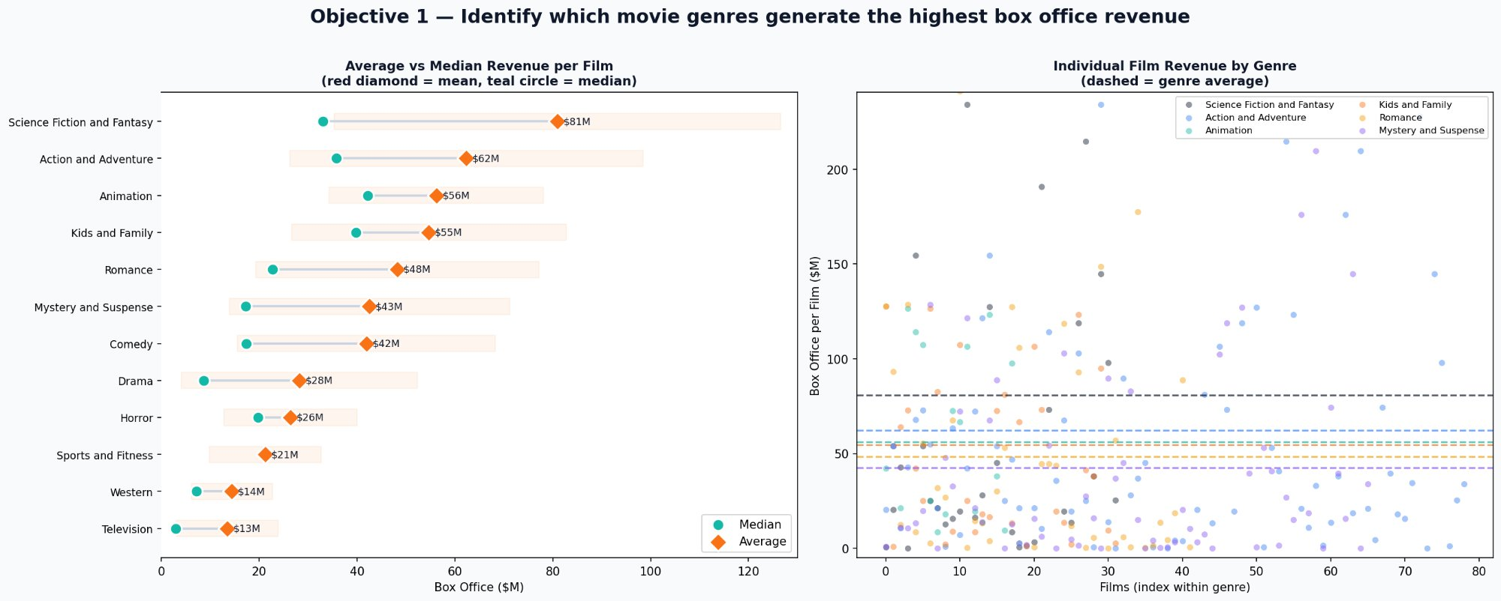
Analysis 1 — Genre Revenue
Which genres consistently earn the most at the box office?
Sci-Fi & Fantasy
$81M avg
#1 earning genre
Action & Adventure
$62M avg
#2 earning genre
Animation
$56M avg
#3 earning genre

Slide 6
Finding 1 — Genre Revenue
What the data tells us about genre performance
Sci-Fi & Fantasy leads at $80.9M avg — a few mega-hits pull the mean up, but the median is also strong.
Action & Adventure offers the best volume + performance balance: 366 films at $62.3M avg.
Animation has only 47 films but is the most consistent — almost no animated wide releases failed.
Comedy & Drama dominate total volume but earn only $41.9M and $28.3M avg — inefficient for a new studio.
Horror earns just $26.4M avg but has exceptional ROI potential at micro-budgets ($1–5M).

Slide 7
Key Insight — Genre Strategy
Strategic implication of the genre analysis
Genre choice significantly influences revenue potential, but the optimal strategy depends on balancing earning power, consistency, and scalability.
High earnings
Consistency
Sci-Fi, Fantasy & Action deliver the highest avg revenue per film
Animation has the lowest failure rate — nearly every wide release succeeds
Caution
Niche play
Comedy & Drama require high volume to generate impact — too risky to lead with
Horror at micro-budgets ($1–5M) offers strong ROI for cash-flow diversification

Slide 8
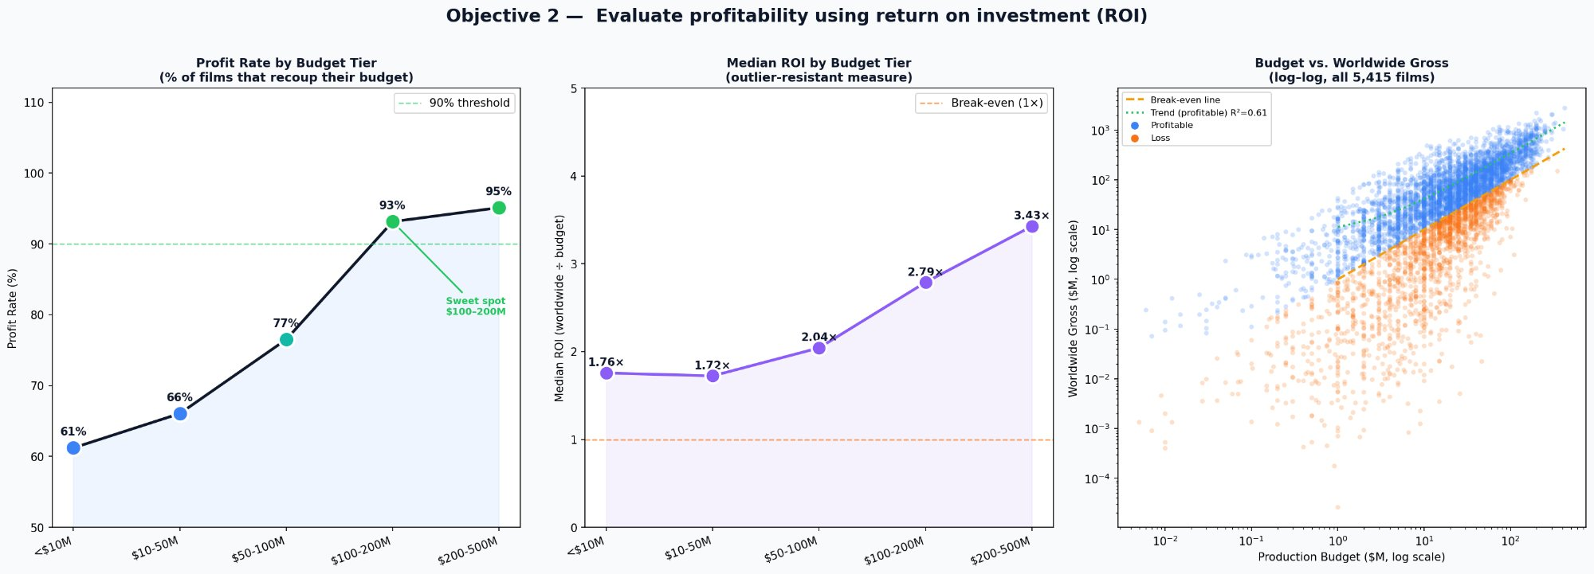
Analysis 2 — Budget & ROI
How does production budget affect profitability and return on investment?
Sweet Spot Budget
$100–200M
93% profit rate
Median ROI at that tier
2.79×
Return on investment
Large budgets ($200M+)
3.43×
ROI — 95% profit rate

Slide 9
Finding 2 — Budget & ROI
How production budget size relates to profitability
$100M–$200M tier achieves a 93.1% profit rate — 93 of every 100 films recoup their budget.
Median ROI of 2.79× means a $150M film earns ~$418M worldwide at the median.
Micro & low tiers (<$50M) have only 61–66% profit rates — cheap films carry more risk than assumed.
High tier ($200M+) has the best stats (95.1%, 3.43× ROI) but requires established infrastructure.
Log-log scatter shows a clear pattern: bigger budgets cluster near break-even; small budgets widely dispersed below.

Slide 10
Key Insight — Budget Strategy
Strategic implication of the budget & ROI analysis
The optimal strategy is not to minimize cost or maximize scale — there is a 'sweet spot' in the $100M–$200M range where profitability and risk are best balanced.
< $50M
$100M–$200M
$200M+
Profit Rate
Profit Rate
Profit Rate
61–66%
93.1%
95.1%
Median ROI
Median ROI
Median ROI
1.72–1.76×
2.79×
3.43×
High variability
Avoid as lead tier
Sweet spot
Start here
Best returns
Scale into later

Slide 11
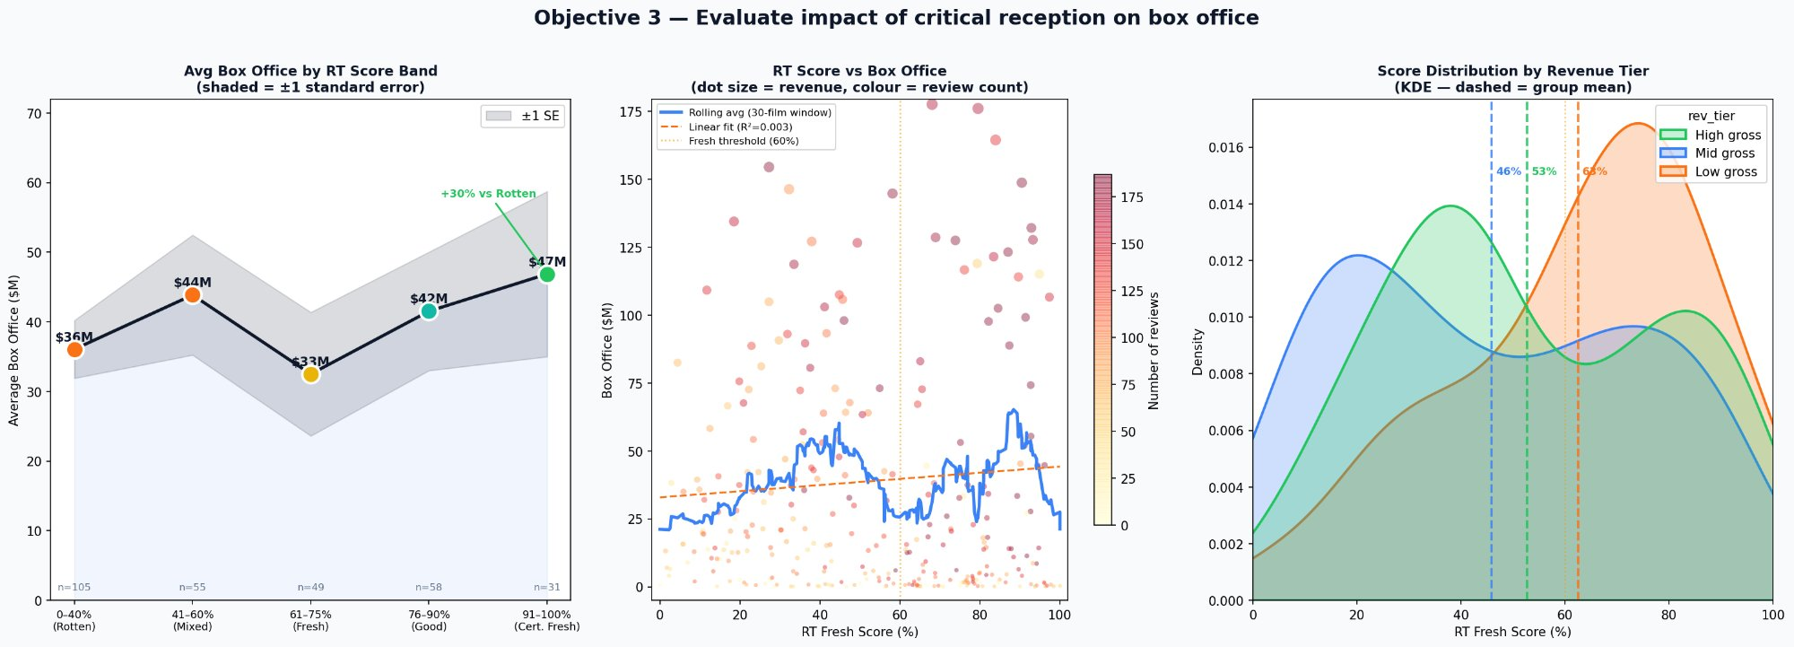
Analysis 3 — Critical Reception
Does a good Rotten Tomatoes score actually drive more box office revenue?
Certified Fresh vs Rotten
+30%
Revenue premium
Cert. Fresh avg gross
$47M
vs $36M for Rotten films
High-gross films median RT
63%
Fresh Score average

Slide 12
Finding 3 — Critical Reception
How Rotten Tomatoes scores relate to box office revenue
Certified Fresh (91–100%) earns $46.9M avg — approximately +30% more than Rotten films ($36.1M).
Not perfectly linear — the 61–75% Fresh band underperforms due to limited-release prestige films with small theatrical footprints.
KDE chart shows high-grossing films cluster at higher RT scores; low-grossing films concentrate at lower ranges.
Low R² — blockbuster franchise films earn huge grosses regardless of reviews, but for most films quality matters.
Implication: invest in script development, experienced directors & post-production. Don't cut quality to hit a release date.

Slide 13
Key Insight — Quality Strategy
Strategic implication of the critical reception analysis
Critical reception is a meaningful but not dominant driver of success. Treat quality as a competitive advantage — not a guarantee.
Hire for quality
Invest in scripts
Directors with strong critical track records for the first 3 films
Budget $2M–$5M for script development before greenlighting production
Distribution matters
Delay over cut
Good scores don't help if the film has a limited release — align scale with quality
Release date flexibility is a competitive advantage — delay rather than compromise quality

Slide 14
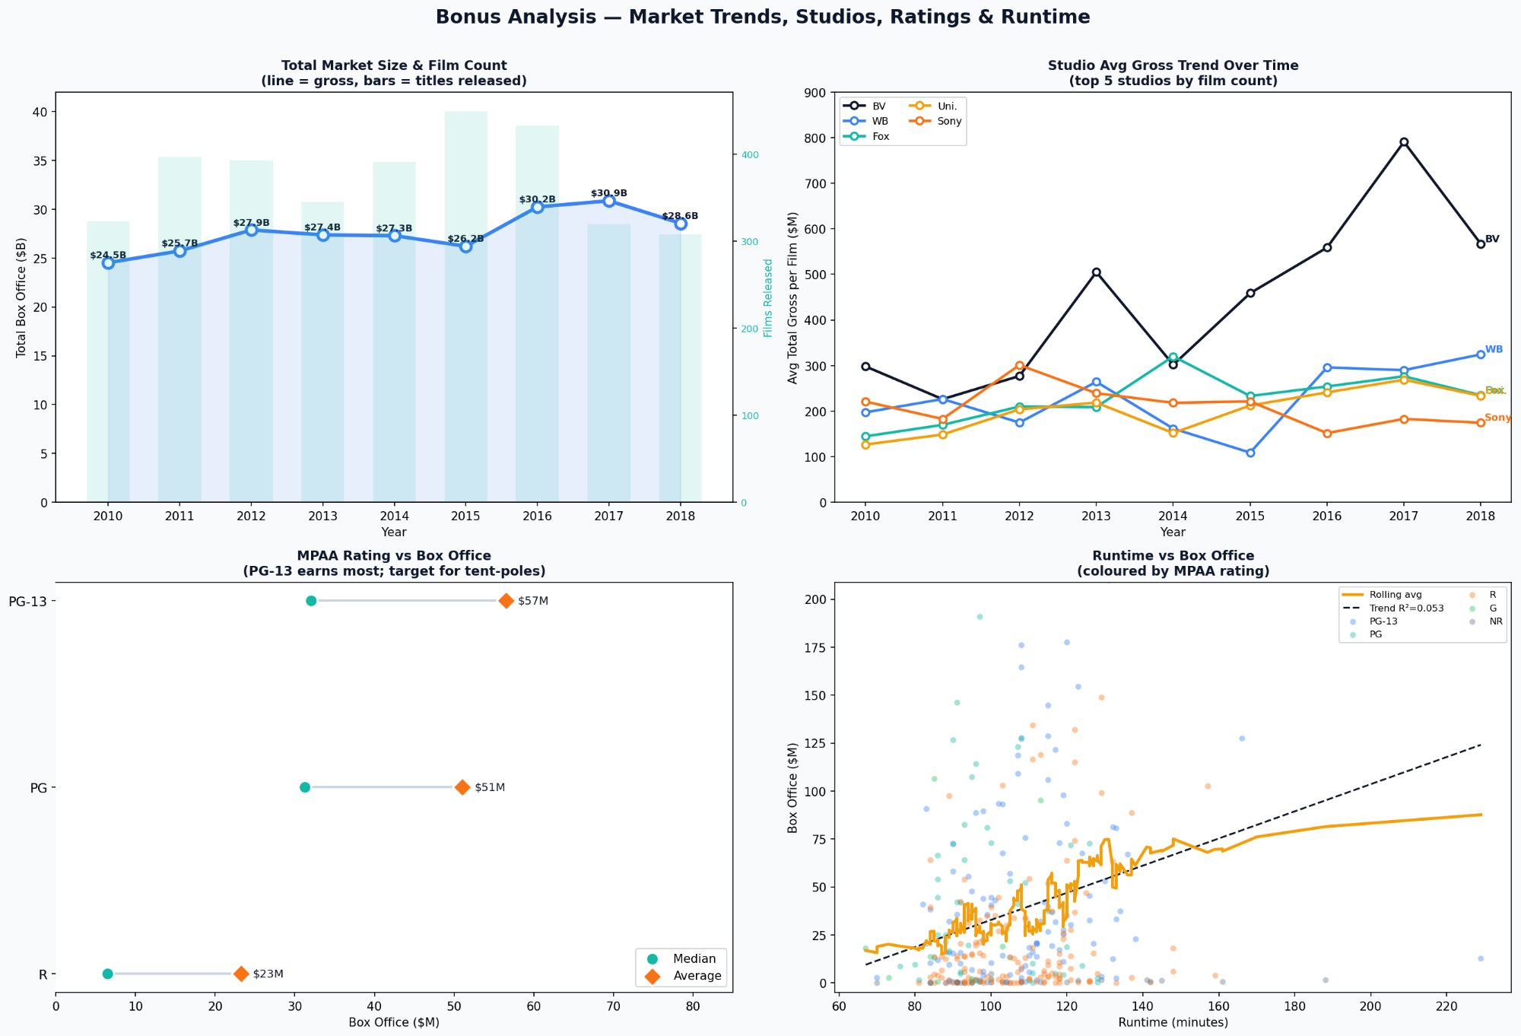
Bonus Analysis — Market Context
Market size trends, studio performance, MPAA ratings, and runtime insights

Slide 15
Our Three Recommendations
Evidence-backed strategies for a successful studio launch
Lead with Sci-Fi, Action & Animation
1
Sci-Fi & Fantasy averages $81M per film — 60% more than Drama. Action & Animation follow at $62M and $56M. These genres dominate worldwide gross and attract the broadest audiences. → Prioritize these three genres in your initial development slate.
Budget $100M–$200M per Tent-Pole
2
Films in the $100–200M budget tier achieve a 93% profit rate — meaning 9 in 10 films recoup their budget — with a median ROI of 2.79×. Larger budgets show higher ROI but require more capital at risk. → Start in this tier and scale as the studio matures.
Invest in Quality — Target Certified Fresh
3
Films scoring above 60% on Rotten Tomatoes earn 30% more revenue than 'Rotten' films. Certified Fresh titles (91–100%) average $47M vs $36M — a clear, measurable premium. → Set a quality threshold: only greenlight projects with a clear path to 60%+ RT.

Slide 16
Detailed Recommendations
Specific actions for each strategic recommendation
Lead with Sci-Fi, Action & Animation
1
Rating target:
PG-13 for max audience breadth ($56.5M avg vs $23.2M for R-rated)
Genres to avoid:
Drama ($28.3M avg), Documentary — too low-margin for a new studio
Secondary play:
Horror micro-budget ($1–5M) for slate diversification & cash flow
Budget $100M–$200M per Tent-Pole
2
Expected returns:
2.79× median ROI = $279M–$558M worldwide on a $100–200M film
Micro-budget option:
$1M–$10M horror films for slate diversification & cash flow
Tier to avoid:
$10M–$50M range: 66% profit rate — worst risk-adjusted tier
Invest in Quality — Target Certified Fresh
3
Hire strategy:
Directors with strong critical track records for first 3 films
Script investment:
Budget $2M–$5M for development before production greenlight
Release policy:
Delay release rather than cut quality — flexibility is a competitive advantage

Slide 17
Final Summary
All objectives, findings and recommendations at a glance
Objective
Key Finding
Statistic
Recommendation
Genre Revenue
Sci-Fi/Fantasy & Action dominate per-film earnings
$80.9M & $62.3M
Lead with Sci-Fi, Action, Animation
Budget vs ROI
$100–200M tier has the best risk-adjusted profit rate
93.1% profit rate
Target $100M–$200M per tent-pole
Critical Quality
Certified Fresh films earn 30% more than Rotten
+$10.8M premium
Invest in quality — Certified Fresh
Market Trend
Market grew 26%; fewer but bigger films each year
$24.5B → $30.9B
Release 2–3 large films per year
Studio Benchmark
Disney earns 2× nearest rival per film
$417M vs $230M
Model: owned IP, family, quality
MPAA Rating
PG-13 earns the most; R-rated significantly lower
$56.5M vs $23.2M
Target PG-13 for all tent-poles

Slide 18
Limitations & Data Notes
Important caveats to consider when interpreting the findings
Nominal figures
⚠
All revenue and budget figures are nominal — not adjusted for inflation. Films from 2010 and 2018 are compared in the same dollar terms despite ~18% cumulative inflation over the period.
Small RT sample
⚠
The critical reception analysis is based on only 299 matched films — directional and meaningful, but not conclusive at the genre or studio level.
No P&A costs included
⚠
Production budgets from The Numbers do not include Prints & Advertising (marketing) spend, which typically equals 50–100% of the production budget. True profitability is lower than the ROI figures suggest.
Genre classification
⚠
Genre labels differ between datasets: Rotten Tomatoes uses text tags; TMDB uses numeric IDs. Both are used independently, which may lead to inconsistencies across analyses.

Slide 19
Next Steps
Phase 1
Phase 2
Phase 3
Months 1–3
Months 4–9
Months 10+
Development Slate
Budget & Partnerships
Production & Marketing
Commission 3–5 scripts in Sci-Fi, Action & Animation
Secure financing for $100–200M tent-pole productions
Begin production on first approved slate film
Engage top-tier writers and directors
Identify studio co-production partners
Build marketing strategy targeting PG/PG-13 audience
Establish quality review with RT score benchmarks
Set up production infrastructure and legal entities
Monitor competitive landscape and adjust slate

Slide 20
Thank You
Questions & Discussion
Presented by Group 1
Chelimo Ivy · Shadrack Symekah
Richard Oketch · Orandi Felix
Data Science Cohort — Moringa School
Data: Box Office Mojo · The Numbers · TMDB · Rotten Tomatoes | 2010–2018 Theatrical | Figures nominal

