Slide 1
Abbott Vascular Digital and Analytics Application

Slide 2
HCL’s understanding of the Vascular Digital and Analytics Application
As part of Digital health initiative to build a Scalable Digital infrastructure and host the vascular data from the providers to enable development and roll out of digital and analytics applications.
Data Sources
From Cathlabs using the IoT based ingestion that will contain the following:
Case Information/Repository (Patient details, demographics, medical history, co-morbodities, Images etc.)
Information from the Powerapp applications that contain the clinical procedures followed for the patient. This is obtained using the Data verse integration available
Additional data that needs to be acquired and used for analytics include
Data from the SFDC and marketing tool used by the sales/marketing teams
Mobile application that is being in trial now to obtain the post procedure data to track patient’s recovery
Provide information on :
Architecture and Solution visualization for the platform (similar to EP cloud and Merlin.Net programs)
Data Aggregator and Data Catalog design thoughts for Data Scientists and Domain experts to build solutions.
Handle around 2500 patients with larger dataset from the marketing tools.
Resources required to build the solution, data engineers etc., to build the platform
Proposal encompassing the solution, resources and the business model for engagement

Slide 3








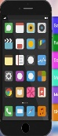

Solution Overview
SFDC and marketing tool
Other Abbott Applications
Provider Applications
Dataverse (PowerApps)
Authentication &
Authorization
Vascular
Applications
IOT Hub
Case Information Repository
DB
Surgeons
Data Catalog
Module
Multitenant
Data Aggregator/ Workflow/Rule Engine
Analytics Service
API Gateway
Audit / Logging
Module
Mobile App
Data Scientists
Vascular Digital and Analytics Platform
Hospital / Clinical / Patient Data Providers
Platform Users
Handle < 2500 patients, ~100K Prospects

Slide 4
Component Flow

Slide 5



Engagement Model – Option 1 (Abbott managed T&M)
Abbott
HCL
Program Manager
HCL Project manager
HCL Onsite
HCL Offshore
Abbott SMEs
HCL Onsite engineers
HCL Offshore team
Program management will be owned by Abbott
Work assignation designed and decided by Abbott program manager
HCL will deploy the skilled resources based on the program need
HCL team members will participate in Abbott SCRUM process and deliver as per the project plan formulated by Abbott PM

Slide 6
Option #1 Commercials – Rate card
Sl.No | Role | Skill | No.Of . Persons | Exp. | Rate Card
1 | Azure Solution Architect | Azure IAAS solution development | 1 | 15+ Years | $40.00
2 | Technical Co-ordinator (Onsite) | Bridge the Offshore and Onsite teams and getting requirements clarity from Product owners. Technical Skills : C# and .Net | 1 | 15 + Years | $120.00
3 | Technical Lead | Core Azure Services, C#, .Net (Backend) | 1 | 10+ Years | $29.00
4 | Technical Lead | IOT Hub, Application API integration, C# and .Net (Backend) | 1 | 10+ Years | $29.00
5 | Software Developer | C#, .Net | 3 | 6+ Years | $27.00
6 | UI Lead | Angular/React experience , CSS, HTML | 1 | 10+ Years | $29.00
7 | UX Lead | User Experience | 1 | 10+ Years | $29.00
8 | UI Developers | Angular/React experience , CSS, HTML | 2 | 6+ Years | $27.00
9 | Test Lead | Testing | 1 | 12 + Years | $29.00
10 | Test Team | Manual Testers | 3 | 6+ Years | $24.00
11 | Test Team | Automation | 3 | 6+ Years | $24.00
12 | DevOps Lead | Azure DevOps | 1 | 10+ Years | $29.00
13 | DevOps Engineer | Azure DevOps | 1 | 6+ Years | $27.00
14 | Data Engineer | Big Data Experience | 1 | 6+ Years | $29.00
15 | Cloud Infra Architect | Azure cloud Infra Architect | 1 | 10+ Years | $40.00
16 | Engineering/Project Manager |  | 1 | 12+ Years | $31.00
17 | Business Analyst/SCRUM Master |  | 1 | 10+ Years | $29.00
18 | Technical Writer |  | 1 | 10+ Years | $27.00
19 | Data Scientist * | AI / ML | 1 | 10+ Years | $140.00
 |  |  | Infrastruture cost

Slide 7
Engagement Model – Option 2 (HCL managed T&M)
Abbott
HCL
Program Manager
HCL Project manager
HCL Onsite
HCL Offshore
HCL Onsite engineers
HCL Offshore team
Abbott SME team
Program management will be owned by HCL
Work assignation designed and decided by HCL program manager
HCL will deploy all the skilled resources required for this program
HCL will drive SCRUM meetings along with Abbott SMEs and deliver as per the project plan
HCL – team

Slide 8
Key Architectural and Technical Considerations
Batch Processing with Incremental data fetch
Data Perimeter Security Policies
Horizontal Scaling as per Surge
Ease of Operations
SFDC and marketing tool
Other Abbott Applications
Meta-Data driven data discovery
Data API and visualization interface
Enforcement of Data Access Policy
Data Security During transit and
Storage
Provider Applications
Dataverse (PowerApps)
Realtime Processing
Async / Non-Blocking Processing
Authentication &
Authorization
Vascular
Applications
IOT Hub
Case Information Repository
Surgeons
Secure – Third party integration with A&A
2. Provide the separate topic to push / Notify
for the new data
DB
Data Catalog
Module
Multitenant
Data Aggregator/ Workflow/Rule Engine
Analytics Service
API Gateway
Audit / Logging
Module
Mobile App
Data Scientists
Vascular Digital and Analytics Platform
Rule based data aggregation.
Workflow/Orchestration based data filtering – transformation – fulfilment
Schema driven Data Validation
Backpressure handling for the incoming messages
Scalable - Horizontally w.r.t Storage and Processing.
Multi-tenant – Logical separation of data across providers.
To handle mutli data models(SQL, NoSQL, Timeseries etc.)
Multi – Dimensional data storage
Hospital / Clinical / Patient Data Providers
Platform Users
Handle < 2500 patients, ~100K Prospects

Slide 9
CARE Vs Azure native for Product Development
Sl. No | CARE | Azure Native
Sl. No | CARE | Azure Native
1 | Have predefined Entity management, User management, Device Management features which can be readily usable | Need to write customized .NET code to implement Entity management, User management, Device management features
2 | Entity relationship among various entities were already defined and owned by CARE team | We must define the ER relationship for each entity
3 | CARE features are available as service api’s and can be dockerized and used in any cloud environment | Azure native code relies of Azure native libraries and works only in Azure environment and can’t be ported to any other cloud environment.
4 | Wait time to use CARE service is nil | We have wait for the service to be built and available for project team to use
5 | CARE relies on third party services like Microsoft communication service or SendGrid for MFA token deliver to end user mobile/email | Azure has its own services that can be used to deliver MFA token to end user mobile/email
6 | CARE can be customized to any feasible extent based on user requirements | Azure native relies on native libraries to implement so we have limited scope for customization

Slide 10
Functional Assumptions and Dependencies
Assumptions | Dependencies
Dataverse will be used for obtaining procedure details performed on the patient. It is understood that this data is originating in the provider as PowerApps data and is made available via Dataverse | Dataverse schema definition and interface details need to provided.
Patient EMR related information will be available Case Information Repository. This information will be exposed through IOT Hub | IOT Hub integration details and schema details will be provided.
Post procedure data to track patient’s recovery will be provided from Mobile App Data source through API Gateway | API Gateway details and schema definition will be made available
SFDC and marketing tool data will be used by the sales/marketing teams | SFDC and marketing tool integration details and data schema details need to be shared.
It is understood that in future the data may come from Other Abbott applications and system should be provisioned to handle the data. | Needs to work with Abbott for future other Abbott applications data collection.
Data Aggregation will be driven by Workflow and Rule Engine definitions. | Workflow and Rule Engine definitions need to be agreed and finalized.

Slide 11
Functional Assumptions and Dependencies
Assumptions | Dependencies
It is understood that the aggregated data will be stored Multi tenant data base. | The DB schema and definition should be finalized.
Data catalog will be used to provide the details about the data reside in multi tenant data base. This information will be utilized to south bound applications like Vascular and Analytics Applications | Catalog definition and tool needs to be finalized.
It is assumed to build one Vascular application and one Analytics (AI) application from the aggregated data stored in the Multi tenant database. | Work with Abbott and finalize the sample vascular application and Analytics applcation.

Slide 12
Program Timeline
MVP #1 – Aug’21
Base platform setup
MVP #2 – Oct’21
Data aggregation
MVP#3 – Jan’22
Vascular apps development
Catalog initial view
Data sources connectivity and ingestion
Catalog and Data API
Rule Engine
Analytical services development
Demo - One Vascular application & one AI Model
Demo - Catalog final view
Demo - Data ingestions and Catalog Initial View
Data Structure Definition for Solution

Slide 13

Detailed Program Timeline
Abbott
Legend
SMEs -3
SMEs -3
SMEs -3
Abbott
IOT Hub Design understanding and Review
Data verse design understanding and Review
Requirements
Definition
HCL
Rule Engines definitions
MVP1 Milestone Demo
8/27/2021
Catalogue Definition
Data structure for the application
Integrations
Review
……. Cont.….
Jun
Jul
Aug
Sep
Mobile app data acquisition plan
IOT Hub Setup in AKS
Catalog requirements
CARE Setup in AKS
IOT Hub Integration
Base Platform setup initiation
Use case identification and planning
Catalog Design
Data verse configuration
HCL
Onsite -2
Offshore -5
Onsite -2
Offshore -16
Onsite -2
Offshore -16
Team ramp up
MVP 1
…….Cont.
MVP 2

Slide 14
Detailed Program Timeline – contd…
Abbott
Legend
SMEs -3
SMEs -3
SMEs -3
Abbott
Rule engine
Tool finalization
Catalog finalization
Data Aggregator Design Review
HCL
SFDC and marketing Tool Design understanding and review
MVP2 Milestone Demo
15/10/2021
One Analytics Application Requirements
…….Cont.
Sep
Oct
Nov
SFDC toll data integration design
Rule Engine Implementation
Data Aggregator
Implementation
One Analytics Application Requirements
Design Analytics Application
Data Aggregator Design
Rule Engine Design
Catalog Final View implementation
HCL
Onsite -2
Offshore -22
Onsite -2
Offshore -18
Onsite -2
Offshore -19
…….Cont.
Team ramp up
MVP2
MVP3

Slide 15
Detailed Program Timeline – cont.…
Abbott
Legend
SMEs -3
Abbott
Vascular Application UI Wireframe
HCL
MVP3 Milestone Demo
01/28/2022
Data for the AI Model
AI Model requirements
Dec
Jan
Production
Model Training Complete
AI Model Design
Analytics – One AI Model Requirements
Vascular Application development Complete
Model Testing / Development Complete
HCL
Onsite -2
Offshore -19
Onsite -2
Offshore -19
MVP3

Slide 16
MVP Features and Dependencies
Phase | Feature/functionality | Dependency | Complexity level
MVP1 | Dataverse Integration | Data Structure definition and types | High
MVP1 | IOT Hub Integration | Data Structure definition | High
MVP1 | Mobile App Data Collection | Availability of standard interface to acquire data | Low
MVP2 | Rule engine implementation | Rules definitions | High
MVP2 | Catalog Implementation | Catalog definition | Medium
MVP2 | Data aggregator Implementation | Rules definitions | High
MVP3 | Vascular apps Implementation | Details around Vascular Apps and Review | Medium - High
MVP3 | Analytics Sample Application | Identify Sample AI Model/application | Medium - High

Slide 17
Commercials – Indicative Costing
Sl.No | Role | Onsite/Offshore | RateCard | Jun-21 | Jul-21 | Aug-21 | Sep-21 | Oct-21 | Nov-21 | Dec-21 | Jan-22 | Total | Price
1 | Solution Architect | Onsite | $120.00 | 1 | 1 | 1 | 1 | 1 | 1 | 1 | 1 | 8 | $153,600.00
2 | Technical Co-ordinator (Onsite) | Onsite | $120.00 | 1 | 1 | 1 | 1 | 1 | 1 | 1 | 1 | 8 | $153,600.00
3 | Business Analyst/SCRUM Master | Offshore | $29.00 | 1 | 1 | 1 | 1 | 1 | 1 | 1 | 1 | 8 | $37,120.00
4 | Dotnet SME | Offshore | $29.00 | 1 | 2 | 2 | 2 | 1 | 1 | 1 | 1 | 11 | $51,040.00
5 | CARE SME | Offshore | $29.00 | 1 | 1 | 1 | 1 | 0 | 0 | 0 | 0 | 4 | $18,560.00
6 | Devops | Offshore | $29.00 | 1 | 2 | 2 | 2 | 2 | 2 | 2 | 2 | 15 | $69,600.00
7 | .Net Senior Dev | Offshore | $29.00 | 0 | 2 | 2 | 2 | 2 | 2 | 2 | 2 | 14 | $64,960.00
8 | .Net Junior Dev | Offshore | $27.00 | 0 | 2 | 2 | 2 | 2 | 2 | 2 | 2 | 14 | $60,480.00
9 | Angular Dev | Offshore | $29.00 | 0 | 2 | 2 | 2 | 2 | 2 | 2 | 2 | 14 | $64,960.00
10 | Test Lead | Offshore | $27.00 | 0 | 1 | 1 | 1 | 1 | 1 | 1 | 1 | 7 | $30,240.00
11 | Manual Testers | Offshore | $24.00 | 0 | 0 | 0 | 2 | 2 | 2 | 2 | 2 | 10 | $38,400.00
12 | Tes Automation Engineers | Offshore | $24.00 | 0 | 0 | 0 | 2 | 2 | 2 | 2 | 2 | 10 | $38,400.00
13 | Data Sciense Analyst | Offshore | $29.00 | 0 | 0 | 0 | 1 | 1 | 1 | 1 | 1 | 5 | $23,200.00
14 | DB Engineer | Offshore | $29.00 | 0 | 0 | 0 | 1 | 1 | 1 | 1 | 1 | 5 | $23,200.00
15 | Cloud Infra Architect | Offshore | $29.00 | 0 | 1 | 1 | 1 | 0 | 0 | 0 | 0 | 3 | $13,920.00
16 | Enginering Manager/Project Manager | Offshore | $31.00 | 0 | 1 | 1 | 1 | 1 | 1 | 1 | 1 | 7 | $34,720.00
21 | Technical Writer | Offshore | $27.00 | 1 | 1 | 1 | 1 | 1 | 1 | 1 | 1 | 8 | $34,560.00
 |  |  |  | 7 | 18 | 18 | 24 | 21 | 21 | 21 | 21 |  | $910,560.00
Note: This is only indicative cost structure based on the requirement assumptions. Accurate estimate will be derived once the requirements are thoroughly hashed out with Abbott SMEs as part of MVP1 phase.

Slide 19
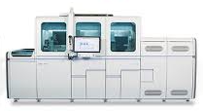

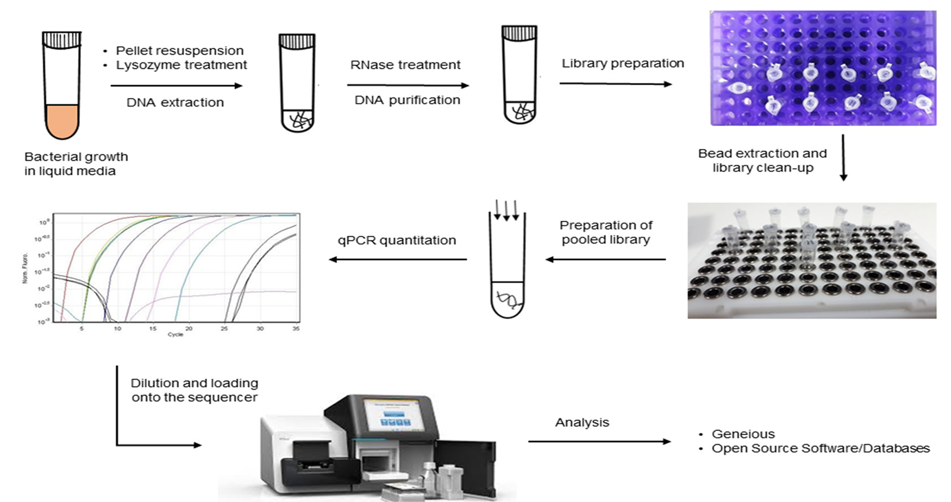


Industry View – Monetizing Lab Data
SERVICE INTELLIGENCE
PROCESS INTELLIGENCE
EFFICIENT WORKFLOW
DATA CORE
CLINICAL INTERVENTION
1
2
3
4
5
Digital Enablement
Dynamic Assay
Workflow Management
AI Enablement
Clinical Decision Support
Data Management Solution –Segregating Data Processing from Instrument Management
Decouple Calculations and Assay development from device – Deliver Assays OTA
Track the Sample and Data over the entire Sequencing flow to increase efficiency of lab processes
Remote Information Systems Platform for Bio-information Research and AI
Laboratory Test data based clinical intelligence
Remote Servicing
5M per upgrade saving
Maximize Return on R&D
Increase Operational Efficiency
Integrate Internal-External Data Ontologies
> 700 Million USD in Revenue

Slide 20

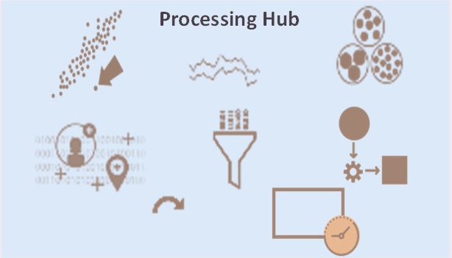

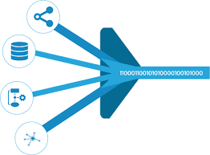


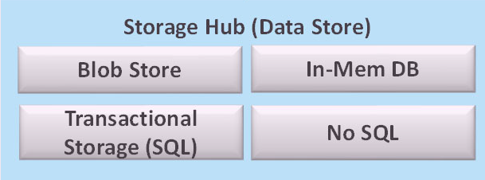

Data As A Service based Rapid Collaboration Platform
Build and Operate a cloud based Data Ontology platform for collaborative bio-informatics research
Cloud Digital Platform
Micro Services
APIS
Short Term HUB
Data Enrichment Hub
Secure Compute Platform
Integration
Hub
VISUALIZATION
Collaborators Device & Software Systems
> 1TB GENOME DATA RIVER
HPC
Catalog
Data Lake [ePHI & non-ePHI]
AI/ML/DL PIPELINE
HETEROGENOUS CONNECTIVITY
Bio-informatics Pipelines
Data Visibility & Access
Analytics
Data Lineage – Guaranteed Data Management Governance Integrity & Traceability
Guaranteed Data Veracity
Multi Tenancy
Security
Data Catalog
Data Privacy
High Volume
Data Leniency
Data Archiving

