Slide 1
Titanic Passenger Survival
Micro-Project 3 (Micro-Projects 1 to 3) https://github.com/OrangeJoe0421/ANA-500-MP3
Travis James
October 4, 2026

Slide 2
Problem Statement
Survival on the Titanic was not random. Using the passenger manifest, this project examines which passenger characteristics were associated with survival, whether those associations hold when the characteristics are considered together, and how accurately survival can be predicted from them.
Characteristics considered: sex, ticket class, age, family size, fare, and port of embarkation.
Scope by micro-project:
  Micro-Project 1: acquire and prepare the data (NumPy, Pandas).
  Micro-Project 2: visual analysis and reporting (Matplotlib, Seaborn).
  Micro-Project 3: modeling and action (logistic regression, SVM, linear regression, SVR).

Slide 3
Hypothesis Formulation
Hypothesis: women and passengers in higher ticket classes survived at higher rates than men and passengers in lower ticket classes.
One variable at a time (Micro-Project 2):
  H1: women survived at a higher rate than men.
  H2: survival rate falls from first to third class.
  H3: women out-survived men inside every class.
Evaluated together (Micro-Project 3):
  H4: sex remains associated with survival after adjusting for class, age, family size, and port.
  H5: class remains associated after the same adjustment.
  H6: the difference between women and men is not the same in every class.
  H7: models predict survival better than always guessing the most common outcome.
  H8 (supporting): fare can be predicted from class, cabin, port, and ticket group size.

Slide 4
Acquire
Source: titanic.csv, loaded with read_csv: 1,309 passengers and 12 columns (PassengerId, Survived, Pclass, Name, Sex, Age, SibSp, Parch, Ticket, Fare, Cabin, Embarked).
Queried: info(), describe(), and value_counts() to inspect data types, ranges, and category counts.
Key finding: Survived is blank for 418 rows (PassengerId 892 to 1309), so only 891 passengers have a known outcome.
Later micro-projects: each one loads the file saved at the end of the previous one (titanic_clean.csv, then titanic_analysis.csv) and confirms it with assertions.

Slide 5
Prepare: Explore
Missing values: Cabin 1,014 (77.5%), Survived 418 (31.9%), Age 263 (20.1%), Embarked 2, Fare 1.
Age gaps are uneven: about 29% of third-class ages are missing versus 3% to 16% in first and second class.
Duplicates: no fully duplicated rows and PassengerId is unique. Two repeated names belong to different passengers (different tickets and ages).
Validity: Pclass, Sex, and Embarked contain only expected values, and no counts are negative.
Suspicious values: 17 fares equal 0 and 12 ages are under 1 (real infants). Fare is strongly right-skewed (skewness 4.37), with 171 values above the IQR upper fence.

Slide 6
Prepare: Clean and Transform
Age (263 missing): filled with the median age of the same ticket class and title, with an AgeWasMissing flag to keep it traceable.
Cabin (77.5% missing): replaced with HasCabin and Deck, and the raw column was dropped.
Embarked, Fare, and zero fares: 2 missing ports filled with the most common port (S), 1 missing fare filled with the median fare of its class, and 17 zero fares kept and flagged.
Survived: converted to nullable Int64 so the 418 unknown outcomes stay blank instead of becoming fake values.
New features: Title, AgeGroup, FamilySize, IsAlone, and FareLog. The np.log1p transform cut Fare skewness from 4.37 to 0.54.

Slide 7
Prepare: Validate and Result
Validation: assertions confirm only Survived has blanks, PassengerId is unique, no rows were lost, and ages, fares, and family sizes are in valid ranges.
Age check: after filling, the mean moved from 29.88 to 29.27 and the median from 28 to 26, so the distribution stayed close to the original.
Result: 1,309 passengers and 20 columns with consistent data types, saved as titanic_clean.csv.
Ready for Step 3: 891 labeled passengers can test the hypothesis, and the 418 holdout rows are set aside.
Notebook and data: https://github.com/OrangeJoe0421/ANA-500-MP1

Slide 8
Prepare: Revisiting the Missing Ports
Feedback: the two passengers with no port share ticket 113572 and cabin B28. Can that support a better fill than the overall mode?
Finding: no one else has that ticket or cabin, so there is no companion whose port can be copied.
Decision: assign Southampton (S) from the ticket series, which is tied to where the ticket was bought. Same value as Micro-Project 1, now backed by passenger-specific evidence and flagged in EmbarkedWasMissing.
Evidence | Points to | Strength
Shared ticket or cabin | None | No other passengers match
Other 113xxx tickets | Southampton | 54 of 64 (84%)
Fare per person ($40) | Cherbourg | Weak: C and S fares overlap
Overall mode (Micro-Project 1) | Southampton | Not specific to them

Slide 9
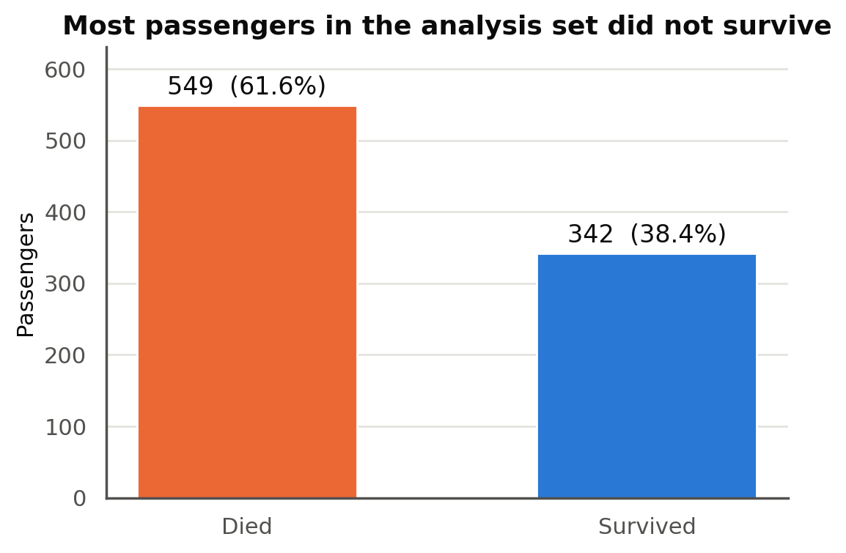
Prepare: Building the Analysis Set
Analysis set: the 891 passengers with a known outcome. The 418 holdout rows stay aside.
Baseline: 549 died (61.6%) and 342 survived (38.4%). Later charts compare each group to 38.4%.
Readable labels: Outcome, Class, Port, and SexLabel columns for chart axes; coded columns kept for calculations.
Consistent style: one color palette across every chart, with values printed on bars and group sizes (n) where they matter.
Age caution: 177 ages were imputed in Micro-Project 1, so age distributions use only the 714 recorded ages.

Slide 10
Prepare: Features, Encoding, and Split
Feature | Type | Preparation
Age, FamilySize, FareLog | Numeric | Standardized (mean 0, SD 1)
Pclass, Sex, Embarked | Category | One-hot encoded
HasCabin, AgeWasMissing | Flag | Used as 0/1
Title | Category | Tested as an iteration
Pipeline: scaling and encoding sit inside each model's pipeline, so they learn only from training data.
Split: 80% training (712) and 20% test (179), stratified so both keep the 38% survival rate.
Tuning: 5-fold cross-validation on the training set; the test set is used once at the end.
Fare split: grouped by ticket so passengers sharing a fare never appear in both training and test.

Slide 11
Analyze: Visual Analysis Techniques
Technique | Question it answers | Library
Grouped survival rates (bar charts) | Which groups survived above or below the 38.4% baseline? | Matplotlib, Seaborn
Two-way comparison (heatmap) | Does the sex gap hold inside every class? | Seaborn
Distributions (histograms, box plots) | How do age and fare differ between survivors and victims? | Seaborn
100% stacked bars | Is a variable (port) really a stand-in for class? | Matplotlib
Chi-square test and Cramer's V | Is each association statistically significant, and how strong is it? | SciPy
Correlation matrix (heatmap) | Which features move with survival and with each other? | Pandas, Seaborn

Slide 12
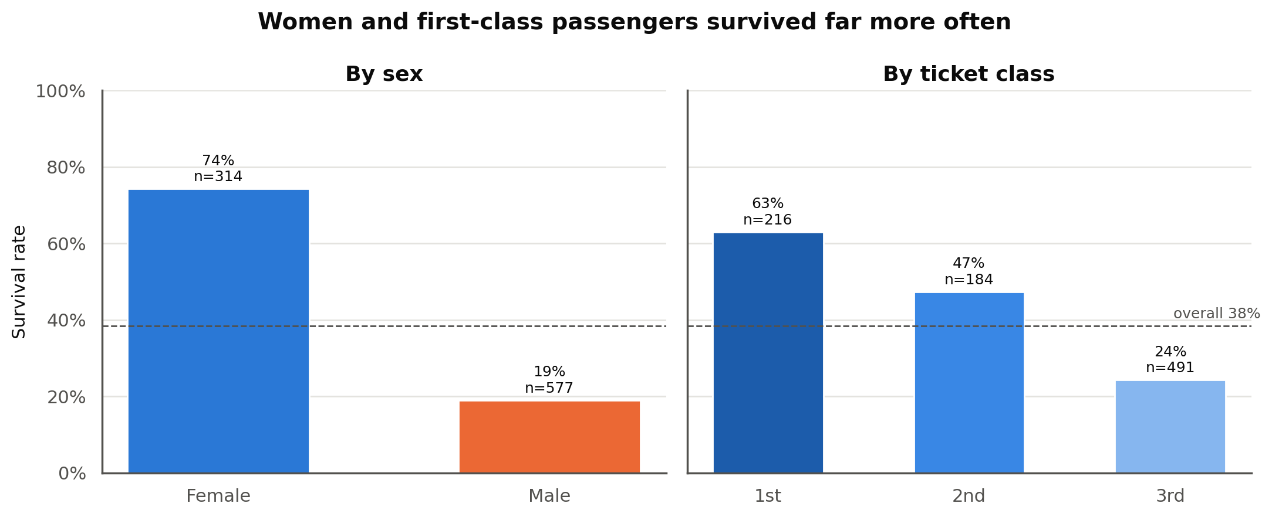
Analyze: Survival by Sex and Class
H1: 74.2% of women survived compared with 18.9% of men.
Women were 35% of passengers but 68% of survivors (233 of 342).
H2: survival falls steadily with class: 63.0% in first, 47.3% in second, 24.2% in third.
Third class was the largest group (491) and the only class below the baseline.

Slide 13
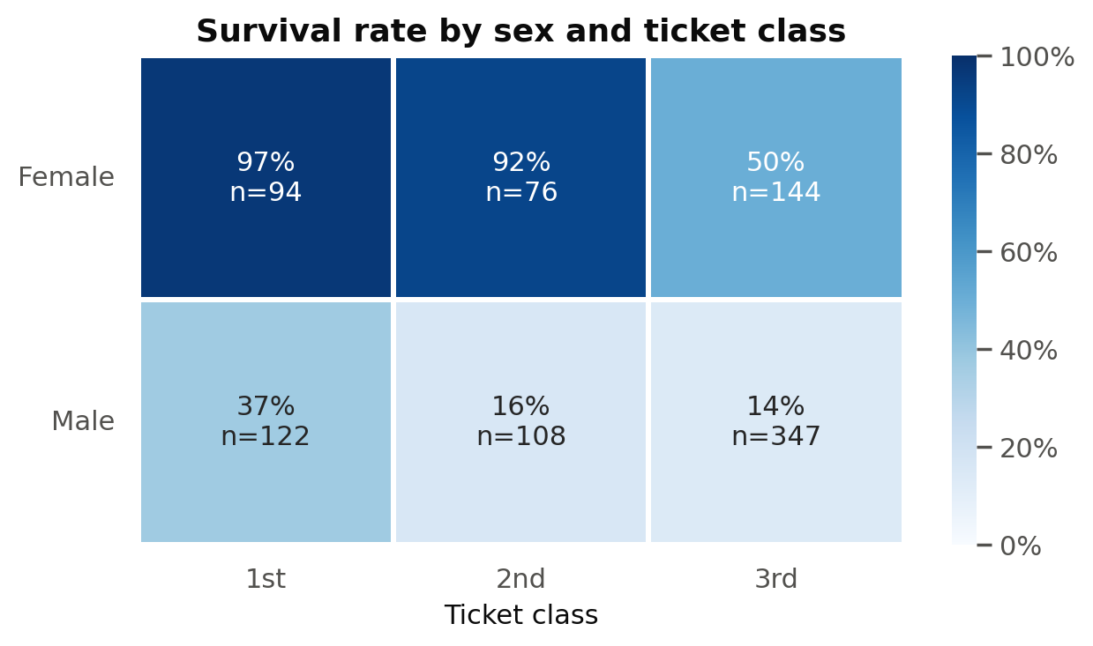
Analyze: Sex and Class Together
H3: women out-survived men in every class, and both sexes did better in higher classes.
First- and second-class women survived at 97% and 92%.
Third-class women (50%) still beat first-class men (37%).
Takeaway: the two factors stack, and the gap between the sexes is larger than the gap between classes in these comparisons.

Slide 14
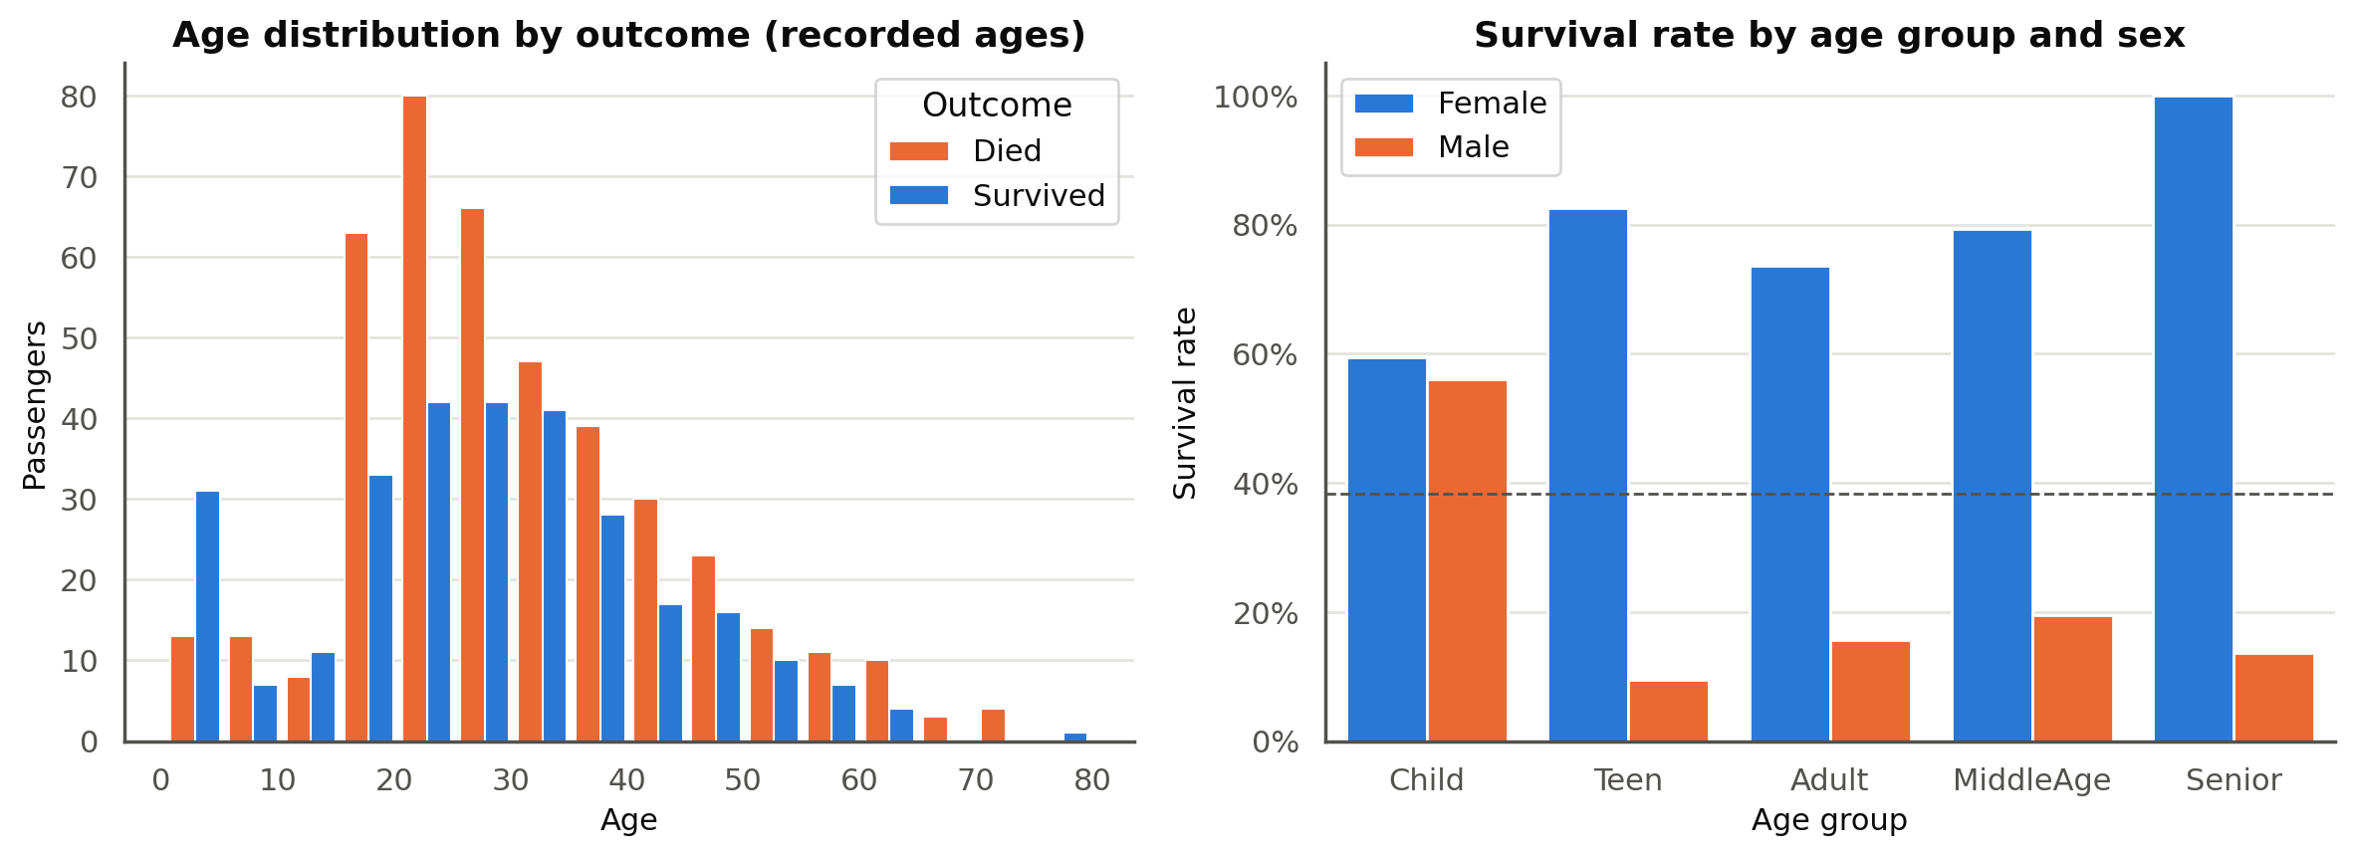
Analyze: Age
Young children survived more often than they died, while ages 20 to 30 were dominated by deaths.
Split by sex, the effect is mostly for males: boys under 13 survived at about 56% versus about 16% for adult men.
Women survived at high rates at every age.

Slide 15
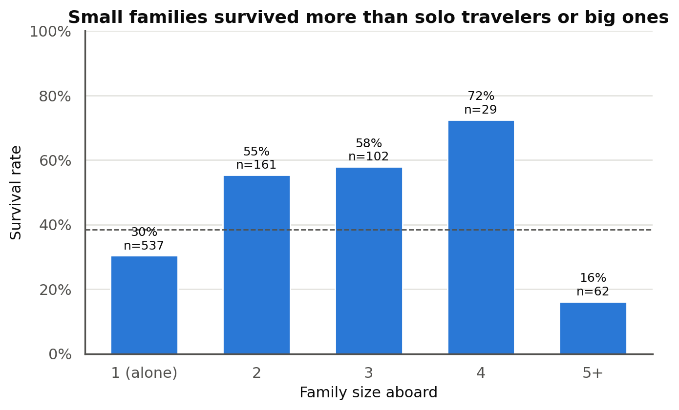
Analyze: Family Size
Survival follows an upside-down U.
Solo travelers (30.4%, the largest group at 537) and families of five or more (16.1%) did worst.
Families of two to four did best, at 55% to 72%.
Follow-up: Micro-Project 3 tests whether this pattern holds once class, sex, and age are taken into account.

Slide 16
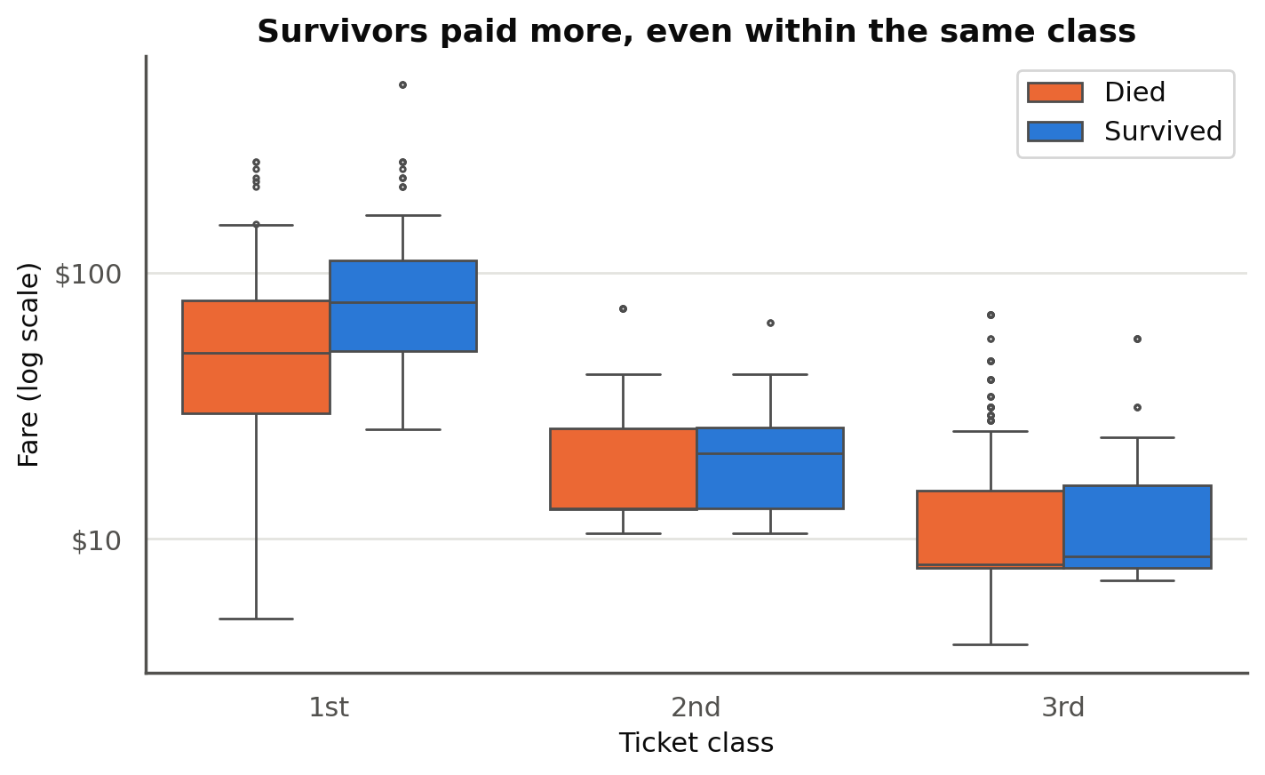
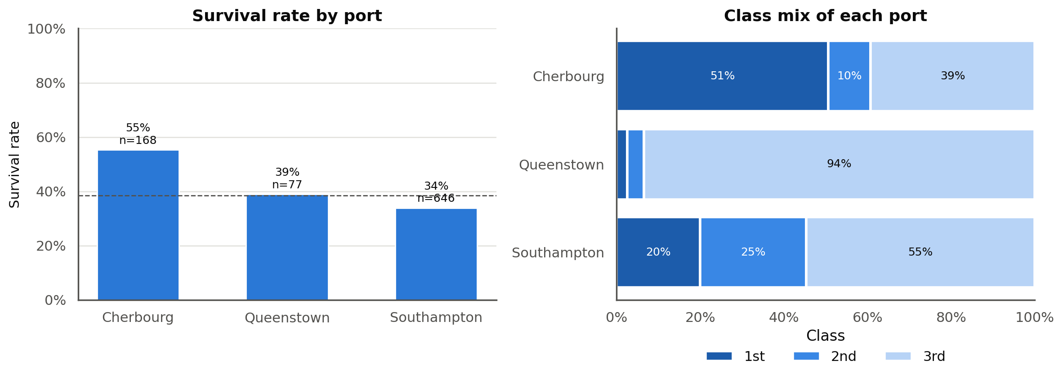
Analyze: Fare and Port Reflect Class
Fare: survivors paid a median of $26.00 versus $10.50, but inside third class the gap nearly disappears ($8.52 versus $8.05).
Port: Cherbourg survived at 55.4%, but 51% of its passengers were first class, compared with 20% at Southampton.
Lesson: a one-variable chart can mislead when another variable is doing the work.

Slide 17
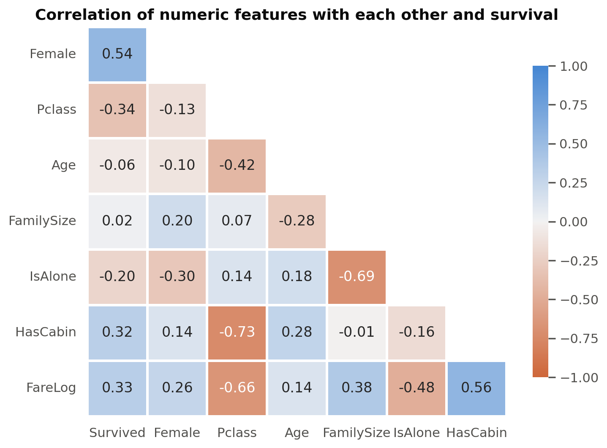
Analyze: Statistical Checks
Variable | Chi-square | p-value | Cramer's V
Title | 288.1 | 4.0e-61 | 0.57
Sex | 260.7 | 1.2e-58 | 0.54
Ticket class | 102.9 | 4.5e-23 | 0.34
Traveling alone | 36.0 | 2.0e-09 | 0.20
Port | 26.0 | 2.3e-06 | 0.17
Age group | 17.1 | 1.8e-03 | 0.14
Every variable shows a statistically significant association (p < 0.05); Cramer's V shows sex and class are the strongest.
Class, cabin, and fare are strongly correlated with each other, so they overlap.

Slide 18
Analyze: Modeling Techniques
Technique | Purpose | Target
Majority-class baseline | The score to beat | Survival
Logistic regression | Linear classifier; odds ratios for H4 to H6 | Survival
Linear and RBF SVM classifiers | Maximum-margin boundaries, straight and curved | Survival
Grid search + 5-fold cross-validation | Choose settings without touching the test set | Both
Likelihood ratio test | Does a sex by class interaction help? (H6) | Survival
Linear regression and SVR | Predict log fare (H8) | Fare

Slide 19
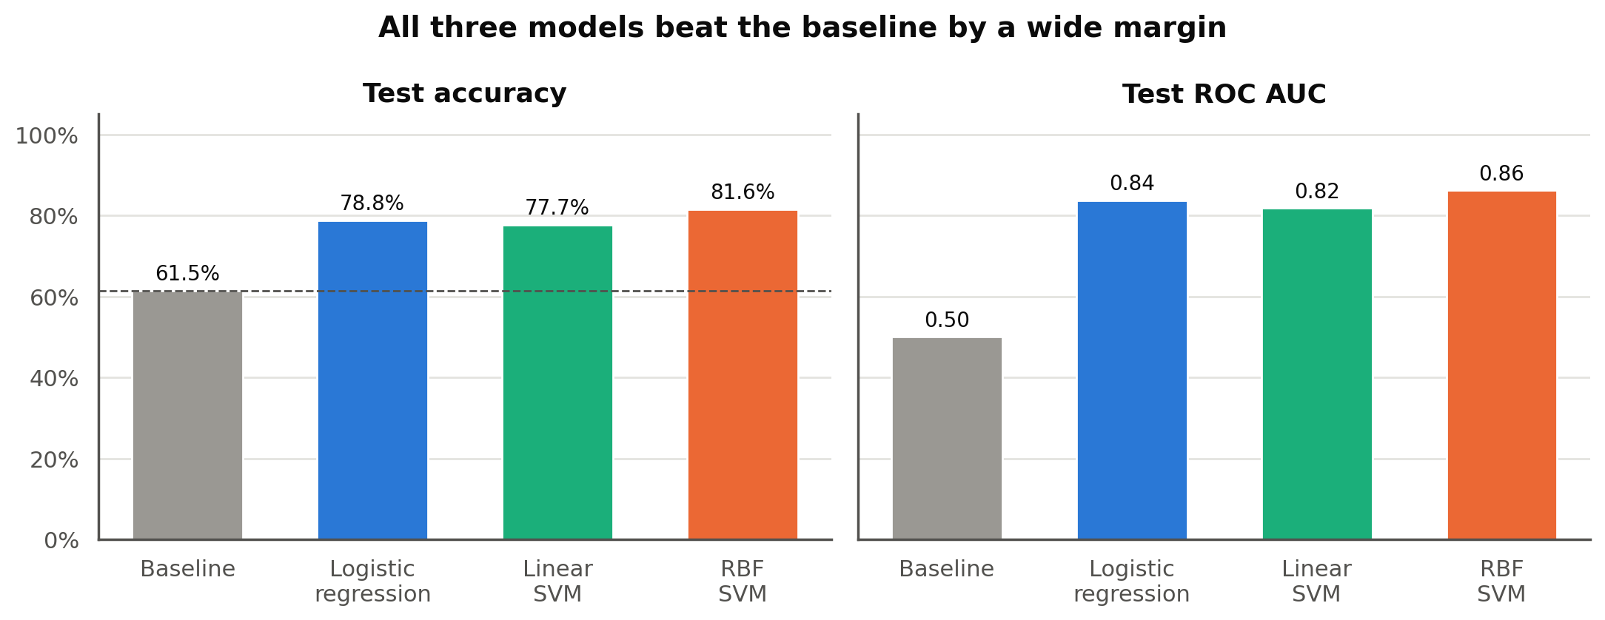
Analyze: Survival Models vs Baseline
H7: all three models beat the 61.5% baseline on the 179 test passengers.
RBF SVM 81.6%, logistic regression 78.8%, linear SVM 77.7%.
ROC AUC of 0.82 to 0.86 shows all three rank survivors well.

Slide 20
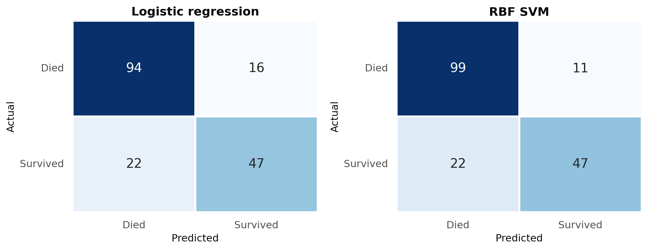
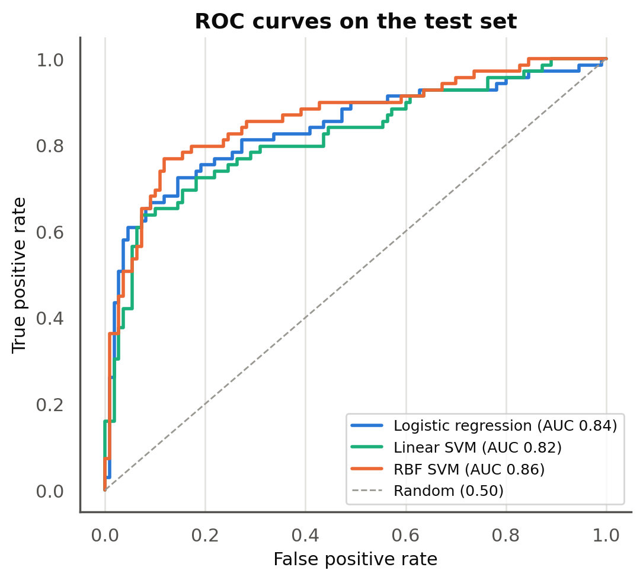
Analyze: Where the Models Miss
Both models miss more survivors (22) than they wrongly flag (11 to 16): precision is higher than recall.
The RBF SVM's gain comes from fewer false alarms, not from finding more survivors.

Slide 21
Analyze: Iteration with Title
Model | CV accuracy without | CV accuracy with Title | Test without | Test with Title
Logistic regression | 80.5% | 83.1% | 78.8% | 84.4%
RBF SVM | 82.4% | 83.8% | 81.6% | 82.7%
Why test it: Title mostly repeats sex and age, but "Master" marks boys, who survived far more often than adult men.
Result: both models improved in cross-validation and on the test set, so the Title versions are used for prediction in Step 5.
Not used for interpretation: Title overlaps so heavily with sex that it would make the sex odds ratio hard to read.

Slide 22
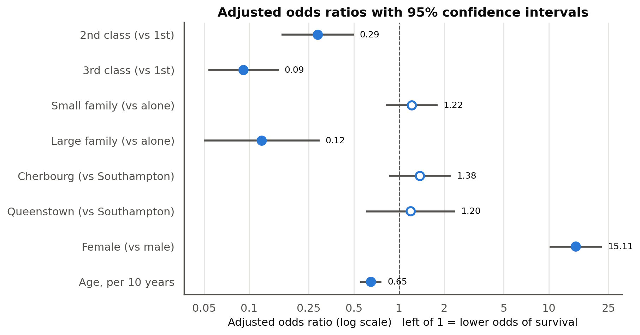
Analyze: Adjusted Odds Ratios (H4, H5)
H4: women had about 15 times the odds of survival of men (95% CI 10 to 23), holding the others constant.
H5: 3rd class 0.09 and 2nd class 0.29 times the odds of 1st class.
No longer significant: port and small family size, once class and sex are in the model.
Large families (0.12) and each 10 years of age (0.65) keep lower odds.

Slide 23
Analyze: The Sex Gap Differs by Class (H6)
Predicted survival | 1st class | 2nd class | 3rd class
Female | 98% | 93% | 41%
Male | 45% | 13% | 11%
Test: adding a sex by class interaction significantly improved the model (likelihood ratio 32.1 on 2 df, p < 0.001).
Women: predicted survival drops sharply in third class.
Men: the largest drop is between first and second class.
This matches the pattern in the sex by class heatmap.
Example passenger: age 30, traveling alone, boarded at Southampton, from the interaction model.

Slide 24
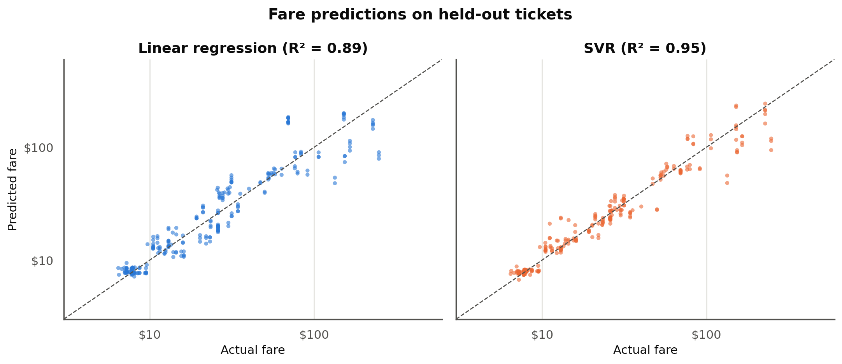
Analyze: Predicting Fare (H8)
Linear regression: R² 0.89, typical error about $14.
SVR: R² 0.95, typical error about $8.
Baseline (mean): R² about 0.
Linear model: 3rd-class fares about 76% lower than 1st; larger ticket groups have higher fares.
Tested on 284 passengers whose tickets were never seen in training.

Slide 25
Report: Results by Hypothesis
 | Hypothesis | Evidence | Result
H1 | Women survived more than men | 74.2% vs 18.9%; V = 0.54 | Supported
H2 | Survival falls from 1st to 3rd class | 63.0% / 47.3% / 24.2%; V = 0.34 | Supported
H3 | Women ahead inside every class | All 3 classes; 3rd-class women (50%) beat 1st-class men (37%) | Supported
H4 | Sex associated after adjustment | OR 15.1 (95% CI 10.1 to 22.6) | Supported
H5 | Class associated after adjustment | 3rd vs 1st OR 0.09 (95% CI 0.05 to 0.16) | Supported
H6 | Sex gap differs by class | Interaction LR test p < 0.001 | Supported
H7 | Models beat the baseline | 78.8% to 84.4% vs 61.5% baseline | Supported
H8 | Fare is predictable | R² 0.89 (linear), 0.95 (SVR) | Supported

Slide 26
Report: Key Findings and Limitations
One variable at a time: sex and class showed the strongest associations with survival (Cramer's V 0.54 and 0.34); fare and port mostly tracked class.
Evaluated together: sex and class each remain significantly associated with survival, and the size of the sex gap depends on class. Port and small family size are not significant after adjustment.
Prediction: survival predicted at 78% to 84% test accuracy against a 61.5% baseline.
Limitations: associations, not causes; about 20% of ages imputed; 179 test passengers; 891 of about 2,200 people aboard.

Slide 27
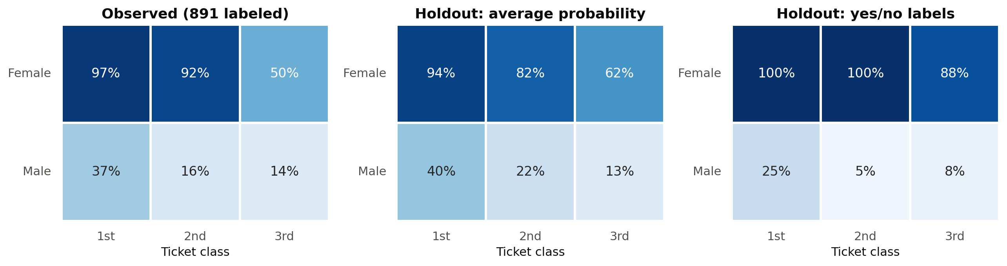
Act: Scoring the 418 Holdout Passengers
Logistic regression with Title, refit on all 891 labeled passengers, expects about 41% of holdout passengers survived (38.4% observed in the labeled set).
Average probabilities follow the observed sex and class pattern. Yes/no labels exaggerate it because each probability is rounded at 0.5.
Logistic regression and the SVM give the same label for 92% of passengers. Predictions are saved for checking if outcomes become available.

Slide 28
Act: Checking the 17 Zero Fares
Class | Ticket group | Passengers | Model estimate | Similar paid tickets
1st | 1 | 5 | $27.52 | $27.81
1st | 2 | 2 | $54.78 | $60.59
2nd | 1 | 3 | $12.52 | $13.00
2nd | 3 | 3 | $37.54 | $29.00
3rd | 4 | 4 | $33.14 | $20.58
Goal: estimate what a comparable paid ticket cost. It does not say what these passengers paid or why their fare was 0.
Result: 8 of 17 estimates are within $1 of similar paid tickets, and 2 more are about $6 low.
Misses: the model runs about $9 to $13 high for solo travelers on shared tickets, a combination rare in the training data.

Slide 29
Act: Connecting to the Problem
Which characteristics: sex and class, with age and large family size as smaller factors; port and fare mostly reflected class.
Do they hold together: yes for sex and class, and the size of the sex gap depends on class.
How accurately: about 84% test accuracy with logistic regression and Title, close to the SVM.
Next steps: repeated cross-validation, the interaction inside the pipelines, and age imputation inside the pipeline.
Notebooks and data: github.com/OrangeJoe0421 (ANA-500-MP1, ANA-500-MP2, ANA-500-MP3)

