Slide 1
Titanic Passenger Survival: Visual Analysis and Reporting
Micro-Project 2 https://github.com/OrangeJoe0421/ANA-500-MP2
Travis James
September 28, 2026

Slide 2
Problem Statement
Survival on the Titanic was not random. This project describes which passenger characteristics were associated with who lived and who died.
Characteristics considered: sex, ticket class, age, family size, fare, and port of embarkation.
Data: the cleaned passenger file produced in Micro-Project 1 (titanic_clean.csv).
Scope of Micro-Project 2: use Matplotlib and Seaborn to analyze the data visually and report the results (Steps 1 through 4 of the data science process).

Slide 3
Hypothesis Formulation
Hypothesis: Women and passengers in higher ticket classes survived at higher rates than men and passengers in lower ticket classes.
H1: Women survived at a higher rate than men.
H2: Survival rate falls from first to third class.
H3: The sex gap holds inside every class, so both factors matter.
Supporting variables: age, family size, fare, and port, which may explain or complicate the main result.

Slide 4
Acquire
Source: titanic_clean.csv, the output of Micro-Project 1 (1,309 passengers, 20 columns).
Also loaded: the raw titanic.csv, to revisit one cleaning decision with the original records.
Retrieved: read_csv, then the category and nullable integer types were restored, since CSV files do not store data types.
Checked: assertions confirm the file matches Micro-Project 1 (same row count, unique IDs, only Survived has blanks).
Libraries: NumPy, Pandas, Matplotlib, Seaborn, and SciPy.

Slide 5
Prepare: Revisiting the Missing Ports
Feedback: the two passengers with no port share ticket 113572 and cabin B28. Can that support a better fill than the overall mode?
Finding: no one else has that ticket or cabin, so there is no companion whose port can be copied.
Decision: assign Southampton (S) from the ticket series, which is tied to where the ticket was bought. Same value as Micro-Project 1, now backed by passenger-specific evidence and flagged in EmbarkedWasMissing.
Evidence | Points to | Strength
Shared ticket or cabin | None | No other passengers match
Other 113xxx tickets | Southampton | 54 of 64 (84%)
Fare per person ($40) | Cherbourg | Weak: C and S fares overlap
Overall mode (Micro-Project 1) | Southampton | Not specific to them

Slide 6
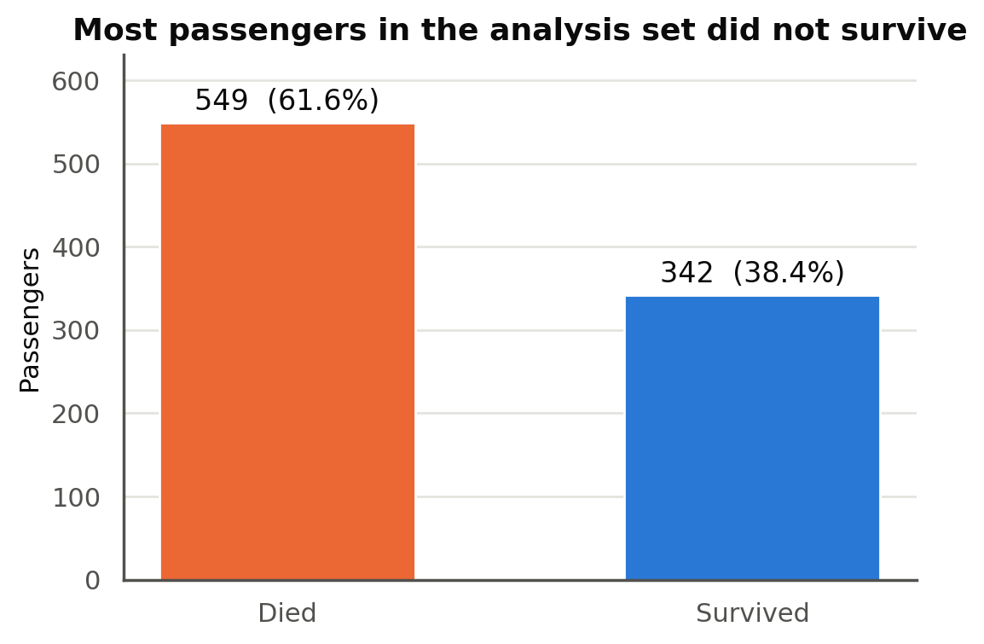
Prepare: Building the Analysis Set
Analysis set: the 891 passengers with a known outcome. The 418 holdout rows stay aside.
Baseline: 549 died (61.6%) and 342 survived (38.4%). Later charts compare each group to 38.4%.
Age caution: 177 ages were imputed in Micro-Project 1, so age distributions use only the 714 recorded ages.

Slide 7
Analyze: Techniques Used
Technique | Question it answers | Library
Grouped survival rates (bar charts) | Which groups survived above or below the 38.4% baseline? | Matplotlib, Seaborn
Two-way comparison (heatmap) | Does the sex gap hold inside every class? | Seaborn
Distributions (histograms, box plots) | How do age and fare differ between survivors and victims? | Seaborn
100% stacked bars | Is a variable (port) really a stand-in for class? | Matplotlib
Chi-square test and Cramer's V | Is each gap larger than chance, and how strong is it? | SciPy
Correlation matrix (heatmap) | Which features move with survival and with each other? | Pandas, Seaborn

Slide 8
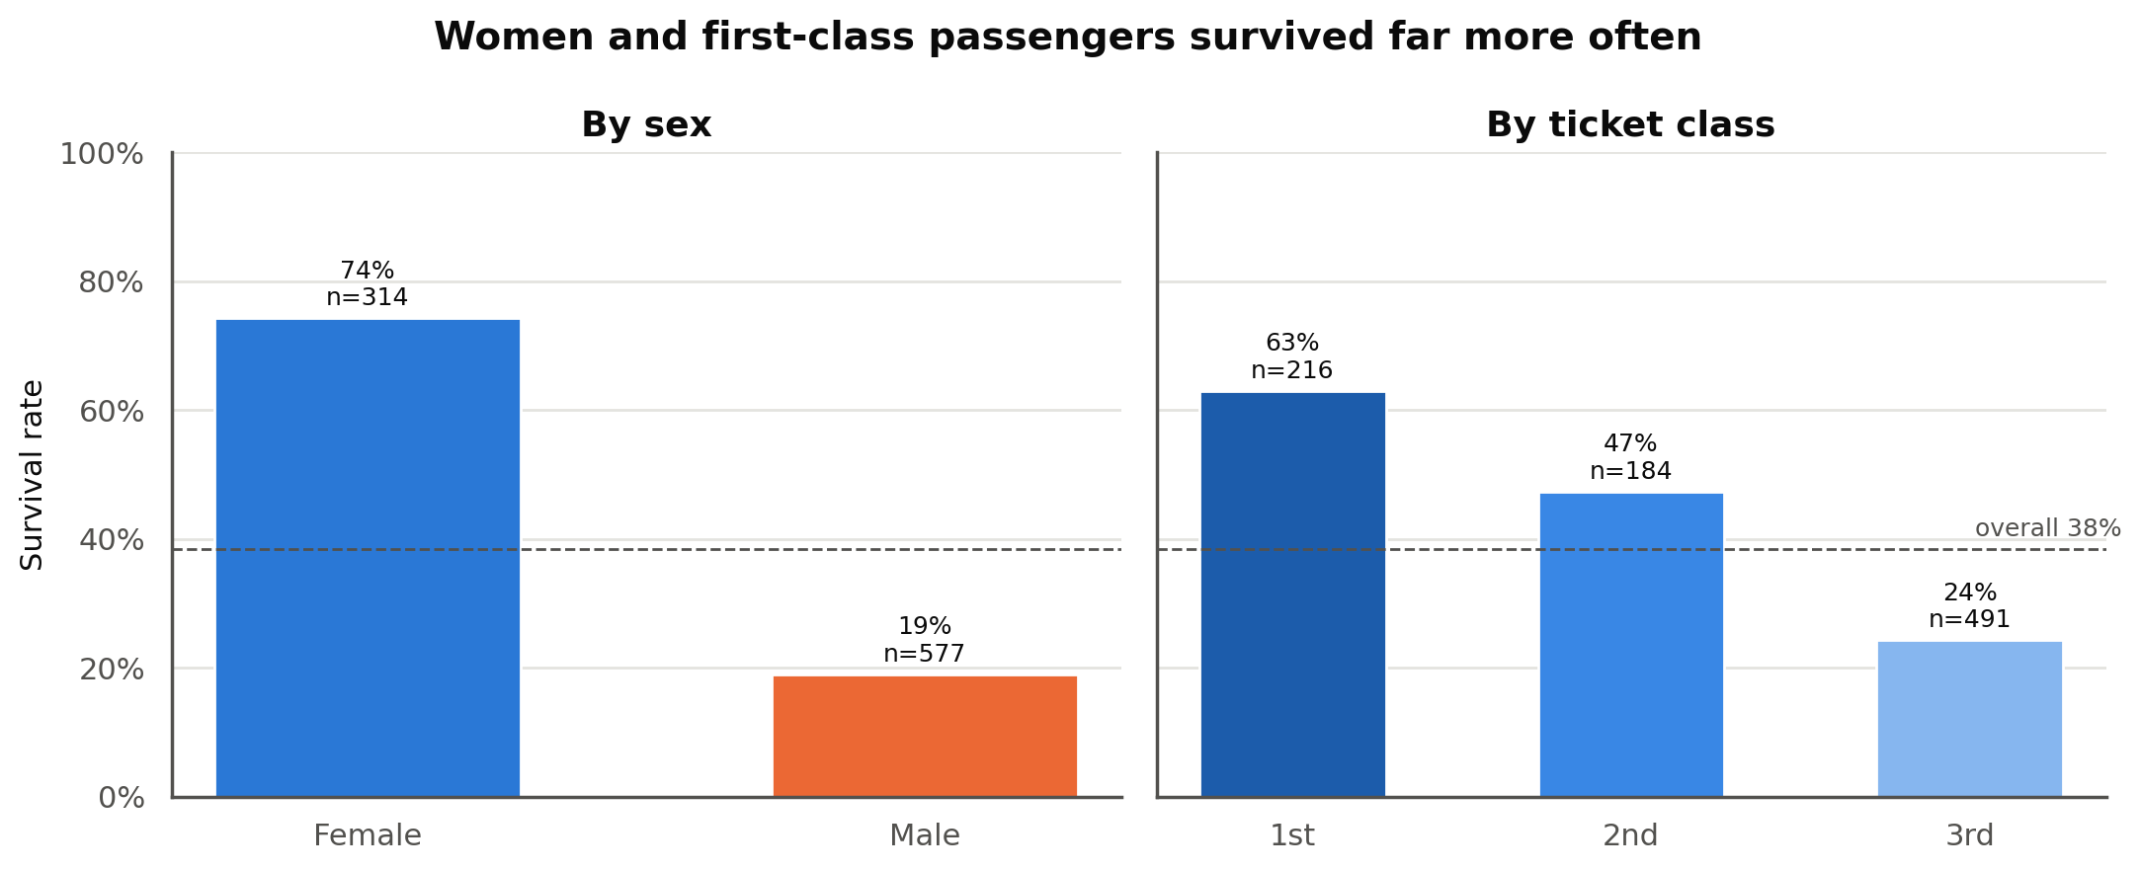
Analyze: Survival by Sex and Class
H1: 74.2% of women survived compared with 18.9% of men.
Women were 35% of passengers but 68% of survivors (233 of 342).
H2: survival falls steadily with class: 63.0% in first, 47.3% in second, 24.2% in third.
Third class was the largest group (491) and the only class below the baseline.

Slide 9
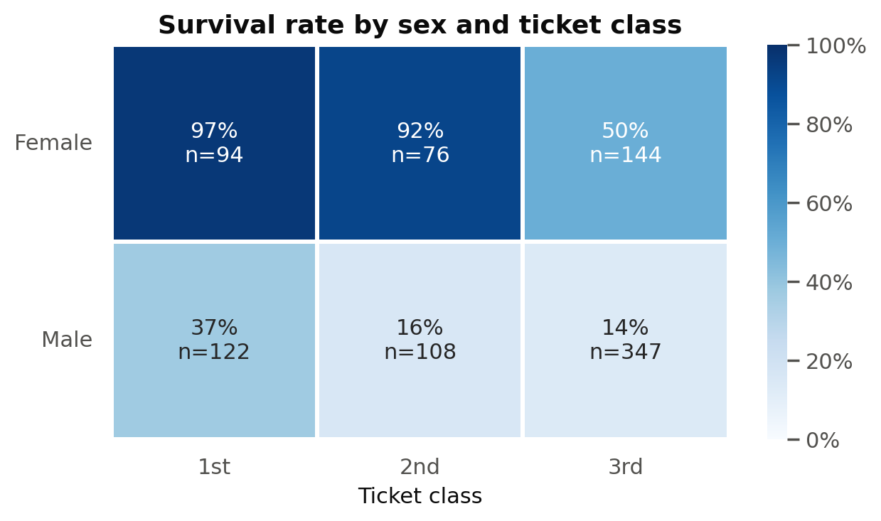
Analyze: Sex and Class Together
Women out-survived men in every class, and both sexes did better in higher classes.
First- and second-class women survived at 97% and 92%.
Third-class women (50%) still beat first-class men (37%).
Takeaway: the two factors stack, and sex is the stronger one.

Slide 10
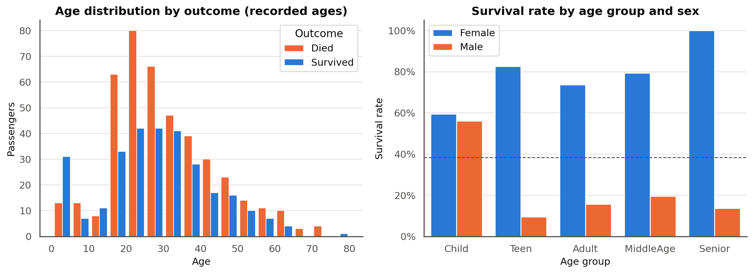
Analyze: Age
Young children survived more often than they died, while ages 20 to 30 were dominated by deaths.
Split by sex, the effect is mostly for males: boys under 13 survived at about 56% versus about 16% for adult men.
Women survived at high rates at every age, which fits a "women and children first" pattern.

Slide 11
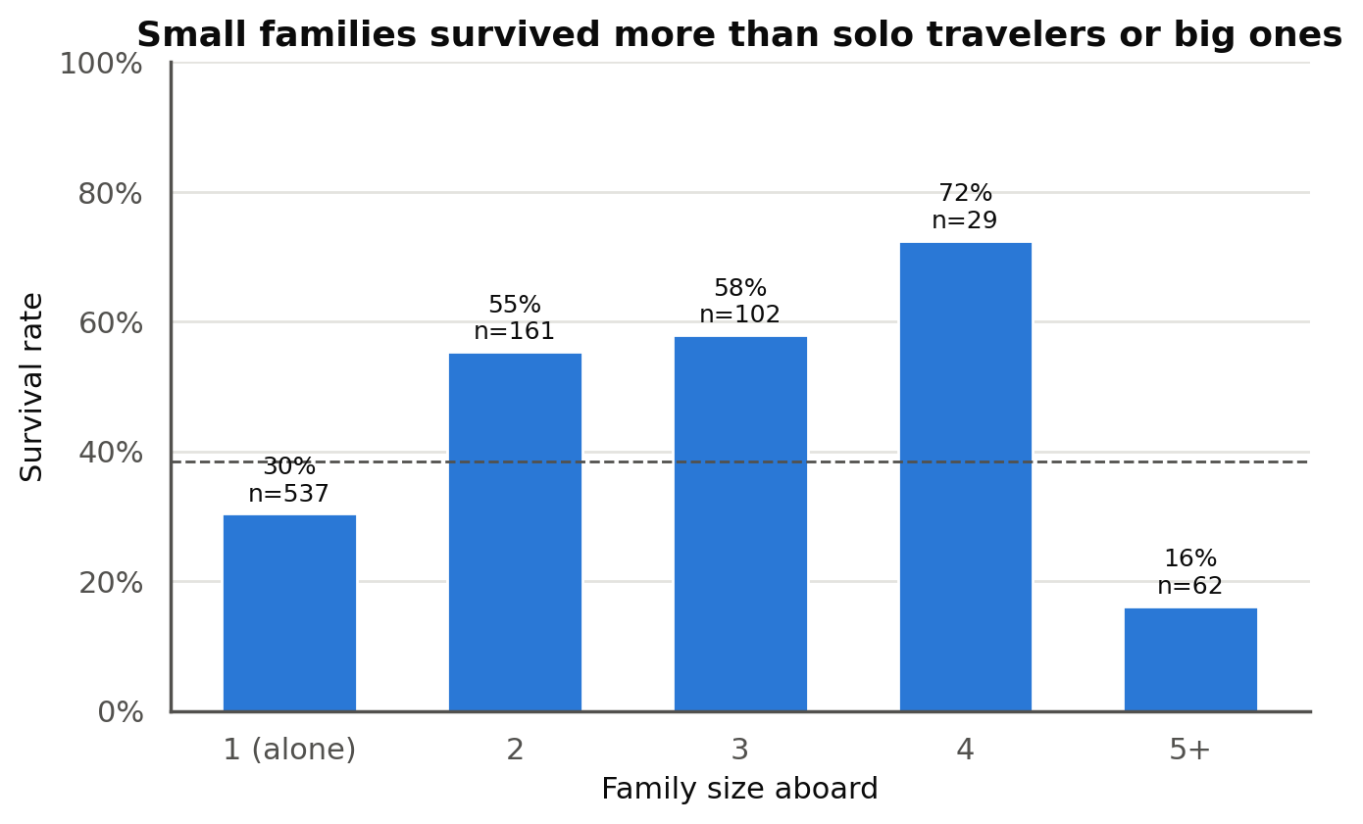
Analyze: Family Size
Survival follows an upside-down U.
Solo travelers (30.4%, the largest group at 537) and families of five or more (16.1%) did worst.
Families of two to four did best, at 55% to 72%.
Likely reason: many solo travelers were third-class men, and large families were mostly third class and harder to keep together.

Slide 12
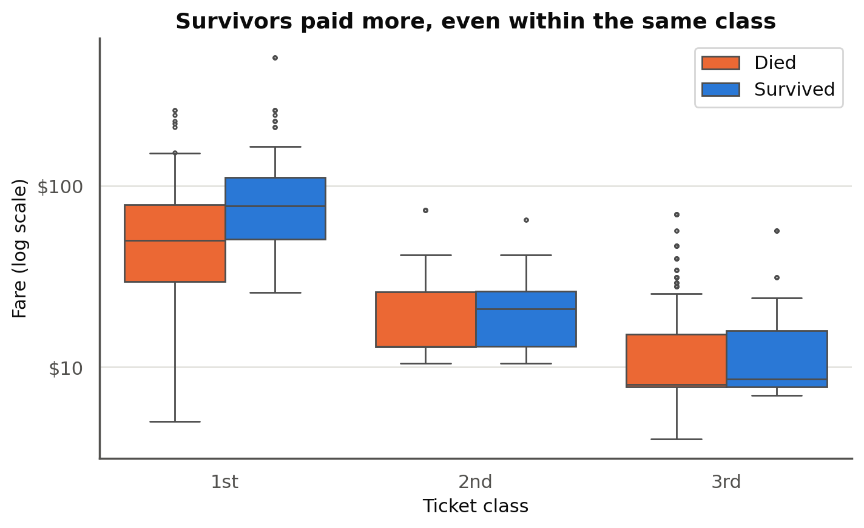
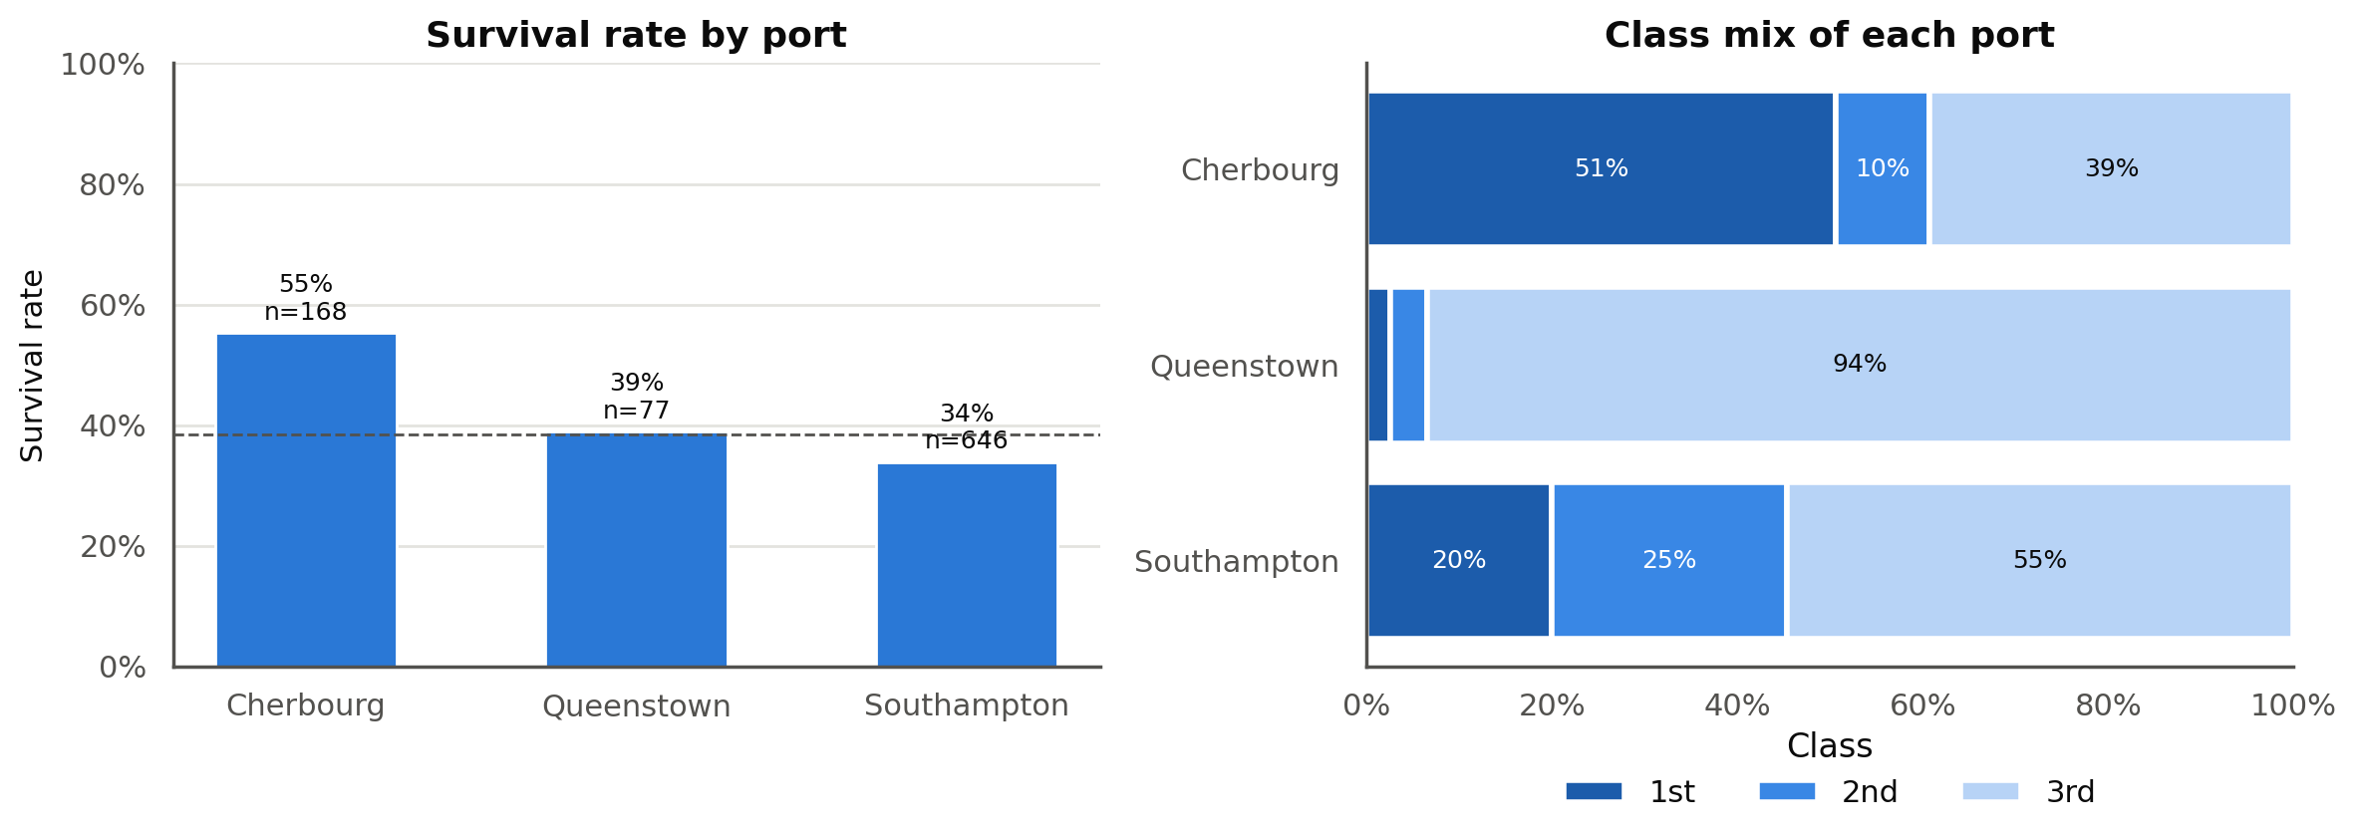
Analyze: Fare and Port Reflect Class
Fare: survivors paid a median of $26.00 versus $10.50, but inside third class the gap nearly disappears ($8.52 versus $8.05).
Port: Cherbourg survived at 55.4%, but 51% of its passengers were first class, compared with 20% at Southampton.
Lesson: a one-variable chart can mislead when another variable is doing the work.

Slide 13
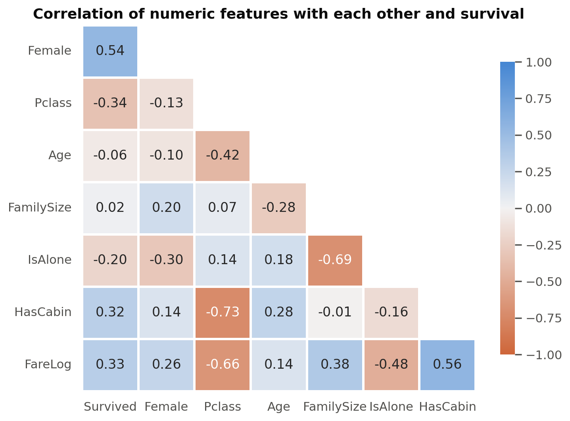
Analyze: Statistical Checks
Variable | Chi-square | p-value | Cramer's V
Title | 288.1 | 4.0e-61 | 0.57
Sex | 260.7 | 1.2e-58 | 0.54
Ticket class | 102.9 | 4.5e-23 | 0.34
Traveling alone | 36.0 | 2.0e-09 | 0.20
Port | 26.0 | 2.3e-06 | 0.17
Age group | 17.1 | 1.8e-03 | 0.14
Every gap is far beyond chance (p < 0.05), but sex and class are much stronger than the rest.
Class, cabin, and fare are strongly correlated with each other, so they overlap.

Slide 14
Report: Results by Sub-Hypothesis
 | Claim | Evidence | Result
H1 | Women survived more than men | Female 74.2% vs male 18.9%; V = 0.54 | Supported
H2 | Survival falls from 1st to 3rd class | 63.0% / 47.3% / 24.2%; V = 0.34 | Supported
H3 | The sex gap holds inside every class | Women ahead in all 3 classes; 3rd-class women (50%) beat 1st-class men (37%) | Supported
Conclusion: the data supports the hypothesis. Sex outweighs class, so survival runs from upper-class women, through lower-class women and upper-class men, down to lower-class men.

Slide 15
Report: Key Findings and Limitations
Strongest factors: sex first, then class, and the two combine: 97% of first-class women survived versus 14% of third-class men.
Secondary factors: boys under 13 survived far more than adult men, and small families survived more than solo travelers or large families.
Proxies: fare and port look important but mostly reflect class.
Limitations: associations, not causes; 20% of ages were imputed; 891 of about 2,200 people aboard; some groups are small.
Notebook and data: https://github.com/OrangeJoe0421/ANA-500-MP2

