Slide 1
Portfolio Slides
Chen_Zhang_T1A2

Slide 2
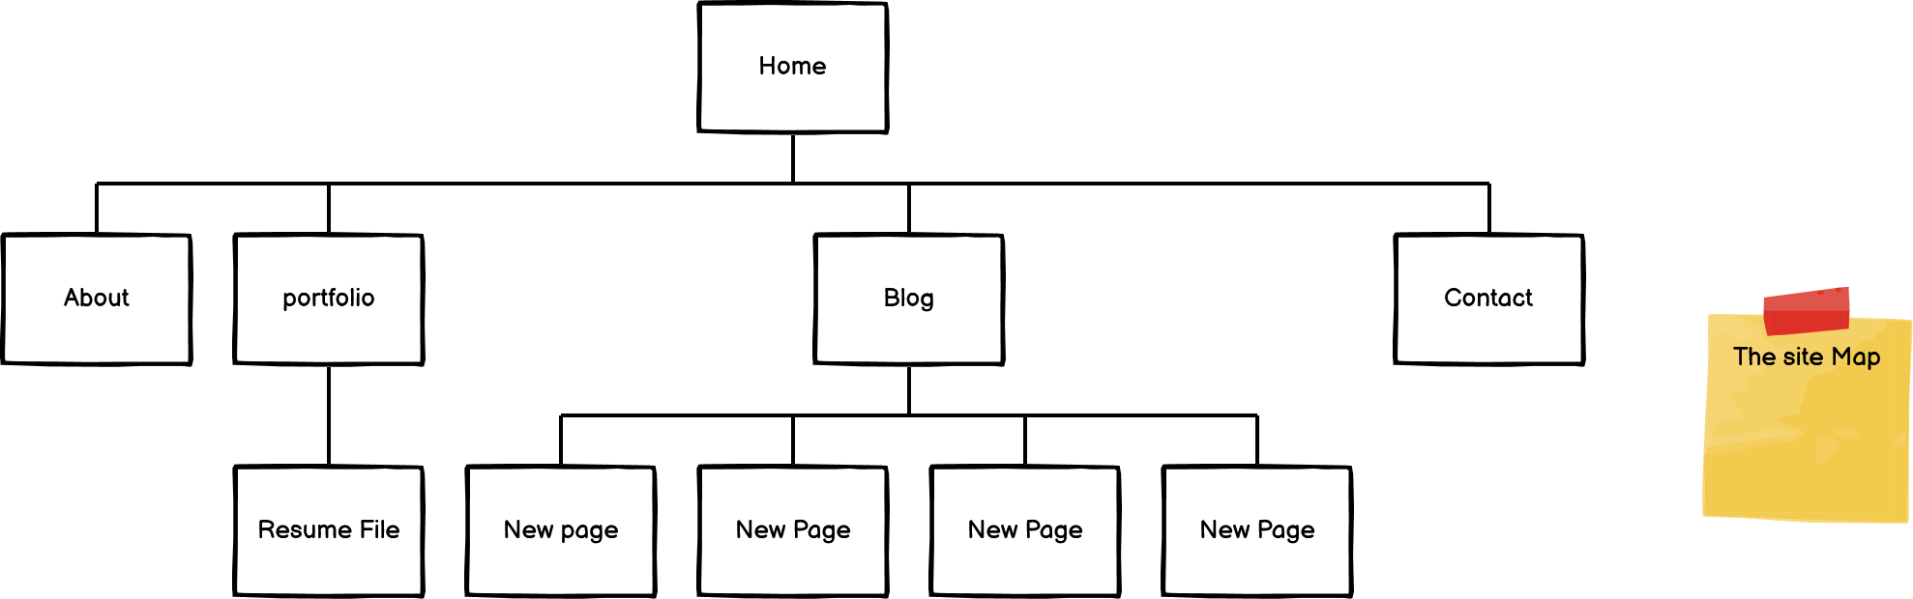
Web Site Map
This is the structure of my Portfolio

Slide 3
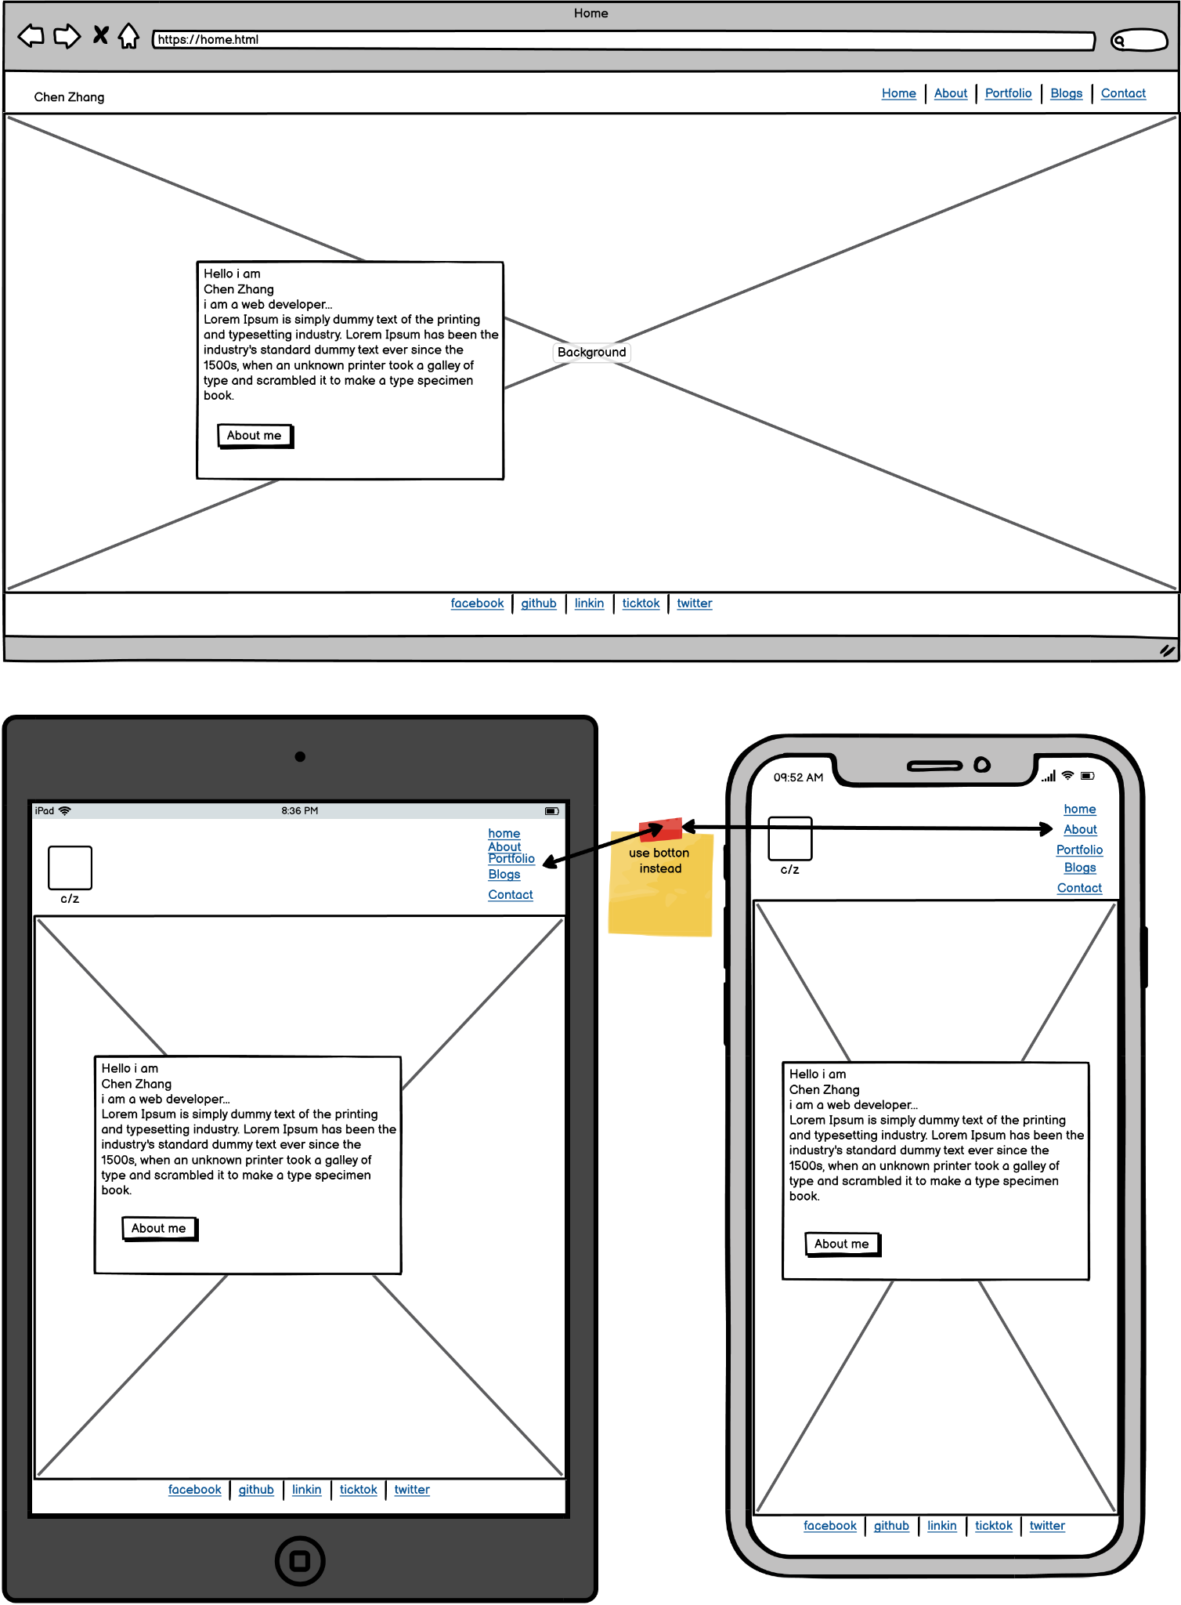
Home Page
This is the home page layout.
Simply with a image as background.
And the buttom “About Me” will nav to
the about page.
Trouble is when use the mobile devices
change the nav bar into a nav buttom.
(still working on it)

Slide 4
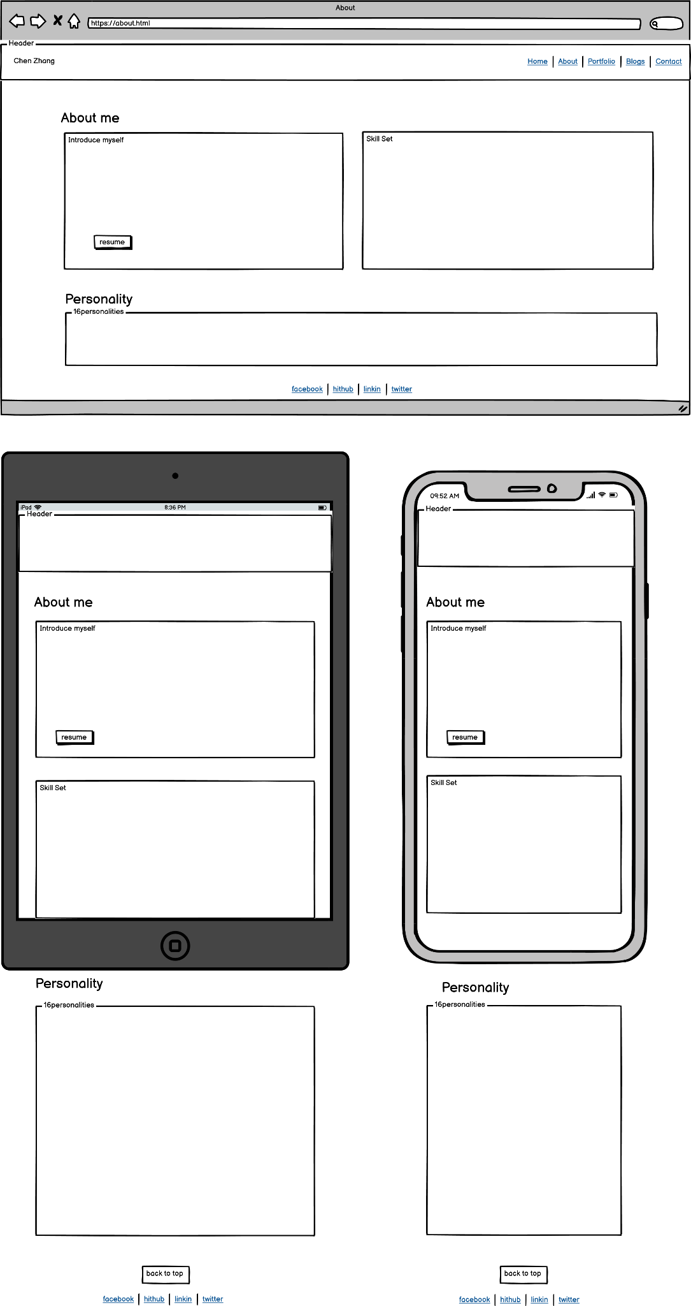
About Page
This page includes three parts:Introduce myself, Skill set and personality.
Intro and skill set as one container that can evenly layout at webpage.
When use the mobile device, the layout of them go column.
The “back to top” is hidden when the page is over 1250px then visible under it.
The skill set use the progress bar to show the stage I got.

Slide 5
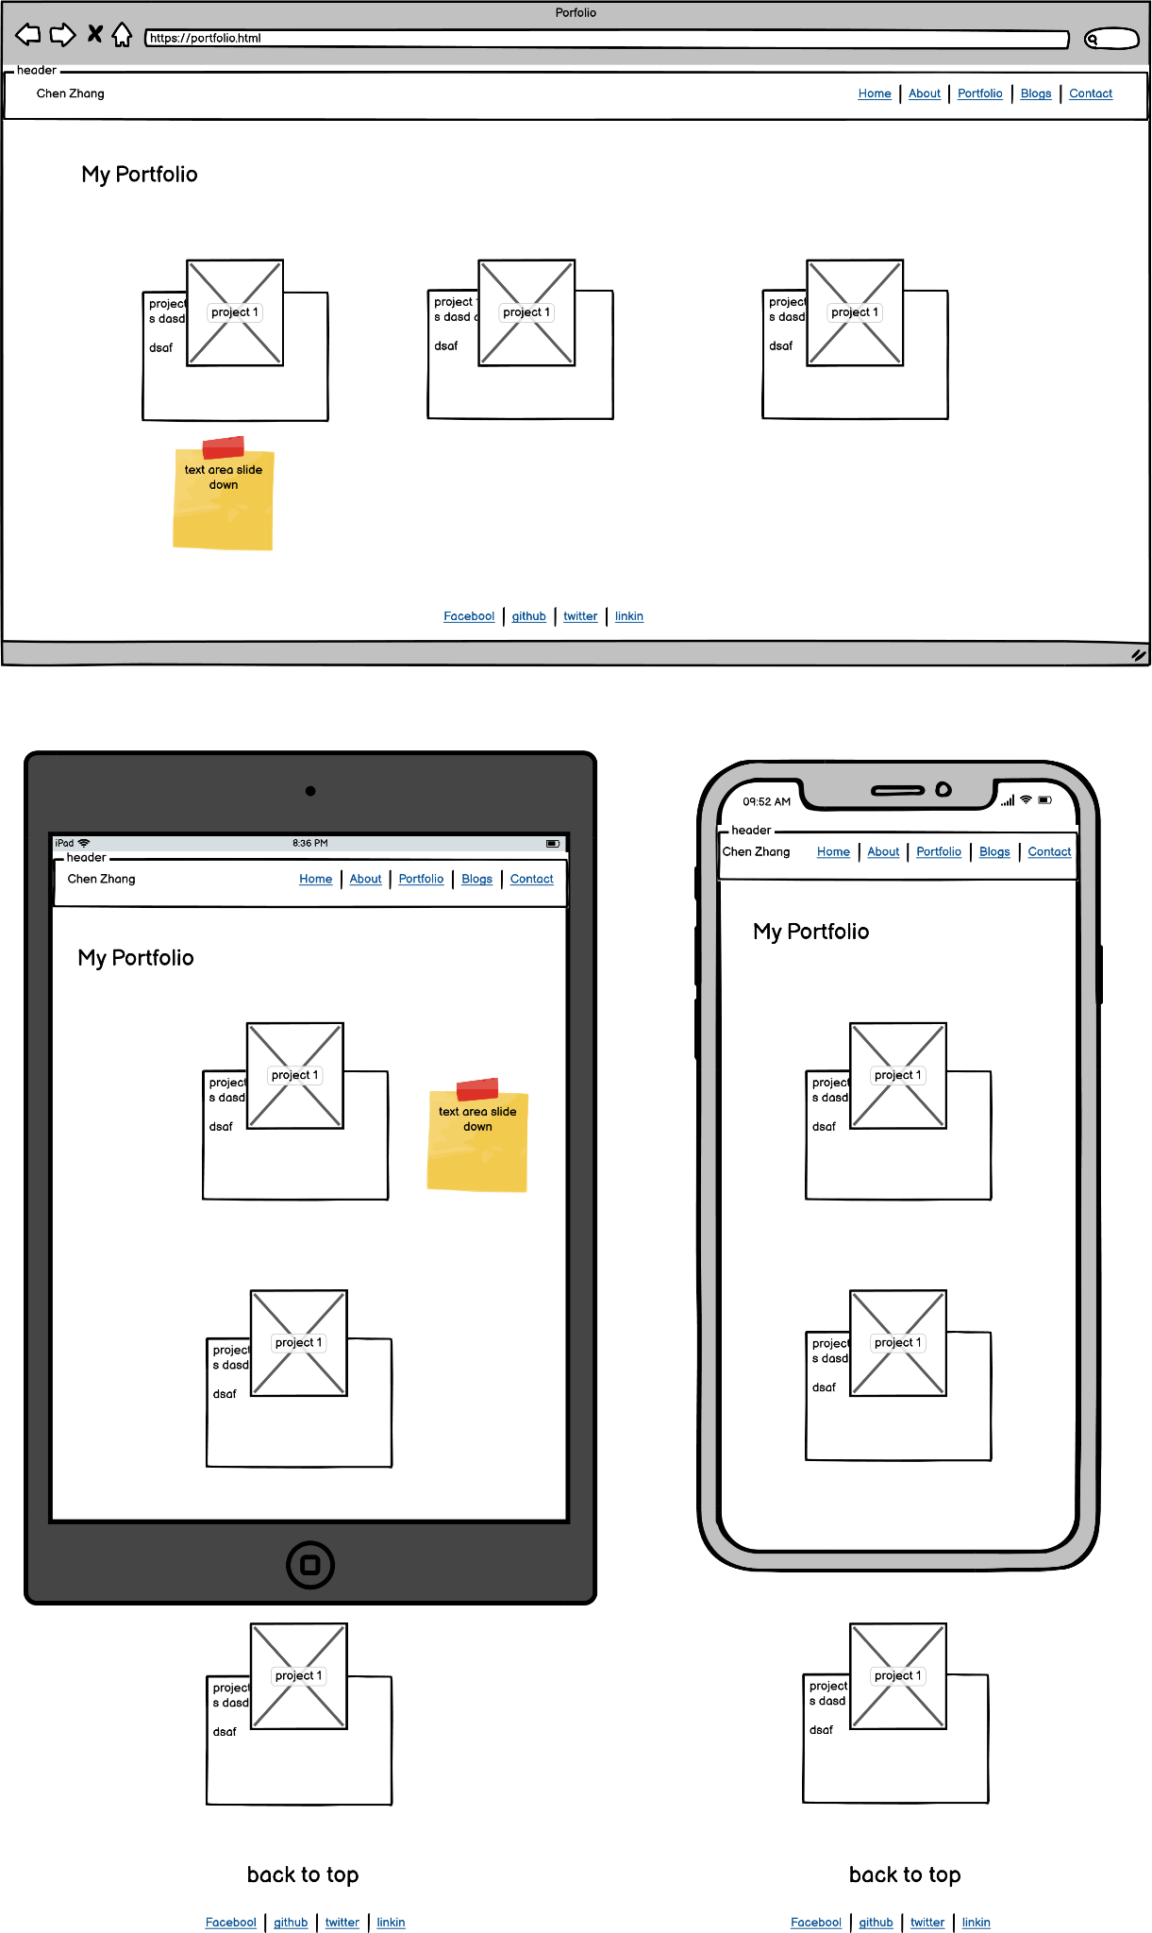
Portfolio Page
This page include three Projects.
The text at text is hidden until the hover and the text area will slide down.
“Back to top” buttom will appear when use the mobile devices.

Slide 6
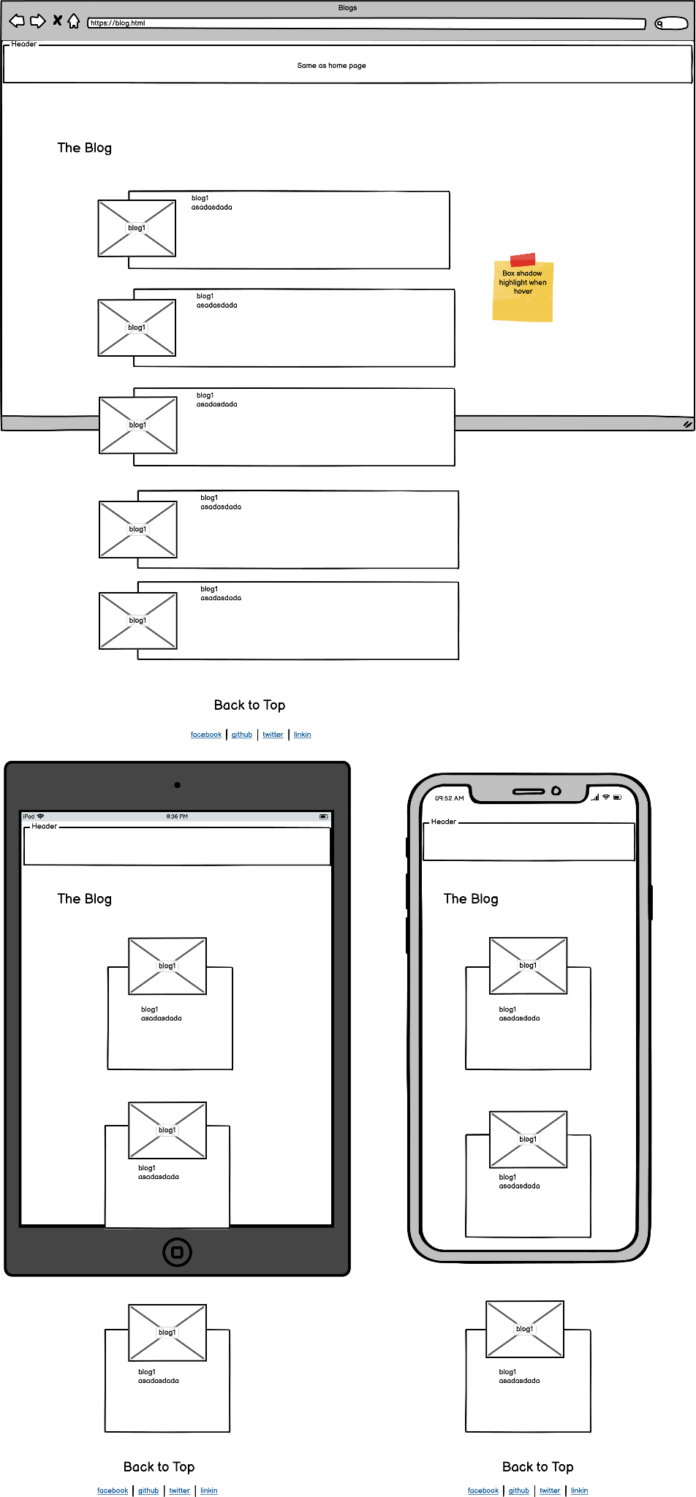
Blogs
The page has 5 blogs.
Each of them has image area and the text area.
Image area is half lay on the text area, when page is about 1250px the image and text are flex inline.
When use mobile devices or page is below 1250px, the image and text are in column layout.
The blog will highlight when hover on it to make sure u can see it clearly.
The “ back to top” button is always shows on this page.

Slide 7
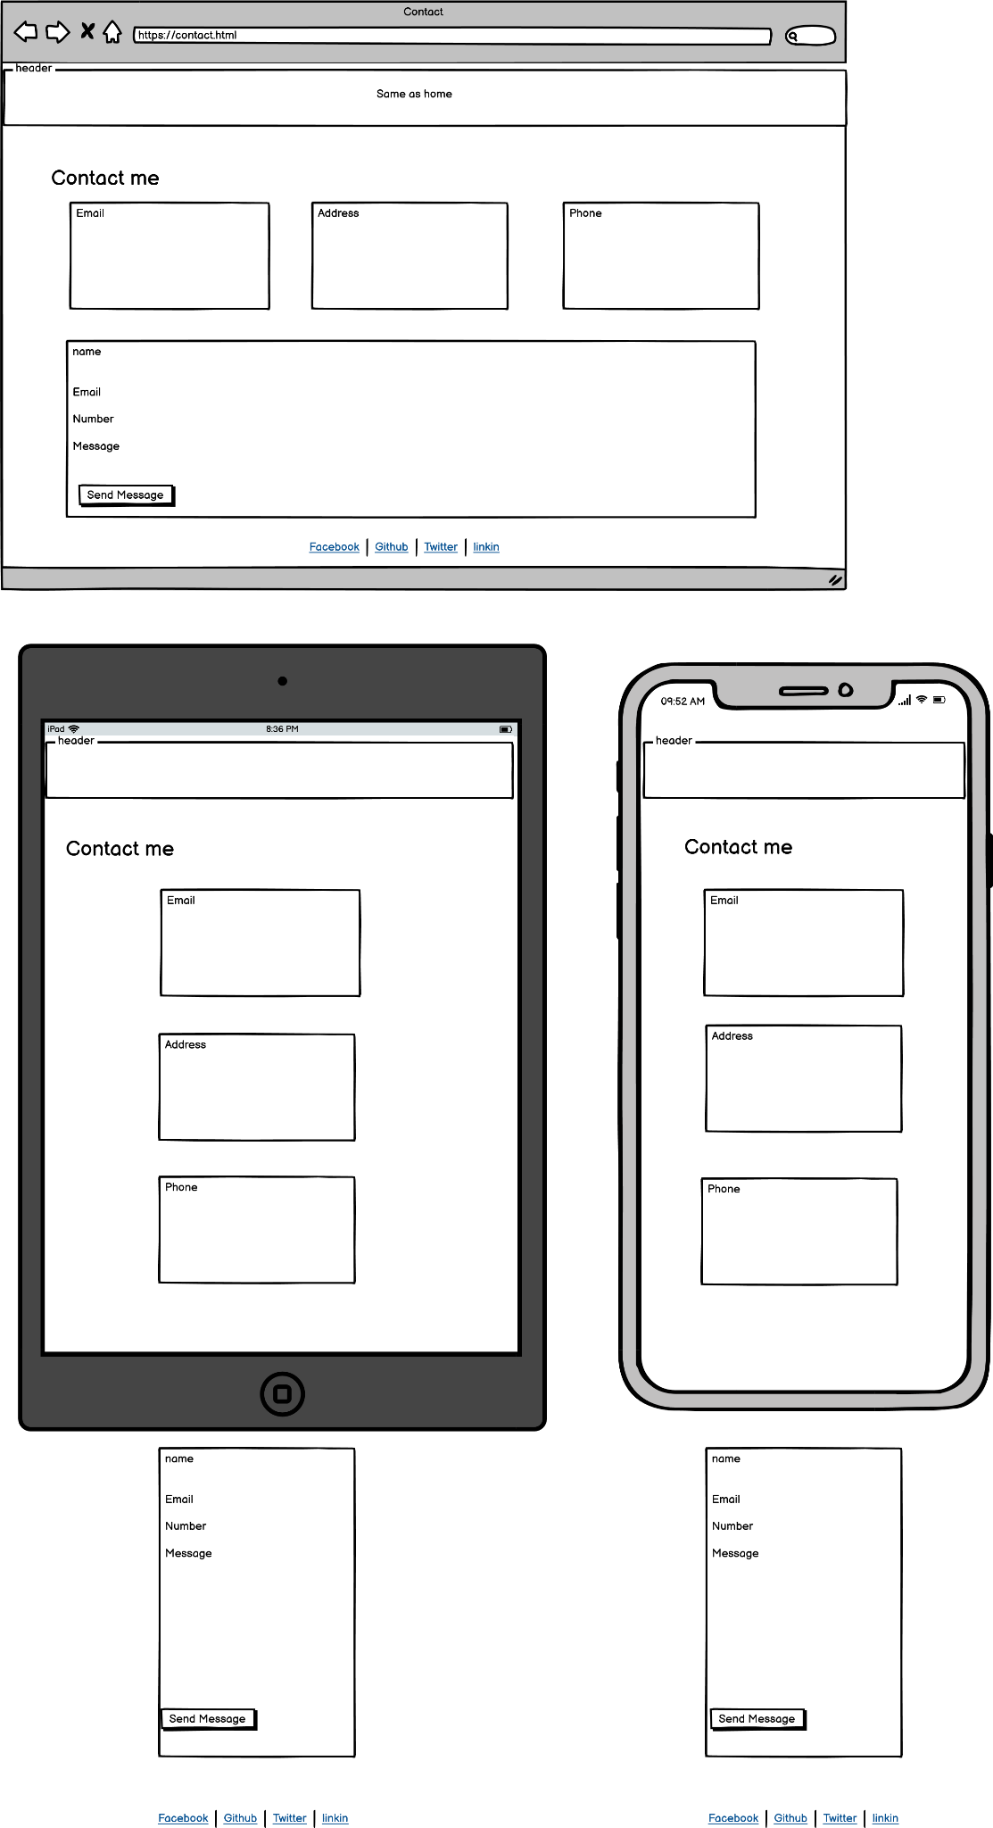
Contact page as usual has four parts: Email, Address, Phone and Send message Page.
Set emails, address and phone as a part, show as one row when page is above 1250px and in colum when in mobile devices.
The “send message page” will automatically narrow when the page change.
The part will highlight and background chage color when hover on it.
Contact Page

Slide 8
Chanlleges, ethics issues and favourite parts.
The challenge is always the responsive which I am still working on it. (Github 70% commits come from the responsive issue)
About the web site, spend most of time on the Portfolio page and Blog page that slider down animation of potfolio and layout issue of the blog page. And its also my favourite parts of the site.
Ethics issues: I did consult some other web sites like codepen and tailwind however, get the idea and try figue it out by myself is a really challenge and fun part of learning css and html.
List of Components:
<head> <body> <header> <section> <article> <footer>
<a></a>
<ul></ul> <li></li>
<nav></nav> and class=”” id=””
@media
:hover
:nth-child()
Visibility: hidden; visible;
Display: none;
box-shadow
And the most important display: flex;

Slide 9
Thank You

