Slide 1



Slide 2

Interactive books or games that every decision made is by yourself
Multiple ending book, every ending is by your choice

Slide 3
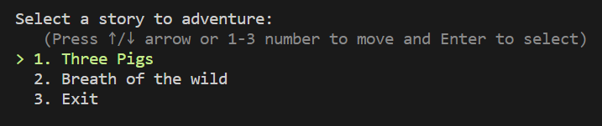
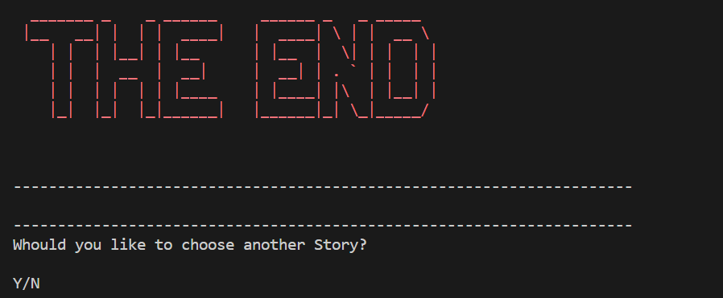
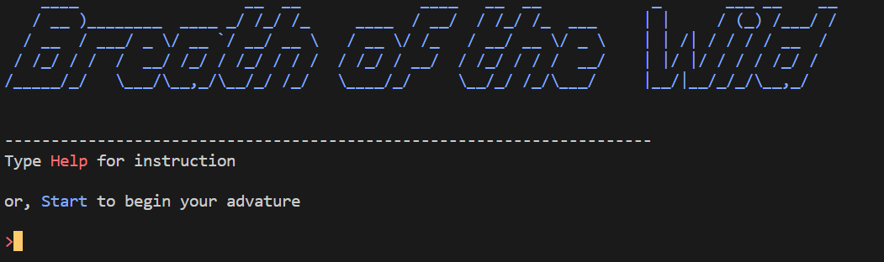
Features of Stroybooks Adventure
Console menu to choose the game
Back to console when the books end
Comand input for game like books

Slide 4
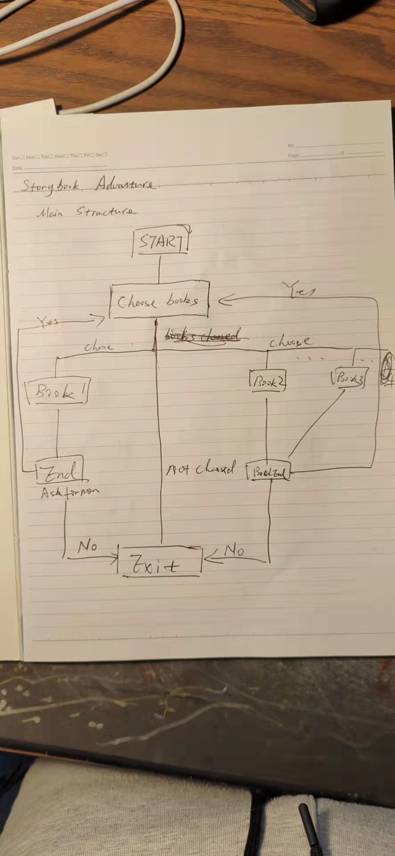
Main Flowchart
Main flow chart for the console
Start
Choose Books
Chosen Book choose other books
Book End
Exit App

Slide 5
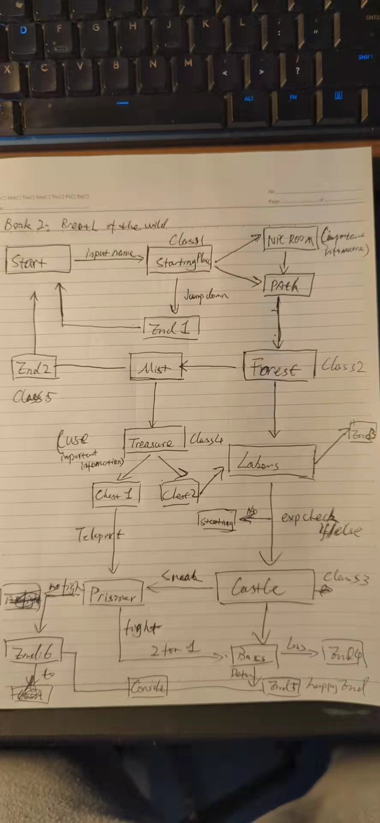
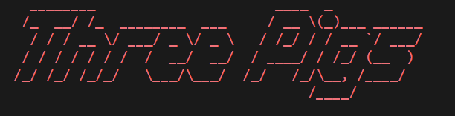
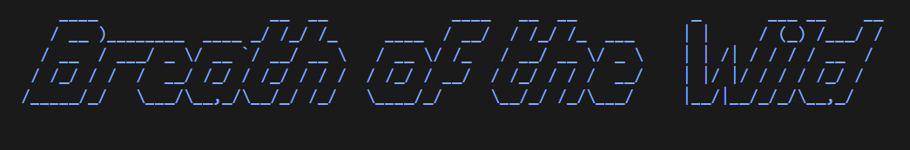
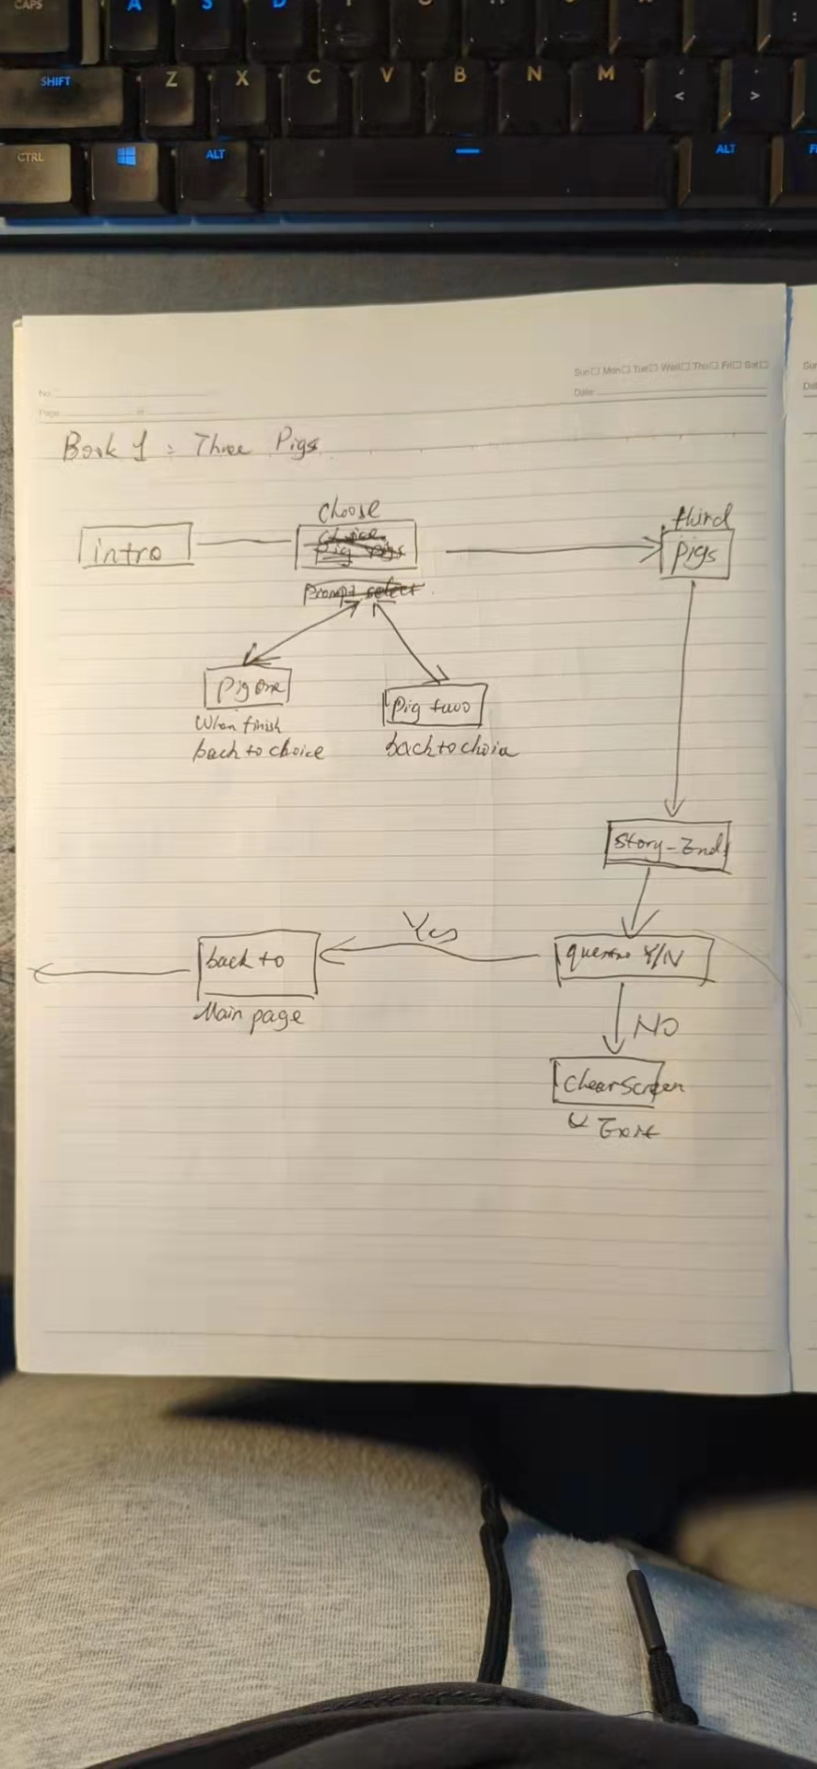

Slide 6



