Slide 1
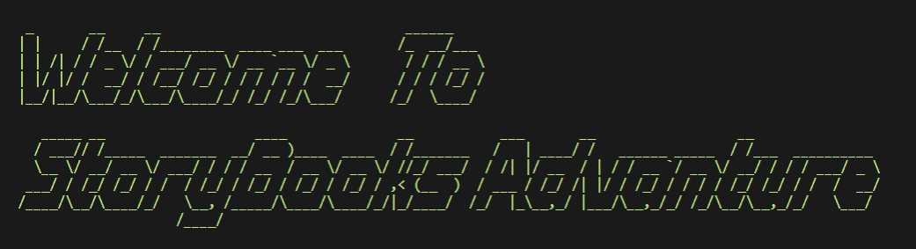


Slide 2
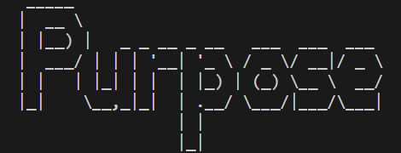
Console / Steam like, choose your own book, games or application
Interactive books or games that every decision made is by yourself
Multiple ending book, every ending is by your choice

Slide 3
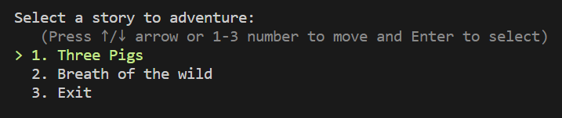
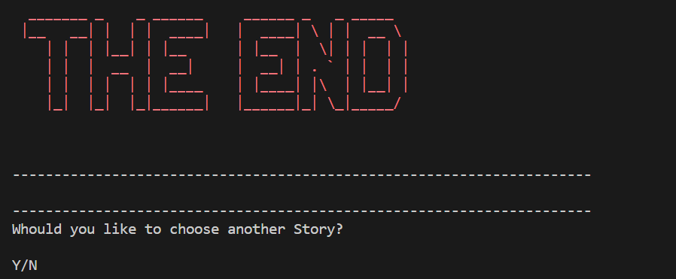
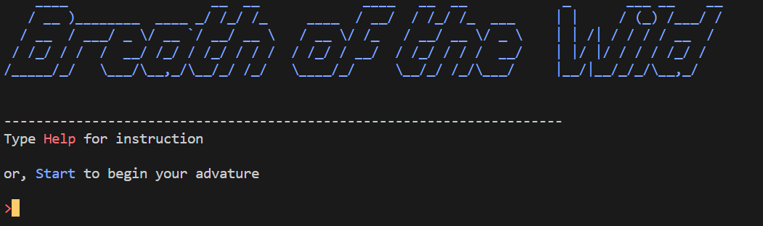
Features of Stroybooks Adventure
Console menu to choose the book/game
Back to console when the books end
Command input for game like books

Slide 4
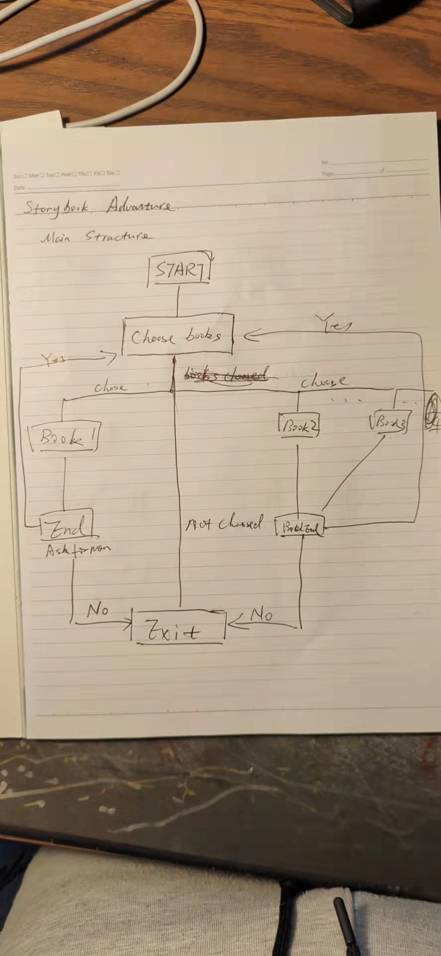
Main Flowchart
Main flow chart for the console
Start
Choose Books
Chosen Book choose another book/game
Book End
Exit App

Slide 5
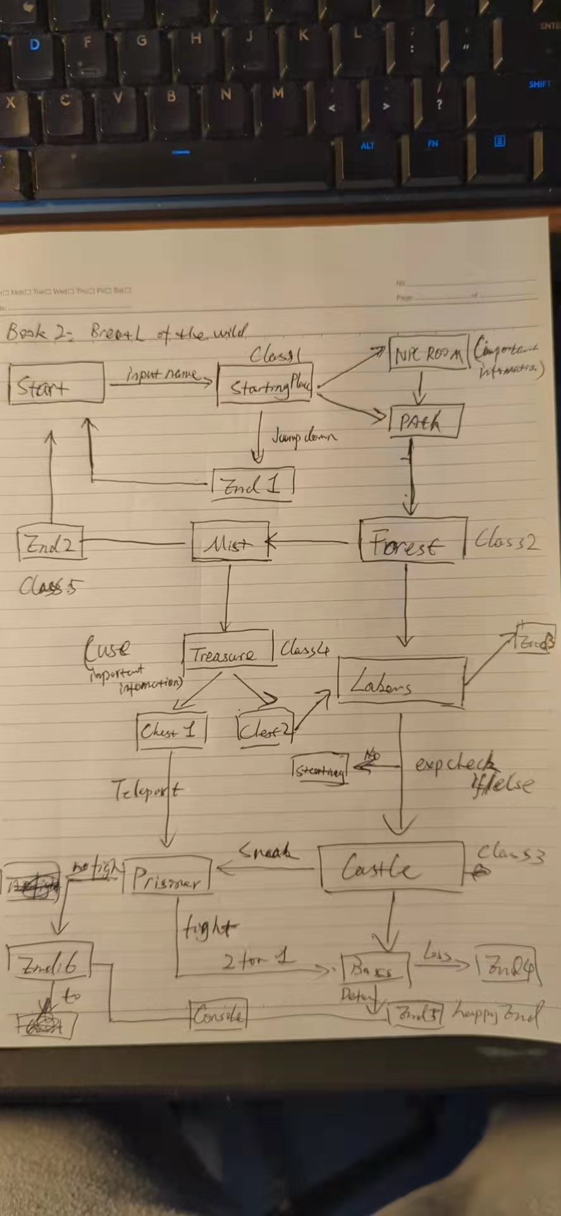
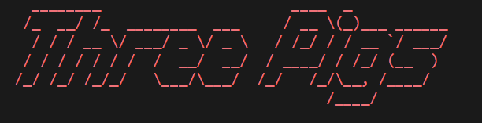
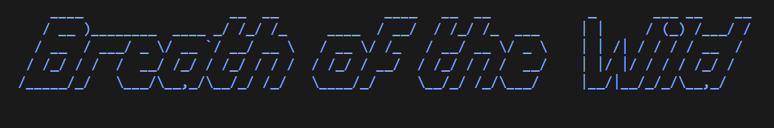
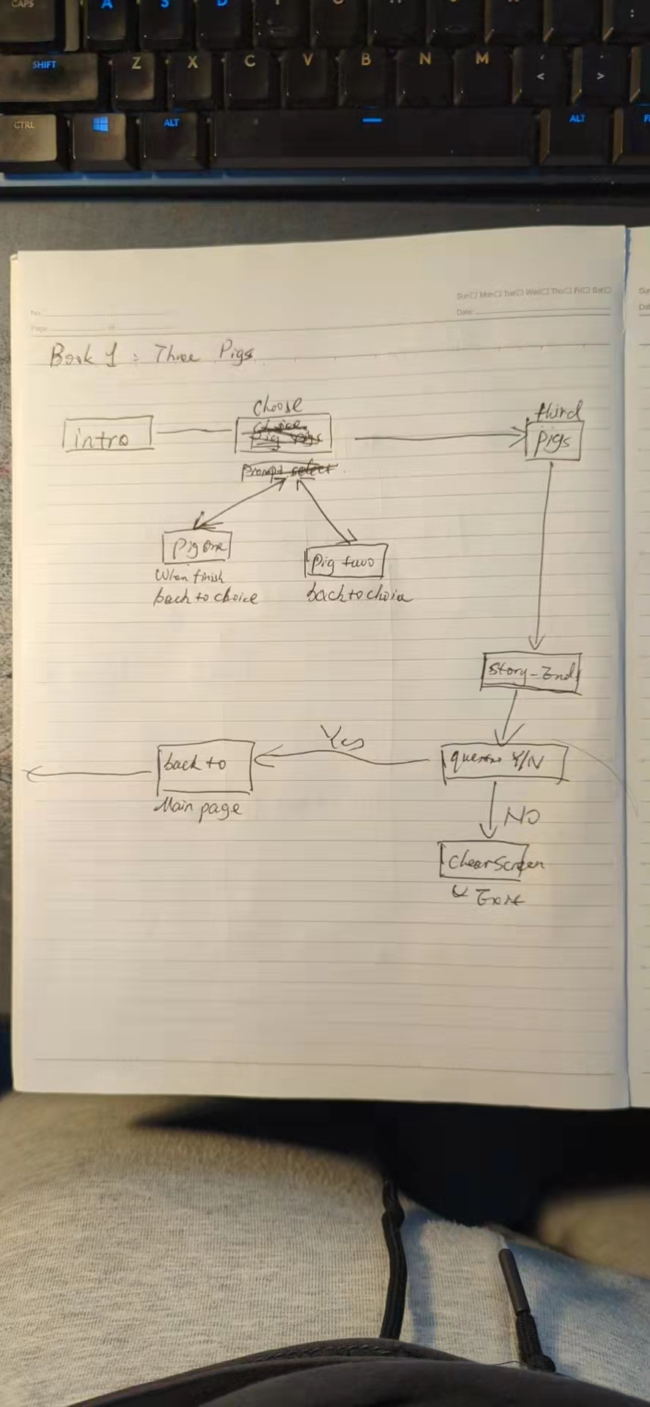

Slide 6
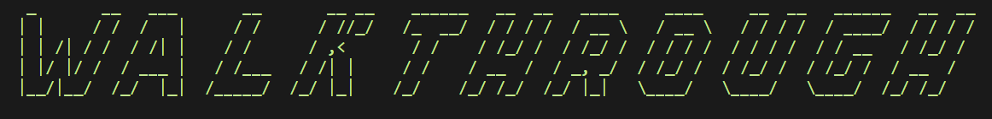

Slide 7

