Slide 1

OFFICIAL BRAND KIT
Ink on paper.
Systems that hold.
Master identity, product system, stationery, and applications.
Built from the approved boards, tokens, and marks — unstretched.
Cypress Command · The AI Playbook, Illustrated Edition · 22 September 2026 · Rev 1.1.1

Slide 2
CYPRESS COMMAND / OFFICIAL BRAND KIT / V1.1
01 / ARCHITECTURE
One master. Named products. No rogue palettes.
01
02
03
Cypress Command
The AI Playbook
Case work
Master identity. The operating brand for documents, products, interfaces, and decisions.
Named product. Illustrated Edition uses Groundwork inks. The mark is recolored into those inks. Cypress Green never appears.
On The Boulevard and Belle Realty may appear as sourced case studies. They do not receive a Cypress palette.
Structure
Meaning
Evidence
Restraint
Consistency
before decoration
before color
before claims
before novelty
before invention
Decision owner: Adam Abdalla. Implementation values live in tokens/tokens.json. Do not hand-edit generated CSS.
PRACTICAL INTELLIGENCE FOR REAL OPERATIONS
02

Slide 3



CYPRESS COMMAND / OFFICIAL BRAND KIT / V1.1
02 / THE MARK
Keep the geometry. Terra leads.
HORIZONTAL · PAPER
HORIZONTAL · NIGHT
Production rules
Clear space: one core-width on every side.
Minimum: horizontal 260 CSS px / 65 mm. Standalone mark 24 px / 12.7 mm.
On photography: sit the mark on a solid Paper or Ink field.
Never distort the C, drop the inner square, rebuild the wordmark from a font, or restore Cypress Green.
MARK · PAPER
MARK · NIGHT
PRACTICAL INTELLIGENCE FOR REAL OPERATIONS
03

Slide 4
CYPRESS COMMAND / OFFICIAL BRAND KIT / V1.1
03 / COLOR · DAY
Color earns its place.
PAPER
PAPER DEEP
INK
INK SOFT
RULE
TERRA
OLIVE
MUSTARD
OXBLOOD
#F4EFE2
#EAE2CD
#1E1B16
#5C554A
#C9BFA8
#A44E12
#49573C
#8F6D0C
#8A2F1F
TERRA
One primary action per decision area. Links, active nav, editorial marker. Small text on Paper uses #95450F.
OLIVE
Verified, complete, grounded panels. Pair with a check or label in operational UI.
MUSTARD
Caution and review. Small warning text on Paper uses #795B08.
OXBLOOD
Error, refusal, critical incident. Never used for emphasis or as a level.
PRACTICAL INTELLIGENCE FOR REAL OPERATIONS
04

Slide 5
CYPRESS COMMAND / OFFICIAL BRAND KIT / V1.1
04 / COLOR · NIGHT
Night is warm. Meaning stays fixed.
NIGHT
RAISED
PAPER
SOFT
RULE
TERRA
OLIVE
MUSTARD
OXBLOOD
#181813
#262218
#F4EFE2
#B8B4A2
#48463A
#D2802F
#9AA989
#CFA032
#C96455
01
Paper becomes the text color. Night is the canvas — never a browser invert.
02
Terra lifts to #D2802F so actions stay visible without glare.
03
Oxblood fill stays #C96455. Small danger text on raised night uses #D87969.
04
Rule is decorative only. Control borders use #827C68.
PRACTICAL INTELLIGENCE FOR REAL OPERATIONS
05

Slide 6
CYPRESS COMMAND / OFFICIAL BRAND KIT / V1.1
05 / TYPOGRAPHY
Three families. One reading order.
Besley
The Ten Interviews
Scale
Display and headings. Warm, editorial. Never for dense UI labels.
Display
Besley 48–64
Archivo
H1
Besley 32–40
NAVIGATION · LABELS · BUTTONS · METADATA
Functional sans. Body 17 / 1.55 in long documents. Eyebrows tracked and uppercase.
H2
Besley 24–28
Courier Prime
H3
Archivo 18–20
inbox/2026-09-21.md USER.md Fig. 02
Code, filenames, figure IDs. Never headlines.
Body
16–17
Label
Archivo 11–12
Mono
Courier 12–14
Caption
FIG. 00
PRACTICAL INTELLIGENCE FOR REAL OPERATIONS
06

Slide 7
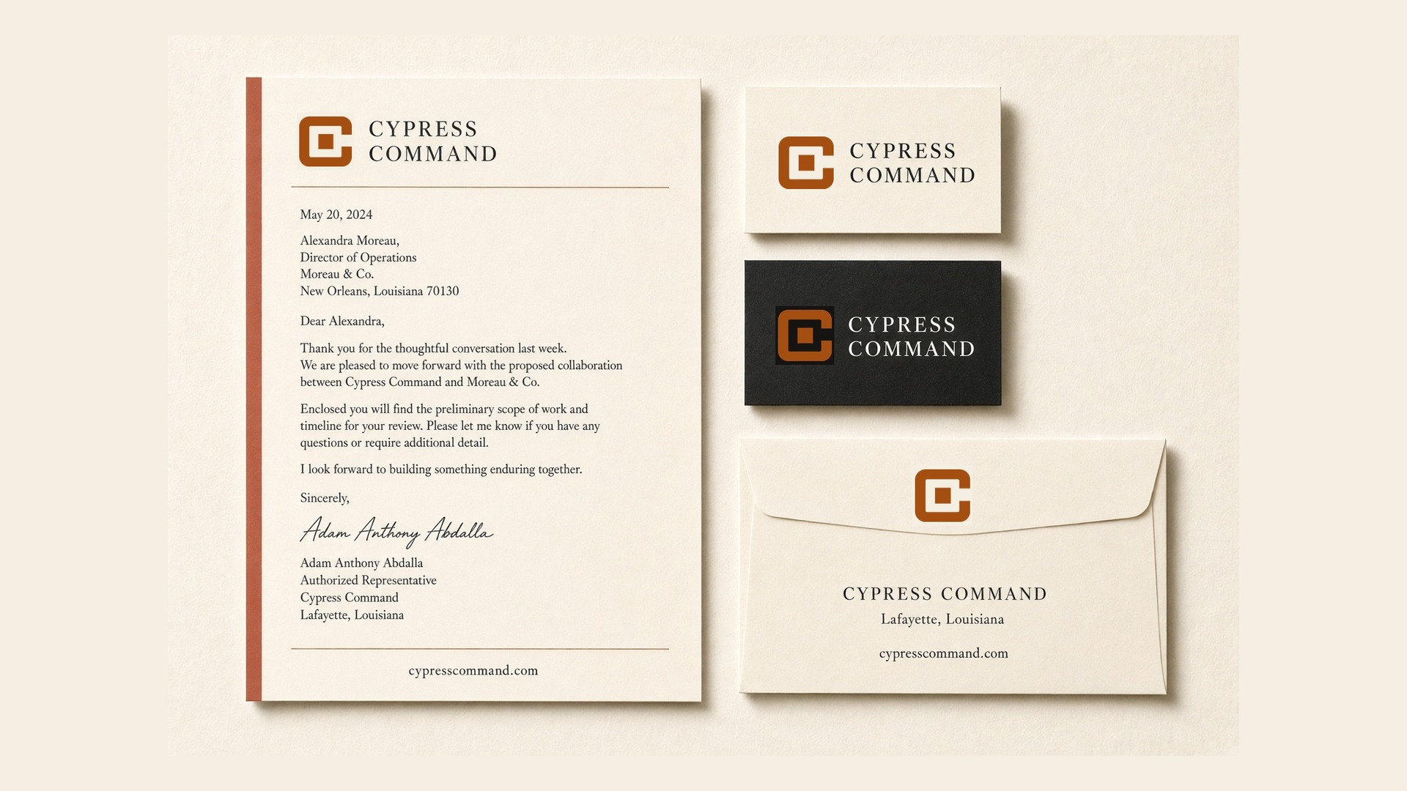
CYPRESS COMMAND / OFFICIAL BRAND KIT / V1.1
06 / STATIONERY
Letterhead, cards, envelope — native proportion.
PRACTICAL INTELLIGENCE FOR REAL OPERATIONS
07

Slide 8
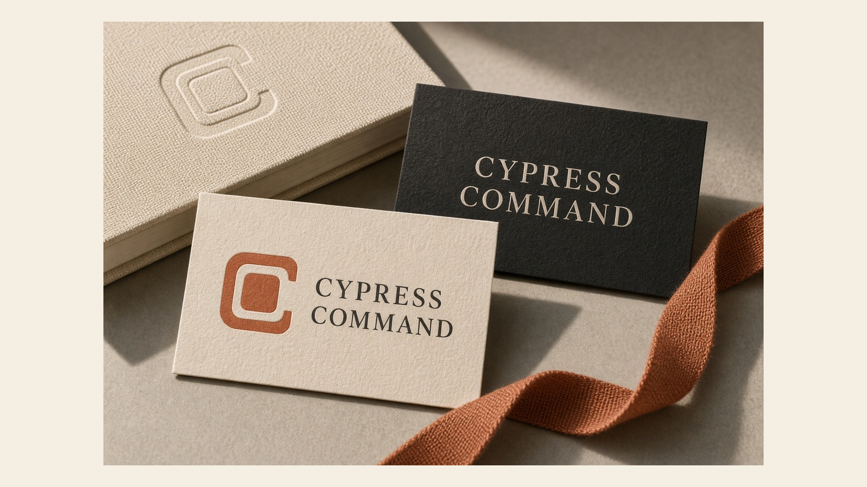
CYPRESS COMMAND / OFFICIAL BRAND KIT / V1.1
07 / OBJECTS
The mark should feel stamped, not pasted.
PRACTICAL INTELLIGENCE FOR REAL OPERATIONS
08

Slide 9

CYPRESS COMMAND / OFFICIAL BRAND KIT / V1.1
08 / DIGITAL
Website, signature, deck, dashboard.
PRACTICAL INTELLIGENCE FOR REAL OPERATIONS
09

Slide 10
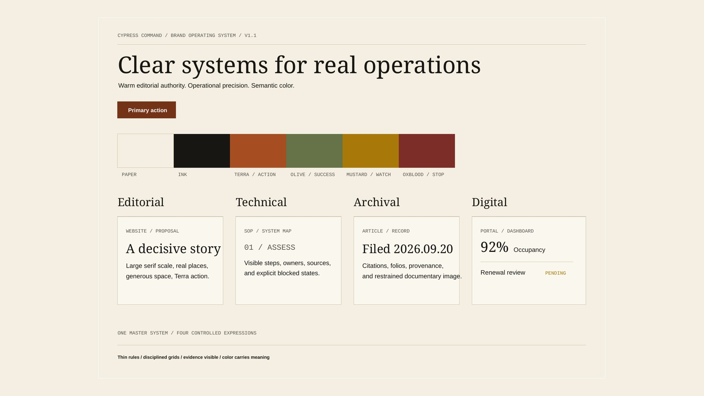
CYPRESS COMMAND / OFFICIAL BRAND KIT / V1.1
09 / MASTER · LIGHT
Approved light operating board.
PRACTICAL INTELLIGENCE FOR REAL OPERATIONS
10

Slide 11
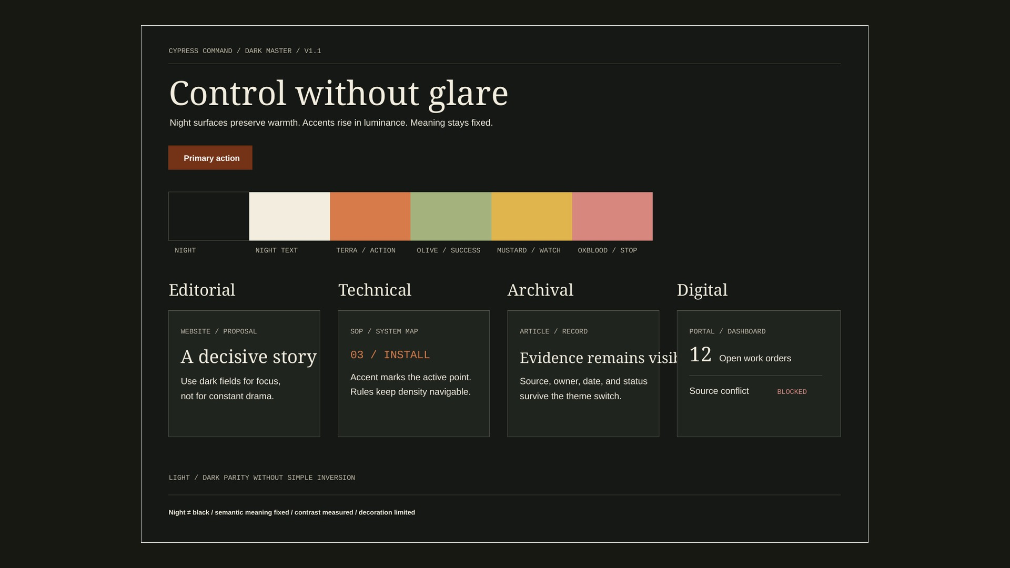
CYPRESS COMMAND / OFFICIAL BRAND KIT / V1.1
10 / MASTER · DARK
Approved dark operating board.
PRACTICAL INTELLIGENCE FOR REAL OPERATIONS
11

Slide 12
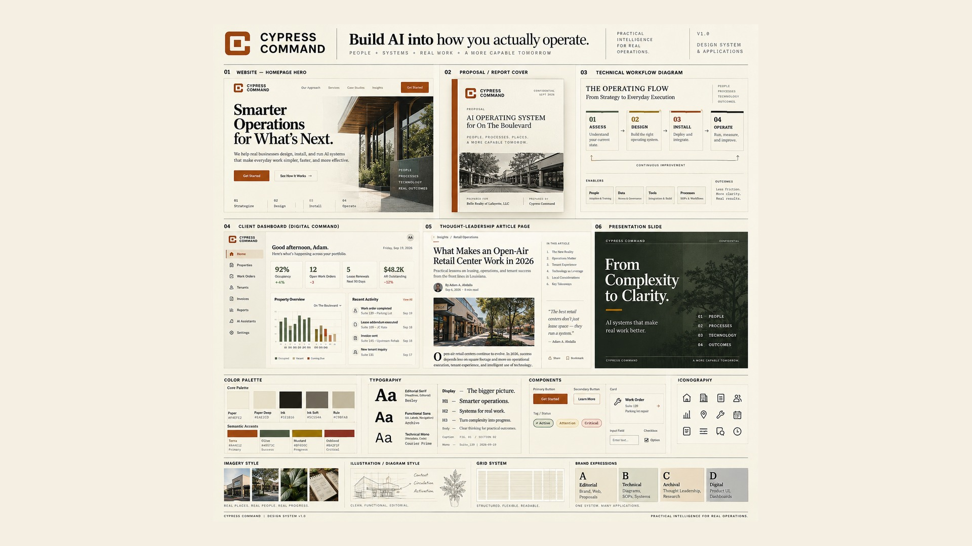
CYPRESS COMMAND / OFFICIAL BRAND KIT / V1.1
11 / APPLICATIONS · LIGHT
Website, proposal, flow, dashboard, article, slide.
PRACTICAL INTELLIGENCE FOR REAL OPERATIONS
12

Slide 13
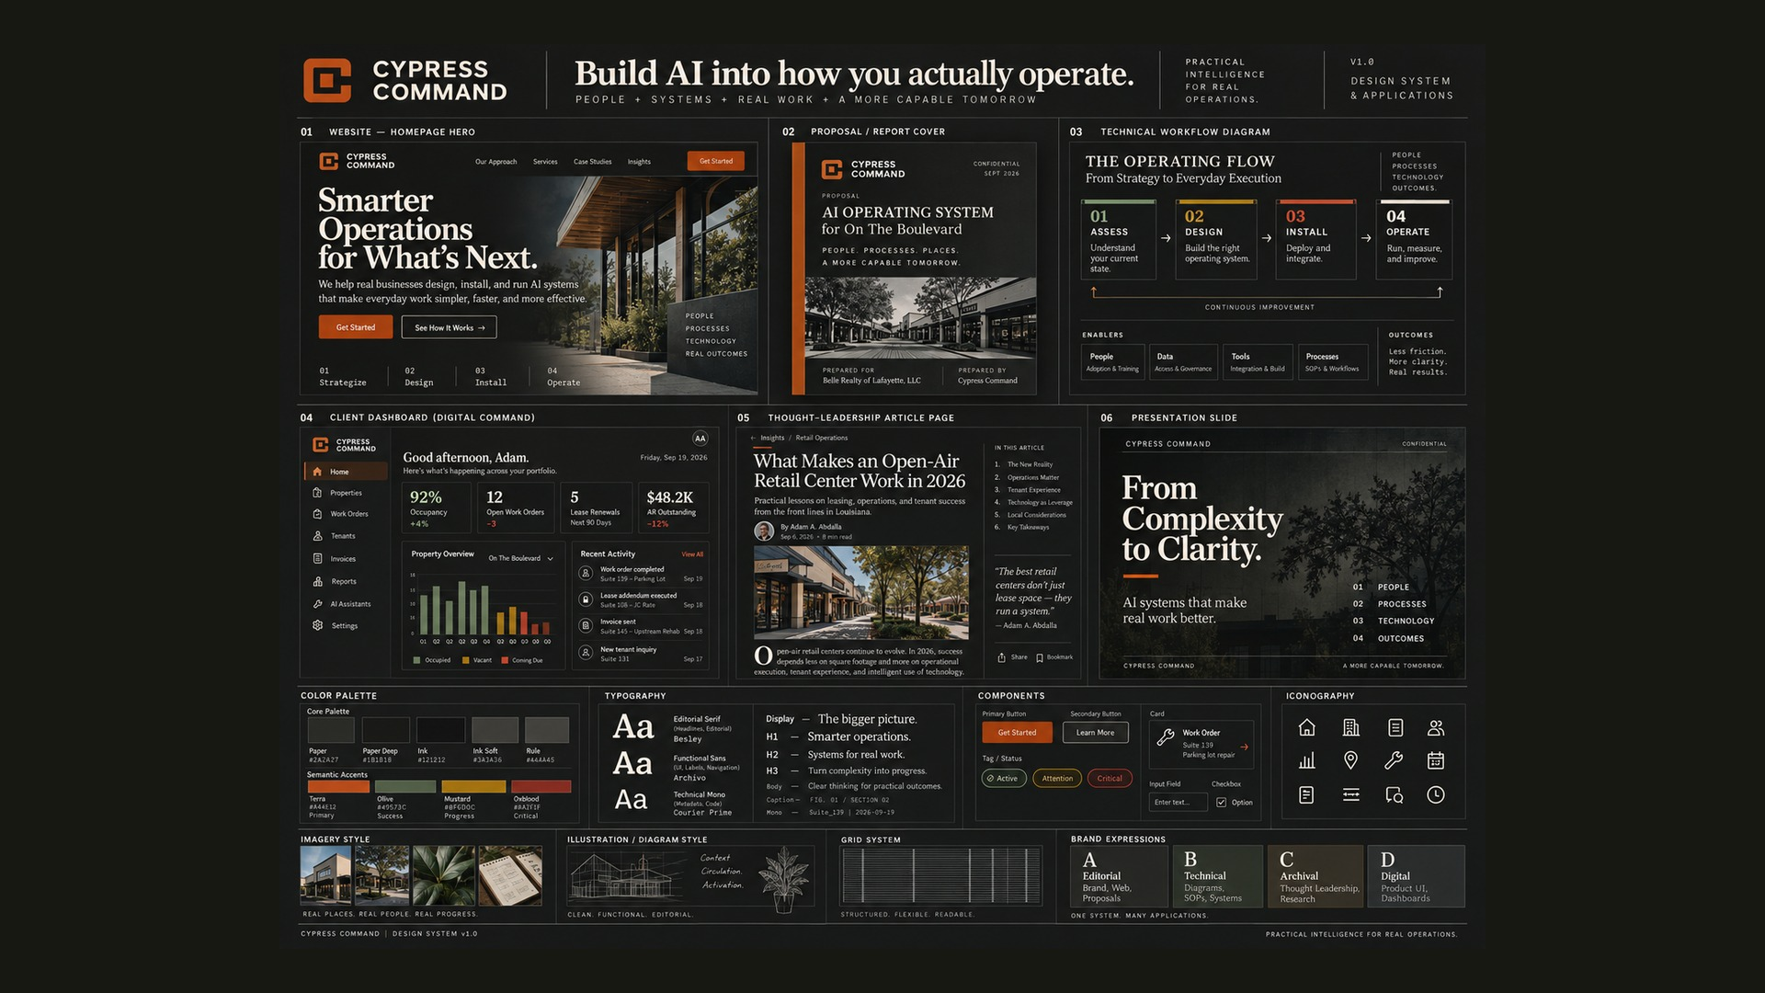
CYPRESS COMMAND / OFFICIAL BRAND KIT / V1.1
12 / APPLICATIONS · DARK
The same system after the night translation.
PRACTICAL INTELLIGENCE FOR REAL OPERATIONS
13

Slide 14
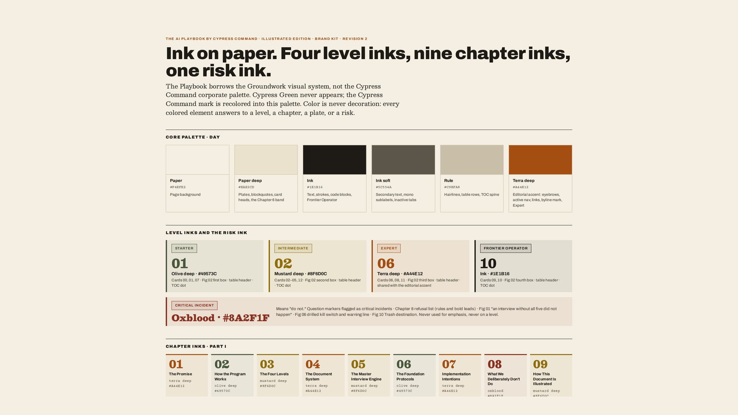
CYPRESS COMMAND / OFFICIAL BRAND KIT / V1.1
13 / PLAYBOOK · FOUNDATION
Core palette, level inks, night values, type.
PRACTICAL INTELLIGENCE FOR REAL OPERATIONS
14

Slide 15
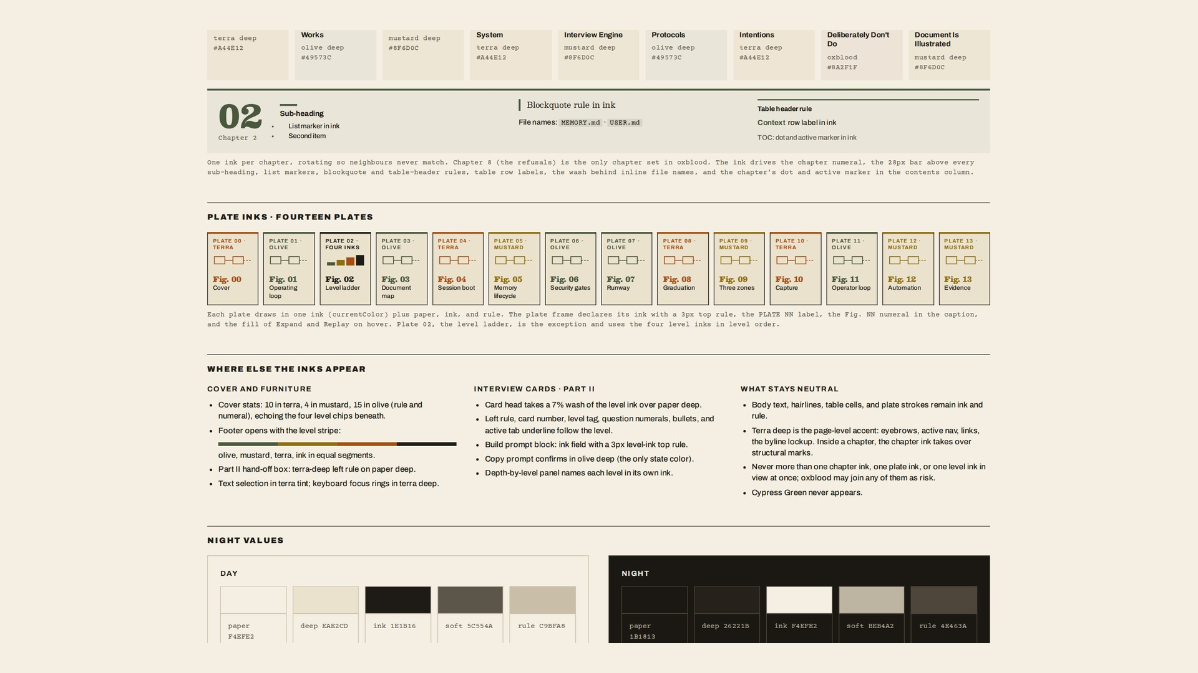
CYPRESS COMMAND / OFFICIAL BRAND KIT / V1.1
14 / PLAYBOOK · CHAPTERS
Chapter inks, plates, figure language.
PRACTICAL INTELLIGENCE FOR REAL OPERATIONS
15

Slide 16
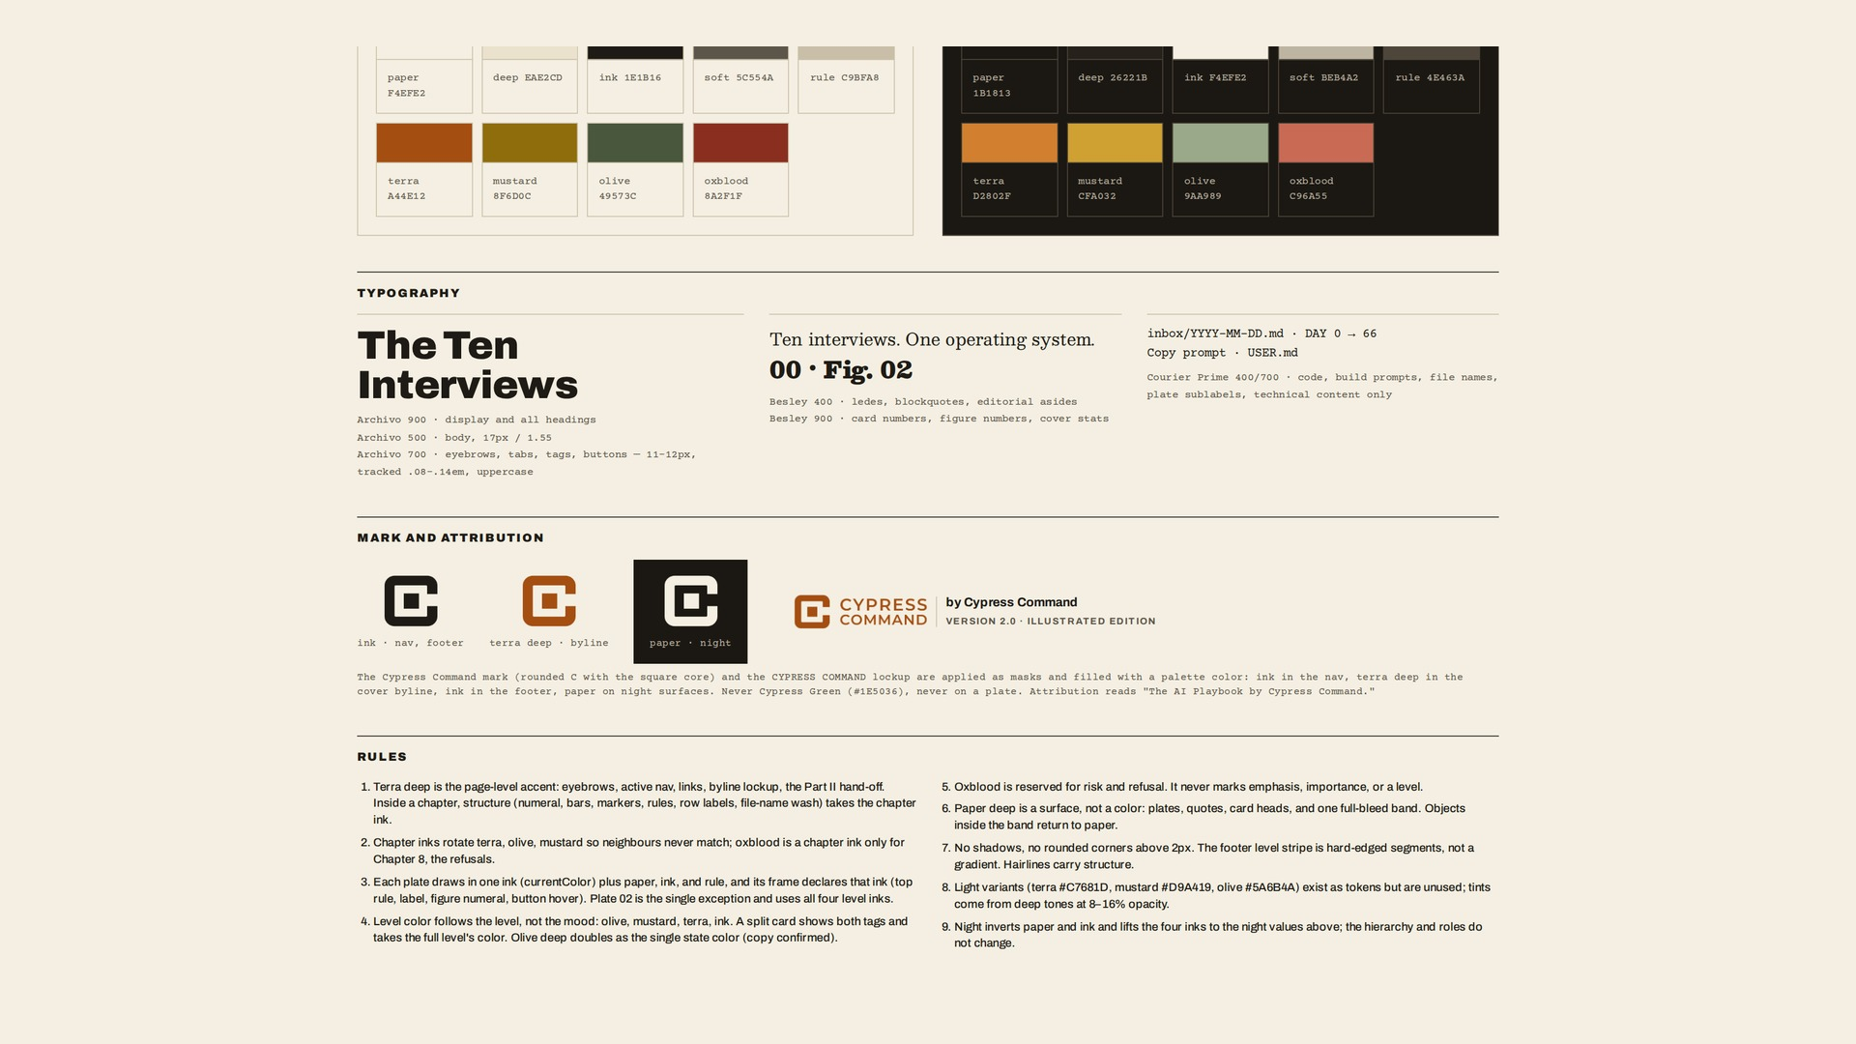
CYPRESS COMMAND / OFFICIAL BRAND KIT / V1.1
15 / PLAYBOOK · PAGE
UI structure, mark attribution, rules.
PRACTICAL INTELLIGENCE FOR REAL OPERATIONS
16

Slide 17
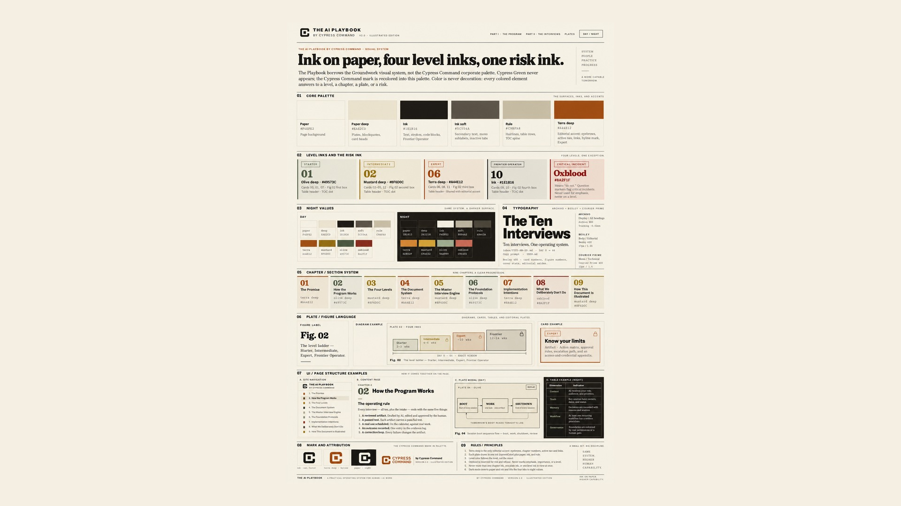
CYPRESS COMMAND / OFFICIAL BRAND KIT / V1.1
16 / PLAYBOOK · SYSTEM
Full Illustrated Edition visual system.
PRACTICAL INTELLIGENCE FOR REAL OPERATIONS
17

Slide 18
CYPRESS COMMAND / OFFICIAL BRAND KIT / V1.1
17 / DO · DON’T
Keep the form coherent.
DO
DON’T
01 Use official SVG masters: cc-v1-horizontal-light / dark and the standalone marks.
01 Do not restore Cypress Green on the mark or in Playbook pages.
02 Hold one dominant expression per artifact: Editorial, Technical, Archival, or Digital.
02 Do not stretch logos or boards to fill a frame. Letterbox instead.
03 Pair color with a label, icon, or numeral. Underline links in prose.
03 Do not use Paper as text on strong Mustard, or Rule as an input outline.
04 Convert to CMYK only against the printer’s profile, then proof on stock.
04 Do not invent metrics, client quotes, or a migrated public website.
05 Edit tokens, rebuild, proof light and dark, then CHANGELOG.
05 Do not give On The Boulevard or Belle Realty a Cypress color system.
PRACTICAL INTELLIGENCE FOR REAL OPERATIONS
18

Slide 19
CYPRESS COMMAND / OFFICIAL BRAND KIT / V1.1
18 / STEWARDSHIP
How the kit is used tomorrow morning.
Email signature
Source of truth
Adam Anthony Abdalla
Authorized Representative
————————————————————
CYPRESS COMMAND
Lafayette, Louisiana
P 337-288-5411
E adam@cypresscommand.com
W cypresscommand.com
Package
Cypress_Command_Design_System_v1/
Tokens
tokens/tokens.json
Marks
assets/logos/cc-v1-*.svg
Guide
Cypress_Command_Design_System_v1.pdf
Change
Edit source → rebuild → proof both themes → CHANGELOG → version.
Mark: 32 px standalone Terra on Paper. No green. No slogan unless the product is The AI Playbook.
PRACTICAL INTELLIGENCE FOR REAL OPERATIONS
19

