Slide 1

Design of the First
Action-Adventure Video Game:
Adventure for the Atari 2600
Warren Robinett
University of North Carolina at Chapel Hill
Department of Computer Science
Notes:
asasdasd.
asdasdasd

Slide 2
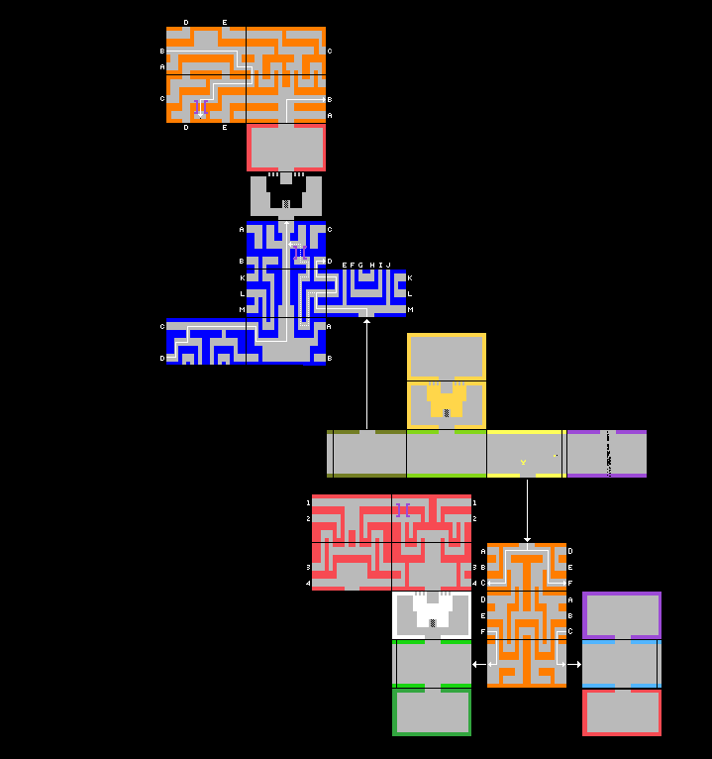
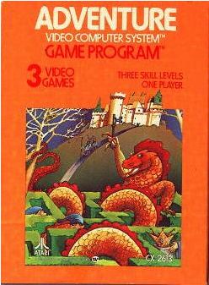
Notes:
asdasdasd

Slide 3
Overview of Talk
Early History of Atari
Architecture of the Atari 2600 Video Game
Programming the Atari 2600:
  How Video Games Were Made in the Late 1970’s
Design of Adventure
Notes:
asdasdasd

Slide 4
History of Atari
Atari invented the video game
  Pong, 1971, coin-op
Atari 2600 hooked up to home TV, 1977
  Games on ROM cartridges
  18 million consoles sold, 500 game carts developed
Creation of game genres
  shooters, driving, sports, adventure, side-scroller
Notes:
asdasdasd

Slide 5
Atari 2600 Specs
4K bytes of ROM
  for game program and data
128 bytes of RAM
  for game variables and stack
1.2 MHz 8-bit processor (6502)
Custom chip (TIA)
  generated video signal to drive TV
  “Television Interface Adaptor” -- codename Stella
Notes:
asdasdasd

Slide 6
Atari 2600 System Diagram
Atari 2600 Console
Game Cart
Processor
ROM
RAM
I/O
TIA
chip
TV
video
joysticks
Notes:
asdasdasd

Slide 7
Atari 2600 -- The Bad News
No frame buffer
No cache
No floating point math
No multiply or divide instructions
  Adding two 8-bit integers: 10 μsec
Must generate a new video frame 60 times per second
  Using 5000 machine instructions per frame
Notes:
asdasdasd

Slide 8
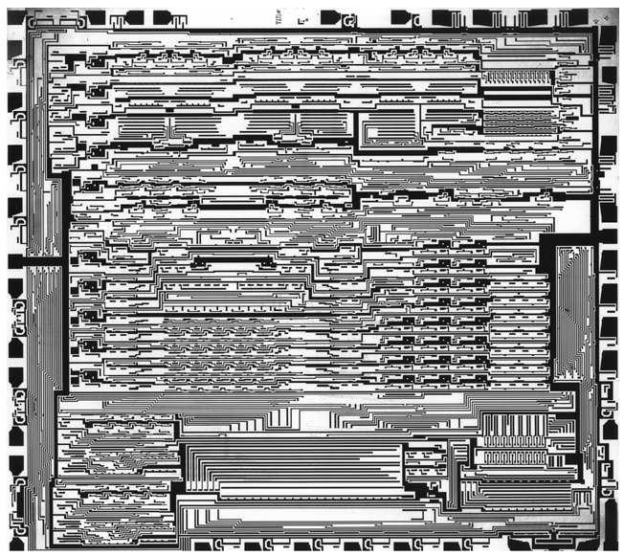
Atari 2600 -- The Good News
TIA chip -- hardware support for video games
  Sprites
  Collision detection
  Audio synthesis
  Interval timer
Notes:
asdasdasd

Slide 9
Memory Map
00 - 2C: TIA chip registers
80 - FF: RAM
280 - 281: Joystick port
282 - 283: Console switches
284 - 297: Interval timer
F000 - FFFF: Game cartridge ROM
Notes:
asdasdasd

Slide 10
Timing of Video Frame
Video Frame
Vertical Blank
Horiz
Blank
262 scan lines
= 1/60 sec
Overscan
228 pixels = 76 machine cycles = 63.5 μsec
Notes:
asdasdasd

Slide 11
Frame Timing
Kernel (display loop synced with scan beam)
  192 scan lines Display
Overscan: 37 scan lines Game play
Vertical Sync: 3 scan lines
Vertical Blank: 30 scan lines Game play
Notes:
asdasdasd

Slide 12
Q: No Frame Buffer?
How do you display anything?
A: There is a buffer that can hold one scan-line
  The processor keeps changing what’s in it as the scan beam moves down the screen.
Unless the processor changes something, it generates the same line again and again
  Vertical stripes when the processor crashes.
Notes:
asdasdasd

Slide 13
TIA chip’s Scan-line Buffer:
6 “bit-planes” + background
Background
Playfield 20 bits
Ball 1 bit
Player 0 8 bits
Missile 0 1 bit
Player 1 8 bits
Missile 1 1 bit
Notes:
asdasdasd

Slide 14
Things sprites could do
Sprite (P0)
  Move horizontally
  Change graphics
  Change color
  Change width
  Replicate
Notes:
asdasdasd

Slide 15
Kernel Programming
Kernel loop synchronized with scan beam.
  76 machine cycles per scan-line.
Two-line kernels were usual.
  2 x 76 = 152 cycles for the loop
If it took one too many cycles, timing failed and the TV screen rolled.
Notes:
asdasdasd

Slide 16
Cycle Counting
3 LDA LINE_COUNT
2 SEC
3 SBC P1_Y_COORD
2 BPL *+10
3 LDY P1_INDEX
4 LDA (P1_PTR),Y
3 STA GRP1
2 BEQ *+2
5 INC P1_INDEX
27 cycles total
Notes:
asdasdasd

Slide 17
Screen Shots
You could do a lot with this hardware.
Every cart had a different kernel.
Notes:
asdasdasd

Slide 18
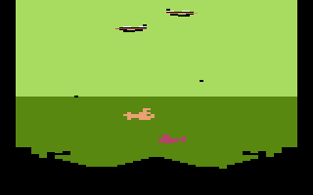
Screen Shots
Notes:
asdasdasd

Slide 19
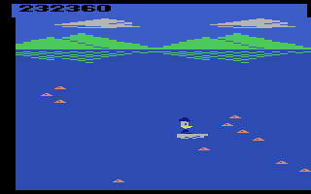
Screen Shots
Notes:
asdasdasd

Slide 20
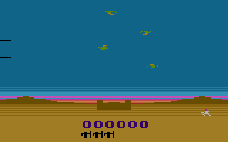
Screen Shots
Notes:
asdasdasd

Slide 21
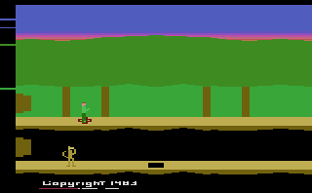
Screen Shots
Notes:
asdasdasd

Slide 22
Collision Detection:
Detects Video Overlap
Background
Playfield
Ball
Player 0
Missile 0
Player 1
Missile 1
Collision when pair of “On” pixels overlap
6 graphic objects (5 sprites + PF)
  15 possible pairs for collisions
  15 1-bit collision registers
Notes:
asdasdasd

Slide 23
Sound Generators
2 independent sound generators
  1-bit wide, 30 kHz sound signal
  4 bit volume control (16 volume levels)
Generates psuedo-random sequences
  4-bit sound type register (16 sound timbres)
  5-bit frequency register (32 pitches)
Processor could change sound parameters
Notes:
asdasdasd

Slide 24
Design of Atari 2600 Adventure
Directly inspired by the original text adventure by Willie Crowther and Don Woods.
Main problems:
  How to do in a 4K video game program what took hundreds of K on a mainframe computer?
  How to adapt the adventure game idea to the video game medium?
  My boss told me it was impossible, and not to work on it.
Notes:
asdasdasd

Slide 25
Crowther & Woods Text Adventure
Welcome to Adventure!! Would you like instructions?
YES
Somewhere nearby is Collosal Cave, where others have found fortunes in treasure and gold, though it is rumored that some who enter are never seen again. Magic is said to work in the cave. I will be your eyes and hands. Direct me with commands of l or 2 words.
You are standing at the end of a road before a small brick building. Around you is a forest. A small stream flows out of the building and down a gully.
Notes:
asdasdasd

Slide 26
Picking up Objects
ENTER BUILDING
You are inside a building, a well house for a large spring.
There are some keys on the ground here.
There is a shiny brass lamp nearby.
TAKE KEYS
OK
TAKE LAMP
OK
Notes:
asdasdasd

Slide 27
Carrying Objects
LEAVE BUILDING
You're in front of building.
INVENTORY
You are currently holding the following:
Set of keys
Brass lantern
Notes:
asdasdasd

Slide 28
Moving from Place to Place
GO SOUTH
You are in a valley in the forest beside a stream tumbling along a rocky bed.
GO SOUTH
At your feet, all the water splashes into a 2-inch slit in the rock. Downstream the streambed is bare rock.
Notes:
asdasdasd

Slide 29
Obstacles
GO SOUTH
You are in a 20-foot depression floored with bare dirt. Set into the dirt is a strong steel grate mounted in concrete. A dry streambed leads into the depression.
The grate is locked.
GO DOWN
You can't go through a locked steel grate!
You're outside grate.
The grate is locked.
Notes:
asdasdasd

Slide 30
Using Objects
USE KEYS
The grate is now unlocked.
GO DOWN
You are in a small chamber beneath a 3x3 steel grate to the surface. A low crawl over cobbles leads inward to the west.
The grate is open.
GO WEST
You are crawling over cobbles in a low passage. There is a dim light at the east end of the passage.
There is a small wicker cage discarded nearby.
Notes:
asdasdasd

Slide 31
Another Obstacle
GO WEST
It is now pitch dark. If you proceed you will likely fall into a pit.
LIGHT LAMP
You are in a debris room filled with stuff washed in from the surface. A low wide passage with cobbles becomes plugged with mud and debris here, but an awkward canyon leads upward and west. A note on the wall says "MAGIC WORD XYZZY".
A three-foot black rod with a rusty star on an end lies nearby.
Notes:
asdasdasd

Slide 32
Creatures
GO WEST
You are in a splendid chamber thirty feet high. The walls are frozen rivers of orange stone. An awkward canyon and a good passage exit from east and west sides of the chamber.
There is a threatening little dwarf in the room with you!
One sharp nasty knife is thrown at you!
It misses!
Notes:
asdasdasd

Slide 33
How to Adapt Adventure Game Idea to Video Game Format?
How to display rooms?
How to display objects?
How to display your own location?
How to move from room to room?
  One room on screen at a time, using PF graphics.
  P0 and P1 sprites.
  Use the Ball sprite. Joystick moves you.
  Move off the edge of screen to adjacent room.
Notes:
asdasdasd

Slide 34
How to Adapt Adventure Game Idea to Video Game Format?
How to pick up objects?
How to drop objects?
How to use objects?
How to do creatures?
  Video overlap of Self and Object sprites.
  Can carry only one object. Button on joystick drops it.
  Video overlap of two objects.
  Object with subroutine to make it do things.
Notes:
asdasdasd

Slide 35
Demo Adventure
Notes:
asdasdasd

Slide 36
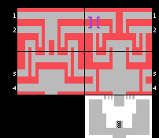
Network of 30 Rooms
Notes:
asdasdasd

Slide 37
Secret Room
I created a secret room and hid my name in it.
This was the first Easter Egg.
  “little hidden surprises”
Notes:
asdasdasd

Slide 38
Objects
3 Keys: opened castle doors.
Sword: killed dragons.
Chalice: won the game.
Magnet: attracts other objects.
Bridge: crosses maze walls.
Dot: gets you into secret room.
Notes:
asdasdasd

Slide 39
Creatures
3 Dragons: chase you and eat you.
Bat: steals what you’re carrying, moves objects around
Behaviorism
  Each creature had a prioritized list of objects to go toward or away from. Responded to highest priority object in the same room with it.
Notes:
asdasdasd

Slide 40
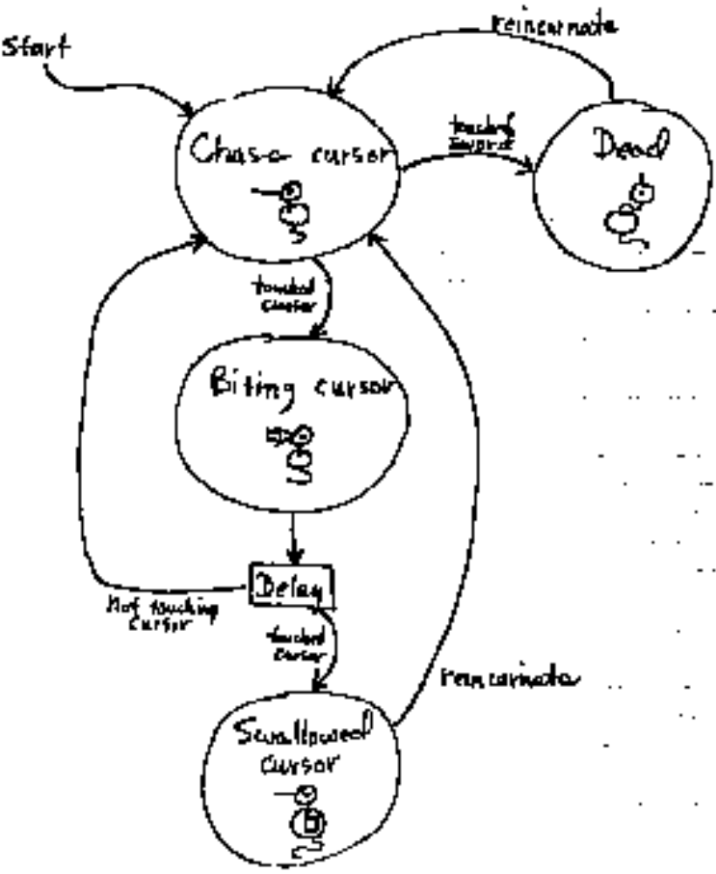
State Diagram for Dragon
Notes:
asdasdasd

Slide 41
Object List Data Structure
room
Ob # 0
Ptr to location
X coord
Ob # 1
Ptr graphics #
Y coord
Ob # 2
Ptr graphics tbl
Ob # 3
Color
graphics #
Ob attributes
Ob # N
#
#
#
Graphics Data
Notes:
asdasdasd

Slide 42
Room List Data Structure
Room 0
Ptr to room grx
Room
Graphics
(21 bytes)
Room 1
Color
Room 2
Room attributes
Room 3
Adjacent North
Rooms South
East
West
Room N
Notes:
asdasdasd

Slide 43
Adventure RAM USage
Kernel variables: 18 bytes
World state: 49 bytes
Program variables: 34 bytes
Reserved for Stack: 14 bytes (max stack depth)
Unused 13 bytes
  TOTAL 128 bytes of RAM
Notes:
asdasdasd

Slide 44
Adventure ROM Usage
Kernel and display code: 751 bytes
General adventure game code: 1081 bytes
Code for creatures and objects: 763 bytes
Sound code and data: 221 bytes
Data structures and graphics data: 1263 bytes
Unused: 17 bytes
  TOTAL ROM 4096 bytes
Notes:
asdasdasd

Slide 45
Summary
First action-adventure video game.
Sold 1 million units ($25 retail).
  I got paid a salary ($22K/year).
Notes:
asdasdasd

Slide 46
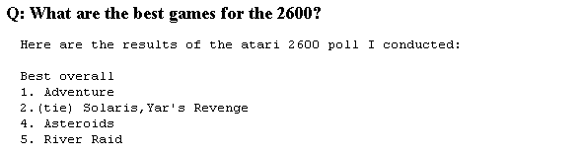
Summary
From the web:
Notes:
asdasdasd

