Slide 1
Minimum Spanning Trees
Data Structures and Algorithms
Nanjing University, Fall 2021
郑朝栋

Slide 2
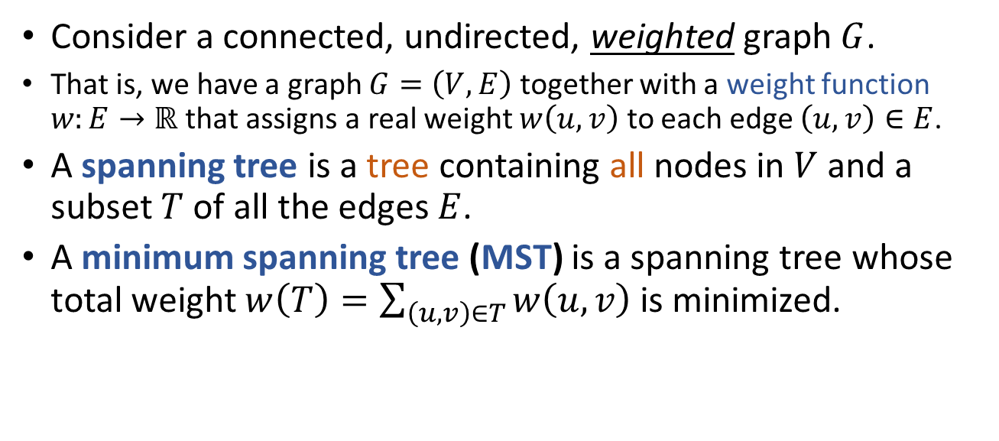
Minimum Spanning Trees (MST)
Consider a connected, undirected, weighted graph $G$.
That is, we have a graph $G=\left(V,E\right)$ together with a weight function $w:E→ℝ$ that assigns a real weight $w\left(u,v\right)$ to each edge $\left(u,v\right)∈E$.
A spanning tree is a tree containing all nodes in $V$ and a subset $T$ of all the edges $E$.
A minimum spanning tree (MST) is a spanning tree whose total weight $w\left(T\right)=\sum_{\left(u,v\right)∈T}{w\left(u,v\right)}$ is minimized.
8
A
5
8
A
5
8
A
5
B
10
C
B
10
C
B
10
C
2
3
2
3
2
3
18
D
16
18
D
30
16
18
D
30
16
12
30
12
12
E
14
F
E
14
F
E
14
F
4
G
26
4
G
26
4
G
26

Slide 3
Application of MST
Network Design: (E.g., build a minimum cost network connecting all nodes.)
Transportation networks.
Water supply networks.
Telecommunication networks.
Computer networks.
Many other applications…
E.g., important subroutine in more advanced algorithms. (E.g., used in a classical approximation algorithm for solving TSP.)

Slide 4
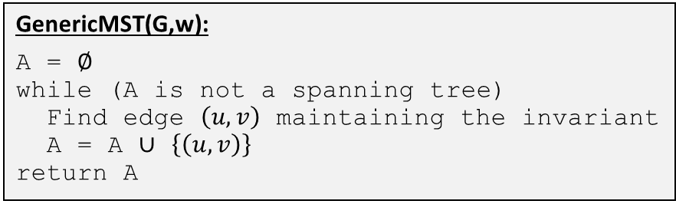

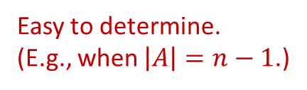
Computing MST
Consider the following generic method:
Starting with all nodes and an empty set of edges $A$.
Find some edge to add to $A$, maintaining the invariant that “$A$ is a subset of some MST”. (At anytime, $A$ is the edge set of a spanning forest.)
Repeat above step until we have a spanning tree. (The resulting spanning tree must be a MST.)
These edges also called “safe edges”.
Easy to determine. (E.g., when $\left|A\right|=n−1$.)
How to identify “safe edges”?
GenericMST(G,w):
A = $∅$
while (A is not a spanning tree)
Find edge $\left(u,v\right)$ maintaining the invariant
A = A $∪$ $\left\{\left(u,v\right)\right\}$
return A

Slide 5

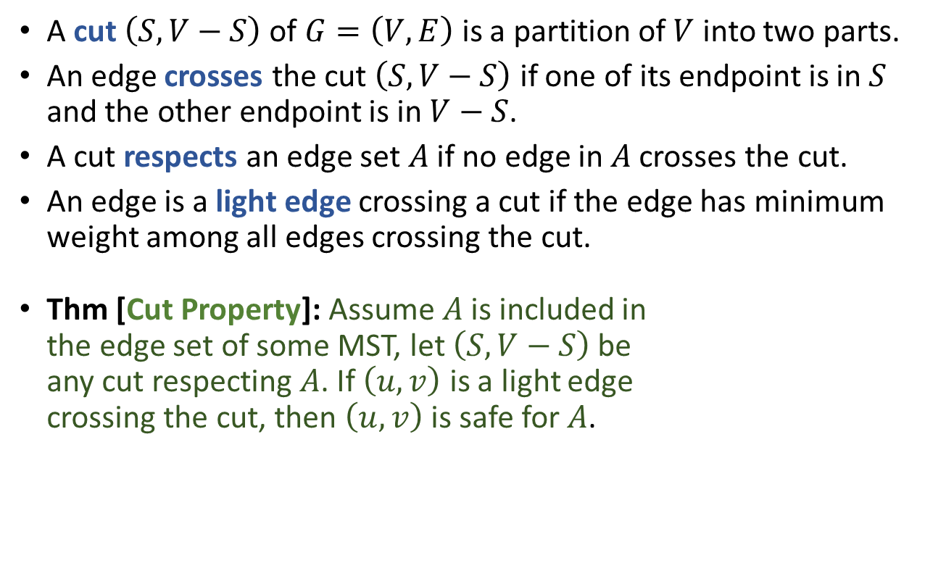

Identifying Safe Edges
A cut $\left(S,V−S\right)$ of $G=\left(V,E\right)$ is a partition of $V$ into two parts.
An edge crosses the cut $\left(S,V−S\right)$ if one of its endpoint is in $S$ and the other endpoint is in $V−S$.
A cut respects an edge set $A$ if no edge in $A$ crosses the cut.
An edge is a light edge crossing a cut if the edge has minimum weight among all edges crossing the cut.
Thm [Cut Property]: Assume $A$ is included in the edge set of some MST, let $\left(S,V−S\right)$ be any cut respecting $A$. If $\left(u,v\right)$ is a light edge crossing the cut, then $\left(u,v\right)$ is safe for $A$.
$$S$$
8
A
5
B
10
C
2
3
18
D
30
16
12
E
14
F
4
G
26
$$V−S$$

Slide 6



Identifying Safe Edges
Thm [Cut Property]: Assume $A$ is included in the edge set of some MST, let $\left(S,V−S\right)$ be any cut respecting $A$. If $\left(u,v\right)$ is a light edge crossing the cut, then $\left(u,v\right)$ is safe for $A$.
Proof:
Let $T$ be a MST containing $A$, assume it does not include $\left(u,v\right)$.
Then some edge in $T$ must cross the cut, let $\left(x,y\right)$ be one such edge.
$T^{′}=T−\left\{\left(x,y\right)\right\}+\left\{\left(u,v\right)\right\}$ must be a spanning tree.
Since $\left(u,v\right)$ is light edge crossing the cut, $T^{′}$ must be a MST, and $\left(u,v\right)$ is safe for $A$ in $T^{′}$.
$$S$$
8
A
5
B
10
C
$$S$$
2
3
u
x
18
D
30
16
12
E
14
F
$$V−S$$
v
y
4
G
26
$$V−S$$

Slide 7

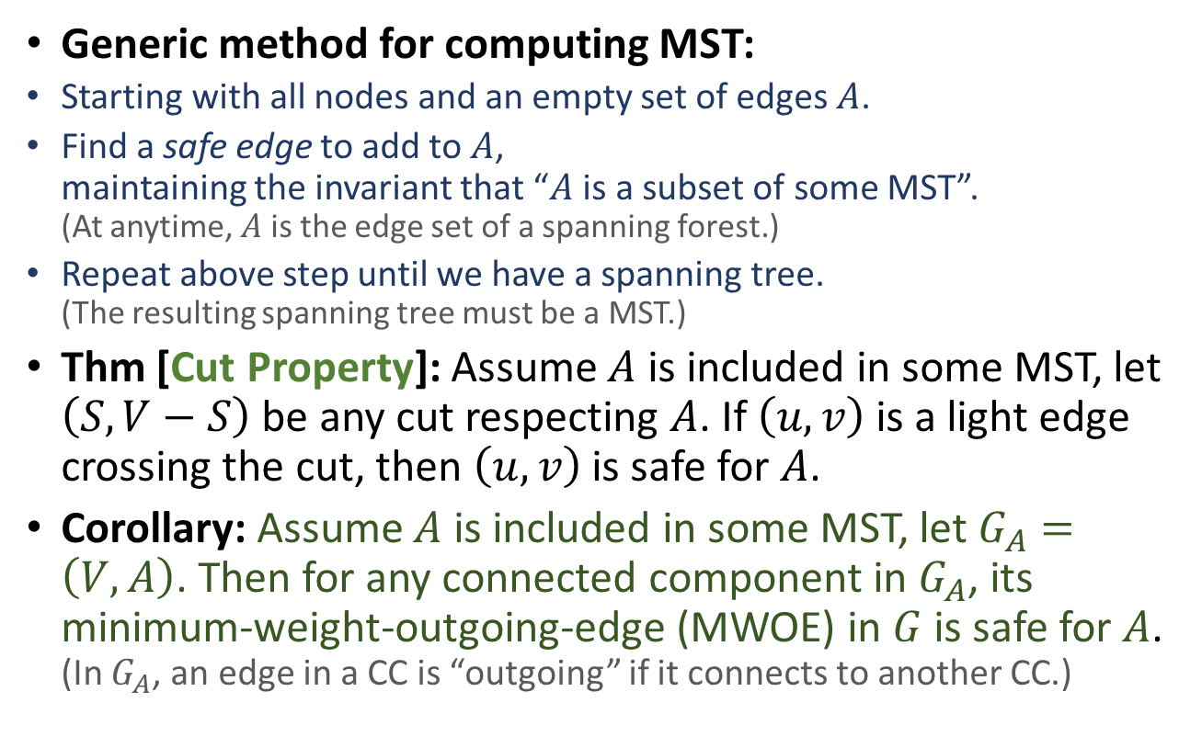
Computing MST
GenericMST(G,w):
A = $∅$
while (A is not a spanning tree)
Find a safe edge $\left(u,v\right)$
A = A $∪$ $\left\{\left(u,v\right)\right\}$
return A
Generic method for computing MST:
Starting with all nodes and an empty set of edges $A$.
Find a safe edge to add to $A$, maintaining the invariant that “$A$ is a subset of some MST”. (At anytime, $A$ is the edge set of a spanning forest.)
Repeat above step until we have a spanning tree. (The resulting spanning tree must be a MST.)
Thm [Cut Property]: Assume $A$ is included in some MST, let $\left(S,V−S\right)$ be any cut respecting $A$. If $\left(u,v\right)$ is a light edge crossing the cut, then $\left(u,v\right)$ is safe for $A$.
Corollary: Assume $A$ is included in some MST, let $G_{A}=\left(V,A\right)$. Then for any connected component in $G_{A}$, its minimum-weight-outgoing-edge (MWOE) in $G$ is safe for $A$. (In $G_{A}$, an edge in a CC is “outgoing” if it connects to another CC.)

Slide 8
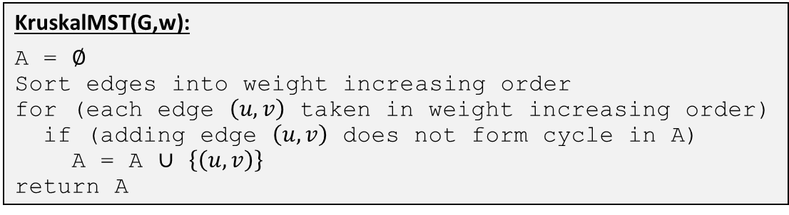

Computing MST Kruskal’s Algorithm
Generic method for computing MST:
Starting with all nodes and an empty set of edges $A$.
Find a safe edge to add to $A$.
Repeat above step until we have a spanning tree.
Cut Property: Assume $A$ is included in some MST, let $G_{A}=\left(V,A\right)$. For any CC in $G_{A}$, its minimum-weight-outgoing-edge in $G$is safe for $A$.
Strategy for finding safe edge in Kruskal’s algorithm: Find minimum weight edge connecting two CC in $G_{A}$.
KruskalMST(G,w):
A = $∅$
Sort edges into weight increasing order
for (each edge $\left(u,v\right)$ taken in weight increasing order)
if (adding edge $\left(u,v\right)$ does not form cycle in A)
A = A $∪$ $\left\{\left(u,v\right)\right\}$
return A

Slide 9
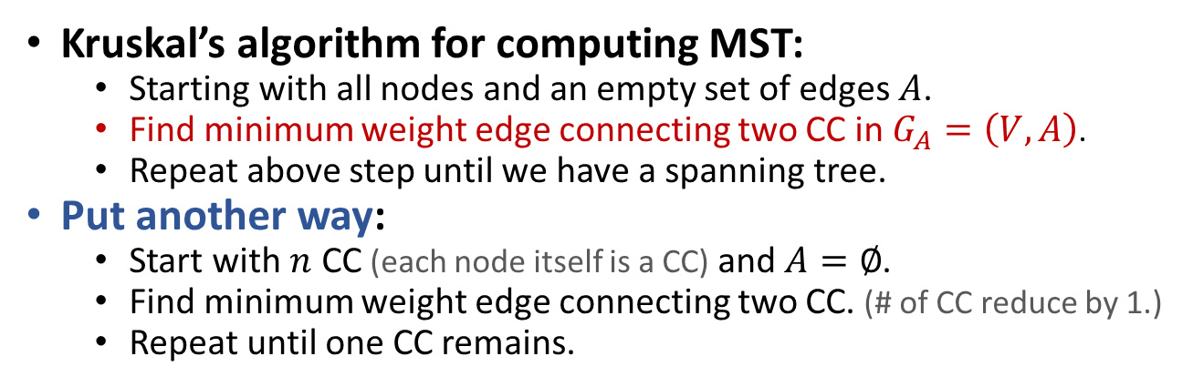
Computing MST Kruskal’s Algorithm
Kruskal’s algorithm for computing MST:
Starting with all nodes and an empty set of edges $A$.
Find minimum weight edge connecting two CC in $G_{A}=\left(V,A\right)$.
Repeat above step until we have a spanning tree.
Put another way:
Start with $n$ CC (each node itself is a CC) and $A=∅$.
Find minimum weight edge connecting two CC. (# of CC reduce by 1.)
Repeat until one CC remains.
8
A
5
8
A
5
B
10
C
B
10
C
Edge weights in increasing order:
2
3
2
3
2
3
4
5
8
10
12
14
16
18
26
30
18
D
30
16
18
D
30
16
12
12
E
14
F
E
14
F
4
G
26
4
G
26

Slide 10
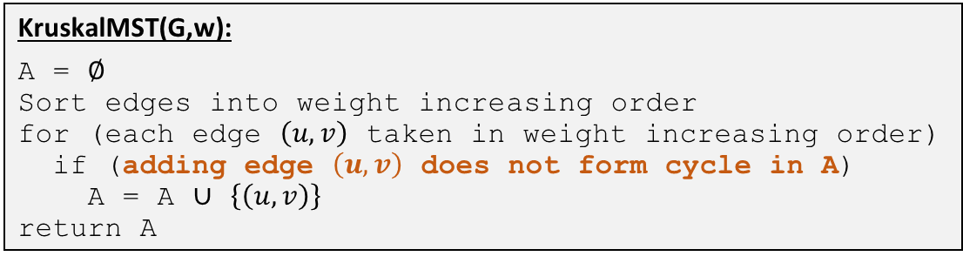
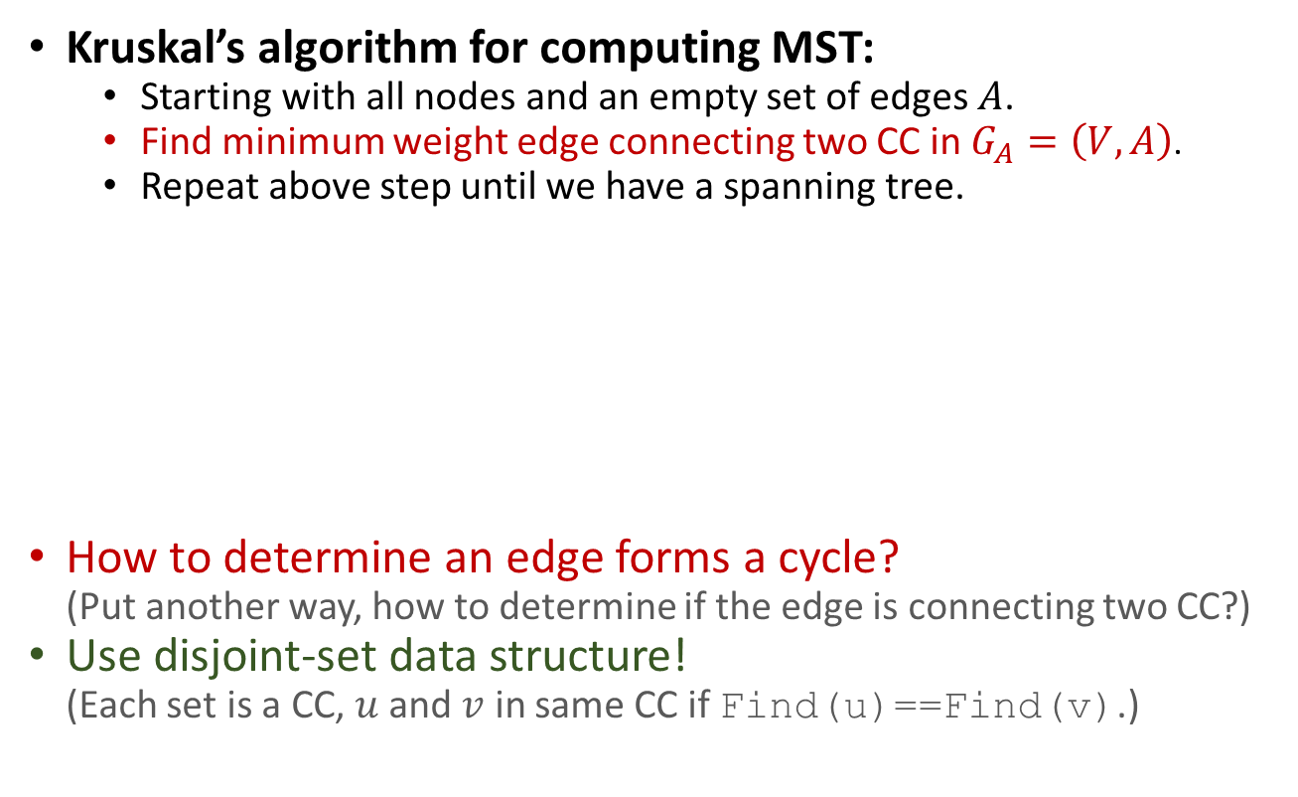
Computing MST Kruskal’s Algorithm
Kruskal’s algorithm for computing MST:
Starting with all nodes and an empty set of edges $A$.
Find minimum weight edge connecting two CC in $G_{A}=\left(V,A\right)$.
Repeat above step until we have a spanning tree.
How to determine an edge forms a cycle? (Put another way, how to determine if the edge is connecting two CC?)
Use disjoint-set data structure! (Each set is a CC, $u$ and $v$ in same CC if Find(u)==Find(v).)
KruskalMST(G,w):
A = $∅$
Sort edges into weight increasing order
for (each edge $\left(u,v\right)$ taken in weight increasing order)
if (adding edge $\left(u,v\right)$ does not form cycle in A)
A = A $∪$ $\left\{\left(u,v\right)\right\}$
return A

Slide 11
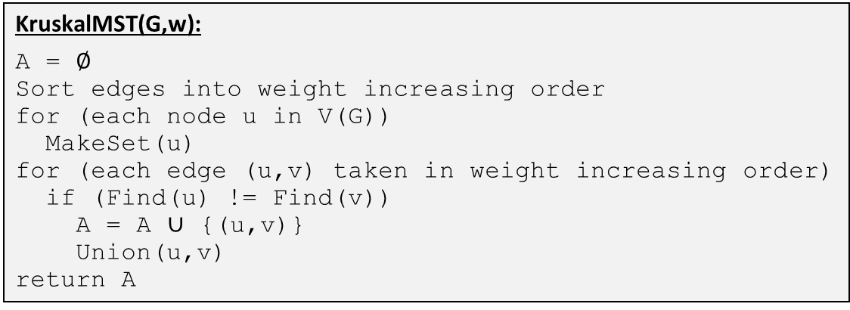
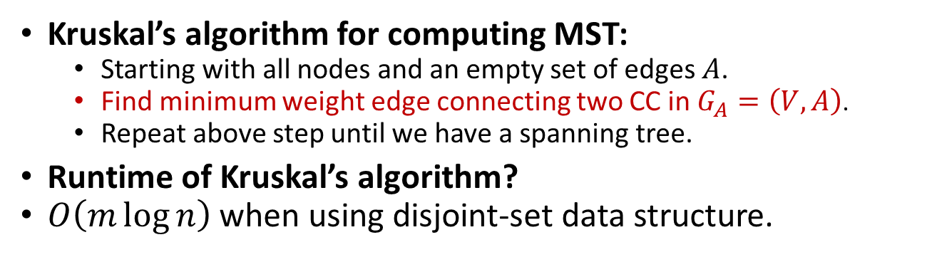



Computing MST Kruskal’s Algorithm
Kruskal’s algorithm for computing MST:
Starting with all nodes and an empty set of edges $A$.
Find minimum weight edge connecting two CC in $G_{A}=\left(V,A\right)$.
Repeat above step until we have a spanning tree.
Runtime of Kruskal’s algorithm?
$O\left(m\log{n}\right)$ when using disjoint-set data structure.
KruskalMST(G,w):
A = $∅$
Sort edges into weight increasing order
for (each node u in V(G))
MakeSet(u)
for (each edge (u,v) taken in weight increasing order)
if (Find(u) != Find(v))
A = A $∪$ {(u,v)}
Union(u,v)
return A
$$O\left(m\log{m}\right)=O(m\log{n})$$
$$O\left(n\right)$$
$$O\left(m\log^{∗}{n}\right)$$

Slide 12
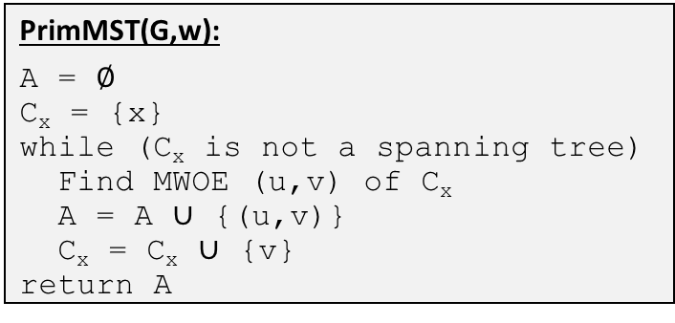

Computing MST Prim’s Algorithm
Generic method for computing MST:
Starting with all nodes and an empty set of edges $A$.
Find a safe edge to add to $A$.
Repeat above step until we have a spanning tree.
Cut Property: Assume $A$ is included in some MST, let $G_{A}=\left(V,A\right)$. For any CC in $G_{A}$, its minimum-weight-outgoing-edge in $G$ is safe for $A$.
Strategy for finding safe edge in Prim’s algorithm: Keep finding MWOE in one fixed CC in $G_{A}$.
PrimMST(G,w):
A = $∅$
C_{x} = {x}
while (C_{x} is not a spanning tree)
Find MWOE (u,v) of C_{x}
A = A $∪$ {(u,v)}
C_{x} = C_{x} $∪$ {v}
return A

Slide 13
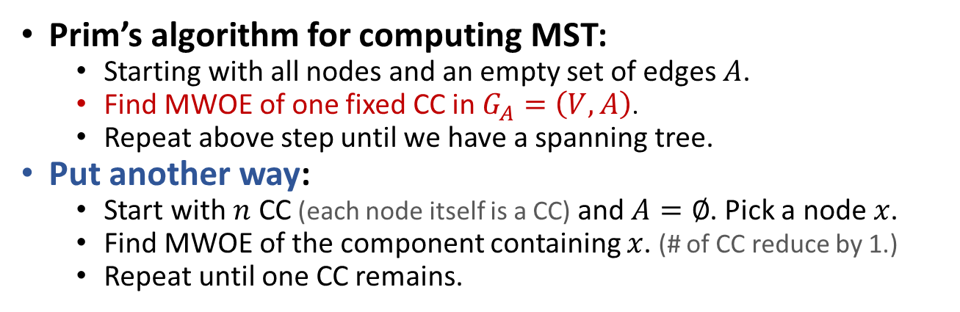
Computing MST Prim’s Algorithm
Prim’s algorithm for computing MST:
Starting with all nodes and an empty set of edges $A$.
Find MWOE of one fixed CC in $G_{A}=\left(V,A\right)$.
Repeat above step until we have a spanning tree.
Put another way:
Start with $n$ CC (each node itself is a CC) and $A=∅$. Pick a node $x$.
Find MWOE of the component containing $x$. (# of CC reduce by 1.)
Repeat until one CC remains.
8
A
5
8
A
5
B
10
C
B
10
C
2
3
2
3
18
D
30
16
18
D
16
12
12
30
E
14
F
E
14
F
4
G
26
4
G
26

Slide 14
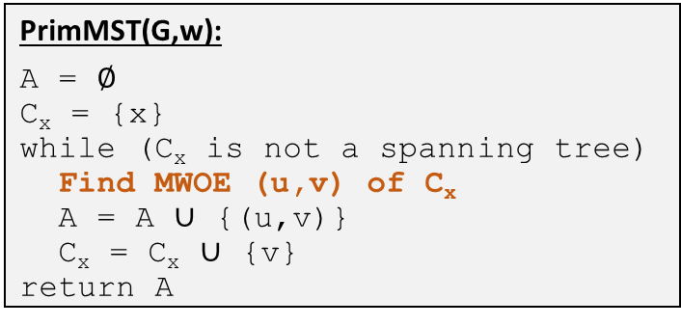
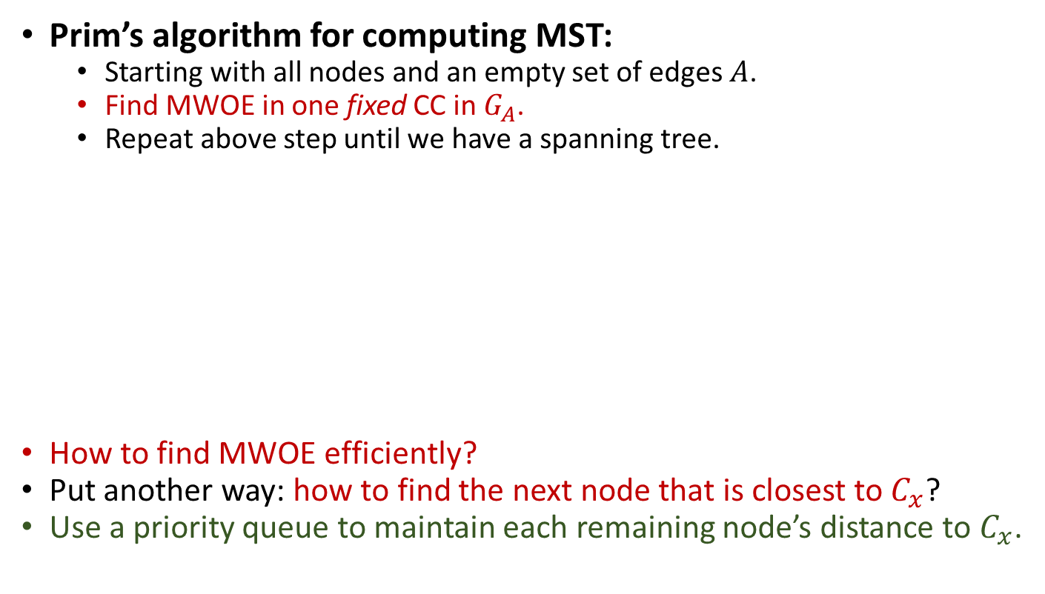
Computing MST Prim’s Algorithm
Prim’s algorithm for computing MST:
Starting with all nodes and an empty set of edges $A$.
Find MWOE in one fixed CC in $G_{A}$.
Repeat above step until we have a spanning tree.
How to find MWOE efficiently?
Put another way: how to find the next node that is closest to $C_{x}$?
Use a priority queue to maintain each remaining node’s distance to $C_{x}$.
PrimMST(G,w):
A = $∅$
C_{x} = {x}
while (C_{x} is not a spanning tree)
Find MWOE (u,v) of C_{x}
A = A $∪$ {(u,v)}
C_{x} = C_{x} $∪$ {v}
return A

Slide 15

Computing MST Prim’s Algorithm
Prim’s algorithm for computing MST:
Starting with all nodes and an empty set of edges $A$.
Find MWOE in one fixed CC in $G_{A}$. (Find next node closest to the fixed CC.)
Repeat above step until we have a spanning tree.
PrimMST(G,w):
Pick an arbitrary node x
for (each node u)
u.dist = INF, u.parent = NIL, u.in = false
x.dist = 0
Build a priority queue Q based on “dist” values
while (Q is not empty)
u = Q.ExtractMin()
u.in = true
for (each edge (u,v))
if (v.in==false and w(u,v)<v.dist)
v.parent = u, v.dist = w(u,v)
Q.Update(v,w(u,v))

Slide 16





Computing MST Prim’s Algorithm
Runtime of the Prim’s algorithm?
$O\left(m\log{n}\right)$ using binary heap to implement priority queue.
Could be faster using better priority queue implementation.
PrimMST(G,w):
Pick an arbitrary node x
for (each node u)
u.dist = INF, u.parent = NIL, u.in = false
x.dist = 0
Build a priority queue Q based on “dist” values
while (Q is not empty)
u = Q.ExtractMin()
u.in = true
for (each edge (u,v))
if (v.in==false and w(u,v)<v.dist)
v.parent = u, v.dist = w(u,v)
Q.Update(v,w(u,v))
$$O(n)$$
$$O(n)$$
$$O(n\log{n})$$
$$O(m\log{n})$$

Slide 17
DFS, BFS, Prim, and others…
DFSIterSkeleton(G,s):
Stack Q
Q.push(s)
while (!Q.empty())
u = Q.pop()
if (!u.visited)
u.visited = true
for (each edge (u,v) in E)
Q.push(v)
BFSSkeletonAlt(G,s):
FIFOQueue Q
Q.enque(s)
while (!Q.empty())
u = Q.dequeue()
if (!u.visited)
u.visited = true
for (each edge (u,v) in E)
Q.enque(v)
PrimMSTSkeleton(G,x):
PriorityQueue Q
Q.add(x)
while (!Q.empty())
u = Q.remove()
if (!u.visited)
u.visited = true
for (each edge (u,v) in E)
if (!v.visited and …)
Q.update(v,…)
GraphExploreSkeleton(G,s):
GenericQueue Q
Q.add(s)
while (!Q.empty())
u = Q.remove()
if (!u.visited)
u.visited = true
for (each edge (u,v) in E)
Q.add(v)

Slide 18
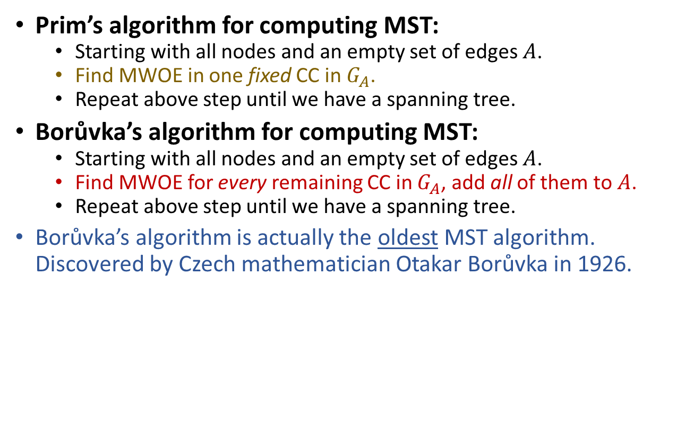
Computing MST Borůvka’s Algorithm
Prim’s algorithm for computing MST:
Starting with all nodes and an empty set of edges $A$.
Find MWOE in one fixed CC in $G_{A}$.
Repeat above step until we have a spanning tree.
Borůvka’s algorithm for computing MST:
Starting with all nodes and an empty set of edges $A$.
Find MWOE for every remaining CC in $G_{A}$, add all of them to $A$.
Repeat above step until we have a spanning tree.
Borůvka’s algorithm is actually the oldest MST algorithm. Discovered by Czech mathematician Otakar Borůvka in 1926.

Slide 19
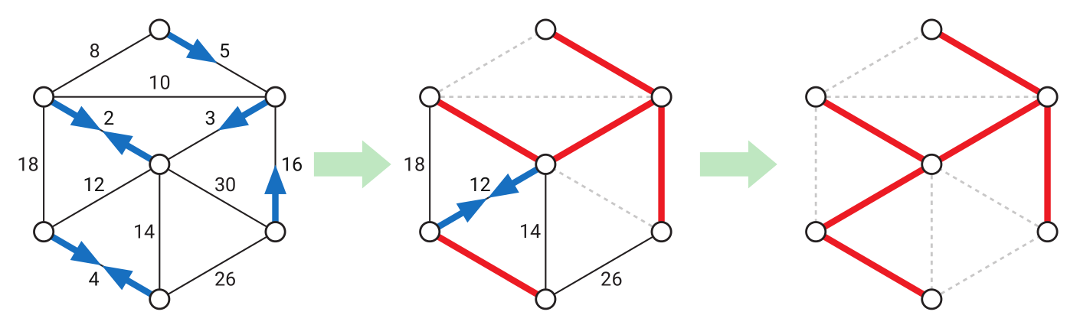
Computing MST Borůvka’s Algorithm
Prim’s algorithm for computing MST:
Starting with all nodes and an empty set of edges $A$.
Find MWOE in one fixed CC in $G_{A}$.
Repeat above step until we have a spanning tree.
Borůvka’s algorithm for computing MST:
Starting with all nodes and an empty set of edges $A$.
Find MWOE for every remaining CC in $G_{A}$, add all of them to $A$.
Repeat above step until we have a spanning tree.
Borůvka’s algorithm is actually the oldest MST algorithm. Discovered by Czech mathematician Otakar Borůvka in 1926.

Slide 20

Computing MST Borůvka’s Algorithm
Borůvka’s algorithm for computing MST:
Starting with all nodes and an empty set of edges $A$.
Find MWOE for every remaining CC in $G_{A}$, add all of them to $A$.
Repeat above step until we have a spanning tree.
Is it okay to add multiple edges simultaneously?
Yes! Assuming all edge weights are distinct, if CC $C_{1}$ propose MWOE $e_{1}$ to connect to $C_{2}$, and $C_{2}$ propose MWOE $e_{2}$ to connect to $C_{1}$, then $e_{1}=e_{2}$.

Slide 21

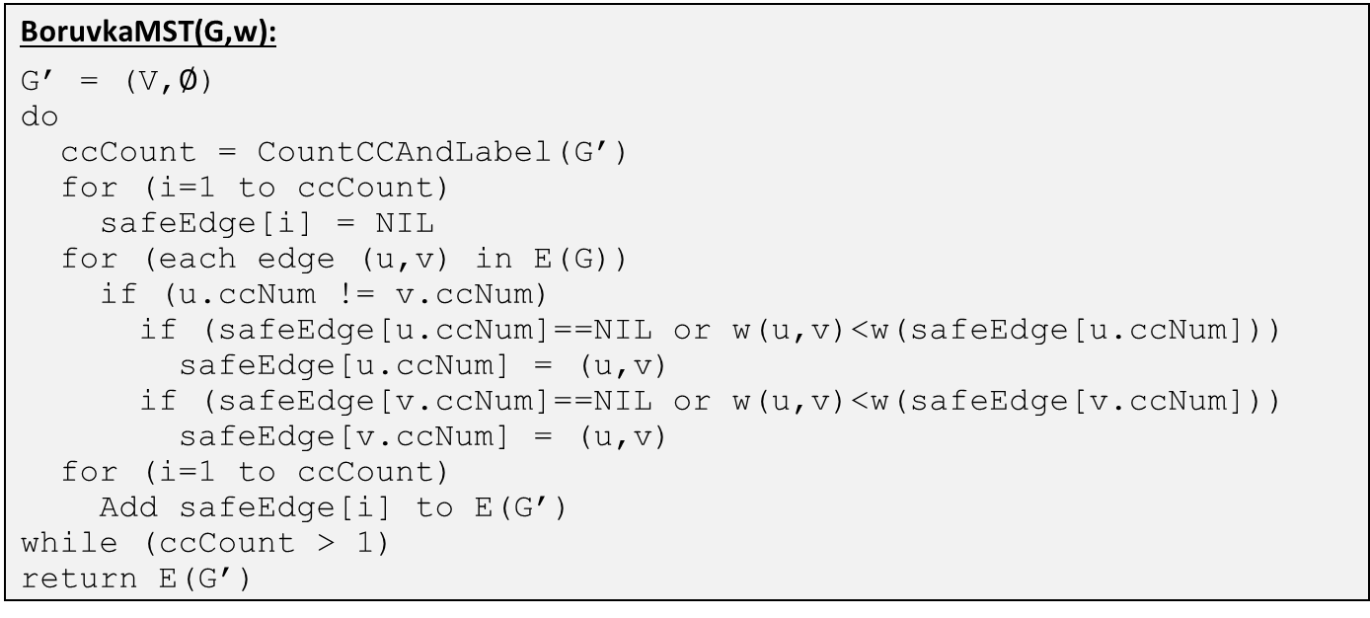





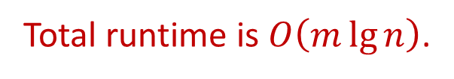
Computing MST Borůvka’s Algorithm
Borůvka’s algorithm for computing MST:
Starting with all nodes and an empty set of edges $A$.
Find MWOE for every remaining CC in $G_{A}$, add all of them to $A$.
Repeat above step until we have a spanning tree.
BoruvkaMST(G,w):
G’ = (V,$∅$)
do
ccCount = CountCCAndLabel(G’)
for (i=1 to ccCount)
safeEdge[i] = NIL
for (each edge (u,v) in E(G))
if (u.ccNum != v.ccNum)
if (safeEdge[u.ccNum]==NIL or w(u,v)<w(safeEdge[u.ccNum]))
safeEdge[u.ccNum] = (u,v)
if (safeEdge[v.ccNum]==NIL or w(u,v)<w(safeEdge[v.ccNum]))
safeEdge[v.ccNum] = (u,v)
for (i=1 to ccCount)
Add safeEdge[i] to E(G’)
while (ccCount > 1)
return E(G’)
Total runtime is $O\left(m\lg{n}\right)$.
$$O(n)$$
// Do DFS/BFS, count # of CC, give ccNum to nodes.
$$O(n)$$
$$O\left(n+m\right)=O\left(m\right)$$
$$O(n)$$
$O\left(\lg{n}\right)$ iterations.

Slide 22
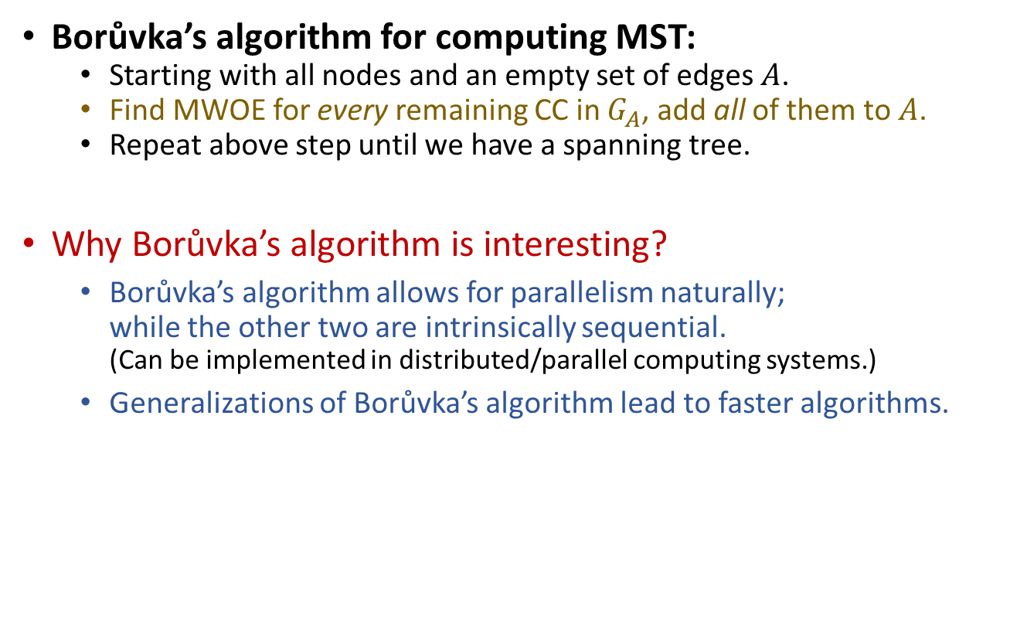
Computing MST Borůvka’s Algorithm
Borůvka’s algorithm for computing MST:
Starting with all nodes and an empty set of edges $A$.
Find MWOE for every remaining CC in $G_{A}$, add all of them to $A$.
Repeat above step until we have a spanning tree.
Why Borůvka’s algorithm is interesting?
Borůvka’s algorithm allows for parallelism naturally; while the other two are intrinsically sequential. (Can be implemented in distributed/parallel computing systems.)
Generalizations of Borůvka’s algorithm lead to faster algorithms.

Slide 23
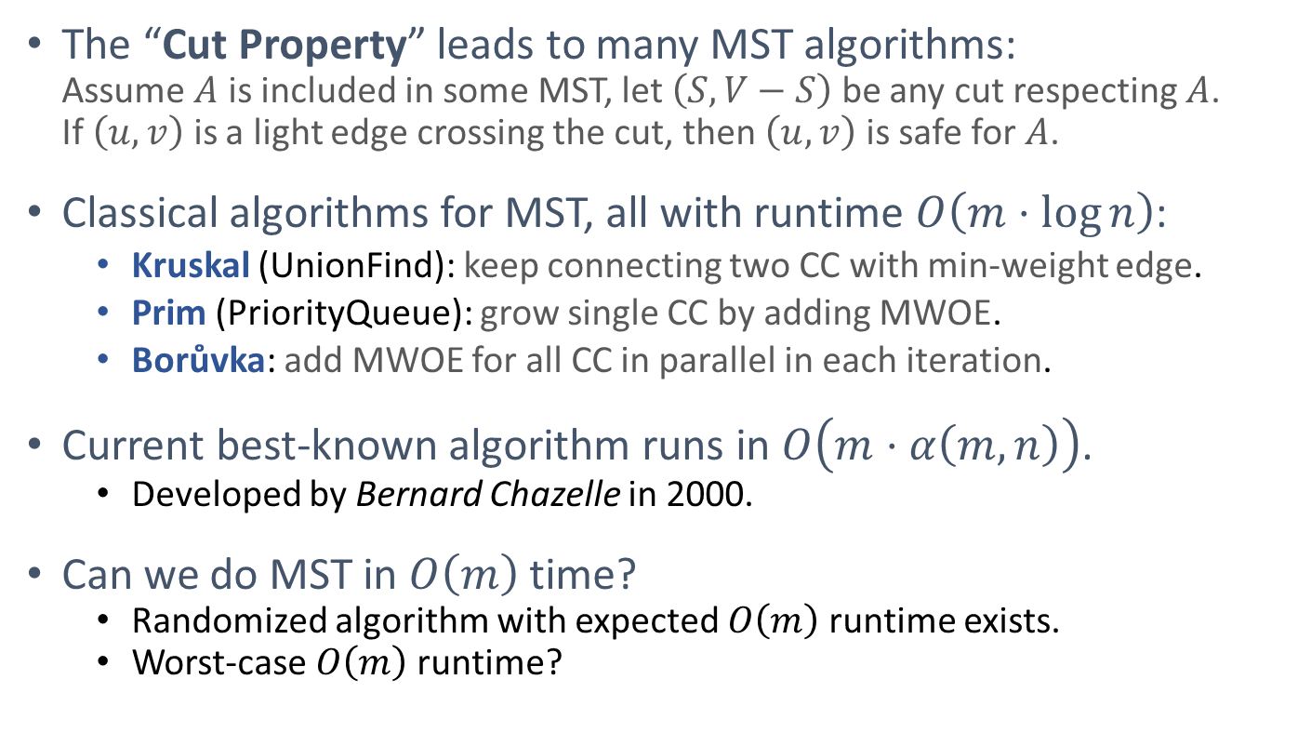
Summary
The “Cut Property” leads to many MST algorithms: Assume $A$ is included in some MST, let $\left(S,V−S\right)$ be any cut respecting $A$. If $\left(u,v\right)$ is a light edge crossing the cut, then $\left(u,v\right)$ is safe for $A$.
Classical algorithms for MST, all with runtime $O\left(m⋅\log{n}\right)$:
Kruskal (UnionFind): keep connecting two CC with min-weight edge.
Prim (PriorityQueue): grow single CC by adding MWOE.
Borůvka: add MWOE for all CC in parallel in each iteration.
Current best-known algorithm runs in $O\left(m⋅α\left(m,n\right)\right)$.
Developed by Bernard Chazelle in 2000.
Can we do MST in $O\left(m\right)$ time?
Randomized algorithm with expected $O\left(m\right)$ runtime exists.
Worst-case $O\left(m\right)$ runtime?

Slide 24
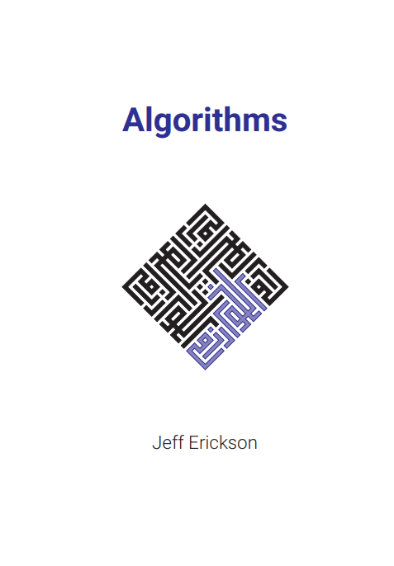
Reading
[CLRS] Ch.23
If you want to know more about Borůvka’s MST algorithm: [Erickson v1] Ch.7 (7.3)

