Slide 1

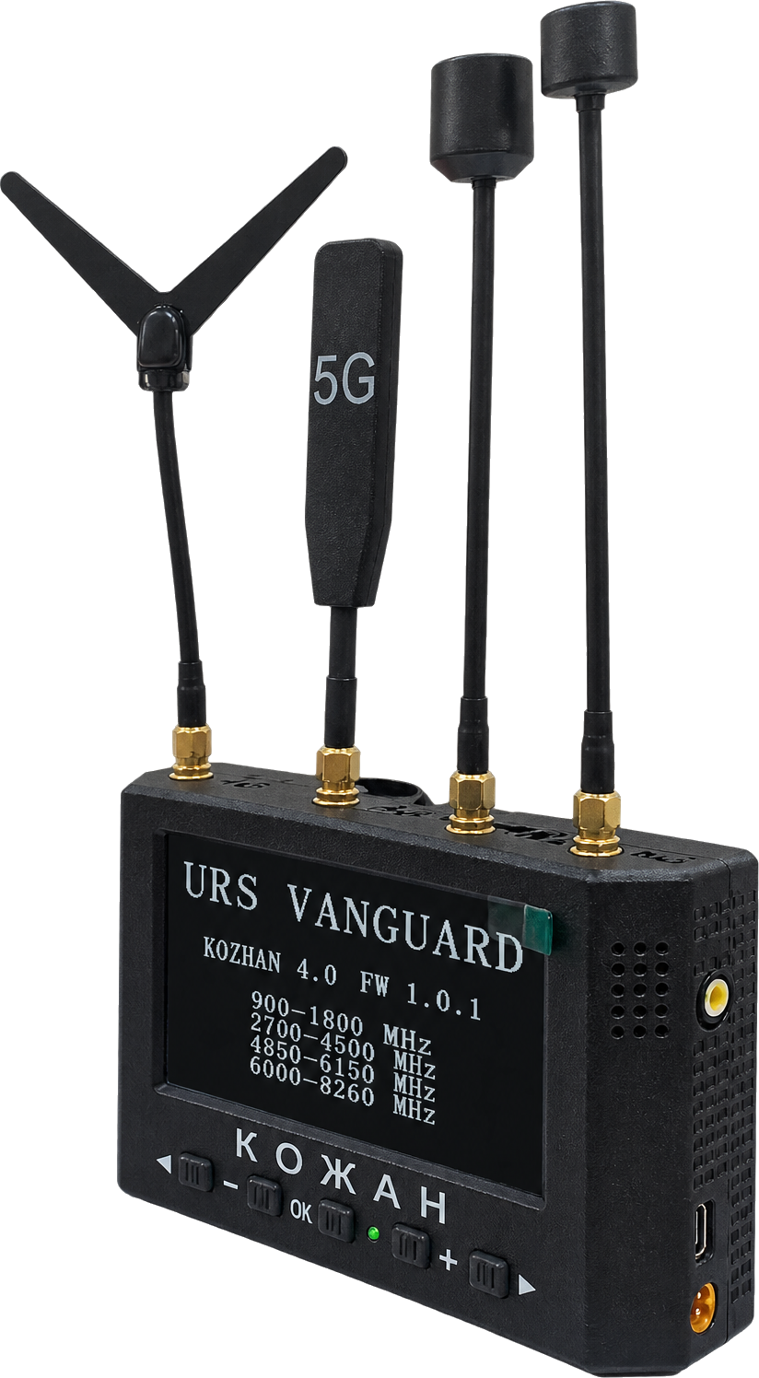

INVESTOR PRESENTATION · NORWAY · 2026
Technologies that Protect
Integrated protection ecosystem: EW, ER and next-generation counter-UAS. Combat-proven, built on proprietary SDR technologies for NATO-market expansion.
URS “Vanguard” · Kyiv, Ukraine
Notes:
Opening. Introduce Vanguard and the purpose of the meeting: present the 2026 product line and discuss partnership with Norwegian investors.

Slide 2



ABOUT URS VANGUARD
Building Europe’s DefenseTech ecosystem
Kyiv-based developer of electronic warfare (EW), radioelectronic reconnaissance (ER) and counter-UAS systems on proprietary SDR technologies.
Our mission
Vision, 3–5 years
Global expansion
Develop real-time technologies that significantly enhance the protection and survival of military personnel and the success of their missions.
Become one of Europe’s key manufacturers of EW, ER and personal protection systems, unified on a single interoperable information-network platform.
Turn battle-tested front-line experience into certified, standardized solutions for NATO countries and international partners.
Notes:
Company, mission and vision (from the earlier Vanguard presentation).

Slide 3
TRACTION
Proven demand and rapid growth
3x
300+
15
6–12
Year-over-year growth
Completed deliveries
Core team
Months of pipeline
Consistent tripling of demand each year.
Production capacity booked more than a month ahead.
In-house specialists covering the full development and production cycle.
Long-term direct contracts with military units under negotiation.
Notes:
Traction figures are taken from the earlier Vanguard presentation; confirm they are current before the meeting.

Slide 4






OUR ADVANTAGES
Control, speed and proven results
100% proprietary software
Widest scanning range
Minimized false alarms
AI-based signal processing, SDR architecture, in-house antenna topology and circuit design.
Maximum frequency coverage for detecting masked and non-standard UAV control channels.
Proprietary digital filtering delivers accurate situational awareness.
Unified ecosystem
Full control of the chain
Faster adaptation
Detection (ER) and suppression (EW) integrated into a single automated network.
R&D, software and production in one company: a high barrier to entry.
Rapid update cycle and direct feedback from front-line operators.
Notes:
Advantages taken from the earlier Vanguard presentation.

Slide 5
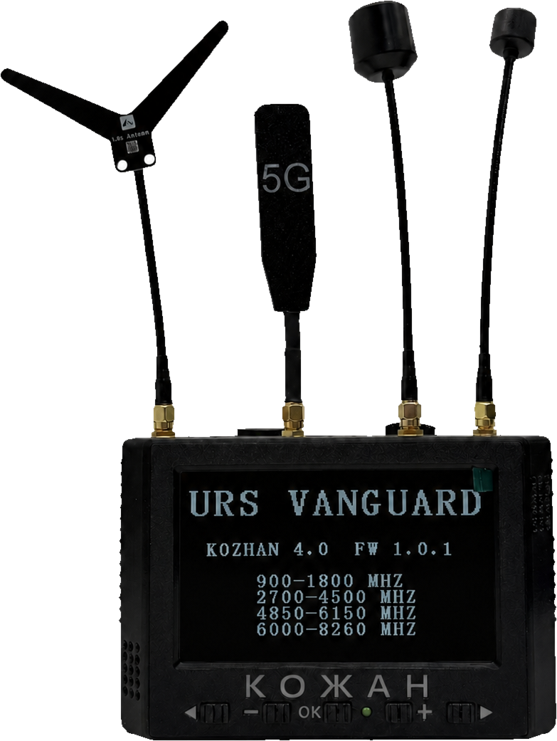



FLAGSHIP PRODUCT · RF RECONNAISSANCE DEVICE (DRONE DETECTOR)
KOZHAN 4.0
A multi-band detector that scans the set frequency ranges and picks up the analog video signal of UAVs. Three automatic scan modes, a log of detected signals and fast software updates over Wi-Fi. Interface languages: Ukrainian, English, German and Polish.
FINAL STAGE OF NATO CODIFICATION · NATO STOCK NUMBER
01 SCAN
02 DETECT
03 ALERT
Automatic monitoring of 4 radio bands in real time
Locks onto the analog UAV video signal
Instant operator notification and log entry
Notes:
KOZHAN 4.0 is the focus of this presentation. How it works: scan, detect, alert.

Slide 6
KOZHAN 4.0
Technical characteristics
4
2 km+
Parameter | Value
Weight | 780 g
Dimensions | 280×110×45 mm; 155×110×45 mm
Display | IPS 5″ (800 × 480)
Built-in battery | 75.6 Wh
Ingress protection | IP-54
External display | AV output
EW auto-activation | MT-30 connector
radio bands
1G · 3G · 5G · 6G
detection
range
12 h
7 s
autonomous
operation
full-scan
time
Bands, MHz: 900–1800 · 2700–4500 · 4850–6150 · 6000–8260
Notes:
Specifications are from the 2026 PDF catalog; re-check against ursvanguard.com (the site was not reachable from the build environment). The catalog gives the upper band edge as 8260 MHz on the overview page and 8200 MHz in the specification table; confirm before sending.

Slide 7
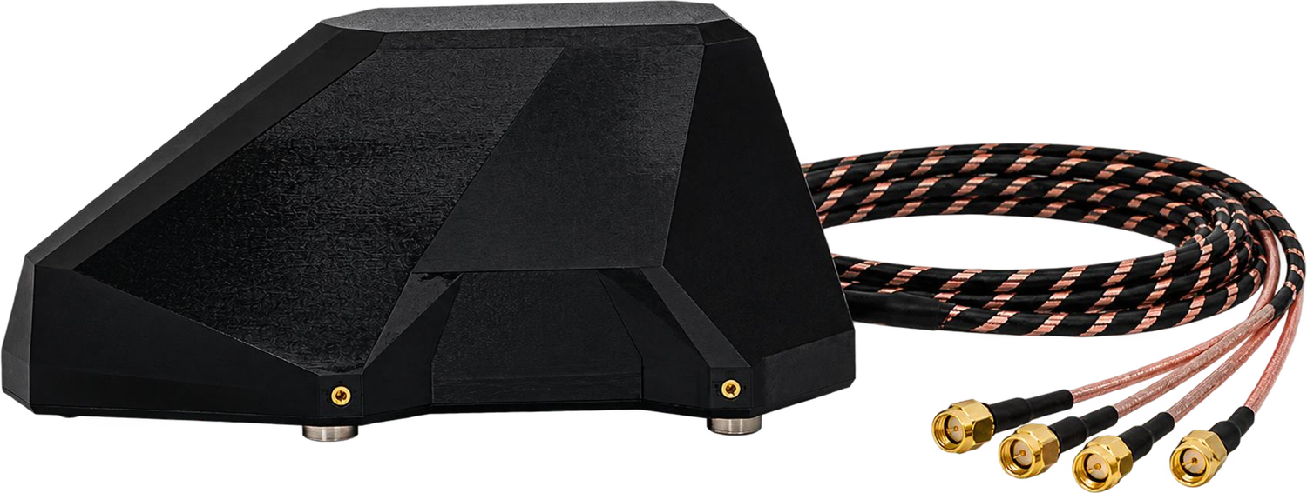


KOZHAN 4.0
Complete kit, ready for the field
DELIVERY SET
INTERFACES
ACCESSORY
4-band receiver 1G+3G+5G+6G in a solid case
Antennas 1G, 3G, 5G, 6G
USB-C charging cable
Device mount
Velcro strap set
AV
External display
USB-C
Active remote antenna
Charging
Magnetic mount, four antenna channels with built-in amplifiers, 3 m RG316 cables. For KOZHAN 4.0 and 3.0.
MT-30
Auto-start of EW system
Notes:
Delivery set, connectors and the optional active remote antenna (powered via MT-30; amplifier gain to be confirmed in the catalog).

Slide 8
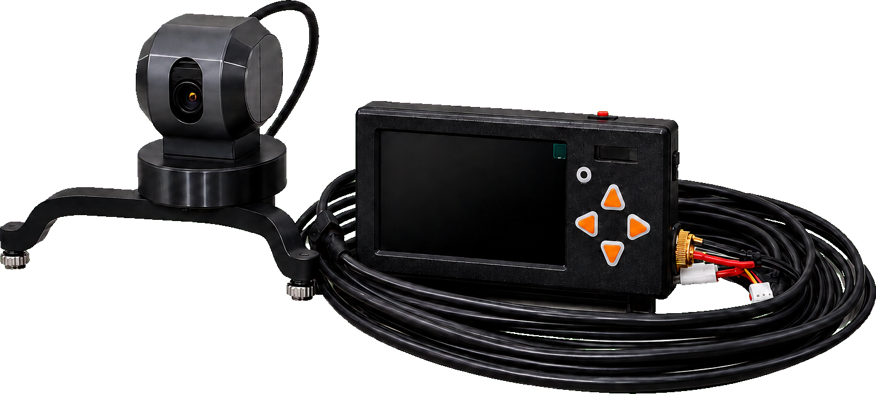
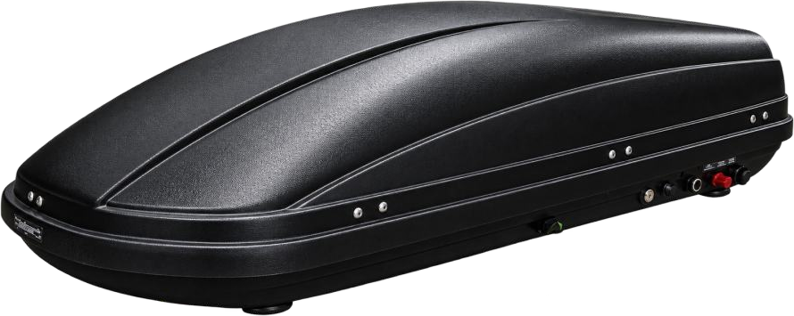
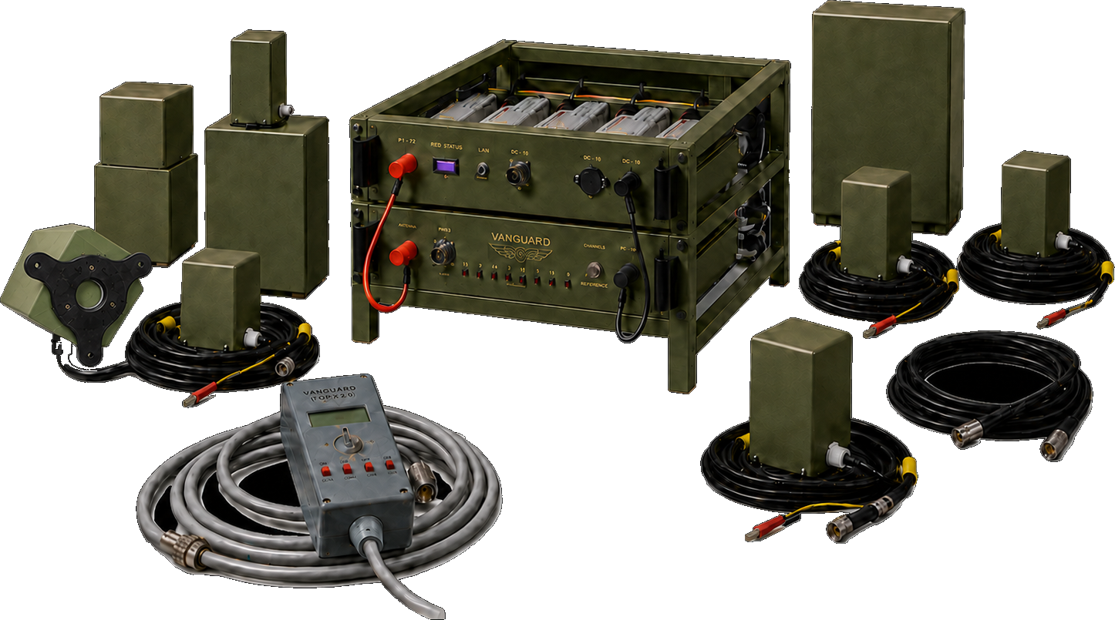
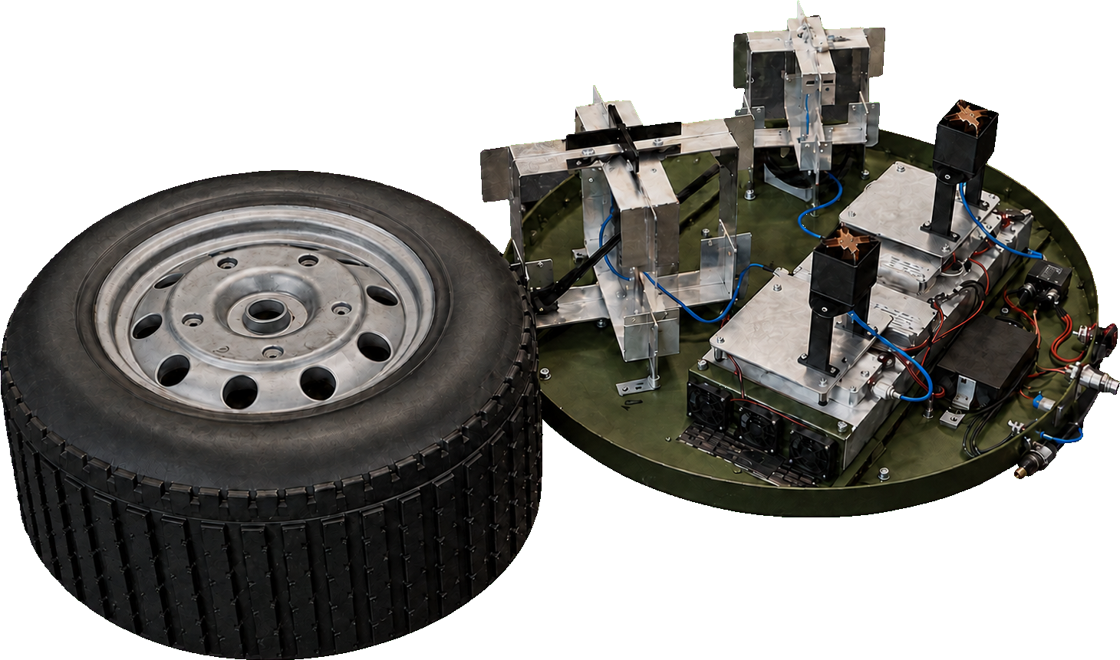
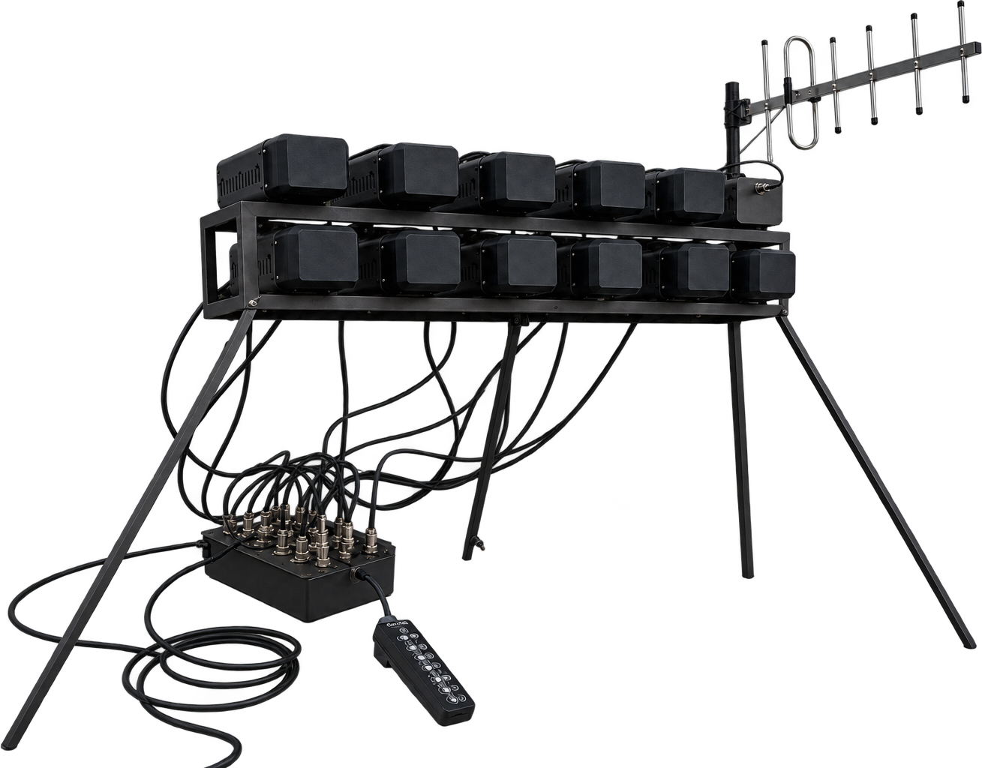
PRODUCT PORTFOLIO
One ecosystem: detect, observe, suppress
Delfin and Kraken are in serial production and used in real operations; EW platforms can be started automatically by KOZHAN.
DETECTION AND SURVEILLANCE
KOZHAN 4.0
Remote antenna
NICH
Multi-band drone detector, 4 bands
Magnetic mount, built-in amplifiers
Pan-controlled thermal camera
ELECTRONIC WARFARE, 300–6000 MHZ
Delfin
Hydra 2U
Dokatka
Kraken
Disguised as a civilian car roof box
19″ rack for heavy vehicles, 8–20 bands
Hidden in truck-wheel form factor
Directional sector suppression
Notes:
Seven products in three groups. All EW platforms can be switched on automatically by the KOZHAN detector.

Slide 9



SCALE AND READINESS
Field-validated, ready to scale
80%
500
50
Days
vertical integration
detectors per month, up to
EW systems per month, up to
for firmware and hardware updates
TRL 9 readiness
International forums
Partnerships and certification
Products passed full verification in real combat conditions, with hundreds of positive feedback reports from military units.
Participation in, and official invitations to, defense events in the USA, Lithuania, Norway, Italy and others.
Preliminary cooperation agreements reached; codification, patenting and international certification under way.
Notes:
Capacity, TRL and international engagement figures are taken from the earlier Vanguard presentation; confirm they are current.

Slide 10
ROADMAP
Our path to the NATO market
1
2
3
4
Export and certification
European hub
Partner network
Serial supply
Complete codification, obtain export permits and international certificates.
Establish an official presence and legal entity in Poland or Italy.
Build distribution and joint ventures with Western defense contractors.
Scale production to meet direct defense contracts with partners.
WHY NOW
Demand for counter-drone systems is rising sharply as European armed forces re-arm. Western buyers want solutions validated in real conditions against a technologically advanced adversary, with better price and speed than bulky alternatives.
Notes:
Roadmap and market drivers are taken from the earlier Vanguard presentation.

Slide 11





Let’s build the future of defense technology together
URS “Vanguard” LLC, Kyiv, Ukraine
+38 (093) 968 59 73
vanguardltd25@gmail.com
SCAN TO VISIT US
ursvanguard.com
ursvanguard.com
Notes:
Closing slide with contacts and the QR code to the company website.

